Slide 1
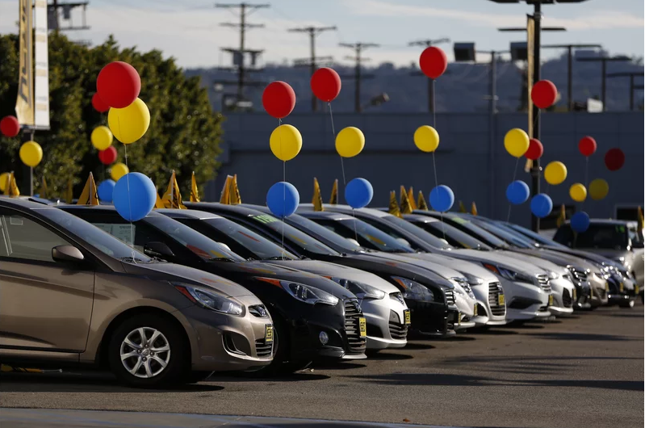

Car Sales Analysis
by Rajendra Solleti

Slide 2
Data Analysis
This is the sales data of the cars from 1953 to 2016 by a
Out of all the columns present model, Registration columns seems to be insignificant hence deleted this columns. Model was deleted due to high cardinality and registration because of only two values present
The missing values of engine Volume were replaced with the mean and missing values of drive were replaced with the mode of the data.

Slide 3
Interesting Observations
267 cars were given to charity inferred as the price was zero.
Number of cars sold per year prior to 2000 is less than 20. Either the dealership was in its initial stages or just run through word of mouth with no proper infratrsucture.
Sedan body type, petrol powered cars were the highest sold in any year.
There was a biggest drop in the number of sales from 2008 to 2009 which could be due to economic recession.

Slide 4
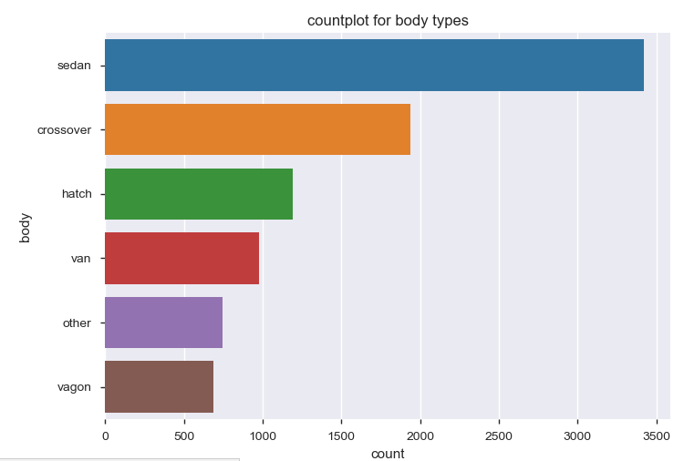
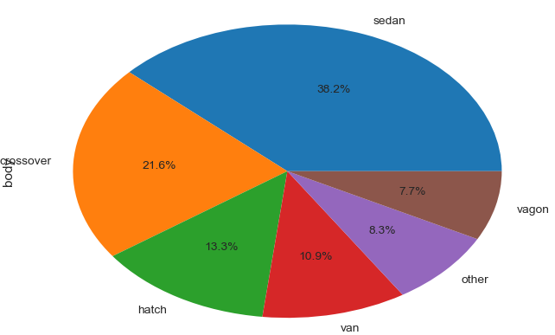
Sales Distribution by Body Type
Sedan(38.2%) is the highest sold body type followed by crossover(21.6%) and hatch(13.3%)

Slide 5
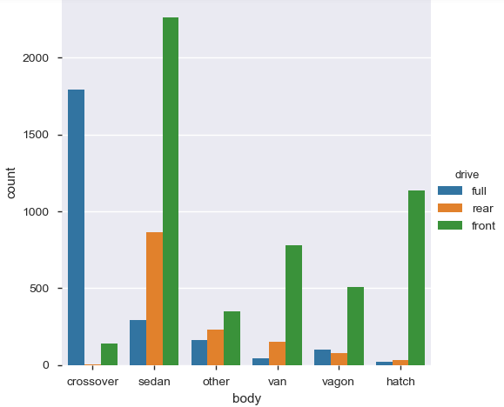
Correlation between body type and drive mode
Except for crossover front wheel driven cars are most likely to be sold for all other body type cars
In crossover full wheel drive will far outsell the front wheel driven cars

Slide 6
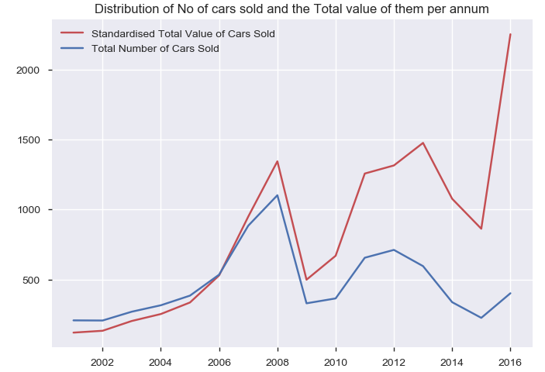
Relation between number of cars sold and the total value of cars
People are preferring high cost luxury cars from 2015 as seen from the quite drastic jump in the total value of cars sold between 2015 and 2016.

Slide 7
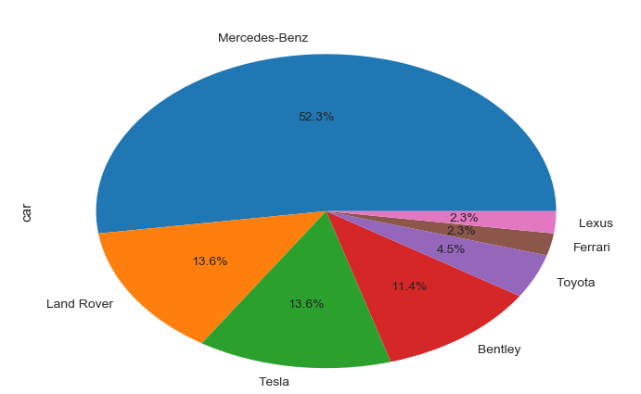
Luxury Cars Observations
More than half of the luxury cars(price>150000) sold are by Mercedes –Benz followed by Land Rover and Tesla
Most of them are petrol powered and crossover body type

Slide 8
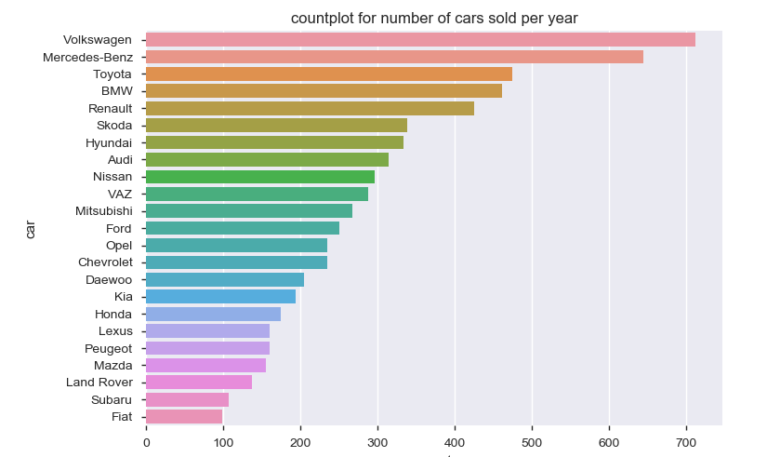
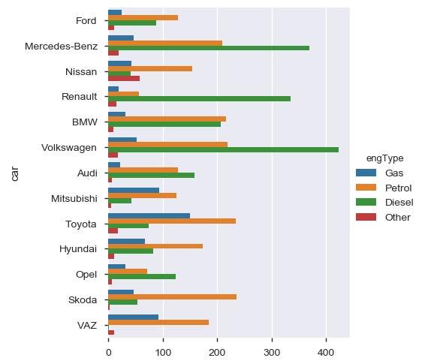
Car Sales by Company
Volkswagen sells the highest number of cars followed by Mercedes-Benz and majority of the cars sold by these are diesel powered.
For all the remaining brands petrol powered cars are still the bread winner for the company.

Slide 9
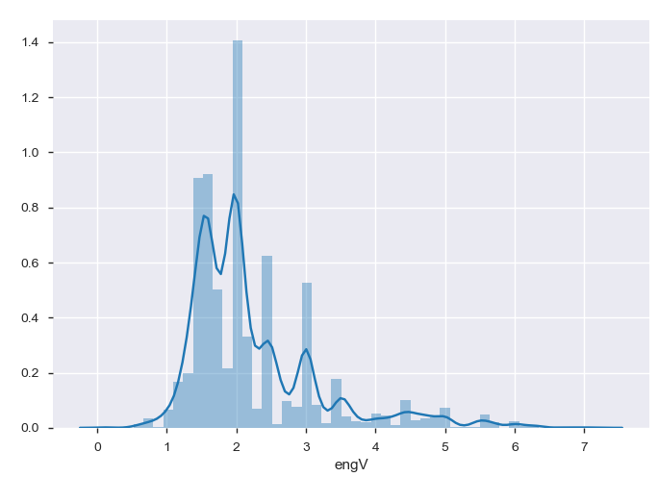
Car Sales by Engine Volume
2.0 engine remains the national engine which is closely followed by 1.5 and 1.6
The plot is right skewed indicating that most of the car manufacturers don’t go beyond 3.0

Slide 10
Conclusions
From this exercise we conclude that petrol powered cars are sold the maximum.
Sedan body type cars are the highest sold.
The per unit cost of car has gone up which could mean either people purchase power has increased or due to government regulations manufacturers have to include more safety features in the car.
Mercedes-Benz still remains the epitome of luxury with every 1 of 2 luxury cars being sold a Mercedes.

