Slide 1
Hackathon

Slide 2
Hackathon Idea
Objective : Automatic License plate character recognition from closed circuit camera footage
Technology Stack : Python, Machine learning
Dependencies : Anaconda

Slide 3













Solution Approach
Camera feed placed at the entrance would be the input to our application.
The application then generates images from this feed.
The images are then processed by applying multiple filters like gray scaling, thresholding, contouring, background checking, ratio checking to identify the possible number plates in this.
Characters are tried to be fetched from the identified number plate. We have created a ML model for this and trained to identify characters & numbers.
Return the identified number.
The number plates identified are saved into the database which could be mapped to vehicle owner details to be used later for toll collection, security purposes etc.

Slide 4
Technology choice and Why?
1. We are choosing python for this as it is open sourced and has a lot of inbuilt libraries to support these kind of experiments.
2. We were choosing the ML model for OCR functionality as the model’s confidence level will increase as we train it more.
3. We used azure web api keeping scalability in mind.

Slide 5
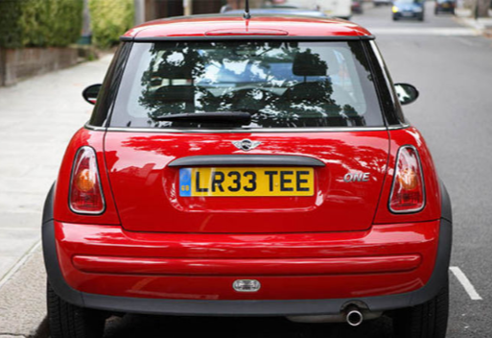
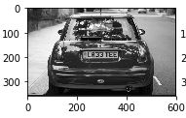
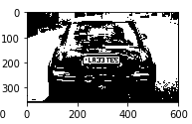
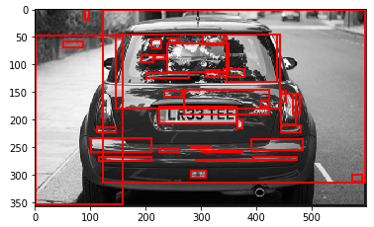
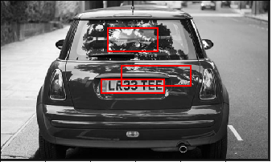

Intermediate Stages

Slide 6
Next Steps
Instead of Tesseract use custom built model. We tried using XGBoost. Integration pending.
We could see the accuracy improves if we are giving the car image instead of the whole frame. So we could add an additional to identify the car object first and then apply our logic.

Slide 7
Hackathon Participation Team
Give a nick name to your Hackathon team
Details about your team
Name | Emp # | Project Code* | DM Name | PM Name
Rajendra Solleti | 115761 | HTADM | Suresh Jampani | Jaikumar_R01
Narsimlu Keshagouni | 778692 | HTADM | Suresh Jampani | Jaikumar_R01
Suresh Kalisetti | 609051 | HTADM | Suresh Jampani | Jaikumar_R01
Prerequisite
Software Required | License Type | Version
Anaconda | NA

