Slide 1
Cross Functional Design Authority (CFDA) DSMS Re-procurement (incorporating FSM DCC395) Phase 3a Contract to Market
Supporting DCC Quality in Systems Engineering and Delivery – right first time

Slide 2
Instructions
Please download a copy of this template and store it in your project folder
Use that version as your “live” document and provide access to the Technical Management team so we can support you
DO NOT change the online version of this template
Technical Management (smb.tmf@smartdcc.co.uk) will support your CFDA journey and will help you complete this deck prior to submission to CFDA

Slide 3
Context
DSMS re-procurement has been split into 4 projects
Future Service Management project DCC 395 - Agreement to proceed beyond phase 3
DCC Internal Only
Reporting
Service Transition
Remedy/SSI disposal

Slide 4


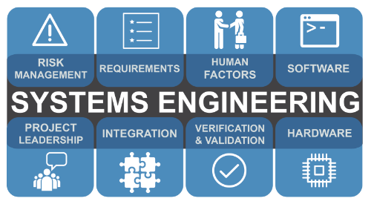



Traceable,
Enforceable,
Testable
Successful Delivery through
Partnerships
Protect DCC and DCC Customers,
Risk/Reward Approach
Intellectual Property Management,
Scalable,
High Quality
Supplier Systems of Interest
DCC System of Systems
On time
On budget
Delivers benefits
Disaggregated,
Scalable,
Futureproof
System of Interest
&
System of Systems
Business Requirements and specifications
Notes:
The System Engineering perspective is based on systems thinking. Systems thinking is a unique perspective on reality—a perspective that sharpens our awareness of wholes and how the parts within those wholes interrelate. When a system is considered as a combination of system elements, systems thinking acknowledges the primacy of the whole (system) and the primacy of the relation of the interrelationships of the system elements to the whole. Systems thinking occurs through discovery, learning, diagnosis, and dialog that lead to sensing, modelling, and talking about the real-world to better understand, define, and work with systems. A systems thinker knows how systems fit into the larger context of day-to-day life, how they behave, and how to manage them.
Deploying SE into a company involves integrating a holistic approach to managing complex systems throughout their lifecycle. We in Technical Management, do not have the in-depth knowledge of the all the systems, documented policies and processes in use in your functional area, which is why we need the help of SMEs (Champions) from each functional area to help us to gather this information and help us to embed SE & DL into DCC.

Slide 5
Some Key Systems Engineering Definitions
Systems of Interest : The system whose life cycle is under consideration.
System of Systems : A System of Interest whose system elements are themselves systems; typically, these entail large‐ scale interdisciplinary problems with multiple, heterogeneous, distributed systems.
Risk Management : a continual process for systematically addressing risk throughout the life cycle of a system, product, or service. It can be applied to risks related to the acquisition, development, maintenance, or operation of a system.
Human Factors : The systematic application of relevant information about human abilities, characteristics, behavior, motivation, and performance.
Verification and Validation : to understand and quantify the cost, schedule, information value, and the uncertainty characteristics inherent among the different choices of methods among inspection, analysis (including simulation), demonstration, and test.
Integration : the combination of system elements (hardware, software, and operational resources) that compose the SoI and verifying the correctness of the static and dynamic aspects of interfaces between, and interaction among, the implemented system elements.

Slide 6
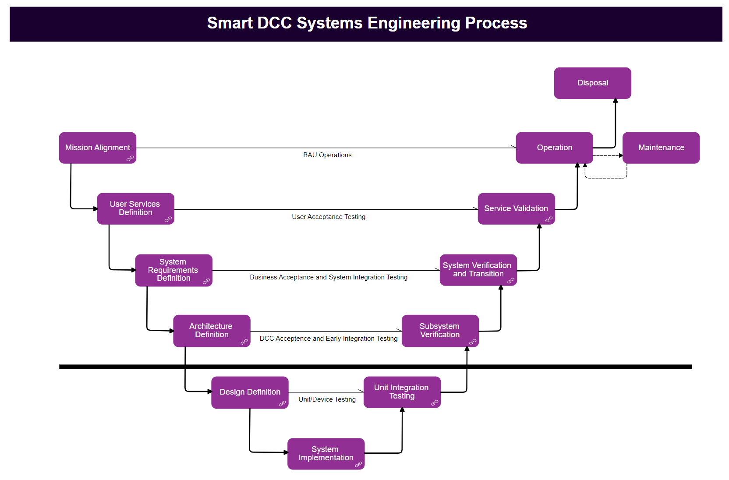
DCC System Engineering: Vee model aligned with CFDA
Phase 0
Phase 3c
Increasing
Integration, Traceability
And
Validation
Increasing
Detailed
Design and
Requirements
Phase 1
Phase 2
DCC Activity
Phase 3b
Phase 3a
Service Provider Activity

Slide 7
TEMPLATE VERSIONING
This template is reviewed every 6 months and refined to keep it for purpose
V 1.0 – Released 08/09/23 – Due for review 08/03/24 – Author – Mark Shaw (Technical Management)
V 2.0 - Released 08/03/24 - Due for review 08/09/24 - Author Mark Shaw (Technical Management)

Slide 8
Support Slide – Please read this information before proceeding
This deck should be used for ALL CFDA sessions; you will be supported by Technical Management (smb.tmf@smartdcc.co.uk – Portal Home (sharepoint.com)) to ensure it has been completed to the required quality and completeness as required by CFDA
Systems Engineering mandates a number of Technical Artefacts which will be “tailored” and confirmed for you by the Technical Management Team.
CFDA is an Industry mandated technical governance process and requires mandated technical artefacts.
OCAT documentation is not assured or governed by this process, however service driven artefacts such as the Service Catalogue are assured by this process. You will need to request resources at the OCAT Front Door to help provide the required Service artefacts for CFDA. OCAT should be aligned with CFDA and if not please contact one of the Technical Management team.
CFDA will provide admin support to ensure that all the relevant baseline folders are set up on your behalf. These folders are to be used to hyperlink the relevant artefacts and your evidence that peer reviews have been completed.
The Project/Programme Manager is responsible for ensuring that all information required is available
Please ensure that you respond to all comments from Technical Management to ensure that comments are addressed prior to any CFDA review
The CFDA Review Matrix slide should provide the functional SME names supporting the project. These SMEs will be invited to the CFDA session. This list will be used on the invites so please make sure it is complete, or you may not achieve approval due to missing functional approval – Please inform cfda@smartdcc.co.uk if you require 3rd party attendance such as DESNZ etc
It is recommended that at least 1 dry run is completed prior to the formal CFDA session
Good preparation will pay dividends when submitting to CFDA – Please factor in plenty of time for dry runs. Technical Management are happy to support, guide and feedback as and when you request it – Please engage … we do not charge ☺
Please refer to the CFDA Terms of Reference for more detailed information

Slide 9
Agenda
CFDA review objective and outcome
Project Overview
Systems Engineering Management Plan (SEMP)
Review Matrix
Phase Slides
CFDA Decision

Slide 10
Phase 0 - CFDA review objective and outcome
Phase 0
CDM gate Objective:
Ensure that architecture have been engaged and reviewed proposed opportunity
CFDA review Objective:
Ensure that proposed opportunity has architecture input and that its implications are understood.
Ensure that the initial opportunity is captured with DCC enterprise repository and that there is an enterprise view of the opportunity.
Key activity and Outcomes:
Ensure that proposed opportunity aligns with DCC technology roadmap and strategy
Hide depending on the Phase

Slide 11
Phase 1 - CFDA review objective and outcome
Phase 1
CDM gate Objective:
Ensure that selected solution is appropriate, aligns to strategy and supports the business need and is baselined
CFDA review Objective:
Verify the solution classes are aligned to DCC Strategy (Alternative solutions)
Verify the conceptual design (selected solution)
Key activity and Outcomes:
Conceptual architecture for the selected solution
Business Requirements have been baselined
Business Requirements demonstrate traceability to the conceptual architecture
Hide depending on the Phase

Slide 12
Phase 2 - CFDA review objective and outcome
Phase 2
CDM gate Objective:
Ensure that detailed requirements are complete (including NF), trace to HL solution design, that test approach is correct
CFDA review Objective:
Verify that High Level Architecture is specified in sufficient detail to enable a 3rd party to undertake design, build and test
Key activity and Outcomes:
High-Level Architecture
Scope of contract and change requests is understood
System Requirements have been baselined
System requirements demonstrate traceability to the High-Level Architecture
Hide depending on the Phase

Slide 13
Phase 3a – Design - CFDA review objective and outcome
Phase 3a Design
CDM gate Objective:
Ensure detailed design has been approved by DCC and aligns to enterprise scope(detail requirement and High-Level architecture) and system integration(SIT/UIT testing approach) supports all parties
CFDA review Objective:
Verify the design is technically aligned to DCC policy and design principle
Verify that the solution can be validated (traceability to the test approach instead of detailed test plan)
Verify that DCC can support the solution (fully completed business process design/service design)
Key activity and Outcomes:
Detailed design documentation has been approved by relevant DCC function
External documentation has been created
Detailed design traceability to the High-Level Architecture
Note: All CRs should be fully approved at this stage. The aim is to ensure there will be no additional change requests raises after this point

Slide 14
Phase 3b – Build - CFDA review objective and outcome
Phase 3b Build
CDM gate Objective:
Ensure that solution build is as designed, that configuration is detailed, that test plans are valid, and all elements align to requirements
CFDA review Objective:
Validate what has been built is what was specified (traceability to PIT test)
Key activity and Outcomes:
Detailed design and the implementation document has been approved by relevant DCC function
External Documentation has been baselined
PIT test coverage and traceability to the Detail design, and then back to the High-Level Architecture
Hide depending on the Phase

Slide 15
Phase 3c – Test - CFDA review objective and outcome
Phase 3c Test
CDM gate Objective:
Ensure testing is complete and defects fixed. Ensure that the business has a clear view of any issues and risks
CFDA review Objective:
Validate what has been built is what was specified( from end-to-end system point of view)
Key activity and Outcomes:
Validate that the system meets the business objective
Validate the solution could be supported by DCC operation (all risks identified are communicated to and accepted by the operation team, no architecture debt exist)
Validate the impacted External User/Party understood/working with DCC system
Hide depending on the Phase

Slide 16
Project Overview (1) - Future Service Management Problem and Approach
Phase 3a Design
Problem:
The current DCC Service Management System (DSMS), part of the current DSP, uses a highly customised instance of BMC Remedy
Remedy is now unsupported by the vendor and CGI intend to stop providing extended support when the existing DSP contract expires. Therefore, we must source a new platform.
Programme Approach:
DCC aim to extend coverage with CGI for Remedy DSMS as part of the wider DSP extension to provide continued service management until October 2025.
Conduct a security impact assessment to identify the risks of running Remedy without vendor support for an extended period and undertake work to resolve issues identified.
Competitively procure, in accordance with the Treasury Green Book Process, an enduring solution that delivers improved service management and business process management by October 2025.
Provide a group of overarching services, management of those services including customisation of the service

Slide 17
Project Overview (2) - Project Scope
Phase 3a Design
The proposed scope of the FSM programme will be to deliver:
A replacement for the existing DCC Service Management System (DSMS) including the pain points identified during the user engagements.
Service Management capability
SSI & SSMI
BMC Remedy Return Record application for 3G & LRR Comms Hub.
Relevant changes to the business processes within DCC that will improve the customer service experience;
A new Order Management System for the 4G Comms Hub & Network capability (forecasting, ordering and returns)
For the avoidance of doubt the 3G & LRR Ordering and Forecast will continue to be delivered by the existing OMS-N & OMS-C&S and out of the scope of FSM program.
DCC have taken the lessons learned from the July user research and previous DSMS programme engagements to inform our approach to identify business needs and user outcomes.

Slide 18
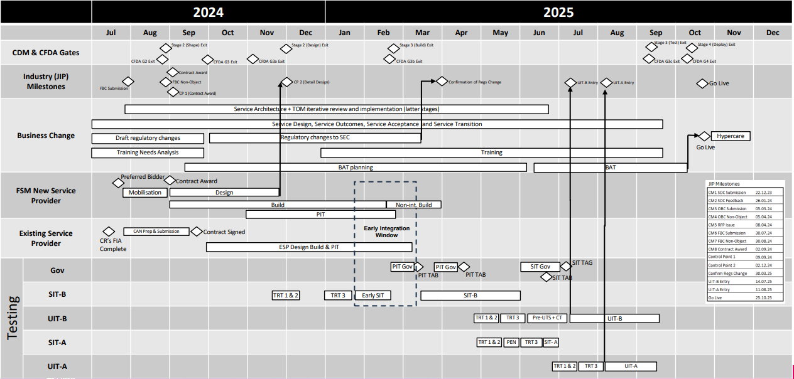
FSM Plan on a page – 13/9/24
Phase 3a Design

Slide 19
Resource Profile
Phase 3a Design
Please provide the approved baselined resource profile from Clarity.
Notes:
This should be a 1-2 page overview of the project

Slide 20
Systems Engineering Management Plan
Phase 3a Design

Slide 21
CFDA Review Matrix Please highlight below who your nominated reviewer is from each team per Phase
Phase 3a Design
Team​​ | Director​​ | Head/Manager​​ | Nominated/Delegated Review ​​ | Approval
(CTO) Engineering & Technical Management | Mannu Rawat | Mark Shaw | Assigned on a per project basis | Provide hyperlink to email
(CTO) Architecture & Design | Graham Robertson | Allan Aitchison | Assigned on a per project basis | Provide hyperlink to email
(CTO) Infrastructure and Connectivity | Mannu Rawat | Mohamed Touhami | Assigned on a per project basis | Provide hyperlink to email
(CTO) Systems Integration | Steve Thun | Abdullah Dawood | Assigned on a per project basis | Provide hyperlink to email
(CTO) Cloud CoE | Graham Robinson | Nagesh Nagara | Assigned on a per project basis | Provide hyperlink to email
(CISO) Security Architecture | Silvano Sogus | Per Project Basis | Assigned on a per project basis | Provide hyperlink to email
(DCO) Business Analysis | Andy King | Per Project Basis | Assigned on a per project basis | Provide hyperlink to email
(DCO) Testing Assurance | Charlotte Semp | Will Leacock | Assigned on a per project basis | Provide hyperlink to email
(COO) Service and Operations | Dan Jessop | Tony Whitrod | Hina Ahmed | Provide hyperlink to email
(CCO) Commercial | Rachel Robinson | Ian Watson | Assigned on a per project basis | Provide hyperlink to email
Regulatory | Steve Hervouet | Refer to Technical Management | Assigned on a per project basis | Provide hyperlink to email

Slide 22
CFDA Artefact Status
Phase 3a Design
Artefact (Phases Required) | Review Complete | Major Comments | Minor Comments | Advisory | Document Link | Approval
Architectural Decision Log (0,1,2,3) | Y/N/NOT REQD | 0 | 0 | 0 | Provide hyperlink to document | Provide hyperlink to email
Architectural Decision Records (0,1,2,3) | Y/N/NOT REQD | 0 | 0 | 0 | Provide hyperlink to document | Provide hyperlink to email
SEMP (0,1,2,3) | Y/N/NOT REQD | 0 | 0 | 0 | Provide hyperlink to document | Provide hyperlink to email
Conceptual Architecture (1) | Y/N/NOT REQD | 0 | 0 | 0 | Provide hyperlink to document | Provide hyperlink to email
High-Level Architecture (2) | Y/N/NOT REQD | 0 | 0 | 0 | Provide hyperlink to document | Provide hyperlink to email
Interface Control Documents (2,3) | Y/N/NOT REQD | 0 | 0 | 0 | Provide hyperlink to document | Provide hyperlink to email
Detailed Design (3) | Y/N/NOT REQD | 0 | 0 | 0 | Provide hyperlink to document | Provide hyperlink to email
Requirements Verification Traceability Matrix (1,2,3) | Y/N/NOT REQD | 0 | 0 | 0 | Provide hyperlink to document | Provide hyperlink to email
Presentation (0,1,2,3) | Y/N/NOT REQD | 0 | 0 | 0 | Provide hyperlink to document | Provide hyperlink to email
All documents for review must be provided to CFDA at a minimum, 5 working days before a gate review meeting could be scheduled. Where many deliverables are to be reviewed, CFDA will engage and agree a timescale. All review comments identified as “Major” should be corrected/agreed on prior to face-to-face review. However, if carried forward to the CFDA session a decision will be made during the meeting whether the approval could be granted without resolving those “Major” comments.
Phase 3 consists of 3a Design, 3b Build, 3c Test (SIT Exit)
Notes:
These are the artefacts detailed in the CFDA review matrix

Slide 23
Phase 3a Design

Slide 24
Work Off Items Outstanding From Phase 2
Phase 3a Design
The presentation should include all the work off items outstanding from Phase 2 and why they have not been completed and a commitment to when they will be complete
Notes:
This section should detail the high-level architecture annotated to show the scope of each contract/change request. System requirements shall demonstrate traceability to the High-Level Architecture

Slide 25
Architectural Decisions, Design Risk and Techncial Debt
Phase 3a Design
Notes:
List of architectural decisions submitted to the CFDA

Slide 26
Change Requests Post Phase 2
Phase 3a Design
Change Requests | Description | Status
Notes:
This section should detail all the contracts and change requests that are associated with this project. SECOMD and DUIS changes are considered change requests

Slide 27
Detailed Design – Requirement and RVTM
Phase 3a Design
Summarise of requirements and RVTM status
Detail Requirement should not change after Gate 2, so it is only expected to present/summarise any new or updated requirements identified since gate 2
Present/summarise any potential contract update required as the result of detail design changes
RVTM should be updated to show traceability to detail design back to detail requirement, contract schedule and high level architecture (including both solution and business process)
RVTM should be updated to show traceability to testing approach/validation method
Compliance status of each requirement shall be clearly indicated (Full, Partial or None) , and matrix presented
How many requirement are non traceable to detail design
How many requirement are non testable and what are the acceptance criteria for such requirement
Present/summarize any Partial and Non-Compliance supported by addition information regarding the deviation
Work off items identified
Notes:
This section should detail the detailed design annotated to show the scope how it maps to the high level architecture

Slide 28
Detailed Design – System Elements
Phase 3a Design
Summarise of the deliverables which details each System Element as specified within the ‘High Level Architecture’
Physical implementation (including geographic locations)
Application software (version, modules, and patch level)
Application architecture mapping to the HLA and Requirement
Configuration/customisation settings (including any customised non-standard components / entities / objects)
Service management
User management
Exception & error handling
Performance monitoring
Availability resilience & integrity management
Capacity and storage management
Backup/recovery process/procedure (BCDR)
Method(s) of user access, specific device, and application version(s)
Work off items identified
Notes:
This section should detail the detailed design annotated to show the scope how it maps to the high level architecture

Slide 29
Detailed Design – Interface Control Documentation
Phase 3a Design
Summarise of the deliverables which details the interfaces defined between each System Element as specified within the ‘High Level Architecture’
Interface specification should not change after Gate 2, so it is only expected to present/summarize any new or updated interface identified since gate 2
To ensure all parties impacted by the interface are aware of the change, it is expected to present
associated CR number
Which party/sub system is impacted by this interface change
Work off items identified
Notes:
This section should detail the detailed design annotated to show the scope how it maps to the high level architecture

Slide 30
Detailed Design – Data Model
Phase 3a Design
Summarise of the deliverables details the data model used within each System Element as specified within the ‘High Level Architecture’.
Provide high level overview of the Data model detail design or statement on approach taken, for example including one or more area from below
Data flow diagrams of major data flows. A major data flow is classified as
System to system
Supports the primary business process
Non-standard/customised data Objects
Name, data type, format and allowable values
Entity relationship diagram
Primary/secondary/composite/foreign key relationships
Constraints/rules
Data mapping between internal and external data entities
DCC Security Classification of each data entity
Work off items identified
Notes:
This section should detail the detailed design annotated to show the scope how it maps to the high level architecture

Slide 31
Detailed Design – Data Governance
Phase 3a Design
Summarise of the deliverables details the Data Governance approach.
Provide high level overview of the Data Governance approach:
Data retention periods and method of removal
Archiving method
Technical methods for measurement and maintenance of data quality
Work off item identified
Notes:
This section should detail the detailed design annotated to show the scope how it maps to the high level architecture

Slide 32
Detailed Design – Technical Performance Measures
Phase 3a Design
Summarise of the deliverables details Technical Performance Measures. Typically this should include
The updated schedule 2.2
TOC/SOC/Performance measure reporting design
Performance measure approach document
Any new version of the SEC/REC that maybe impacted
Testing approach on the performance measure
Provide high level overview of the Technical Performance Measures that have been defined for the system
How these meet the Measures of performance defined in the High-Level Design, and
how the technical performance measures are used to calculate the contractual performance measures(schedule 2.2)
Work off items identified
Notes:
This section should detail the detailed design annotated to show the scope how it maps to the high level architecture

Slide 33
Detailed Design – Business Processes (service design)
Phase 3a Design
Summarise of the deliverables details the business process which demonstrate how the solution could be supported by the operation. Typically this should include
Preferred : ArchiMate/Bizzdesign model capture the business process, and interactions with internal and external systems, business role object
Or a link to the service design produced which may include but not limited to
High level Business process
Low level business process contains work instructions
BAT validation method
Provide high level overview of the business process
Work off items identified
Notes:
This section should detail the detailed design annotated to show the scope how it maps to the high level architecture

Slide 34
Detailed Design – Security Compliance/detail design
Phase 3a Design
Summarise of the deliverables details the security compliance and detail design
This section maybe confidential, so a link to the deliverables is sufficient
Deliverables should align to DCC Schedule 2.5
Provide high level overview of the Security Compliance/detail design
This section maybe confidential, so summarises of the DCC independent cross functional security review and approval evidence maybe sufficient to cover this
Work off items identified
Notes:
This section should detail the detailed design annotated to show the scope how it maps to the high level architecture

Slide 35
Detailed Design – BCDR
Phase 3a Design
Summarise of the deliverables details the BCDR plan and testing approach
BCDR will normally be specified within contract schedule 8.6.
Deliverables should align to DCC Schedule 8.6 and explain how the individual system element is integrated with schedule 8.6
Provide high level overview of the BCDR
Present the technical features/processes for each system element that contribute towards DCC’s Business Continuity Disaster Recovery Plan.
Work off items identified
Notes:
This section should detail the detailed design annotated to show the scope how it maps to the high level architecture

Slide 36
Detailed Design – Infrastructure and Software Development
Phase 3a Design
Summarise of the deliverables details the infrastructure and software development
Documents sets shall include details of:
Development tools registry: Version/ Modules / Configuration
Production and Non-Production environments
Purpose and location of each environment
System / Service configuration, Code configuration, Data Configuration
Access Controls
Backup/recovery
Refresh frequency
Source code control system: Versioning scheme /List of packages/configuration items /Branch/merging methodology
Deployment
Promotion of configuration between environments
Promotion of software between environments
Promotion of data between environments
Rollback process/procedures
Provide high level overview
Work off items identified
Notes:
This section should detail the detailed design annotated to show the scope how it maps to the high level architecture

Slide 37
Detailed Design – Validation
Phase 3a Design
Summarise of the deliverables details the how the validation is achieved (normally within contract schedule 6.2)
Documents sets shall include details of:
Validation Method
Validation Lifecycle (including environments)
Temporary systems/services required to enable validation
Test approach
Provide high level overview
Work off items identified
Notes:
This section should detail the detailed design annotated to show the scope how it maps to the high level architecture

Slide 38
External Documentation Checklist Identify the list of any external documentation program/project needs to prepare/update at this phase
Phase 3a Design
Document | Required (Y/N)
Program Release Note
External communications
Parse & Corollate compatibility matrix
Parse & Corollate Release note
Anomaly Detection Threshold / Anomaly Detection Attributes guidance
Self Service Interface Specification
Error Handling Strategy
DCC guidance -Use of DUIS
Operational DUGIDS
DCC Business Process Document
Certified Products List
Knowledge Base Article
Notes:
Projects that directly or indirectly change the existing functionality of the ‘Total System’ are required to update external documentation. This section is a checklist to ensure that the appropriate updates have been completed

Slide 39
System Engineering Management Plan Overview
Phase 3a Design
Notes:
This should be a single page overview on the End-2-End System engineering approach

Slide 40
Work Off Items identified & Carried Forward to Phase 3b Build
Phase 3a Design
The presentation should include all the work off items identified before or during the CFDA review process, the reason why it is not completed, and the mitigation plan to address them during Gate 3B Build activity
Notes:
This section should detail the high-level architecture annotated to show the scope of each contract/change request. System requirements shall demonstrate traceability to the High-Level Architecture

Slide 41
Risk Profile

Slide 42
Risks and issues – Identified for Phase 3
ID | Item | Owner (tbc) | Mitigation | Further Steps
 | SoW is high level, and more detailed architectural documents are not explicitly referenced and locked in. This means details arising within requirements confirmation and LLD may be disputed as in/out of scope | Neil Rogers | Workshops are trying to cooperatively resolve details as they progress, which appears to be successful so far | Confirm a forum or process for escalating and resolving any disputes arising
 | Traceability between RTM and User Stories is currently an issue, meaning that Test Assurance is unsure how testing can be assured
 | Development timeline remains very aggressive, and sequencing of sprint content is not yet aligned between CGI, Capgemini and testing | Neil Rogers | Capgemini to share scope of first 4 sprints | Review and align
 | Connectivity is critical path but is currently over-running. | Steve Hyde | PR presented and SoW requested. Contingency budget to cover any in-flight amendments | Confirm budget cover
 | Intensive detailed requirements confirmation and user story activity has raised extensive questions and actions list. If these are not resolved promptly, LLD may be impacted | Phil Hood
 | Migration testing approach has not been designed yet | Capgemini | Develop test strategy and HL plan by mid-October
 | Data migration has been scoped as requiring no cleansing by Capgemini
 | Data migration impact on Remedy production is unknown, so risks impacting production performance | Capgemini (and CGI) | Various scheduling, batching and throttling techniques proposed. Early testing of impacts and these techniques | Develop mitigation plans as part of migration design work
 | NFRs are only defined in limited areas and with low detail. Ultimate performance may be determined by SaaS
 | Failure to complete DS&A report build will impact regulatory reporting, but this remains outside FMSP scope | Phil Hood | Ops to support DS&A resourcing needs to achieve timetable | Develop formal plan confirm resourcing
 | Failure to migrate/align Sharepoint will prevent SSO outcome for SUs. This concern was raised by Julian, but remains outside FSMP scope | Phil Hood | Propose that ops sponsor effort and cost by EIT (potentially leveraging FSM SP or CTO and BA resources) | Develop funding case and path

Slide 43
Work off items

Slide 44
CFDA Decision
Date | Date | Decision | Cert Issued | Notes
Phase 0
Phase 1
Phase 2
Phase 3a
Phase 3b
Phase 3c

Slide 45
Thank you. Smart DCC cfda@smartdcc.co.uk smb.tmf@smartdcc.co.uk

Slide 46

CFDA High level Governance Activities Overview
Stage 3: Develop
Ensure that architecture have been engaged and reviewed proposed opportunity | Ensure that selected solution is appropriate, aligns to strategy and supports the business need and is baselined | Ensure that detailed requirements are complete (including NF), trace to HL solution design, that test approach is correct | Ensure detailed design aligns to enterprise scope and system integration supports all parries | Ensure that solution build is as designed, that configuration is detailed, that test plans are valid and all elements align to requirements | Ensure testing is complete and defects fixed. Ensure that the business has a clear view of any issues and risks | Support Go Live / deploy, incubate, ensure that lessens learned are captured/understood | Support the capture realisation of target business outcomes against solution
Ensure that proposed opportunity has architecture input and that its implication are understood. Ensure that the initial opportunity is captured with DCC enterprise repository and that there is an enterprise view of the opportunity. Ensure that proposed opportunity aligns with DCC technology roadmap and strategy. | Ensure that that the business scope is correct and aligns to the enterprise roadmap, strategy, vision of change. Ensure that enterprise impact to the business architecture and service is captured Ensure technology design choices align to DCC, principles and technology strategy Review solution options and approve solution choice. Ensure CFDA governance plan exists for next phase | Ensure detailed requirements are correct, complete and baselined Ensure full end to end engineering traceability.. Ensure that all parties have an HL enterprise integrated systems engineering solution that will support the business need. Ensure HL service design is correct Ensure that the test scope is correct. Ensure CFDA governance plan exists for next phase | Ensure that detailed design align to requirements and are correct before build. Ensure full end to end engineering traceability Ensure that SP system integrated design are aligned. Ensure detailed service design is correct Ensure that test scope and plan is correct. Ensure CFDA governance plan exists for next phase | Ensure built as designed and all solution deliverables are baselined and traceable. Ensure detailed service design are complete. Ensure that test plans have been align across all stakeholders. Ensure configuration items are detailed and deployable. Ensure all environments are appropriate and that production environments will support solution. Ensure CFDA governance plan exists for next phase | Ensure end to end testing is completed. Ensure that severity 1 & 2 defects have been fixed. Ensure that the business has a clear view of and solution risks. Ensure that solution will support business migration activities. Provide solution approval for deployment into production | Support go Live and solutions deployment Support Incubation / post implementation support Support outcome realisation & tracking Support handover to BAU Support review of Project & capture lessons learned | Support the ongoing outcome realisation & tracking against solution Support post investment review Support & share lessons learned
●●●●● | ●●●●● | ●●●●● | ●●●●● | ●●●●● | ●●●●● | ●●●●● | ●●●●●
Stage
Stage 0:
Identify
Stage 1: Investigate
Stage 2:
Shape
Design
Build
Test
Stage 4:
Deploy
Stage 5:
Realise
Gate
G0
G1
G2
G3 Design
G3
Build
G3
Test
G4
G5
Objectives
Key Activities/
Outcomes
Commercial Alignment
Review G2 Business Case
Engineering
Approval
CFDA
Solution option approval
via CFDA
High level solution approval
via CFDA
Low level Solution approval
via CFDA
Solution approval of Build
via CFDA
Solution approval of Test
via CFDA
Relative Effort
PCRs follow standard project change process
PCRs follow exception project change process

Slide 47
DCC Change Delivery Methodology
The Change Delivery Methodology (CDM)
What will the CDM do for me?
The CDM provides a defined method of delivering end-to-end change across the wide and varied portfolio of change within DCC. It defines a repeatable staged approach, standards, and governance required to deliver Change for our customers and
internally in a flexible, but controlled and auditable manner.
It ensure that the right deliverables are produced at the right time and with the right level of stakeholder input and approval in order to help deliver target outcomes within the planned time, quality and budget.
SCOPE LOCK
CR/PRs after low level design sign off will require C Suite review
.
Level 0: Stage Process
Stage 3:
Stage
Stage 0:
Identify
Stage 1: Investigate
Stage 2:
Shape
Design
Build
Test
Stage 4:
Deploy
Stage 5:
Realise
Identify opportunity for change & justify investment to investigate it further | Determine the feasibility of the change and the business case to proceed | Define detailed requirements, approach, plans and resourcing. Break into projects / sprints |  | Complete detailed design and gain approval to proceed. Final scope/finances/ resources confirmed |  |  | Commence solution build and complete test plans to validate build | Complete testing and business readiness checks in readiness to go live with the solution | Go Live / deploy, incubate and embed the change within the business, agreeing handover before project closure | Enable and track realisation of target business outcomes and capture actionable lessons learned
Kick Off meeting with functions (slide X) Describe the opportunity and target outcomes Identify the business areas impacted Confirm strategic alignment to DCC and overall sponsorship Confirm S1 costs Confirm S1 dates including resources and plans Confirm S1 Deliverables | Define high level business and ensure it aligns to the enterprise roadmap, strategy and vision for change Assess High-Level impact (incl. PA & RFI if required) Review solution options and gain CFDA approval on solution choice Develop an outline business case Provide ROM to S2-S5 costs but confirm S2 costs Provide indicative G2 – G5 dates, including resources and plans Confirm S2 deliverables | Detailed Impact Assessment (incl. FIA and RFP’s if required) High-Level design completed Ensure E2E engineering traceability Define the delivery approach, work-breakdown structure and resource plan Initiate benefits tracking Develop a detailed business case Confirm S3-5 costs and S3 – Design deliverables |  | Award contracts once G2 is passed Ensure detailed design is correct before build Ensure that SP system integrated designs are aligned Ensure detailed service design is correct Plan testing scope and approach Update G2 Business case as a result of any changes from detailed design Confirm S3 – Build deliverables |  |  | Commence solution build Manage 3rd parties Complete and align test plans Ensure detailed service design are complete Ensure configuration items are detailed and deployable Plan deployment and ensure all environments are appropriate and that production will support solution Confirm S3 - Test deliverables | Carry out business readiness activities Commence test, pilots and training Resolve severity 1 and 2 defects Determine whether the solution can be deployed to production End to End testing Ensure that the business has a clear view of any issues and risks Ensure that solution will support business migration activities Confirm S4 deliverables All functions ‘Go No Go’ prior to go live | Complete training Go Live and deploy solution Incubation / post implementation support Begin outcome realisation & tracking Handover to BAU and close project Review Project & capture lessons learned Confirm S5 deliverables | Ongoing outcome realisation & tracking Post investment review Update & share lessons learned Celebrate successes Remove programme from Portfolio Inventory
●●●●● | ●●●●● | ●●●●● |  | ●●●●● |  |  | ●●●●● | ●●●●● | ●●●●● | ●●●●●
Gate
0
1
2
Design
Build
Test
3
4
5
Objectives
Commercial Alignment and confirm G2 Business Cas
Review revised business case against G2 Business Case
Key Activities
CFDA provide critical approvals throughout the project lifecycle. CFDA governance activities can be viewed here
Opportunity captured CFDA
Solution approval at CFDA
HL solution approval at CFDA
LL solution approval at CFDA
Solution
build approval at CFDA
Solution
test approval at CFDA
Solution
approval at CFDA
Relative Effort
PCRs follow standard project change process
PCRs follow exception project change process

Slide 48
CFDA Members
Cross Functional Design Authority (System Engineering Governance)
DCC CFDA Functional Members
CTO/COO Architecture
Teams
Business Analysis
Service Design
Security Architecture
Test Architecture
Test Assurance
Operations
Transition
OCAT
Migration Control
Regulation
Commercial
Devices
Team
Capacity
Team
BCDR
Team
Early Life Support
External Customer Engagement
Programme & Project
External Service Providers
DESNZ
OFGEM
SECAS
TABASC
Project Manager
Delivery Project
Team
System Engineering Teams
All Service providers
Technical Management and Systems Engineering

