Slide 1
DATA ANALYSIS & MACHINE LEARNING PROJECT
Pollution Risk Forecasting
PM2.5
54.7
Air Quality Intelligence through PM2.5 Prediction
mean concentration
GOOD
≤ 30
Predicting fine particulate matter from pollutant and weather conditions —
then translating the prediction into an interpretable risk level.
MODERATE
31–60
POOR
61–90
SEVERE
> 90
Presented by: Team Aarambh

Slide 2
INTRODUCTION
Project Introduction & Objective
THE PROBLEM
PROJECT OBJECTIVE
Air pollution risk is driven by multiple
interacting factors.
Build a complete, explainable forecasting
workflow
• PM2.5 is the target variable and the main output of the forecasting pipeline.
• Other pollutant readings and weather conditions are used as predictive inputs.
• A numerical PM2.5 prediction is converted into a simple risk category: Good, Moderate, Poor or Severe.
01
Prepare
Inspect, clean and encode the air-quality data.
02
Explore
Understand PM2.5 distribution and relationships.
03
Predict
Compare four regression approaches.
04
Interpret
Explain the best ensemble model and classify risk.
POLLUTION RISK FORECASTING
02

Slide 3
PHASE 01
Understanding the Raw Data
500
14
11
2
Records
Columns
Numeric features
Categorical fields
DATASET STRUCTURE
INITIAL INSPECTION
Target
PM2.5
• All 500 rows are non-null in the raw dataset.
• PM2.5, pollutants and weather variables are primarily numeric.
• Location_Type and Source_Label are categorical.
• Initial inspection exposed physically impossible negative values in NOx, NO2 and SO2.
Pollutant inputs
PM10 • NOx • NO2 • SO2 • VOCs • CO • CO2 • CH4
Weather / context
Temperature • Humidity • Wind_Direction • Location_Type
POLLUTION RISK FORECASTING
03

Slide 4
PHASE 02
Data Quality Assessment
WHAT WAS CHECKED
WHY THESE ISSUES MATTER
Missing values
0 in the raw dataset
Data quality is part of the model.
• Impossible negative pollutant values can distort learned relationships.
• Redundant information adds noise without adding predictive value.
• Categorical and circular variables need suitable representations before modeling.
Duplicate records
Not identified during inspection
Negative concentrations
Found in NOx, NO2 and SO2
Redundant field
Source_Label closely duplicates Location_Type
Categorical text
Location_Type requires numeric encoding
Wind direction
Circular 0–359° representation
Key takeaway
Clean inputs → more trustworthy predictions
POLLUTION RISK FORECASTING
04

Slide 5
PHASE 03
Cleaning & Feature Engineering
01
02
03
04
05
RAW DATA
→
CLEAN
→
ENCODE
→
ENGINEER
→
MODEL-READY
500 × 14
clip impossible negatives remove redundant field
one-hot Location_Type
sin / cos wind direction
14 features
CIRCULAR FEATURE ENGINEERING
Solution
Wind_Direction is measured in degrees, so 359° and 1° are close in reality but far apart numerically.
sin(θ) + cos(θ)
Then drop the original degree column.
POLLUTION RISK FORECASTING
05

Slide 6
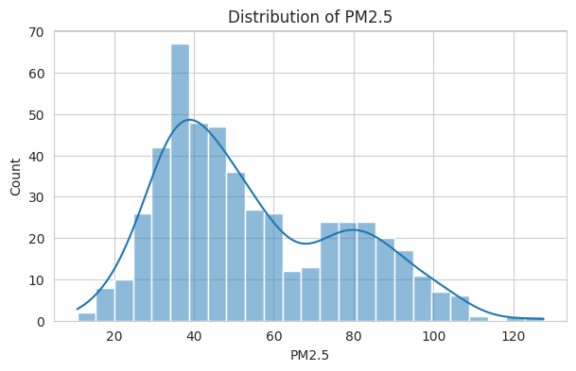
PHASE 04 — EDA
Overall PM2.5 Distribution
WHAT THE DATA SAYS
54.67
Mean PM2.5
22.80
Standard deviation
10.76 → 127.62
The target spans a broad range, making accurate continuous
prediction more useful than a single fixed threshold.
POLLUTION RISK FORECASTING
06

Slide 7
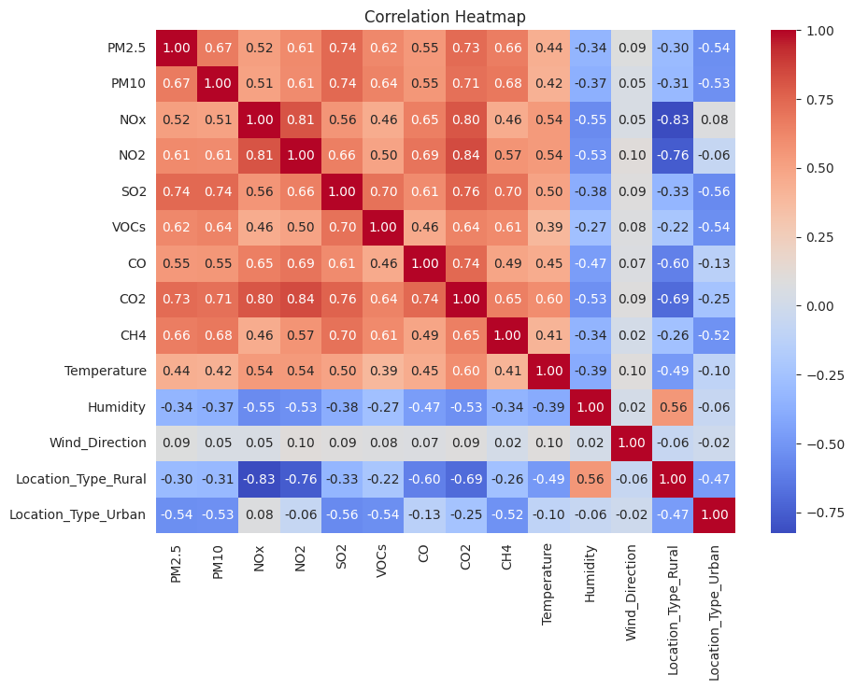
EDA — RELATIONSHIPS
Correlation Analysis
STRONGEST RELATIONSHIPS WITH PM2.5
SO2
0.740
CO2
0.731
PM10
0.670
CH4
0.664
VOCs
0.621
NO2
0.610
Interpretation
Several pollutant concentrations move strongly
with PM2.5, supporting a multivariable regression
approach.
POLLUTION RISK FORECASTING
07

Slide 8
PHASE 05
Modeling Strategy
TARGET
FOUR REGRESSION APPROACHES
PM2.5
01
Linear Regression
Baseline — simple, interpretable
Continuous regression problem
02
Random Forest
Ensemble of decision trees
Train / Test Split
400 training records
03
Gradient Boosting
Sequentially improves weak learners
100 test records
04
XGBoost
Optimized gradient-boosting implementation
80% / 20%
Evaluation metrics
RMSE • MAE • R²
POLLUTION RISK FORECASTING
08

Slide 9
PHASE 06
Model Performance Comparison
MODEL
RMSE ↓
MAE ↓
R² ↑
THE IMPORTANT DISTINCTION
Linear Regression
13.395
10.131
0.683
Best overall score
Linear Regression
Gradient Boosting
13.599
10.891
0.673
Best among the three required ensemble models
Random Forest
13.852
10.978
0.661
Gradient Boosting
XGBoost
14.527
11.258
0.627
Selected automatically by lowest RMSE among
Random Forest , Gradient Boosting and XGBoost.
POLLUTION RISK FORECASTING
09

Slide 10
MODEL SELECTION
Why Gradient Boosting?
SELECTION RULE
MODELING NOTE
Lowest RMSE wins.
• No hyperparameter tuning was applied in the notebook.
• RandomizedSearchCV is imported, but the final workflow uses the trained default model settings.
• This keeps the comparison transparent and reproducible for the presentation.
• The selected model is then used for feature-importance interpretation and risk classification.
The notebook compares the three main ensemble models
and selects the one with the smallest test-set RMSE.
Gradient Boosting
RMSE = 13.5985 • MAE = 10.8912 • R² = 0.6734
Interpretability layer
Feature importance → explains what drives PM2.5 predictions
POLLUTION RISK FORECASTING
10

Slide 11
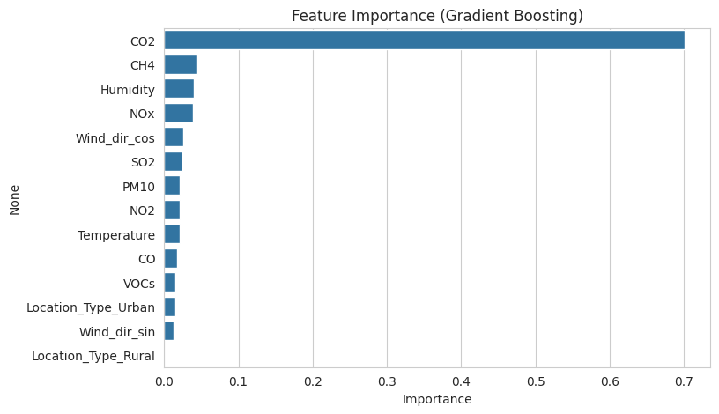
PHASE 07
Feature Importance — The Intelligence Layer
TOP DRIVERS
CO2
~0.70
CH4
~0.04
Humidity
~0.04
NOx
~0.04
Wind_dir_cos
~0.03
Key insight
CO2 dominates the fitted Gradient Boosting
feature-importance ranking in this dataset.
POLLUTION RISK FORECASTING
11

Slide 12
PHASE 08
From PM2.5 Prediction to Risk Forecast
THE FORECASTING OUTPUT
WHY THIS MATTERS
Predicted PM2.5
→
Risk Category
A regression number becomes
a decision-friendly signal.
GOOD
≤ 30
lower-risk band
• The model predicts a continuous PM2.5 value.
• The predicted value is mapped to one of four risk levels.
• This creates the final 'risk intelligence' layer of the project.
MODERATE
31–60
intermediate-risk band
POOR
61–90
elevated-risk band
SEVERE
> 90
highest-risk band
Example from the notebook
Predicted 81.23 → Poor
POLLUTION RISK FORECASTING
12

Slide 13
SYNTHESIS
Key Findings
01
Data quality
02
Target behavior
500 records were available with no missing values in the raw dataset.
PM2.5 has a mean of 54.67 and a broad observed range of
10.76–127.62.
03
Strong signals
04
Model result
SO2, CO2, PM10 and CH4 show the strongest positive correlations
with PM2.5.
Linear Regression has the best overall RMSE; Gradient Boosting is
best among the three required ensembles.
05
Model intelligence
06
Risk output
CO2 is by far the largest feature-importance contributor in the
selected Gradient Boosting model.
Predicted PM2.5 is translated into Good / Moderate / Poor /
Severe categories.
POLLUTION RISK FORECASTING
13

Slide 14
CONCLUSION
From Raw Readings to Risk Intelligence
COMPLETE PIPELINE
LIMITATIONS & NEXT STEPS
01
Inspect the dataset
02
Clean impossible / redundant fields
• The dataset contains only 500 records, so additional data would strengthen generalization.
• No hyperparameter tuning was performed in the current notebook.
• Risk labels are produced by the implemented PM2.5 thresholds.
• Next improvement: tune models and validate on a larger, independent dataset.
03
Encode categorical information
04
Engineer circular wind features
05
Explore PM2.5 relationships
06
Train and compare regressors
07
Interpret the selected model
08
Forecast risk category
Bottom line
Prediction + explanation + risk category
POLLUTION RISK FORECASTING
14

Slide 15
FINAL TAKEAWAY
Turning air-quality readings into an understandable risk signal.
A complete workflow: data quality → feature engineering → EDA → model comparison → explainability → risk forecasting
PREDICT
EXPLAIN
CLASSIFY
PM2.5 from pollutant + weather inputs
Understand which features drive the model
Translate the prediction into a risk level
THANK YOU
Questions & Discussion
Source: Pollution_Risk_Forecasting.ipynb

