Slide 1
Java 8 – part 1 – Lambda Expression

Slide 2
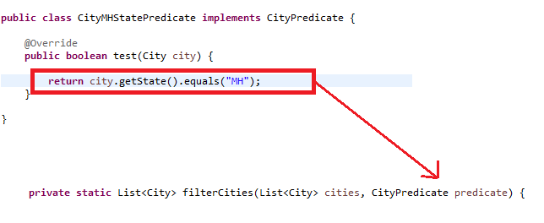
Multiple behaviors, one parameter
Boilerplate code
Pass as argument behaviour parameterisation
Multiple behaviors, one parameter

Slide 3
Exercise
1) reverse string
2) Upper case
3) Start with letter C
4) Sum of all the name length of country friends.stream() .mapToInt(name -> name.length()) .sum());
5) Longest name friends.stream() .reduce((name1, name2) -> name1.length() >= name2.length() ? name1 : name2);
6) Sort by age people.stream() .sorted((person1, person2) -> person1.ageDifference(person2)) .collect(toList());
public int ageDifference(final Person other) { return age - other.age; }
Comparator<Person> compareAscending = (person1, person2) -> person1.ageDifference(person2); Comparator<Person> compareDescending = compareAscending.reversed();
people.stream() .sorted(compareAscending) .collect(toList())
8) Group by age
Map<Integer, List<Person>> peopleByAge = people.stream() .collect(Collectors.groupingBy(Person::getAge));
9) Listing files Files.list(Paths.get(".")) .forEach(System.out::println); or
Files.list(Paths.get(".")) .filter(Files::isDirectory) .forEach(System.out::println);
final File[] files = new File(".").listFiles(file -> file.isHidden());
10) Calculate NAV of shares
public class CalculateNAV { public BigDecimal computeStockWorth(final String ticker, final int shares) { return priceFinder.apply(ticker).multiply(BigDecimal.valueOf(shares)); }
//... other methods that use the priceFinder ...
}
public CalculateNAV(final Function<String, BigDecimal> aPriceFinder) { priceFinder = aPriceFinder; }

Slide 4
Exercise 2
1) public class YahooFinance { public static BigDecimal getPrice(final String ticker) { try { final URL url = new URL("http://ichart.finance.yahoo.com/table.csv?s=" + ticker);
final BufferedReader reader = new BufferedReader(new InputStreamReader(url.openStream())); final String data = reader.lines().skip(1).findFirst().get(); final String[] dataItems = data.split(","); return new BigDecimal(dataItems[dataItems.length - 1]); } catch(Exception ex) { throw new RuntimeException(ex); }
}
}
final CalculateNAV calculateNav = new CalculateNAV(YahooFinance::getPrice);
System.out.println(String.format("100 shares of Google worth: $%.2f", calculateNav.computeStockWorth("GOOG", 100)));
2) Multiple filters
public void setFilters(final Function<Color, Color>... filters) { filter = Arrays.asList(filters).stream() .reduce((filter, next) -> filter.compose(next)) .orElse(color -> color); }
camera.setFilters(Color::brighter, Color::darker); decorator pattern
3) public static void findHighPriced(final Stream<String> symbols) { final StockInfo highPriced = symbols .map(StockUtil::getPrice) .filter(StockUtil.isPriceLessThan(500)) .reduce(StockUtil::pickHigh) .get();
System.out.println("High priced under $500 is " + highPriced);
}

Slide 5
The body of a lambda expression can be a block statement or a single expression. A block statement is enclosed in braces; a single expression is not enclosed in braces.
Uses a block statement. Takes two int parameters and returns their sum. (int x, int y) -> { return x + y; }
Uses an expression. Takes a two int parameters and returns their sum. (int x, int y) -> x + y
The following two lambda expressions are the same; one uses a block statement as the body and the other an expression that evaluates to void:
Uses a block statement
(String msg) -> { System.out.println(msg); }
Uses an expression
(String msg) -> System.out.println(msg)

Slide 6
Function<Integer,Integer> a = x - > x +1;
Function <Integer,Integer>b= x-> x*2;
Function <Integer,Integer>c = a.andThen(b);
c.apply(1) = ?
Function <Integer,Integer>d = a.compose(b);
d.apply(1) = ?
Write function interface to execute steps of making tea.

Slide 7
Using the Predicate<T> Interface
A predicate represents a condition that is either true or false for a given input.
The Predicate interface contains the following default and static methods that let you compose a predicate based on other predicates using logical NOT, AND, and OR.
default Predicate<T> negate()
default Predicate<T> and(Predicate<? super T> other)
default Predicate<T> or(Predicate<? super T> other)
static <T> Predicate<T> isEqual(Object targetRef)
Predicate<Integer> greaterThanTen = x -> x > 10;
greaterThanTen.test(10);
exercise – try other predicate. Using predicate write programme to find empty string in a list.

Slide 8
Target Typing for Poly Expressions
Diamond Operator
Generic Methods
Conditional Operator Expressions
Method and Constructor References
Target Typing & Checked Exceptions
Target Typing & the Return Type
For lambda
Assignment Context
Return Context
Method Invocation Context
Casting Context
Casting to an Intersection Type ( Java 8 onwards)

Slide 9
User Site Workarounds for Type Inference Issues
If you run into type inference problems the resolution strategy is: provide more type information. This can mean:
use explicit lambdas instead of implicit ones, i.e. explicitly specify the lambda's argument types;
try out method references instead of lambda expressions; sometimes it helps, sometimes it doesn't;
add casts that specify the lambda's or method reference's intended type;
break down a chain of operations into single steps by introducing a separate variable for each lambda expression / method reference
Function<? super String,C> f;
f = C::new; // error
f = (Function<CharSequence,C>)C::new; // fine
f = (Function<Serializable,C>)C::new; // fine

Slide 10
Intersection type
Java 8 introduced a new type called an intersection type that is an intersection (or subtype) of multiple types. An intersection type may appear as the target type in a cast. An ampersand is used between two types, such as (Type1 & Type2 & Type3), represents a new type that is an intersection of Type1, Type2, and Type3.
Serializable ser = (x, y) -> x + y; // compile error.
Serializable ser = (Serializable & Adder) (x, y) -> x + y;

Slide 11
Functional Interface in Java API
IntFunction<Integer> square2 = x -> x * x;
System.out.println(square1.apply(5)); output : 25
Function<Long, Long> square = x -> x * x;
Function<Long, Long> addOne = x -> x + 1;
// Compose functions from the two functions
Function<Long, Long> squareAddOne = square.andThen(addOne);
System.out.println("Square and then add one: " + squareAddOne.apply(5L));
// Square the input, add one to the result, and square the result
Function<Long, Long> chainedFunction = ((Function<Long, Long>)(x -> x * x)) .andThen(x -> x + 1) .andThen(x -> x * x);
System.out.println(chainedFunction.apply(3L));
Example 6

Slide 12
Primitive specializations
Boxed primitive required more memory and lookup. Java 8 brings a specialized version of the functional interfaces we described earlier in order to avoid autoboxing operations when the inputs or outputs are primitives. For example IntPredicate
IntPredicate numbers = (int num)-> num > 10;
numbers.test(20); // return true no auto boxing
Predicate<Integer> numbers = (Integer num)-> num > 10;
numbers.test(20); // autoboxing

Slide 13
Functional interface and function descriptor
Predicate<T> | T -> boolean
Consumer<T> | T -> void
Function<T, R> | T -> R
Supplier<T> | () -> T
UnaryOperator<T> | T -> T
BinaryOperator<T> | (T, T) -> T
BiPredicate<L, R> | (L, R) -> boolean
BiConsumer<T, U> | (T, U) -> void
BiFunction<T, U, R> | (T, U) -> R

Slide 14
Match the following.
(List<String> list) -> list.isEmpty() | Function<String, Integer> or ToIntFunction<String>
() -> new Student(10) | IntBinaryOperator
(Student s) -> System.out.println(s.getRollNumber()) | Predicate<List<String>>
(String s) -> s.length() | Comparator< Student > or BiFunction< Student, Student, Integer> or ToIntBiFunction< Student, Student >
(int a, int b) -> a * b | Supplier<Student>
(Student a1, Student a2) -> a1.getTotalMarks().compareTo (a2. getTotalMarks ()) | Consumer<Student>

Slide 15
The Java compiler deduces what functional interface to associate with a lambda expression from its surrounding context (the target type), meaning it can also deduce an appropriate signature for the lambda because the function descriptor is available through the target type. The benefit is that the compiler has access to the types of the parameters of a lambda expression, and they can be omitted in the lambda syntax.
Comparator<Student> s = (Student s1,Student s2) -> s1.compareTo(s2)
Comparator<Student> s = (s1,s2) -> s1.compareTo(s2)

Slide 16
Examples of lambdas
1) A boolean expression
(List<String> list) -> list.isEmpty()
2) Creating objects
() -> new Apple(10)
3) Consuming from an object
(Apple a) -> { System.out.println(a.getWeight()); }
4) Select/extract from an object
(String s) -> s.length()
5) Combine two values
(int a, int b) -> a * b
6) Compare two objects
(Apple a1, Apple a2) -> a1.getWeight().compareTo(a2.getWeight())

Slide 17
More Examples of lambdas
1) Takes an int parameter and returns the parameter value incremented by 1 (int x) -> x + 1
2) Takes two int parameters and returns their sum (int x, int y) -> x + y
3) Takes two int parameters and returns the maximum of the two
(int x, int y) -> { int max = x > y ? x : y; return max; }
4) Takes no parameters and returns void () -> { }
5) Takes no parameters and returns a string "OK" () -> "OK"
6) Takes a String parameter and prints it on the standard output
(String msg) -> { System.out.println(msg); }
data type sting might not required.
7) Takes a String parameter and returns its length (String str) -> str.length()

Slide 18
Lambda summary till now.
Why does the Java programming language need lambda expressions?
Because many modern programming languages have a similar language features., as a preparation for finegrained automated parallelization on multi-core hardware, in particular for bulk operations on collections
What is a lambda expression in Java?
A concise notation for a method without a name.
What do lambda expression and anonymous inner classes have in common?
Both are used to implement ad-hoc functionality aka anonymous methods.
What is a method? What is a function? How do they differ?
Functions are executed, but also passed around like data. They do not mutate data; they just produce new results. The order of their invocation does not matter. Methods are executed and may mutate data and produce side effects. The invocation order matters.
How is a lambda expression represented at runtime?
By a lambda object; both the lambda object and its type are dynamically created by the virtual machine at runtime.
6. What is the type of a lambda expression?
In isolation a lambda expression has no definite type; its type depends on the context in which it appears and is inferred by the compiler.
What is the target type of a lambda expression?
A type to which the lambda expression can be converted in a given context; the target type must be a functional interface type.
What is a functional interface?
An interface with a single abstract method.

Slide 19
Lambda summary till now contd.
For an anonymous inner class type definition and instance creation are tied together. How are lambda expression translated?
Creation of the lambda object and its type is implicitly taken care of by the virtual machine; it is done at runtime
Anonymous inner class can have bindings to variables of the enclosing scope. Is the same true for lambdas?
Yes, lambda expressions can capture effectively final variables from their enclosing scope and can bind to the enclosing instance via this and super.
An anonymous inner class is a name scope of its own. How about lambda expressions? Lambda expressions are part of the scope in which they appear; they are not scopes of their own.
What does this refer to in a lambda expression?
It refers to the enclosing instance (different from an anonymous class where this refers to the inner class's instance).
What do we need lambda expressions in Java for?
To enable convenient use of the overhauled collection framework in general and it parallel bulk operations in particular
What is a bulk operation?
An operation that concern many or all elements in a sequence.
What is internal and external iteration?
External iteration uses an iterator for access to all sequence elements. Internal iteration is performed by the sequence itself; the user just supplies an operation to be applied to all sequence elements.

Slide 20
Lambda summary till now contd.
For an anonymous inner class type definition and instance creation are tied together. How are lambda expression translated?
Creation of the lambda object and its type is implicitly taken care of by the virtual machine; it is done at runtime
Anonymous inner class can have bindings to variables of the enclosing scope. Is the same true for lambdas?
Yes, lambda expressions can capture effectively final variables from their enclosing scope and can bind to the enclosing instance via this and super.
An anonymous inner class is a name scope of its own. How about lambda expressions? Lambda expressions are part of the scope in which they appear; they are not scopes of their own.
What does this refer to in a lambda expression?
It refers to the enclosing instance (different from an anonymous class where this refers to the inner class's instance).
What do we need lambda expressions in Java for?
To enable convenient use of the overhauled collection framework in general and it parallel bulk operations in particular
What is a bulk operation?
An operation that concern many or all elements in a sequence.
What is internal and external iteration?
External iteration uses an iterator for access to all sequence elements. Internal iteration is performed by the sequence itself; the user just supplies an operation to be applied to all sequence elements.

Slide 21
Lambda summary till now contd.
For an anonymous inner class type definition and instance creation are tied together. How are lambda expression translated?
Creation of the lambda object and its type is implicitly taken care of by the virtual machine; it is done at runtime
Anonymous inner class can have bindings to variables of the enclosing scope. Is the same true for lambdas?
Yes, lambda expressions can capture effectively final variables from their enclosing scope and can bind to the enclosing instance via this and super.
An anonymous inner class is a name scope of its own. How about lambda expressions? Lambda expressions are part of the scope in which they appear; they are not scopes of their own.
What does this refer to in a lambda expression?
It refers to the enclosing instance (different from an anonymous class where this refers to the inner class's instance).
What do we need lambda expressions in Java for?
To enable convenient use of the overhauled collection framework in general and it parallel bulk operations in particular
What is a bulk operation?
An operation that concern many or all elements in a sequence.
What is internal and external iteration?
External iteration uses an iterator for access to all sequence elements. Internal iteration is performed by the sequence itself; the user just supplies an operation to be applied to all sequence elements.

Slide 22
Lambda summary till now contd.
What is the syntax for a lambda expression?
It consists of a parameter list, the "->" symbol, and a body. Anonymous inner class can have bindings to variables of the enclosing scope.
What does the body of a lambda expression look like?
It is either an expression or a sequence of statements
What does the parameter list of a lambda expression look like?
It consists of none, one, or several parameters. Each parameter has a name and a type. The name must be specified; the type can be specified or omitted.
How do I specify return type and exceptions of a lambda?
Not at all; the return type is always inferred.
What happens if a lambda expression declares the same name as its enclosing class? The inner name shadows the outer name.
What happens if a local or anonymous inner class declares the same name as its enclosing method?
The inner class defines new variables in its class scope that shadow variable with identical names in the enclosing method scope
What happens if a lambda expression declares the same name as its enclosing method?
The compiler will complain about a duplicate definition because every name used inside a lambda expression has the same meaning as in the enclosing scope
What is lexical scoping?
If a scope is part of its enclosing scope, i.e., if an unqualified name used in the inner scope refers to a name defined in the outer scope.
What do this and super mean in a lambda expression?
They mean the same as in the enclosing scope

Slide 23
Lambda summary till now contd.
Why is name binding in a lambda expression restricted to implicitly final variables of the enclosing scope?
In order to preserve the properties of local variables regarding lifetime and threadsafety.
Can a name in a lambda bind to a primitive type local variable of the enclosing scope? Yes, but the lambda cannot modify the primitive type local variable.
Can a name in a lambda bind to a reference type local variable of the enclosing scope? Yes, and the lambda may modify the referenced object, but must not modify the reference variable itself
Do anonymous and local inner classes - like lambdas - have access to effectively final variables?
Yes, since Java 8 the explicit final declaration can be omitted.
Can a lambda have bindings to non-final fields of the enclosing scope?
Yes, fields accessed in a lambda can be modified
What does return or throw mean in the body of a lambda?
It means a regular or exceptional return from the lambda.
Can lambda expressions be recursive?
No, they can't. Use anonymous inner classes instead
Can lambda expressions be generic?
No, they can't. Use method references instead.
What is a method or constructor reference?
A shortcut notation for a lambda created from an existing method or constructor
How do I refer to the constructor of a class or array?
Via typename::new.

Slide 24
Lambda summary till now contd.
Can I refer to a particular signature of an overloaded constructor?
No, you can only refer to a name, but not to a signature.
How do I refer to a generic constructor of a class?
There is no difference between a reference to a generic or non-generic constructor; the generic constructor's type parameters are always inferred.
reference
How do I refer to a static method?
Via typename :: methodname.
How do I refer to a non-static method?
Via typename :: methodname if the receiver is unspecified. Via expression :: methodname where the expression is the receiver
What are functional interfaces needed for?
Functional interfaces are needed as the target type of a lambda expression or method / constructor reference
Can a functional interface have nonabstract methods?
Yes, it can have default methods and methods inherited from Object.
What is the purpose of the @Functional Interface annotation?
It indicates that an interface is intended as a functional interface and triggers certain compiler checks.
Can functional interfaces be generic? Yes.
Is the intersection of several functional interfaces functional, too? Yes, if the intersection contains a single abstract method.
What can I do if I pass a lambda to an overloaded method and the compiler rejects it due to an ambiguity? Specify the lambda's arguments types explicitly

Slide 25
className::staticMethod A method reference to a static method of a class, an interface, or an enum
TypeName::staticMethod A method reference to a static method of a class, an interface, or an enum
Function<Integer, String> func1 = x -> Integer.toBinaryString(x);
BiFunction<Integer, Integer, Integer> func2 = Integer::sum;
static Integer valueOf(int i)
Function<Integer, Integer> func1 = Integer::valueOf;
static Integer valueOf(String s)
Function<String, Integer> func2 = Integer::valueOf;
static Integer valueOf(String s, int radix)
BiFunction<String, Integer, Integer> func3 = Integer::valueOf;
static List<Person> getPersons()
Supplier<List<Person>>supplier = Person::getPersons;
List<Person> personList = supplier.get();
Arrays::<String>asList (String[] array) -> Arrays.asList(array) or Array -> Arrays .<String>asList(array)

Slide 26
objectRef::instanceMethod A method reference to an instance method of the specified object – Bounded receiver
An instance method is invoked on an object's reference. The object reference on which an instance method is invoked is known as the receiver of the method invocation. The receiver of a method invocation can be an object reference or an expression that evaluates to an object's reference
name.length or “Hello”.length()
Specifying the receiver of the method invocation explicitly called bounded receiver
Supplier<Integer> supplier = () -> "Ellen".length();
System.out.println(supplier.get());
Supplier<Integer> supplier = "Ellen"::length; Ellen is bounded receiver.
Consumer<String> consumer = str -> System.out.println(str);
Consumer<String> consumer = System.out::println; consumer.accept("Hello");
When the method reference System.out::println is used, the compiler looks at its target type, which is Consumer<String> that represents a function type that takes a String as an argument and returns void. The compiler finds a println(String) method in the PrintStream class of the System.out object and uses that method for the method reference.

Slide 27
objectRef::instanceMethod A method reference to an instance method of the specified object – unbounded receiver
Specifying the receiver of the method invocation implicitly called unbounded receiver. For an unbound receiver, use the ClassName::instanceMethod syntax
Function<Person, String> fNameFunc = (Person p) -> p.getFirstName();
Function<Person, String> fNameFunc = Person::getFirstName;
Function<String, Integer> strLengthFunc = String::length;
The receiver object in the example of String::length is a String object that is used when the length method is invoked via the method reference. Obviously, the method reference String::length does not specifiy any particular string object as the receiver. This is why we talk of an unbound receiver
Constructor reference
String::new same as () -> new String()
ArrayList<String>::new
String[]::new
int[]::new
Tuple<String>::<String>new // generic
The compiler picks the right constructor depending on the context in which the constructor reference appears

Slide 28
TypeName.super::instanceMethod A method reference to an instance method of the supertype of a particular object.
See example 3
ClassName::new A constructor reference to the constructor of the specified class
a)Supplier<String> func1 = String::new;
b) Function<String,String> func2 = String::new;
c)
public Exception()
public Exception(String message)
<T> void foo(Supplier<T> factory)
<T,U> void foo(Function<T,U> transformer)
this.<Exception>foo(Exception::new); this.<String,Exception>foo(Exception::new);
ArrayTypeName::new An array constructor reference to the constructor of the specified array type
d) Uses a lambda expression
IntFunction<int[]> arrayCreator1 = size -> new int[size];
int[] empIds1 = arrayCreator1.apply(5);
e) Uses an array constructor reference
IntFunction<int[]> arrayCreator2 = int[]::new;
int[] empIds2 = arrayCreator2.apply(5); // Creates an int array of five elements

Slide 29
The syntax for a method reference also supports specifying the actual type parameters for generic types.
the actual type parameters are specified just before the two consecutive colons. For example, the constructor reference ArrayList<Long>::new specifies Long as the actual type parameter for the generic ArrayList<T> class.
static <T> List<T> asList(T... a)
Arrays::<String>asList.

Slide 30
Exercize
void sort(Comparator<? super E> c)
I have List<Student>
public class StudentComparator implements Comparator<Student> { public int compare(Student a1, Student a2)
{
return a1.getTotal().compareTo(a2.getTotal()); }
}
students.sort(new StudentComparator());
or use anonymous
Or students.sort((Student s1,Student s2)->s1.getTotal().compareTo….
Students.sort(comparing((s1)->s1.getTotal()))
Comparator.comparing static method
Students.sort(comparing(Student::getTotal)

Slide 31
Quiz method reference
What are equivalent method references for the following lambda expressions?
1. Function<String, Integer> stringToInteger = (String s) -> Integer.parseInt(s);
2. BiPredicate<List<String>, String> contains = (list, element) -> list.contains(element);
3 You saw how to transform zero-, one-, and two-argument constructors into constructor references. What would you need to do in order to use a constructor reference for a three-argument constructor such as Color(int, int, int)?

Slide 32
public class Test {
public static void main(String[] args) {
String msg = "Hello"; // A compile-time error.
Printer printer = msg -> System.out.println(msg);
}
}
class UnrestrictedAccessToFields {
private static int staticField = 0;
private int nonStaticField = 0;
public void demonstrate() {
int localVariable = 0;
new Thread(()-> {
staticField++; // fine
nonStaticField--; // fine
localVariable++; // error: local variable must be final
}).start();
}
}

Slide 35
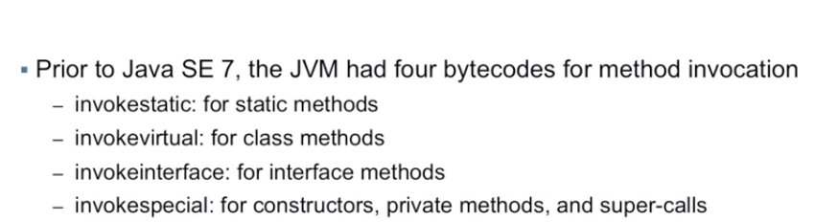

Slide 36
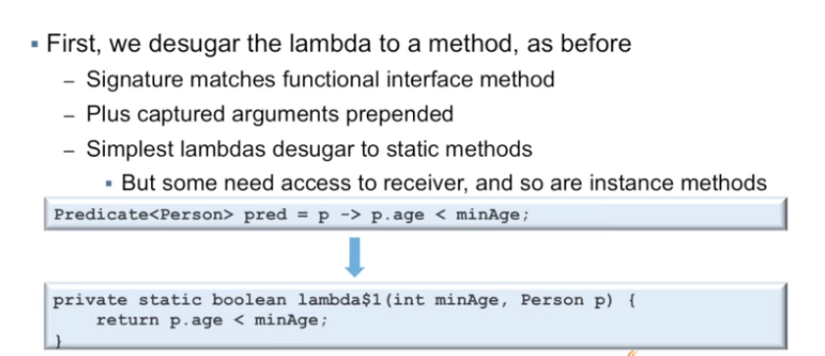

Slide 37
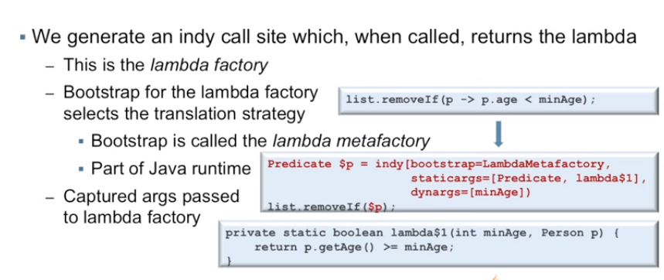

Slide 38
Summary
A lambda expression can be understood as a kind of anonymous function: it doesn’t have a name, but it has a list of parameters, a body, a return type, and also possibly a list of exceptions that can be thrown.
Lambda expressions let you pass code concisely.
A functional interface is an interface that declares exactly one abstract method.
Lambda expressions can be used only where a functional interface is expected.
Lambda expressions let you provide the implementation of the abstract method of a functional interface directly inline and treat the whole expression as an instance of a functional interface.
Java 8 comes with a list of common functional interfaces in the java.util .function package, which includes Predicate<T>, Function<T, R>, Supplier<T>, Consumer<T>, and BinaryOperator<T>, described in table 3.2.
There are primitive specializations of common generic functional interfaces such as Predicate<T> and Function<T, R> that can be used to avoid boxing operations: IntPredicate, IntToLongFunction, and so on.
The execute around pattern (that is, you need to execute a bit of behavior in the middle of code that’s always required in a method, for example, resource allocation and cleanup) can be used with lambdas to gain additional flexibility and reusability.
The type expected for a lambda expression is called the target type.
Method references let you reuse an existing method implementation and pass it around directly.
Functional interfaces such as Comparator, Predicate, and Function have several default methods that can be used to combine lambda expressions.

