Slide 1

LDAP
LIGHTWEIGHT DIRECTORY ACCESS PROTOCOL

Slide 2
AGENDA
WHY IS LDAP USED
WHAT IS DIRECTORY
LDAP STRUCTURE
CLIENT – SERVER INTERACTION
LDAP ADVANTAGES
LDAP DISADVANTAGES

Slide 3
WHY LDAP ?
To access information from directories
Functional model of LDAP is simpler due to this it omits duplicate
It is easier to understand and implement
It uses strings to represent data

Slide 4
WHAT IS DIRECTORY ?
Directories are set of object with similar attributes, organized in a logical and hierarchical manner.

Slide 5
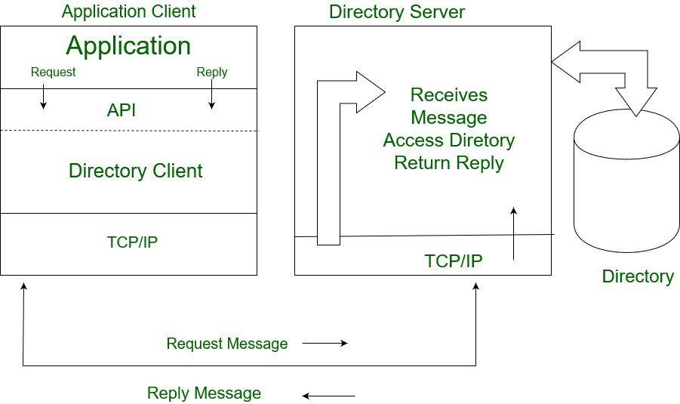

Slide 6
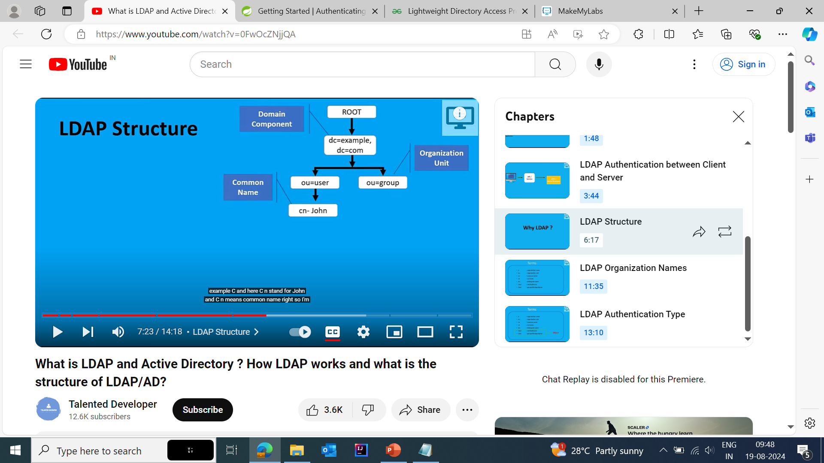
STRUCTURE

Slide 7
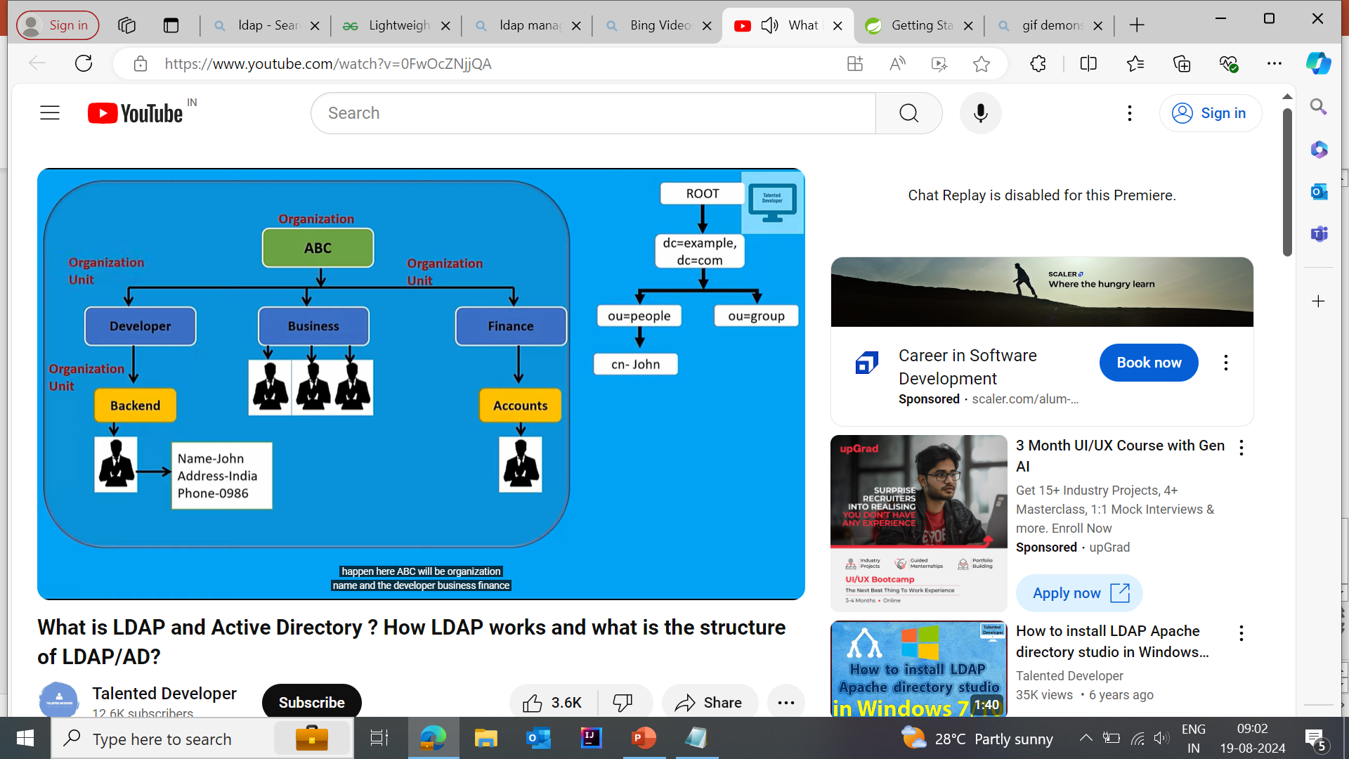
STRUCTURE

Slide 8
dn: uid=jsmith1,ou=People,dc=example,dc=com
objectClass: inetOrgPerson
cn: John Smith
sn: Smith
uid: jsmith1

Slide 9
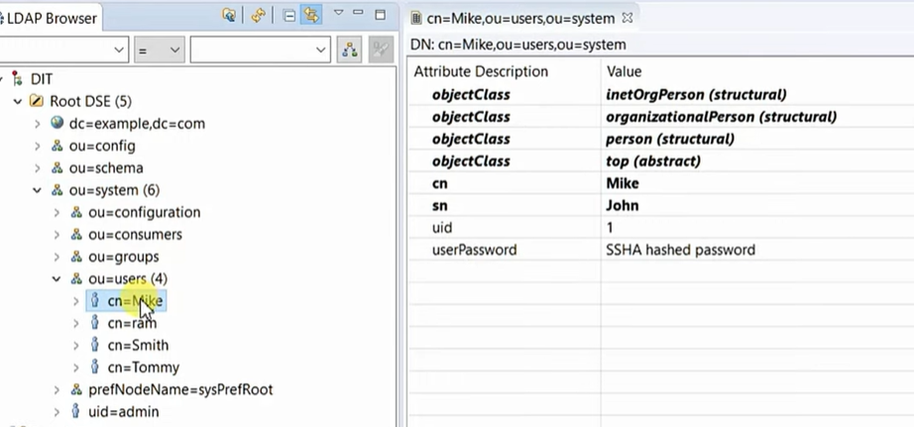

Slide 10
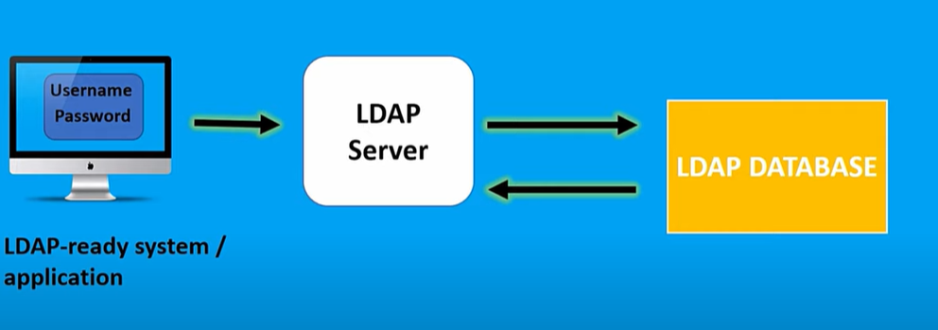
CLIENT SERVER INTERACTION

Slide 11
ADVANTAGES
Data present in LDAP is available to many clients and libraries.
LDAP support many types of application.
LDAP is very general and has basic security.

Slide 12
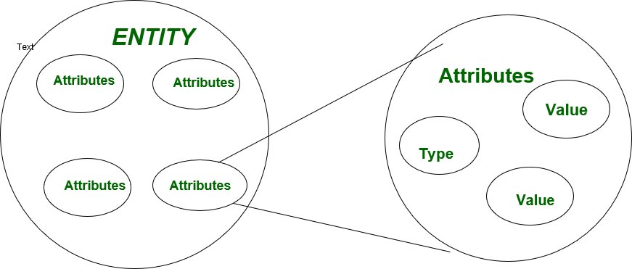
DISADVANTAGES
It does not handle well relational database.

Slide 13
REFERENCES
What is LDAP and Active Directory ? How LDAP works and what is the structure of LDAP/AD? (youtube.com)
https://spring.io/guides/gs/authenticating-ldap
Lightweight Directory Access Protocol (LDAP) – GeeksforGeeks

Slide 14
THANK YOU

