Slide 1

Computer Architecture Winter School 2020 FPGAs and Parallel Computing
Madhura Purnaprajna

Slide 2
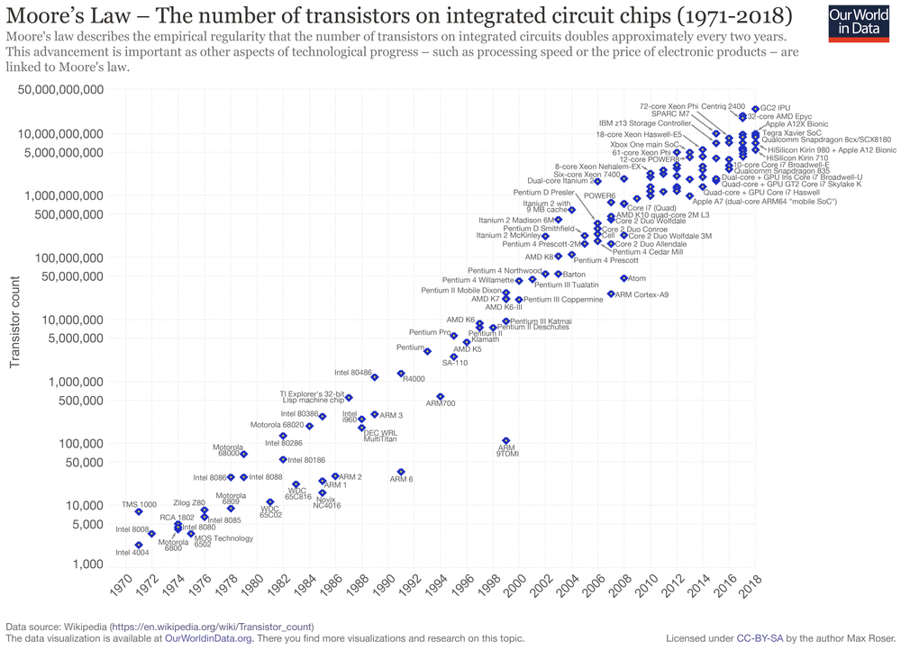
Moore’s Law

Slide 3
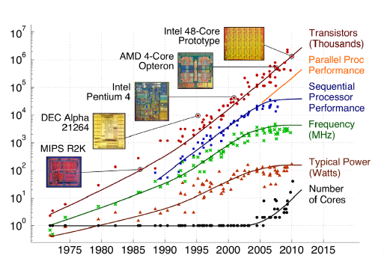
Its Melting!
Source: https://medium.com/@magicsilicon/is-software-eating-hardware-too-a899d343644

Slide 4
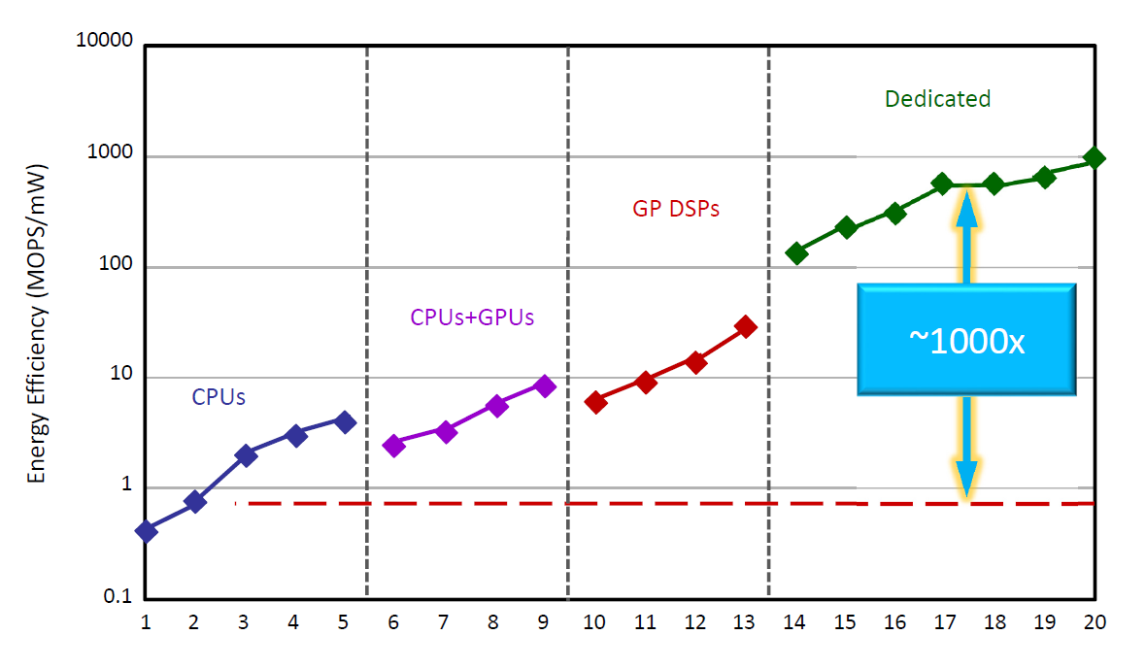
Computing’s Energy Problem:
(and what we can do about it)
Algo-tecture
Graph core
FFT Engine
BLAS accelerator
Custom Processors
Source Mark Horowitz, ISSCC 2014

Slide 5
Should FPGAs be taken seriously?
Can FPGAs compete with single and multi-core CPUs?

Slide 6
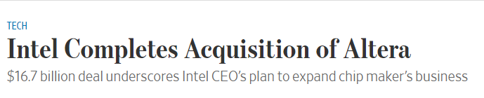
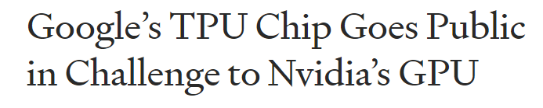
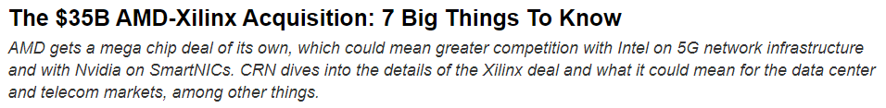
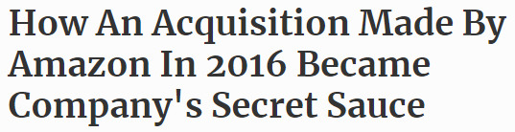
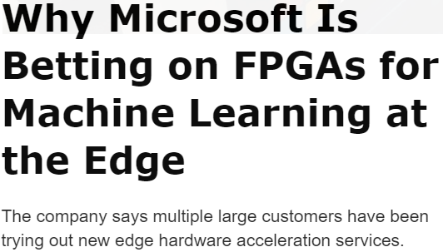
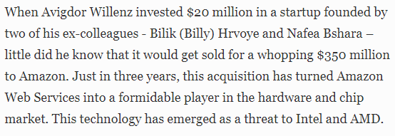
Towards custom hardware?

Slide 7
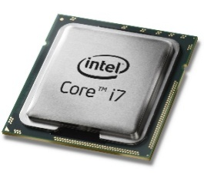
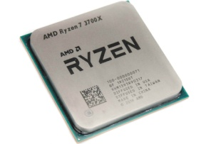

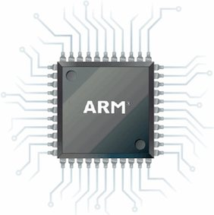
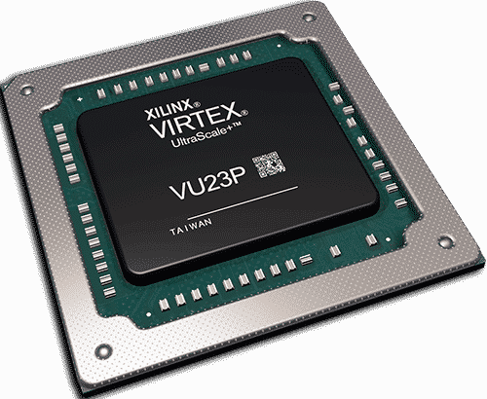
This presentation
CPU versus FPGA
CPU
ARM/Intel/AMD etc.
FPGA
Intel/AMD
CPUs
FPGAs
Target Devices

Slide 8









The two domains ...

Slide 9
Processors
Temporal computing
Instruction-level parallelism
Instruction Memory
Decoder
Registers
ALU
Data Memory
Registers

Slide 10
FPGAs
User configurable
Spatial computing
User-defined parallelism
FFs
FFs
FFs
00 0
01 1
10 1
11 1
FU
FU
FU
FFs
FFs
FFs
FU
FU
FU
FFs
FFs
FFs
FU
FU
FU

Slide 11
Application Mapping
Processor
FPGA
< N
N

Slide 12
Temporal v/s Spatial Computing
Processor
FPGA
Instruction Memory
00 0
01 1
10 1
11 1
FFs
FFs
FFs
Decoder
FU
FU
FU
Registers
FFs
FFs
FFs
FU
FU
FU
ALU
FFs
FFs
FFs
Data Memory
FU
FU
FU
Registers
x Limited parallelism
x Fixed architecture
x Scalability?
User-defined parallelism
Flexibility
Performance per Watt

Slide 13
Application Mapping
Application
Algorithm
Programming
Optimisations
Architecture
Fabrication
Device

Slide 14
Design Effort: ASIC
HDL
Logic Synthesis
Technology Mapping
Place & Route
Fabrication
ASIC

Slide 15
Design Effort: FPGA
HDL
Logic Synthesis
Technology Mapping
Pack, Place & Route
FPGA

Slide 16
Design Effort: Processor
HLL
Compilation
Processor

Slide 17
Application-to-Algorithm
HLL
T
HDL
100T
Compilation
Logic Synthesis
Processor
Technology Mapping
Pack, Place & Route
FPGA

Slide 18
Algorithm-to-Architecture
HLL
HDL
Compilation
few mins
Logic Synthesis
hours
Processor
Technology Mapping
Pack, Place & Route
FPGA

Slide 19
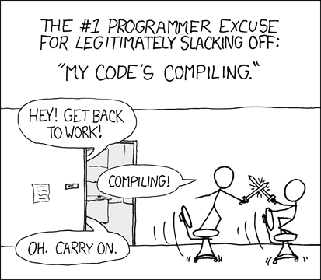
Application-to-Architecture
HLL
HDL
Compilation
mins
Logic Synthesis
days
Processor
Technology Mapping
Pack, Place & Route
FPGA
Programming FPGAs gives you a lot of time to slack off (image credit: XKCD)

Slide 20
Application-to-Architecture
High-level Synthesis: C-to-Hardware
SystemC, C, OpenCL, DSL
HLL
HLL
Compilation
mins
Logic Synthesis
hours
Processor
Technology Mapping
Pack, Place & Route
FPGA

Slide 21
Design time versus Performance
Introduction to FPGA Design with Vivado High-Level Synthesis, Xilinx UG998 (v1.1) January 22, 2019

Slide 22
Design time versus Performance
Introduction to FPGA Design with Vivado High-Level Synthesis, Xilinx UG998 (v1.1) January 22, 2019

Slide 23
HLS Pragmas
HLS tools provide pragmas to optimize the design:
reduce latency
improve throughput performance
reduce area
device resource utilization
pragmas can be added directly to the source code for the kernel
Loop/array/kernel optimisations

Slide 24
Unique to FPGAs

Slide 25
FPGA Fabric: User configurable
VLIW Processor on FPGA
Block RAMs
DSP Blocks
Configurable Logic Blocks
VLIW Processor
Instruction Memory
Multiplier, Shifter
Data Memory
Up to 2-port Register File
ALU, multi-ported register files, multiplexing,
control logic, state-machines, etc.

Slide 26
FPGA Fabric: User configurable
Run-time reconfigurable
Crypto
Processor
Image Processing
Ethernet
Controller
Block RAMs
DSP Blocks
Configurable Logic Blocks

Slide 27
FPGA Fabric: User configurable
Run-time reconfigurable
Graphics
Processor
Game: Chess
MIPS Processor
Block RAMs
DSP Blocks
Configurable Logic Blocks

Slide 28
Processor v/s FPGA
Processors
~35x
FPGA
Area
Ease of Adaptability
~5x
Speed
~15x
Power
ASIC
Performance

Slide 29
FPGA Architecture

Slide 30
FPGA Architecture
Programmable Logic
Programmable Routing
Programmable I/O

Slide 31
Programmable Logic

Slide 32
Logic: Lookup Tables
LUT
FF
2^{K}
SRAM
LUT
FF
2^{K}:1
MUX
LUT
FF
K
LUT
FF
Slice/Cluster

Slide 33
Look-up Table
2^{K} SRAM Cells
2^{2K} different functions
2^{K}:1 MUX
K-levels of 2:1 muxes
2^{K}
SRAM
2^{K}:1
MUX
K

Slide 34
Look-up Table: 2-inputs
2² SRAM Cells
2²² different functions
2²:1 MUX
2-levels of 2:1 muxes
2²
SRAM
2²:1
MUX
2

Slide 35
Look-up Table: 2-input NAND
4 SRAM Cells
6 transistors each
4:1 MUX
~12 transistors
~40 Transistors
1
1
1
0
4:1
MUX
2

Slide 36
Look-up Table: 2-input NAND
HUGE!
1
1
1
0
4:1
MUX
2
40 Transistors
4 Transistors

Slide 37
Look-up Table: 2-bit ALU
2-bit ALU: Adder, Subtractor, Divider, “anything”….
4-input LUT
1
1
1
0
..
..
1
16:1
MUX
4

Slide 38
Design decisions
LUT size
Number of LUTs per cluster
Inputs/Outputs to/from each cluster
Area and Speed

Slide 39
No. of Logic Blocks vs. Logic Block Functionality
LUT size increases exponentially with K
Routing tracks surrounding logic increases
with the number of input pins

Slide 40
Total FPGA area vs. LUT size

Slide 41
Terminology
Basic logic element (BLE)
Cluster
Size grows quadratically
Local interconnect
Fewer inputs (shared)
LUT
FF
LUT
FF
LUT
FF
LUT
FF

Slide 42
LUTs on critical path & LUT delay v/s LUT size
Functionality increases=> fewer logic blocks on critical path
=> internal delay increases

Slide 43
Critical path: Function of LUT and Cluster size
Diminishing returns beyond
LUT6 and cluster size 3,4

Slide 44
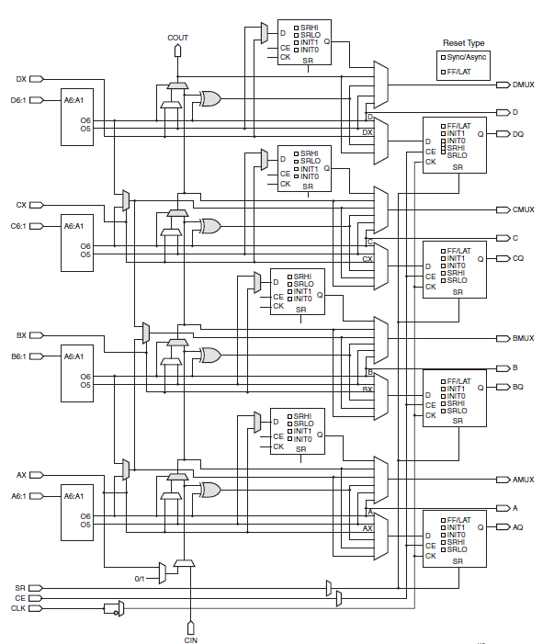
Logic: Soft
Programmable Logic Blocks

Slide 45
Logic: Hard Blocks
Memory
Blocks
Configurable: Width x Depth
Dual/ Single Port/FIFO

Slide 46
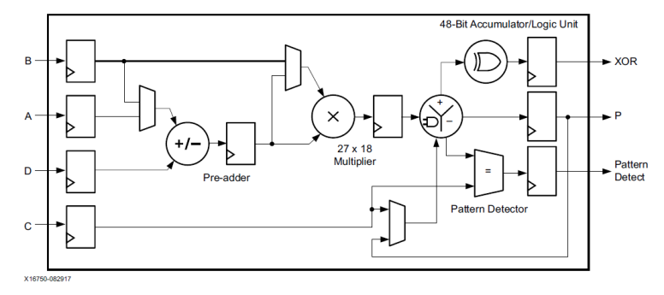
Logic: Hard Blocks
DSP Slice
DSP Blocks
Multiplier
Pre-adder
Accumulator
AND/OR/NAND/XOR
Pattern detector
Xilinx UltraScale Architecture DSP Slice User Guide UG579 (v1.10) September 22, 2020

Slide 47
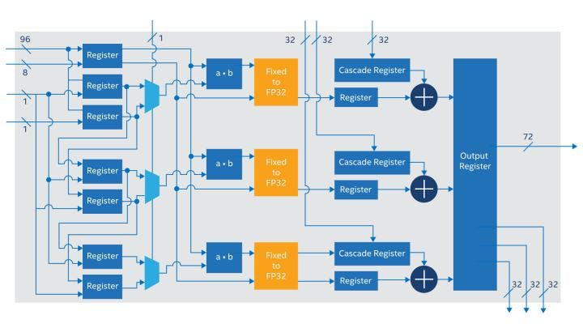
Logic: Hard Blocks
AI Tensor Block
Intel Stratix 10 NX FPGA
Int 8 inference
MM/MV multiplications

Slide 48
Hard blocks
FFs (set, reset, enable, load,…), Carry chains
ADCs, DACs
Security (AES, SHA..)
Processors
ZYNQ (Single, Dual, Quad ARM)
GPU
ARM Mali
..
..
System-on-chip

Slide 49
Programmable Routing

Slide 50
FPGA Architecture
Programmable Logic
Programmable Routing
Programmable I/O

Slide 51
Routing in FPGAs
Connect logic blocks and I/O
To define a user circuit
Flexible
Support local and distant routing demands
Locality
Short, Fast, with intermediate long wires
Global clocks and resets

Slide 52
FPGA Architecture
Routing
1
2
3
I
O
1
2
3
Connection box
1
2
3
1
1
2
2
3
3
1
2
3
Switch box

Slide 53
Routing
Connection Box
1
2
3
Any input to any output
Program the connectivity
I
O
1
2
3

Slide 54
Routing
Switch Box
Routes in X-Y direction
Uni- or Bi-directional
1
2
3
1
1
2
2
3
3
1
2
3

Slide 55
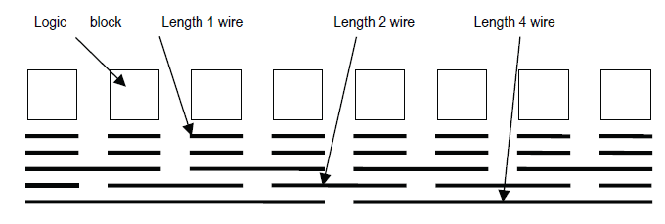
Routing
Wires
Short wires: 1 block
Long wires: Multiple blocks

Slide 56
Programmable I/O

Slide 57
FPGA Architecture
Programmable Logic
Programmable Routing
Programmable I/O

Slide 58
High-performance I/O
DDR on all I/Os
DDR4 up to 2,667Mb/s, DDR3, DDR3L, RLDRAM3, and QDR IV.
Gigabit Ethernet TX/RX
Integrated PCIe Gen3 x16
Transceivers transfer data up to 58.0Gb/s

Slide 59
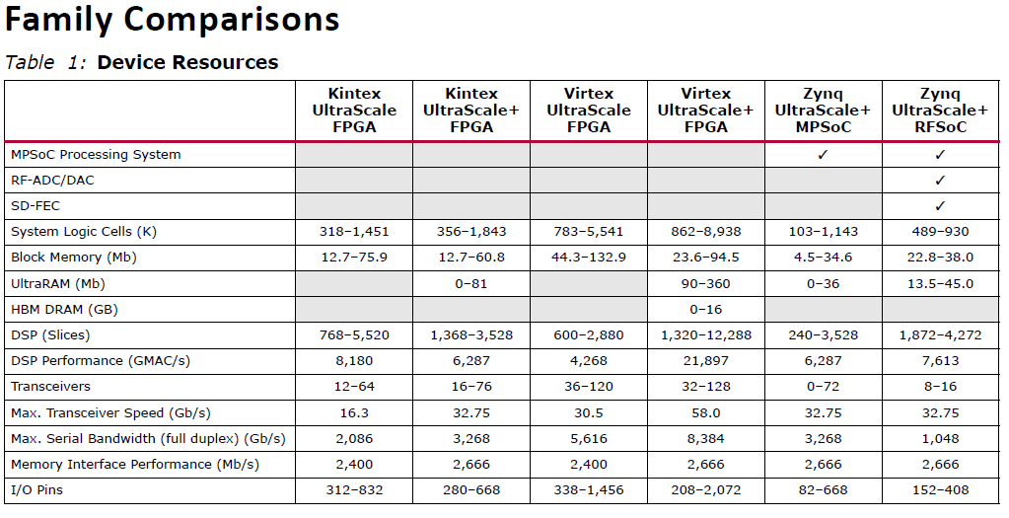
Reality check
Xilinx Ultrascale Datasheet, September 2020

Slide 60
Some examples …
CPU/GPU/FPGA

Slide 61
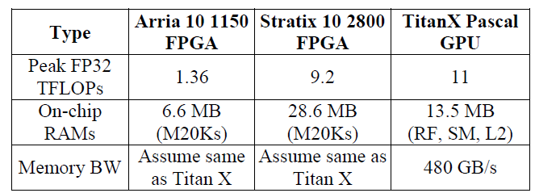
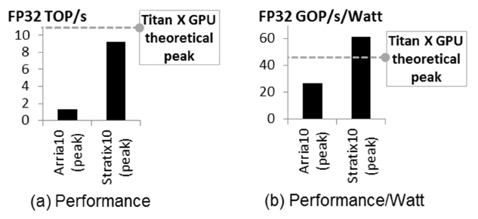
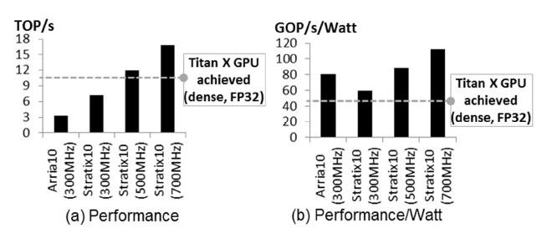
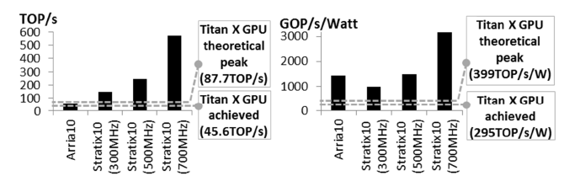
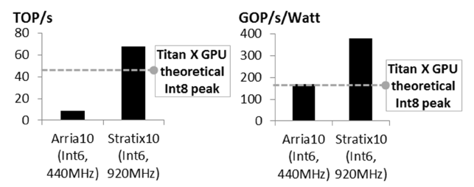
Deep Neural Networks
Can FPGAs beat GPUs?
Dense Matrices
Binarised DNNs
6-bit Integer
85% Sparse Matrices
Can FPGAs Beat GPUs in Accelerating Next-Generation Deep Neural Networks?, Intel Programmable Solutions Group

Slide 62
Other algorithms
Ternary CNN
~40 TOPS
Genomics
Sequence Alignment: 70x over CPUs
K-mer counter: 6x with HLS
Graph processing
2-3x better performance/watt

Slide 63
What next?
Heterogeneous Architectures
Co-operation between CPUs, GPUs and FPGAs
FPGAs with custom structures
AI, Multi-cores, ..?
Data centers
Compression/Decompression
Alternative to LUTs
AICs :Rethinking FPGAs (EPFL)

Slide 64
How do I get started with FPGAs?

Slide 65
Tools
Opensource
VTR: https://verilogtorouting.org/
PP4FPGAs: https://github.com/KastnerRG/pp4fpgas/tree/master/examples
Xilinx VITIS (free)
https://www.xilinx.com/products/design-tools/vitis.html
Intel Devcloud
https://software.intel.com/content/www/us/en/develop/tools/devcloud.html

Slide 66
References
FPGA Architecture: Survey and Challenges
Ian Kuon, Russell Tessier, Jonathan Rose
Datasheets from Xilinx

Slide 67
Thank you!
madhurap@pes.edu

Slide 68
Questions?

