Slide 1
What is Scala
Scala is a high-level, general-purpose programming language that fuses functional and object-oriented
programming .
Created by Martin Odersky and released in 2003.
Runs on the Java Virtual Machine (JVM) and is compatible with Java.
Key Features:
Statically typed, yet allows for type inference.
Supports both object-oriented and functional programming styles.
Compact and expressive syntax.
Interoperable with Java.
Notes:
Functional programming is a programs using functions as the primary building blocks, focusing on expressions and immutable data
Functions as First-Class Citizens: Functions can be treated like any other data, meaning they can be assigned to variables, passed as arguments to other functions, and returned from functions.
Immutability: Data is not modified after it's created
Pure Functions: Functions that always return the same output for the same input
Recursion: Instead of using loops, functional programming often uses recursion (functions calling themselves) to repeat operations.

Slide 2
Scala in the Real World
Use Cases:
Web development (via frameworks like Play).
Big Data processing (Apache Spark is written in Scala).
Distributed systems (Akka).
Advantages:
Combines the best of object-oriented and functional programming.
Concise and expressive syntax.
Scalable and powerful for both small applications and large systems.
Popular Companies Using Scala:
Twitter, LinkedIn, Netflix, and Airbnb.

Slide 3
Object-Oriented Features
Classes and Objects:
Like Java, Scala supports classes and objects, but with concise syntax.
Every value in Scala is an object.
Traits:
Similar to interfaces in Java, but can also contain concrete methods.
Allows for composition over inheritance.
Inheritance:
Scala supports both single and multiple inheritance via traits.

Slide 4
Functional Programming in Scala
First-Class Functions:
Functions can be assigned to variables, passed as arguments
Immutable Data:
Emphasis on immutability to ensure simplicity.
Collections are immutable by default.
Higher-Order Functions:
Functions that can accept other functions as parameters or return them.

Slide 5
Overview
Write some code
Run it
Explain it
Change it
Learn about comments
REPL

Slide 6
Comments
Comments are ignored by the runtime
They can describe anything
Explain what a piece of code does
Remove a piece of code from execution

Slide 7
Comments - types
Single line comment
Inline comment
In code comment
// This code is awesome
print("Hello World!") // This code prints out a message
print/*This code prints a message*/("Hello World!")

Slide 8
Comments - types
Multiline comment
Documentation comment Scaladoc
/*
This is a
multiline
message
*/
/**Initial starter function*/
/**Initial starter function
*
* This function starts the code
* and prints out a message
*/

Slide 9
Strings
A string is a chain of zero or more characters surrounded by double quotes
A string can contain any letter, number, character or symbol except double quote “ and backslash \
print("cat")
print("This is also a string 123 %^&")
print("") // empty string

Slide 10
Strings
If a string contains double quotes, they need to be escaped
A character is escaped with a backslash \
If a string contains a backslash, it needs to be escaped
A double backslash in a string is interpreted as a single backslash
"The answer is \"yes\" so you can proceed"
"I like to put a backslash \\ in my code"

Slide 11
Strings
\t | Tab
\b | Backspace
\n | New line
\” | Quote
\\ | Forward slash

Slide 12
Variables
A variable is like a container for data
Creating (assigning) a variable
Changing a variable
Cannot change variable’s type
var tvShowsWatched = "many"
var dogs = 3
var age = 25
age = 26
var newAge = age + 1
var age = 25
age = "many" // Error

Slide 13


Variables
Changeable (mutable)
var
Read only (immutable)
val

Slide 14
Variables
var color = "blue"
color = "red" // OK
val color1 = "blue"
color1 = "red" // Error

Slide 15
Practice Variables and Strings
Create an immutable variable and print it to the console
The outcome should be
My cat's name is "Fluffy"
The outcome should be
Two types of slashes: \ and /
The outcome should be
http://www.google.com

Slide 16
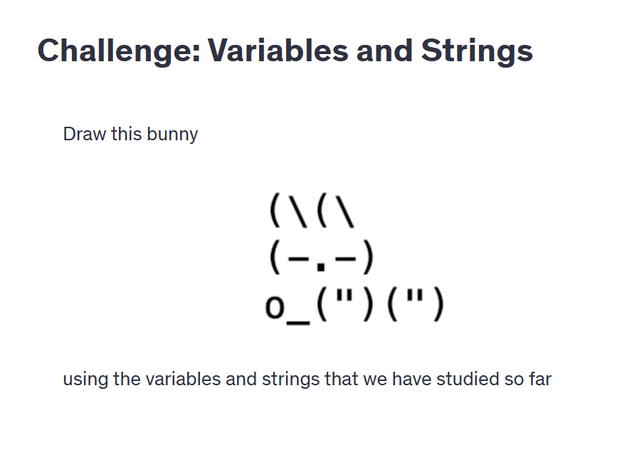

Slide 17
Strings - functions
Get a character positions always start at 0
Another way to get a character
Get part of a string
val myPet = "Crocodile"
myPet(3) // c
val myPet = "Crocodile"
myPet.charAt(3) // c
val myPet = "Crocodile"
myPet.substring(3) // codile
val myPet = "Crocodile"
myPet.substring(3, 6) // cod

Slide 18
Strings - functions
Get a character positions always start at 0
Another way to get a character
Get part of a string
val myPet = "Crocodile"
myPet(3) // c
val myPet = "Crocodile"
myPet.charAt(3) // c
val myPet = "Crocodile"
myPet.substring(3) // codile
val myPet = "Crocodile"
myPet.substring(3, 6) // cod

Slide 19
Strings
Print out the length of this variable
val catName = "My cat’s name is \"Fluffy\""
Extract the string “car” from this variable and print it
val myCar = "My car won’t start"
print a personalised message for that customer to the console
val clientName = "John"
Print to the console the amount of fruit available
val apples = 3
val oranges = 6

Slide 20
String interpolation
Interpolators: s, f and raw
Strings in Scala can contain expressions
The expression is evaluated and inserted (concatenated) into the string
An expression starts with a $ sign and can have braces { }
val dogName = "Teddy"
println(s"My dog’s name is $dogName")
println(s"I have ${1+1} cats")

Slide 21
String interpolation
Raw interpolator
println(raw"This is a \n new \\line") // This is a \n new \\line

Slide 22
Multiline strings
Using the \n separator
Using the """ operator
Using stripMargin
val str1 = "This is a\nmultiline\nstring"
val str2 = """This is a
multiline
string
"""
val str3 = """This is a
|multiline
|string
|""".stripMargin

Slide 23
User input
User input can come from many sources
One source is command line
import scala.io.StdIn
val input = StdIn.readLine()

Slide 24
Input a number
Input is read as a string
Can be converted into a number (integer)
val input = StdIn.readLine()
val i = input.toInt

Slide 25
Challenge Create a program that asks a user’s birth year. Then prints out the user’s estimated age (currentYear - birthYear)

Slide 26
Number types
Different types that are stored in memory in different ways
Type | Size (bits) | Min value | Max value
Byte | 8 | -128 | 127
Short | 16 | -32768 | 32767
Int | 32 | -2147483648 (-2³¹) | 2147483647 (2³¹-1)
Long | 64 | -9,223,372,036,854,775,808 (-2⁶⁴) | 9,223,372,036,854,775,807 (2⁶⁴-1)
Type | Size (bits) | Decimal digits
Float | 32 | 6-7
Double | 64 | 15-16

Slide 27
User input
Create an int variable and print it.
Confirm by printing its class.
Create a float variable and print it.
Confirm by printing its class.

Slide 28
Challenge
Ask the user to input a number and read it into a variable.
Convert it to an integer.
Multiply that value with a double variable that you created.
What is the type of the new variable?
Print it to the console.

Slide 29
Numbers - explicit
We can instruct Scala to assign a different type to our variables
val cats = 3 // Int
val dogs: Byte = 5 // Byte
val days: Short = 30000 // Short
val meals: Int = 3 // Int
val life: Long = 42 // Long
val life = 42L // Long

Slide 30
Type conversions
A variable of a certain type can be converted into a different type
The variable itself does not get converted The result of the operation can be assigned to a new variable
val cats = 3 // Int
val longCats = cats.toLong // Long
println(cats.getClass) // Int
println(longCats.getClass) // Long

Slide 31
Type conversions
toByte
toShort
toInt
toLong
toFloat
toDouble

Slide 32
Type conversions
If you convert to a smaller type, some information might be lost or corrupted
val people = 8_000_000_000L
val fewPeople = people.toInt // -589934592

Slide 33
Challenge: Data types
Ask the user to input a number of type double.
Multiply it by pi
var pi = 3.14159
Print the type of the resulting variable.
Print the result.

Slide 34
Operators - Math
5 + 2 // 7
"Hi " + "John" // Hi John
+ Addition
- Subtraction
* Multiplication
/ Division
% Modulus (remainder)
5 - 2 // 3
5 * 2 // 10
5 / 2 // 2
5 % 2 // 1

Slide 35
Operators - Result type
The type of the result of an operation is the same as the type of the largest operand in terms of size in memory
Byte < Short < Int < Long < Float < Double
val a: Float = 19F
val b: Double = 54.34564
val r = a * b
println(r.getClass)

Slide 36
Operators - Assignment
= Assignment
$ Reference
${ } Reference expression
val dozen = 12
var months = dozen
println(months) // 12
val userName = "Lucy"
val greeting = s"Hello, $userName"
val products = 3
val price = 9.99
val total = s"Total is ${products * price}"

Slide 37
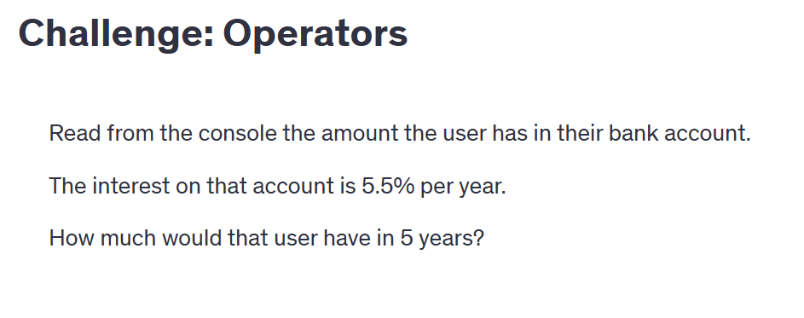
Operators Challenge

Slide 38
Operators - Augmented assignment
+=
-=
*=
/=
%=
var bikes = 5
bikes += 1 // 6
bikes -= 1 // 4
bikes *= 2 // 10
bikes /= 2 // 2
bikes %= 2 // 1

Slide 39
Booleans
True / false value
Very memory efficient
Enable logical operations
Enable program flow control
val isDay = true
val isNight = false

Slide 40
Operators - Logical
&& And
|| Or
! Not
true && true // true
true && false // false
false && true // false
false && false // false
true || true // true
true || false // true
false || true // true
false || false // false
!true // false
!false // true

Slide 41
Operators - Comparison
> Greater than
< Smaller than
>= Greater than or equal to
<= Smaller than or equal to
== Equals
!= Not equals
3 > 2 // true
3 < 2 // true
3 >= 3 // true
3 <= 3 // true
3 == 2 // false
3 != 2 // true

Slide 42
Challenge: Logical operators
A farmer has 3 cows, of which only one produces milk
He has two children
He is trying to apply for funding.
The requirements are
You must have no more than 5 animals
Animals must produce something that can be sold
Regardless of the other conditions, funding will be approved if the family has 3 or more members
Does the farmer receive the funding?

Slide 43
Collections
A way to group elements together
Zero or more elements
Different data types
Mutable vs immutable
val a = List(1, 2, 3, 632, 9, 52, 6)
val b = List(1, "hello", true)
val c = List()

Slide 44
List
Ordered collection
Elements can be accessed by the position (index)
Can contain duplicate elements
A sentence is a list of words. They have an order and can repeat.
Remember
Indices always start with 0
List(1, 2, 3, 632 ,2, 52, 2)
List(43, 44.3, 3, 76.352 , 9.234, 983)

Slide 45
List
Immutable, ordered collection that can contain duplicate elements
Can contain various data types
A list can be empty
List(1, 2, 3, 2, 5)
List(1, true, "third element")
List()
Nil

Slide 46
List
We can limit the data types
Multi dimensional lists
val l = List(1, 2, 3, true) // Ok
val m = List[Int](1, 2, 3, true) // Error
val matrix =
List(
List(1, 0, 0),
List(0, 1, 0),
List(0, 0, 1)
)

Slide 47
List
Get an element from the list
Get the head and tail
Get the list length
val colors = List("red", "green", "blue")
colors(0) // red
colors.head // red
colors.tail // List(green, blue)
colors.length // 3

Slide 48
Array
A mutable (changeable) ordered collection
Any data type (although we can restrict it)
Printing an array
Array(1, 2, 3, 2, 5)
val a = Array(1, 2, true) // Ok
val b = Array[String]("one", "two", 3) // Error
a.foreach(println)
println(a.mkString)
println(a.toList)

Slide 49
Array
The size of an array can’t be changed
Adding elements to an array
Concatenate arrays
b = 0 +: a :+ 4
val a = Array(1, 2, 3)
val b = Array(4, 5, 6)
a ++ b // Array(1, 2, 3, 4, 5, 6)

Slide 50
ArrayBuffer
Removing elements
Removing all elements of a collection
a.remove(1)
a.remove(1, 3)
a --= List(4, 7, 8)

Slide 51
Challenge: Lists and Arrays
You have a number of items on your desk.
val items = ArrayBuffer("laptop", "mouse", "pen", "paper", "mug", "phone")
You clean up your desk and remove as many items as you can to be more productive.
val removedItems = ArrayBuffer("pen", "paper", "mug", "phone")
Print out the remaining items.

Slide 52
List functions
val colors = List("blue", "red", "blue", "green")
println(colors.isEmpty)
println(colors.length)
println(colors.contains("red"))
println(colors.contains("pink"))
println(colors.indexOf("red"))
println(colors.lastIndexOf("blue"))

Slide 53
Challenge: List functions
A zoo has a list of animals.
val animals = ArrayBuffer("lion", "zebra", "chimp", "elephant")
A new panda bear cub has arrived.
Print out the new list of animals.
The lion has been sold to a different zoo.
Print out the new list of animals.
Does the zoo have both elephants and giraffes?

Slide 54
Set
Stores unique elements in an undefined order
Data types can vary, but can be restricted
Sets are immutable
val numbers = Set(6, 34, 6, 42)
println(numbers) // (6, 42, 34)
val values = Set(1, true, "yes") // Ok
val numbers = Set[Int](1, 2, true) // Error
numbers.remove(true) // Error

Slide 55
HashSet
A mutable set
We can add and remove elements in a hashSet
val values = mutable.HashSet(3, 4, true, "hi")
val noValues = mutable.HashSet()
values.add(14) // (hi, 3, 4, 14, true)
values.remove(4) // (hi, 3, 14, true)
values += 9 // (9, hi, 3, 4, true)
values -= 3 // (9, hi, 4, true)

Slide 56
HashSet
Add and remove another collection
values.addAll(List(3, 4, 5)) //(hi, 3, 4, 5, 14, true)
values += (10, 11) // (hi, 4, 9, 10, 11, true)
values -= (4, 9) // (hi, 10, 11, true)
colors ++= Set("pink", "orange")
colors --= Set("red", "blue")

Slide 57
Challenge: Set and HashSet
You have a list of customers for your online store.
A new customer has joined.
Print the list of customers.
A customer has chosen to leave.
Print the list of customers.

Slide 58
Set functions
val items = Set(3, 4, true, "hi")
items.size // 4
items.contains(4) // true
items.contains(5) // false
items.isEmpty // false
items.nonEmpty // true
items.head // 3
items.tail // Set(4, true, hi)

Slide 59
HashSet functions
val numbers = HashSet(3, 4, null, 83, 56)
numbers.addOne(22)
numbers.addAll(List(5, 6, 83))
numbers.remove(5)
numbers.subtractOne(22)

Slide 60
Challenge: Set and HashSet functions
Your company has very strict dress code. Only certain color clothes can be worn in the office.
val acceptedColors = mutable.HashSet("white", "black", "gray")
You have certain colors in your wardrobe.
val myColors = Set("blue", "red", "black", "green")
What color clothes can you wear? What colors can you not wear?
Your company has added another color, “red” to their list. What options do you have now?

Slide 61
Map
A map is a set of key-value pairs keys are unique, values can be duplicates
Can specify the type
Empty map
Map(1 -> "one", 2 -> "two", 3 -> "three")
Map((1, "one"), (2, "two"), (3, "three"))
Map[Int, String](5 -> 5) // Error
Map()

Slide 62
Map
Get a value based on a key
Get the whole set of keys (they are unique)
Get the collection of values (can have duplicates)
println(count(2)) // two
println(count.keySet) // Set(1, 2, 3)
println(count.values) // Iterable(one, two, three)

Slide 63
HashMap
A mutable map
Add a key value pair
Add all elements of another map
val count = HashMap(1 -> "one", 2 -> "two", 3 -> "three")
count += (4 -> "four")
count.addOne(5 -> "five")
count ++= Map(10 -> "ten", 11 -> "eleven")
count.addAll(Map(12 -> "twelve", 13 -> "thirteen"))

Slide 64
HashMap
Removing elements
count -= 4
count.remove(5)
count --= Set(10, 11)
count(12) = "ten plus two"
count.clear()

Slide 65
Challenge: Map and HashMap
You manage an amusement park, and you have a map that stores dates and attendance.
val attendance = mutable.HashMap("23/09" -> 3726, "24/09" -> 4735, "25/09" -> 2836)
Add a value for 26 Sept.
How many people attended in total on 25 and 26 Sept?
Is data for 22 Sept available?

Slide 66
Tuple
An immutable group of elements
Can specify data types
Retrieve elements
val conn = (80, "www", "google.com", true)
val conn2 = Tuple4(80, "www", "google.com", true)
val tup = Tuple2[Int, String](123, "abc")
println(conn(1)) // "www"
println(conn._1) // 80

Slide 67
Tuple functions
val conn = (80, "www", "google.com", true)
println(conn.toString())
conn.copy(_2 = "ftp") // (80,ftp,google.com,true)
println(conn.productArity) // 4
val conn2 = ("abc", 123)
println(conn2.swap)

Slide 68
Tuple functions
val info = ("auth", "cache")
conn ++ info // (80,www,google.com,true,auth,cache)

Slide 69
Challenge: Tuple
Your business has 3 physical stores. Your accounting software generates a Tuple3 that contains Tuple2 elements with store name and total revenue.
val stores = (("Downtown", 36253), ("West side", 27362), ("East side", 29483))
Print out the total revenue of all stores.
Create a tuple that only contains store names and print it to the console.

Slide 70
Flow control - If
expression
is true
if
then
do something
else
do something else

Slide 71
If
if (night)
println("Sleep")
else
println("Be active")

Slide 72
If
var clientFunds = 100
val price = 50
var clientProducts = 0
if clientFunds > price
clientFunds -= price
clientProducts += 1
// continue purchase flow
else
println("You have insufficient funds")
// stop purchase flow

Slide 73
If - multiple branches
if
expressionA
is true
then
do something
else if
expressionB
is true
then
do something else
else if
expressionC
is true
then
do something else
else
do something else

Slide 74
If - multiple branches
The flow moves from one branch to another until it finds a true expression
It skips the rest of the branches
If none are true, it runs the code in the else branch
if (expressionA)
println("Do something A")
else if (expressionB)
println("Do something B")
else if (expressionC)
println("Do something C")
else
println("Do something else")

Slide 75
If - multiple branches
val action = if (animal == "dog")
"pet it"
else if (animal == "cat")
"feed it"
else if (animal == "crocodile")
"run away"
else
"google it"

Slide 76
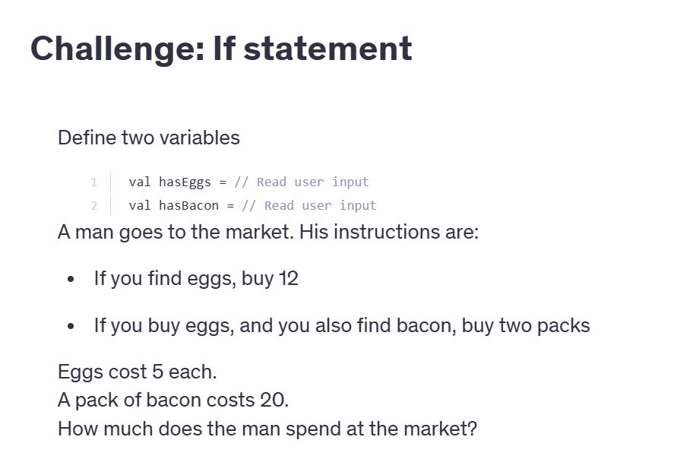

Slide 77
Logical expressions
In conditional statements we can use any logical expression
println(1 + 1 == 2) // true
(326 / 72 * 15 + 93 % 13 == 65) // false
if (326 / 72 * 15 + 93 % 13 == 65)
println("Math is hard")
else
println("Math is easy")

Slide 78
Ranges
A collection that contains all the elements between two given values
to includes last value, until excludes it
1 to 10 // 1, 2, 3, 4, 5, 6, 7, 8, 9, 10
'a' to 'z' // a, b, c, d, e ... z
1 until 10 // 1, 2, 3, 4, 5, 6, 7, 8, 9
'a' until 'z' // a, b, c, d, e ... y

Slide 79
Ranges
Step over a number of items
Using Range
1 to 10 by 2 // 1, 3, 5, 7, 9
Range(1, 10) // 1 until 10
Range.inclusive(1, 10) // 1 to 10
Range(1, 10, 3) // 1 until 10 by 3

Slide 80
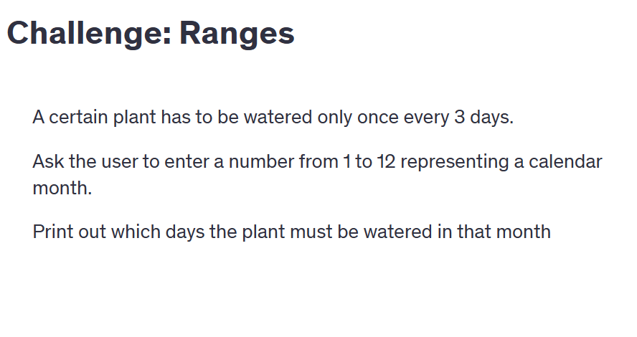
Ranges
Descending
10 to 1 by -2 // 10, 8, 6, 4, 2
(1 to 10).reverse // 10, 9, 8, 7, 6, 5, 4, 3, 2, 1

Slide 81
Flow control - Match
Variable or expression
match
case v1
do something
case v2
do something
case vN
do something
case _
do something

Slide 82
Match
var action = ""
input match
case "dog" => action = "pet it"
case "cat" => action = "feed it"
case "crocodile" => action = "run away"
case _ => action = "google it"

Slide 83
Match
Make decisions based on values of a variable or expression
number % 2 match
case 0 => println("Number is even")
case 1 => println("Number is odd")

Slide 84
Match
Matching lists
val numbers = List(1, 2, 3)
numbers match
case List(1, 2, 3) => println("Single digits")
case List(10, 11, 12) => println("Double digits")
case _ => println("Unknown")

Slide 85
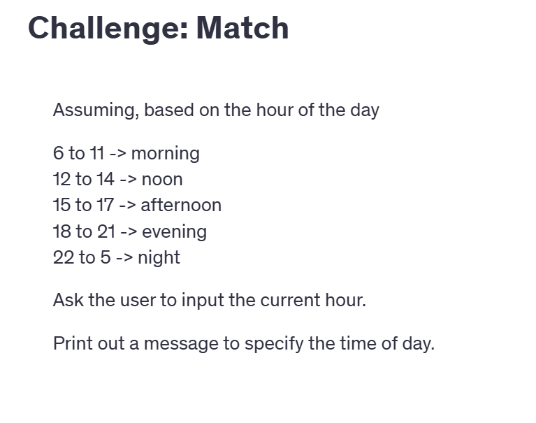

Slide 86
Flow control - For loop
collection C
for each element in collection C
do something

Slide 87
For loop
Executes a block of code for each element in an iterator
Collection
Range
val iterable = ...
for (x <- iterable)
// do something

Slide 88
For loop
val animals = List("cat", "dog", "mouse", "bear")
for (animal <- animals)
println(s"Feed the $animal")

Slide 89
For loop
for (i <- 1 to 12)
val month = i match
case 1 => "January"
case 2 => "February"
case 3 => "March"
case 4 => "April"
case 5 => "May"
case 6 => "June"
case 7 => "July"
case 8 => "August"
case 9 => "September"
case 10 => "October"
case 11 => "November"
case 12 => "December"
case _ => ""
println(s"Month #$i is called $month")

Slide 90
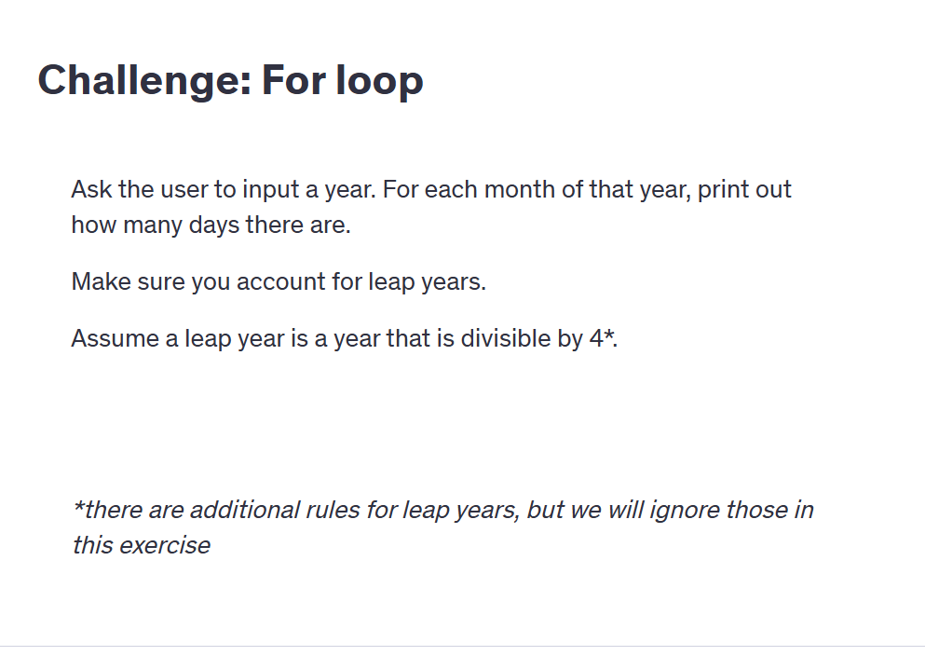

Slide 91
While loop
Executes a block of code while a condition is true
var i = 0
while (i < 10)
// do something
i += 1
var i = 0
while
i < 10
do
// do something
i += 1

Slide 92
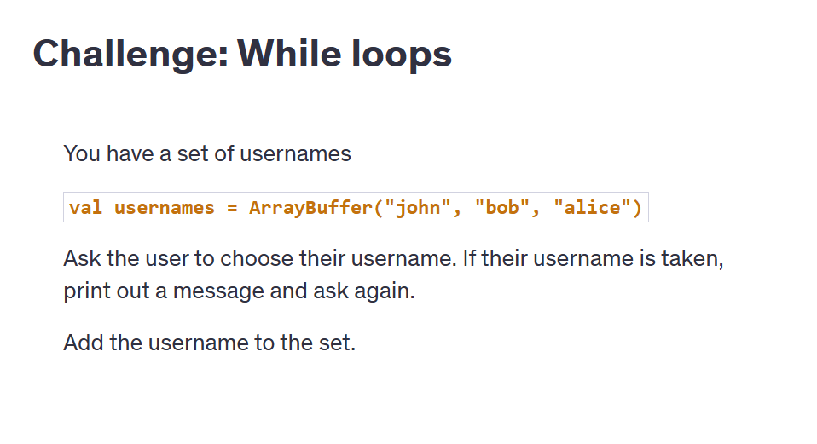
While loop
val puzzlePieces = 20
var piecesPlaced = 0
while (piecesPlaced < puzzlePieces)
piecesPlaced += 1
println(s"place piece $piecesPlaced")

Slide 93
Functions
A way to group code that can be executed 0 or more times
May not get the same result on different runs
Can accept input and return output
Create a function
Call / invoke a function
def functionName(): Unit = {
// do something
}
functionName()

Slide 94
Functions
def sayHello(): Unit = {
println("Hello everyone")
}
for (i <- 1 to 10) {
sayHello()
}

Slide 95
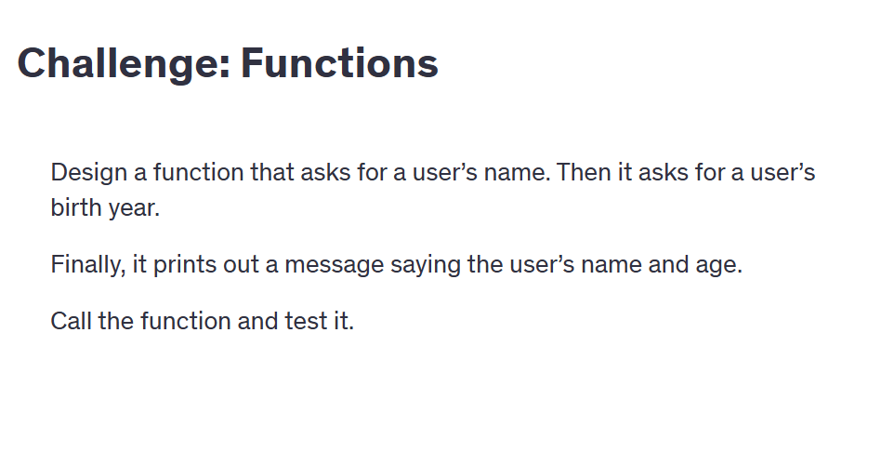
Functions
def printAlphabet(): Unit = {
println("a, b, c, d, e, f, g, h, i, j, k, l, m, n, o, p, q, r, s, t, u, v, w, x, y, z")
}
var i = 5
while (i > 0) {
printAlphabet()
i -= 1
}

Slide 96
Function parameters
A function can accept parameters (arguments)
def double (number: Int) = {
println(s"Double of $number is ${number * 2}")
}
double(5)

Slide 97
Function parameters
def sayHello (people: List[String]): Unit = {
for (person <- people) {
println(s"Hi $person")
}
}
val clients = List("Anna", "John", "Michelle")
sayHello(clients)

Slide 98
Function parameters
We can have multiple parameters, separated by comma
Parameters can have default values
def double(number: Int, message: String = "Double is"): Unit = {
println(s"$message ${number * 2}")
}
double(5, "5 * 2 = ")
double(5)

Slide 99
Function return
A function can return a result
The return keyword can be omitted
def calculateCircleArea(radius: Int): Double = {
val pi = 3.1415
return pi * radius * radius
}
val r = 24
println(s"A circle with a radius of $r has an area of ${calculateCircleArea(r)}")
def calculateCircleArea(radius: Int): Double = {
val pi = 3.1415
pi * radius * radius
}

Slide 100
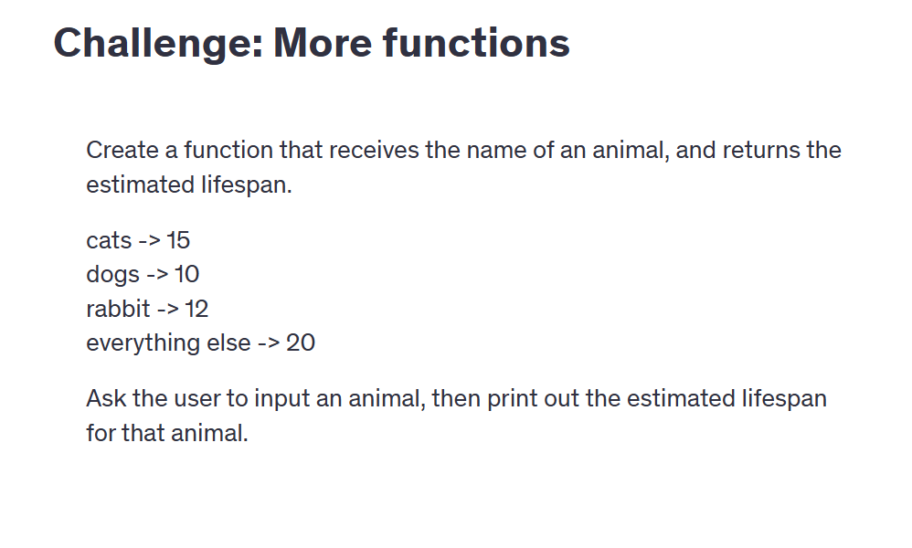
Function return
def personalisedGreeting(person: String): String = {
person(0) match
case 'A' => s"Are you ok $person"
case 'W' => s"What's up $person"
case _ => s"Hi $person"
}
val clients = List("Anna", "Bob", "William")
for(client <- clients) {
val greeting = personalisedGreeting(client)
println(greeting)
}

Slide 101
Overloading
Two functions can have the same name if they have the different numbers or types of parameters
def multiply( number: Int ) = number * 2
def multiply( number: Int, multiplier: Int)
= number * multiplier
println(multiply(3))
println(multiply(3, 5))

Slide 102
Overloading
def sayHello(person: String): Unit =
println(s"Hi $person")
def sayHello(people: Iterable[String]): Unit =
for (person <- people)
println(s"Hi $person")
sayHello("John")
sayHello(List("Anna", "Bob", "Carol"))

Slide 103
Exception Handling
Exception Hanlding mechanism that allows a program to gracefully respond to and recover from unexpected errors or events (called exceptions) that occur during runtime, preventing crashes and ensuring continued operation.

Slide 104
try {
// Code that might throw an exception
} catch {
case ex: ExceptionType1 => // Handle exception type 1
case ex: ExceptionType2 => // Handle exception type 2
} finally {
// Code that always runs (optional)
}

Slide 105
Division with Exception Handling
object ExceptionExample {
def main(args: Array[String]): Unit = {
try {
val numerator = 10
val denominator = 0
val result = numerator / denominator
println(s"Result: $result")
} catch {
case ex: ArithmeticException =>
println(s"Caught an arithmetic exception: ${ex.getMessage}")
case ex: Exception =>
println(s"Some other exception occurred: ${ex.getMessage}")
} finally {
println("This block always runs (e.g., clean up resources).")
}
}
}

Slide 106
try {
val arr = Array(1, 2, 3)
println(arr(5)) // ArrayIndexOutOfBoundsException
} catch {
case ex: ArithmeticException =>
println("Arithmetic exception: " + ex.getMessage)
case ex: ArrayIndexOutOfBoundsException =>
println("Array index out of bounds: " + ex.getMessage)
case ex: Exception =>
println("General exception: " + ex.getMessage)
}

Slide 107
import scala.util.{Try, Success, Failure}
object TryExample {
def divide(x: Int, y: Int): Try[Int] = Try(x / y)
def main(args: Array[String]): Unit = {
val result = divide(10, 0)
result match {
case Success(value) => println(s"Result: $value")
case Failure(exception) => println(s"Failed with exception: ${exception.getMessage}")
}
}
}

Slide 108
object ThrowExample {
def getAge(age: Int): String = {
if (age < 0)
throw new IllegalArgumentException("Age cannot be negative")
else
s"Your age is $age"
}
def main(args: Array[String]): Unit = {
try {
println(getAge(-5))
} catch {
case ex: IllegalArgumentException =>
println("Invalid argument: " + ex.getMessage)
}
}
}

Slide 109
Pure Functions
A pure function is a function that:
Always returns the same output for the same input.
Has no side effects (does not modify variables, files, databases, etc.)
def add(a: Int, b: Int): Int = a + b.
Why is this pure?
The function only depends on its input arguments.
There are no side effects (e.g., printing to console, modifying a global variable).

Slide 110
Impure Functions
An impure function does one or both of the following:
Produces different outputs for the same input due to external factors.
Causes side effects, such as modifying a global variable, writing to a file, or printing to the console
var counter = 0
def incrementAndPrint(): Int = {
counter += 1 // Modifies a global variable (side effect)
println(s"Counter is now: $counter") // Prints output (side effect)
counter
}
Why is this impure?
The function modifies external state (counter changes).
It has a side effect (printing to the console).
Calling it multiple times returns different results.

Slide 111
Higher-Order Functions in Scala
A Higher-Order Function (HOF) is a function that either:
Takes one or more functions as arguments, or
Returns a function as a result
This allows for more flexible, reusable, and concise code.

Slide 112
Case calss
In Scala, a case class is a special kind of class that comes with a lot of built-in functionality,
making it easier and more concise to use for modeling immutable data.
Features of a Case Class:
Immutable by default (if you don’t use var)
Automatically provides:
toString()
equals() and hashCode()
copy() method
apply() method in companion object
Pattern matching support
person3 = person1.copy(age = 31)

Slide 113
// Define a case class
case class Person(name: String, age: Int)
// Creating instances (no need for 'new')
val person1 = Person("Alice", 30)
val person2 = Person("Bob", 25)
// Access fields
println(person1.name) // Output: Alice
// Use copy method
val person3 = person1.copy(age = 31)
println(person3) // Output: Person(Alice,31)
// Pattern matching
person2 match {
case Person(name, age) => println(s"Name: $name, Age: $age")
}

Slide 114
Abstract Class
Abstract classes
You can't create an object of an abstract class directly because it might have unimplemented members
Can have:
Abstract members (methods or fields with no body)
Concrete members (methods or fields with a body)
Is meant to be extended by other classes

Slide 115
Trait
A trait in Scala is like a mixin or an interface with optional implementation.
Can define abstract members (just method signatures)
Can define concrete members (with actual code)
Classes can extend multiple traits

Slide 116
Pattern Matching
What is Pattern Matching?
Pattern matching is like a switch statement . but way more flexible. You can match:
Values
Types
Case classes
Lists
Tuples
And even extract data while matching!

