Slide 1


Introduction to Hive

Slide 2
Outline
Motivation
Overview
Data Model / Metadata
Architecture
Performance
Cons and Pros
Application
Related Work
Introduction to Hive

Slide 3
Outline
Started at Facbook
Data was collected by nightly
by corn job into Oracle db
Etl via hadcode python
Grew form 10s of Gb to 1 Tb/day new data(2007)
now 100 x
Introduction to Hive

Slide 4
Limitation of MR
  Have to use M/R model
  Not Reusable
  Error prone
  For complex jobs:
    Multiple stage of Map/Reduce functions
    Just like ask dev to write specify physical execution plan in the database
Introduction to Hive

Slide 5
Limitation of MR
  Have to use M/R model
  Not Reusable
  Error prone
  For complex jobs:
    Multiple stage of Map/Reduce functions
    Just like ask dev to write specify physical execution plan in the database
Introduction to Hive

Slide 6
Motivation
Limitation of MR
  Have to use M/R model
  Not Reusable
  Error prone
  For complex jobs:
    Multiple stage of Map/Reduce functions
    Just like ask dev to write specify physical execution plan in the database
Introduction to Hive

Slide 7
Motivation
Limitation of MR
  Have to use M/R model
  Not Reusable
  Error prone
  For complex jobs:
    Multiple stage of Map/Reduce functions
    Just like ask dev to write specify physical execution plan in the database
Introduction to Hive

Slide 8
Overview
Intuitive
  Make the unstructured data looks like tables regardless how it really lay out
  SQL based query can be directly against these tables
  Generate specify execution plan for this query
What’s Hive
  A data warehousing system to store structured data on Hadoop file system
  Provide an easy query these data by execution Hadoop MapReduce plans
Introduction to Hive

Slide 9
Hive applications
Log Processing
Text Mining
Business intelligence
Introduction to Hive

Slide 10
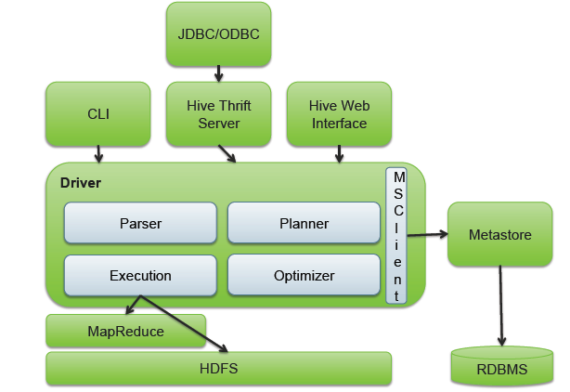
Hive architecture
Introduction to Hive

Slide 11
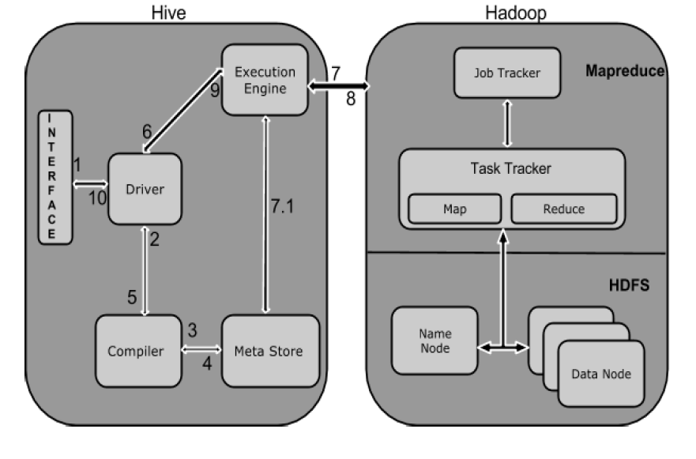
Working of Hive
Introduction to Hive

Slide 12
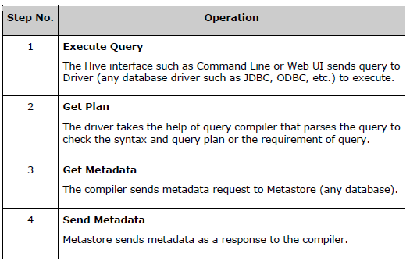
Working of Hive
Introduction to Hive

Slide 13
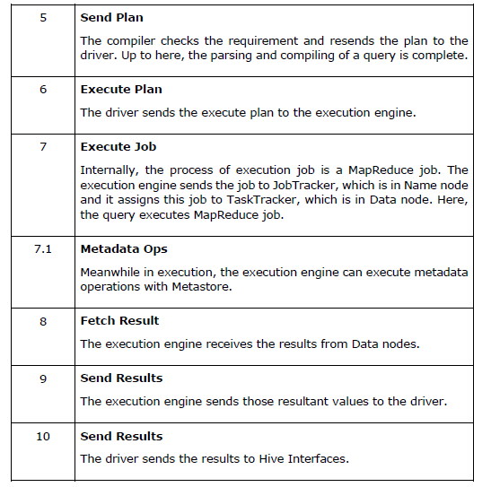
Working of Hive
Introduction to Hive

Slide 14
Data Model
Tables
  Basic type columns (int, float, boolean)
  Complex type: List / Map ( associate array)
Partitions
Buckets
CREATE TABLE sales( id INT, items ARRAY<STRUCT<id:INT,name:STRING>
) PARITIONED BY (ds STRING)
CLUSTERED BY (id) INTO 32 BUCKETS;
SELECT id FROM sales TABLESAMPLE (BUCKET 1 OUT OF 32)
Introduction to Hive

Slide 15
Metadata
Database namespace
Table definitions
  schema info, physical location In HDFS
Partition data
ORM Framework
  All the metadata can be stored in Derby by default
  Any database with JDBC can be configed
Introduction to Hive

Slide 16
Performance
GROUP BY operation
  Efficient execution plans based on:
    Data skew:
      how evenly distributed data across a number of physical nodes
      bottleneck VS load balance
    Partial aggregation:
      Group the data with the same group by value as soon as possible
      In memory hash-table for mapper
      Earlier than combiner
Introduction to Hive

Slide 17
Performance
JOIN operation
  Traditional Map-Reduce Join
  Early Map-side Join
    very efficient for joining a small table with a large table
    Keep smaller table data in memory first
    Join with a chunk of larger table data each time
    Space complexity for time complexity
7/20/2010
Introduction to Hive

Slide 18
Performance
Ser/De
  Describe how to load the data from the file into a representation that make it looks like a table;
Lazy load
  Create the field object when necessary
  Reduce the overhead to create unnecessary objects in Hive
  Java is expensive to create objects
  Increase performance
7/20/2010
Introduction to Hive

Slide 19
Pros
Pros
  A easy way to process large scale data
  Support SQL-based queries
  Provide more user defined interfaces to extend
  Programmability
  Efficient execution plans for performance
  Interoperability with other database tools
Introduction to Hive

Slide 20
Cons
Cons
  No easy way to append data
  Files in HDFS are immutable
Future work
  Views / Variables
  More operator
    In/Exists semantic
  More future work in the mail list
Introduction to Hive

Slide 21
Primitive Data Types
TINYINT 1 byte signed integer. 20
SMALLINT 2 byte signed integer. 20
INT 4 byte signed integer. 20
BIGINT 8 byte signed integer. 20
BOOLEAN Boolean true or false. TRUE
FLOAT Single precision floating point. 3.14159
DOUBLE Double precision floating point. 3.14159
String
Time Stamp
Binary
Introduction to Hive

Slide 22
Collection Data Types
STRUCT struct('John', 'Doe')
MAP map('first', 'John‘,'last', 'Doe')
ARRAY array('John', 'Doe')
CREATE TABLE employees (
name STRING,
salary FLOAT,
subordinates ARRAY<STRING>,
deductions MAP<STRING, FLOAT>,
address STRUCT<street:STRING, city:STRING, state:STRING, zip:INT>);
Introduction to Hive

Slide 23
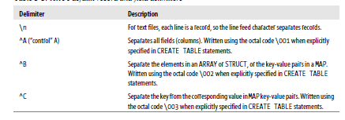
Text File Encoding of Data Values
Introduction to Hive

Slide 24
Databases in Hive
The Hive concept of a database is essentially just a catalog or namespace of tables.
However, they are very useful for larger clusters with multiple teams and users, as away of avoiding table name collisions.
Introduction to Hive

Slide 25
syntax for creating and listing database
hive> CREATE DATABASE financials;
hive> CREATE DATABASE IF NOT EXISTS financials;
hive> CREATE DATABASE financials
> LOCATION '/my/preferred/directory';
hive> SHOW DATABASES;
default
Financials
Introduction to Hive

Slide 26
Create database
hive> CREATE DATABASE financials
> COMMENT 'Holds all financial tables';
DESCRIBE DATABASE financials;
hive> CREATE DATABASE financials
> WITH DBPROPERTIES ('creator' = 'Mark Moneybags', 'date' = '2012-01-02');
hive> DESCRIBE DATABASE EXTENDED financials;
financials hdfs://master-server/user/hive/warehouse/financials.db
{date=2012-01-02, creator=Mark Moneybags);
Introduction to Hive

Slide 27
hive> USE financials;
SHOW TABLES; will list the tables in this database.
hive> set hive.cli.print.current.db=true;
hive (financials)> USE default;false;
Introduction to Hive

Slide 28
Drop database & Alter database
hive> DROP DATABASE IF EXISTS financials;
hive> DROP DATABASE IF EXISTS financials CASCADE;
hive> ALTER DATABASE financials SET DBPROPERTIES ('edited-by' = ‘Babjee');
Introduction to Hive

Slide 29

Creating Tables
CREATE TABLE IF NOT EXISTS sales_db (
name STRING COMMENT 'Employee name',
salary FLOAT COMMENT 'Employee salary',
subordinates ARRAY<STRING> COMMENT 'Names of subordinates',
deductions MAP<STRING, FLOAT>)
\LOCATION '/user/hive/warehouse/sales_db/employees';
Introduction to Hive

Slide 30
CREATE TABLE IF NOT EXISTS mydb.employees2
LIKE mydb.employees;
hive> SHOW TABLES;
employees
table1
Table2
show tables in sales_db;
SHOW TABLES 'empl.*';
employees
Introduction to Hive

Slide 31
Describle tables
hive> DESCRIBE EXTENDED employees;
name string Employee name
salary float Employee salary
subordinates array<string> Names of subordinates
deductions map<string,float> Keys are deductions names, values are percentages
address struct<street:string,city:string,state:string,zip:int> Home address
Detailed Table Information Table(tableName:employees, dbName:mydb, owner:me,
Introduction to Hive

Slide 32
Managed tables/internal tables
Managed called internal tables, because Hive controls the lifecycle of their data (more or less)
External Tables used when the data is stored outside the Hive warehouse directory. Hive only manages the metadata for external tables, while the actual data remains in its original location
create external table if not exists employees(employees string,ename string,city string)
row format delimited fields terminated by ‘,’
Introduction to Hive

Slide 33
Hive Partition
Partitions. Partitioning is a way of dividing a table into related parts based on the values of particular columns like date, city, and department.

Slide 34
Partitioned managed table
CREATE TABLE employees (
name STRING,
salary FLOAT,
subordinates ARRAY<STRING>,
deductions MAP<STRING, FLOAT>,
address STRUCT<street:STRING, city:STRING, state:STRING, zip:INT>
)
PARTITIONED BY (country STRING, state STRING);
Introduction to Hive
Notes:
t

Slide 35
Partitioned table
hdfs://master_server/user/hive/warehouse/mydb.db/employees
.../employees/country=CA/state=AB
.../employees/country=CA/state=BC
...
.../employees/country=US/state=AL
.../employees/country=US/state=AK
SELECT * FROM employees
WHERE country = 'US' AND state = 'IL';
Introduction to Hive

Slide 36
Partitions
hive> SHOW PARTITIONS employees;
...
Country=CA/state=AB
country=CA/state=BC
...
country=US/state=AL
country=US/state=AK
hive> SHOW PARTITIONS employees PARTITION(country='US');
country=US/state=AL
country=US/state=AK
Introduction to Hive

Slide 37
External Partitioned Tables
CREATE EXTERNAL TABLE IF NOT EXISTS log_messages (
hms INT,
severity STRING,
server STRING,
process_id INT,
message STRING)
PARTITIONED BY (year INT, month INT, day INT)
ROW FORMAT DELIMITED FIELDS TERMINATED BY '\t';
Introduction to Hive

Slide 38
Describe extended
hive> DESCRIBE EXTENDED log_messages;
...
message string,
year int,
month int,
day int
Detailed Table Information...
partitionKeys:[FieldSchema(name:year, type:int, comment:null),
FieldSchema(name:month, type:int, comment:null),
FieldSchema(name:day, type:int, comment:null)],
Introduction to Hive

Slide 39
Drop /alter table
DROP TABLE IF EXISTS employees;
ALTER TABLE log_messages RENAME TO logmsgs;
ALTER TABLE log_messages ADD IF NOT EXISTS
PARTITION (year = 2011, month = 1, day = 1) LOCATION '/logs/2011/01/01'
PARTITION (year = 2011, month = 1, day = 2) LOCATION '/logs/2011/01/02'
PARTITION (year = 2011, month = 1, day = 3) LOCATION '/logs/2011/01/03‘
ALTER TABLE log_messages DROP IF EXISTS PARTITION(year = 2011, month = 12, day = 2);
Introduction to Hive

Slide 40
ALTER TABLE log_messages
CHANGE COLUMN hms hours_minutes_seconds INT
COMMENT 'The hours, minutes, and seconds part of the timestamp'
AFTER severity;
ALTER TABLE log_messages SET TBLPROPERTIES (
'notes' = 'The process id is no longer captured; this column is always NULL');
Introduction to Hive

Slide 41
HiveQL: Data Manipulation
LOAD DATA LOCAL INPATH '${env:HOME}/california-employees‘ OVERWRITE INTO TABLE employees
LOAD DATA LOCAL INPATH '${env:HOME}/california-employees‘ OVERWRITE INTO TABLE employees
PARTITION (country = 'US', state = 'CA');
INSERT OVERWRITE TABLE employees
PARTITION (country = 'US', state = 'OR')
SELECT * FROM staged_employees se
WHERE se.cnty = 'US' AND se.st = 'OR';
Introduction to Hive

Slide 42
Create table
CREATE TABLE ca_employees
AS SELECT name, salary, address
FROM employees
WHERE se.state = 'CA';
INSERT OVERWRITE LOCAL DIRECTORY '/tmp/ca_employees'
SELECT name, salary, address
FROM employees
WHERE se.state = 'CA';
Introduction to Hive

Slide 43
Inserting Data into Tables from Queries
INSERT OVERWRITE TABLE employees
PARTITION (country = 'US', state = 'OR')
SELECT * FROM staged_employees se
WHERE se.cnty = 'US' AND se.st = 'OR';
Introduction to Hive

Slide 44
Inserting Data into Tables from Queries
FROM staged_employees se
INSERT OVERWRITE TABLE employees
PARTITION (country = 'US', state = 'OR')
SELECT * WHERE se.cnty = 'US' AND se.st = 'OR'
INSERT OVERWRITE TABLE employees
PARTITION (country = 'US', state = 'CA')
SELECT * WHERE se.cnty = 'US' AND se.st = 'CA'
INSERT OVERWRITE TABLE employees
PARTITION (country = 'US', state = 'IL')
SELECT * WHERE se.cnty = 'US' AND se.st = 'IL';
Introduction to Hive

Slide 45
Dynamic Partition Inserts
INSERT OVERWRITE TABLE employees
PARTITION (country, state)
SELECT ..., se.cnty, se.st
FROM staged_employees se;
Introduction to Hive

Slide 46
Exporting Data
INSERT OVERWRITE LOCAL DIRECTORY '/tmp/ca_employees'
SELECT name, salary, address
FROM employees
WHERE se.state = 'CA';
FROM staged_employees se
INSERT OVERWRITE DIRECTORY '/tmp/or_employees'
SELECT * WHERE se.cty = 'US' and se.st = 'OR'
INSERT OVERWRITE DIRECTORY '/tmp/ca_employees'
SELECT * WHERE se.cty = 'US' and se.st = 'CA'
INSERT OVERWRITE DIRECTORY '/tmp/il_employees'
SELECT * WHERE se.cty = 'US' and se.st = 'IL';
Introduction to Hive

Slide 47
Bucketing
Bucketing
Bucketing, is another technique to further divide the data into more manageable files. It uses a hash function on the bucketing column to distribute the data into a specified number of buckets. Bucketing can be applied to both partitioned and non-partitioned tables.
CREATE TABLE zipcodes(
RecordNumber int,
Country string,
City string,
Zipcode int
)
PARTITIONED BY(state string)
CLUSTERED BY (Zipcode) INTO 10 BUCKETS
ROW FORMAT DELIMITED
FIELDS TERMINATED BY ',';

Slide 48
Differences Between Partitioning and Bucketing
Structure: Partitioning: Creates a directory for each partition on HDFS. Bucketing: Creates a file for each bucket within the partition directories.
Columns: Partitioning: Can have one or more partition columns. Bucketing: Can have only one bucketing column.
Management: Partitioning: The number of partitions is determined by the distinct values of the partition column. Bucketing: The number of buckets is specified by the user.
Usage: Partitioning: Uses PARTITIONED BY. Bucketing: Uses CLUSTERED BY.

