Slide 1
Demonstrating API development using Python FastAPI
Rajesh P E
January 23, 2025

Slide 2
Python
What is Python?
Why Python?

Slide 3
Python trivia
Python interpreter 'CPython' is written in C language
Python (1991) is older than Java (1995)
Python is used in the International Space Station (ISS).

Slide 4
APIs …
Application Programming Interface
Messenger between different software systems/components, allowing them to communicate and exchange data.
Analogy: Restaurant Order

Slide 5




Restaurant Order Processing
1
1 Request: GET /menu
2
2 Response: Menu
3
3 Request: POST /order
4
4 Response: Unique order ID (token)
5
6
5 Internal: Update the order with progress
7
6 Request: GET /order/{id} - Check order status
7 Response: Order status with details
8 Order delivery
8

Slide 6
Synchronous Vs Asynchronous APIs
Request
Users / client
Client is waiting
API Server
Response
Request
Users / client
API Server
Response

Slide 7
Python FastAPI
Introduction
Setup the environment (venv, create project structure)
What is venv? Why is it required?
Hello World API
Create a basic GET API
Demonstration
Sample API Specification, HTTP methods
Student app
Implement POST and GET methods
Demonstration

Slide 8
Q&A

Slide 9
A bit on the current trend …
Introduction to Generative AI, Language Models
Demonstrate programmatically interfacing with language models using python and ollama
Introduction to AI Agents

Slide 10
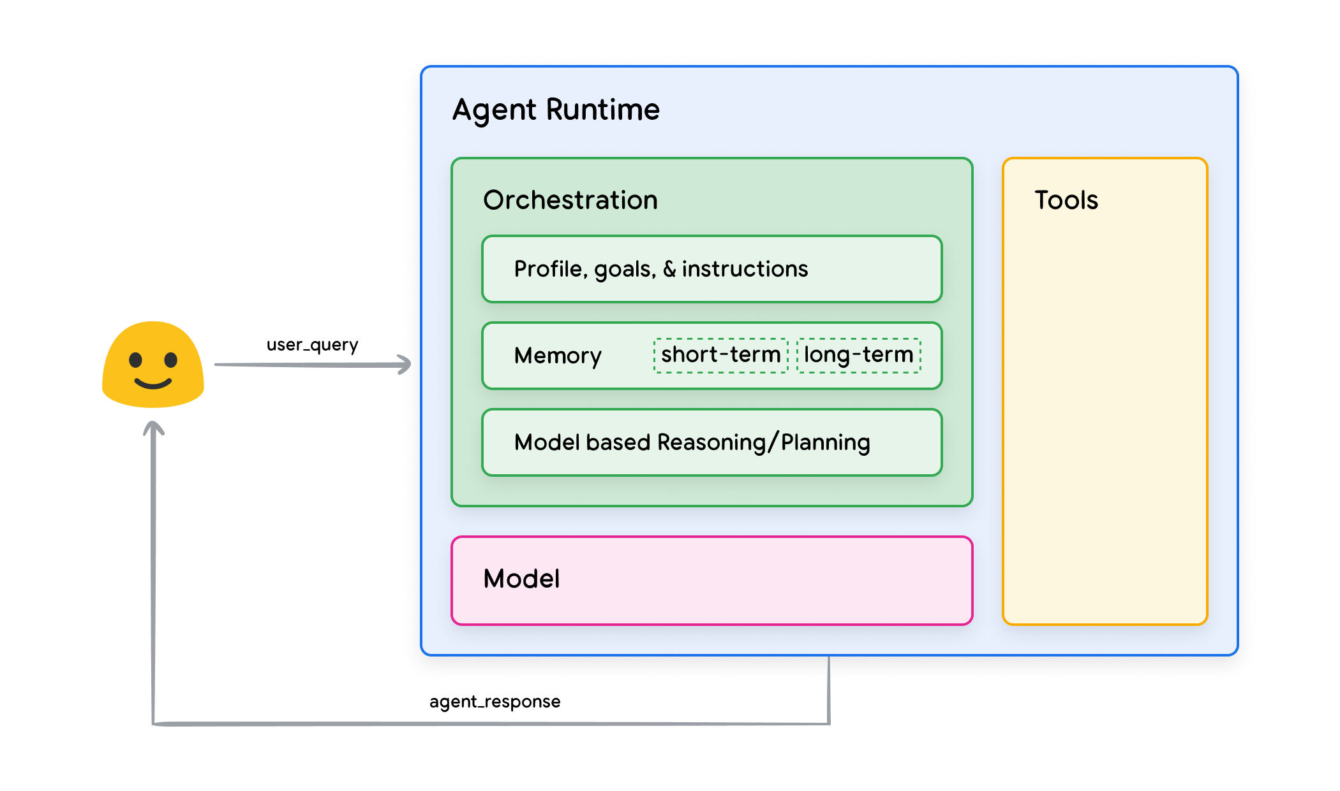
AI Agents

Slide 11
Summary
APIs
Synchronous, Asynchronous APIs
FastAPI demonstration
Current trends on AI
Programmatic access to GenAI

Slide 12
Thank you
E-mail: rajesh.mit84@gmail.com
GitHub: https://github.com/rajesh1084/fdp
LinkedIn: https://www.linkedin.com/in/rajesh-p-e

