Slide 1

ANDROID APPLICATION TO ADDRESS CIVIC ISSUES BY HELPING CITIZENS TO GET IN TOUCH WITH LOCAL AUTHORITIES
CVR College Of Engineering
Team Members:
18B81A05G6-M.Shiva Nandh Reddy
18B81A05D2-T.Dheeraj Kumar
18B81A05F2-R.Rajesh Kumar
Supervisor: Mrs. Meghamala
Designation: Associate Professor
Date Of Presentation: 19th June 2021

Slide 2
Problem Statement
Cities all over the world are challenged with problems evolving from increasing urbanity, population growth, and density. Pointing to the complaints of the citizens in urban areas is a prime factor that can ensure the trust of different citizens. And it is difficult for the local governing bodies to look upon all the problems all the time. So in this project, it will help the common people under the jurisdiction of the Municipal Corporation to register their grievances day-to-day complaints in their ward through a mobile application. This application provides an interface to register one’s complaint and follow it up.

Slide 3
Proposed Solution
So the proposed system would be in which people can take pictures of the issues of the neighborhood and submit the picture along with details to a local government body, the complaint would be lodged along with the address of the issue with the local government which in turn can forward the problem to the appropriate department and the department will look after the issue. The citizens will be made available with the current status of the complaint and what action is being taken against it and how quickly the problem can be solved.
The main purpose of this project is to help the public by providing them a system that can be used for the betterment of the city and can make the city clean and problem-free as well as the citizen life easier.

Slide 4
Technology Stack
1.Android Studio
1.XML
2.Java
3.Camera Module
2.Firebase

Slide 5
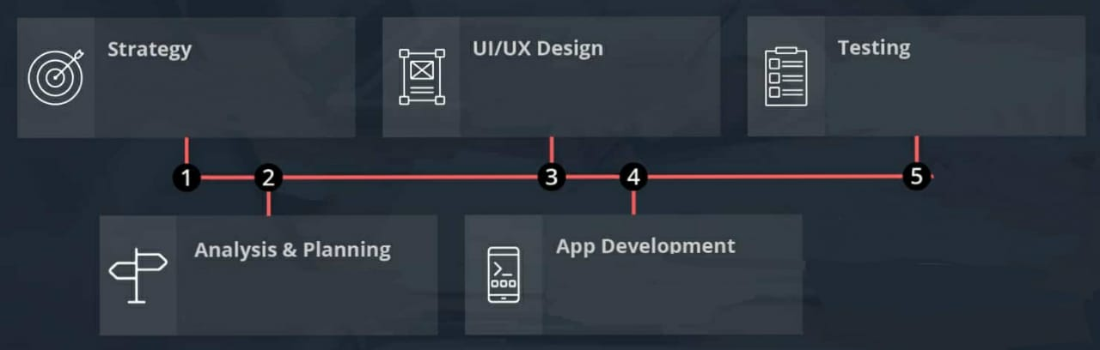
Phases of Development
To devise a strategy to ease the process of submitting an issue
Create seamless and effortless user experiences with a good design
Tested with series of complaints and Result has been checked
Identified Requirements and
prepared technology stack
Using Firebase as backend
and Java, XML as frontend

Slide 6
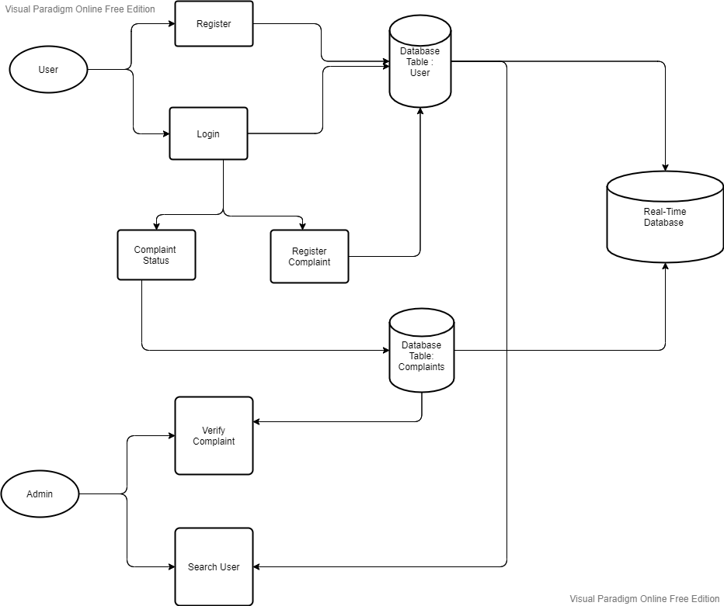
Architecture Diagram

Slide 7
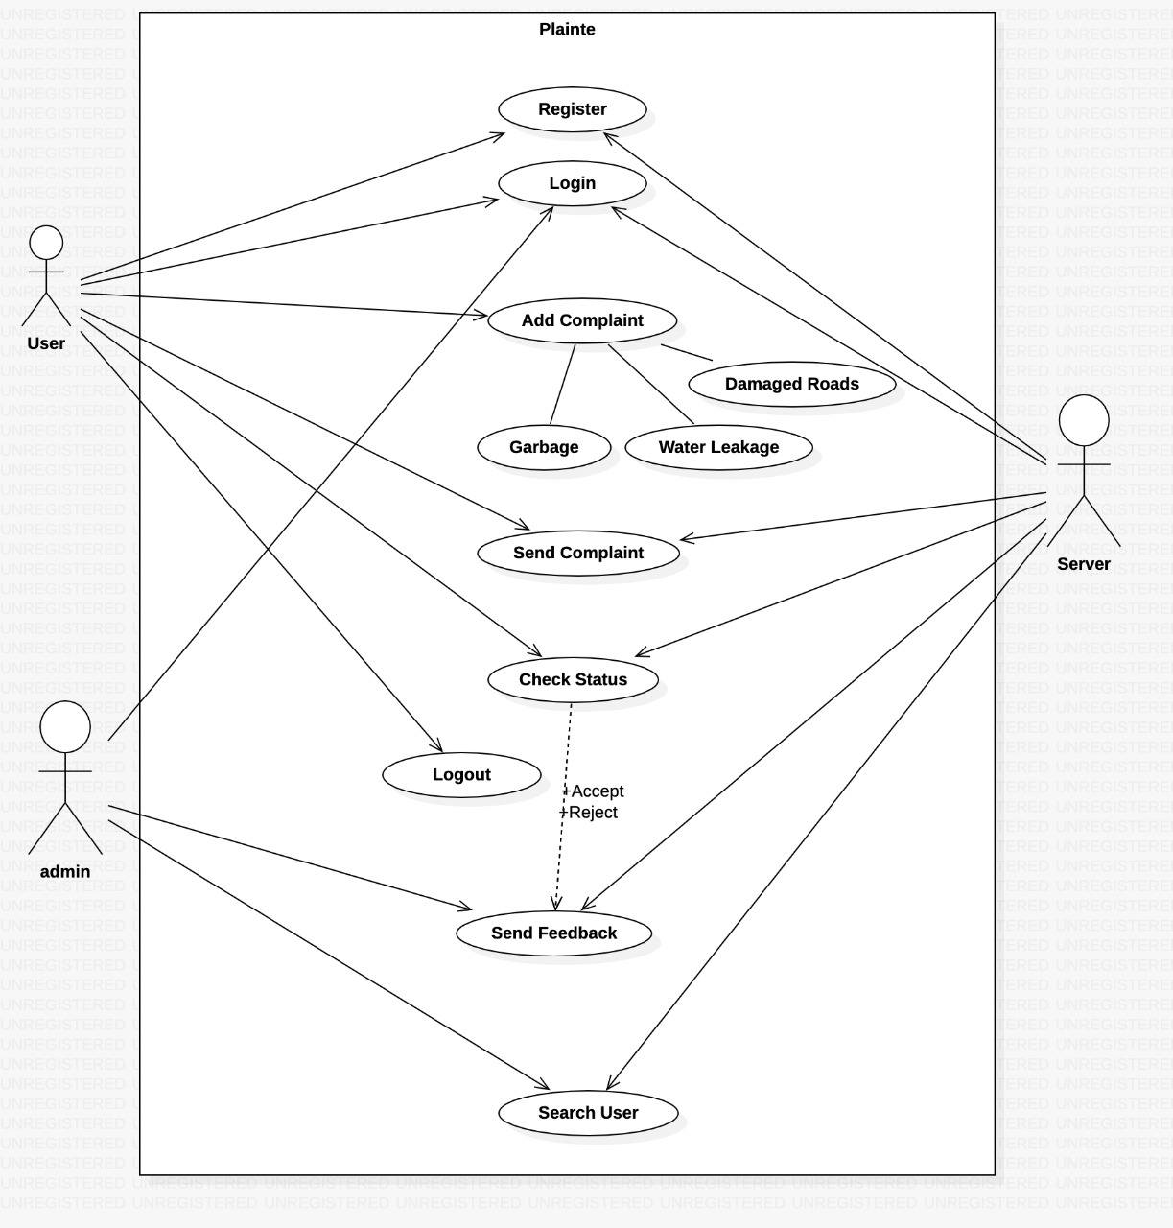
Use-Case Diagram

Slide 8
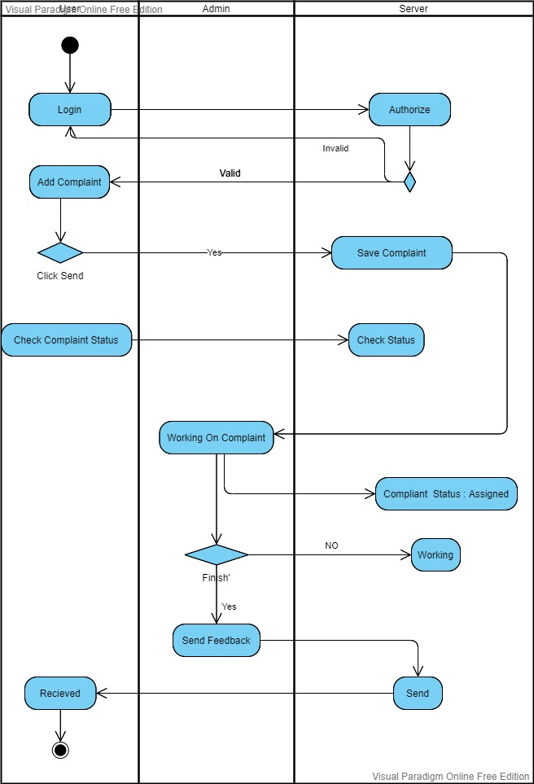
Activity Diagram

Slide 9
Contribution Of Student 1:
User Login Page frontend and backend
Adding a Complaint frontend and backend
View Complaint frontend and backend
Dashboard of User

Slide 10
Contribution Of Student 2:
Admin Login frontend and backend
Register Page frontend and backend
Admin verify Complaint frontend and backend
Splash screen

Slide 11
Contribution Of Student 3:
Camera Module in Adding a complaint
Search User frontend and backend
User Complaint Adapter and Model
Dashboard of Admin

Slide 12
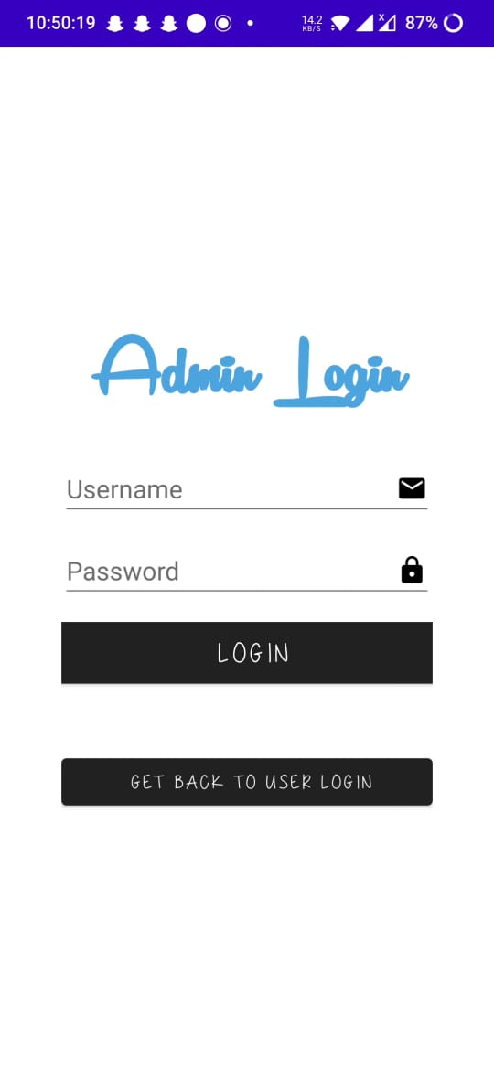
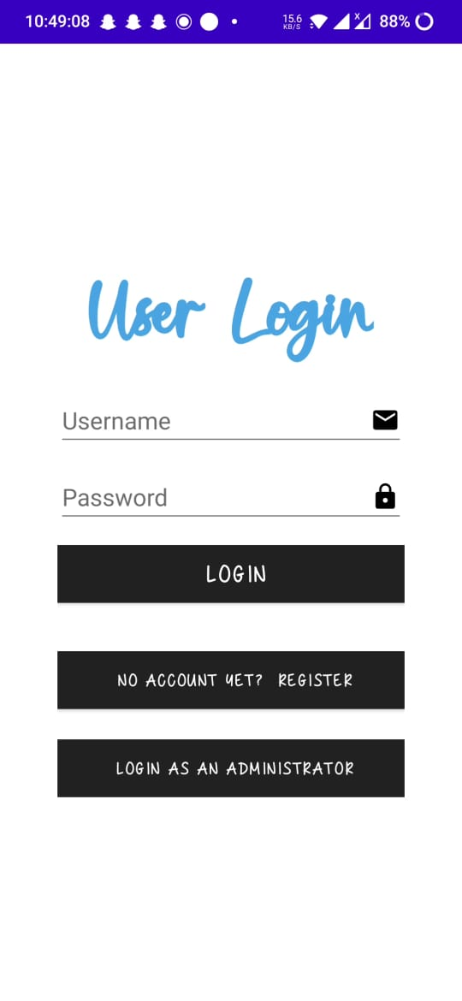
Result:
Login Pages
of User and Admin

Slide 13
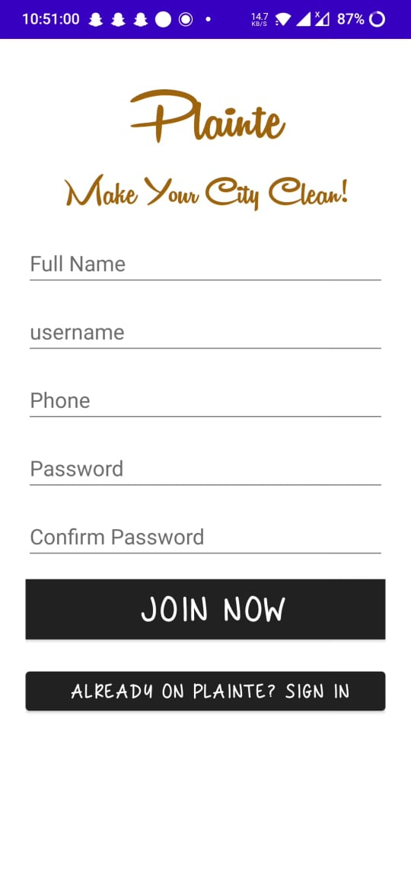
User register Page

Slide 14
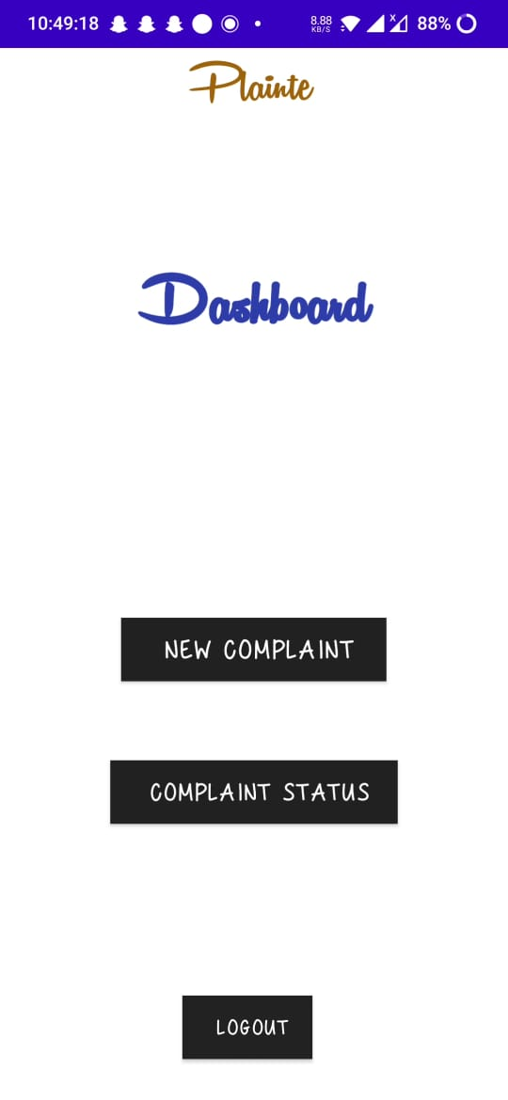
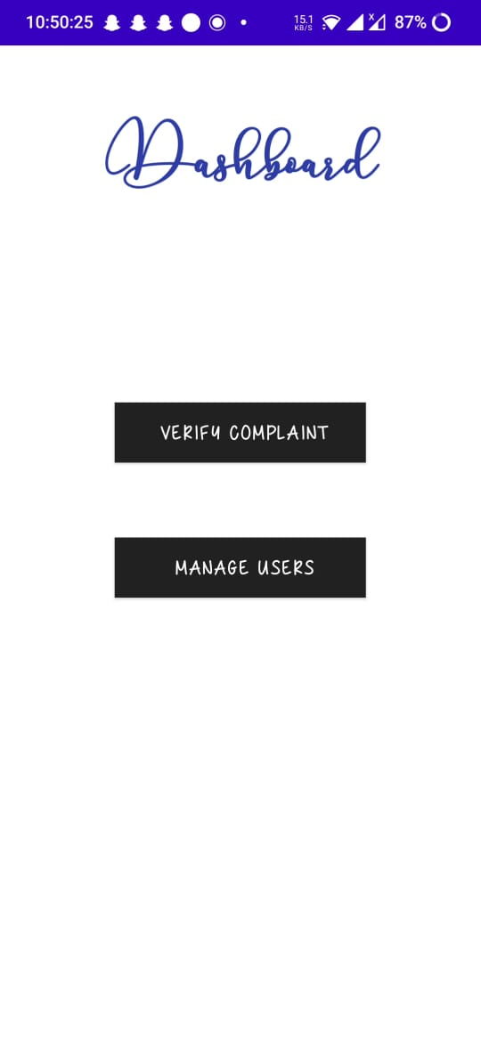
Dashboard of User and Admin

Slide 15
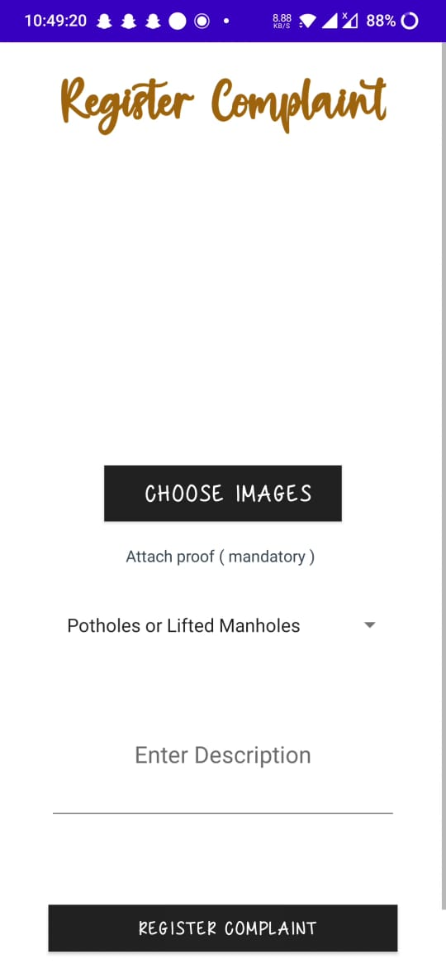
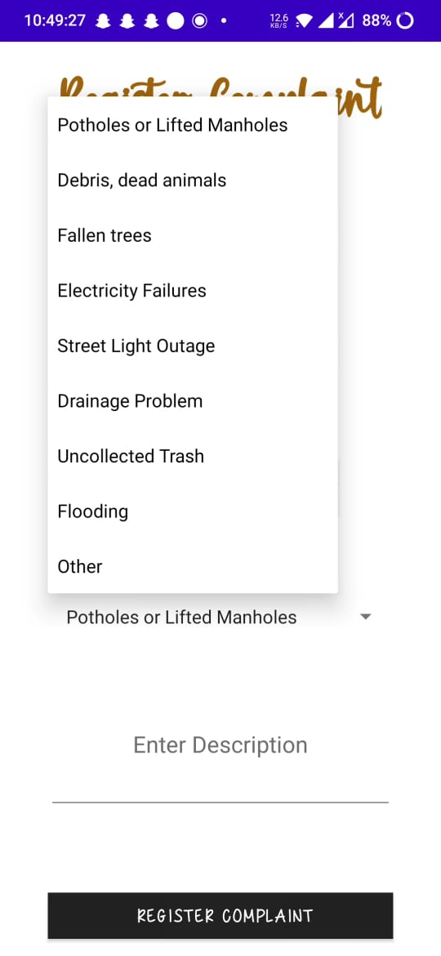
Add a Complaint & Types of Complaint

Slide 16
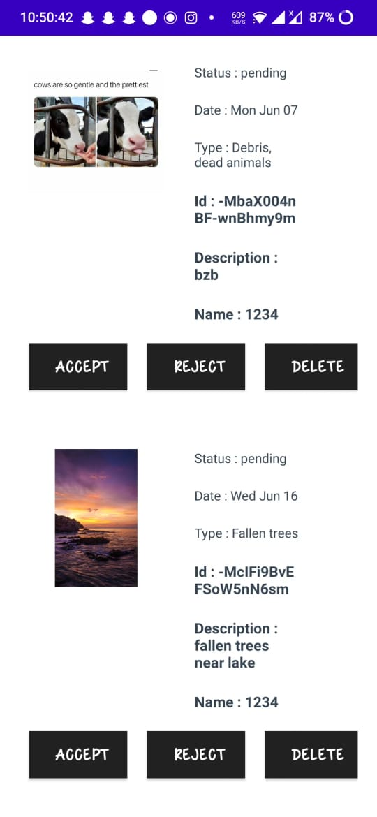
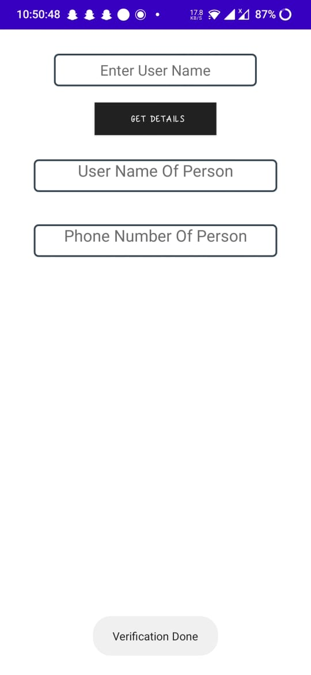
Verify Complaint & Search users

Slide 17
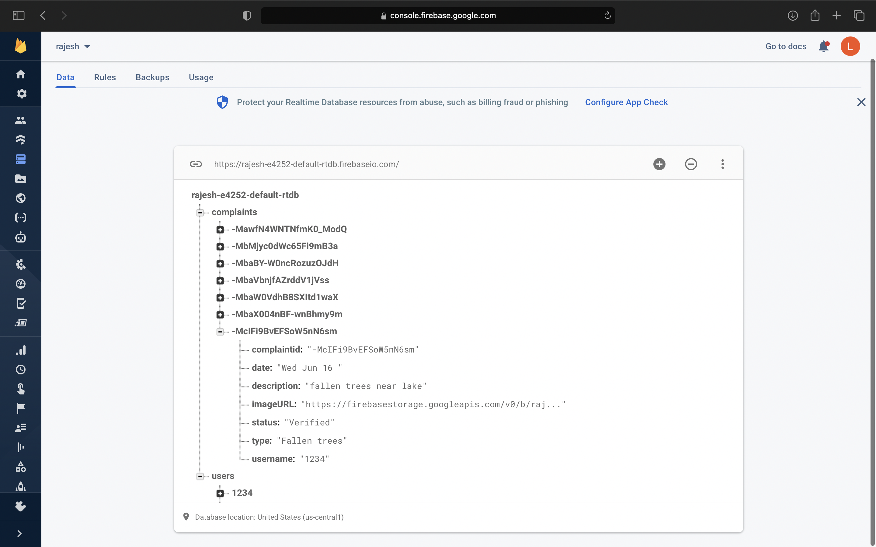
Realtime Database of Complaints and Users

Slide 18
Conclusion
The implementation of a complaint system in a city has a potential to make a city operations more responsive and efficient, that will assist citizens with better utilization of services provided by Municipal Corporation within a particular area but such gains are entirely dependent on citizen participation. The direct communication between the municipal corporation and the citizen to help in registered problems that citizen facing in urban areas and by continuously track them will result in a clean, peaceful and good environment.

Slide 19
Future Enhancement
The future version of this project would consist of features like app notification, google maps, and OTP's to easily login to app. It can be easily deployed to use by the citizens and the Municipal Corporations.

Slide 20
Thank You

