Slide 1


Student Name :
Tarigonda Rajesh
Student ID: STU66891de979f591720262121
Name of Project :
Air Quality Index Prediction Model

Slide 2

Learning Objectives
Python Libraries
--NumPy , Pandas
--Scikit-learn , Matplotlib ,etc
Data Preprocessing
Visualizing Trends in Data
Future Selection and Importance
Machine Learning Models
Train data for ML Models
Model Evaluation and Optimization
Model Deployment
GOAL
Source :
www.freepik.com/

Slide 3
Tools and Technologies used
Jupyter Notebook
GitHub
Pickle
Python Program
Pandas & NumPy
Scikit-learn
Matplotlib & Seaborn
Random Forest & Linear Regression
Decision Tree & KNeighbors Regressor
Streamlit

Slide 4
Methodology
1. Data Collection:
-- Uses dataset contains Air Quality Parameters.
2. Data Preprocessing:
-- Handling missing values by dropping or filling with appropriate statistics
-- Removing duplicate entries and outliers using IQR method
-- Data normalization using StandardScaler to standardise the feature
3. Exploratory Data Analysis(EDA):
-- Visualizing the distribution of air quality parameters using histograms and Box plots
-- Analyzing correlations between different features and the AQI using Heatmap

Slide 5
Methodology
4. Model Training:
-- Implementing various Regression models
Linear Regression
Decision Tree Regressor
Random Forest Regressor
-- Splitting the training and testing sets to evaluate model performance
5. Model Evaluation:
-- Using metrics such as Root Mean Squared Error(RMSE) and R-squared values to assess model accuracy and performance.
6. Deployment:
-- Creating a Streamlit application to provide a user-friendly interface for predicting Air Quality

Slide 6
Problem Statement:
Development of Machine Learning Model for predicting Air Quality Index(AQI) using various environmental factors such as PM2.5,PM10,NO,NO2,Nox,CO,SO2 and meteorological data.
The model aims to provide accurate AQI predictions that can help assess air quality levels and inform the public about potential health risks associated with poor air quality. By leveraging machine learning techniques, the project seeks to enhance the understanding of air pollution dynamics and facilitate timely interventions to improve air quality in urban areas.

Slide 7
Solution:
Load and preprocess the air quality dataset.
Analysis of data patterns through visualization.
Checking the correlation between AQI and pollutants.
Feature extraction and Scaling the numerical features.
Split the data as training data(80%) & testing data(20%).
Training the different ML models like Random Forest , Decision Tree , Linear Regression ,etc.
Model evaluation and performance metrics :
--Root Mean Squared error(RMSE)&R-Squared score(R² value)
Based on the RMSE and R² value we can select the model.
The Random Forest Regressor has the good train and test score.
Saving the model as the “.pkl” file format.
By using the Streamlit created a interactive web app.
GitHub link: https://github.com/rajesh1835/Air-Quality-Prediction-.git

Slide 8
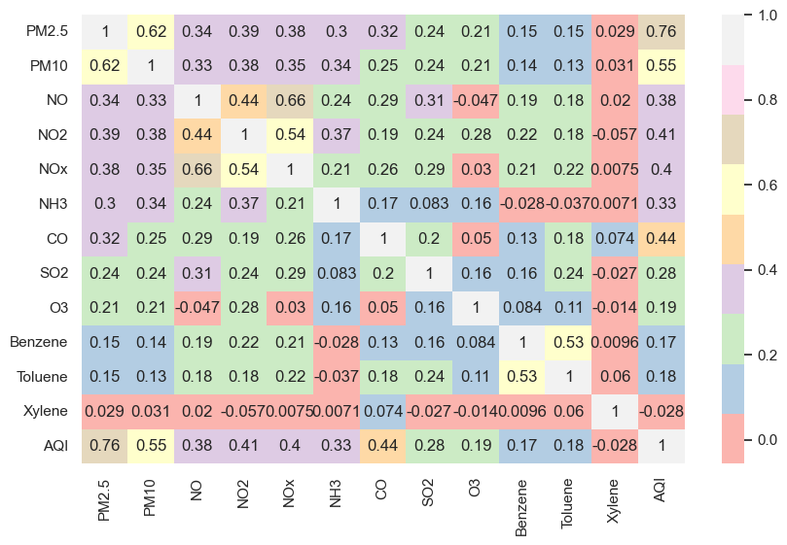
Screenshot of Output:
Correlation between AQI and Pollutants :

Slide 9
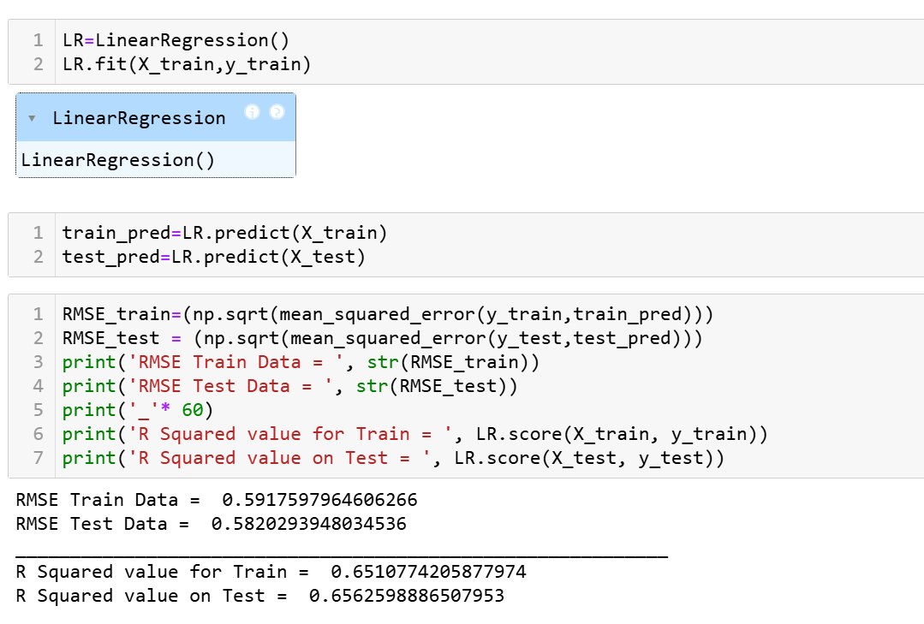
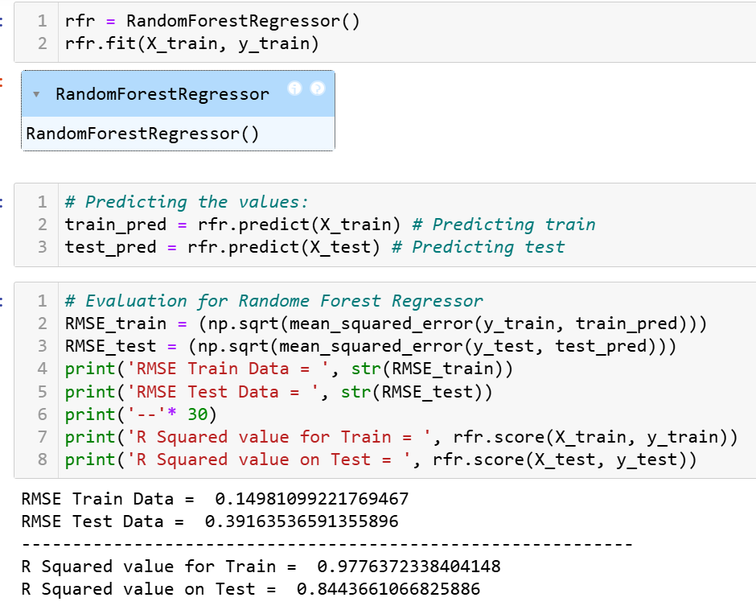
Linear Regression Model :
Random Forest Regressor:

Slide 10
Conclusion:
The development of AQI prediction model showcases the significant potential of Machine Learning techniques. So, this model can efficiently forecast AQI levels, providing valuable insights for policymakers, environmental agencies and the general public. These predictions can help in making proactive measures to mitigate pollution effects and enhance public health.
Therefore, this project demonstrates the potential of AI and data-driven approaches to tackle environmental challenges, paving the way for smarter and more sustainable air quality management.

