Slide 1
Financial Sentiment Analysis with DistilBERT
Hugging Face Transformers
Fine-Tuning a Large Language Model
Rajesh Kumar Rama Reddy
NUID: 002303770

Slide 2
Problem & Objective
Task: classify financial news sentences into
Negative / Neutral / Positive
Approach: fine-tune a pre-trained transformer for
3-class sentiment
Deliverables: training pipeline, tuning, evaluation, error analysis, inference demo

Slide 3
Dataset
Financial PhraseBank (Kaggle: all-data.csv)
Fields: sentiment label + sentence text
Label mapping:
negative→0
neutral→1
positive→2
Train/Val/Test split (stratified): 70/15/15

Slide 4
Model
Pretrained model: distilbert-base-uncased (compact BERT)
Hugging Face Transformers: AutoTokenizer, AutoModelForSequenceClassification, Trainer
Hugging Face Datasets: DatasetDict, map(tokenize)

Slide 5
Training Setup
Dynamic padding with DataCollatorWithPadding
Training: 3 epochs, AdamW, weight decay
Evaluate each epoch; keep the best model by macro-F1
Saved checkpoints per epoch for reproducibility

Slide 6
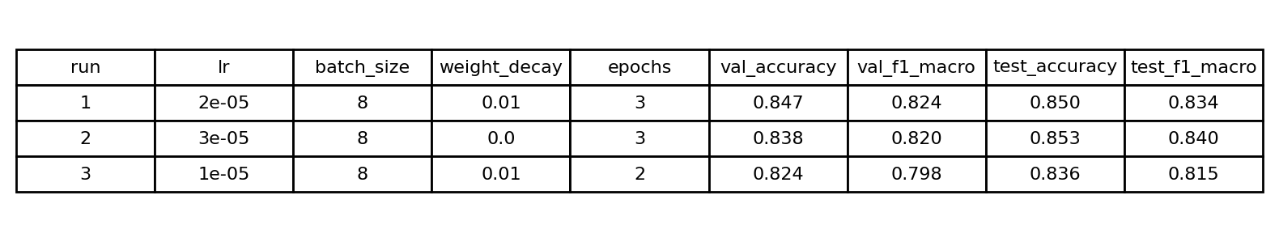
Hyperparameter Tuning (3 configs)
Selection based on highest validation macro-F1.
Best: Run 1 (lr=2e-5, wd=0.01, bs=8, 3 epochs).

Slide 7
Results (Test Set)
Accuracy: 0.850
Macro F1: 0.835
Main confusion: Neutral ↔ Positive due to subtle wording

Slide 8
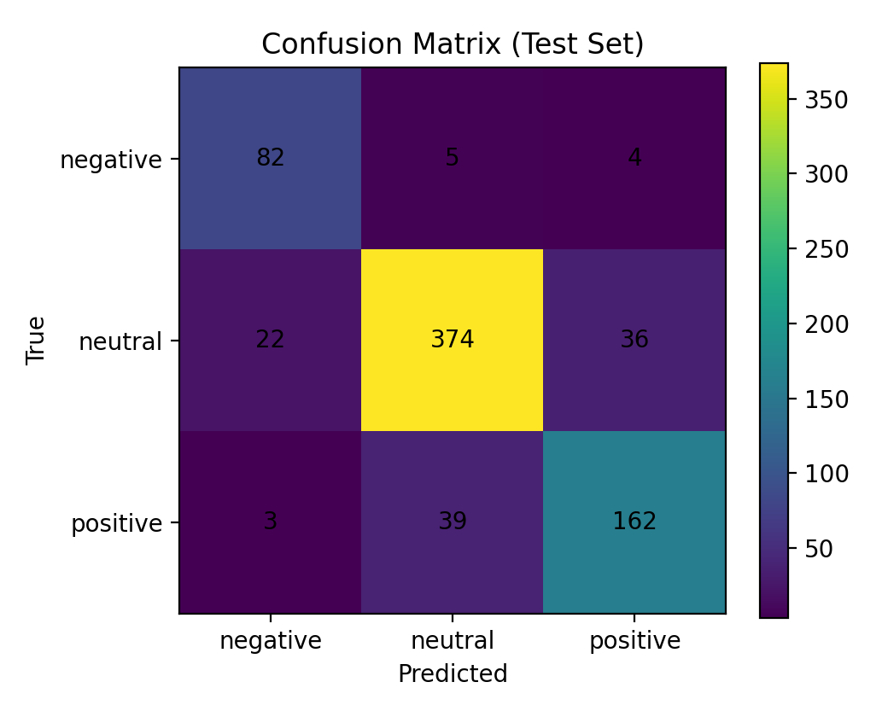
Confusion Matrix (Test)
Most errors occur between Neutral and Positive;
Negative class recall remains strong.

Slide 9
Error Analysis & Improvements
Errors: ambiguous tone, expectation statements, limited context
Improvements: finance-domain pretraining (FinBERT), more labeled data, threshold calibration

Slide 10
Inference Demo
Saved model + tokenizer to local folder
Pipeline: text-classification → label + confidence
Example:
“higher revenue and strong quarterly profits” → Positive (~0.99)

Slide 11
How to Reproduce
Create conda env (python 3.11) and install transformers/datasets/torch
Run notebook end-to-end; select kernel Python (finetune-llm)
Train → evaluate → save → inference demo

Slide 12
Thank you !

