Slide 1
CANCELLATION OF HOTEL BOOKINGS USING ML ALGORITHM
119EC0028
Rajesh Vukoti
Notes:
We designed this template so that each member of the project team has a set of slides with its own theme. Members, here’s how you add a new slide to just your set:
Mark where you want to add the slide: Select an existing one in the Thumbnails pane, click the New Slide button, then choose a layout. The new slide gets the same theme as the other slides in your set.
Careful! Don’t annoy your fellow presenters by accidentally changing their themes. That can happen if you choose a different theme from the Design tab, which changes all of the slides in the presentation to that look.

Slide 2
Contents:
Problem Statement
Given Data
Visualization
Steps Involved
Model Chosen
Conclusion

Slide 3
Problem Statement:
Hotel booking cancellation predicting with binary classification is a problem based on data analysis techniques which gives an idea to create best classification model.
With given a data set containing the details of applicants for hotel booking and status of their booking application approval whether approved or not . By using above details we need to create an binary classification model with maximum a

Slide 4
Data Given:
Number of hotel bookings cancelled(Data Set)
Data types
https://raw.githubusercontent.com/Premalatha-success/Datasets/main/hotel_bookings.csv

Slide 5
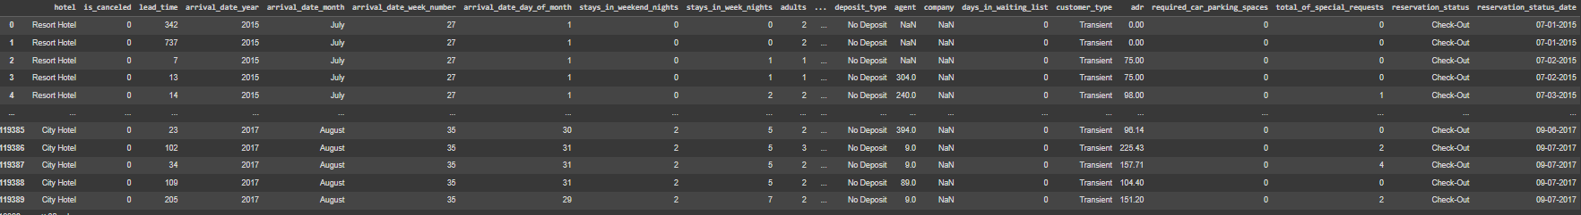
Data Set:

Slide 6
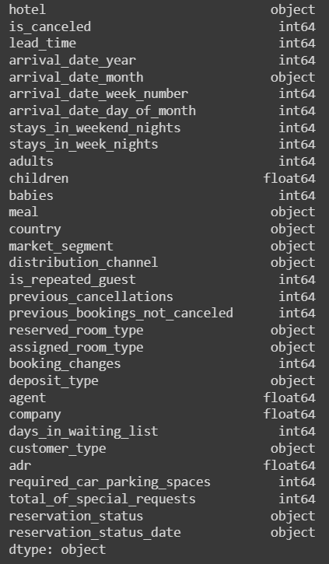
Data types:

Slide 7
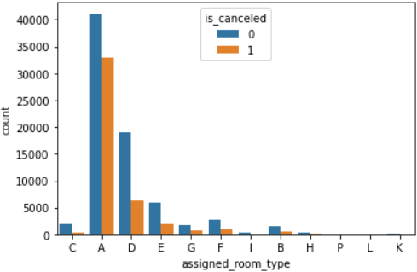
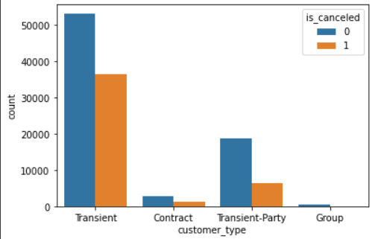
Visualizing Feature to feature :

Slide 8
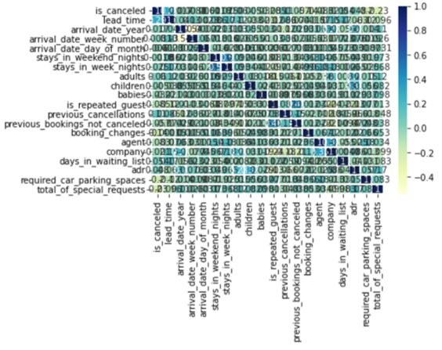
Heatmap of correlation:

Slide 9
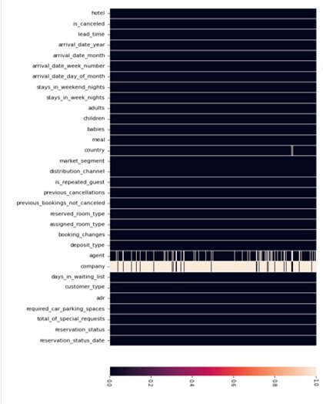
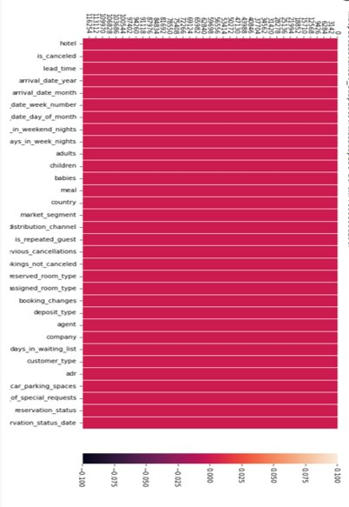
Visualization of null values:

Slide 10
Steps :
Step 1 - Import the packages numpy,pandas,matplotlib,seaborn,sklearn,train test split,metrics ▪
Step 2 - Load the Dataset ▪
Step 3 - Explore the data-shape,visualisation ▪
Step 4 - X,y-->train data test data->Fit the model with training data predict with the test

Slide 11
Model chosen: Decision Tree
Here I tried Three of the Machine Learning Algorithms such as Logistic Regression, K-Nearest Neighbors & Decision Tree Algorithms.
But Finally I have chosen Decision tree model because the accuracy rate of this algorithm is 100%

Slide 12
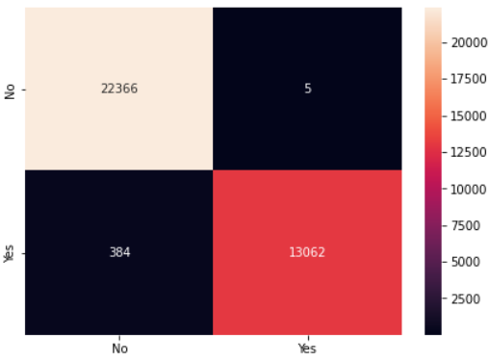
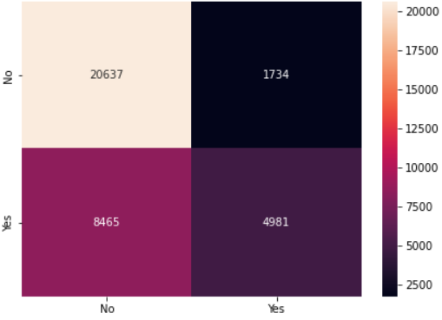
Confusion Matrix:
Logistic regression SVM

Slide 13
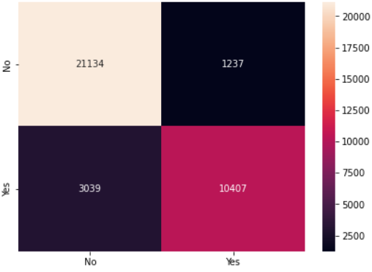
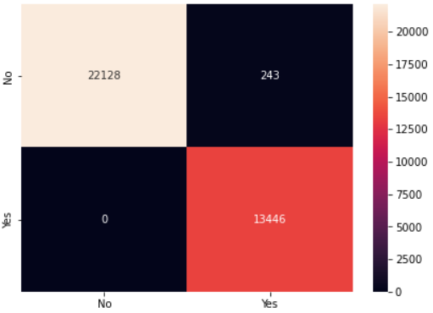
Confusion Matrix:
KNN Naive’s bayes

Slide 14
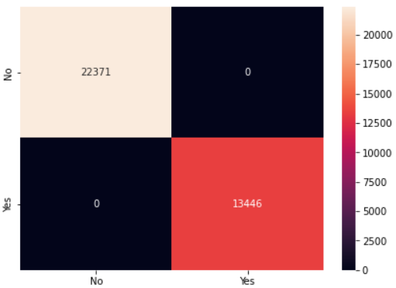
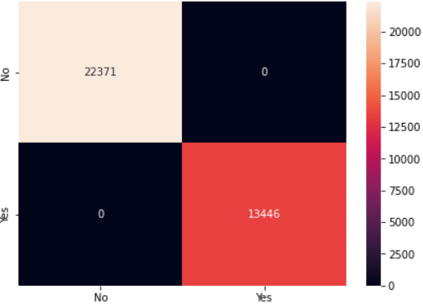
Confusion Matrix:
Decision Tree Gradeint Boosting

Slide 15
Conclusion:
We have used following ml algorithms to solve the given problem. From that we have concluded that decision tree is more accurate for this problem.
The accuracy rate and precision rate for the models are as folows :
Logistic regression:
1.Training set : 0.9899967692915176
2.Testing set : 0.9891392355585337
SVM:
1.Training set : 0.7187967405741089
2.Testing set : 0.7152469497724544

Slide 16
Conclusion:
KNN:
1.Training set : 0.9193639093965754
2.Testing set : 0.8806153502526733
Naive's bayes:
1.Training set : 0.9928565445777943
2.Testing set : 0.9932155121869504
Decision Tree:
1.Training set : 1.0
2.Testing set : 1.0

Slide 17
Thank you
119EC0028
Rajesh Vukoti

