Slide 1
Bay Atlantic University Computer Network & Mobile Communication CMPS 524 Group Project - Cisco Packet Tracer 6/13/2025 Group Members Gaurav Pandey Rajesh Singh Abubakarr Kargbo Brayan Parra Maca Prince Adjei Prabhjyot Kaur

Slide 2
Introduction
Cisco Packet Tracer is a powerful and user-friendly network simulation tool created by Cisco Systems. It’s designed to virtually design, build, and test computer networks just like in the real world.
The tool mimics the behavior of real Cisco hardware like routers, switches, firewalls, and PCs, making it a go-to platform for anyone learning networking or cybersecurity.
With its drag-and-drop interface, users can easily create network topologies, assign IP addresses, and configure settings such as routing protocols, VLANs, and access control lists (ACLs).

Slide 3
One of its greatest strengths is that it offers both a logical view (how devices communicate) and a physical view (where devices are placed)

Slide 4
Physcial view
The physical view is more like a bird’s-eye view of a real city.
It shows the actual locations like which devices are in the server room, which are on the third floor, and which are in another building across the street.
In Packet Tracer, you can see a model of offices, racks, or even cities to understand where devices are physically located.
In a university campus, routers may be in the IT building, switches in every classroom building, and servers in the data center. The physical view helps visualize where these devices are placed in real life, not just how they connect

Slide 5
Logical View
The logical view is like a Google Map of your city’s roads. It shows how everything is connected and how data moves like the roads between homes, schools, and offices.
In Packet Tracer, this is where you drag and drop devices like routers, switches, and PCs and connect them with cables.
You assign IP addresses, configure routing, test pings everything needed to make the network work.

Slide 6
Cisco Hardware we used
Workstation(6)
Switch (2)
Server (1)
Copper straight-through cable.

Slide 7
Workstation
In Cisco Packet Tracer, a workstation refers to a user computer or end device typically a PC or laptop that is part of a network.
Found under End Devices.
We can assign IP address, Subnet mask, Default gateway, DNS server.
Equipped with a command prompt, web browser, email client, and terminal for simulation
Can send/receive pings, access web servers, or simulate file transfers (FTP)

Slide 8
Switch
In Cisco Packet Tracer, a switch is a networking device that connects multiple devices (like PCs, printers, and servers) within the same Local Area Network (LAN) and allows them to communicate efficiently.
It receives data from one device and forwards it only to the destination device, not to all devices on the network.
It receives data from one device and forwards it only to the destination device, not to all devices on the network.
You can find switches under “Switches” in the device list.
Common examples: 2960, 3560, or generic switch.

Slide 9
Server
A server is like a digital helper in a network.
It is a device that provides services or resources to other devices on the network, like PCs or workstations.
Servers respond to client requests, enabling access to things like websites, files, emails, and more.
Servers are located under End Devices -> Server.

Slide 10
Copper Straight Cable
A Copper Straight-Through Cable is the most common type of Ethernet cable used in networking.
It connects different types of devices, like a PC to a switch or a router to a switch, using copper wires inside.
Lightning bolt icon has the cables where copper straight cable can be found.

Slide 11
Problem Faced
At first understanding the interface, all the icons
Wrong cable connection to similar device as we use copper cross over cable instead of copper straight through.
We encountered an issue while attempting to ping from PC0 to PC5.

Slide 12
How we overcome ?
Youtube video about the basics understanding of cisco packet tracer helped us to know about the interface and all those icons and their functionality.
We figured out we need copper straight through as copper cross over is only used when to connect similar devices.
We came to know Although all the PCs were configured with the same IP address settings, they are connected through a router, which requires devices on different sides to belong to separate networks or subnets.

Slide 13
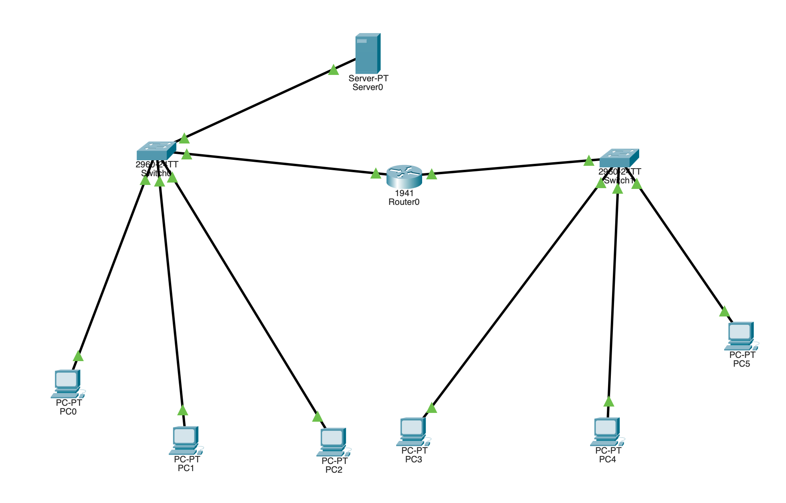
Network Topology

Slide 14
Network Topology
It is a Hybrid Topology, more specifically a combination of Star and Hierarchical
Each switch acts as the central device in a star layout, As star topology:
On the left, PCs and a server connect to Switch0.
On the right, PCs connect to Switch1
As Hierarchical
Switch0 and Switch1 are connected to Router0, which connects both LAN segments.
This forms a structure where multiple star networks are connected through a central router.

Slide 15
Conclusion
In conclusion, this network topology demonstrates a well-structured hybrid network, combining star and hierarchical designs to efficiently connect multiple PCs, a server, and switches through a central router and also offers a balanced approach to performance, manageability, and future growth, making it ideal for small to medium-sized enterprise networks.

Slide 16
Simulation..

