Slide 1




Amazon Product Review Sentiment Analysis
Amazon, being one of the largest e-commerce platforms in the world, hosts a vast array of customer reviews and feedback for millions of products. Sentiment analysis on Amazon reviews provides valuable insights into how customers feel about various products and services. By understanding the sentiment expressed in these reviews, businesses, organizations, and researchers can gain valuable insights to inform decision-making, enhance customer experiences, and monitor brand reputation.

Slide 2

Understanding Sentiment Analysis
1
What is Sentiment Analysis?
2
The Importance of Sentiment Analysis
3
Techniques and Approaches
Sentiment analysis, also known as opinion mining, is the process of analyzing text data to determine the emotional tone or sentiment expressed in it. This can be used to determine whether a tweet, review, or comment is positive, negative, or neutral.
Sentiment analysis is crucial for understanding how people perceive and feel about various topics, products or services. This information can be used to improve customer satisfaction, identify areas for improvement, and monitor brand reputation.
Sentiment analysis can be conducted using a variety of techniques, including rule-based, machine learning, and deep learning approaches. Each approach has its own strengths and weaknesses, and the choice of technique depends on the specific use case and available data.

Slide 3

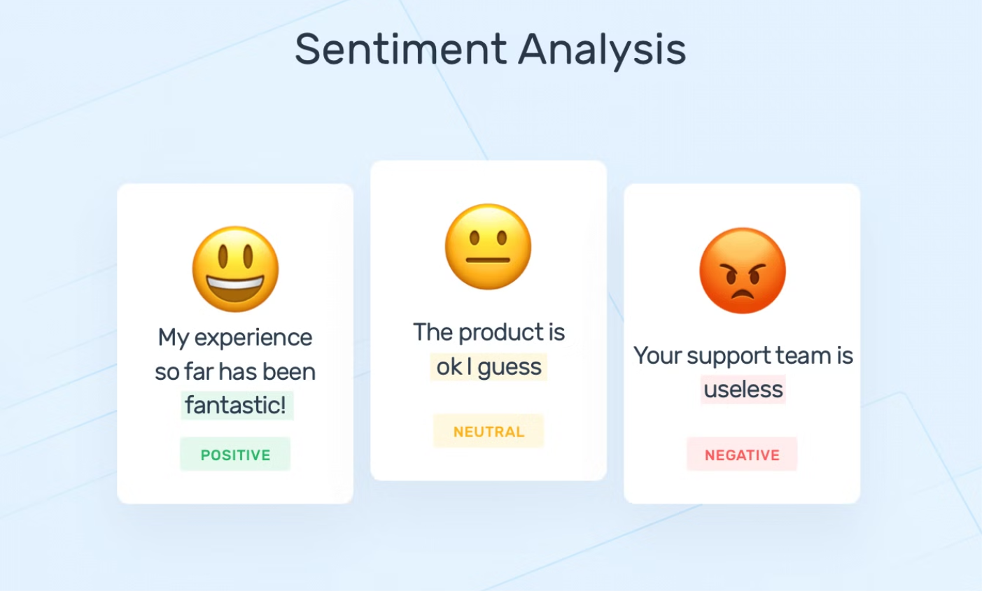

Slide 4

Preprocessing and Cleaning Data
Feature Engineering
Data Cleaning
Depending on the specific sentiment analysis techniques being used, feature engineering may be necessary. This could involve creating new features from the raw data, such as sentiment scores, hashtag frequencies, or user engagement metrics.
The first step in any sentiment analysis project is to clean and preprocess the raw amazon data. This involves tasks like removing duplicates, Hyperlinks, Symbols, emojis and handling missing values.
1
2
3
Text Normalization
To ensure consistency and accuracy in sentiment analysis, it's important to normalize the text data. This can include converting text to lowercase, removing stopwords, and performing stemming or lemmatization.

Slide 5





Sentiment Classification Techniques
Rule-based
Machine Learning
Rule-based sentiment analysis uses a predefined set of rules or lexicons to classify the sentiment of a text. This approach is often simple to implement but may not be as accurate as machine learning techniques.
Machine learning models, such as logistic regression, support vector machines, or deep learning, can be trained on labeled sentiment data to classify new tweets or texts. These models often achieve higher accuracy but require more extensive data preparation and training.
Deep Learning
Hybrid Approaches
Deep learning approaches, like recurrent neural networks or transformers, can capture more complex patterns in text data and often outperform traditional machine learning methods in sentiment analysis tasks.
Combining rule-based and machine learning techniques can leverage the strengths of both approaches, resulting in more robust and accurate sentiment classification models.

Slide 6



Analyzing Sentiment Trends
Temporal Analysis
Topic-based Analysis
Demographic Analysis
Tracking sentiment over time can reveal interesting patterns and trends, such as how sentiments change in response to specific events or marketing campaigns.
Analyzing the sentiment associated with different topics or keywords can provide insights into how users feel about specific products, industries, or social issues.
Examining sentiment data by user demographics, such as location, age, or gender, can help identify targeted marketing opportunities or areas for improvement.

Slide 7
Visualizing Sentiment Data
Visualization
Use Case
Example
Word Clouds
Identifying the most common words or phrases associated with positive, negative, or neutral sentiment
product and service reviews
Amazon, You Tube, Netflix etc.
Sentiment Timelines
Tracking sentiment changes over time, such as in response to specific events or campaigns
Social Media Reactions to an Event,
Movie or TV Show Reception
Sentiment Maps
Visualizing the geographic distribution of sentiment, which can be useful for localized marketing or customer service efforts
Geographical Sentiment Map
Temporal Sentiment Map

Slide 8
Applications and Use Cases
Brand Monitoring
Customer Service
Sentiment analysis can be used to monitor and track the online reputation of a brand, product, or service. This can help identify areas for improvement and inform marketing strategies.
By analyzing customer sentiment expressed in social media, businesses can proactively address customer concerns, improve product offerings, and enhance the overall customer experience.
Crisis Management
Political and Social Insights
Sentiment analysis can be used to quickly identify and respond to emerging issues or crises, allowing organizations to address negative sentiment and mitigate potential damage to their reputation.
Sentiment analysis on Twitter data can provide valuable insights into public opinion on political issues, social movements, and current events, informing decision-making and policy development.

Slide 9

Case study,
What is Alexa?
Alexa is a virtual assistant developed by Amazon. It is primarily used on Amazon's Echo line of smart speakersand other compatible devices. Alexa can perform a variety of tasks such as playing music, setting timers and alarms, answering questions, and controlling smart home devices. It uses natural language processing to understand voice commands and provide responses. Alexa is powered by artificial intelligence and is constantly learning to improve its capabilities.

Slide 10
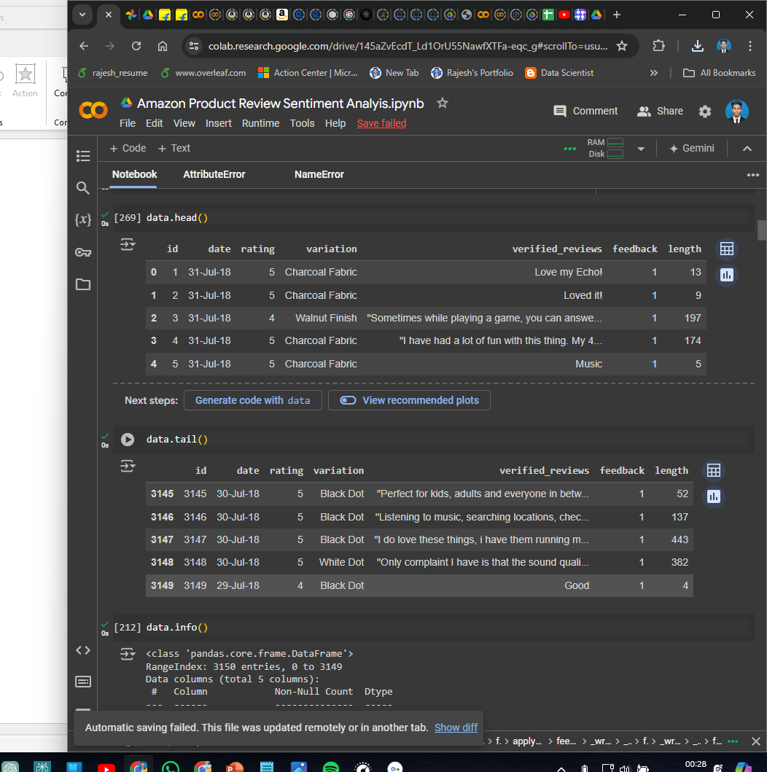
Dataset Overview,
Uncover a treasure trove of customer reviews! Our dataset boasts an impressive 3,150 entries,
complete with 5 columns: Id, Date, Variation, Verified Reviews, and Feedback Length.

Slide 11
Libraries and Modules,
numpy (np)
This library provides the foundation for numerical computing in Python. It offers efficient multidimensional arrays, linear algebra functions, random number generation, and other mathematical operations. In your code, it's likely used for numerical computations related to your data or model.
pandas (pd)
for data analysis and manipulation. It offers DataFrames (tabular data structures) and Series (one-dimensional data) for working with structured data. You might use pandas to read data from CSV files, clean and pre-process it, and perform exploratory data analysis.

Slide 12
Visualization
matplotlib.pyplot (plt)
This library is a comprehensive plotting library that allows you to create a wide variety of static, animated, and interactive visualizations. You could use it to create histograms, scatter plots, line plots, and more to understand the distribution and relationships within your data.
seaborn (sns)
builds on top of matplotlib, providing a high-level interface for creating statistical graphics. It offers a simpler syntax and a collection of built-in themes and styles, making it easier to create visually appealing and informative data visualizations.

Slide 13
Natural Language Processing (NLP)
nltk: This comprehensive library provides tools for various NLP tasks. Here's how some of its components are used in your code:
nltk.download('stopwords'): This downloads the stopwords corpus, which is a list of common words
(e.g., "the", "a", "an") that are often removed during text pre-processing as they don't carry much meaning.
nltk.corpus.stopwords: This allows you to access the downloaded stopwords list.
PorterStemmer: This implements the Porter stemming algorithm, which reduces words to their base forms
(e.g., "running" becomes "run").
nltk.download('punkt'): This downloads the punkt tokenizer model, which is used to split text into sentences.
nltk.download('averaged_perceptron_tagger'): This downloads a part-of-speech (POS) tagger model,
which assigns grammatical labels (e.g., noun, verb, adjective) to words.
nltk.download('maxent_ne_chunker'): This downloads a named entity recognition (NER) model, which can identify and
classify named entities in text (e.g., people, locations, organizations).
nltk.download('words'): This downloads a word corpus, which could be useful for tasks like vocabulary building.
nltk.download('vader_lexicon'): This downloads VADER (Valence Aware Dictionary and sEntiment Reasoner),
a lexicon for sentiment analysis, which can help you determine the sentiment (positive, negative, or neutral) of text.

Slide 14
Machine Learning (ML):
sklearn.model_selection: This submodule of Scikit-learn provides tools for splitting data into training and
testing sets, cross-validation, and model selection.
train_test_split: This function splits your data into training and testing sets for model training and evaluation.
sklearn.preprocessing.MinMaxScaler: This function scales features (columns) to a range of 0 to 1 or -1 to 1,
which can be helpful for some machine learning algorithms that are sensitive to feature scales.
sklearn.feature_extraction.text.CountVectorizer: This function vectorizes text data by converting it into numerical
features that represent the occurrence counts or frequencies of words in the documents.
sklearn.ensemble.RandomForestClassifier: This implements the random forest algorithm,
a popular ensemble learning method that combines multiple decision trees for improved performance.
sklearn.metrics: This submodule provides various metrics for evaluating the performance of machine learning models.
confusion_matrix: This function creates a confusion matrix, which helps visualize how well your model classified the data points.

Slide 15
ConfusionMatrixDisplay: This class provides a visual representation of the confusion matrix.
accuracy_score: This function calculates the accuracy of your model, which is the proportion of correctly classified data points.
wordcloud: This library allows you to create word clouds, visual representations of text data where the size of a word reflects its frequency. This can be helpful for getting a quick overview of the most words in the feedback.

Slide 16
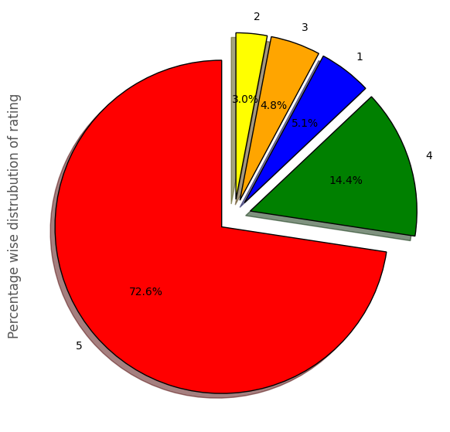
Pie chart illustrates the customers ratings for Alexa product in a different Star ratings

Slide 17
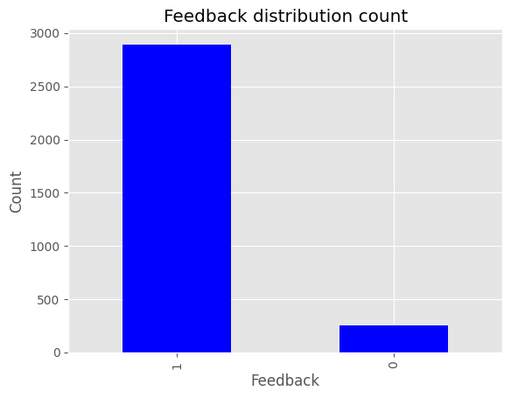
The feedback distribution count to represent the user activity to write feedbacks

Slide 18
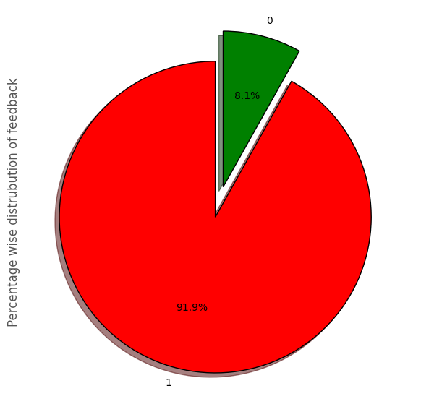
Pie chart Represents the customers Interest for rating Alexa product

Slide 19
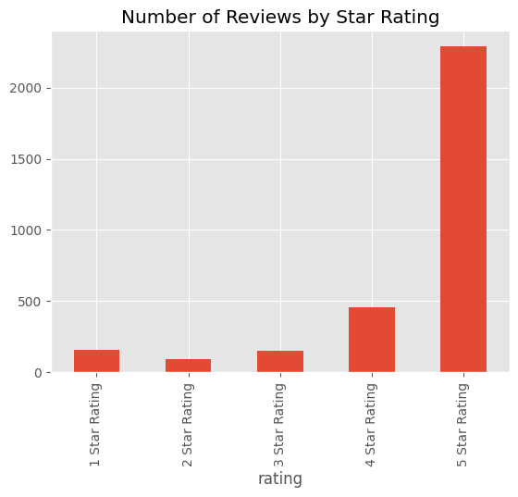
The total count of star ratings, Can illustrate in the bar graph

Slide 20
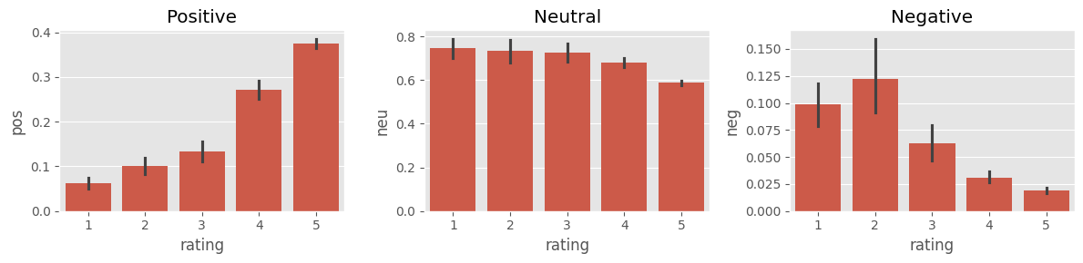
The image representing the distribution of ratings across these categories. "Positive", "Neutral", and "Negative"

Slide 21
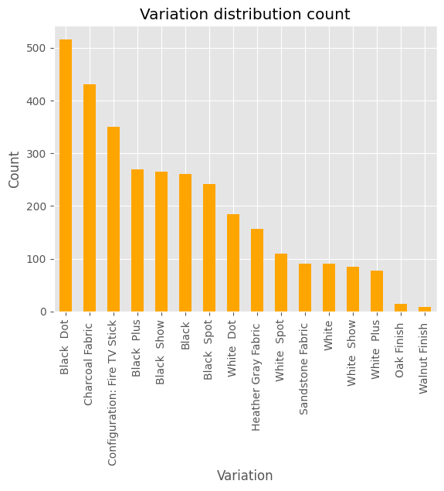
Variation distribution count for Alexa product to Identify the most purchased variation

Slide 22
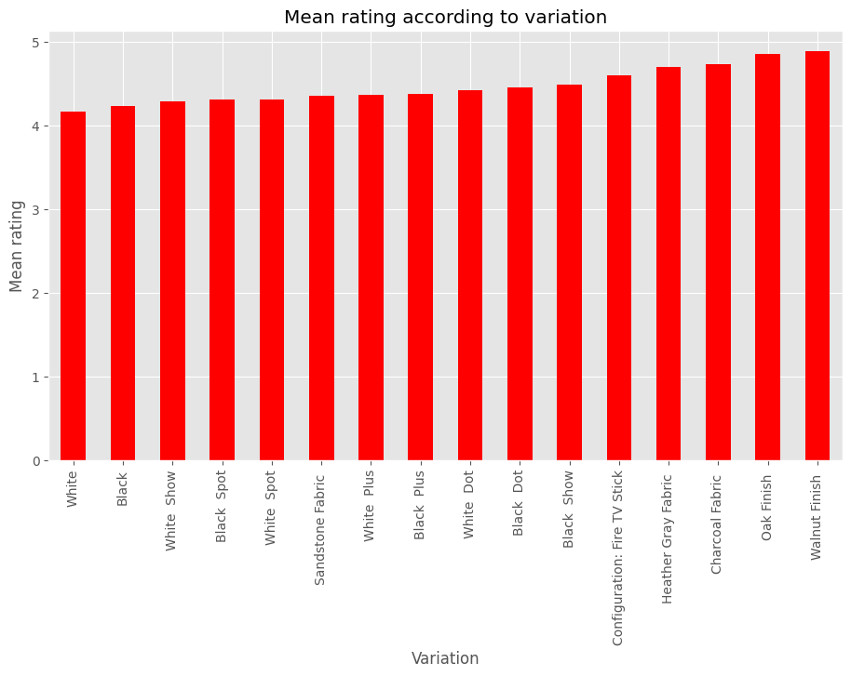
The graph suggests that customers tend to rate the "Show" variations (possibly pre-Made or complete
products) higher than
the individual fabric variations

Slide 23
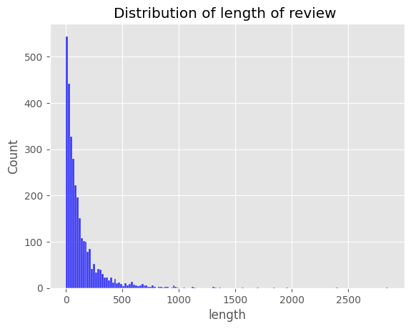
The graph visualize the model's performance or the distribution of sentiment labels in the review data.

Slide 24
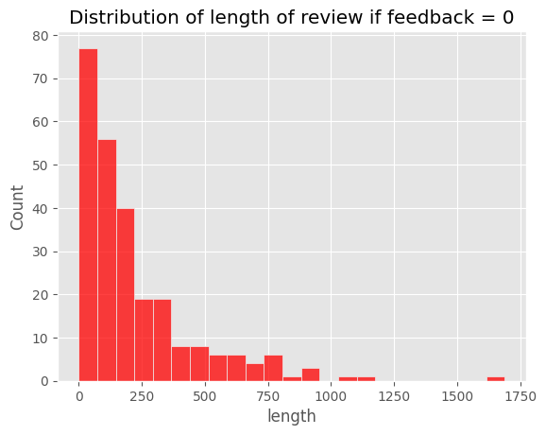
Bar chart provides the characteristics of reviews with zero feedback in this particular feedback dataset

Slide 25
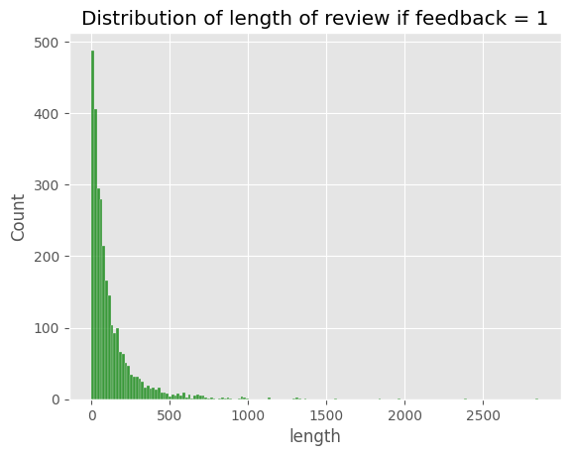
Graph showing the distribution of ratings for products with a feedback of 1.

Slide 26
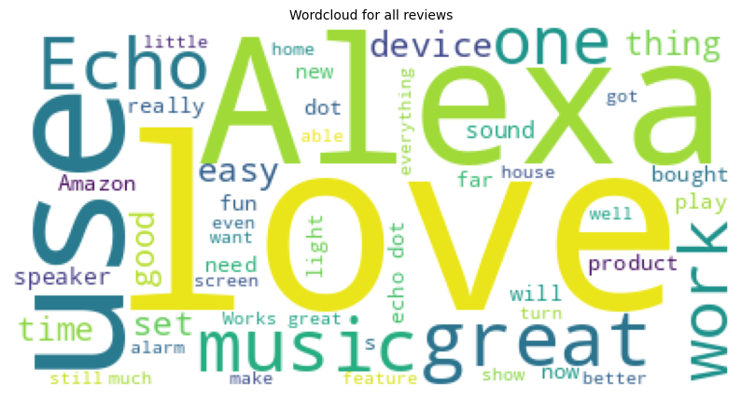
Overall words used in review section for the Alexa product

Slide 27
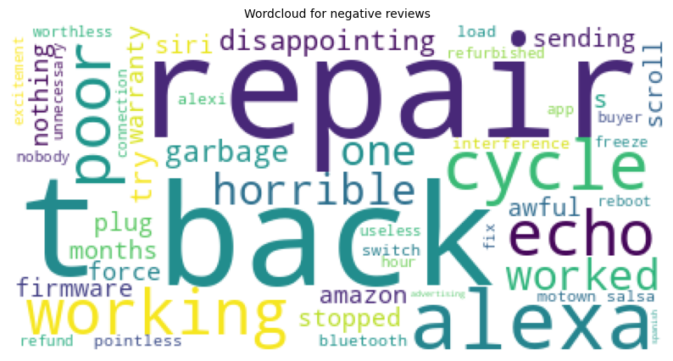
These words are the most used negative review words in the review section

Slide 28
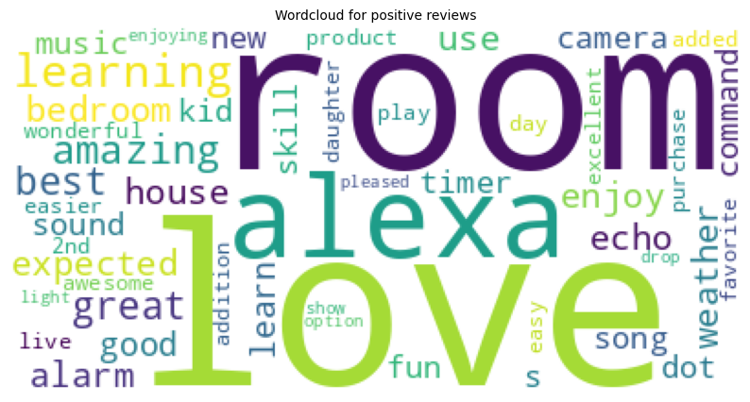
Customers use These positive words in their review section that represent in word cloud Image.

Slide 29

Thank You

