Slide 1
IBM DATA SCIENCE PROFESSIONAL COURSE CAPSTONE PROJECT
Segmenting & Clustering
Neighborhoods in
LONDON
Rajesh A C

Slide 2

IF SOMEONE IS LOOKING TO OPEN AN JAPANESE RESTAURANT IN THE CITY OF LONDON, WHERE
WOULD YOU RECOMMEND THAT THEY OPEN IT?

Slide 3
BUSINESS PROBLEM
The project goal is to perform a Segmenting and Clustering Neighborhoods in London
Assist who is looking to open an Japanese restaurant in the city of London with recommendations.

Slide 4
DATA REQUIREMENTS
Steps needs to be completed
List of Neighborhoods in London
Latitude and Longitude coordinates of city London
Venue data (powered by Foursquare), particularly related to Japanese Restaurants
Clustering

Slide 5
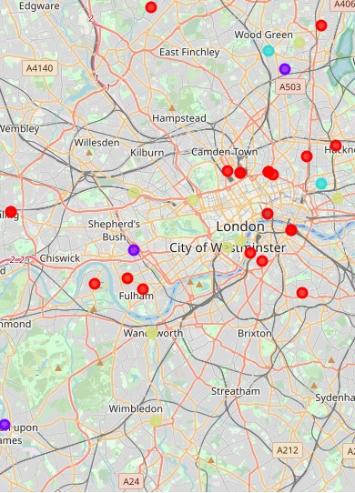
RESULTS
The output from the clustering algorithm shows the division of all the neighborhoods into 4 groups in terms of number of Japanese restaurants present in that area.
Cluster 0: Neighborhoods with very low number of Japanese restaurants
Cluster 1: Neighborhoods with low number of Italian restaurants
Cluster 2: Neighborhoods with heavy competition of Italian restaurants
Cluster 3: Neighborhoods with heavy competition of Italian restaurants

Slide 6
SUGGESTIONS
Recommendations
Category 3 having intense competition which is not recommended.
Category 0 also non-existence of competition, hence, it is not recommended
Japanese restaurant with variety of food, cheap prices etc. can go for
Category 1 but Category 2 is recommended more than Category 1 due to
a significantly higher expected target audience.

Slide 7
Thank you

