Slide 1

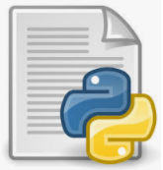








CI/CD pipeline for SMS SPAM Detection problem using GKE
Create Project
Use the service
Activated Cloud Shell
Expose
Create Docker Image
Push Docker Image
Create Cluster
Deploy

