Slide 2


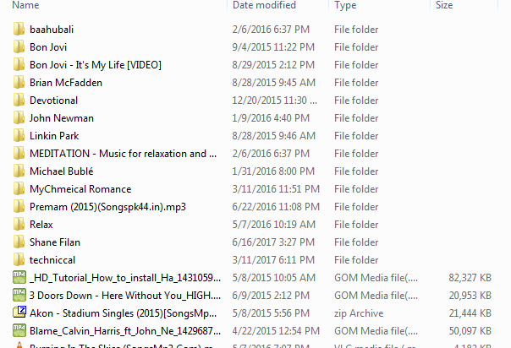
BLibrary
Home
backup
options
Total books count - 100

Slide 3

BLibrary
Home
Add, Remove, Filter, search
backup
options
Total books count - 100

Slide 4
BLibrary
home
Back up to PC, cloud, remote pc
backup
options
Total books count - 100

Slide 5
BLibrary
home
Import/export,copy/paste(context menu), theme, top most, scan books(ext), open book, book collection(favourite), integration (drive, one drive) , about
backup
options
Total books count - 100

Slide 6
Properties
Property items
values
Ok

Slide 7
Home
Backup
print
Import/export
Options

