Slide 1
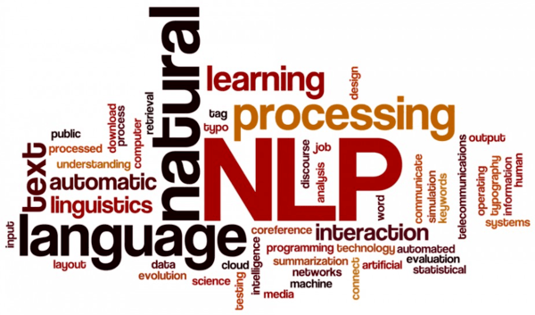
Natural Language Processing
Rajesh Babu A
Dept. of Computational Biology

Slide 2
What is NLP?
Natural language processing (NLP) is a subfield of computer science, information engineering, and artificial intelligence concerned with the interactions between computers and human (natural) languages, in particular how to program computers to process and analyze large amounts of natural language data.
(----from wikipedia)
INPUT
TEXT
OUTPUT
TEXT
computer

Slide 3
Natural Language Processing
NLU
NLG
Natural language
Understanding Natural langauge Generation

Slide 4
INPUT
TEXT
Natural Language
Understanding
computer
OUTPUT
TEXT
Natural Language
Generation
computer

Slide 5

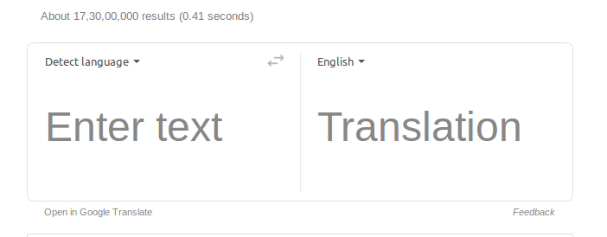
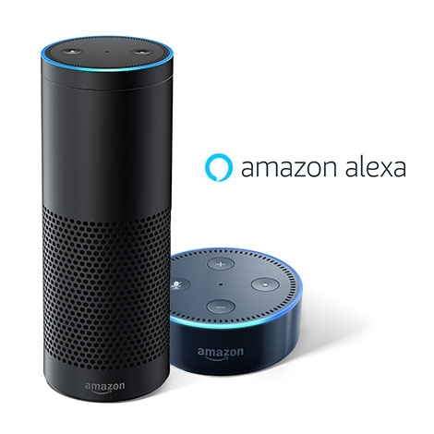
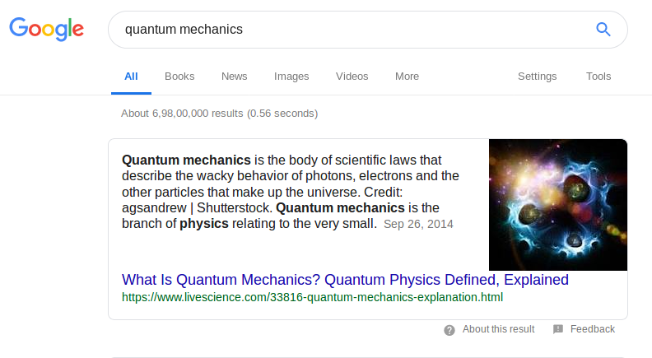

A Use case images in every day life

Slide 6
A few tasks in NLP...
Name Entity recognition
Parts of speech Tagging
Language Modeling
Sentimental Analysis
Text Generation
Topic modeling
Text Summarization
Question Answering
Information Retrival
Machine translation

Slide 7
A few terms you often hear in NLP
Corpora-Plural, Corpus-singular
Gram{unigram, bi-gram, trigram,N-gram}
Token
parsing
Vocabulary
Entropy
Zipfs law
Perplexity

Slide 8
How machine Recognize?
obama was the president of america
[('obama', 'NN'), ('was', 'VBD'), ('the', 'DT'), ('president', 'NN'), ('of', 'IN'), ('america', 'NN')]

Slide 9
Prerequisites
NLTK toolkit in python
OpenNLP, rJAVA in R
Ipython/ Colaboratory(google) / Kaggle
Installation:
Pip install nltk
!pip install nltk( *in colab)
Download requirements for nltk:
import nltk
nltk.download(“all”) / choose all after running nltk.download() or
nltk.download() then select all libraries (in Colab)

Slide 10
Pipeline of NLP
Data
Collection
Pre-
processing
Feature
engineering
Output
NLP
Analysis

Slide 11
Data Collection / Source / Extraction!!
What??How??Where??
HTML pages / Url pages ----> Web scraping
how?-->Using python library
---> Beautiful Soup / requests / Urllib
PDF files, .TXT , .DOC
how? ----> Using python library PDF2 for pdf files
RSS feeds
youtube comments
Twitter tweets

Slide 12
Preprocessing Text Data
Steps to be followed
1. Removal of punctuation marks:
can be done using regular expression
2. tokenizing
ex: cat is sitting on the mat for a long time.
Tokenized :---> [cat, is, sitting, on, the, mat, for, a, long, time]
3. Stemming
ex :- sitting----> Sit, gone---> go, best---> good.
Lemmatize:
gone----> gon, increases---> increase
4. Stop words:
5. Normalizing to lower case.
He is Mr.abc----> he is mr.abc

Slide 13
A few trival tasks with the help of library functions....
Pos
NE_Chunk
Collocations
Most_common
FredDist
Bigram
Trigram
Concordance
CondFreqDist

Slide 14
Feature Engineering
Bag-of-words(BOW)
One-hot Encoding
Tf-Idf
Word2vec
1. Word2Vec (using GENSIM/ spaCy)
2. Embeddings (using TF / KERAS)
Doc2vec

Slide 15
Bag-of-Words(BoW)
A machine only understands numerical values
So text has to be represented in numerical format.
Ex :
sent1: [the movie is good, not bad at all]
BoW : [ 1,1,1,1,1,1,1,1]
sent2 : [the movie is bad, not good at all]
BoW: [1,1,1,1,1,1,1,1]
Bow cannot preserve order of words in text so it is not efficient to use for preserving semantics .
Used in information retrevial based on frequency of words occouring, Kind of feature extraction

Slide 16
One-Hot Encoding
One more technique to decode text data preserving order of the text in the sentence
Ex:
[i am coming on monday] == [on monday i am coming]
[i ] = 10000
[am] = 01000
[coming] =00100
[on] = 00010
[monday] = 00001
[ 10000 01000 00100 00010 00001 ] ! = [ 00010 00001 10000 01000 00100 ]
Used to represent categorical data in terms of boolean and feed to a neural network or ML Algorithm

Slide 17
Tf-idf(term frequency and inverse document frequency)
Given the docs 'Xn' containing terms n terms{Tn} in doc
Tf-term frequency for t1 term =
count( t1) in X1 / Total number of terms(Tn)
Tf = count(t1) / Tn
Idf = Total no. Of Docs / total no. Docs containing t1
idf = log (Xn/ all docs containing t1)
Tf-idf = tf * idf = [count(t1)/Tn]*[log(Xn / t1 in all docs)]
Used in text mining , Information retreival

Slide 18
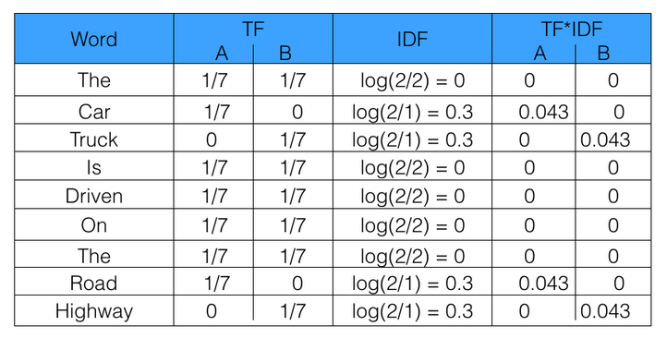
Example:
doc1-- the car is driven on the road
doc2-- the truck is driven on the highway

Slide 19
A few techniques used in NLP Analysis.......
Machine learning{ naive bayes, support vector machine...}
Perceptron
Deep Learning{feed forward multi layer}
RNN, Lstm, BiLstm, Gru
CNN
Encoder, Decoder

Slide 20

Perceptron
I
w1
Training through back propagation
I
w2
summation
Non-linear activation
function
Output
Loss Function
w3
I
W
w4
I
w5
Parameters are not shared
Loss funciton = actual value – predicted value
u
I
1

Slide 21
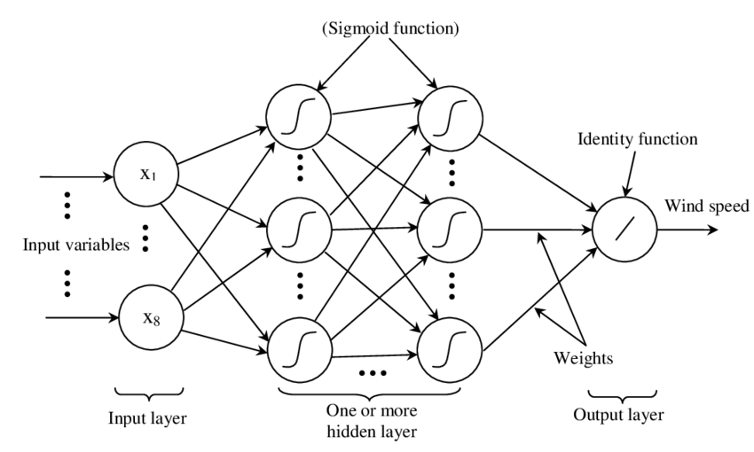
Multi Layer Perceptron(MLP)
Architecture of MLP (Hassen Bouzgou et. All, 2012)

Slide 22
Activation Functions(Non-Linear)
Hyberolic Tangent
Rectified Linear Unit(ReLU)
Sigmoid
1
1
1
0
0
0
-1
-1
f(x) = 0 for x<= 0
=1 for x>=1

Slide 23
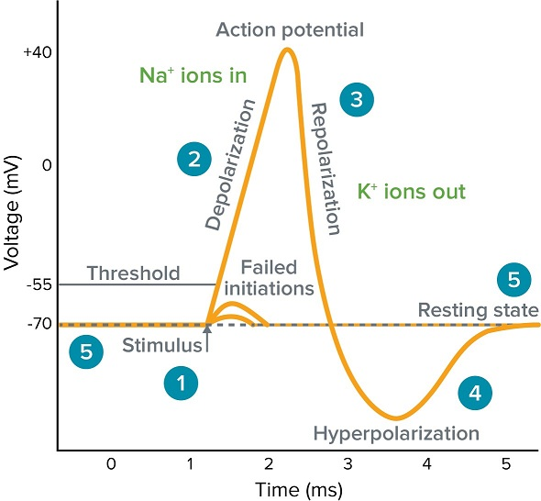
Activation Function analogous to Action Potential
Image courtesy: neuroncells.wordpress

Slide 24
Training Neural Network
Technique : Back Propagation Algorithm
Back propagation in done in NN through Gradient descent which is nothing but calculating the loss with respect to parameters and shifting back from right to left changing in NN to reduce the loss
Gradient is vector of partial derivatives w.r.t all independent variables(parameters that affects the training of the model)
Learning rates matter during training in order to avoid gradiemt vanishing and gradient exploding
Different types of optimizers like SGD, mini-batch, are used for optimizing weights/learning rates
Overfitting
Underrfitting
Avoiding the above both using Dropout function

Slide 25

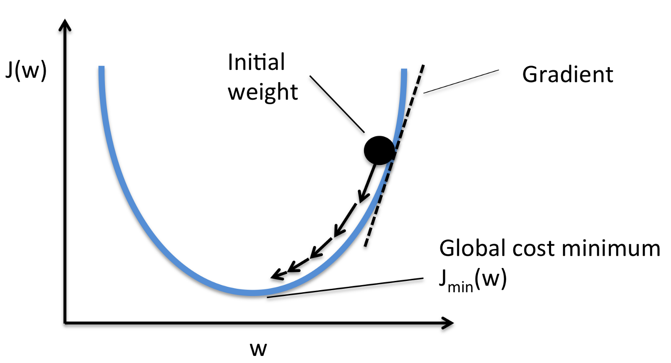

Calculation of Loss using Gradient descent
I1
W1
H0
W2
O
Predicted
actual
Examples
Chain Rule

Slide 26
Recurrent Neural Network
I
I
I
I
Softmax output
INPUTS
Hidden layer

Slide 27
How RNN hidden unit Computes??
S0 : cell state at t = 0
S1 : cell state at t = 1
x0 – vector represenatation of input text
W, U are weights
x0
S1
W
INPUT
S0
U
t =0

Slide 28

Contd...
S1 : cell state at t = 1
S2 : cell state at t = 2
x1 – vector represenatation of input text
W, U are weights
x1
S2
W
INPUT
S1
U
t =1

Slide 29
RNN across the input text(x0...xn)
s0
s1
s2
s3
........
U
U
U
U
W
W
W
W
x1
x3
x4
x0

Slide 30
Trained RNN for prediction
y0
y1
y2
y3
s0
s1
s2
s3
U
U
U
U
W
W
W
W
x1
x3
x4
x0
X0 = input.
Y1 = predicted == x1
Y is the probability distrubution of the outputs at each stage

Slide 31
Training RNN through Backpropagation at each input
j3
Loss at each time step/ input text
j0
j1
j2
y0
y1
y2
y3
V
V
V
V
s0
s1
s2
s3
....
U
U
U
U
W
W
W
W
x1
x3
x4
x0
S - Cell states
X0 = input.
Y1 = predicted == x1
Y is the probability distrubution of the outputs at each stage
W,U are weights
PARAMETERS ARE SHARED V,W,U

Slide 32




Training RNN using Back Propagation
Loss at time step
Total loss
So our gradients w.r.t each parameter
Here our parameters are weights U and W
Loss at time step t =3 w.r.t W
But S3 also depends on S2
Cell states at time t depends on all the t-1 previous cells states

Slide 33



Contd...
Gradient of loss can be written in general as chain rule form
Here comes the problem of gradient vanishing i.e actual value - predicted value = 0
As the chain length increases the gradient becomes smaller and smaller

Slide 34
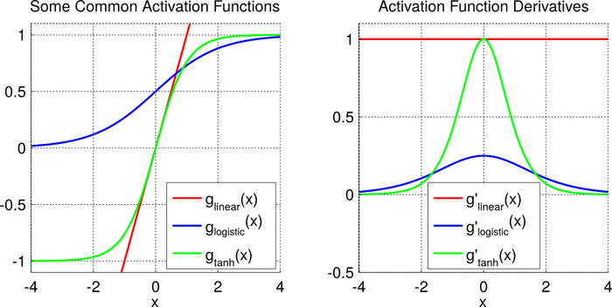
Why Gradient explosion or vanishing happends ????
Picture courtesy: theclevermachine.com

Slide 35
Embeddings for everything
So far we have discrete representation of words like BoW, one-hot encode.
Lets us see the state of art techiques currenly used by top most IT companies like GOOGLE, FACEBOOK, MICROSOFT....
Hyderabad = [0.4 0.5 0.91 0.2]
Bangalore = [0.30 0.6 0.1 0.2]
Chennai = [0.44 0.8 0.88 0.2]
Trivandrum = [0.42 0.42 0.123 0.2]
Cochin = [0.41 0.125 0.91 0.2]
Andhra pradesh = [0.4 0.52324 0.1 0.254]
Karnataka = [0.30 0.612 0.11 0.254]
Tamil nadu = [0.44 0.338 0.88 0.254]
kerala = [0.42 0.41 0.123 0.254]

Slide 36
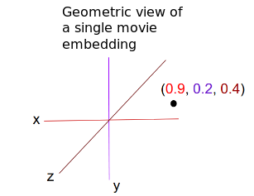
Contd...
Vector Space model in two dimensions
Cosine similarity = w1.w2/ norm(w1).norm(w2)
hyderabad
Andhra pradesh
trivandrum
kerala
cochin
bangalore
Karnataka
chennai
Tamil nadu
Cochin - bangalore+karnataka = kerala

Slide 37
How do we get embeddings??
Types of Word2Vec architectures...
Word2Vec(tomas mikolov et. Al 2013)
Skip-gram
Continous Bag of Words
Objective functions:
Softmax function
Noise-contrastive estimation loss

Slide 38
Skip-gram model:
Window size = 2
The cat sat on mat
Target words
Context word
Target words
CBow model:
The cat sat on mat
Context words
Target word

Slide 39
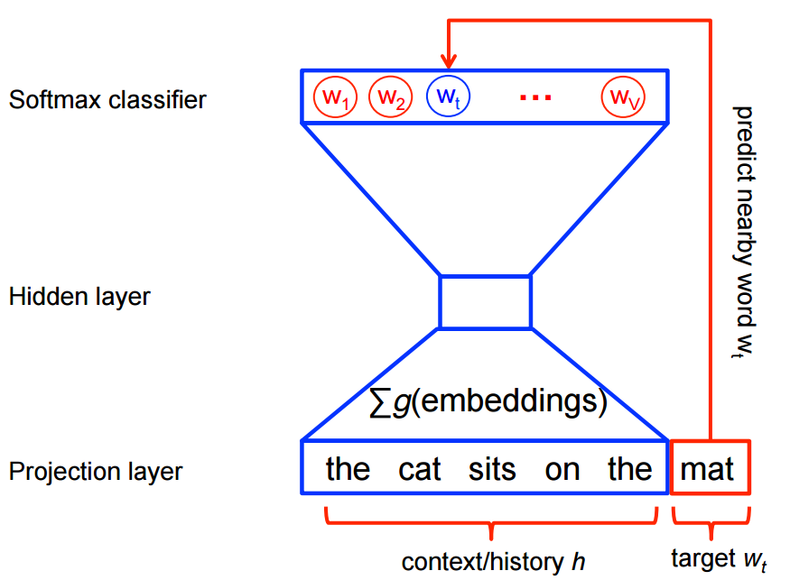
Continous bag of words(CBoW)

Slide 40
Unfolding Skip-gram neural network
0
0
0
0
0
0
0
0
0
0
0
0
1
0
0
0
0
H
I
D
D
E
N
L
A
Y
E
R
Softmax output
0.745..................0.887
0.753..................0.634
0.75....................0.647
.
.
.
.
.
.
.
.
.
.
.
0.744..................0.678
0.877.................0.786
0.877.......................0.98
0
1
0
0
Dot product
0.745..................0.887
0.753..................0.634
0.75....................0.689
.
.
0.744....................0.678
0.877....................0.786
0.877.......................0.98
0
0
0
0
0
1
0
0
Dot
Product
Weight matrix N*V
0
1
0
0
.
.
1* V
Weight matrix V*N
One-hot encoding of term SAT
N neurons
Target words

Slide 41
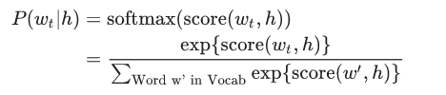
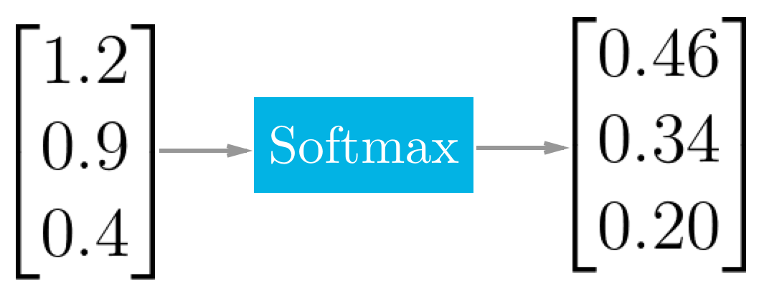

Softmax function
It is nothing but a MULTI CLASS LINEAR REGRESSION
Computational complexity as it considers all the words in vocabulary
Loss Function:
We train the above loss function using stochastic gradient descent

Slide 42

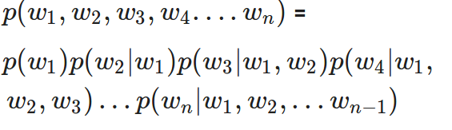
Case Study 1: Language Modeling
l
Can we hand-code rules of any single language to teach the machine???
Solution: Use Statistical interference techniques to model a language A Traditional Method
LM is a way of assigning probablities to each and every word in the sequence.
Decomposing the joint probablity into sequence of conditional probablities emplying chaine rule

Slide 43
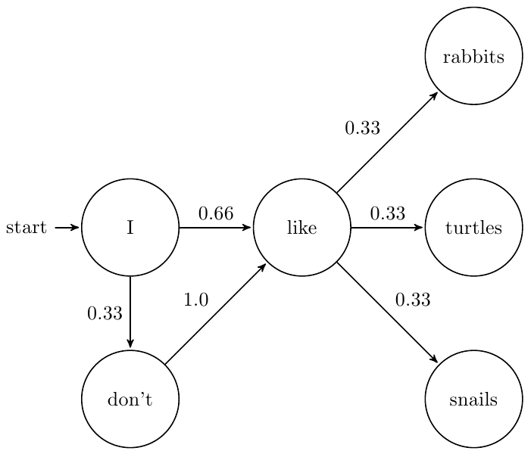
Example: Translation
p(he likes apples) > P(apples likes he)
Example: Speech Recognition
p(i want apples and pear salad) > P(i wan apples and pair salad)
Markov first assumption

Slide 44
Drawbacks with traditional approach
Markov assumption can help us model based on only a finite no of states
N-gram conditional probalility technique cannot predict novel ngram sentences
Example:
p(there was heavy rain last night)=
p(there) p(was|there) p(heavy|there was) p(rain |there was heavy) p(last|there was heavy rain) p(night |there was heavy rain last)
can we find the probability of p(rain|there was) a bigram ???

Slide 45
What is important to model a langauge other than input with correct syntactics and sematics ??
Here comes Neural Networks to model a good efficient model ....
Recurrent neural network an option because of its capacity to memorise the past
How About this sentence??
Sentence:
“ In France, i had a great time and i learnt some of the ..........Language “

Slide 46
Training RNN through Backpropagation at each input
j3
Loss at each time step/ input text
j0
j1
j2
y0
y1
y2
y3
V
V
V
V
s0
s1
s2
s3
....
U
U
U
U
W
W
W
W
x1
x3
x4
x0
S - Cell states
X0 = input.
Y1 = predicted == x1
Y is the probability distrubution of the outputs at each stage
W,U are weights
PARAMETERS ARE SHARED V,W,U

Slide 47
Here comes Long-short Term Memory(LSTMs) to the Rescue
j3
Loss at each time step/ input text
j0
j1
j2
y0
y1
y2
y3
V
V
V
V
s0
s1
s2
s3
....
U
U
U
U
W
W
W
W
x1
x3
x4
x0
S - Cell states
X0 = input.
Y1 = predicted == x1
Y is the probability distrubution of the outputs at each stage
W,U are weights
PARAMETERS ARE SHARED V,W,U

Slide 48
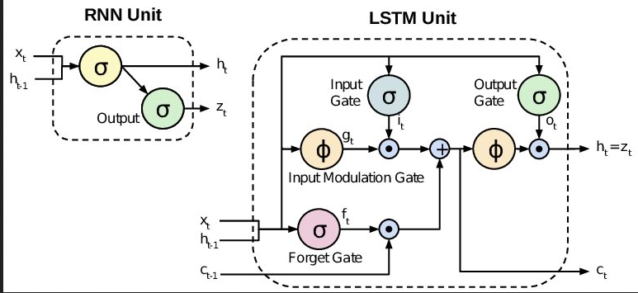
How LSTM hidden unit compute?

Slide 49
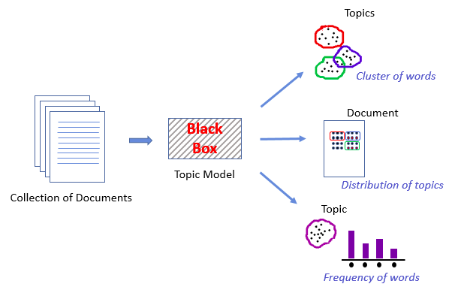
Case Study 2 : Topic Modeling using Latent Semantic
Analysis(LSA) / Latent Semantic Indexing(LSI)
Latent semantic analysis (LSA) is a technique in natural language processing, in particular distributional semantics, of analyzing relationships between a set of documents and the terms they contain by producing a set of concepts related to the documents and terms.
(--from wikipedia)
Picture Courtesy: Analytical vidya

Slide 50
Example:
'
cyclin orphan cyclin product fam58a whose mutations cause star syndrome human developmental anomaly whose features include toe syndactyly telecanthus anogenital renal malformations .'
.
Concepts related to above topic:
fam58a
syndrome
cells
star syndrome
western
blot
western blot
analysis

Slide 51
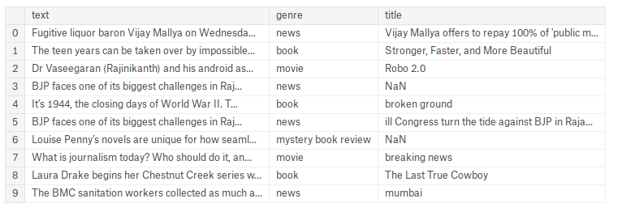
Can use either Gensim or spaCy or NLTK
Topic Modeling at Low Level
Step 1: Collection of Text data

Slide 52
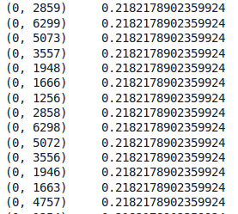

Step 2: Preprocessing the text data
includes : Removal puncutation marks, special characters, stop words--> breaking into sentences
Step 3: calculating the tem frequency and document frequecy

Slide 53
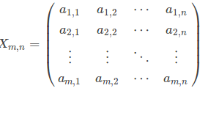
Now we have terms and its frequencies
We also have data packed in a matrix[X] of shape (m*n) but it is sparse m-documents(rows) n-terms(columns)

Slide 54




Singular Value Decomposition
When matrix is not square;Reduce the dimension; preserve the semantics;helps to find similarity between documents.
Eigen values are possibly obtained . Shape of V is n*r. Where r is number of eigen values obtained. This is possibily the term correlations.
This diagonal matrix contains Singular Values of the Factorization. Shape is r * r
Eigen values are possibly obtained . Shape of U is m*r. Where r is number of eigen values obtained. This is possibily the Document correlations.

Slide 55
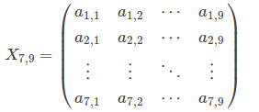
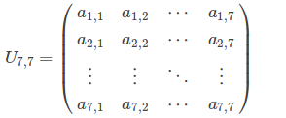
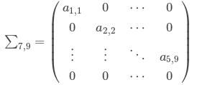
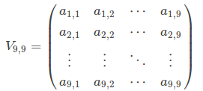

Singular value
decomposition

Slide 56
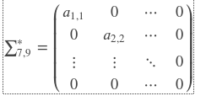

Dimensionality Reduction
Similarity between the documents
Phrases that represent the document

Slide 57

Sentimental Analysis
General Idea :
It is very bad—[0,0,0,-1]
It is too good -- [ 0,0,0,1]
Movie is good but actor is bad – [0,0,1,0,0,0,-1]
Rating:
Good > 0
bad < 0
Neutral = 0

Slide 58
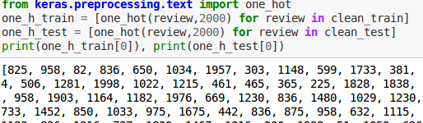

Feed data to Machine
One hot encoding
Creating word Embeddings to learn semantic meaning of the text

Slide 59
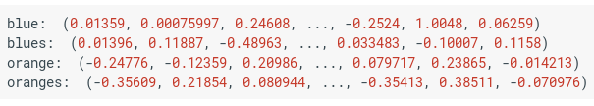
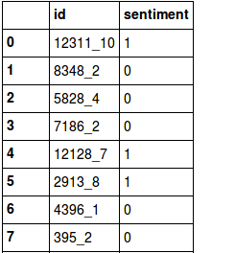
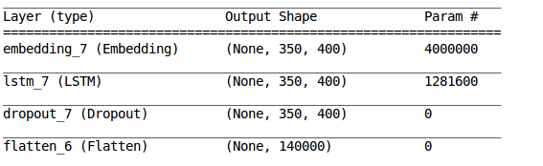
Contd...
WORD EMBEDDINGS
Creating a model(training) using a classifier/Network
Evaluating and predicting Sentiment

