Slide 1

Community Project Branch: CSE-Artificial Intelligence & Machine Learning Department: Data Engineering Semester: V Section: A Regulation: R24 Course Code: R24MSCSP001
Project Title: TransPulse: Smart Transit Orchestration Platform
Batch Number: Batch 12 (CSE-AIML)
SS. No | Register Number | Student Name
1 | 24331A4216 | BENDI RAJESH
2 | 24331A4265 | MATHA VIGNAN VAMSI
3 | 24331A4255 | KUDUPUDI LAKSHMI VINAY
4 | 24331A4234 | GURALA SRAVAN KUMAR
Guide Name: k. amaravathi
Designation: assistant professor
Project Coordinator: k. amaravathi
Designation: assistant professor
Head of the Department: Dr. V. Jyothi
Designation: Associate Professor

Slide 2
Abstract
Context: Public transit systems suffer from scheduling opacity, tracking errors, and high operational overhead.
Platform: TransPulse is a production-grade mobility platform that connects passengers, drivers, and administrators.
Backend Integration: Synthesizes static GTFS schedules with high-frequency live GPS coordinate telemetry.
Key Engine: Employs geodetic stop-progression calculations and smoothed speed formulas for robust delay modeling.
Offline Support: PWA-enabled app ensuring transit tracking resilience under limited regional network conditions.

Slide 3
Introduction
Modern Smart Transit: Transitioning public fleet coordination into a high-visibility, responsive tracking ecosystem.
Unified Platform: Single-pane command interface for fleet administrators, passenger clients, and drivers.
AP Smart Mobility: Tailored to Andhra Pradesh geography covering 26 districts and 8000+ active routes.
Centralized Orchestration: Integrates live telemetry to optimize dispatcher workflows and commuter predictability.

Slide 4
Problem Statement
Commuter Uncertainty: Passengers lack live visual tracking, leading to extended wait times and transit anxiety.
Erratic Telemetry: Raw GPS inputs contain high signal jitter and drift, corrupting linear map routes and ETA projections.
Outdated ETA Math: Standard estimations rely on static distance metrics, ignoring real-time traffic and delays.
Isolated Workflows: No synchronized channel between administrative dispatches, drivers, and real-time passengers.

Slide 5
Project Objectives
Real-Time Map Tracking: Provide passengers with instant Leaflet-based map visualization of route transit.
Monotonic Checkpoints: Introduce strict stop- progression criteria to filter GPS noise and drift.
Dynamic ETA Projections: Formulate blended speed algorithms combining live telemetry with schedule baselines.
App Installability: Deploy responsive role dashboards as an offline-resilient Progressive Web App (PWA).

Slide 6
Project Scope
Regional Network: Designed for Andhra Pradesh transit operations, centered around the Palasa regional hub.
Comprehensive Routing: 25 major corridors connecting Visakhapatnam, Vijayawada, Rajahmundry, and Tirupati.
Fleet Orchestration: Simulates continuous trip cycles using a 15-bus fleet to stress-test real-time engines.
Layered Map Fallbacks: Combines GTFS shape rendering with backend road caches and client-side OSRM queries.

Slide 7
Literature Review
Legacy Tracking Systems: Hardware-intensive setups that lack real-time integration with standardized schedule schemas.
Static GTFS Constraints: Timetables remain rigid and fail to adapt dynamically to real-world gridlock or vehicle breakdowns.
Modern Smart Platforms: Employ GTFS-Realtime for transit alerts, but require stable internet and high infrastructure budgets.
TransPulse Edge: Introduces high-efficiency, offline-capable mapping and journey transitions at minimal deployment costs.

Slide 8
Data Collection & Ingestion
Static Schedule Database: Parses GTFS routes, shapes, stops, trips, and schedules directly into SQLite/PostgreSQL.
Live GPS Telemetry: Collects latitude, longitude, speed, and heading coordinates broadcast from active driver devices.
Segment History: Logs historic segment traversal times to continuously retrain the ETA estimation module.
Spatial Polylines: Stores precise geospatial polyline vectors representing official road networks.

Slide 9
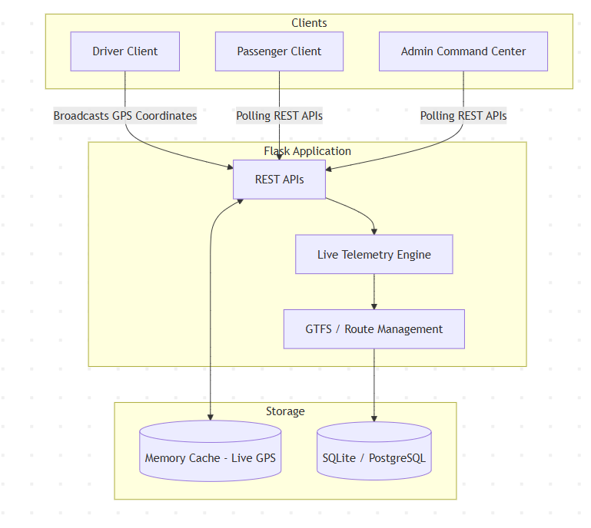
System Flowchart
Client Tracking Loop: Driver starts trip → Broadcasts GPS telemetry → Backend updates live segment coordinates → Passenger portal pulls update.
Flowchart:

Slide 10
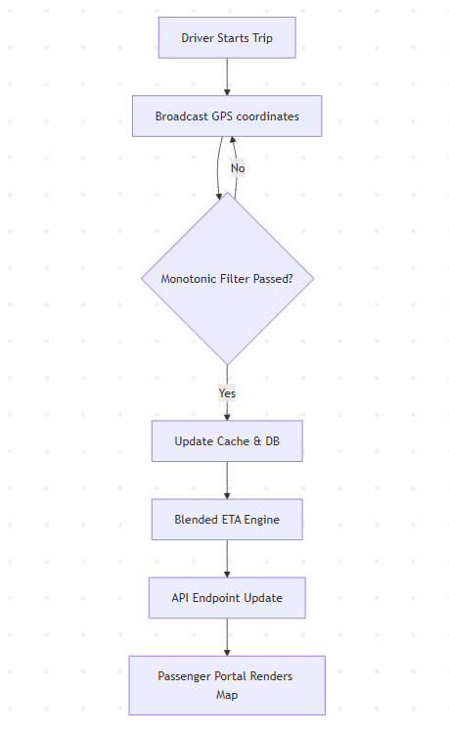
Architecture Block Diagram
Modular Design: Consists of the storage layer (SQLite / Memory Cache), REST API controllers, and three client dashboards.
Block Diagram Code: See Mermaid structure representing the architectural components:

Slide 11
Implementation Details
Admin Command Center: Fleet dashboard for dispatcher assignments, live bus visual tracking, and SOS signal resolution.
Driver Dashboards: Progress meters showing stop-by-stop timelines, occupancy updates, and automatic route-reversal controls.
Passenger Portal: Searchable index of transit routes, live schedule alerts, and instant geolocated SOS triggers.
Codebase Repository: Built using Flask backend, SQLAlchemy models, and pure LeafletJS/JavaScript client interfaces.

Slide 12
Results & Screenshots
Dispatch Center: Interactive live map showcasing coordinates of all buses in the active transit simulation.
Passenger Timeline: Step-by-step progress checklist showing stop sequences and color-coded ETA countdown alerts.
Mobile PWA Prompt: Seamless mobile installation trigger allowing users to save TransPulse directly to home screens.
Offline Alert: Resilient banner showing network disruption alerts and falling back to offline route information.

Slide 13
Impact Assessment
Technical Impact: PWA architecture cuts bandwidth requirements. SQLite/PostgreSQL layer ensures stable data retrieval.
Social Impact: Reduces rider waiting times at isolated stops, improving safety and providing SOS emergency layers.
Economic Impact: Reduces operational dispatch errors, prevents empty mileage runs, and lowers administrative tracking costs.

Slide 14
Challenges & Mitigations
Telemetry Noise: Enforced a strict monotonic stop-matching filter to eliminate coordinate jumps caused by GPS signal drift.
Dynamic State Reversal: Built automatic shape, stop, and distance sequence inversion when return trips commence.
Offline Operations: Developed a tiered mapping engine that shifts to OSRM queries or stop-to-stop paths during network drops.

Slide 15
Conclusion
Success: Created a fully-functional, production-ready Smart Mobility Platform for Andhra Pradesh state transit.
Rigorous Testing: Successfully validated routing accuracy over 25 distinct corridors using simulated fleet operations.
Enterprise Baseline: Establishes a highly-scalable, low-cost framework for regional bus transit automation.

Slide 16
Future Scope
FCM Push Alerts: Deploy Firebase Cloud Messaging to send real-time delays and emergency notifications to passenger devices.
Machine Learning ETAs: Incorporate historical travel segment datasets to model traffic and weather anomalies for ETA accuracy.
Eco-Driving Analytics: Track driver acceleration and braking metrics to improve fuel efficiency and passenger ride comfort.

Slide 17
References
[1] GTFS Standard: General Transit Feed Specification Reference, Google Transit Development Group, 2026.
[2] Web Framework: Flask Documentation & Database Orchestration with SQLAlchemy, Pallets Projects, 2026.
[3] Map Rendering: Leaflet Mobile-Friendly Interactive Mapping, JS Foundation, 2026.
[4] Distance Calculations: Haversine Geodetic Formulation for Spherical Grid Calculations, 2026.

Slide 18
Project Name: TransPulse: Smart Transit Orchestration Platform
Department: Data Engineering (CSE-AIML)
Team Members: Bendi Rajesh, Matha Vignan Vamsi, Kudupudi Lakshmi Vinay, Gurala Sravan Kumar
Thank You: We appreciate your time. Please let us know if you have any questions!

