Slide 1


GIT and GITHUB
Dr. Rajesh Kumar Burra
EECE, GIT, Vizag

Slide 2
What is GIT?
Git is software for tracking changes in any set of files, usually used for coordinating work among programmers collaboratively developing source code during software development.
Its goals include speed, data integrity, and support for distributed, non-linear workflows (thousands of parallel branches running on different systems).
Git was created by Linus Torvalds in 2005 for development of the Linux kernel, with other kernel developers contributing to its initial development.

Slide 3
What is GIT?
Every Git directory on every computer is a full-fledged repository with complete history and full version-tracking abilities, independent of network access or a central server.
Git is free and open-source software distributed under GNU General Public License Version 2.

Slide 4
What is GIT?
Version Control System (VCS) for tracking changes in computer files
Distributed version control
Coordinates work between multiple developers
Who made wat changes and when
Revert back at any time
Local & remote repos

Slide 5
Concepts of GIT
Keeps track of code history
Takes “snapshots” of your files
You decide when to take a snapshot by making a “commit”
You can visit any snapshot at any time
You can stage files before commiting

Slide 6
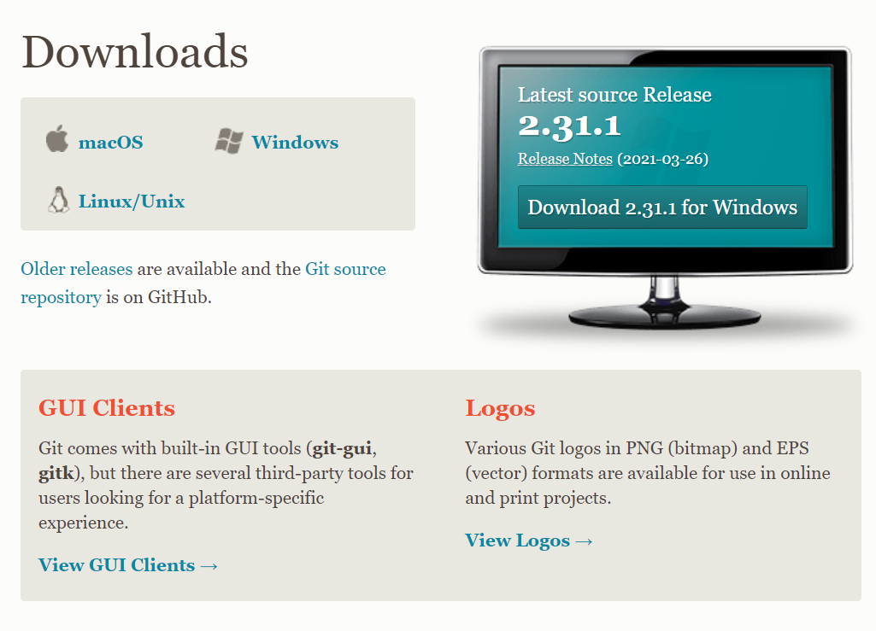
Installing GIT
http://git-scm.com/downloads/

Slide 7
Basic commands
$ git init // Initialize local Git repository
$ git add <file> // Add files(s) to index
$ git status // Check status of working tree
$ git commit // commit changes in index
$ git push // push to remote repository
$ git pull // pull latest into a new directory
$ git clone // clone repository into a new directory

Slide 8
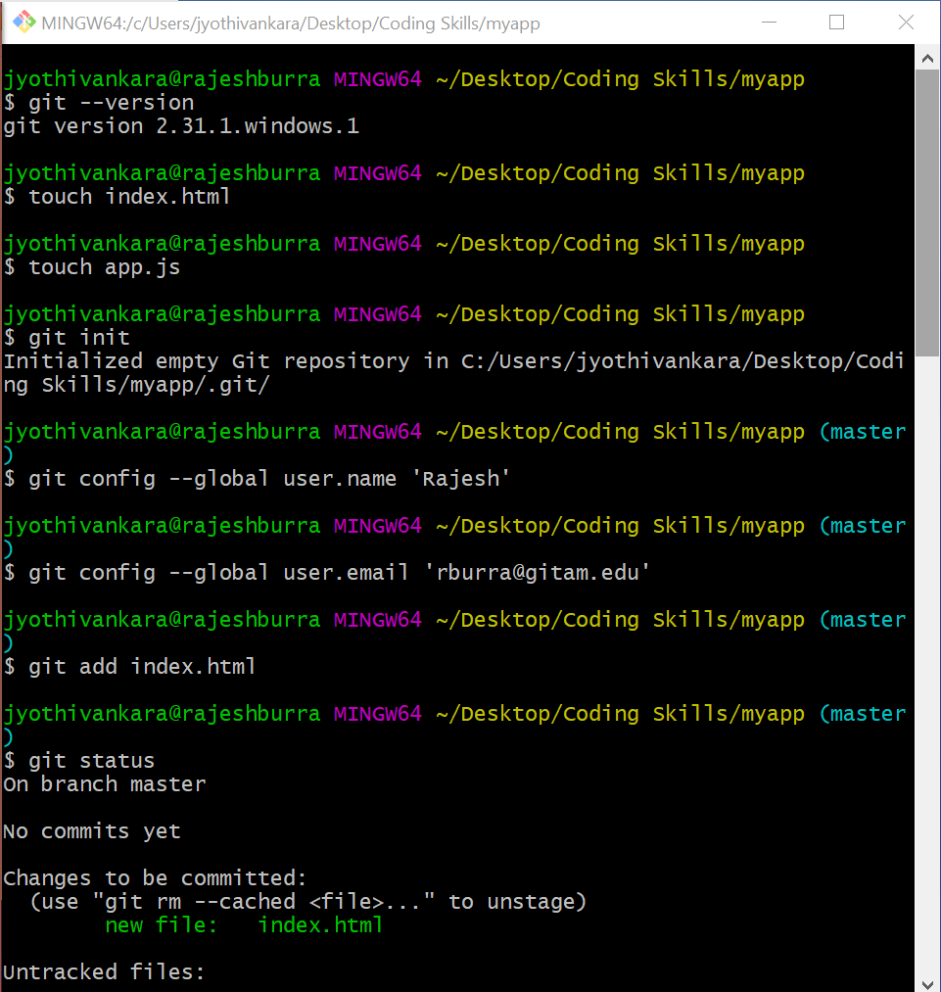
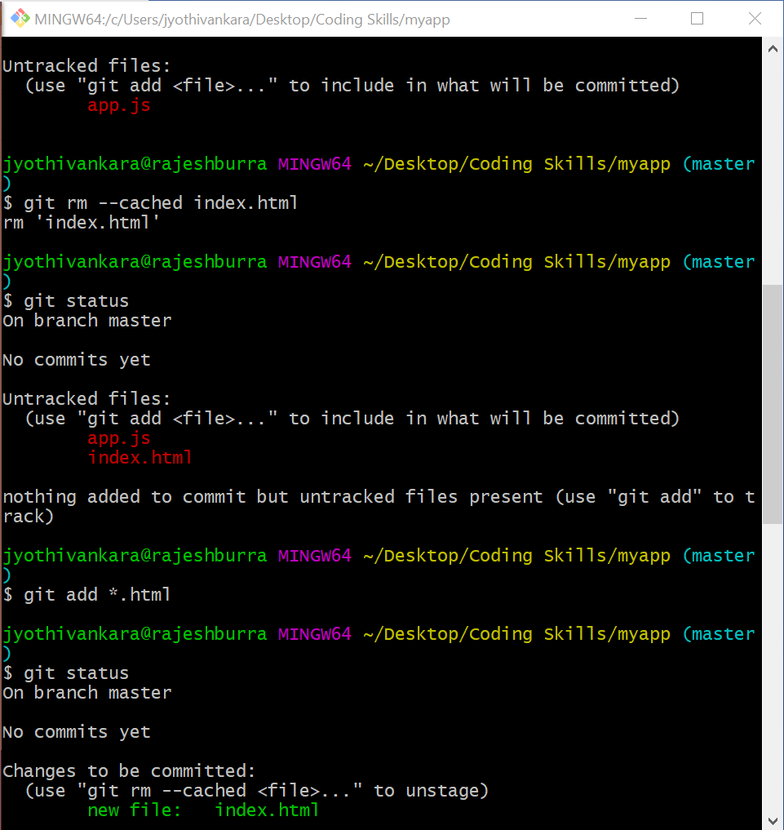

Slide 9
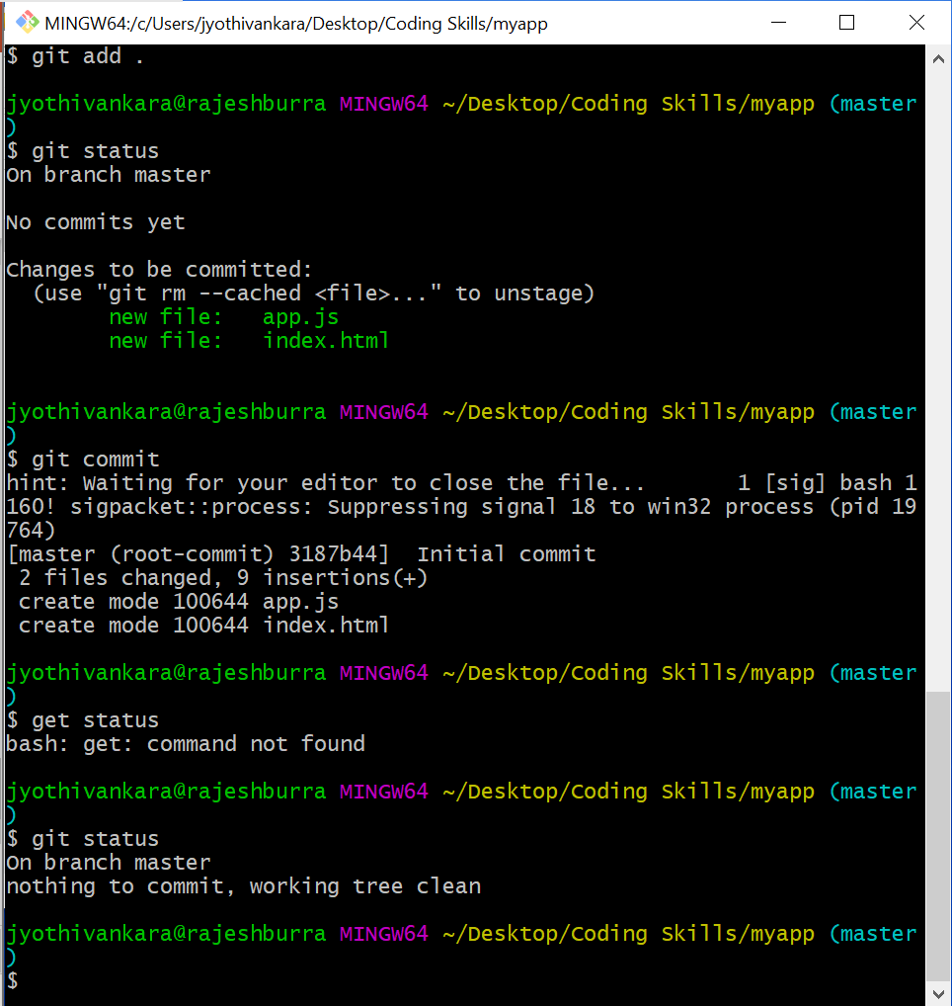

Slide 10
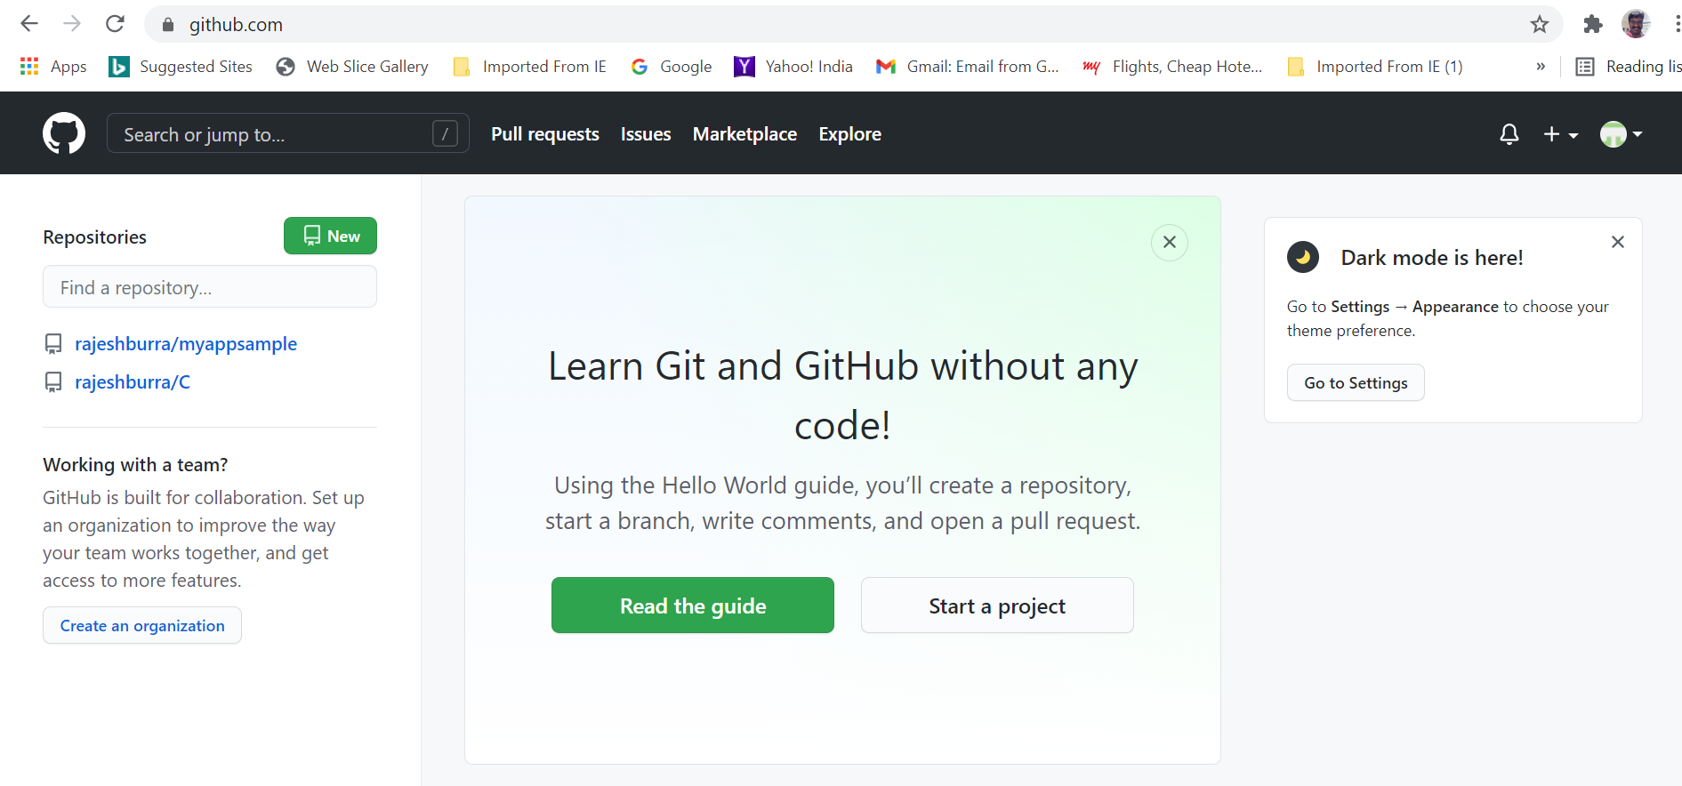
GITHUB

Slide 11
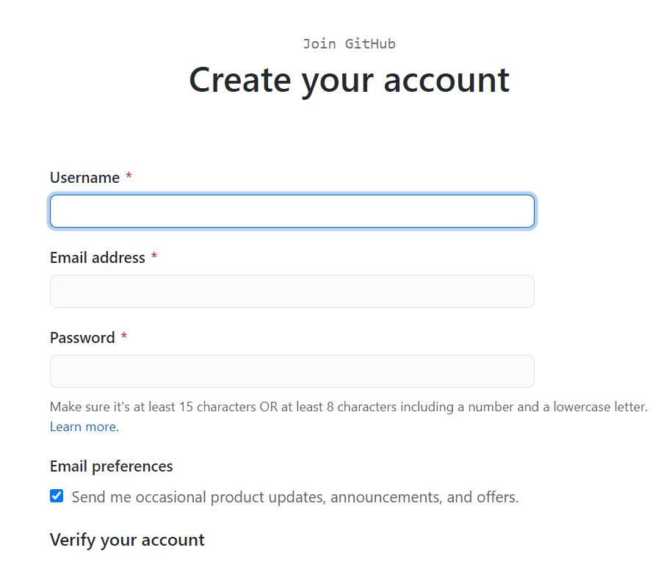
GITHUB Installation

Slide 12
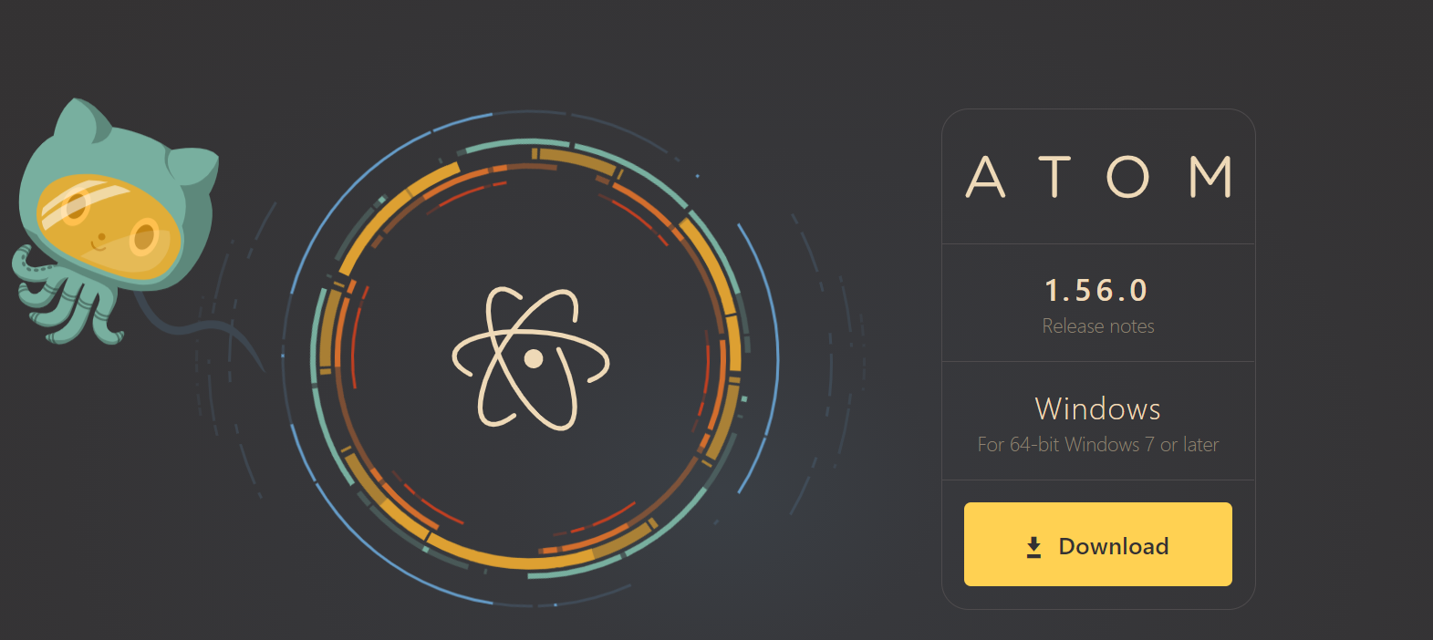
Atom installation

