Slide 1
Fraudulent website Detection using Machine Learning
EECE5644 – Machine Learning/Pattern Recognition PROJECT
Project members:
1. ADARSH REDDY
2. VENKATA B
3. RAJESH CHINNAGA

Slide 2
Problem Statement
The goal of the project is to predict best classification model using Machine learning and deep neural networks that help a user to identify if a website is a phishing website. The goal is to seek more information about how characteristics like websites with email in the URL, websites with a valid TSL or SSL certificate, websites with IP addresses instead of domain names in the URL, affects the website classification.
To achieve this, we collect data from a data set that contains data about normal website URLs as well as phishing website URLs. In addition, we will also extract the required URL and website content-based features.

Slide 3
Data Collection and Feature Extraction
We used Phishtank website and UNB site for getting the phishing and True/Legit datasets.
We collected 5000 samples from Phishing dataset and 5000 samples from True/Legit dataset and extracted 18 features out of these URL’s.
created a final dataset that contains 10,000 samples of Phishing and True/Legit URLs with all the features that we extracted.

Slide 4
Features Extracted:
['Domain’,
'Have_IP’,
'Have_At’,
'URL_Length’,
'URL_Depth’,
'Redirection’,
'https_Domain’,
'TinyURL’,
'Prefix/Suffix’,
'DNS_Record’,
'Web_Traffic’,
'Domain_Age’,
'Domain_End’,
'iFrame’,
'Mouse_Over’,
'Right_Click’,
'Web_Forwards’,
'Label']

Slide 5
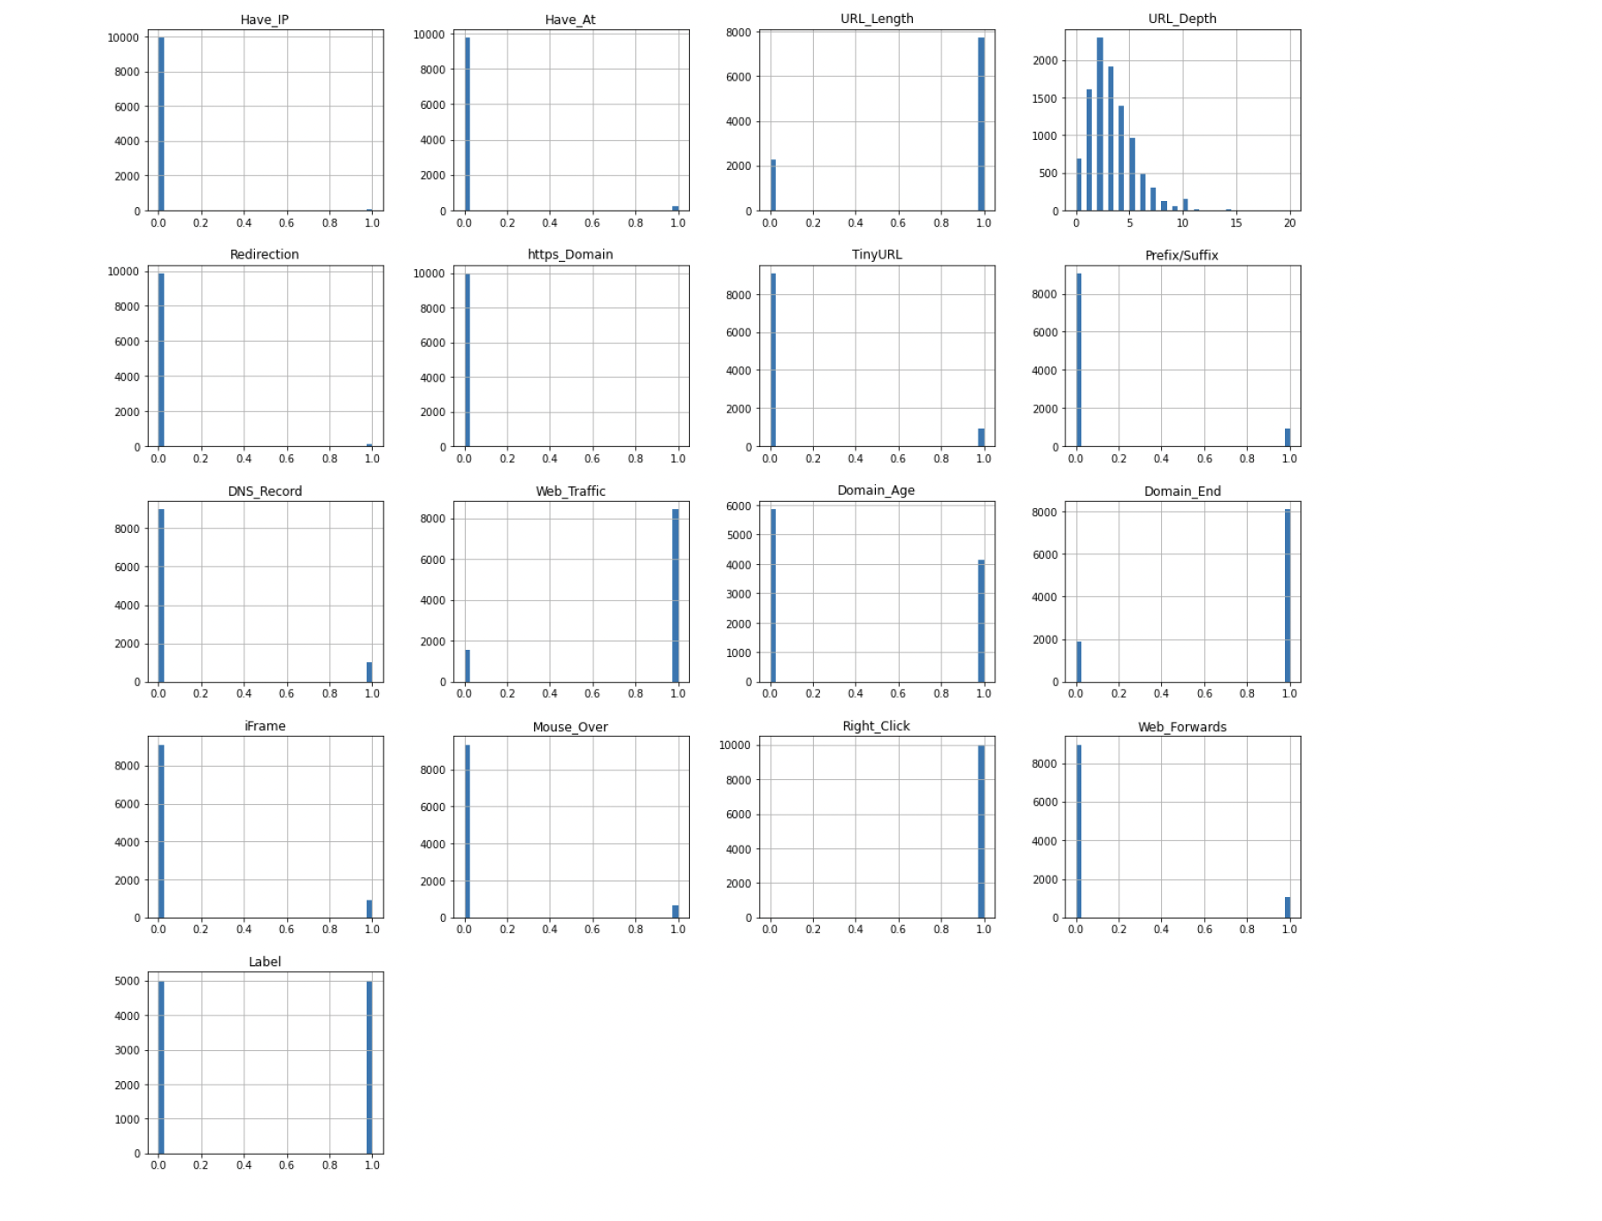
Histogram

Slide 6
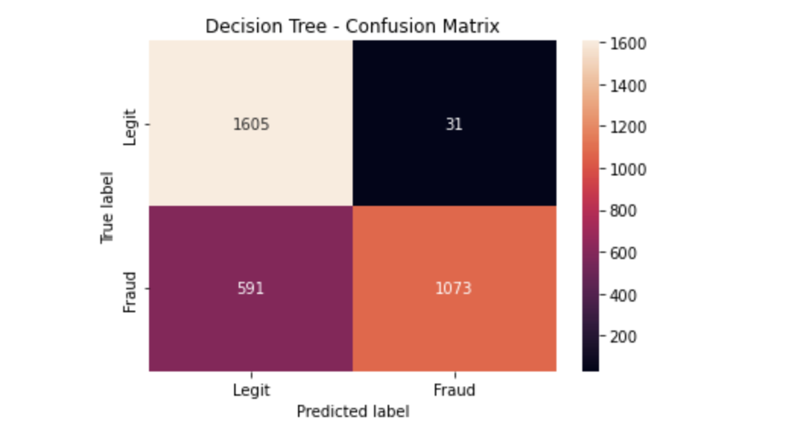
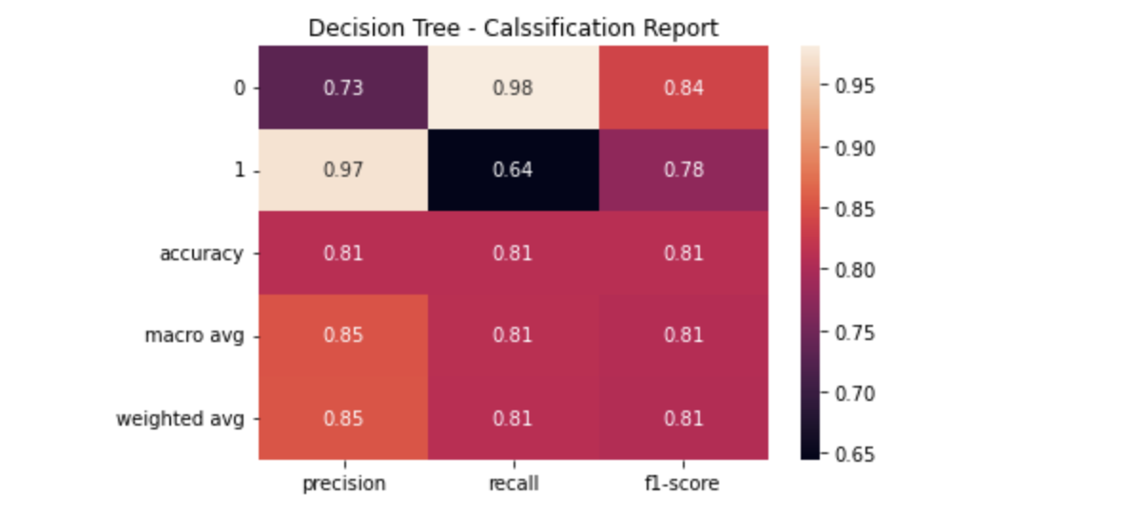
Decision Tree Model
We have used the Decision Tree Classification model from the sklearn library and trained the model with a max depth of 5. We used the model on the test data and predicted the result.
The decision tree has an accuracy of almost 81.3 % on predicting the result based on the test data, when compared to the actual data.
We Observed that the URL Length was the most important feature for classification.

Slide 7
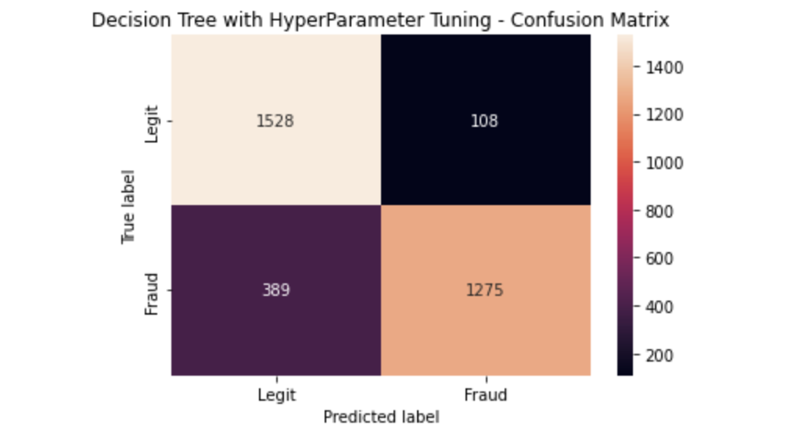
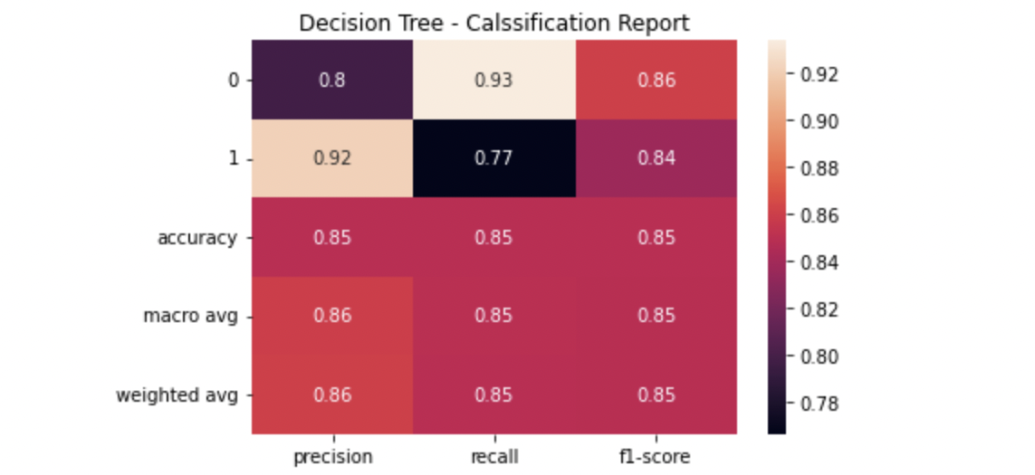
Decision Tree Model With Hyper Parameter Tuning
Parameters used are 'max_depth': [2, 3, 5, 10, 20],'min_samples_leaf': [5, 10, 20, 50, 100], 'criterion': ["gini", "entropy"].
Generated the best estimator model out of the given parameters.
The decision tree with hyper parameter tuning has an accuracy of 84.93 % on predicting the result based on the test data.

Slide 8
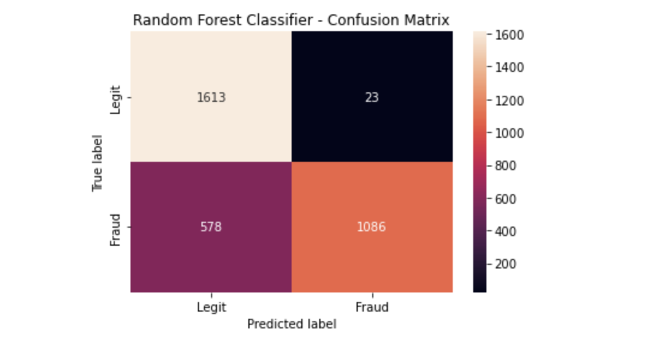
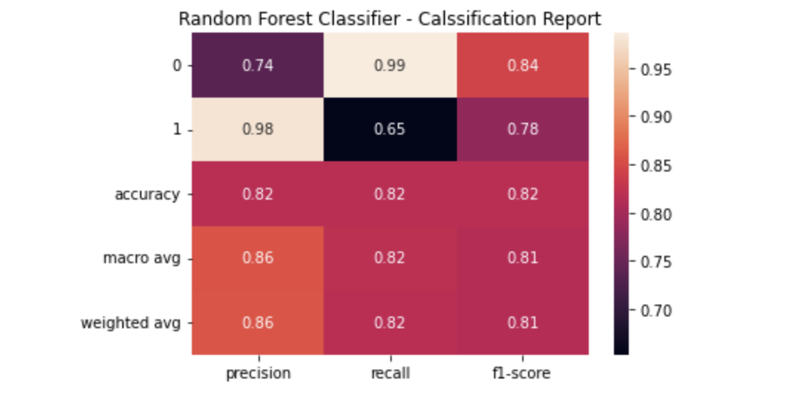
Random Forest Classification
We have used the Random Forest Classification model from the sklearn library and trained the model with a max depth of 5. We used the model on the test data and predicted the result.
The Random Forest Classification has an accuracy of almost 81.5 % on predicting the result based on the test data, when compared to the actual data.
We can also observe that the URL Length was the most important feature for classification.

Slide 9
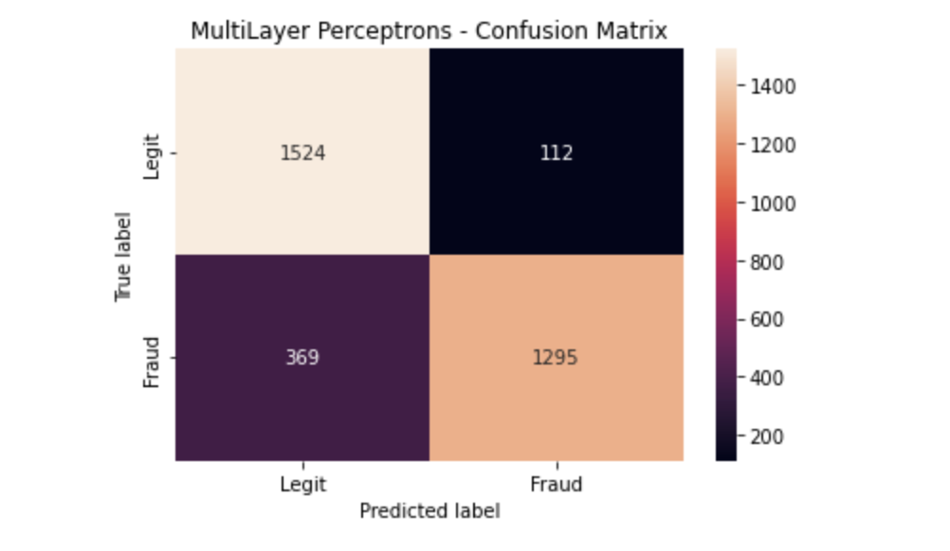
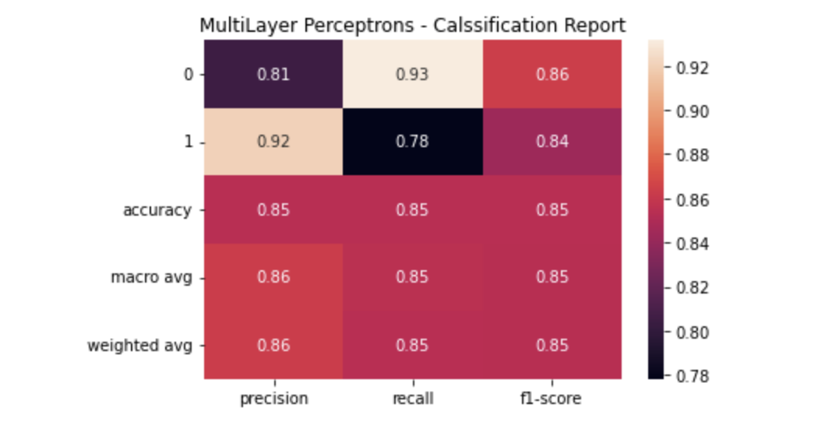
Multilayer Perceptron’s (MLP)
MLPClassifier relies on an underlying Neural Network to perform the task of classification.
We have used the multilayer perceptron artificial neural network from the sklearn.neural_network and we have used the MLP Classifier to classify the urls into legitimate and phishing by training the model and then predicting the result of the test data.
The accuracy of the model was found to be 85.1% better than both the decision tree and the random forest classification models.

Slide 10
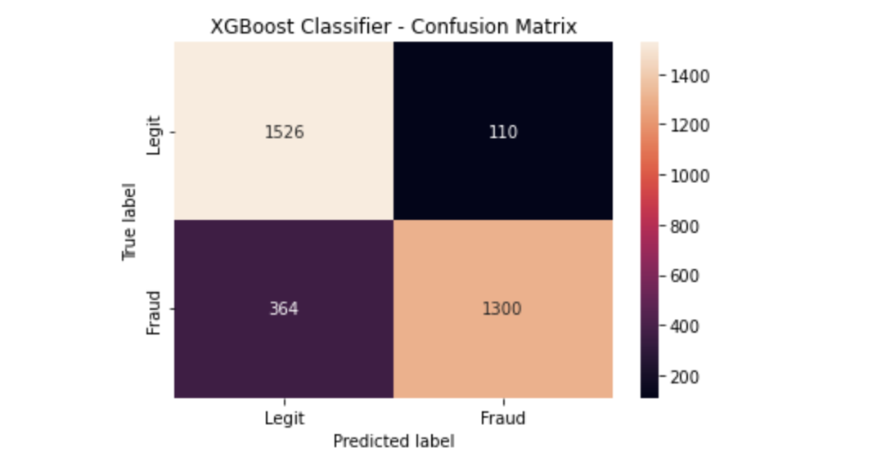
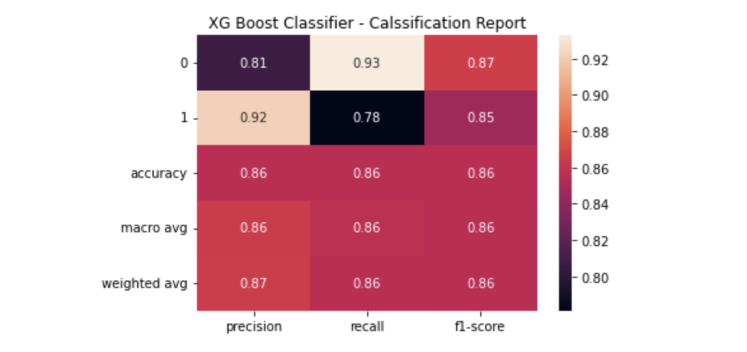
XGBoost Classifier
XGBoost is a decision-tree-based ensemble Machine Learning algorithm that uses a gradient boosting framework. In prediction problems involving unstructured data (images, text, etc.) artificial neural networks tend to outperform all other algorithms or frameworks.
We have used the XGBoost Classifier from the xgboost library to classify the data. We have set the max depth as 7 and the learning rate as 0.4.
The model was trained using the test data and the result predicted for the test data had an accuracy of 85.2 % which was better than that of the above-mentioned classifiers.

Slide 11
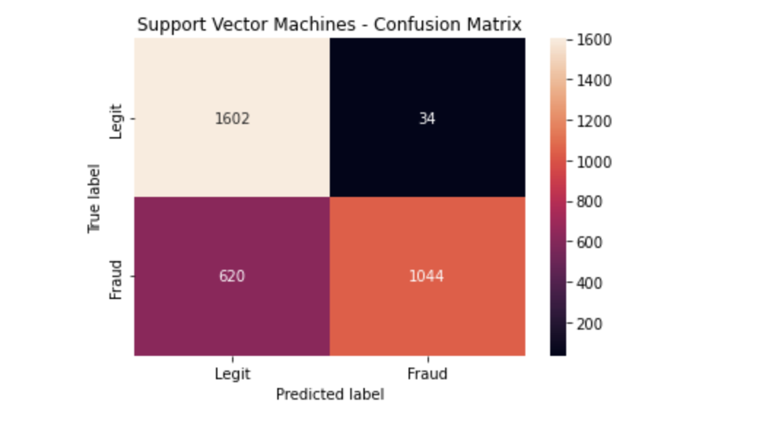

Support Vector Machines (SVM)
SVM is a supervised machine learning algorithm which can be used for classification or regression problems. It uses a technique called the kernel trick to transform your data and then based on these transformations it finds an optimal boundary between the possible outputs.
We have used the support vector machine model from the sklearn library to classify the data into phishing or legitimate.
The support vector classifier with a linear kernel had an accuracy of 80% which is lesser than all the remaining classifiers.

Slide 12
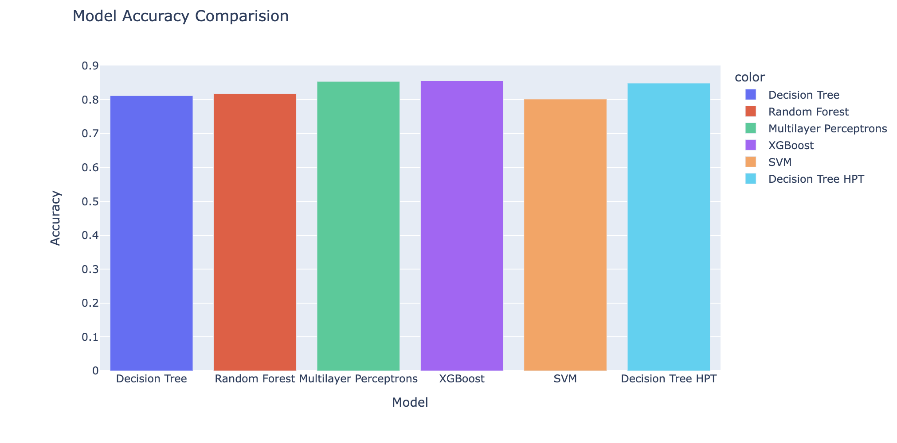
Results

Slide 13

THANK YOU

