Slide 1


CS6611 – Creative and Innovative Project
Real-Time Threat Identification and Alert System using CCTV Footage
DEPARTMENT OF COMPUTER SCIENCE AND ENGINEERING
COLLEGE OF ENGINEERING, GUINDY
ANNA UNIVERSITY, CHENNAI – 25.

Slide 2
TEAM MEMBERS
SHARUKESH K 2022103017
RAJESH KUMAR C 2022103513
DAKSHINESH M 2022103514
RAGUL KAILASH M 2022103536

Slide 3
PROBLEM STATEMENT
With the increasing need for public safety and security, real-time threat detection in surveillance systems is crucial.
Continuous human surveillance of CCTV footage is prone to fatigue, oversight, and delayed response times, making it unreliable for real-time threat detection.
The inability to detect violent activities promptly can lead to escalated conflicts, injuries, and safety hazards in public and private spaces.
A scalable and intelligent system is required to automatically detect violent behaviors, reducing reliance on manual monitoring and ensuring faster intervention.

Slide 4
OBJECTIVES
Real-Time Analysis of CCTV Feeds – Continuously monitor live surveillance footage to identify potential threats.
Automated Detection of Violent Activities – Accurately recognize aggressive behaviors and physical altercations using machine learning.
Implement a Real-Time Alert System – Instantly notify the nearest police control room upon detecting a violent incident.
Provide Critical Incident Details – Include key information such as the type of incident, a snapshot, location, and timestamp to ensure a swift response.

Slide 5

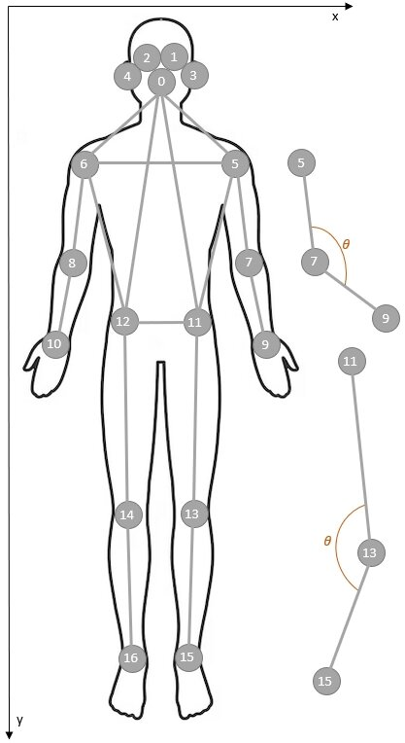

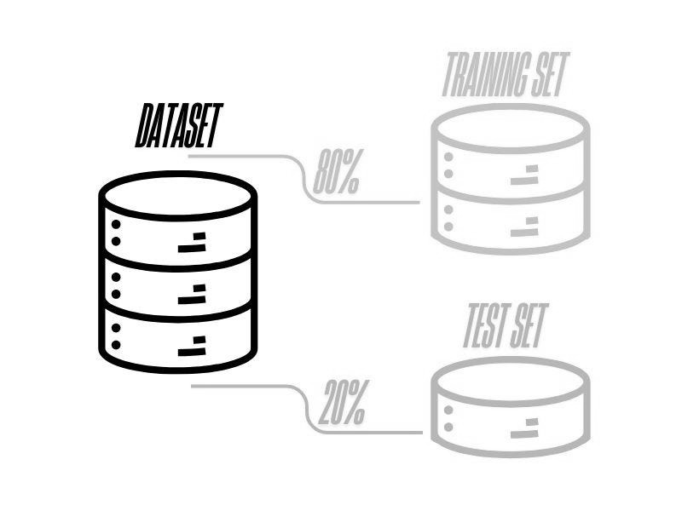


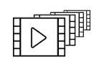
BLOCK DIAGRAM
CCTV video dataset
Labelling
Yolo v11
Labelling
Frame Extraction
Pose Key points Detection
Velocity Features Computation
Per Sequence Normalization
Train Test Split
Data Preprocessing
Labelling
Labelling
Model Initialization
Model
Compilation
Model Training
Model Evaluation
Metrics Calculation
Model Architecture
Untrained Model + Optimiser + Loss fn. + Eval. Metrics
Trainable Model + Pre-processed Data
Trained Model
Test Dataset + Trained Model
Model Predictions
Metrics and Scores
Model Training
Model Testing

Slide 6
MODEL ARCHITECTURE
Labelling
Input Layer
Positional Encoding
Vision Transformer
BiLSTM
layer
Fully Connected Layer
Position-enhanced Key Points
Temporal Dependencies Captured Features
Key Point
Sequences
Embedded
key Points
Context-aware
Motion Features
Score

Slide 7




BLOCK DIAGRAM (contd)
Labelling
Capture Live Video Feed
Pose Estimation
Trained
ViT+BiLSTM Model
Threshold Based Classification
Violence
or
Normal
CCTV Stream/ Webcam
Extracted Video Frames
Key Points
Frame-wise Classification
Sequence-wise Classification
Real-Time Detection
Labelling
Snapshot, Timestamp
Capture Incident Details
Alert Trigger
Find Nearest Police Control Room
Send Alert via Mail
Current Location
Mail Address
Alert System

Slide 8
BASE PAPER
Summary:
The base paper proposes an AI-powered threat detection system that identifies violent activities using weapon detection (guns, knives, etc.) via YOLOv5.
It employs person tracking and CNN with ST-GCN for action recognition, focusing primarily on weapon-based violence detection.
Alerts are triggered when weapons are detected, and incidents are monitored through a web-based dashboard.
While effective, it cannot detect violence without visible weapons.
“Hawk-Eye: An AI-Powered Threat Detector for Intelligent Surveillance Cameras”, IEEE ACCESS, Ahmed Abdelmoamen Ahmed , (Member, IEEE), and Mathias Echi, Department of Computer Science, Prairie View A&M University, Prairie View, TX 77446, USA

Slide 9

DATASET

Slide 10
NEW CONTRIBUTION
Model Architecture Improvement:
Replacing CNN with BiLSTM (Bidirectional Long Short-Term Memory) to better capture temporal dependencies in human actions.
Integrating Vision Transformer (ViT) layers with BiLSTM for improved feature extraction and classification.
Behavior and Threshold-Based Classification Enhancement:
While the base paper only detects violence through weapons, we integrate pose-based behavior recognition to identify violent actions.
Instead of classifying each frame individually, we accumulate classifications over a sequence of frames and apply a voting mechanism to minimize false positives.
Enhanced Alert System:
Once a violent activity is confirmed, we send an alert to the nearest police control room.
The alert includes:
Snapshot of the incident.
Timestamp of the event.
Current location extracted from the surveillance system.

Slide 11
MODULE SEGMENTATION
1. Data Preprocessing
Objective:
Prepare the raw video frames by extracting relevant features to make them suitable for training the violence detection model.
Components Used:
OpenCV (Frame extraction & image processing)
Ultralytics YOLO Pose Model (Keypoint detection)
NumPy (Feature computation & normalization)

Slide 12
1. Data Preprocessing (contd)
Implementation:
Labeling: For annotating data as Violent or Normal
Frame Extraction: Extract frames from CCTV footage using OpenCV.
Pose Estimation: Use the YOLO pose model to detect 17 key points for each person in the frame.
Feature Engineering: Compute velocity features based on the movement of key points.
Normalization: Normalize key points and velocity features to maintain consistency.
Dataset Preparation: Store labeled frames (Violent/Normal) for training and testing.

Slide 13
MODULE SEGMENTATION
2. Model Training
Objective:
Train a deep learning model that can classify video sequences as Violent or Normal based on extracted pose features.
Components Used:
TensorFlow/Keras (Model Development)
ViT (Vision Transformer) for feature extraction
BiLSTM (Bidirectional LSTM) for sequential learning
AdamW Optimizer for efficient training

Slide 14
2. Model Training (contd)
Implementation:
Model Architecture:
ViT (Vision Transformer) extracts spatial features.
BiLSTM learns temporal relationships in sequences.
Dense Layer classifies the frame sequence as Violent or Normal.
Loss Function & Optimization:
Binary Cross-Entropy for classification.
AdamW Optimizer for efficient weight updates.
Training Process:
Input: Sequences of pose key points & velocity features.
Training on preprocessed dataset using epochs and mini-batches.
Save trained weights for deployment.

Slide 15
MODULE SEGMENTATION
3. Model Testing
Objective:
Evaluate the trained model on test data to measure accuracy, detect errors, and fine-tune performance.
Components Used:
Trained ViT + BiLSTM Model
Evaluation Metrics (Accuracy, Precision, Recall, F1-Score, False Alarm Rate)

Slide 16
3. Model Testing (contd)
Implementation:
Load Trained Model: Use the trained model for predictions on test data
Evaluation Metrics: Compute:
Accuracy: Measures overall correctness.
Precision & Recall: Determines detection performance.
F1-Score: Balance between precision and recall.
False Alarm Rate (FAR): The proportion of normal frames misclassified as violent.
3. Error Analysis: Identify misclassified frames and adjust thresholds if needed.

Slide 17
MODULE SEGMENTATION
4. Real-Time Detection
Objective:
Continuously analyze live CCTV footage and classify frames as Violent or Normal in real time.
Components Used:
OpenCV (Live Video Capture)
YOLO Pose Model (Keypoint Extraction)
Trained ViT+BiLSTM Model (Classification)
Threshold-based Aggregation for Sequence Classification

Slide 18
4. Real-Time Detection (contd)
Implementation:
Video Feed: Capture live footage using OpenCV.
Pose Estimation: Extract 17 key points per person using YOLO Pose Model.
Feature Extraction: Compute key point velocities for motion analysis.
Frame Classification:
Feed extracted features into ViT + BiLSTM Model.
Classify each frame as Violent or Normal.
5. Threshold-Based Sequence Classification:
If a threshold of consecutive violent frames is exceeded → Classify as Violence.
Else → Classify as Normal.

Slide 19
MODULE SEGMENTATION
5. Alert System
Objective:
If violence is detected, alert the nearest police control room with incident details.
Components Used:
SQLite (Database for storing control room locations)
Geolocation API (Retrieve current location)
Email SMTP (Send alert email)

Slide 20
5. Alert System (contd)
Implementation:
Trigger Alert: If threshold-based classification confirms violence, initiate an alert.
Get Current Location: Retrieve the GPS location of the CCTV camera.
Find Nearest Police Control Room: Query SQLite database to find the closest station.
Prepare Alert Data:
Snapshot of the incident frame
Timestamp of detection
CCTV location
5. Send Alert:
Format alert details and send via SMTP email.
Notify police for immediate response.

Slide 21




PERFORMANCE METRICS
1. Accuracy – Measures overall correctness but may be misleading for imbalanced data.
2. Precision – Proportion of correctly classified violent frames out of all classified as violent. High precision reduces false alarms.
3. Recall – Proportion of actual violent frames correctly detected. High recall ensures fewer violent incidents are missed.
4. F1-Score – Harmonic mean of precision and recall. Balances false positives and false negatives.
.

Slide 22

PERFORMANCE METRICS (contd)
5. False Alarm Rate – Proportion of normal frames misclassified as violent. Lower FAR means fewer unnecessary alerts.
(TP, FP, FN, TN are obtained from Confusion matrix.)
6. ROC Curve & AUC Score
ROC Curve plots True Positive Rate vs. False Positive Rate.
AUC quantifies overall model performance.
Higher AUC indicates better discrimination between violent and normal frames.

Slide 23
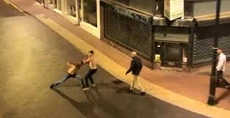
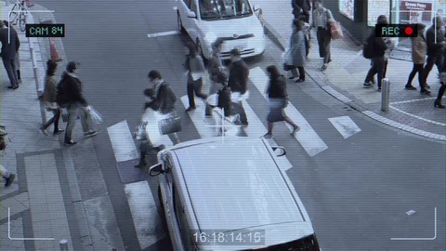
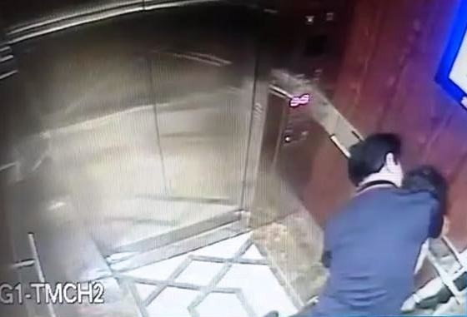
TEST CASES
Test Case Description | Input | Expected Output
Two People fighting in the street |  | Classified as threat and an alert is sent.
A guy abusing a girl |  | Classified as threat and an alert is sent.

Slide 24

TEST CASES (contd)
Test Case Description | Input | Expected Output
People walking in the street |  | Classified as normal and no alert is sent.
People crossing the road at zebra crossing |  | Classified as normal and no alert is sent.

