Slide 1
Data Structures with Javascript
Rajesh Kumar
Notes:
Hi , I am Rajesh Kumar, a software engineer at Uber. Today I am going to talk about using data structures with Javascript.

Slide 2


Why Data Structures
Notes:
I have talked to lot of front end engineers, and many of them have asked do we really need Data Structure knowledge for the front end development. Javascript is now used as backend language(Node), and for visualization (D3). Understanding of data structures is necessary to write efficient programs. And making sure that your applications are efficient and very responsive.

Slide 3
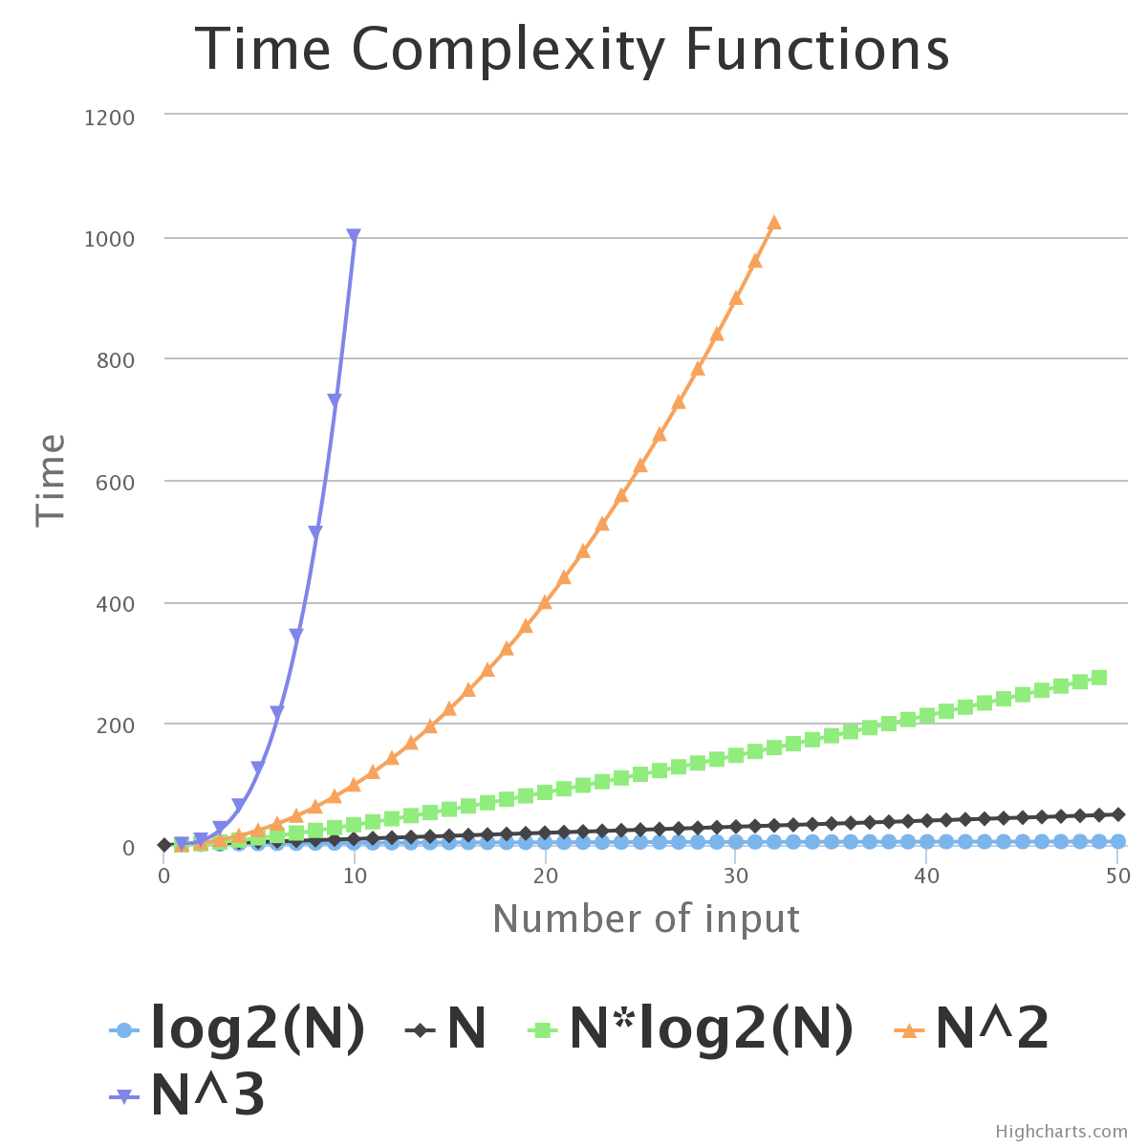
Notes:
If there is one thing which you could take from this talk is this slide, if you understand this I would be satisfied that I have done my job today.

Slide 4
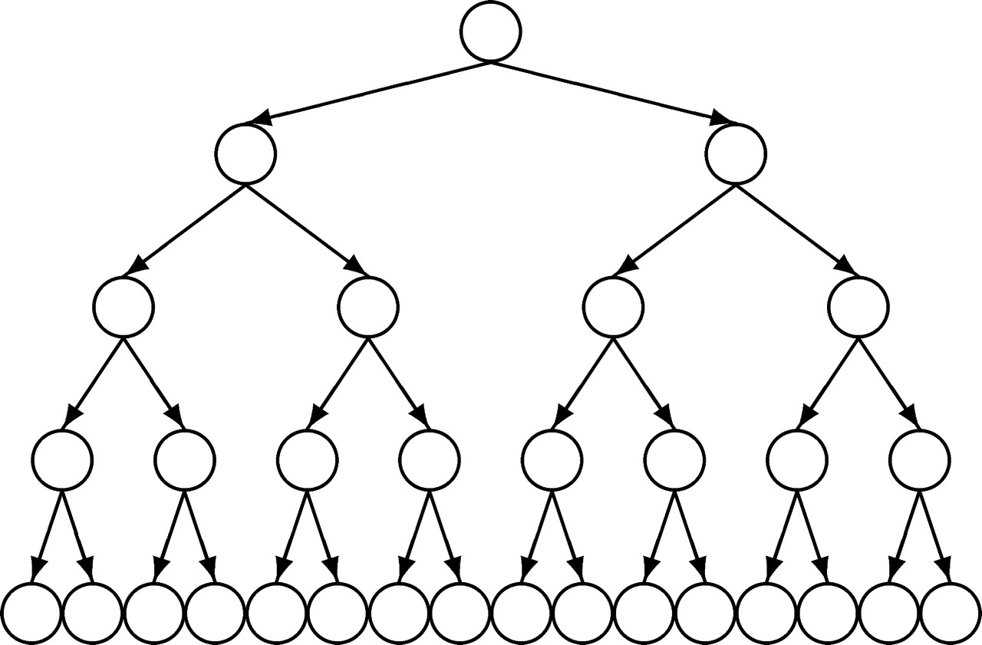
Log(n)

Slide 5
Outline
Basic Data Structures
Advanced Data Structures
Resources
Sample Problems

Slide 6
Array
var myArr = []
myArr[0] = "hi"
myArr[1] = "there"
var myArr1 = new Array(40, 100)
print(myArr1.length)
var myArr2 = new Array(40)
print(myArr2.length)
Notes:
Let us start with Array, Array is most simple and widely used data structure. It is very simple to use as well, We can initialize the array in two ways as shown here.

Slide 7
Array
Length
var myArray = [];
print(myArray.length);
myArray[100] = true;
print(myArray.length);
Notes:
0
101

Slide 8
Enumeration of Array
for in does not guarantee order of properties
var myArray = [];
myArray[1000] = 1000;
myArray[0] = 0;
for(var i in myArray) {
print("index " + i + "=" + myArray[i]);
}
Notes:
index 0=0
index 1000=1000, can print in order of insertion

Slide 9
Enumeration of Array
var myArray = [];
myArray[1000] = 1000;
myArray[0] = 0;
for(var i = 0; i < myArray.length; i += 1) {
print(myArray[i])
}
Notes:
Iterates till the index last inserted + 1
0
undefined
undefined
…
1000

Slide 10
Multi Dimensional Arrays
function matrix(m, n, initial) {
var i, j, a, mat = [];
for(i = 0; i < m; i += 1) {
a = []
for(j = 0; j < n; j += 1) {
a[j] = initial;
}
mat[i] = a;
}
return mat;
}

Slide 11
Multi Dimensional Array
var mat4_3 = matrix(4, 3, 0);
mat4_3[2][1] = 4;
print(mat4_3);
Notes:
0,0,0,
0,0,0,
0,4,0,
0,0,0

Slide 12
Map
Which state is a city in
Array vs Map
Constant time lookup
WA
seattle
portland
OR
var map = {}
map["san_francisco"] = "CA"
map["seattle"] = "WA"
map["portland"] = "OR"
for(var key in map) {
print("key="+ key + " value=" + map[key])
}
Notes:
key=san_francisco value=CA
key=seattle value=WA
key=portland value=OR

Slide 13
Map
Limitation
Keys are strings
ECMAScript6 has native support
Not supported by all browsers
https://developer.mozilla.org/en-US/docs/Web/JavaScript/Reference/Global_Objects/Map
WeakMap

Slide 14
Stack
Last in first out
var stack = [];
stack.push(1);
stack.push(2);
stack.push(3);
stack.push(4);
for(var i = 0 ; i < 4; i += 1) {
print(stack.pop())
}
4
3
2
1
Notes:
4
3
2
1

Slide 15
Queue
First In First Out
1
2
3
4
var queue = [];
queue.push(1);
queue.push(2);
queue.push(3);
queue.push(4);
for(var i = 0 ; i < 4; i += 1) {
print(queue.shift())
}
Notes:
1
2
3
4

Slide 16
Set
seattle
portland
San_francisco
var westCoastCities = {}
westCoastCities["san_francisco"] = true
westCoastCities["seattle"] = true
westCoastCities["portland"] = true
print(Object.keys(westCoastCities).length)
delete westCoastCities ["san_francisco"]
print(Object.keys(westCoastCities).length)
Notes:
3
2

Slide 17
Set
ECMAScript6 has native support
Not supported by all browsers
WeakSet
https://developer.mozilla.org/en-US/docs/Web/JavaScript/Reference/Global_Objects/Set

Slide 18
Basic Data Structures Summary
 | Insertion | Deletion | Search
Array | O(1) | O(1) | ?
Map | O(1) | O(1) | ?
Stack | O(1) | O(1) | O(n)
Queue | O(1) | O(1) | O(n)
Set | O(1) | O(1) | O(1)

Slide 19
Outline
Basic Data Structures
Advanced Data Structures
Resources
Sample Problems

Slide 20
Binary Tree
10
80
29
19
28
1
Notes:
Binary tree has a simple structure

Slide 21
Binary Search Tree
10
8
14
3
9
13
16
Notes:
Binary search
Time complexity

Slide 22
Binary Search Tree
Inorder traversal
Left, root, right
10
8
14
3
9
13
16
Notes:
Inorder traversal

Slide 23
Binary Heap
3
8
9
10
14
13
16
Notes:
Heap Property
Finding smallest element
Removing smallest element – reheapify
Time complexity
Inserting
Priority Queue – implemented as binary heap

Slide 24
Remove Element : Reheapify
3
8
9
10
14
13
16

Slide 25
Reheapify
8
9
10
14
13
16

Slide 26
Reheapify
8
10
9
14
13
16

Slide 27
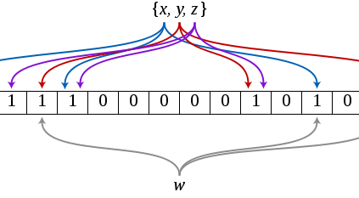
Bloom Filters

Slide 28
Advanced Data Structures Summary
 | Insertion | Deletion | Search | Find Smallest
Binary Tree | O(log n) | O(1) | O(n) | O(n)
Binary Search Tree | O(log n) | O(n) | ? | O(log n)
Heap | O(log n) | O(log n) | ? | O(1)
Bloom Filter | O(1) | Not supported | O(1) | Not supported

Slide 29
Outline
Basic Data Structures
Advanced Data Structures
Resources
Sample Problems

Slide 30
Implementations
https://github.com/mauriciosantos/buckets/
https://github.com/felipernb/algorithms.js
https://github.com/montagejs/collections
https://github.com/monmohan/dsjslib

Slide 31
Image Credits
http://cs.anu.edu.au/~bdm/tree.png
http://comjnl.oxfordjournals.org/content/51/2/216/F1.large.jpg
http://en.wikipedia.org/wiki/Bloom_filter#mediaviewer/File:Bloom_filter.svg

Slide 32
References
Javascript : The Good Parts
http://blog.caplin.com/2012/01/13/javascript-is-hard-part-1-you-cant-trust-arrays/
https://www.coursera.org/course/algo
https://www.udemy.com/computer-sc-data-structures-and-algorithms/#/
http://www.comp.nus.edu.sg/~stevenha/visualization/index.html
https://github.com/mauriciosantos/buckets/
https://developer.mozilla.org/en-US/docs/Web/JavaScript/Reference/Global_Objects/Set
http://kangax.github.io/compat-table/es6/

Slide 33
Outline
Basic Data Structures
Advanced Data Structures
Resources
Sample Problems

Slide 34
Sample Problems
Given an array of size n, find if there are any duplicate elements
Notes:
What data structure can I apply – Map, Set, BST, Heap, Stack. Queue?
Set
Space Complexity
Time Complexity - Array – will sorting help?

Slide 35
Sample Problems
Given two arrays – Find smallest common element

Slide 36
Sample Problems
Reverse a sentence
I am solving a problem
problem a solving am I
Notes:
Stack
Time complexity

Slide 37
Sample Problems
For a given book, find the k most occurring words
Find the count of all words
Find the k most occurring
Notes:
Map
Then sort by value

Slide 38
Sample Problems
Given a stream of integers, find k smallest integers
Notes:
Heap

Slide 39
Thanks!
http://alumni.cs.ucsb.edu/~rajesh/js_talk.pptx
https://github.com/rajeshcs/jstalk
rajesh@uber.com

