Slide 1
Data Structures with Javascript
Rajesh Kumar

Slide 2


Why Data Structures
Notes:
Javascript is now used as backend language(Node), and for visualization (D3). Understanding of data structures is necessary to write efficient programs

Slide 3
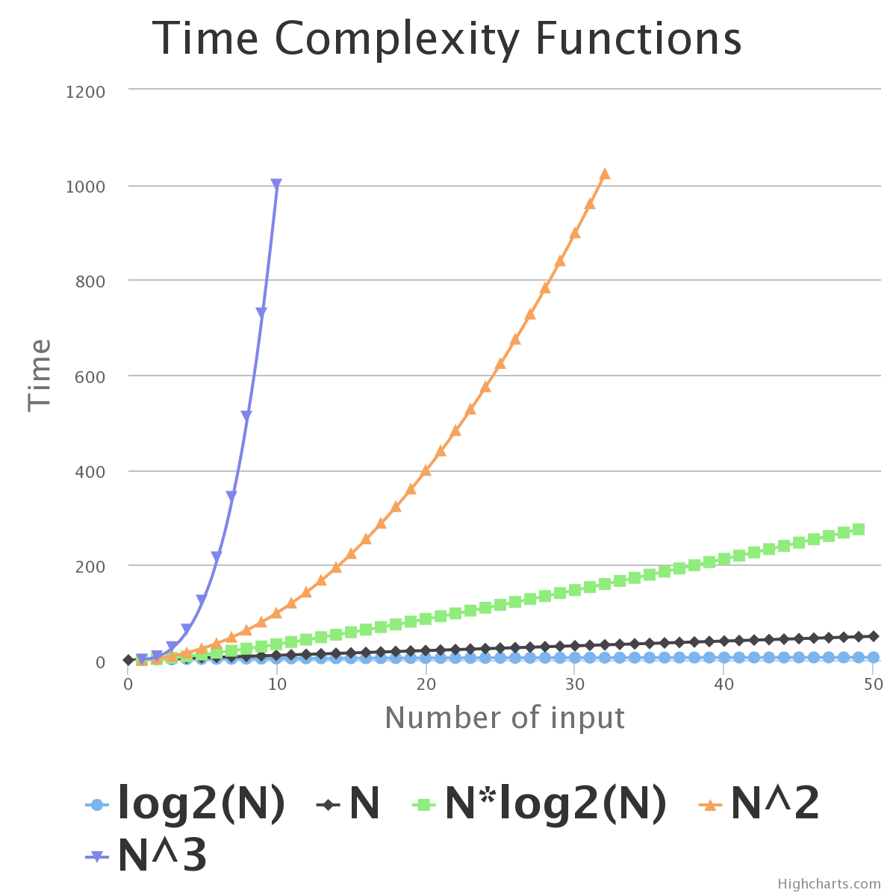

Slide 4
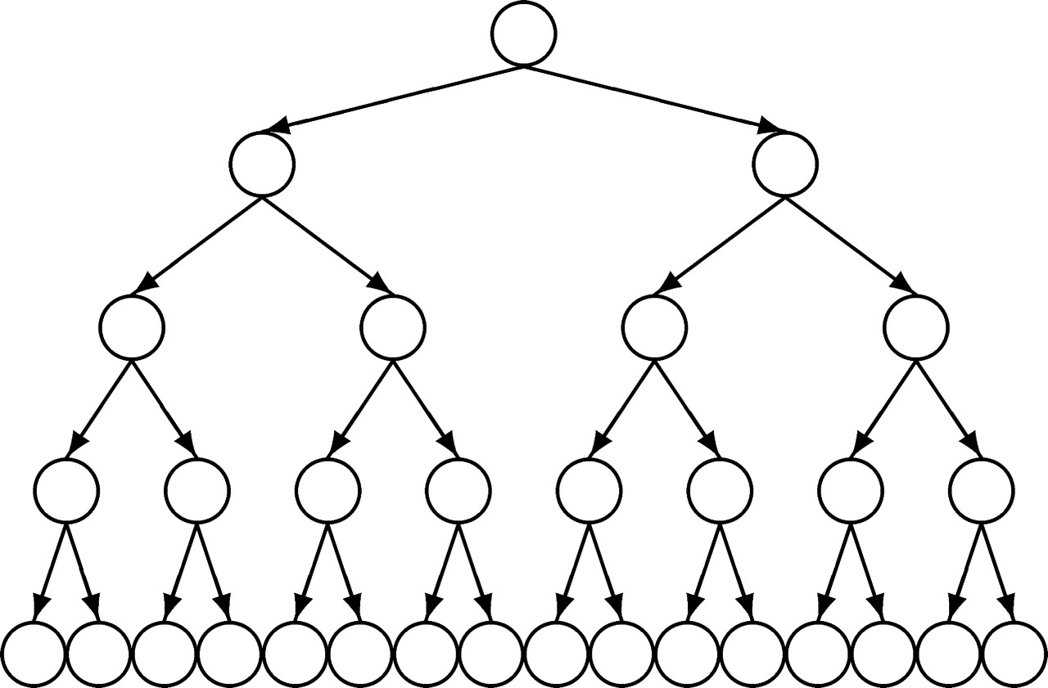
Log(n)

Slide 5
Array in Javascript
Length
var myArray = [];
print(myArray.length);
myArray[100] = true;
print(myArray.length);
Notes:
0
101

Slide 6
Enumeration of Array
for in does not guarantee order of properties
var myArray = [];
myArray[1000] = 1000;
myArray[0] = 0;
for(var i in myArray) {
print("index " + i + "=" + myArray[i]);
}
Notes:
index 0=0
index 1000=1000

Slide 7
Enumeration of Array ..
var myArray = [];
myArray[1000] = 1000;
myArray[0] = 0;
for(var i = 0; i < myArray.length; i += 1) {
print(myArray[i])
}
Notes:
0
undefined
undefined
…
1000

Slide 8
Multi Dimensional Arrays
function matrix(m, n, initial) {
var i, j, a, mat = [];
for(i = 0; i < m; i += 1) {
a = []
for(j = 0; j < n; j += 1) {
a[j] = initial;
}
mat[i] = a;
}
return mat;
}

Slide 9
Multi Dimensional Array ..
var mat4_3 = matrix(4, 3, 0);
mat4_3[2][1] = 4;
print(mat4_3);

Slide 10
Map
Which state is a city in
Array vs Map
Constant time lookup
WA
seattle
portland
OR
var map = {}
map["san_francisco"] = "CA"
map["seattle"] = "WA"
map["portland"] = "OR"
for(var key in map) {
print("key="+ key + " value=" + map[key])
}
Notes:
key=san_francisco value=CA
key=seattle value=WA
key=portland value=OR

Slide 11
Map ...
ECMAScript6 has native support
Not supported by all browsers
https://developer.mozilla.org/en-US/docs/Web/JavaScript/Reference/Global_Objects/Map

Slide 12
Stack
Last in first out
var stack = [];
stack.push(1);
stack.push(2);
stack.push(3);
stack.push(4);
for(var i = 0 ; i < 4; i += 1) {
print(stack.pop())
}
4
3
2
1
Notes:
4
3
2
1

Slide 13
Queue
First In First Out
1
2
3
4
var queue = [];
queue.push(1);
queue.push(2);
queue.push(3);
queue.push(4);
for(var i = 0 ; i < 4; i += 1) {
print(queue.shift())
}
Notes:
1
2
3
4

Slide 14
Set
seattle
portland
San_francisco
var westCoastCities = {}
westCoastCities["san_francisco"] = true
westCoastCities["seattle"] = true
westCoastCities["portland"] = true
print(Object.keys(westCoastCities).length)
delete westCoastCities ["san_francisco"]
print(Object.keys(westCoastCities).length)
Notes:
3
2

Slide 15
Set ..
ECMAScript6 has native support
Not supported by all browsers
https://developer.mozilla.org/en-US/docs/Web/JavaScript/Reference/Global_Objects/Set

Slide 16
Binary Tree
10
80
29
19
28
1

Slide 17
Binary Search Tree
10
8
14
3
9
13
16
Notes:
Inorder traversal
Binary search
Time complexity

Slide 18
Binary Heap
3
8
9
10
14
13
16
Notes:
Heap Property
Finding smallest element
Removing smallest element – reheapify
Time complexity
Inserting
Priority Queue – implemented as binary heap

Slide 19
Implementations
https://github.com/mauriciosantos/buckets/
https://github.com/felipernb/algorithms.js

Slide 20
Image Credits
http://cs.anu.edu.au/~bdm/tree.png
http://comjnl.oxfordjournals.org/content/51/2/216/F1.large.jpg

Slide 21
References
Javascript : The Good Parts
http://blog.caplin.com/2012/01/13/javascript-is-hard-part-1-you-cant-trust-arrays/
https://www.coursera.org/course/algo
https://www.udemy.com/computer-sc-data-structures-and-algorithms/#/
http://www.comp.nus.edu.sg/~stevenha/visualization/index.html
https://github.com/mauriciosantos/buckets/
https://developer.mozilla.org/en-US/docs/Web/JavaScript/Reference/Global_Objects/Set

