Slide 1
Domain Driven Design Demo

Slide 2
Introduction
Anemic Data Model
Domain Driven Design(DDD)
DDD Layers
Application
Domain
Infrastructure
Interfaces
Building Blocks
Bounded Context
Ubiquitous Language
Entity
Value Objects
Aggregates
Services
Repositories
Factories

Slide 3
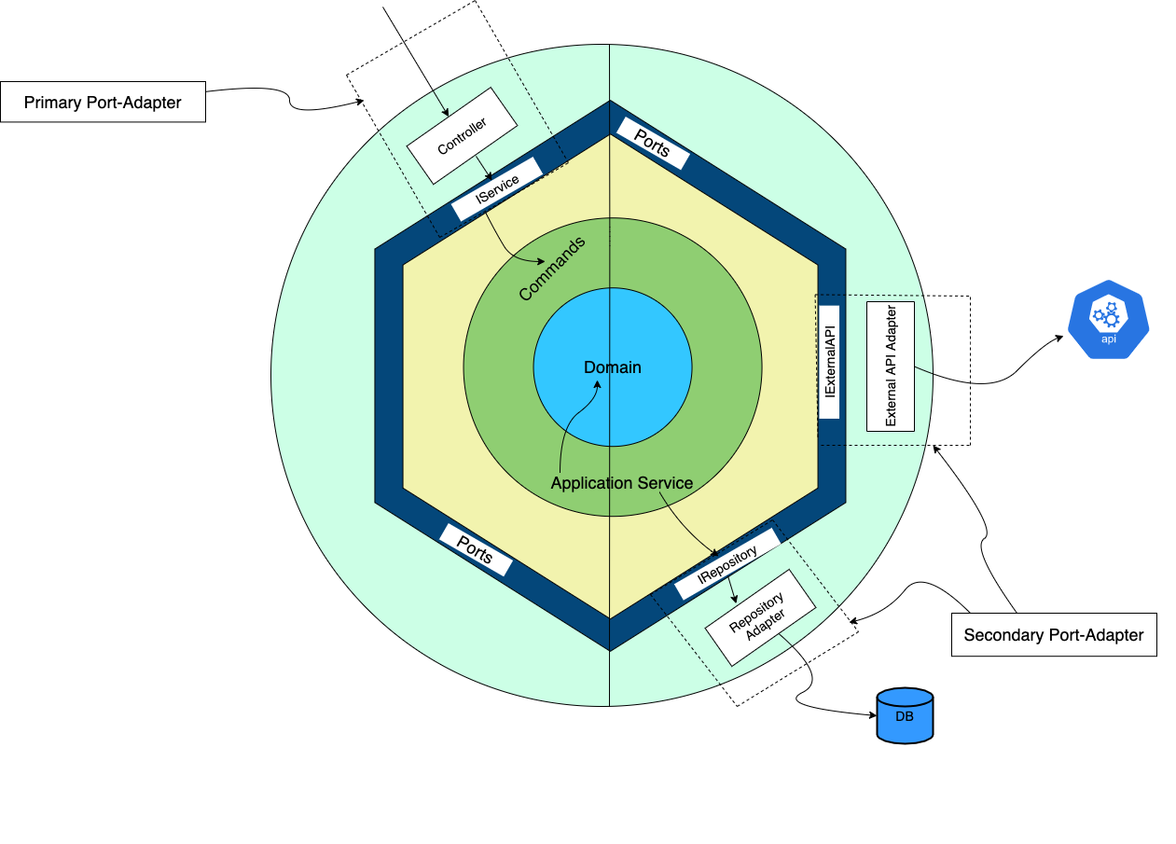
Architecture
Design Patterns
Ports-Adapters Pattern
Aggregate Pattern
Factory Pattern
Anti-Corruption Layer Pattern
Command Pattern

Slide 4
Understand :
Entity vs Value Objects
Aggregate vs Aggregate Root
Application Service vs Domain Service
Primary Port-Adapter vs Secondary Port-Adapters
Pros:
Uses patterns and principles for solving difficult problems in software and it helps in improving communication
Helps in writing a testable and clear code that represents the domain
Cons:
Additional effort required to adopt this software development approach
Requires domain expertise

Slide 5
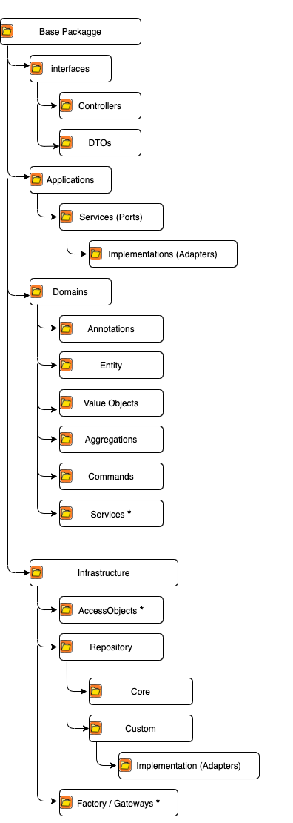
Folder Structure

Slide 6
Q&A
(Liked ? Implement : Ignore)

Slide 7
References
https://github.com/citerus/dddsample-core/tree/master/src/main/java/se/citerus/dddsample
https://martinfowler.com/bliki/DDD_Aggregate.html
https://www.martinfowler.com/bliki/AnemicDomainModel.html
https://martinfowler.com/bliki/UbiquitousLanguage.html
https://martinfowler.com/bliki/BoundedContext.html
https://docs.microsoft.com/en-us/dotnet/architecture/microservices/microservice-ddd-cqrs-patterns/ddd-oriented-microservice
https://docs.microsoft.com/en-us/azure/architecture/patterns/

