Slide 1

Interactive Quiz Application:
Name: DOPPA RAJESH
AF-ID: AF05221450
Batch Code: ANP-D3572
Presented by: Rajesh

Slide 2

Abstract:
The Interactive Quiz Application is a web-based front-end application designed to provide an engaging and user-friendly platform for online quizzes. The application allows users to register and log in, select quiz categories, answer multiple-choice questions, and receive instant results. It includes features such as a timer, progress bar, leaderboard, and performance charts to improve the learning experience. The application is developed using HTML, CSS, JavaScript, and Bootstrap, with Local Storage used to maintain user and quiz data. The responsive and interactive interface makes the application suitable for students and learners to test their knowledge, improve their skills, and track their performance.

Slide 3

Introduction:
The Interactive Quiz Application is a web-based platform developed to make learning and knowledge assessment more interactive, engaging, and user-friendly. It allows users to log in, select quiz categories, answer multiple-choice questions, and receive instant results.
The application provides features such as timed quizzes, progress tracking, score calculation, leaderboard rankings, performance charts, certificate generation, and dark mode. It is developed using HTML, CSS, JavaScript, and Bootstrap, with Local Storage used to maintain user and quiz information.
The main objective of the project is to provide a responsive and interactive learning environment where users can test their knowledge, identify their strengths and weaknesses, and improve their performance through repeated practice.

Slide 4
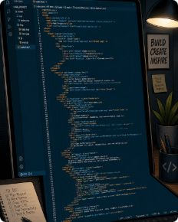


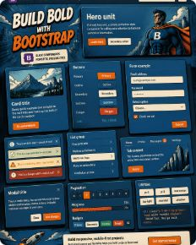
Technologies:
HTML
CSS
JavaScript
Bootstrap
Accessible, semantic structure that supports ARIA and progressive enhancement.
Responsive styling, Flexbox/Grid layouts and transitions for smooth UI behaviour.
Client-side logic, state management, and DOM updates for instant feedback and scoring.
Rapid, consistent UI components and utility classes to accelerate development.

Slide 5
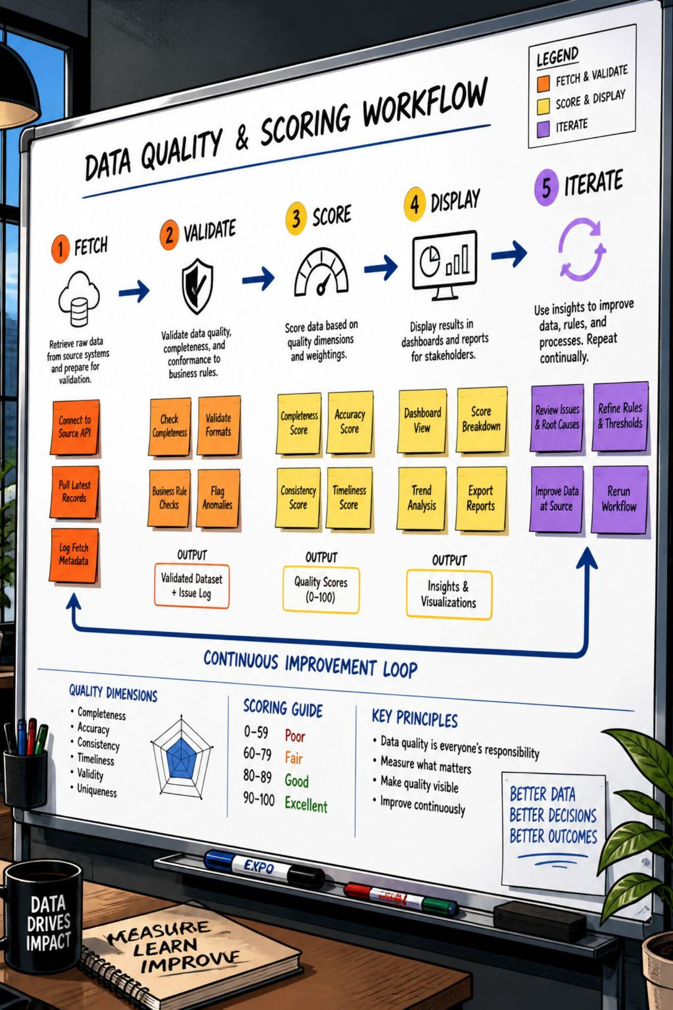
Workflow
The pipeline ensures fresh content and smooth interactions:
Dynamic fetching for varied question pools and categories
Client-side validation with immediate answer feedback
Real-time score calculation, progress tracking and end-of-quiz summary
Extensible hooks for custom question types and timed challenges

Slide 6
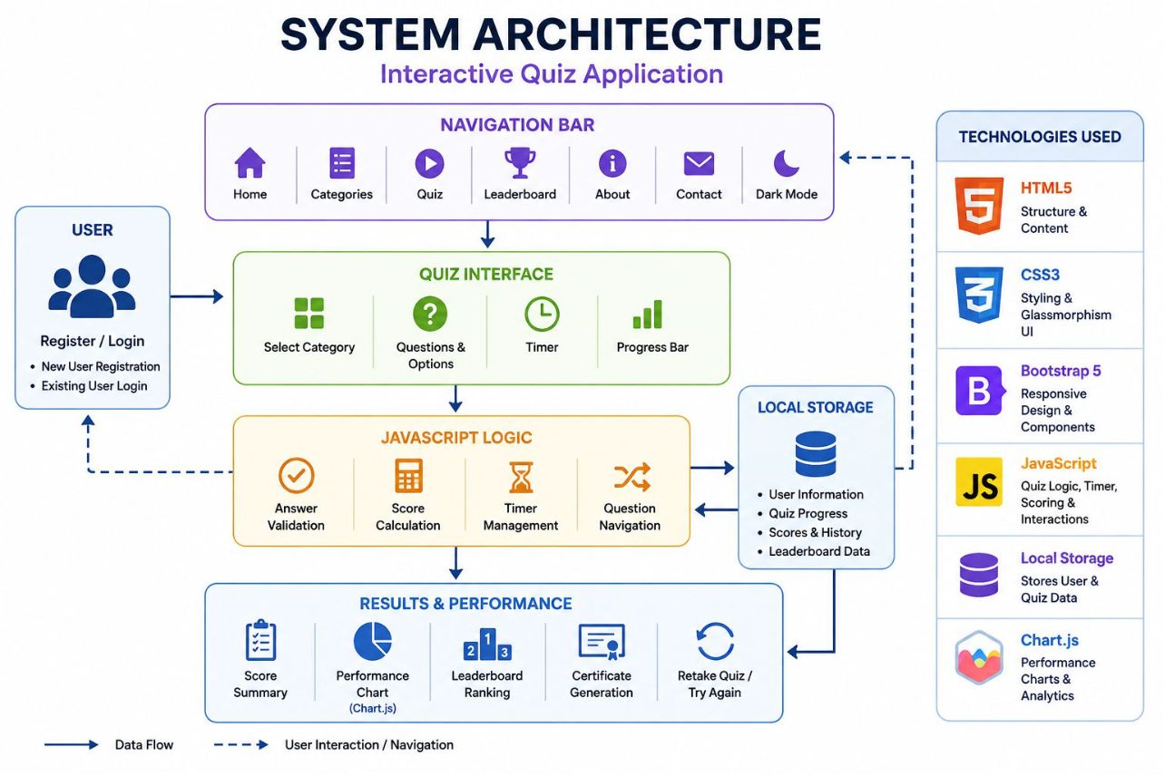
System Architecture
The user interacts with the responsive interface through the navigation bar. JavaScript manages quiz questions, answers, timer, progress and scoring. User information and scores are maintained using Local Storage. Finally, the application displays results, performance charts, leaderboard rankings and certificates

Slide 7

Thank You

