Slide 1
Practical Privacy-Preserving Content-Based Retrieval in Cloud Image Repositories
E . Rajesh (16TP1A0534)

Slide 2
ABSTRACT
Now a day’s visual data is responsible for one of the largest shares of global Internet traffic in both corporate and personal use scenarios.
The amount of images, graphics, and photos being generated and shared every day, especially through mobile devices, is growing at an ever increasing rate.
The storage needs for such large amounts of data in resource-constrained mobile devices has been a driving factor for data outsourcing services such as the ones leveraging Cloud Storage and computing solutions.
Such services (e.g. Instagram) have been reported to be among the largest growing internet services.

Slide 3
Scope of the Project
The scope of the project is retrieving the images from the repositories based on content search.
The repositories will maintain their unique keys and the images in the repositories also maintain their unique keys for the purpose of security.

Slide 4
REQUIREMENTS:
HARDWARE REQUIREMENTS
PROCESSOR : DUAL CORE
RAM : 4GB RAM
HARD DISK : 250 GB
SOFTWARE REQUIREMENTS
FRONT END : J2EE (JSP, SERVLET)
BACK END : MY SQL 5.5
OPERATING SYSTEM : WINDOWS 07
IDE : ECLIPSE

Slide 5
MODULES
User Interface
Repository Owner
Image Owner
Third party
Admin

Slide 6
1.User Interface:
First we are differentiating the users depending on access permissions. The following are the different type of user’s .
Repository Owner
Image Owner
Third party
Home
Page
Register
Database
Login verify
User
Login
Error/Login page
Access permissions
Third party
Repository owner
Image owner

Slide 7
2. Repository Owner:
Repository owner means he is creating the repository. And he had the key for that repository. If any want to add the images into his repository the user must need key.
Following are the operations for Repository owner.
Register.
Login.
Send repository creating request for admin.
Store repository key which he created.
Adding the images into repository.
Share key with other users.
Logout.

Slide 8
Logout
Repository Owner
Request
(Repository key/image key)
Response
(Repository key/image key)
Home page
Request to admin
Create
Repository
Add images
Key maintenance
Admin process

Slide 9
3. Image Owner:
Image owner will store the images into different repositories by getting the keys from that particular repository owner. And he had the keys of images which he stored.
Following are the operations for image owner.
Register.
Login.
View repositories.
Send Repository Key request for respected Repository owner.
Get the Repository Key from repository owner.
Upload images into repository.
Store the image keys which he uploaded.
Share image keys with different users.
Logout.

Slide 10
Image Owner
Home page
Repository List
Request
(Repository Key/Image Key)
Response
(Repository Key/Image Key)
Add Image to Repository
Key Maintenance
Logout

Slide 11
4. Third Party User:
The third party users have the permissions for searching the images and get images and he don’t have permission like add images.
Register.
Login.
Searching image by content based.
Select image.
Send image key request for image owner.
Get image key from respected owner.
View the image.
Download the image.
Create repository.
Logout.

Slide 12
Search with Content
Related Images
TPU
Home Page
Key request to image owner
Create Repository
Response
Download Image
Logout

Slide 13
5. Admin:
Admin have the following operations to do.
Login.
View repository requests.
Give response (Accept/decline) the repository request.
View repository keys.
View image keys.
He had his unique username and password apart from those he can’t be able to perform any operation why because he can’t get into his home page where these operations are maintained.

Slide 14
View image keys
Admin
Login
Home Page
View repository keys
Repository requests
Response
(Accept/delete)

Slide 15
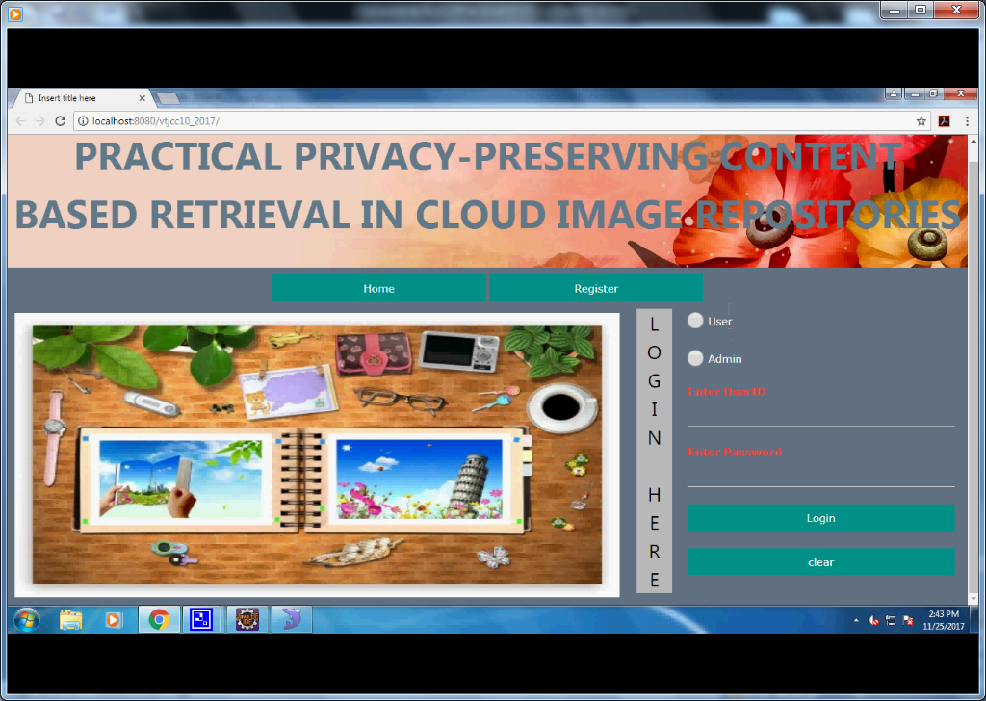
Registration Screenshot

Slide 16
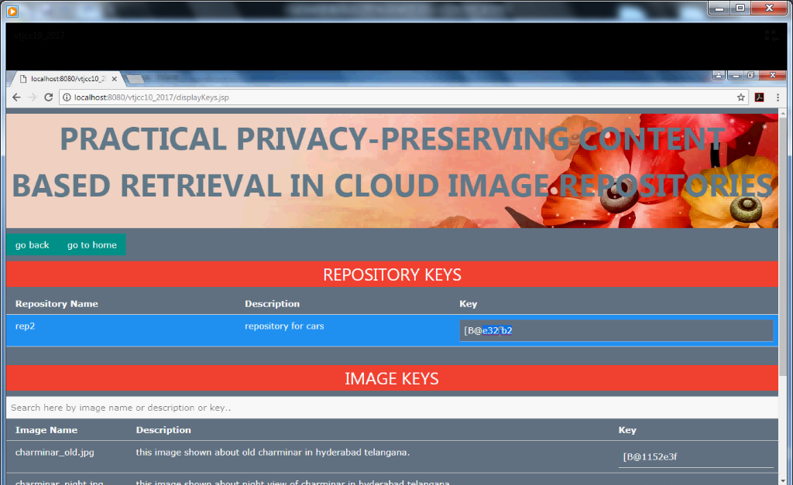
Repository , Image keys

Slide 17
EXISTING SYSTEM | PROPOSED SYSTEM
EXISTING CONCEPT:- Despite the fact that data outsourcing, Means that storage usability is increasing especially to cloud computing infrastructure. Privacy should not be expected to be provided by cloud providers. Furthermore, not securing leads to the access for unauthorized users | PROPOSED CONCEPT:- While the generations are increasing in the technology , the utilization of the storages are increased .so,it is developed in current developed system. Image based retrievals are also been improved in current systems . The algorithm we use is IES-CBIR.

Slide 18
EXISTING SYSTEM | PROPOSED SYSTEM
DRAWBACKS:- Malicious or simply careless system administrators working for the providers have full access to data on the hosting cloud machines. The risk of information leakage, a user should obtain authorization from the data owner for accessing the encrypted data. | ADVANTAGES:- Privacy preserving outsourced storage, search, and retrieval of large-scale, dynamically updated image repositories. To upload their endless data.
4.DRAWBACKS:- No provision of fixed resource capacity. No central resource manager Competing users | ADVANTAGES:- This model can predict capacity with 95 percent accuracy. Selecting a node that is likely to satisfy the given resource requirement. Scheduled process.

Slide 19
TEST CASES:
User Interface
Input: submit username and password as login inputs.
Output: if valid homepage otherwise error page.
Repository Owner
Input: create repository by providing repository name.
Output: repository key will be generated and distributed to repository owner through admin.
Image Owner
Input: send request to repository owner for repository key.
Output: repository owner send repository key and allow to upload images to the repository.

Slide 20
Third party
Input: search the images with the help of content.
Output: getting related images which are in encrypted format.
Admin
Input: properly login to the account which is centralized.
Output: view repository and image keys as well as proceed the repository creation requests from the repository owners.

Slide 21
Algorithm Used:
Image Encryption Scheme (IES) with Content-Based Image Retrieval (CBIR)
Storage requirements for visual data have been increasing in recent years, following the emergence of many new highly interactive multimedia services and applications for both personal and corporate use.
Outsourced and distributed privacy preserving storage and retrieval in large image repositories. Our proposal is based on a novel cryptographic scheme, named IES-CBIR, specifically designed for media image data. Our solution enables both encrypted storage and querying using Content Based Image Retrieval (CBIR) while preserving privacy.

Slide 22
FUTURE ENHANCEMENT:
Additional experimental evaluation of implemented prototypes revealed that our approach achieves an interesting trade-off between precision and recall in CBIR, while exhibiting high performance and scalability when compared with alternative solutions. An interesting future work direction is to investigate the applicability of our methodology - i.e. the separation of information contexts when processing data (color and texture in this contribution) - in other domains beyond image data.

Slide 23
CONCLUSION:
We have proposed a new secure framework for the privacy-preserving outsourced storage, search, and retrieval of large-scale, dynamically updated image repositories.
In the basis of our framework is a novel cryptographic scheme, specifically designed for images, named IES-CBIR.
Key to its design is the observation that in images, color information can be separated from texture information, enabling the use of different encryption techniques with different properties for each one, and allowing privacy preserving Content-Based Image Retrieval to be performed by third-party, un-trusted cloud servers.

