Slide 1

FY2025 Expense Management
Budget vs. Actual Performance Review & Interactive Dashboard
Prepared by Finance Analyst | Source: 250 transactions, FY2025 | Region • Department • Category view

Slide 2

Business Problem
Finance was tracking 250+ expense transactions across 4 regions, 6 departments, and 8 categories in disconnected spreadsheets — with no fast way to see where spend was outpacing budget.
250
4
No single view of budget vs. actual across regions, departments, and categories
Variance and overspend were only discovered after month-end close
Approval status (Approved / Pending / Rejected) wasn't visible to budget owners
Manual SUM/COUNT work in Excel took hours and was error-prone
Transactions Logged
Regions
6
8
Departments
Expense Categories

Slide 3
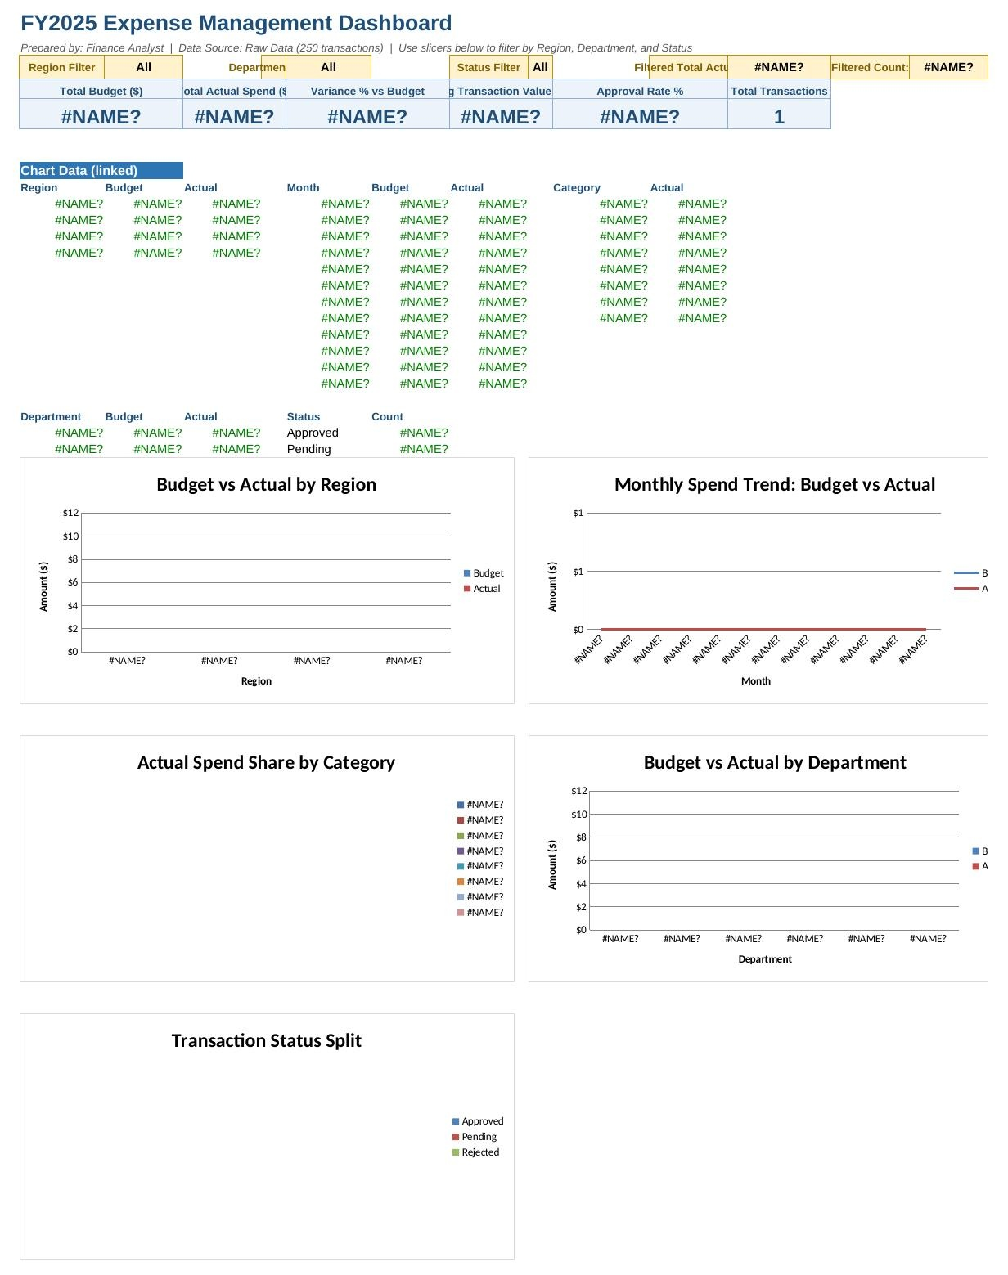
The Solution: Interactive Dashboard
Built in Excel from the Raw Data table, with live formulas throughout — no hardcoded numbers.
6 KPIs
Total budget, total actual, variance %, average transaction, approval rate, transaction count
5 Charts
Budget vs. actual by region & department, monthly trend, category mix, and approval-status split
3 Slicers
Filter dropdowns for Region, Department, and Status, with a live filtered total and count
Bottom line
Any budget owner can filter to their region or department and see performance in seconds.

Slide 4




Key Insights
+2.1% Over Budget
Marketing & Sales Drive Overruns
Actual spend of $625,941 exceeded the $612,904 budget by $13,037 across all 250 transactions.
Marketing (+8.6%) and Sales (+5.6%) posted the largest percentage overruns of any department.
IT & HR Under Budget
30% of Transactions Not Yet Approved
IT (–0.3%) and HR (–1.5%) were the only two departments to finish under budget.
Only 70% of transactions carry “Approved” status — a possible workflow bottleneck.

Slide 5

Recommendations
1
Tighten spend controls in Marketing & Sales
Require pre-approval above a set threshold in the two departments with the largest overruns.
2
Clear the approval backlog
Audit the 30% of pending/rejected transactions to remove workflow bottlenecks.
3
Review Salaries & Consulting costs
These are the largest dollar-value categories, so small % overruns carry outsized budget impact.
4
Scale IT & HR's cost discipline
Use their under-budget practices as a model, and set monthly variance alerts (>5%) via the dashboard.
Next step: review the dashboard filters together to prioritize which region or department to address first.

