Slide 1
Digital Portfolio
STUDENT NAME: RAJESH J
REGISTER NO AND NMID: 222407875&265EB9952B676CCA47D47F33E45BF9AB
DEPARTMENT: Bsc. computer science & data science
COLLEGE: Tagore college of arts & science/Madras university

Slide 2
PROJECT TITLE
Rajesh J — Creative Portfolio Web Developer · Passionate about Modern Web Design

Slide 3


AGENDA
Problem Statement
Project Overview
End Users
Tools and Technologies
Portfolio design and Layout
Features and Functionality
Results and Screenshots
Conclusion
Github Link
3/21/2024 Annual Review

Slide 4

PROBLEM STATEMENT
Students and professionals often rely only on resumes, which are static and text-heavy.
Resumes don’t show creativity, coding ability, or design sense.
A digital portfolio website provides:
A professional personal brand.
A space to highlight skills, achievements, and projects.
An engaging, interactive experience for viewers.

Slide 5

PROJECT OVERVIEW
Developed a personal portfolio website in Opulence Era style.
Purpose: To create a professional online identity.
Features:
Hero section with name & tagline.
About Me section with short bio.
Skills grid showcasing programming & creative tools.
Contact section with elegant design.
Responsive and user-friendly across devices

Slide 6

WHO ARE THE END USERS?
Recruiters & Employers → evaluating candidates.
Collaborators → developers & designers seeking partnerships.
Academic evaluators → assessing project & presentation skills.
General audience → exploring my creative work.

Slide 7

TOOLS AND TECHNIQUES
Frontend: HTML5, CSS3, JavaScript
Styling: Tailwind CSS + custom theme
Typography: Playfair Display, Great Vibes, Inter
(luxury aesthetic)
Creative Tools: DaVinci Resolve (media editing)
Hosting: GitHub Pages (or any static hosting)

Slide 8
POTFOLIO DESIGN AND LAYOUT
Header & Hero: Branding, tagline, and CTA button (Work With Me).
About Me: Personal introduction and creative philosophy.
Skills Section: Grid layout of programming & multimedia skills.
Projects Section (expandable): Placeholder for future works.
Contact Section: Stylish design with phone/email for easy reach.
Footer: Minimal © Rajesh — Crafted with care.
8

Slide 9
FEATURES AND FUNCTIONALITY
Smooth scrolling & sticky navigation.
Fully responsive design (desktop, tablet, mobile).
Elegant typography + warm earthy color palette.
Interactive elements (buttons, project cards).
Call-to-action for collaboration.

Slide 10
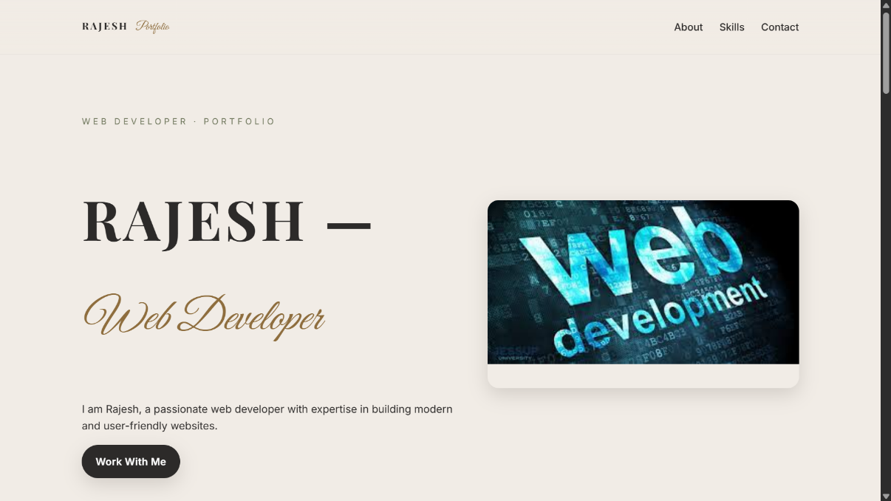
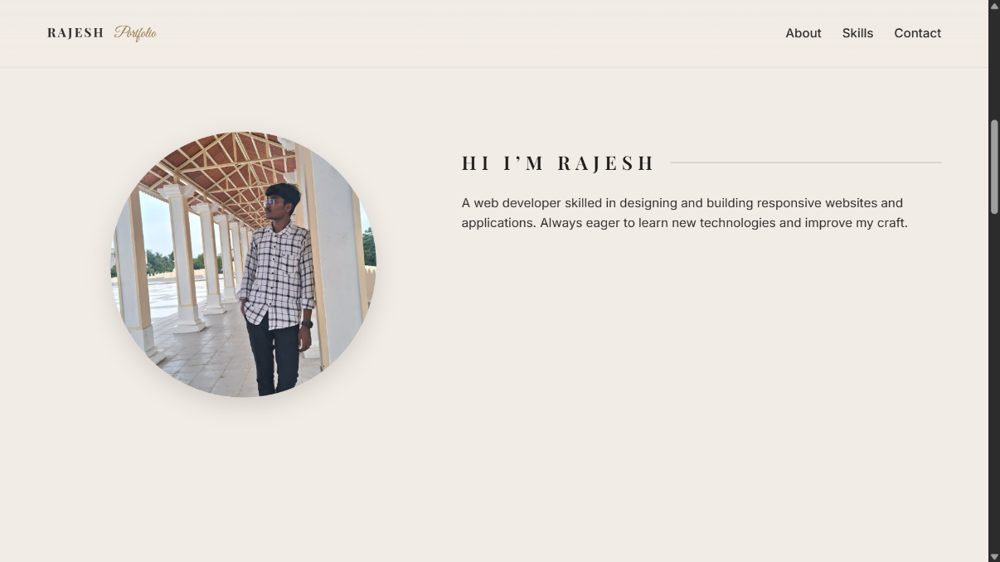
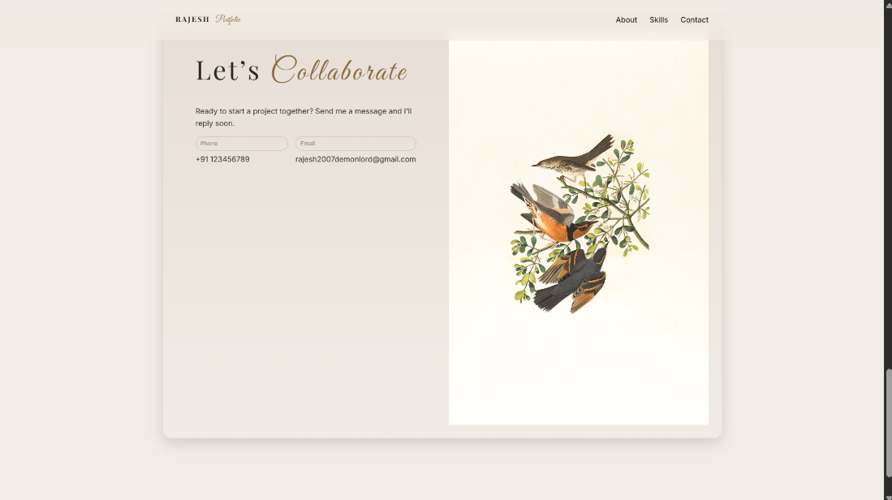
RESULTS AND SCREENSHOTS
10

Slide 11
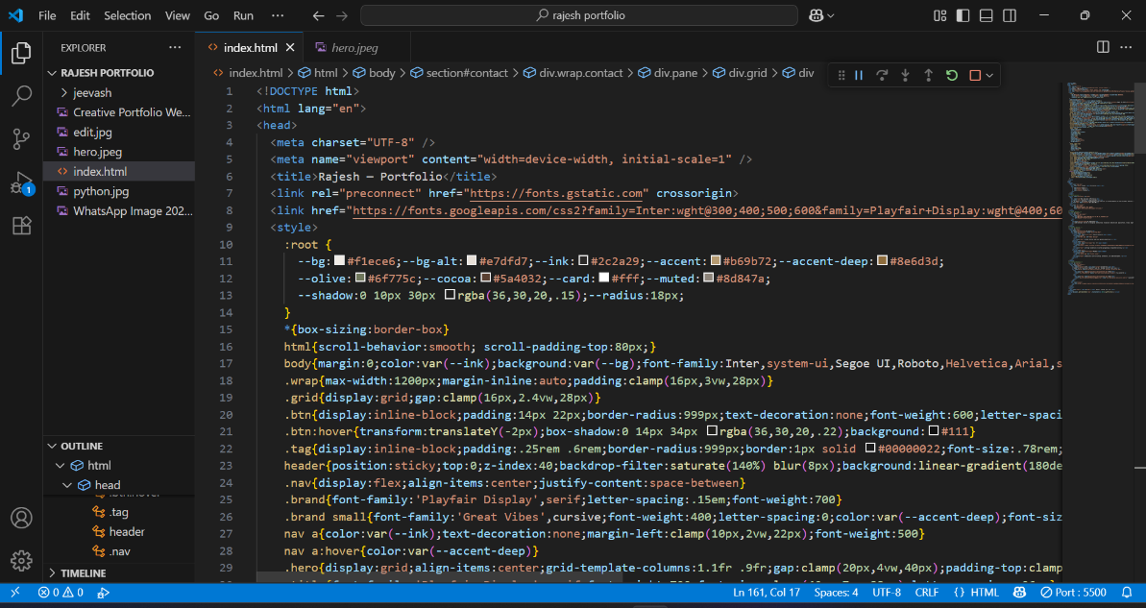
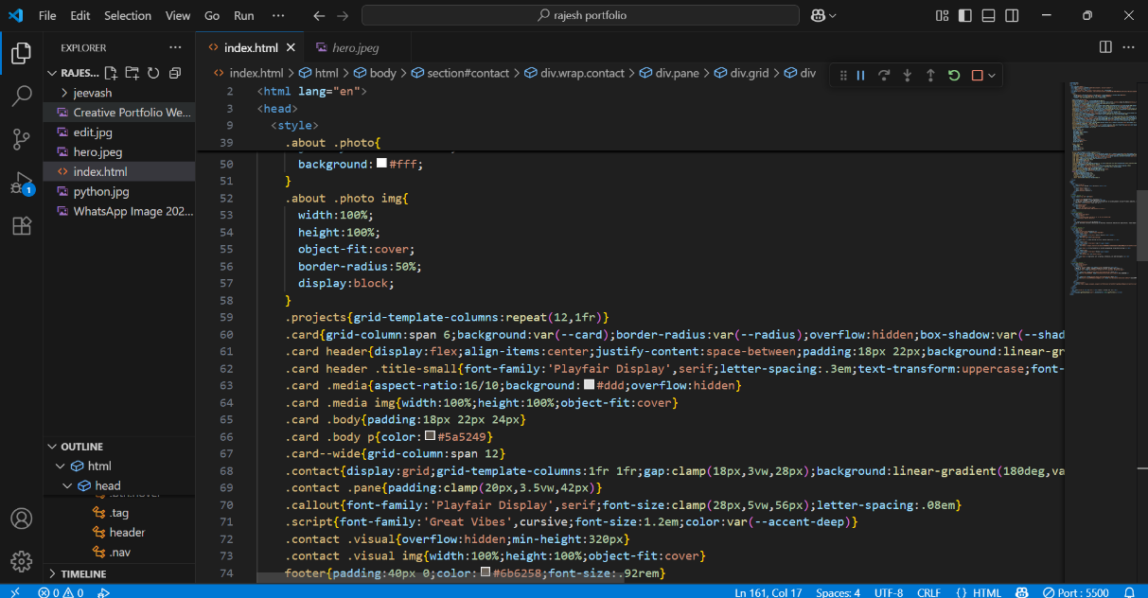
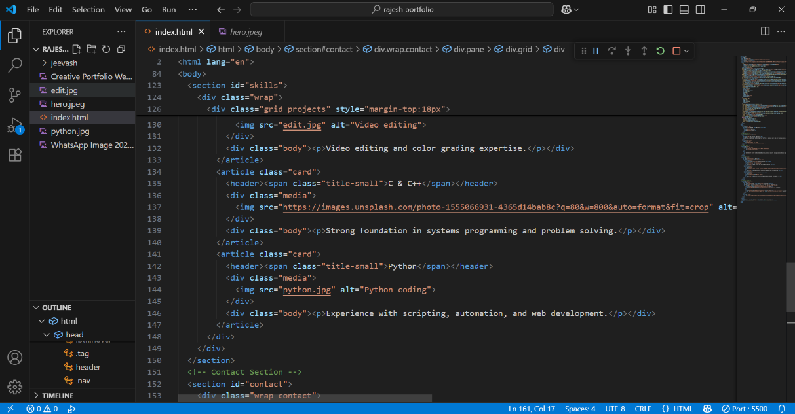
RESULTS AND SCREENSHOTS

Slide 12
CONCLUSION
Portfolio website highlights my identity as a web developer.
Combines technical skill + luxury design.
Acts as an interactive resume & creative showcase.
Future plans: Add more projects, blogs, and advanced animations
12

Slide 13
GITHUB LINK
https://github.com/rajeshj1983/RAJESH.git

