Slide 1
AgriEdgeNet
Edge-ready crop segmentation and calibrated multispectral indices for UAVs
Results of the 1 Nov 2026 Colab run | committee review
Notes:
Two pipelines in one notebook: (1) crop segmentation of Raspberry Pi Camera v2 RGB images with a sub-50k-parameter CNN of our own, benchmarked against YOLO26n-seg; (2) NDVI and NDRE from Parrot Sequoia multispectral captures after radiometric calibration and band alignment. All numbers in this deck come from the 1 Nov run (single seed) unless marked otherwise.

Slide 2
Four findings from the first full run
0.07
34.7k
0.798
5.6x
median NDRE after calibration
parameters in AgriSegNet-Nano
test mIoU, Nano (640 px)
faster on 1 CPU thread at 640 px
was 0.39: the old indices were raw-DN ratios
88x fewer than YOLO26n-seg (3.05M)
vs 0.873 for YOLO26n-seg; gap is significant
19.6 ms vs 109.5 ms; 72x smaller FP32 file
Nano trades about 9 % mIoU for an 88x smaller model; its niche is memory-limited devices, not accuracy.
Notes:
Takeaways. 1) The earlier NDVI/NDRE outputs were wrong: calibration never ran. Fixed and verified. 2) Our CNN fits the budget comfortably. 3) YOLO26n-seg trained from scratch is more accurate, and the difference is statistically significant on the 18 test images. 4) Nano is much smaller and faster. The honest claim is a trade-off, not 'smaller and better'.

Slide 3
One notebook, two independent pipelines
RGB segmentation
Roboflow v4
Train
Benchmark
Per-field output
Pi Cam v2 frames, 640x640, train/valid/test
Nano and YOLO26n-seg, both from scratch
ONNX: 640/480/320 px x FP32/INT8
class, area (m2), GLI on each field
Sequoia indices
Google Drive
Calibrate
Align
NDVI / NDRE
12 TIFs: 4 captures x NIR/RED/REG
Parrot sensor model + vignetting + Sunshine
ECC homography, flight-median check
GeoTIFF, PNG, QC, CSV, report
Not fused yet: per-crop NDVI needs RGB masks and Sequoia bands on one pixel grid. The RGB frames come from a different camera, and the 12 Sequoia frames show tree canopy over a road, not the five crops. Fix: fly the Sequoia over the plots, or co-register orthomosaics.
Notes:
The consolidated notebook runs both parts back to back and zips the results to Drive. They cannot yet be combined per crop: there is no shared pixel grid between the RGB camera and the Sequoia, and the multispectral test scene is not the crop field.

Slide 4
A. Sequoia NDVI and NDRE
Radiometric calibration, band alignment, results

Slide 5
The earlier indices skipped calibration entirely
Old code asked exiftool for 'Black Level', 'Sensor Gain', 'Irradiance': Sequoia TIFFs contain none of them
Silent defaults (black 64, gain 1, irradiance 1) turned NDVI and NDRE into raw-DN ratios
Symptom in the old output: mean NDRE > mean NDVI, which is physically backwards for vegetation
Fix: Parrot model from XMP/EXIF, I = f² (DN − B) / (A·t·ISO + C), then vignetting, then Sunshine normalisation
Band | A (sensitivity) | B (dark, DN) | Vignetting, centre to corner
NIR | 3.01e8 | 4,310 | 0.98 to 0.73
RED | 2.76e8 | 4,617 | 0.98 to 0.72
REG | 0.87e8 | 4,192 | 0.98 to 0.70
Old code | 1 | 64 | none
Values from the XMP of capture 0064. Dark offset is ~70x the assumed 64; RED vs REG sensitivity differs 3.2x.
Notes:
The calibration data was in the files all along, in XMP fields Camera:SensorModel and Camera:VignettingPolynomial2D. The new code reads them directly with no exiftool dependency, and raises an error if any field is missing instead of falling back to defaults.

Slide 6
Dark offset fixes NDVI, band sensitivity fixes NDRE
Each step adds one correction on the same pixels
NDRE falls from 0.61 to 0.09 once RED-edge sensitivity (3.2x lower) is applied
Vignetting barely moves ratio indices but matters for reflectance values
Notes:
Ablation on capture 0064 with identical registration. The dark offset dominates the NDVI error; the per-band sensitivity coefficient dominates the NDRE error. After full correction, NDRE exceeds NDVI on under 0.25% of vegetation pixels, which the notebook now checks automatically.

Slide 7
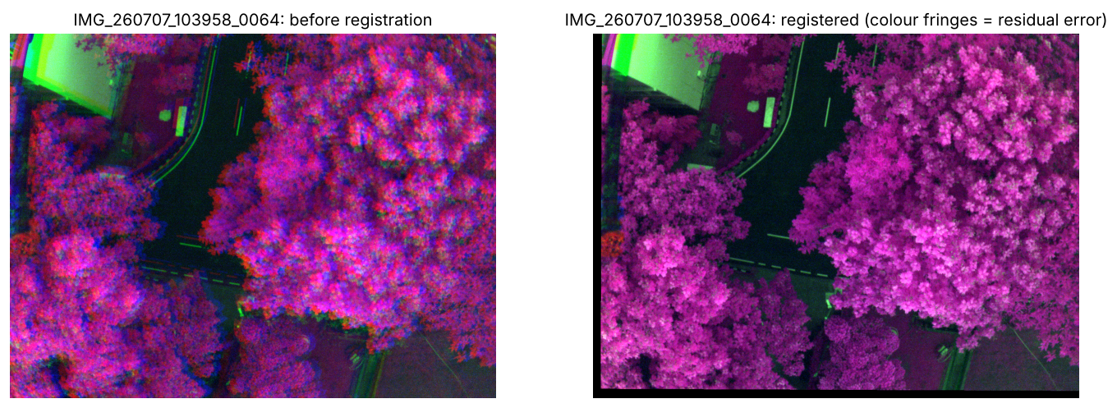
Band alignment is consistent to under 2 px
Gradient images, phase-correlation start, coarse-to-fine ECC homography; REG as reference
Rigid rig: shifts agree across captures, so a failed capture can fall back to the flight median
Residual at image corners: 0.3 to 1.0 px
Fisheye undistortion tested and dropped: it made registration worse
False colour (NIR, RED, REG): colour fringes before registration disappear after it.
Capture | NIR shift (px) | RED shift (px) | Max dev. from median
0064 | (−18.9, +3.2) | (−12.5, +22.9) | 1.6 px
0065 | (−18.9, +3.4) | (−12.3, +23.3) | 0.3 px
0066 | (−18.9, +3.5) | (−12.5, +23.3) | 1.6 px
0067 | (−18.9, +3.5) | (−12.4, +23.3) | 0.3 px
Notes:
Fixed bugs from the earlier version: affine composition in the wrong order, NCC scored on zero borders, identity fallback. Shifts relative to REG are stable across the four captures: NIR about (-18.9, +3.3) px, RED about (-12.4, +23.1) px, as expected for a rigid four-lens rig.

Slide 8
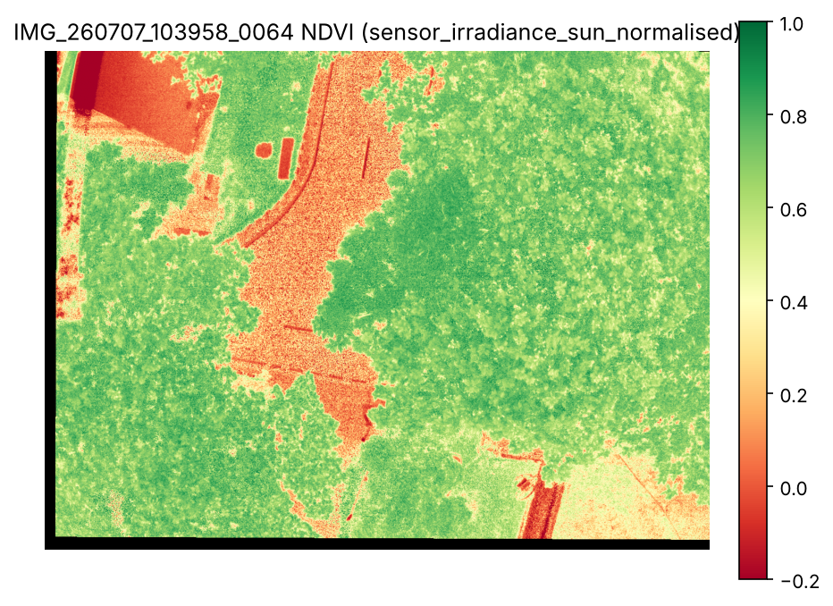
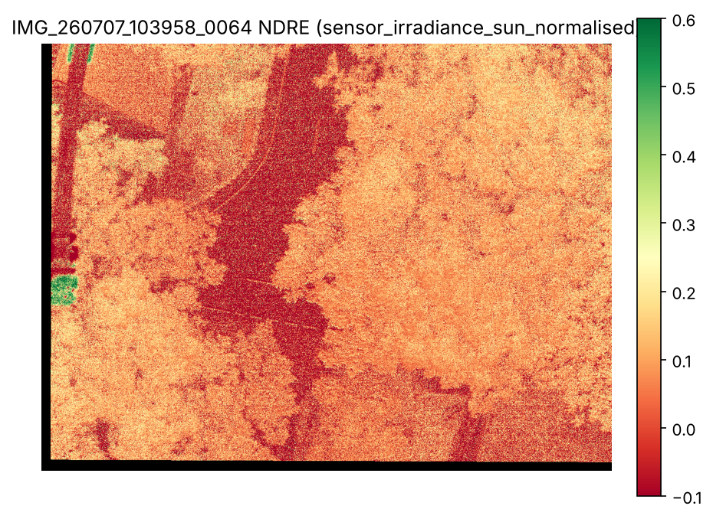
Corrected indices are physically consistent
Capture | NDVI med. | NDRE med.
0064 | 0.66 | 0.08
0065 | 0.57 | 0.05
0066 | 0.55 | 0.03
0067 | 0.55 | 0.04
Canopy NDVI 0.6 to 0.8, road ~0, roof < 0
NDRE > NDVI on at most 0.21 % of vegetation pixels
Not reflectance: no calibration panel was imaged; values are calibrated at-sensor ratios
Notes:
Left: NDVI, right: NDRE for capture 0064. These are consistent within the flight but not comparable to literature thresholds until a reflectance panel is photographed before and after each flight. There is no ground truth for these 12 frames yet; validation needs handheld NDVI or SPAD readings at GPS-marked spots.

Slide 9
B. Lightweight crop segmentation
AgriSegNet-Nano vs YOLO26n-seg, five crops, Roboflow RGB

Slide 10
Experimental design: same data, budget and scoring
Data
Ground scale
Baseline
Roboflow v4: Pi Camera v2 frames resized to 640x640; train / valid / test. Test: 18 images, 68 fields
25 m AGL: 30.3 x 22.7 m footprint; 4.73 x 3.55 cm/px at 640x640 (16.8 cm² per pixel)
YOLO26n-seg (3.05M params), smallest YOLO26 seg model, trained from scratch like Nano
Training
Fairness
Metrics
Max 300 epochs, early stopping on valid (patience 50). Nano best epoch 173/223, YOLO 245/295
YOLO confidence chosen on valid (0.4); same INT8 recipe and calibration images; both scored as ONNX
mIoU over 5 crops (primary), per-crop IoU, paired bootstrap 95 % CI over test images
Notes:
Both models start from random weights: Nano has no pretrained weights, so pretraining YOLO would confound architecture with pretraining. YOLO's instance masks are converted to a per-pixel crop map (highest confidence wins) and scored with exactly the same mIoU code as Nano.

Slide 11
Nano is built for any edge runtime
Depthwise-separable encoder to 1/32, global-context gate, prediction at 1/8
Static graph, ops only: Conv, Add, Mul, Clip, GlobalAveragePool, Sigmoid, Resize. No dilation, no NMS
Runs on TensorRT, ONNX Runtime, OpenVINO, NPUs; TFLite-Micro via conversion
Memory is the real limit: weights are 34 KiB INT8, activations are ~80x larger at 640 px
Input | Peak INT8 activations | Fits
640 px | 2.73 MiB | Pi, Jetson
320 px | 0.68 MiB | Large MCU / NPU
256 px | 0.44 MiB | MCU
34,742 params | 0.25 GMACs @ 640
Input size, not parameter count, decides which devices can run the model.
Notes:
Design follows the device-agnostic requirement: one model for MCU, Pi, Jetson Nano and Orin, light enough to share the device with other scheduled tasks. The exported ONNX graph is fully static, which MCU and NPU compilers require.

Slide 12
YOLO26n-seg is more accurate at every setting
Nano − YOLO, 95 % CI
640 FP32: −0.108 [−0.21, −0.03]
480 FP32: −0.098 [−0.19, −0.03]
320 FP32: −0.145 [−0.25, −0.05]
Every interval excludes 0. INT8 costs Nano nothing at 640 px, 3 points at 320 px.
Notes:
Pooled mIoU per setting. The confidence intervals come from a paired bootstrap over the 18 test images (2,000 resamples of per-image mIoU differences). Note the per-image average gap (-0.108) differs from the pooled gap (0.798 - 0.873 = -0.075) because small minority-crop images weigh more per image. Nano degrades with smaller inputs; YOLO barely does.

Slide 13
The gap sits in the three minority crops
Wheat and potato: parity (0.94 to 0.97)
Fenugreek −0.15, linseed −0.14, gram −0.08
These crops have the fewest images: validation holds 1 image each of fenugreek and linseed
Notes:
The averaged gap is driven almost entirely by the look-alike minority crops. Their IoUs also carry the most uncertainty, because validation and test contain very few of them. More labelled images of these crops is the single most valuable data improvement.

Slide 14
The trade-off: 9 % mIoU for 88x fewer parameters
 | AgriSegNet-Nano | YOLO26n-seg | Ratio
Parameters | 34,742 | 3,054,875 | 88x
ONNX file FP32 / INT8 | 150 / 125 KB | 10.8 / 3.3 MB | 72x / 27x
CPU, 1 thread, 640 px | 19.6 ms | 109.5 ms | 5.6x
CPU, 1 thread, 320 px | 7.3 ms | 26.0 ms | 3.6x
Test mIoU 640 / 320 px | 0.798 / 0.740 | 0.873 / 0.864 | −0.075 / −0.124
Where Nano wins: where YOLO does not fit (microcontrollers) or must share a small CPU. On a Pi or Jetson, YOLO at 320 px (0.864, 26 ms) beats Nano at 640 px (0.798, 20 ms). INT8 latency on desktop CPU is emulated, so measure it on the target device.
Notes:
FLOPs fall about 19x but CPU latency only 5.6x: depthwise convolutions are memory-bound. The INT8 timings from ONNX Runtime on the Colab CPU are slower than FP32 and are not reported; INT8 speed must be measured with TensorRT on Jetson or TFLite on Pi/MCU.

Slide 15
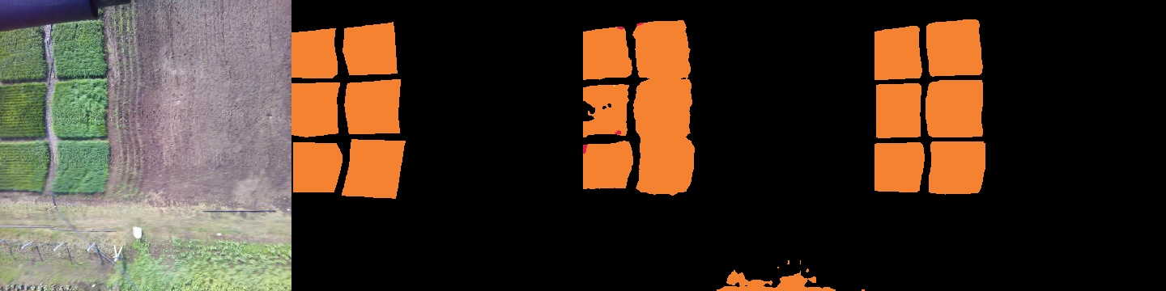
Why we need per-field output
Test image
Ground truth
AgriSegNet-Nano
YOLO26n-seg
Six wheat plots: YOLO keeps them separate; Nano merges neighbouring plots and adds a false patch at the bottom
Nano was semantic (one label per pixel), so touching fields of one crop become one region
Done since: a 2.3k-parameter field-boundary head (37.0k total) gives per-field output and mask mAP. Run pending
Notes:
Semantic segmentation labels every pixel with a crop but has no notion of separate fields. YOLO is an instance model: each field is its own object with class, confidence and mask. The new boundary head turns Nano into a bottom-up instance model: it predicts field boundaries and a grouping step splits touching fields. The COCO-style mask AP code was verified to match pycocotools exactly.

Slide 16
Application output: area and greenness per field
Each field gets area (pixels x 16.8 cm²) and mean GLI, drawn on the image with the GSD in a header
Total 7,472 m²; plausible against 18 x 687 m² frame footprints
Mean GLI 0.03 to 0.08 mixes soil and canopy; the CSV also reports GLI over vegetation pixels only
Yield figures are indicative: thresholds and factors are not validated
Notes:
Area assumes full frames resized to 640x640, flat ground, nadir view and a constant 25 m altitude; a 1 m height error gives about 8% area error. Area error against ground-truth masks per crop is the next metric to add, since area is the application's output.

Slide 17
Limits of the current evidence
Small test set
Single seed
18 images; wide confidence intervals (0.03 to 0.21)
one training run per model; seed variance not yet measured
Random split
Few minority crops
Roboflow split, not by field or date: leakage possible
1 valid image each of fenugreek and linseed
Desktop latency only
Indices unvalidated
INT8 and on-device speed still to measure on Pi, Jetson, MCU
no panel, no field NDVI; scene is not the crop field
Notes:
These limits do not change the direction of the result: YOLO's advantage is significant even with the wide intervals. They do limit how precisely the gap can be stated, and whether it generalises to new fields and dates.

Slide 18
Next steps
1. Run Nano with the field-boundary head; compare mask mAP with YOLO (code ready)
2. Three seeds per model; per-crop area error against ground truth
3. Close the gap at the same size: distillation from YOLO, a 320 px model for MCUs
4. Data: more fenugreek, linseed and gram; split by field or date
5. Ground truth: reflectance panel and handheld NDVI/SPAD; fly the Sequoia over the plots
6. On-device latency and energy on Pi, Jetson Nano/Orin and an MCU
Notes:
Items 1 and 2 need only another Colab run. Item 3 is the main research lever for the model. Items 4 and 5 need a field campaign. Item 6 turns the trade-off into the deployment numbers the committee will ask for.

