Slide 1
Exploratory Analysis - Statistics
Summary values for all passengers: | Summary values for survivors:
Most common class: 3 | Most common class: 1
Most common sex: male | Most common sex: female
Average age: 29.69911764705882 | Average age: 28.343689655172415
Most common SibSp: 0 | Most common SibSp: 0
Most common Parch: 0 | Most common Parch: 0
Average fare: 32.2042079685746 | Average fare: 48.39540760233917
Most common embarked: S | Most common embarked: S

Slide 2
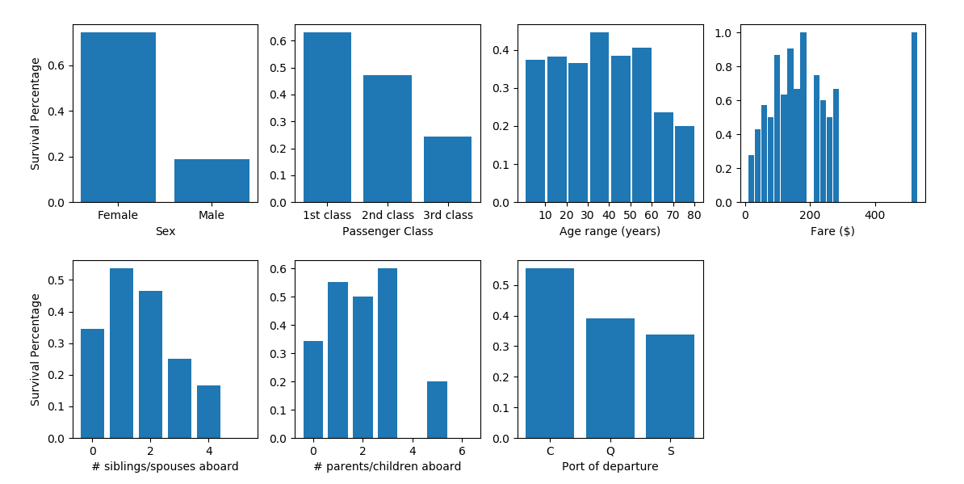
Exploratory Analysis - Graphs

Slide 3
Random Forest Classifier
Generated 100 decision trees with a max depth of 20
Features used were sex, age, passenger class, embark location, number of sibling/spouses aboard, and number of parents/children aboard
Best score was 0.74641

Slide 4
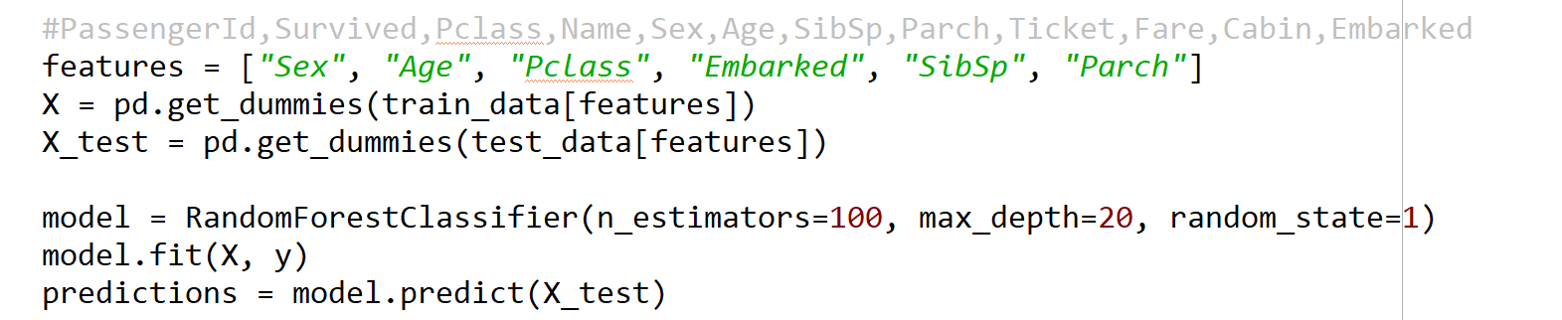
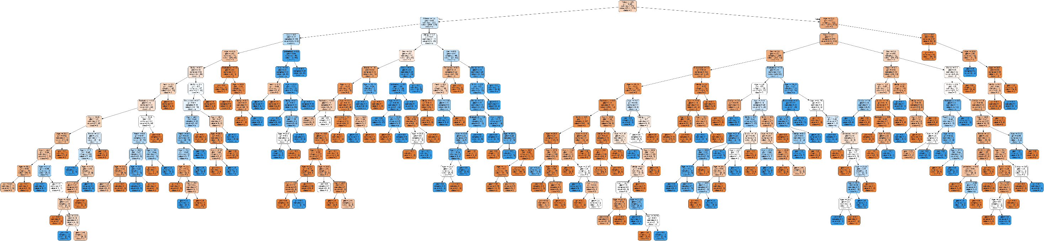
Random Forest Classifier

