Slide 1
Preprocessing Challenges
Data types not uniform across columns
‘Pclass’ and ‘Sex’ had categorical data
‘Fare’ and ‘Age’ had continuous data
Not all columns contained numerical data
Some columns had missing data
Determine which columns are relevant
Initial dataset: Missing data cells in yellow

Slide 2
Feature Engineering: Data Preparation
Embarked Mapping
Key | Value
S | 0
C | 1
Q | 2
Age Mapping
Bucket | Value
<= 10 | 0
11 – 20 | 1
21 – 30 | 2
31 – 40 | 3
41 – 50 | 4
51 – 60 | 5
61 – 70 | 6
71 – 80 | 7
>= 80 | 8
‘Sex’ and ‘Embarked’ column categorical text features mapped to integers
‘Age’ and ‘Fare’ column continuous features discretized into buckets
‘Cabin’ column features mapped to integers based on character prefix
‘Ticket’ column features binarized based on presence of string prefix
‘SibSp’ and ‘Parch’ columns summed to create ‘PartySize’ column
‘Name’ column was dropped
Cabin Mapping
Key | Value
Unknown | 0
A | 1
B | 2
C | 3
D | 4
E | 5
F | 6
G | 7
T | 8

Slide 3
Feature Engineering: Missing Data Handling
PassengerID | Pclss | Sex | Age | Ticket | Fare | Cabin | Embarked | PartySize
0 | 3 | 0 | 2 | 1 | 0 | 0 | 0 | 1
1 | 1 | 1 | 3 | 1 | 6 | 3 | 1 | 1
2 | 3 | 1 | 2 | 1 | 0 | 0 | 0 | 0
3 | 1 | 1 | 3 | 0 | 4 | 3 | 0 | 1
4 | 3 | 0 | 3 | 0 | 0 | 0 | 0 | 0
5 | 3 | 0 | 3 | 0 | 0 | 0 | 2 | 0
6 | 1 | 0 | 5 | 0 | 4 | 5 | 0 | 0
7 | 3 | 0 | 0 | 0 | 2 | 0 | 0 | 4
8 | 3 | 1 | 2 | 0 | 1 | 0 | 0 | 2
‘Age’, ‘Fare’, and ‘Embarked’ columns contained missing data
Passengers with missing ‘Age’ assigned the average age of their ‘Sex’
Passengers with missing ‘Fare’ assigned modal bucket of their ‘Pclass’
Passenger with missing ‘Embarked’ assigned ‘S’
Dataset post feature engineering

Slide 4


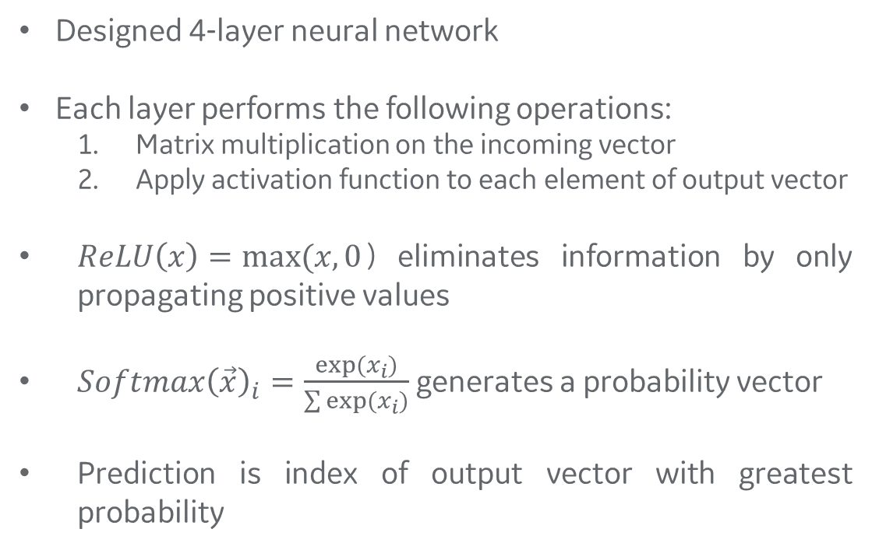
Neural Network Architecture
$$\vec{x}$$
(1 X 8 input vector)
Designed 4-layer neural network
Each layer performs the following operations:
Matrix multiplication on the incoming vector
Apply activation function to each element of output vector
$ReLU\left(x\right)=max⁡(x,0$) eliminates information by only propagating positive values
$Softmax{\left(\vec{x}\right)}_{i}=\frac{exp⁡(x_{i})}{\sum{exp⁡(x_{i})}}$ generates a probability vector
Prediction is index of output vector with greatest probability
Width: 64 Activation: ReLU
Width: 16 Activation: ReLU
Width: 4 Activation: ReLU
Width: 2 Activation: Softmax
$$\vec{y}$$
(1 X 2 output vector)

Slide 5
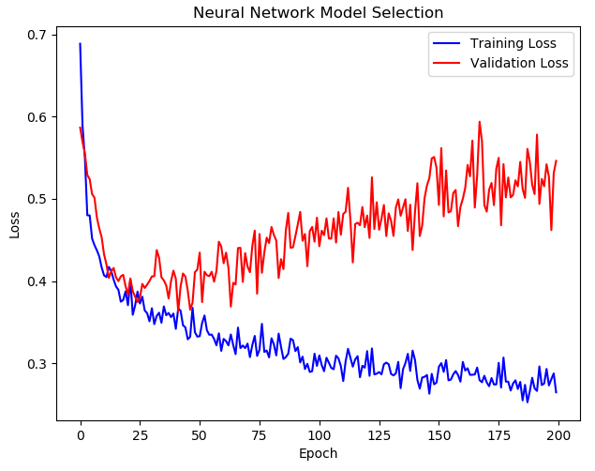
Neural Network Training and Performance
Model trained using gradient descent (ADAM) for 200 epochs
Training data split into training set and validation set along 90-10 split
Selected model with lowest validation loss to avoid overfitting
Achieved 77.035% accuracy on test set
Model Selected at Epoch 41

