Slide 1
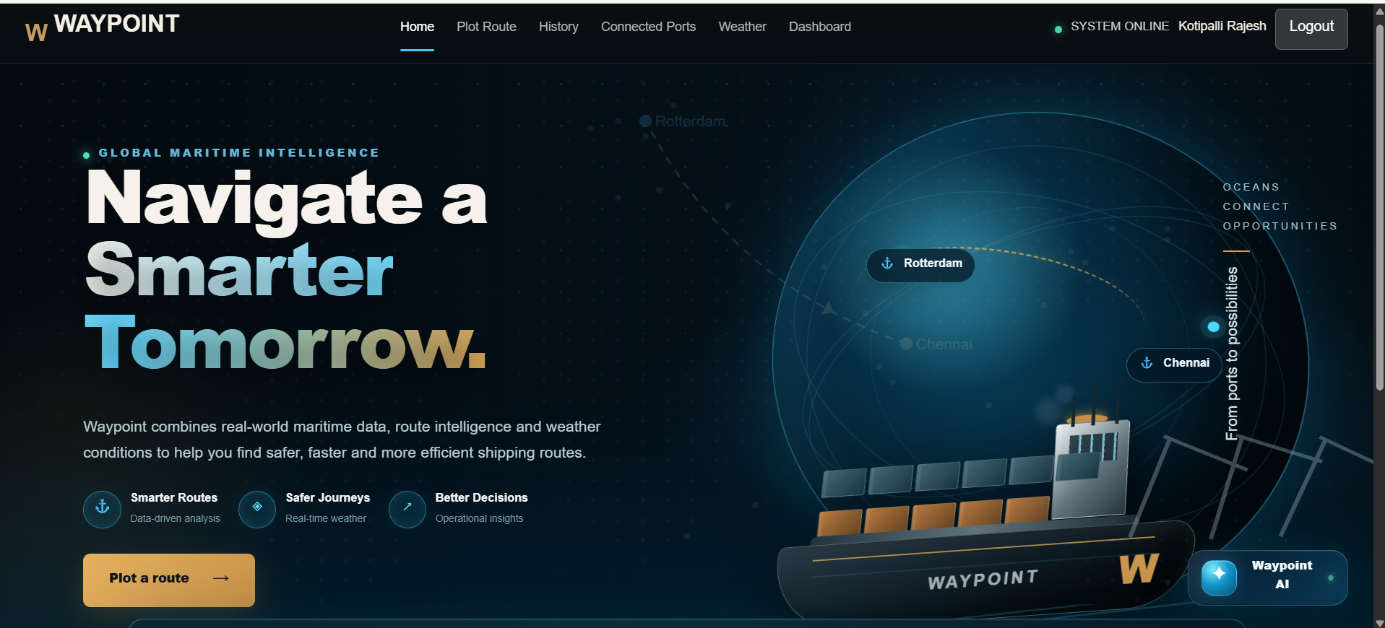
Presented By: Kotipalli Rajesh

Slide 2
Introduction
What is Waypoint?
Waypoint is an AI-assisted maritime brokerage platform designed to simplify and digitize the process of marine route analysis, port connectivity, weather assessment, quotation management and operational monitoring.
The platform combines:
Route intelligence
Maritime weather information
Connected-port discovery
Digital quotation requests
Search history
Operations analytics
Multilingual AI assistance

Slide 3

Problem Statement
Manual Route Planning
Fragmented Information
Manual Quotation Process
Limited Operational Visibility
Limited Intelligent Assistance

Slide 4
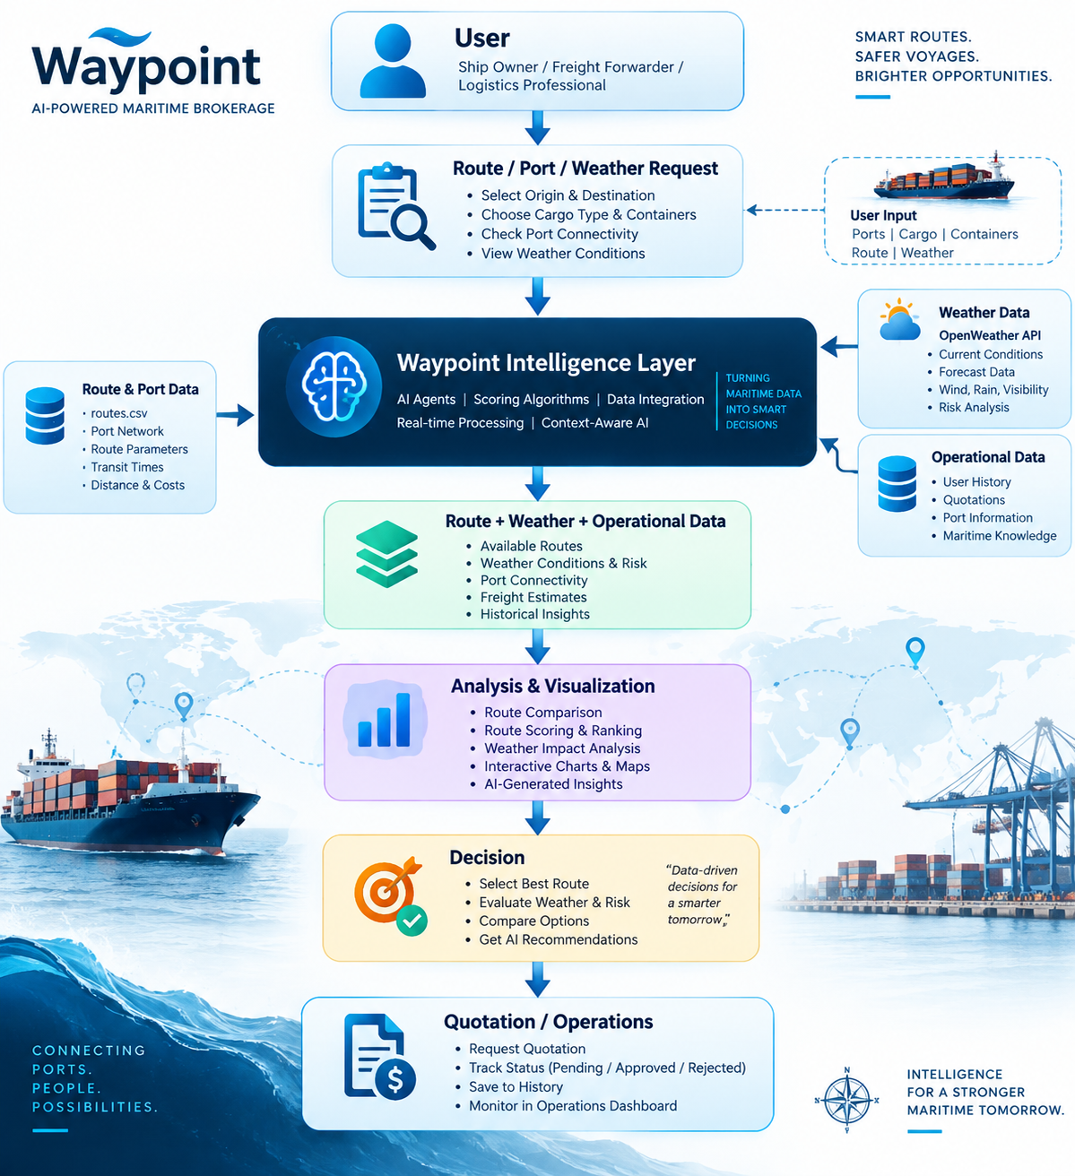
Proposed Solution
&
Objectives
🚢 Intelligent Route Planning.
⚓ Port & Weather Intelligence
💼 Digital Quotation Management
📊 Operational Analytics 🤖 AI-Powered Assist

Slide 5
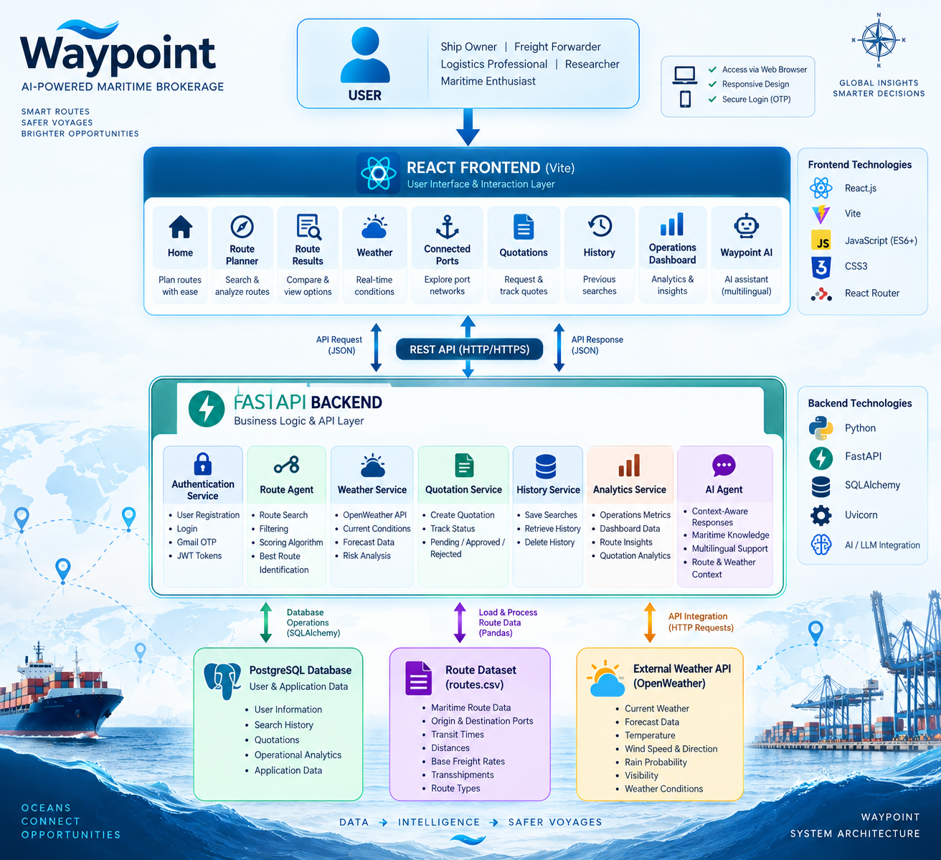
System Architecture

Slide 6
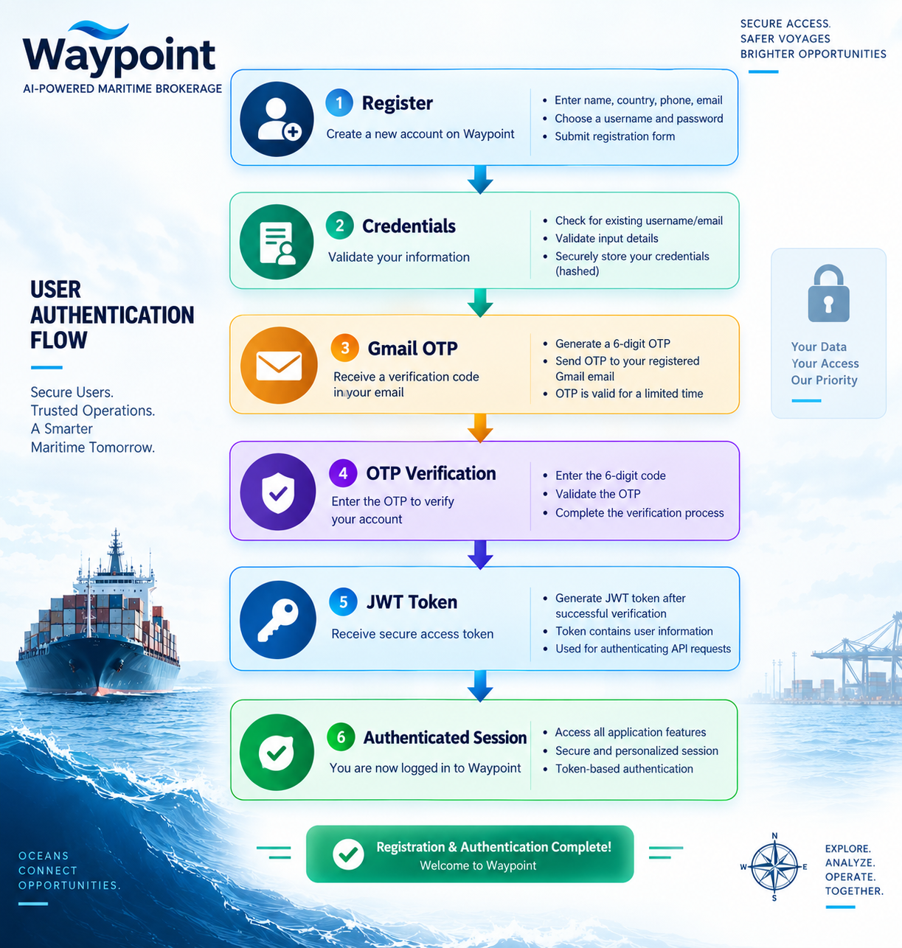
Authentication & Security
Security mechanisms
Password hashing
JWT authentication
Token-based API authorization
OTP verification
Protected user-specific history and quotations

Slide 7
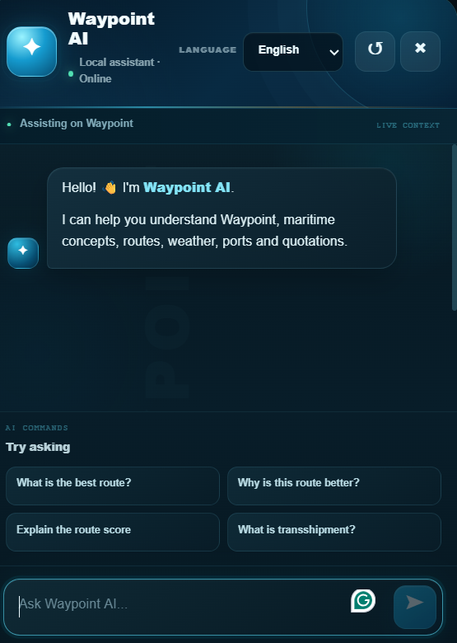
Waypoint AI
Waypoint AI acts as an intelligent assistant inside the application.
Users can ask questions about:
Maritime concepts
Routes
Route scores
Transshipments
Weather
Ports
Quotations

Slide 8
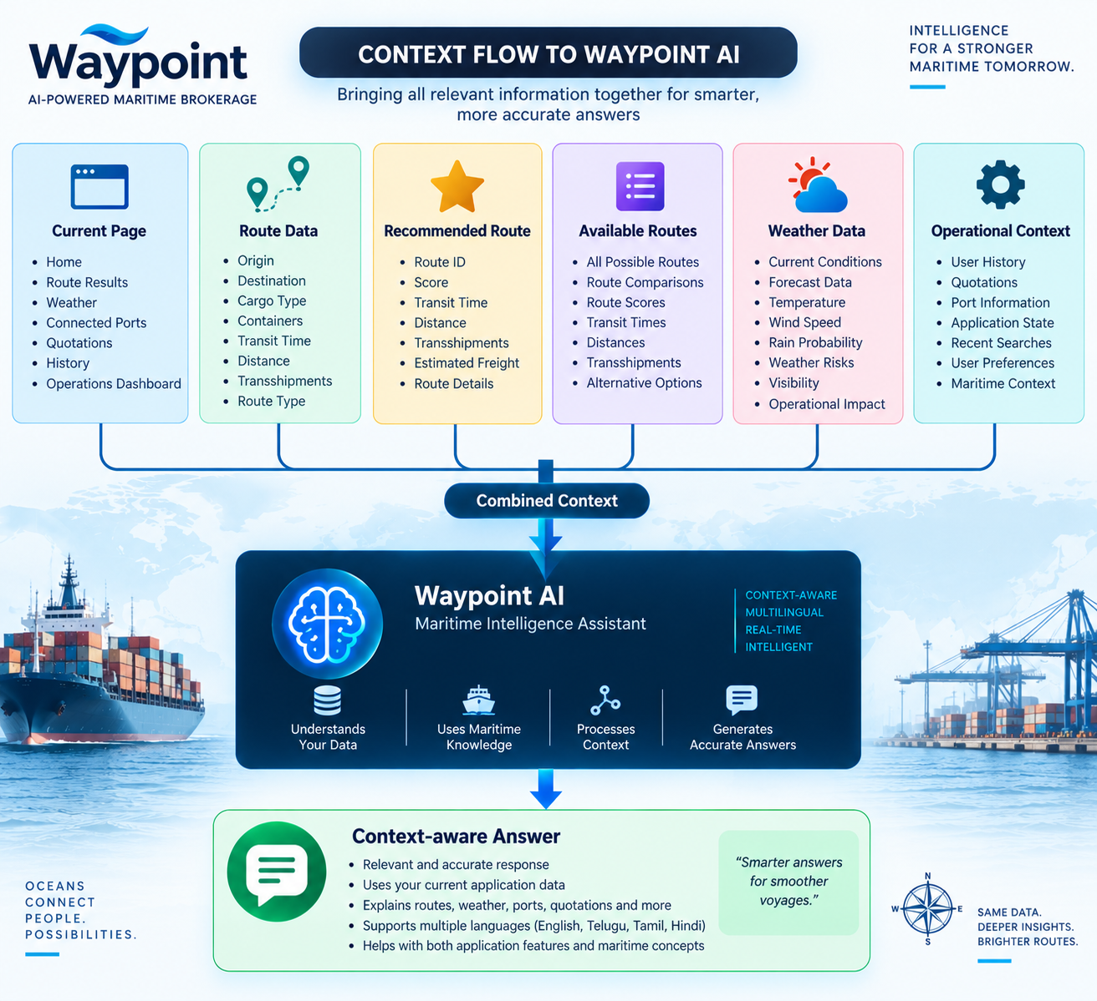
Waypoint AI is a Context-aware AI
Traditional AI Chatbot | Context-Aware AI — Waypoint AI
Responds mainly to the user's message | Responds using the user's message plus application context
Usually treats every question independently | Understands what the user is currently doing
Has little or no knowledge of current application state | Can use current page, route data, weather data, etc.
Generic responses | Specific, relevant responses
User may need to provide all details manually | Application can automatically provide relevant details
Example: “What is the best route?” → generic explanation | Example: “What is the best route?” → analyzes the current route information

Slide 9
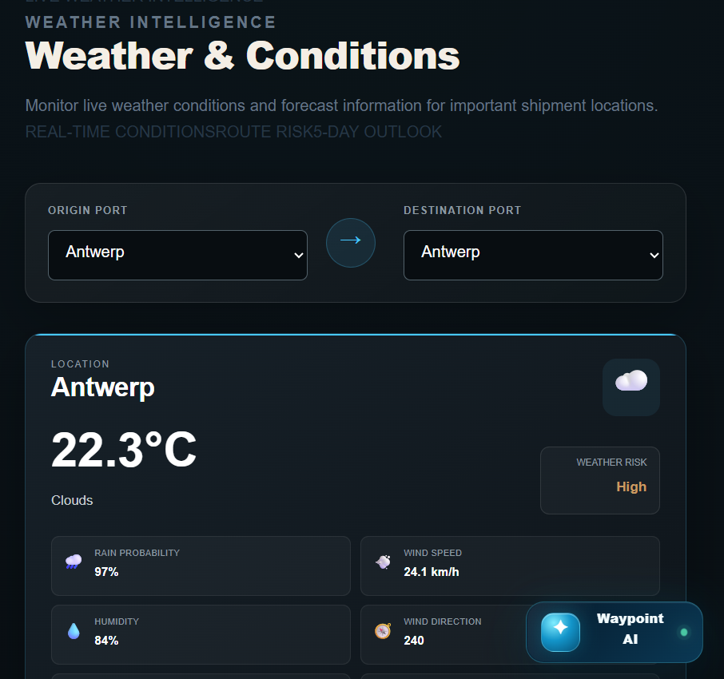
Weather Intelligence
Current weather information
Temperature
Feels-like temperature
Humidity
Atmospheric pressure
Wind speed
Wind direction
Visibility
Weather condition
Precipitation / rain probability
Forecast
The system also provides forecast information for future periods.

Slide 10
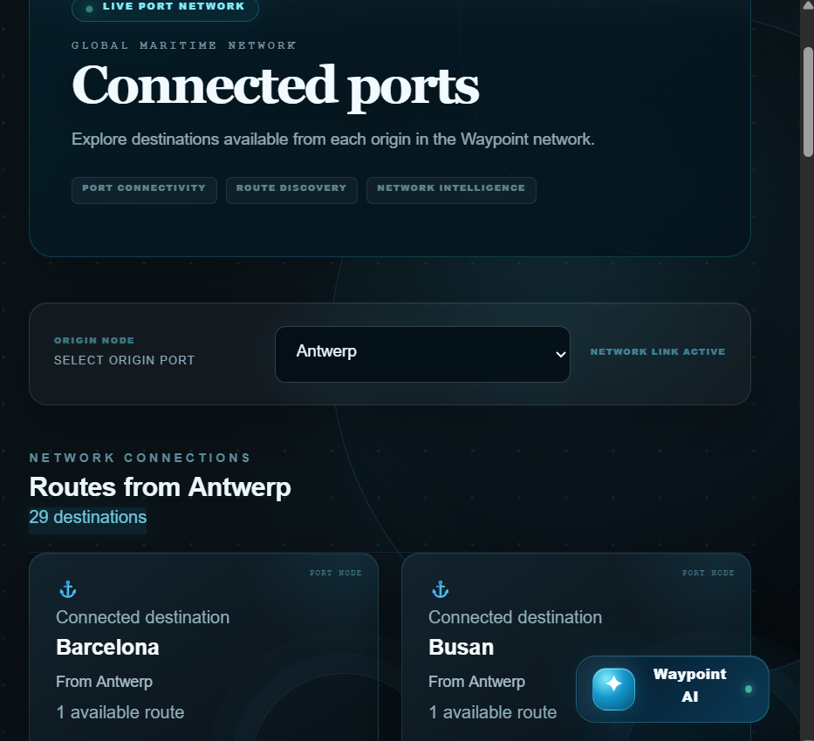
Connected Ports
Port Network Intelligence
Connected Ports allows users to select an origin port and discover destinations connected through the available route network.
Displays
Origin port
Destination port
Number of routes
Network connections
Total connected destinations

Slide 11
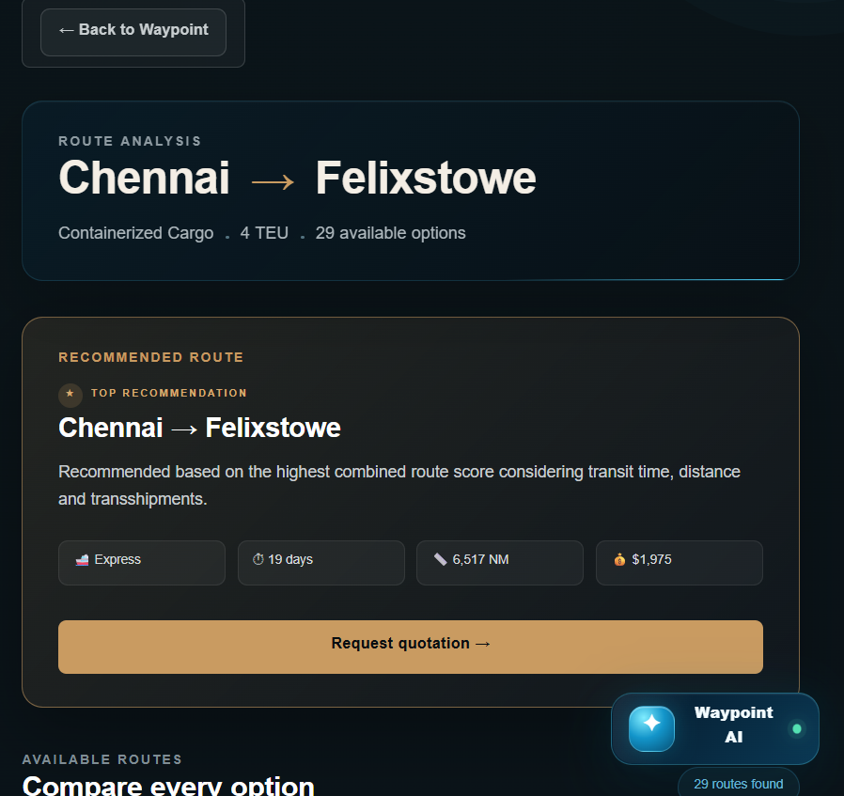
Digital Quotation System
After selecting a route, users can request a quotation digitally.
Input information
Company name
Email
Phone
Origin
Destination
Route
Cargo type
Cargo weight
Container quantity
Special requirements

Slide 12
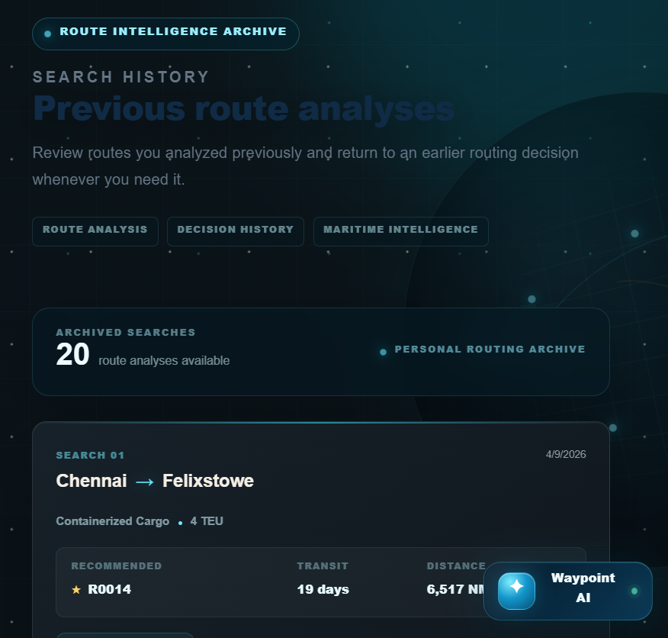
Search History
Waypoint automatically maintains previous route analyses.
Users can:
View previous searches
See origin and destination
View cargo information
See recommended route
Review transit time
Review distance
Open detailed analysis
Delete previous searches

Slide 13
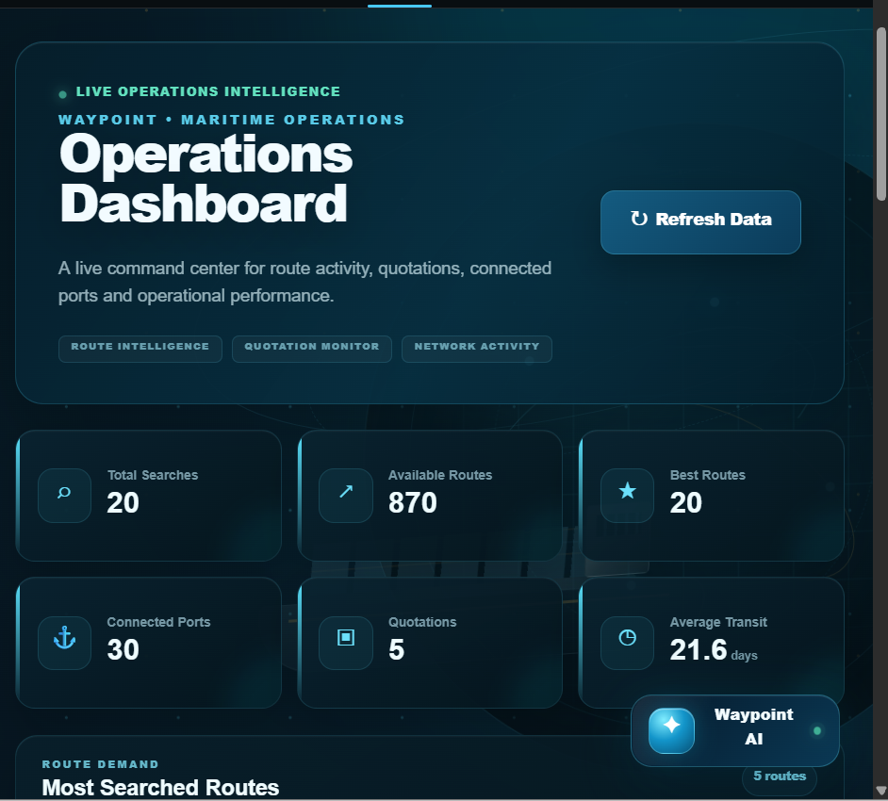
Operations Dashboard
The dashboard provides a centralized view of operational activity.
KPI indicators
Total searches
Available routes
Best routes
Connected ports
Total quotations
Average transit time
Analytics
📊 Most searched routes 🥧 Quotation status distribution 📈 Route ranking 💰 Freight intelligence 🕘 Recent searches 📋 Recent quotations 🟢 System status

Slide 14
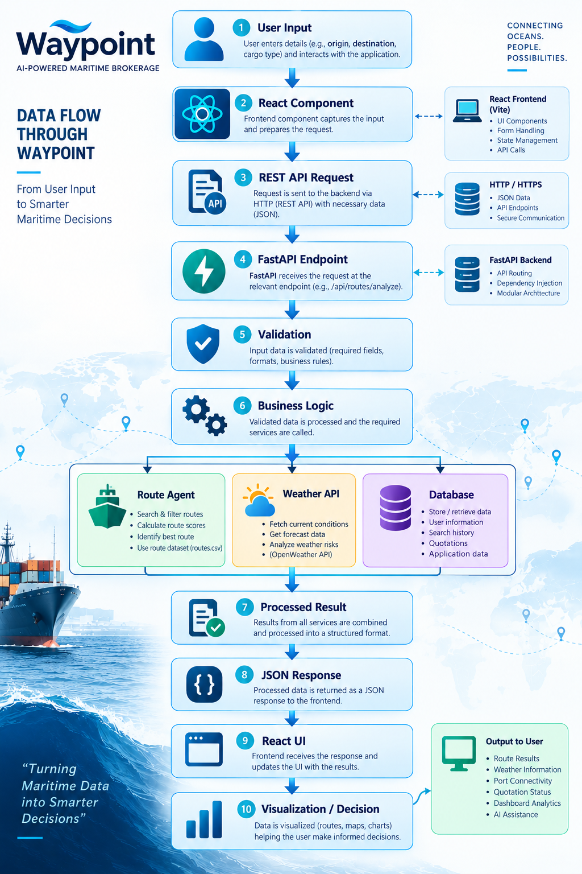

Data Flow

Slide 15
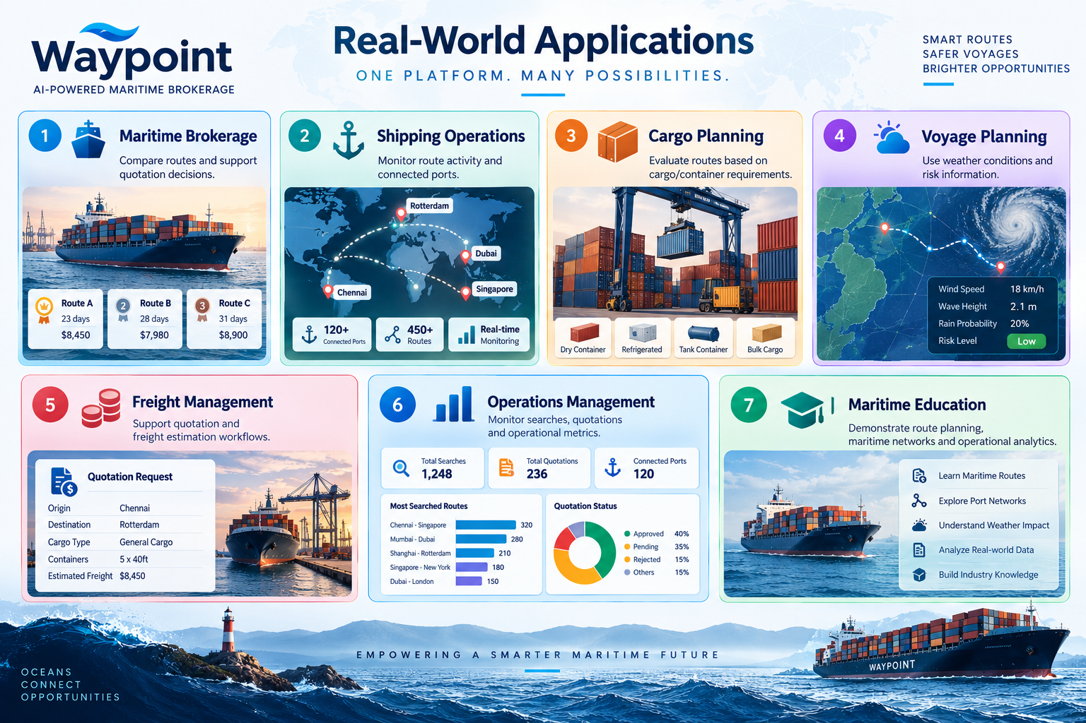

Slide 16
Conclusion
Waypoint demonstrates how modern web technologies, maritime datasets, weather intelligence and AI assistance can be integrated into a single maritime brokerage platform.
The system provides:
Route Intelligence + Weather Intelligence + Port Connectivity + Quotations + Analytics + AI

Slide 17
