Slide 1

.
HTML enhanced for web apps!
Training on AngularJS
Prepared by: Rana Inturi
September 1 – 2, 2015
For Unisys Internal Training Purpose only

Slide 2
Agenda
Overview of DOM
JavaScript overview
Angular JS

Slide 3
DOM as per www.w3.org/dom
What is the Document Object Model?
The Document Object Model is a platform- and language-neutral interface that will allow programs and scripts to dynamically access and update the content, structure and style of documents.
The document can be further processed and the results of that processing can be incorporated back into the presented page.
Why the Document Object Model?
"Dynamic HTML" is a term used by some vendors to describe the combination of HTML, style sheets and scripts that allows documents to be animated.
The W3C has received several submissions from members companies on the way in which the object model of HTML documents should be exposed to scripts.
These submissions do not propose any new HTML tags or style sheet technology. The W3C DOM Activity is working hard to make sure interoperable and scripting-language neutral solutions are agreed upon.

Slide 4
ECMA European Computer Manufacturers Association
on April 27, 1960, in Brussels; it was decided that an association of manufacturers should be formed which would be called European Computer Manufacturers Association
A Committee was nominated to prepare the formation of the Association and to draw up By-laws and Rules.

Slide 5
ECMA European Computer Manufacturers Association
Formed in 1961 by major multinational computer hardware manufacturers present in Europe.
Originally “ECMA” stood for “European Computer Manufacturers’ Association”.
In 1994 - due to the high reputation and wide public knowledge - the “brand name” was kept, but changed to simply “Ecma” (now with capital and small letters, signalling the change of the original mission of the Association).
“International” was added because membership is from around the world, in Asia, Australia, Europe and North America.
Broad scope of standardisation topics including hardware, software, communications, consumer electronics, media, storage, environmental subjects, etc…

Slide 6
JavaScript Code
JavaScript Engine
Web Browser
Creates HTML DOM Tree
HTTP Request
Static Web Page
Dynamic Web Page
HTTP
Response
HTML
+
CSS
+
JS
window
Rendering
document
html
head
body
Web Server
div
PHP, Java, C#, C++, JS

Slide 7
JavaScript
Dynamic Language
variables do not have type
data has type
no Compilation – Load and Go
Supports OO and NON-OO
Full access to DOM tree
Full access HTTP feature of the browser
ES 5

Slide 8
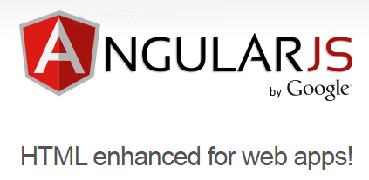
What is Angular JS?
A client-side JavaScript Framework for adding interactivity to HTML.
How do we tell our HTML when to trigger our JavaScript?
function hello() {
alert(‘Hello, World!');
}

Slide 10
Everything in AngularJS can be categorized into four buckets namely:
controllers, directives, filters, and services.
These constructs are neatly organized using AngularJS modules.
Services are reusable pieces of code that can be shared across controllers, directives, filters, and services itself. Services are singleton in nature so they also provide a mechanism for sharing data across these constructs.
Filters are a simple concept. Filters in Angular are used to transform model data from one format to another. Filters are mostly used in combination with views.
For example, Angular filters such as date and number are used to format date and numeric data that get rendered in the view.

Slide 11
Modules
Modules
Where we write pieces of our Angular application.
Makes our code more maintainable, testable, and readable.
Where we define dependencies for our app.
Modules can use other Modules...

Slide 12
Creating our first Module
Creating Our First Module
var app = angular.module(‘Employees', [ ]);
[] → Dependencies.
Employees → Application Name
angular → AngularJS

Slide 13
Modules
Modules
Including Our Module
<!DOCTYPE html>
<html ng-app="store">
<head>
<link rel="stylesheet" type="text / css" href=“Style.css" />
</head>
<body>
<script type="text / javascript" src="angular.js"></script>
<script type="text / javascript" src="app.js"></script>
</body>
</html>
App.js
var app = angular.module(‘Employees', [ ]); app.js

Slide 14
Expressions
Allow you to insert dynamic values into your HTML.
Numerical Operations
<p>
Addition: {{4 + 6}}
</p>
String Operations
<p>
{{“Hello," + " World!"}}
</p>

Slide 15
Controllers
Controllers are where we define our app’s behavior by defining functions and values.
(function(){
var myApp = angular.module(‘EmployeesApp’, []);
myApp.controller(‘EmployeeController’, function() {
this.employee = Employee;
});
var Employee= {
Salutation: ‘Mr’,
firstname: ‘Rana',
Lastname: ‘Inturi’,
basicpay: 35000.00,
}
})();

Slide 16
Controllers
HTML
<div>
<div>
Employee Firstname :
</div>
<div>
Basic Pay
</div>
</div>

Slide 17
Controllers
HTML
<div ng-controller="EmployeeController as empCtrl">
<div>
{{empCtrl.employee.Salutation + " - " + empCtrl.employee.firstname}}
</div>
<div>
Basic Pay : {{empCtrl.employee.basicpay}}
</div>
</div>

Slide 18
Filters
Name | Description
filter | Selects a subset of items from array and returns it as a new array.
currency | Formats a number as a currency (ie $1,234.56). When no currency symbol is provided, default symbol for current locale is used.
number | Formats a number as text.
date | Formats date to a string based on the requested format.
json | Allows you to convert a JavaScript object into JSON string.
lowercase | Converts string to lowercase.
uppercase | Converts string to uppercase.
limitTo | Creates a new array or string containing only a specified number of elements. The elements are taken from either the beginning or the end of the source array, string or number, as specified by the value and sign (positive or negative) oflimit. If a number is used as input, it is converted to a string.
orderBy | Orders a specified array by the expression predicate. It is ordered alphabetically for strings and numerically for numbers. Note: if you notice numbers are not being sorted as expected, make sure they are actually being saved as numbers and not strings.

Slide 19
Filters
HTML
<div ng-controller="EmployeeController as empCtrl">
<div>
{{empCtrl.employee.Salutation + " - " + empCtrl.employee.firstname}}
</div>
<div>
Basic Pay : {{empCtrl.employee.basicpay | number:2}}
</div>
</div>

Slide 20
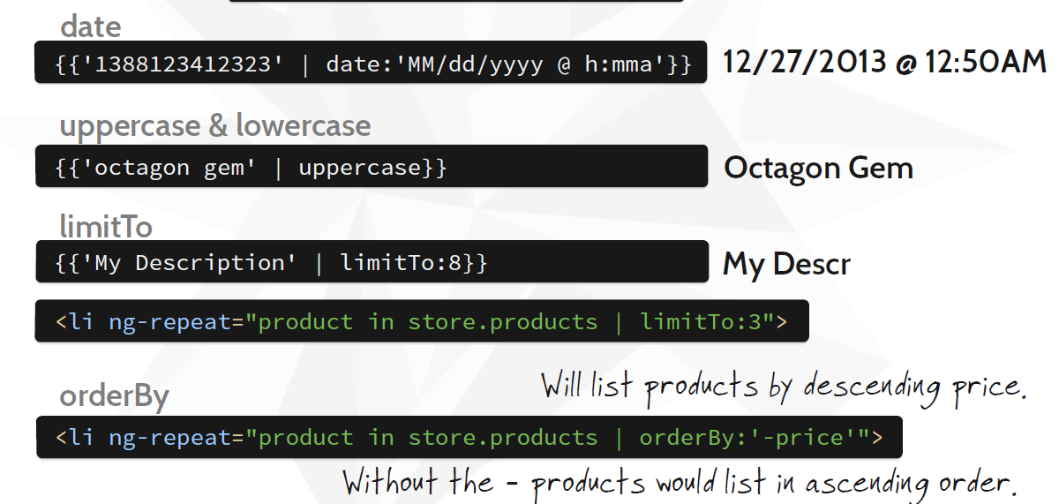
Filters - Examples

Slide 21
Scope
Scopes Scope object refers to the application model, used to evaluate expressions inside an application model.
{{companyName}} in a template can be evaluated against this scope object.
Scope has certain characteristics like $watch, $apply, $digest. What do they do?
$watch: Any mutation that occurs inside the model.
$apply: Updates the DOM - after the scope properties are changed.
$digest: Triggers after $apply. Notifies all the $watches.
Works as communicator between the controller and the view. Both the controller and the directive have a reference to scope. Every app has one root scope and may contain several child scopes. Scopes are arranged in hierarchical order similar to the DOM tree.

Slide 22
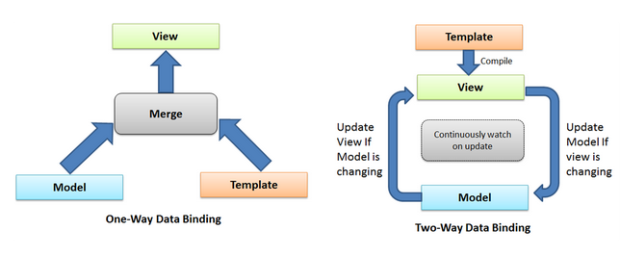
Data Binding

Slide 23
Working with Data
var Employee = {
Salutation: ‘Mr’,
firstname: ‘Rana',
Lastname: ‘Inturi’,
basicpay: 35000.00,
}

Slide 24
Directives
A Directive is a marker on a HTML tag that tells Angular to run or reference
<!DOCTYPE html>
<html>
<body ng-controller=“EmployeeController“>
. . .
</body>
</html>
Function EmployeeController() {
Alert(‘Hello, Rana’);
}

Slide 25
Directives - Binding
AngularJs provides many predefined data binding directives. ng-bind
Updates the text content of the specified HTML element with the expression value
Text content changes on expression changes
<h2 ng-bind="expression"> </h2>

Slide 26
Directives - Binding
ng-bind-html
Inserts the HTML content into the element in a secure way.
It uses the $sanitize service, so to use this functionality, be sure that $sanitize is available.
<h2 ng-bind="expression"> </h2>

Slide 27
Directives - Binding
ng-bind-template
Replaces the element text with the template content.
<h2 ng-bind-template="ng-bind-template=" {{expression1}} {{expression2}} … {{expressionn}} "> </h2>

Slide 28
Directives - Binding
ng-non-bindable
Informs AngularJs to not compile or bind the contents of the current DOM element
Useful when the expression should not be executed by AngularJs.
<h2 ng-non-bindable>{{expression}} </h2>

Slide 29
Directives - Binding
ng-model
Binds with any html element and custom form control.
Provides two-way binding.
Provides validation behaviour (keeps the state of the control - valid/invalid, dirty/pristine, touched/untouched etc).
<h2 ng-model=“expression”> </h2>

Slide 30
Directives
Ng-Show, ng-hide
The ngShow directive shows or hides the given HTML element based on the expression provided to the ngShow attribute.
<htmlelement ng-show="expression">
...
</htmlelement>
employedata-ngshow.html

Slide 31
Directives
Ng-repeat
The ngRepeat directive instantiates a template once per item from a collection. Each template instance gets its own scope, where the given loop variable is set to the current collection item, and $index is set to the item index or key.
<htmlelement ng-show="expression">
...
</htmlelement>
employedata-ngshow.html

Slide 32
Summary
Directives – HTML annotations that trigger Javascript behaviors
Modules – Where our application components live
Controllers – Where we add application behavior
Expressions – How values get displayed within the page

Slide 33
AngularJS - References AngularJS logo, some slides, content and examples are referred and used from the following sites.
Angularjs.org
Codeschool – shaping up with angular.js

Slide 34
AngularJS - further reading
Angularjs.org
https://angularjs.org/
https://www.codecademy.com/courses/learn-angularjs
Codeschool – shaping up with angular.js

Slide 35
AngularJS - further reading
Angularjs.org
https://angularjs.org/
https://www.codecademy.com/courses/learn-angularjs
Codeschool – shaping up with angular.js
http://tinyurl.com/AngularJSDemos

