Slide 1
Design Patterns
Subrahmanya ORUGANTI

Slide 2


Slide 3
Agenda
Introduction to Software Design
Introduction to Patterns
Design Patterns

Slide 4
Section A:
Introduction to Design

Slide 5
What Is Design?
Software design is a process of problem-solving and planning for a software solution. After the purpose and specifications of software is determined, software developers will design or employ designers to develop a plan for a solution. It includes low-level component and algorithm implementation issues as well as the architectural view.
Designing software is an exercise in managing complexity. The complexity exits within the software design itself, within the software organization of the company, and within the industry as a whole.

Slide 6
Symptoms of Rotting Design
Any application that exhibits the below signs is suffering from a design that is rotting from the inside out.
Rigidity
Rigidity is the tendency for software to be difficult to change, even in simple ways
Fragility
Fragility is the tendency of the software to break in many places every time it is changed
Immobility
Immobility is the inability to reuse software from other projects or from parts of the same project
Viscosity
When faced with a change, making the change in such a way that it won’t preserve the design

Slide 7
Section B:
Introduction to Patterns

Slide 8
The Three Layers Of Expertise
Patterns
Principles
Rules

Slide 9
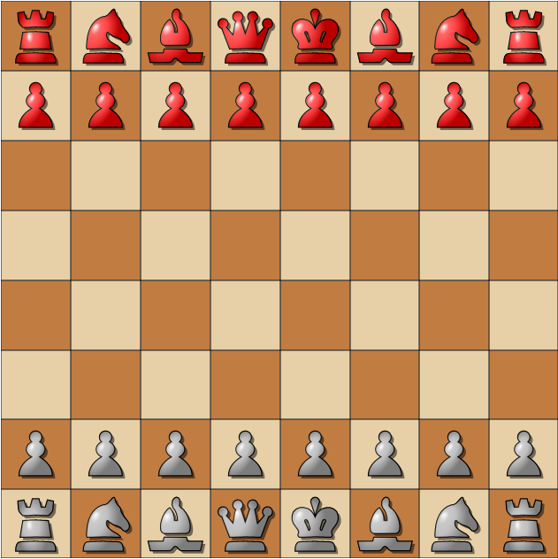
The Rules Of Chess
Board Layout
Piece Names
Movement Rules
Capture Rules

Slide 10

The Principles Of Chess
The relative value of the pieces
The importance of the center
The need to guard pieces
Threats and sacrifices
= 3

Slide 11

The Patterns Of Chess

Slide 12
The Rules of Software Design
Language Syntax
Standard Algorithms
Control statements
while (expression)
statement(s)
do statement(s)
while (expression);
for(for-init-statement(s); expression(s); expression(s))
statement(s)
InOrderTreeTraversal(Node node)
{
if (node !=null)
{
InOrderTreeTraversal(node.LeftNode);
Visit(node);
InOrderTreeTraversal(node.RightNode);
}
}
UML Notation
Common Data Structures
Class Name
State Variables
Operations
NULL

Slide 13
The Principles Of Software Design
Encapsulate what varies
Favour composition over inheritance
Program to interfaces, not to implementations
Strive for loosely coupled designs between objects that interact
Classes should be open for extension but closed for modification
Depend on abstraction. Do not depend on concrete classes
Delegate responsibilities
Class should have only one reason to change

Slide 14
What Is Design Pattern?
A solutions to a commonly occurring design problem
Help create flexible and reusable designs
Larger scope than a single class or algorithm
Describes the circumstances in which the pattern is applicable
Describes the consequences and trade-offs of using the pattern within a larger design
Language Independent

Slide 15
Benefits of Design Patterns
Establish a vocabulary
  Allows teams to communicate at a higher lever
  Reusing a technical solution allows you to focus on the business problem
  Makes design documentation easier to understand
Your code improves
  More maintainable: Less coupling, greater cohesion
  Internalize concepts of commonality vs. variability
Your productivity improves
  Why re-invent the wheel?

Slide 16
The Patterns Frame
OLTP
Object Oriented
Layered Architecture
Tiered Distribution
 | Data | Application | Deployment | Infrastructure
Architecture
Design
Implementation

Slide 17
Section C:
Design Patterns

Slide 18
GoF Design Patterns
Gang of Four (Erich Gamma, Richard Helm, Ralph Johnson, John Vlissides)
Creational | Structural | Behavioral
Abstract Factory | Adapter | Chain of Responsibility
Builder | Bridge | Command
Factory Method | Composite | Interpreter
Prototype | Decorator | Iterator
Singleton | Façade | Mediator
 | Flyweight | Memento
 | Proxy | Observer
 |  | State
 |  | Strategy
 |  | Template Method
 |  | Visitor

Slide 19
Pattern I

Slide 20
The Sorting Problem
class Employee
{
public int ID;
public String Name;
public String Designation;
public DateTime DateOfJoin;
public float Salary;
}
class EmployeeSorter
{
public void Sort(Employee[] employees)
{
for (int i = 0; i < employees.Length; i++)
{
for (int j = 0; j < employees.Length; j++)
{
if (employees[i].ID > employees[j].ID)
{
Employee temp = employees[j];
employees[j] = employees[i];
employees[i] = temp;
}
}
}
}

Slide 21
The Sorting Problem – Solution I
class EmployeeSorter
{
public void Sort(Employee[] employees, string sortBy)
{
for (int i = 0; i < employees.Length; i++)
{
for (int j = 0; j < employees.Length; j++)
{
bool isGrater = false;
switch (sortBy)
{
case "ID":
isGrater = employees[i].ID > employees[j].ID; break;
case "SALARY":
isGrater = employees[i].Salary > employees[j].Salary; break;
}
if (isGrater)
{
Employee temp = employees[j];
employees[j] = employees[i];
employees[i] = temp;
}
}
}
}
}

Slide 22
The Sorting Problem – Solution II
class EmployeeSorterByID
{
public void Sort(Employee[] employees)
{
for (int i = 0; i < employees.Length; i++)
{
for (int j = 0; j < employees.Length; j++)
{
if (employees[i].ID > employees[j].ID)
{
Employee temp = employees[j];
employees[j] = employees[i];
employees[i] = temp;
}
}
}
}
}
class EmployeeSorterBySalary
{
public void Sort(Employee[] employees)
{
for (int i = 0; i < employees.Length; i++)
{
for (int j = 0; j < employees.Length; j++)
{
if (employees[i].Salary > employees[j].Salary)
{
Employee temp = employees[j];
employees[j] = employees[i];
employees[i] = temp;
}
}
}
}
}

Slide 23
The Sorting Problem – Solution III
abstract class EmployeeSorter
{
public abstract int Compare(Employee e1, Employee e2);
public void Sort(Employee[] employees)
{
for (int i = 0; i < employees.Length; i++)
{
for (int j = 0; j < employees.Length; j++)
{
if (Compare(employees[i], employees[j]) > 0)
{
Employee temp = employees[j];
employees[j] = employees[i];
employees[i] = temp;
}
}
}
}
}
class EmployeeSorterByID : EmployeeSorter
{
public override int Compare(Employee e1, Employee e2)
{
if (e1.ID == e2.ID)
return 0;
return e1.ID > e2.ID ? 1 : 0;
}
}
class EmployeeSorterBySalary : EmployeeSorter
{
public override int Compare(Employee e1, Employee e2)
{
if (e1.Salary == e2.Salary)
return 0;
return e1.Salary > e2.Salary ? 1 : 0;
}
}

Slide 24
IS-A vs HAS-A (Inheritance vs Composition)
You can extract the volatile parts of your code and encapsulate them as objects, you can use those objects as you need them — and the entire task is handled by the code in such an object, it’s not spread out over generations of classes. Doing so allows you to customize your code by creating composites of objects. With composites, you select and use the objects you want, instead of having a rigid hard-coded internal way of doing things. That gives you a “has-a” relationship.
One object, one task often makes sense instead of writing multi-generation code where one task is spread out over a dozen generations. In other words, you’re reorganizing around the tasks, not around the generations of classes that inheritance gives you.
Using inheritance automatically sets things up in terms of strict, inclusive “is-a” relationships, which is more likely to cause maintenance and extensibility issues down the line. If you want to plan for change, it usually helps to think as much as you can in terms of “has-a” relationships, where your code has a number of objects whose code can be more easily updated as change happens.
When planning for change, consider “has-a” instead of “is-a” relationships, and put volatile code in the objects your application contains, rather than inheriting that code.

Slide 25
The Sorting Problem – Solution IV (Final)
interface IEmployeeComparer
{
int Compare(Employee e1, Employee e2);
}
class EmployeeSorter
{
public void Sort(Employee[] employees,
IEmployeeComparer comparer)
{
for (int i = 0; i < employees.Length; i++)
{
for (int j = 0; j < employees.Length; j++)
{
if (comparer.Compare(employees[i], employees[j]) > 0)
{
Employee temp = employees[j];
employees[j] = employees[i];
employees[i] = temp;
}
}
}
}
}
class EmployeeComparerByID : IEmployeeComparer
{
public int Compare(Employee e1, Employee e2)
{
if (e1.ID == e2.ID)
return 0;
return e1.ID > e2.ID ? 1 : 0;
}
}
class EmployeeComparerBySalary : IEmployeeComparer
{
public int Compare(Employee e1, Employee e2)
{
if (e1.Salary == e2.Salary)
return 0;
return e1.Salary > e2.Salary ? 1 : 0;
}
}

Slide 26
The Sorting Problem – Solution V (Final)
class EmployeeSorter
{
private IEmployeeComparer comparer = null;
public void setEmployeeComparer(IEmployeeComparer comparer)
{
comparer = comparer;
}
public void Sort(Employee[] employees)
{
if (comparer != null)
{
for (int i = 0; i < employees.Length; i++)
{
for (int j = 0; j < employees.Length; j++)
{
if (comparer.Compare(employees[i], employees[j]) > 0)
{
Employee temp = employees[j];
employees[j] = employees[i];
employees[i] = temp;
}
}
}
}
}
}

Slide 27
The Sorting Problem – Testing Solution
class TestSolutionV
{
public static void Main(String[] args)
{
Employee[] employees = <-Get employees from data source
EmployeeSorter sorter = new EmployeeSorter();
sorter.setEmployeeComparer(new EmployeeComparerByID());
sorter.Sort(employees);
Console.WriteLine("Employees: Order By ID");
PrintEmployees(employees);
sorter.setEmployeeComparer(new EmployeeComparerBySalary());
sorter.Sort(employees);
Console.WriteLine("Employees: Order By Salary");
PrintEmployees(employees);
}
private static void PrintEmployees(Employee[] employees)
{
for (int i = 0; i < employees.Length; i++)
{
Console.WriteLine(employees[i].Name);
}
}
}

Slide 28
Congratulations – You learnt Strategy (Policy) Pattern
Principles Applied
Separate what varies and encapsulate it in a class
Favour Composition over Inheritance
Open for Expansion and closed for Modification (Open-Closed Principle (OCP))
Advantages
EmployeeSorter class need not be changed by whatever the order the sorting could be.
The solution can be extended to support sorting by any clause, by implementing a new class by implementing the IEmployeeComparer interface.

Slide 29
Strategy (Policy) Pattern – GoF Definition
Define a family of algorithms, encapsulate each one, and make them interchangeable.
Strategy lets the algorithm vary independently from clients that use it.

Slide 30
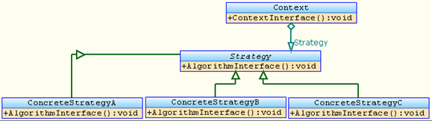
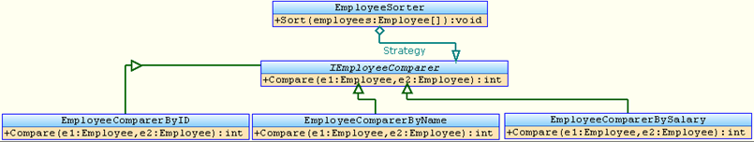
Strategy Pattern - UML Representation

Slide 31
Strategy Pattern - Q & A
?

Slide 32
Pattern II

Slide 33
The Connection Problem
class Employee
{
public int ID;
public String Name;
public float Salary;
}
class EmployeeDataAccessClass
{
public void Insert(Employee e)
{
String selectStatement = String.Format("INSERT INTO EMP VALUES({0},’{1}’,{2})", e.ID, e.Name, e.Salary);
OracleConnection con = new OracleConnection(<-ConnectionString);
OracleCommand cmd = con.CreateCommand();
cmd.CommandText = selectStatement;
con.Open();
cmd.ExecuteNonQuery();
con.Close();
}
}

Slide 34
The Connection Problem – Solution I
class EmployeeDataAccessClass
{
public void Insert(Employee e)
{
String selectStatement = String.Format("INSERT INTO EMP VALUES({0},’{1}’,{2})", e.ID, e.Name, e.Salary);
DbConnection con = null;
switch (<-Db Type)
{
case "ORACLE":
con = new OracleConnection(<-ConnectionString); break;
case "SQLSERVER":
con = new SqlConnection(<-ConnectionString); break;
}
DbCommand cmd = con.CreateCommand();
cmd.CommandText = selectStatement;
con.Open();
cmd.ExecuteNonQuery();
con.Close();
}
}

Slide 35
The Connection Problem – Solution II
class EmployeeDataAccessClassForOracle
{
public void Insert(Employee e)
{
String selectStatement = String.Format("INSERT INTO EMP VALUES({0},’{1}’,{2})", e.ID, e.Name, e.Salary);
DbConnection con = new OracleConnection(<-ConnectionString);
DbCommand cmd = con.CreateCommand();
cmd.CommandText = selectStatement;
con.Open();
cmd.ExecuteNonQuery();
con.Close();
}
}
class EmployeeDataAccessClassForSqlServer
{
public void Insert(Employee e)
{
String selectStatement = String.Format("INSERT INTO EMP VALUES({0},’{1}’,{2})", e.ID, e.Name, e.Salary);
DbConnection con = new SqlConnection(<-ConnectionString);
DbCommand cmd = con.CreateCommand();
cmd.CommandText = selectStatement;
con.Open();
cmd.ExecuteNonQuery();
con.Close();
}
}

Slide 36
The Connection Problem – Solution III
abstract class EmployeeDataAccessClass
{
protected abstract DbConnection CreateConnection();
public void Insert(Employee e)
{
String selectStatement = String.Format("INSERT INTO EMP VALUES({0},’{1}’,{2})", e.ID, e.Name, e.Salary);
DbConnection con = CreateConnection();
DbCommand cmd = con.CreateCommand();
cmd.CommandText = selectStatement;
con.Open();
cmd.ExecuteNonQuery();
con.Close();
}
}
class EmployeeDataAccessClassForOracle : EmployeeDataAccessClass
{
protected override DbConnection CreateConnection()
{
return new OracleConnection(<-ConnectionString);
}
}
class EmployeeDataAccessClassForSqlServer : EmployeeDataAccessClass
{
protected override DbConnection CreateConnection()
{
return new SqlConnection(<-ConnectionString);
}
}

Slide 37
The Connection Problem – Solution IV
class ConnectionFactory
{
public static DbConnection CreateConnection(String dbType)
{
switch (dbType)
{
case "ORACLE": return new OracleConnection(<-ConnectionString);
case "SQLSERVER": return new SqlConnection(<-ConnectionString);
}
return null;
}
}
class EmployeeDataAccessClass
{
public void Insert(Employee e)
{
String selectStatement = String.Format("INSERT INTO EMP VALUES({0},’{1}’,{2})", e.ID, e.Name, e.Salary);
DbConnection con = ConnectionFactory.CreateConnection(<-Db Type);
if (con != null)
{
DbCommand cmd = con.CreateCommand();
cmd.CommandText = selectStatement;
con.Open();
cmd.ExecuteNonQuery();
con.Close();
}
}
}

Slide 38
The Connection Problem – Solution V (Final)
class ConnectionFactory
{
public virtual DbConnection CreateConnection(String dbType)
{
switch (dbType)
{
case "ORACLE": return new OracleConnection(<-ConnectionString);
case "SQLSERVER": return new SqlConnection(<-ConnectionString);
}
return null;
}
}
class EmployeeDataAccessClass
{
public void Insert(Employee e)
{
String selectStatement = String.Format("INSERT INTO EMP VALUES({0},’{1}’,{2})", e.ID, e.Name, e.Salary);
ConnectionFactory factory = new ConnectionFactory();
DbConnection con = factory.CreateConnection(<-Db Type);
if (con != null)
{
DbCommand cmd = con.CreateCommand();
cmd.CommandText = selectStatement;
con.Open();
cmd.ExecuteNonQuery();
con.Close();
}
}
}

Slide 39
The Connection Problem – Solution V (Final)
class ExtendedConnectionFactory : ConnectionFactory
{
public override DbConnection CreateConnection(String dbType)
{
switch (dbType)
{
case “MYSQL": return new MySqlConnection(<-ConnectionString);
}
return base.CreateConnection(dbType);
}
}
class EmployeeDataAccessClass
{
public void Insert(Employee e)
{
String selectStatement = String.Format("INSERT INTO EMP VALUES({0},’{1}’,{2})", e.ID, e.Name, e.Salary);
ConnectionFactory factory = new ExtendedConnectionFactory();
DbConnection con = factory.CreateConnection(<-Db Type);
if (con != null)
{
DbCommand cmd = con.CreateCommand();
cmd.CommandText = selectStatement;
con.Open();
cmd.ExecuteNonQuery();
con.Close();
}
}
}

Slide 40
Congratulations – You learnt Factory Method Pattern
Principles Applied
Separate what varies and encapsulate it in a class
Favour Composition over Inheritance
Open for Expansion and closed for Modification (Open-Closed Principle (OCP))
Delegation of Responsibility
Advantages
EmployeeDataAccessClass class and any other data access classes need not be changed whatever the dbType could be. The only class that will be changed by adding/removing a new dbType is “ConnectionFactory”.
The solution can be extended to support any kind of dbType if its Connection class is derived from DbConnection.

Slide 41
Factory Method Pattern – GoF Definition
Define an interface for creating an object, but let subclasses decide which class to instantiate.
Factory Method lets a class defer instantiation to subclasses.

Slide 42
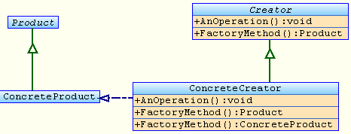
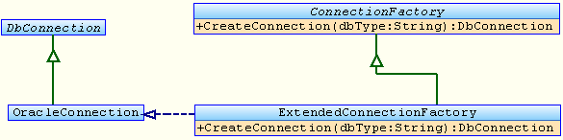
Factory Method Pattern - UML Representation

Slide 43
Factory Method Pattern - Q & A
?

Slide 44
Pattern III

Slide 45
The Notification Problem
class SystemClock
{
public DateTime Current;
}
Assume that:
This class monitors the hardware clock and the field “Current” is updated after every second.

Slide 46
The Notification Problem – Solution I
class DigitalClock
{
SystemClock sysClockObj =<-Get it from global
public void Start()
{
DateTime current = sysClockObj.Current;
while (true)
{
if (sysClockObj.Current != current)
{
current = sysClockObj.Current;
renderDateTime(current);
}
}
}
private void renderDateTime(DateTime dt)
{
<-Rendering logic
}
}
class AlaramClock
{
private List<DateTime> alarams = new List<DateTime>();
SystemClock sysClockObj =<-Get it from global
public void Start()
{
DateTime current = sysClockObj.Current;
while (true)
{
if (sysClockObj.Current != current)
{
current = sysClockObj.Current;
if (alarams.Contains(current))
{
playAlarm();
alarams.Remove(current);
}
}
}
}
private void playAlarm()
{
<-Alarm logic
}
public void AddAlaram(DateTime dt)
{
if (!alarams.Contains(dt))
alarams.Add(dt);
}
}

Slide 47
The Notification Problem – Solution II – Slide I
interface ISystemClockSubscriber
{
void UpdateTime(DateTime dt);
}
class SystemClock
{
private DateTime Current;
private List<ISystemClockSubscriber> subscribers = new List<ISystemClockSubscriber>();
public void TimeChanged(DateTime dt)
{
Current = dt;
for (int i = 0; i < subscribers.Count; i++)
{
subscribers[i].UpdateTime(Current);
}
}
public void Subscribe(ISystemClockSubscriber subscriber)
{
subscribers.Add(subscriber);
}
public void Unsubscribe(ISystemClockSubscriber subscriber)
{
subscribers.Remove(subscriber);
}
}

Slide 48
The Notification Problem – Solution II – Slide II
class DigitalClock : ISystemClockSubscriber
{
SystemClock sysClockObj =<-Get it from global
public void Start()
{
sysClockObj.Subscribe(this);
}
public void UpdateTime(DateTime dt)
{
renderDateTime(dt);
}
private void renderDateTime(DateTime dt)
{
<-Rendering logic
}
}
class AlaramClock : ISystemClockSubscriber
{
private List<DateTime> alarams = new List<DateTime>();
SystemClock sysClockObj =<-Get it from global
public void Start()
{
sysClockObj.Subscribe(this);
}
public void UpdateTime(DateTime dt)
{
if (alarams.Contains(dt))
{
playAlaram();
alarams.Remove(dt);
}
}
private void playAlaram()
{
<-Alarm Logic
}
public void AddAlaram(DateTime dt)
{
if (!alarams.Contains(dt))
alarams.Add(dt);
}
}

Slide 49
The Notification Problem – Solution III (Final) – Slide I
interface ISystemClockSubscriber
{
void UpdateTime(DateTime dt);
}
interface ISystemClockPublisher
{
void Subscribe(ISystemClockSubscriber subscriber);
void Unsubscribe(ISystemClockSubscriber subscriber);
}
class SystemClock : ISystemClockPublisher
{
private DateTime Current;
private List<ISystemClockSubscriber> subscribers = new List<ISystemClockSubscriber>();
public void TimeChanged(DateTime dt)
{
Current = dt;
for (int i = 0; i < subscribers.Count; i++)
subscribers[i].UpdateTime(Current);
}
public void Subscribe(ISystemClockSubscriber subscriber)
{
subscribers.Add(subscriber);
}
public void Unsubscribe(ISystemClockSubscriber subscriber)
{
subscribers.Remove(subscriber);
}
}

Slide 50
The Notification Problem – Solution III (Final) – Slide II
class DigitalClock : ISystemClockSubscriber
{
ISystemClockPublisher publisher =<-Get from global
public void Start()
{
publisher.Subscribe(this);
}
public void UpdateTime(DateTime dt)
{
renderDateTime(dt);
}
private void renderDateTime(DateTime dt)
{
<-Rendering logic
}
}
class AlaramClock : ISystemClockSubscriber
{
private List<DateTime> alarams = new List<DateTime>();
ISystemClockPublisher publisher =<-Get from global
public void Start()
{
publisher.Subscribe(this);
}
public void UpdateTime(DateTime dt)
{
if (alarams.Contains(dt))
{
playAlarm();
alarams.Remove(dt);
}
}
private void playAlarm()
{
<-Alarm Logic
}
public void AddAlaram(DateTime dt)
{
if (!alarams.Contains(dt))
alarams.Add(dt);
}
}

Slide 51
Congratulations – You learnt Observer Pattern
Principles Applied
Delegation of Responsibility
Don’t call me. I will call you. (Hollywood Principle)
Advantages
Any number of subscribers can subscribe / Unsubscribe to the publisher.
The publisher and subscribers are loosely coupled (need not know each other) as they are communicating based on the contract.
The responsibility of notifying the change is delegated to the subject (publisher) itself instead of all the objects monitoring the subject in a infinitive loop.

Slide 52
Observer Pattern – GoF Definition
Define a one-to-many dependency between objects so that when one object changes state, all its dependents are notified and updated automatically.

Slide 53
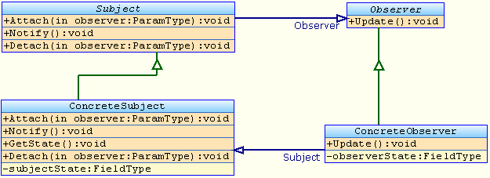
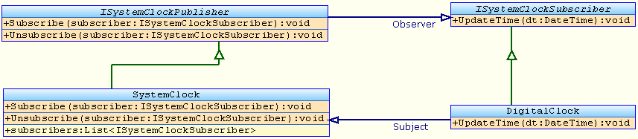
Observer Pattern - UML Representation

Slide 54
Observer Pattern - Q & A
?

Slide 55
Pattern IV

Slide 56
The Single Instance Problem
class SystemClock : ISystemClockPublisher
{
private DateTime Current;
private List<ISystemClockSubscriber> subscribers = new List<ISystemClockSubscriber>();
public void TimeChanged(DateTime dt)
{
Current = dt;
for (int i = 0; i < subscribers.Count; i++)
subscribers[i].UpdateTime(Current);
}
public void Subscribe(ISystemClockSubscriber subscriber)
{
subscribers.Add(subscriber);
}
public void Unsubscribe(ISystemClockSubscriber subscriber)
{
subscribers.Remove(subscriber);
}
}

Slide 57
The Single Instance Problem – Solution I
sealed class SystemClock : ISystemClockPublisher
{
private List<ISystemClockSubscriber> subscribers = new List<ISystemClockSubscriber>();
private static SystemClock instance = new SystemClock();
private SystemClock()
{
}
public static SystemClock GetInstance()
{
return instance;
}
public void Subscribe(ISystemClockSubscriber subscriber)
{
subscribers.Add(subscriber);
}
public void Unsubscribe(ISystemClockSubscriber subscriber)
{
subscribers.Remove(subscriber);
}
}

Slide 58
The Single Instance Problem – Solution II
sealed class SystemClock : ISystemClockPublisher
{
private List<ISystemClockSubscriber> subscribers = new List<ISystemClockSubscriber>();
private static SystemClock _instance = null;
private SystemClock()
{
}
public static SystemClock GetInstance()
{
if (_instance == null)
{
_instance = new SystemClock();
}
return instance;
}
public void Subscribe(ISystemClockSubscriber subscriber)
{
subscribers.Add(subscriber);
}
public void Unsubscribe(ISystemClockSubscriber subscriber)
{
subscribers.Remove(subscriber);
}
}

Slide 59
The Single Instance Problem – Solution III
sealed class SystemClock : ISystemClockPublisher
{
private List<ISystemClockSubscriber> subscribers = new List<ISystemClockSubscriber>();
private static SystemClock _instance = null;
private static Object _syncLock = new Object();
private SystemClock()
{
}
public static SystemClock GetInstance()
{
lock (_syncLock)
{
if (_instance == null)
{
_instance = new SystemClock();
}
return _instance;
}
}
public void Subscribe(ISystemClockSubscriber subscriber)
{
subscribers.Add(subscriber);
}
public void Unsubscribe(ISystemClockSubscriber subscriber)
{
subscribers.Remove(subscriber);
}
}

Slide 60
The Single Instance Problem – Solution IV (Final)
sealed class SystemClock : ISystemClockPublisher
{
private List<ISystemClockSubscriber> subscribers = new List<ISystemClockSubscriber>();
private static SystemClock _instance = null;
private static Object _syncLock = new Object();
private SystemClock()
{
}
public static SystemClock GetInstance()
{
if (_instance == null)
{
lock (_syncLock)
{
if (_instance == null)
{
_instance = new SystemClock();
}
}
}
return _instance;
}
public void Subscribe(ISystemClockSubscriber subscriber)
{
subscribers.Add(subscriber);
}
public void Unsubscribe(ISystemClockSubscriber subscriber)
{
subscribers.Remove(subscriber);
}
}

Slide 61
Congratulations – You learnt Singleton Pattern
Principles Applied
Delegation of Responsibility
Advantages
There will be only one instance for the class “SystemClock” even in multithreaded environment.
Supports lazy creation and initialization. (NOTE: This is not an added advantage in .NET as in .NET, CLR always does lazy creation and initialization)
The responsibility of creating instance is delegated to the same class itself.
It is a good alternative for static class if the class has to implement any contract (Interface)

Slide 62
Singleton Pattern – GoF Definition
Ensure a class only has one instance, and provide a global point of access to it.

Slide 63


Singleton Pattern - UML Representation

Slide 64
Singleton Pattern - Q & A
?

Slide 65
Pattern V

Slide 66
The Complex Interface Problem
class CoffeeMachine
{
public void SendMilkToContainer(float quantity)
{
<-Logic
}
public void SendSugarToContainer(int quantity)
{
<-Logic
}
public void SendDecoctionToContainer(float quantity)
{
<-Logic
}
public void MixWell()
{
<-Logic
}
public void Pour()
{
<-Logic
}
}

Slide 67
The Complex Interface Problem
To get Coffee
CoffeeMachine machine = new CoffeeMachine();
machine.SendMilkToContainer(0.5f);
machine.SendDecoctionToContainer(0.5f);
machine.SendSugarToContainer(1);
machine.MixWell();
machine.Pour();
To get Black Coffee
CoffeeMachine machine = new CoffeeMachine();
machine.SendDecoctionToContainer(1);
machine.SendSugarToContainer(1);
machine.MixWell();
machine.Pour();
To get Sweet Milk
CoffeeMachine machine = new CoffeeMachine();
machine.SendMilkToContainer(1);
machine.SendSugarToContainer(1);
machine.MixWell();
machine.Pour();
To get Only Milk
CoffeeMachine machine = new CoffeeMachine();
machine.SendMilkToContainer(1);
machine.Pour();

Slide 68
The Complex Interface Problem – Solution I (Final)
class CoffeeMachine
{
public void GetCoffee()
{
SendMilkToContainer(0.5f);
SendDecoctionToContainer(0.5f);
SendSugarToContainer(1);
Pour();
}
public void GetBlackCoffee()
{
SendDecoctionToContainer(1);
SendSugarToContainer(1);
Pour();
}
public void GetSweetMilk()
{
SendMilkToContainer(1);
SendSugarToContainer(1);
Pour();
}
public void GetOnlyMilk()
{
SendMilkToContainer(1);
Pour();
}
private void SendMilkToContainer(float quantity) { <-Logic }
private void SendSugarToContainer(int quantity) { <-Logic }
private void SendDecoctionToContainer(float quantity) { <-Logic }
private void MixWell() { <-Logic }
private void Pour() { <-Logic }
}
To get Coffee
CoffeeMachine machine = new CoffeeMachine();
machine.GetCoffee();
To get Black Coffee
CoffeeMachine machine = new CoffeeMachine();
machine.GetBlackCoffee();
To get Sweet Milk
CoffeeMachine machine = new CoffeeMachine();
machine.GetSweetMilk();
To get Only Milk
CoffeeMachine machine = new CoffeeMachine();
machine.GetOnlyMilk();

Slide 69
Congratulations – You learnt FAÇADE Pattern
Principles Applied
Delegation of Responsibility
Abstraction
Advantages
It simplifies the usage of the class. Communication to the subsystem is simplified in such a way that the consumer of the class need not make n calls to make the work done
The complexities are abstracted.

Slide 70
FAÇADE Pattern – GoF Definition
Provide a unified interface to a set of interfaces in a subsystem. Facade defines a higher-level interface that makes the subsystem easier to use.

Slide 71
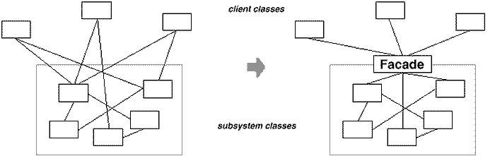
FAÇADE Pattern - UML Representation

Slide 72
FAÇADE Pattern - Q & A
?

Slide 73
Pattern VI

Slide 74
The Incompatibility Problem
interface IUniversalCoffeeMachine
{
void GetCoffee();
void GetBlackCoffee();
void GetSweetMilk();
void GetOnlyMilk();
}
class UniversalCoffeeMachineConsole
{
private IUniversalCoffeeMachine _machine = null;
public UniversalCoffeeMachineConsole(IUniversalCoffeeMachine machine)
{
_machine = machine;
}
private void ButtonPressed(Button b)
{
switch (b.Name)
{
case "COFFEE": _machine.GetCoffee();
return;
case "BLACKCOFFEE": _machine.GetBlackCoffee();
return;
case "SWEETMILK": _machine.GetSweetMilk();
return;
case "ONLYMILK": _machine.GetOnlyMilk();
return;
}
}
}

Slide 75
The Incompatibility Problem – Solution I (Final)-Slide I
class CoffeeMachineByBru
{
public void SendMilkToContainer(float quantity)
{
<-Logic
}
public void SendSugarToContainer(int quantity)
{
<-Logic
}
public void SendDecoctionToContainer(float quantity)
{
<-Logic
}
public void MixWell()
{
<-Logic
}
public void Pour()
{
<-Logic
}
}

Slide 76
The Incompatibility Problem – Solution I (Final)-Slide II
class CoffeeMachineByBruAdapter : IUniversalCoffeeMachine
{
private CoffeeMachineByBru _adaptee = null;
public CoffeeMachineByBruAdapter()
{
_adaptee = new CoffeeMachineByBru();
}
public void GetCoffee()
{
_adaptee.SendMilkToContainer(0.5f);
_adaptee.SendDecoctionToContainer(0.5f);
_adaptee.SendSugarToContainer(1);
_adaptee.Pour();
}
public void GetBlackCoffee()
{
_adaptee.SendDecoctionToContainer(1);
_adaptee.SendSugarToContainer(1);
_adaptee.Pour();
}
public void GetSweetMilk()
{
_adaptee.SendMilkToContainer(1);
_adaptee.SendSugarToContainer(1);
_adaptee.Pour();
}
public void GetOnlyMilk()
{
_adaptee.SendMilkToContainer(1);
_adaptee.Pour();
}
}

Slide 77
Congratulations – You learnt Adapter (Wrapper) Pattern
Principles Applied
Delegation of Responsibility
Advantages
The Adapter makes an “incompatible” object “compatible” by your application.

Slide 78
Adapter Pattern – GoF Definition
Convert the interface of a class into another interface clients expect.
Adapter lets classes work together that couldn't otherwise because of incompatible interfaces.

Slide 79
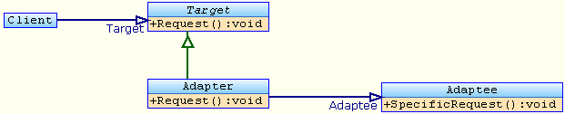
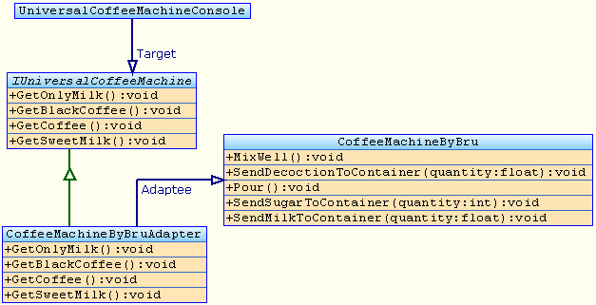
Adapter Pattern - UML Representation

Slide 80
Adapter Pattern - Q & A
?

Slide 81
Pattern VII

Slide 82
The Reusability Problem
class Employee
{
public int ID;
public String Name;
public decimal Salary;
}
class Department
{
public int ID;
public String Name;
public int ManagerID;
}

Slide 83
The Reusability Problem
class EmployeeDao
{
public List<Employee> GetAll()
{
return getOneOrMore("SELECT * FROM EMP");
}
private List<Employee> getOneOrMore(String commandText)
{
IDataReader reader = getReader(commandText);
List<Employee> emps = new List<Employee>();
while (reader.Read())
{
Employee emp = populateFromReader(reader); emps.Add(emp);
}
return emps;
}
public Employee GetById(int id)
{
List<Employee> emps = getOneOrMore(String.Format("SELECT * FROM EMP WHERE EID={0}", id));
return emps.Count > 0 ? emps[0] : null;
}
private IDataReader getReader(String commandText)
{
DbConnection con = ConnectionFactory.CreateConnection(<-DB Type);
DbCommand com = con.CreateCommand();
com.CommandText = commandText;
con.Open();
return com.ExecuteReader();
}
private Employee populateFromReader(IDataReader reader)
{
Employee emp = new Employee(); emp.ID = Convert.ToInt32(reader["EID"]);
emp.Name = Convert.ToString(reader["ENAME"]); emp.Salary = Convert.ToDecimal(reader["SAL"]);
return emp;
}
}

Slide 84
The Reusability Problem
class DepartmentDao
{
public List<Department> GetAll()
{
return getOneOrMore("SELECT * FROM DEPT");
}
private List<Department> getOneOrMore(String commandText)
{
IDataReader reader = getReader(commandText);
List<Department> depts = new List<Department>();
while (reader.Read())
{
Department dept = populateFromReader(reader); depts.Add(dept);
}
return depts;
}
public Department GetById(int id)
{
List<Department> depts = getOneOrMore(String.Format("SELECT * FROM DEPT WHERE DID={0}", id));
return depts.Count > 0 ? depts[0] : null;
}
private IDataReader getReader(String commandText)
{
DbConnection con = ConnectionFactory.CreateConnection(<-DB Type);
DbCommand com = con.CreateCommand();
com.CommandText = commandText;
con.Open();
return com.ExecuteReader();
}
private Department populateFromReader(IDataReader reader)
{
Department dept = new Department(); dept.ID = Convert.ToInt32(reader["DID"]);
dept.Name = Convert.ToString(reader["DNAME"]); dept.ManagerID = Convert.ToInt32(reader["MGRID"]);
return dept;
}
}

Slide 85
The Reusability Problem – Solution I
abstract class GeneralDao
{
protected abstract String getCommandForAll();
protected abstract String getCommandForSingle(int id);
protected abstract Object populateFromReader(IDataReader reader);
public List<Object> GetAll()
{
return getOneOrMore(getCommandForAll());
}
private List<Object> getOneOrMore(String commandText)
{
IDataReader reader = getReader(commandText);
List<Object> objs = new List<Object>();
while (reader.Read())
{
Object obj = populateFromReader(reader);
objs.Add(obj);
}
return objs;
}
public Object GetById(int id)
{
List<Object> objs = getOneOrMore(getCommandForSingle(id));
return objs.Count > 0 ? objs[0] : null;
}
private IDataReader getReader(String commandText)
{
DbConnection con = ConnectionFactory.CreateConnection(<-DB Type);
DbCommand com = con.CreateCommand();
com.CommandText = commandText;
con.Open();
return com.ExecuteReader();
}
}

Slide 86
The Reusability Problem – Solution II (Final) – Slide I
abstract class GenericDao<T> where T:class
{
protected abstract String getCommandForAll();
protected abstract String getCommandForSingle(int id);
protected abstract T populateFromReader(IDataReader reader);
public List<T> GetAll()
{
return getOneOrMore(getCommandForAll());
}
private List<T> getOneOrMore(String commandText)
{
IDataReader reader = getReader(commandText);
List<T> objs = new List<T>();
while (reader.Read())
{
T obj = populateFromReader(reader);
objs.Add(obj);
}
return objs;
}
public T GetById(int id)
{
List<T> objs = getOneOrMore(getCommandForSingle(id));
return objs.Count > 0 ? objs[0] : null;
}
private IDataReader getReader(String commandText)
{
DbConnection con = ConnectionFactory.CreateConnection("ORACLE");
DbCommand com = con.CreateCommand();
com.CommandText = commandText;
con.Open();
return com.ExecuteReader();
}
}

Slide 87
The Reusability Problem – Solution II (Final) – Slide II
class EmployeeDao:GenericDao<Employee>
{
protected override String getCommandForAll()
{
return "SELECT * FROM EMP";
}
protected override String getCommandForSingle(int id)
{
return String.Format("SELECT * FROM EMP WHERE EID={0}", id);
}
protected override Employee populateFromReader(IDataReader reader)
{
Employee emp = new Employee(); emp.ID = Convert.ToInt32(reader["EID"]);
emp.Name = Convert.ToString(reader["ENAME"]); emp.Salary = Convert.ToDecimal(reader["SAL"]);
return emp;
}
}
class DepartmentDao:GenericDao<Department>
{
protected override String getCommandForAll()
{
return "SELECT * FROM DEPT";
}
protected override String getCommandForSingle(int id)
{
return String.Format("SELECT * FROM DEPT WHERE DID={0}", id);
}
protected override Department populateFromReader(IDataReader reader)
{
Department dept = new Department(); dept.ID = Convert.ToInt32(reader["DID"]);
dept.Name = Convert.ToString(reader["DNAME"]); dept.ManagerID = Convert.ToInt32(reader["MGRID"]);
return dept;
}
}

Slide 88
Congratulations – You learnt Template Method Pattern
Principles Applied
Generalization
Abstraction
Advantages
Effective code re-use
Centralized control over the algorithm
Allows subclasses to customize the steps of the algorithm

Slide 89
Template Method Pattern – GoF Definition
Define the skeleton of an algorithm in an operation, deferring some steps to subclasses.
Template Method lets subclasses redefine certain steps of an algorithm without changing the algorithm's structure.

Slide 90
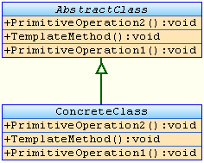
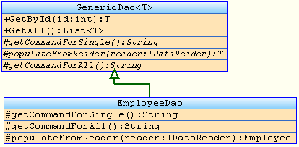
Template Method Pattern - UML Representation

Slide 91
Template Method Pattern - Q & A
?

Slide 92

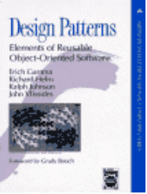


Resources
Design Patterns For Dummies by Steve Holzner
Design Patterns: Elements of Reusable Object-Oriented Software by Gamma, Helm, Johnson, and Vlissides
Design Patterns Explained: A New Perspective on Object Oriented Design by Shalloway and Trott
Anti-Patterns: Refactoring Software, Architectures and Projects in Crisis by Brown, Malveau, McCormick, and Mowbray

Slide 93
Design Patterns – Q & A
?

Slide 94
Thank You

