Slide 1


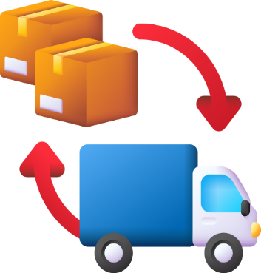
FMCG
SUPPLY CHAIN ANALYSIS
PRESENTED BY RAJESH

Slide 2

Agenda

Slide 3
Agenda
About Company

Slide 4
Agenda
About Company
Problem Statement

Slide 5
Agenda
About Company
Problem Statement
Management request

Slide 6
Agenda
About Company
Problem Statement
Management request
Key service metrics

Slide 7
Agenda
About Company
Problem Statement
Management request
Key service metrics
My Role in this project

Slide 8
Agenda
About Company
Problem Statement
Management request
Key service metrics
My Role in this project
Data sets

Slide 9
Agenda
About Company
Problem Statement
Management request
Key service metrics
My Role in this project
Data sets
Dashboard

Slide 10
Agenda
About Company
Problem Statement
Management request
Key service metrics
My Role in this project
Data sets
Dashboard
Insights

Slide 11


About Company

Slide 12
About Company
AtliQ Mart is a growing FMCG manufacturer headquartered in Gujarat, India. It is currently operational in three cities

Slide 13
About Company
AtliQ Mart is a growing FMCG manufacturer headquartered in Gujarat, India. It is currently operational in three cities
Surat

Slide 14
About Company
AtliQ Mart is a growing FMCG manufacturer headquartered in Gujarat, India. It is currently operational in three cities
Surat
Ahmedabad

Slide 15
About Company
AtliQ Mart is a growing FMCG manufacturer headquartered in Gujarat, India. It is currently operational in three cities
Surat
Ahmedabad
Vadodara.

Slide 16
Problem Statement

Slide 17
Problem Statement
AtliQ Mart aims to expand its operations to other metro cities within the next two years.

Slide 18
Problem Statement
AtliQ Mart aims to expand its operations to other metro cities within the next two years.
However, the company is currently facing a critical challenge. Several key customers have not renewed their annual contracts due to service issues.

Slide 19
Problem Statement
AtliQ Mart aims to expand its operations to other metro cities within the next two years.
However, the company is currently facing a critical challenge. Several key customers have not renewed their annual contracts due to service issues.
These problems are mainly related to the delivery of essential products.

Slide 20
Problem Statement
AtliQ Mart aims to expand its operations to other metro cities within the next two years.
However, the company is currently facing a critical challenge. Several key customers have not renewed their annual contracts due to service issues.
These problems are mainly related to the delivery of essential products.
On several occasions, these products were either not delivered “on time” or not delivered “in full” over an extended period.

Slide 21
Problem Statement
AtliQ Mart aims to expand its operations to other metro cities within the next two years.
However, the company is currently facing a critical challenge. Several key customers have not renewed their annual contracts due to service issues.
These problems are mainly related to the delivery of essential products.
On several occasions, these products were either not delivered “on time” or not delivered “in full” over an extended period.
This has resulted in poor customer service and dissatisfaction.

Slide 22
Management Request

Slide 23
Management Request
Management has identified service issues and aims to address them before expanding to new cities.

Slide 24
Management Request
Management has identified service issues and aims to address them before expanding to new cities.
They have instructed the supply chain analytics team to monitor daily 'On-time' and 'In Full' delivery service levels for all customers to enable prompt issue resolution.

Slide 25
Key Service Metrics

Slide 26
Key Service Metrics
The Supply Chain team employs a standardized approach for measuring service levels.

Slide 27
Key Service Metrics
The Supply Chain team employs a standardized approach for measuring service levels.
Key metrics include

Slide 28
Key Service Metrics
The Supply Chain team employs a standardized approach for measuring service levels.
Key metrics include
Total Orders

Slide 29
Key Service Metrics
The Supply Chain team employs a standardized approach for measuring service levels.
Key metrics include
Total Orders
Total Orders Lines

Slide 30
Key Service Metrics
The Supply Chain team employs a standardized approach for measuring service levels.
Key metrics include
Total Orders
Total Orders Lines
On-time delivery (OT)%

Slide 31
Key Service Metrics
The Supply Chain team employs a standardized approach for measuring service levels.
Key metrics include
Total Orders
Total Orders Lines
On-time delivery (OT)%
In-full delivery(IF)%

Slide 32
Key Service Metrics
The Supply Chain team employs a standardized approach for measuring service levels.
Key metrics include
Total Orders
Total Orders Lines
On-time delivery (OT)%
In-full delivery(IF)%
Line Fill Rate (LIFR)%

Slide 33
Key Service Metrics
The Supply Chain team employs a standardized approach for measuring service levels.
Key metrics include
Total Orders
Total Orders Lines
On-time delivery (OT)%
In-full delivery(IF)%
Line Fill Rate (LIFR)%
Volume Fill Rate (VOFR)%

Slide 34
Key Service Metrics
The Supply Chain team employs a standardized approach for measuring service levels.
Key metrics include
Total Orders
Total Orders Lines
On-time delivery (OT)%
In-full delivery(IF)%
Line Fill Rate (LIFR)%
Volume Fill Rate (VOFR)%
The team monitors 'Total Order' and 'Total Order Lines ' for daily customer orders.

Slide 35
Key Service Metrics
The Supply Chain team employs a standardized approach for measuring service levels.
Key metrics include
Total Orders
Total Orders Lines
On-time delivery (OT)%
In-full delivery(IF)%
Line Fill Rate (LIFR)%
Volume Fill Rate (VOFR)%
The team monitors 'Total Order' and 'Total Order Lines ' for daily customer orders.
These metrics are compared against the target service levels established for each customer.

Slide 36
My Role In This Project

Slide 37
My Role In This Project
Hi, I’m Rajesh, the data analyst in the supply chain team at AtliQ Mart.

Slide 38
My Role In This Project
Hi, I’m Rajesh, the data analyst in the supply chain team at AtliQ Mart.
I recently joined the company and briefed about the task in the stakeholder business review meeting.

Slide 39
My Role In This Project
Hi, I’m Rajesh, the data analyst in the supply chain team at AtliQ Mart.
I recently joined the company and briefed about the task in the stakeholder business review meeting.
Today, I'm excited to discuss the role I'll be building a dashboard to address the supply chain challenges.

Slide 40
Data Sets Tables
Dim-date
Dim-customer
Dim-Products
Dim-Targets-Orders
Fact-Order-Lines
Fact-Order-Aggregate
Notes:
The Data is Available Only for 6 months from March to August of 2022

Slide 41
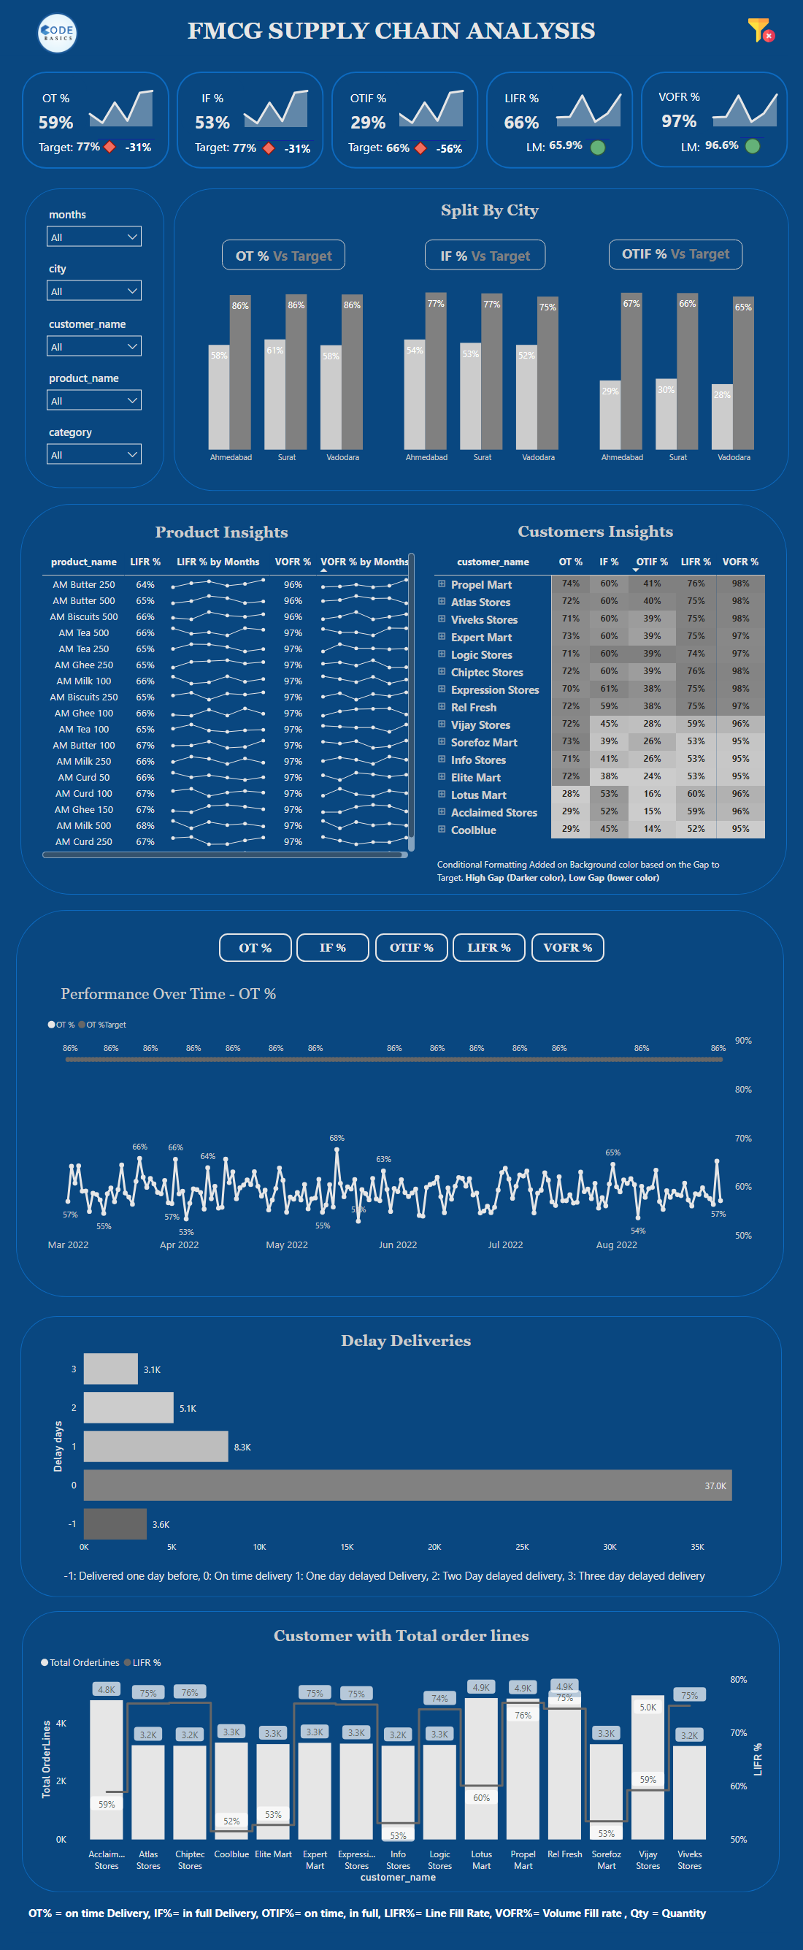
Dashboard:-
Notes:
The Data is Available Only for 6 months from March to August of 2022

Slide 42
Insights
Notes:
The Data is Available Only for 6 months from March to August of 2022

Slide 43
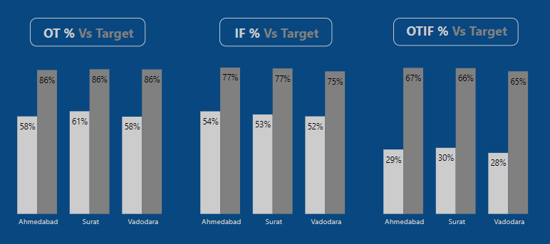
Key Metrics By Cities
Ahmedabad, Surat, and Vadodara are not meeting the targets for On-time Delivery (OT%) and On Time in Full (OTIF%), highlighting performance gaps in these areas.
The primary focus should be on enhancing OT% and OTIF% to improve overall service quality and avoid customer dissatisfaction.
Operational adjustments might be necessary to ensure orders are delivered on time and in full, aligning with the established targets.

Slide 44
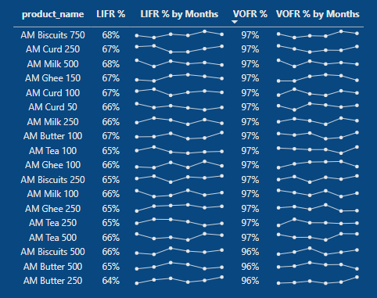
Product Insights
Some products may not be fully delivered (LIFR%: 66%), while most of the ordered volume is fulfilled (VOFR%: 97%).
Understanding why certain products face delivery issues, such as order processing or stock availability, can improve overall delivery.
To enhance efficiency, we'll optimize processes and improve communication with suppliers, using these insights keep refining our processes for ongoing enhancement.

Slide 45
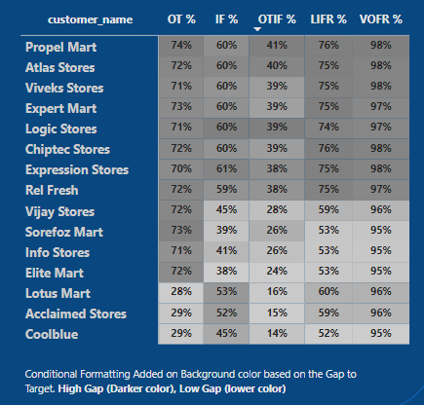
Customer Insights
Key customers like Cool Blue, Acclaimed Stores, and Lotus Mart are experiencing delays in receiving their orders on time, indicating potential issues with delivery timelines.
Elite Mart, Soreforz Mart, and Info Stores struggle with delivering complete orders, possibly leading to customer dissatisfaction due to incomplete deliveries.
Expression Stores, Logic Stores, and Chiptec Stores exhibit better performance in providing complete orders, ensuring higher customer satisfaction.
Propel Mart, Expert Mart, and Vivek Stores excel in meeting both delivery timelines and providing complete orders, demonstrating superior delivery service compared to others.

Slide 46
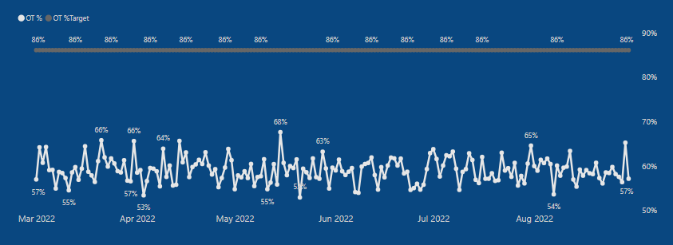
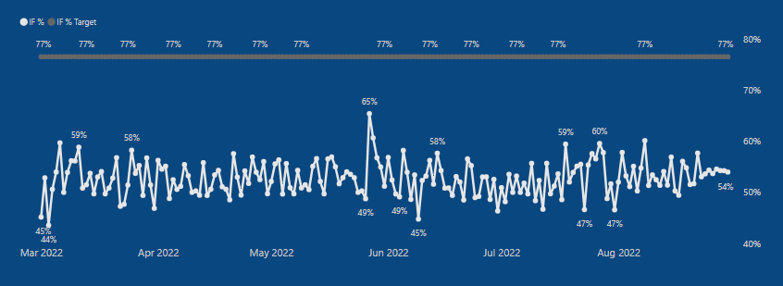
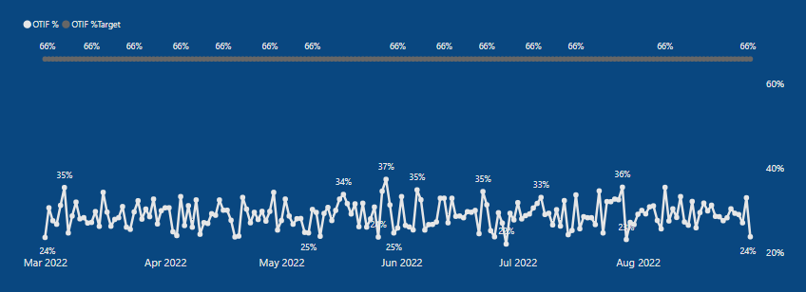
Performance Over Time
The key performance metrics, including On-time Delivery (OT%), In-full Delivery (IF%), and On Time in Full (OTIF%), have not reached their targets over time.
This shortfall indicates a consistent trend where the actual performance of these metrics.
Failure to meet these key performance indicators (KPIs) might signify challenges or inefficiencies in the delivery process that need to be addressed.

Slide 47
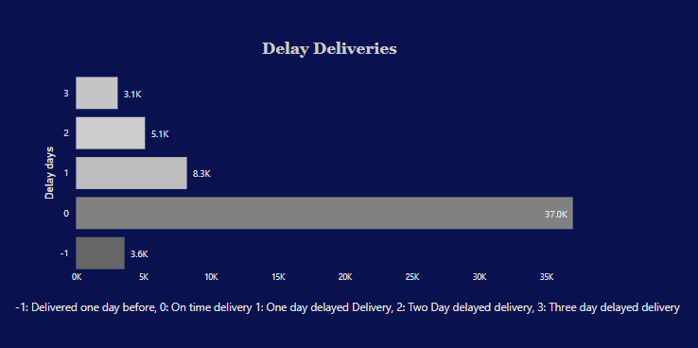
Delay Deliveries
37k orders are delivered on time, the largest segment.
3.6k orders arrive a day early, showing some early deliveries.
8.3k orders face a one-day delay, while 5.1k and 3.1k are delayed by two and three days.
Most deliveries are on time or slightly late by a day, but a few face longer delays of two or three days.

Slide 48
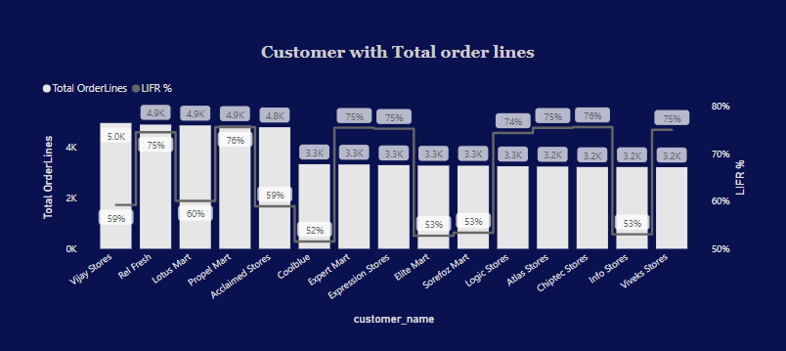
Total order lines with LIFR % of the customers
Vijay Stores, Rel Fresh, Lotus Mart, Propel Mart, and Acclaim Stores have the highest total order lines among customers.
Higher total order lines may suggest greater demand or a wider range of products/services offered by these customers.
Lower line fill rates for Cool blue, Elite Mart, and Info Stores could indicate potential challenges in meeting order requirements or fulfillment issues that need attention for improved customer service.

Slide 49
Thank You

Slide 50
Insights
The low OTIF% of 29% suggests that Atliq Mart may be experiencing significant issues with delivery service. To improve this metric, it may be necessary to identify and address the root causes of these issues.
The lower LIFR% of 66% compared to the higher VOFR% of 97% suggests that there may be specific lines or products that are causing delivery issues. It may be helpful to analyze data on individual lines or products to identify any patterns or trends that could be causing these issues.
The fact that Lotus Mart and Acclaimed stores are the most ordering customers and also have the most delayed deliveries could indicate that these customers have particularly high expectations or demands for timely and accurate delivery. It may be helpful to engage with these customers to understand their needs and concerns and to develop strategies to better meet their expectations.
The gap in IF% for many customers could be due to a variety of factors, including production issues, supply chain disruptions, or problems with the delivery process itself. It will be important to investigate the root cause of this issue in order to address it effectively.
The lack of improvement in any of the key metrics in the last few months suggests that Atliq Mart may need to take more significant action to address these issues. This could involve implementing new processes or technologies to improve the accuracy and timeliness of deliveries, or addressing issues within the production or supply chain.
Notes:
The Data is Available Only for 6 months from March to August of 2022

Slide 51
Insights
➜ AtliQ mart has total orders of on time in full delivery(OTIF%) is 29% in all cities.
➜There is huge gap between the Key metrics (OT%, IF%, OTIF%) and target.
➜ LIFR is 66% of all products and VOFR% is 97%.
➜AM Milk, AM Curd, and AM Butter are the most selling products.
➜ The Most Ordering customers are Lotus Mart, Acclaimed stores as well as most delayed the delivery of the products on time.
➜There is a huge gap in IF% for most of the customers. Is it because of less production
Notes:
The Data is Available Only for 6 months from March to August of 2022

