Slide 1
AMAZON REVIEW ANALYTICS
SPARTAN

Slide 2
Team Members
Rima Halder
Rajesh Kusuma
Pavan Sai Reddy Koduru
Guided by: Dr. Jun Wang

Slide 3

Problem Statement
For Instance, A media company wants to start a new product line to boost the revenue of the company.
Since starting a new product line, they want to be sure about the choice of products that they buy (and sell).among CDs and Vinyl, Movies and eBooks (Kindle).
Objective:
To use data about reviews to estimate some key metrics.
To identify the product category that is correct for investing.

Slide 4

Key Points
Specifically, the company manager use the gigantic amazon dataset to identify:
Which product category has a larger market size?
Which product category is likely to be purchased heavily?
Which product category is likely to make the customers happy after the purchase?

Slide 5
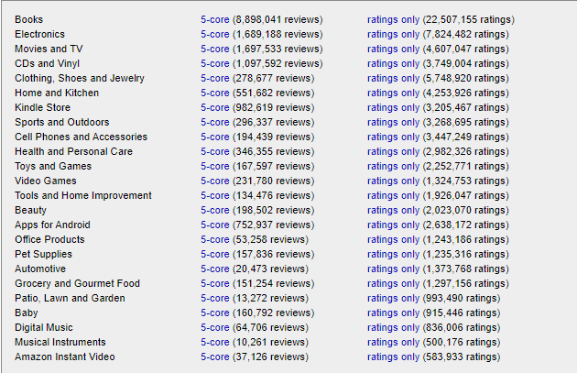

Amazon Datasets

Slide 6
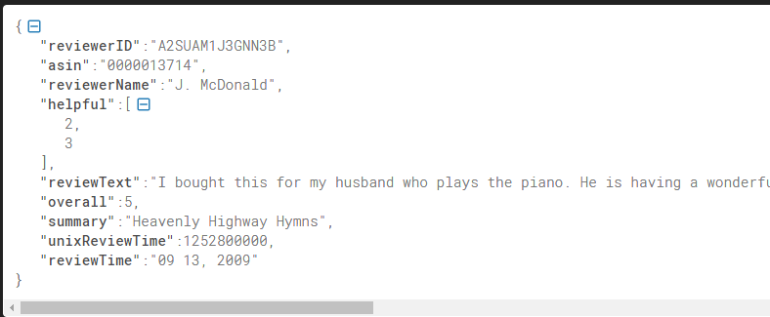
Sample Review Data

Slide 7
Solution
Use
Amazon S3 to store the Amazon review data
Use
Amazon EMR Cluster for processing data
Use
Amazon EC2 Instance as virtual server.
Use
SparkR to do exploratory data analysis.
Predict
The best product category

Slide 8



Architecture

Slide 9
Technologies
Amazon S3
Amazon Simple Storage Service (Amazon S3) is an object storage service that offers industry-leading scalability.
We can use it to store and protect any amount of data.
Amazon EMR
Industry-leading cloud big data platform for processing vast amounts of data.
use open-source tools such as Apache Spark, Apache Hive, Apache HBase,
Amazon EC2
Amazon Elastic Compute Cloud provides secure, resizable compute capacity in the cloud.
SparkR (R on Spark)
SparkR is an R package that provides a light-weight frontend to use Apache Spark from R

Slide 10

Simple Storage Solution(S3)
reviews_CDs_and_Vinyl_5.json.gz
reviews_Kindle_Store_5.json.gz
reviews_Movies_and_TV_5.json.gz
rstudio_sparklyr_emr5.sh

Slide 11
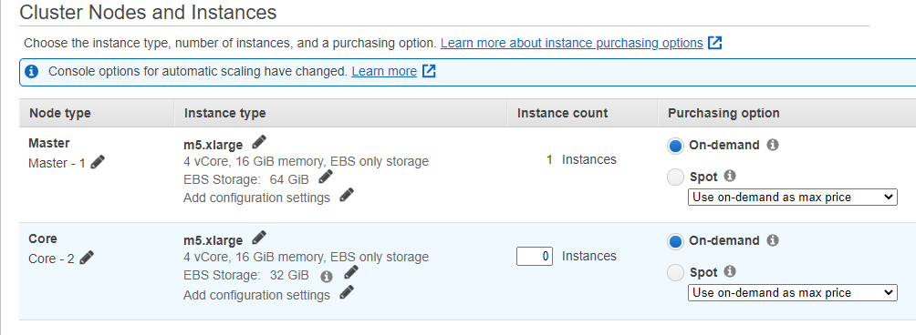
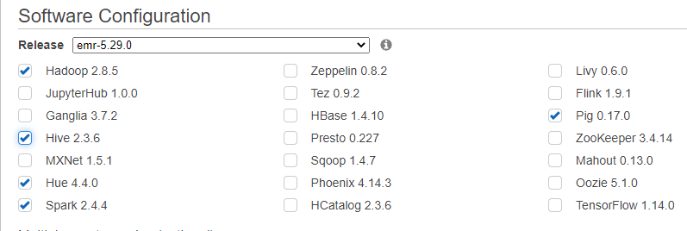
Amazon EMR

Slide 12
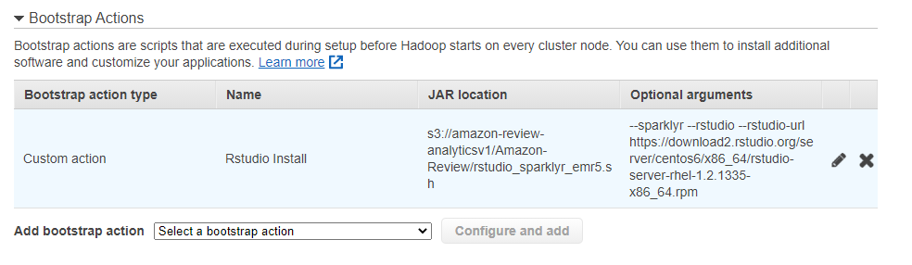
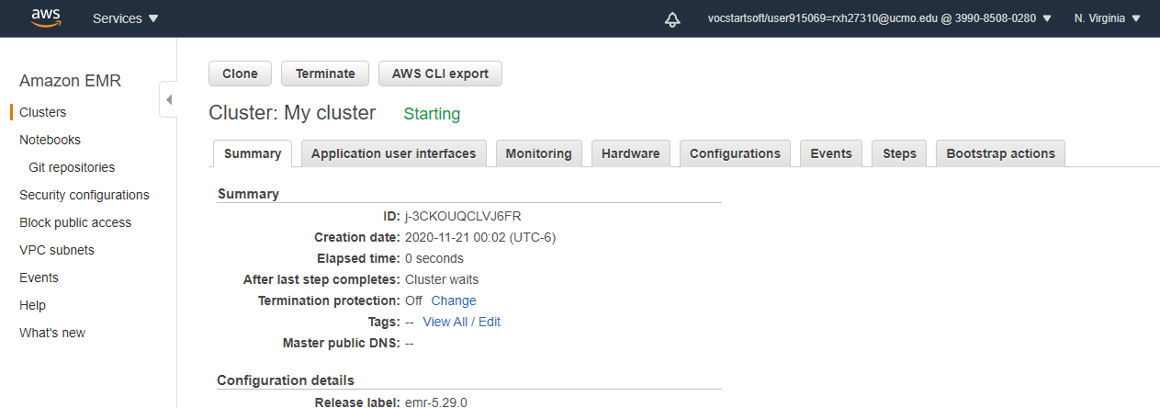
Amazon EMR

Slide 13
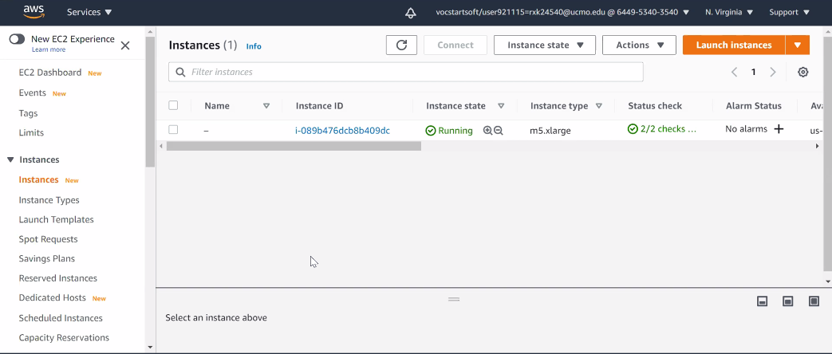
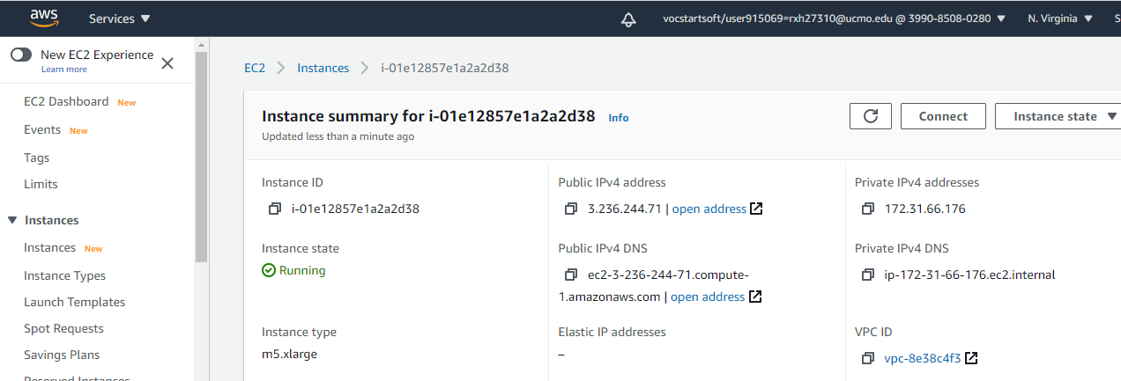
Amazon EC2

Slide 14
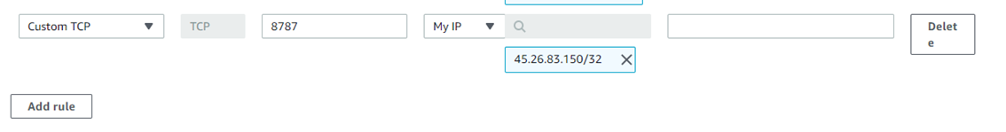
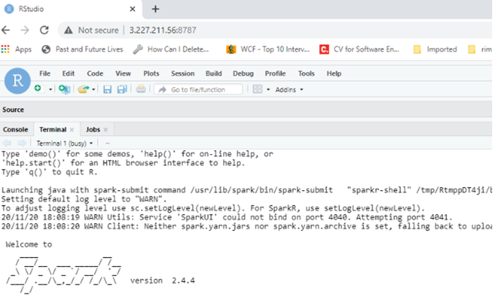
Add Rule & Run RStudio in Chrome

Slide 15
Load Datasets
library(SparkR)
sc = sparkR.session(master='local’)
S3_BUCKET_NAME <- "s3://adb-amazon-review/Amazon-Review/“
ar_Movies_and_TV <- SparkR::read.df(path=paste(S3_BUCKET_NAME, "/reviews_Movies_and_TV_5.json", sep = ""), source="json")
ar_CDs_and_Vinyl <- SparkR::read.df(path=paste(S3_BUCKET_NAME,"/reviews_CDs_and_Vinyl_5.json", sep = ""), source="json")
ar_Kindle_Store <-SparkR::read.df(path=paste(S3_BUCKET_NAME,"/reviews_Kindle_Store_5.json", sep = ""), source="json")

Slide 16
Data Analysis
1. Which product category has a larger market size ?
Examine the size of each datasets with following queries:
Input Query | No of Rows | No of Columns
dim_cd <- dim(ar_CDs_and_Vinyl) | 1097592 | 9
dim_kindle <- dim(ar_Kindle_Store) | 982619 | 9
dim_movies <- dim(ar_Movies_and_TV) | 1697533 | 9

Slide 17
Data Analysis
1. Which product category has a larger market size ?
Sum up total number of reviews from all three products
Calculate the percentage of total review data for each product type.
Query(Total Review/Each product Review Percentage | Result
Total_reviews <- dim_cd[1] + dim_kindle[1] + dim_movies[1] (Total review count) | 3777744
msize_Movies_and_TV <- (dim_movies[1]/Total_reviews)*100 | 44.9351%
msize_CDs_and_Vinyl <- (dim_cd[1]/Total_reviews)*100 | 29.05417%
msize_Kindle_Store <- (dim_kindle[1]/Total_reviews)*100 | 26.01074%
Result : Movies and TV product category has largest market size i.e. 45% among three

Slide 18
Data Analysis
2. Which product category is likely to make the customer happy after the purchase?
Assumption is customers are happy if the rating is equal or greater than four i.e. =>4?
Group each dataset by overall column
Filter the output of group By
Example Query for CDs & Vinyl
count_overall_rating_CDs_and_Vinyl <- summarize(groupBy(ar_CDs_and_Vinyl, ar_CDs_and_Vinyl$overall),
count = count(ar_CDs_and_Vinyl$overall))
high_rating_CDs_and_Vinyl <- filter(count_overall_rating_CDs_and_Vinyl,
count_overall_rating_CDs_and_Vinyl$overall>=4 )
overall | count
1.0 | 46195
4.0 | 246326
3.0 | 101824
2.0 | 46571
5.0 | 656676
overall | count
4.0 | 246326
5.0 | 656676

Slide 19
Data Analysis
2. Which product category is likely to make the customer happy after the purchase?
use aggregate function to sum the count of review data for overall >=4.
Sum of filtered review count with rating>=4 | Result (count)
showDF(agg(high_rating_CDs_and_Vinyl, tot = sum(high_rating_CDs_and_Vinyl$count))) | 903002
showDF(agg(high_rating_Kindle_Store, tot = sum(high_rating_Kindle_Store$count))) | 829277
showDF(agg(high_rating_Movies_and_TV, tot = sum(high_rating_Movies_and_TV$count)) | 1289602
Result : The product category is likely to make customer happy is Movies and TV segment.

Slide 20
Data Analysis
3. Which product category is likely to be purchased heavily based on grant total of helpful ratio?
Helpful ratio = number of people who found the review helpful/ total number of people
Extract 1st and 2n values from helpful column to find helpful ratio
Example Query for Movies & TV
temp_Movies_and_TV <- select(ar_Movies_and_TV,posexplode(ar_Movies_and_TV$helpful))
temp_Movies_and_TV_helpful <- filter(temp_Movies_and_TV,temp_Movies_and_TV$pos == 0)
temp_Movies_and_TV_totalreview <- filter(temp_Movies_and_TV,temp_Movies_and_TV$pos == 1)

Slide 21
Data Analysis
3. Which product category is likely to be purchased heavily based on grant total of helpful ratio?
Collects all the elements of a SparkDataFrame and coerces them into an R data.frame.
Example Query:
temp_Movies_and_TV_helpful_r_df <- collect(temp_Movies_and_TV_helpful)
temp_Movies_and_TV_totalreview_r_df <- collect(temp_Movies_and_TV_totalreview)

Slide 22
Data Analysis
3. Which product category is likely to be purchased heavily based on grant total of helpful ratio?
Example of Movies & TV.
Add helpful ratio for each row
temp_Movies_and_TV_helpful_r_df$tot <-temp_Movies_and_TV_totalreview_r_df$col
colnames(temp_Movies_and_TV_helpful_r_df)[2] <- "fnd_helpful"
temp_Movies_and_TV_helpful_r_df$helpful_ratio <- temp_Movies_and_TV_helpful_r_df$fnd_helpful/ temp_Movies_and_TV_helpful_r_df$tot
Find grant total of helpful ratio.
Movies_and_TV_helpful_r_total_help_ratio <- dplyr::summarize(temp_Movies_and_TV_helpful_r_df,sum(temp_Movies_and_TV_helpful_r_df$helpful_ratio,na.rm = TRUE))

Slide 23
Data Analysis
3. Which product category is likely to be purchased heavily based on grant total of helpful ratio?
Helpful Ratio | Output
Movies_and_TV_helpful_r_total_help_ratio | 678481.9
CDs_and_Vinyl_helpful_r_total_help_ratio | 566979.2
Kindle_Store_helpful_r_total_help_ratio | 367361.5
Result : Movies and TV has got higher helpful ratio i.e.678481.9 ,hence Movies and TV is likely to be purchased heavily

Slide 24
Data Analysis
4. Which product category is likely to be purchased heavily based on average help ratio?
Helpful ratio = number of people who found the review helpful/ total number of people
Used dplyr ,which is an R package(installation needed) for working with structured data both in and outside of R.
Perform Select, filter, and aggregate data
Use Summarize as aggregator to perform mean/average on the input R data frame for each of the product.

Slide 25
Data Analysis
4. Which product category is likely to be purchased heavily based on average help ratio?
Help Ratio | Output
CDs_and_Vinyl_helpful_r_avg_help_ratio <- dplyr::summarize(temp_CDs_and_Vinyl_helpful_r_df, mean (temp_CDs_and_Vinyl_helpful_r_df$helpful_ratio,na.rm = TRUE)) | 0.7073386
Movies_and_TV_helpful_r_avg_help_ratio <- dplyr::summarize(temp_Movies_and_TV_helpful_r_df,mean(temp_Movies_and_TV_helpful_r_df$helpful_ratio,na.rm = TRUE)) | 0.6231739
Kindle_Store_helpful_r_avg_help_ratio <- dplyr::summarize(temp_Kindle_Store_helpful_r_df, mean(temp_Kindle_Store_helpful_r_df$helpful_ratio,na.rm = TRUE)) | 0.8122255
Result : kindle store is famous product line based on average helpful ratio

Slide 26
Data Analysis
5. Which product category is famous across reviewers based on length of the review text?
Assumption : If length of the review text is more, then customers are happy.
Add length of the review text as a new column to the for each review in each product category data frame .
Aggregate the review text length column with sum function to get the total length of review text for each product category.

Slide 27
Data Analysis
5. Which product category is famous across reviewers based on length of the review text?
Assumption : If length of the review text is more, then customers are happy.
ar_Movies_and_TV$reviewtext_length <-length(ar_Movies_and_TV$reviewText) (Example with Movies & TV)
Total length of review text Query | Output
head(agg(ar_Movies_and_TV, length_tol = sum(ar_Movies_and_TV$reviewtext_length))) | 1565297599
head(agg(ar_Kindle_Store, length_tol = sum(ar_Kindle_Store$reviewtext_length))) | 593450774
head(agg(ar_CDs_and_Vinyl, length_tol = sum(ar_CDs_and_Vinyl$reviewtext_length))) | 1089459822
Result : As per the output of review length ,Movies and TV is the product is famous across reviewers.

Slide 28
Data Analysis
6. Which product category is famous across high rated reviewers based on length of the review text?
Assumption : If length of the review text is more & rating is 5, then customers are happy.
Find the total length of the review text for reviews got 5 ratings for each product by using filter.
Aggregate the review text length column with sum function to get the total length of review text for each product category.

Slide 29
Data Analysis
6. Which product category is famous across high rated reviewers based on length of the review text?
Assumption : If length of the review text is more & rating is 5, then customers are happy.
Filter the total length of the review text for reviews got 5 ratings (Example of Movies & TV)
high_rating_movies_TV_rev_txt_tol_len <- filter(ar_Movies_and_TV, ar_Movies_and_TV$overall==5 )
Total length of review text for high rating reviews | output
showDF(agg(high_rating_Kindle_Store_rev_txt_tol_len, tot = sum(high_rating_Kindle_Store_rev_txt_tol_len$reviewtext_length))) | 319591343
showDF(agg(high_rating_movies_TV_rev_txt_tol_len, tot = sum(high_rating_movies_TV_rev_txt_tol_len$reviewtext_length))) | 712575303
showDF(agg(high_rating_CDs_Vinyl_rev_txt_tol_len, tot = sum(high_rating_CDs_Vinyl_rev_txt_tol_len$reviewtext_length))) | 622567752
Result : Movies and TV is the product is famous across top rated reviews.

Slide 30
Data Analysis
7. Which product category is famous based on +ve key words in summary text ?
Assumption : If summary text contains below keywords, then it is assumed customers are happy
Positive Keywords:
Good
Nice
Excellent
Happy
Satisfied
worth

Slide 31

Data Analysis
7. Which product category is famous based on +ve key words in summary text ??
Use RDD API to filter the data using positive keywords (good/nice/excellent/happy/satisfied/worth).
Convert RDD to DataFrame and count positive reviews received for each of the product category.
(Example of Movies & TV)
ar_Movies_and_TV.rdd <- SparkR:::toRDD(ar_Movies_and_TV)

Slide 32
RDD Vs DataFrame
RDD
RDD stands for resilient distributed datasets. It is the basic data structure defined by Spark so the data can be distributed among cluster nodes.
RDD contains large information, we can apply actions to RDD to return values, and transformations to return new RDD.
It is simply a set of Java or Scala objects representing data. Spark distributes data within a cluster using Java serialization, which is a process of converting an object to a series of bytes
Commonly used RDD transformation include map, filter, reduce, and reduceByKey.
DataFrame
DataFrame API was introduced in Spark 1.3. Comparing to RDD, Dataframe introduces the concept of schema, which refers to the structure of data.
Dataframe allows Spark to manage the structure and only send the data between nodes, which is more efficient than Jave serialization.
Dataframe API is a lot like relational queries. We can use various relational operations that are similar to SQL expression.

Slide 33
Data Analysis
7. Which product category is famous based on +ve key words in summary text ??
ar_Movies_and_TV.rdd.filtered <- SparkR:::filterRDD(ar_Movies_and_TV.rdd, function(s) { grepl("good|nice|excellent|happy|satisfied|worth", s$summary, ignore.case = TRUE, perl = TRUE) }) | 164546
ar_CDs_and_Vinyl.rdd.filtered <- SparkR:::filterRDD(CDs_and_Vinyl.rdd, function(s) { grepl("good|nice|excellent|happy|satisfied|worth", s$summary, ignore.case = TRUE, perl = TRUE) }) | 96649
ar_Kindle_Store.rdd.filtered <- SparkR:::filterRDD(ar_Kindle_Store.rdd, function(s) { grepl("good|nice|excellent|happy|satisfied|worth", s$summary, ignore.case = TRUE, perl = TRUE) }) | 86578
Result : Movies and TV have got more positive reviews.

Slide 34
Conclusion
MOVIES and TV product line is recommended to invest.
This product line scores high in all the metrics except one.
Hence, movies and TV has been selected.
Assumption:
Since MOVIES and TV product line is famous product,
So this could be the reason why Amazon has launched Amazon Prime video streaming product!

Slide 35
References
Amazon Data: http://jmcauley.ucsd.edu/data/amazon/
Database System Concepts (7th ed.), Silberschatz, Korth, and Sudarshan, McGraw-Hill 2011.
Book: Learning Spark - Damji, Jules S ; Wenig, Brooke ; Das, Tathagata ; Lee, Denny 2020
PySpark:https://www.datacamp.com/community/tutorials/apache-spark-tutorial-machine-learning
Book: Hadoop: The Definitive Guide-Storage and Analysis at Internet Scale - White, Tom 2015
Some useful links
https://www.youtube.com/watch?v=T_P-AXR-YCk
https://aws.amazon.com/blogs/big-data/running-sparklyr-rstudios-r-interface-to-spark-on-amazon-emr/
https://docs.aws.amazon.com/emr/latest/ReleaseGuide/emr-spark-configure.html
https://gist.github.com/cosmincatalin/a2e2b63fcb6ca6e3aaac71717669ab7f/eefdb19af6d3afdcb0506a797c2a5927fac72d5f#file-install-rstudio-server-sh
https://gist.github.com/cosmincatalin/a2e2b63fcb6ca6e3aaac71717669ab7f/eefdb19af6d3afdcb0506a797c2a5927fac72d5f

Slide 36

Thank You!!

