Slide 1
AMAZON REVIEW ANALYTICS
SPARTAN

Slide 2
Team Members
Rima Halder
Rajesh Kusuma
Pavan Sai Reddy Koduru
Guided by: Dr. Jun Wang

Slide 3
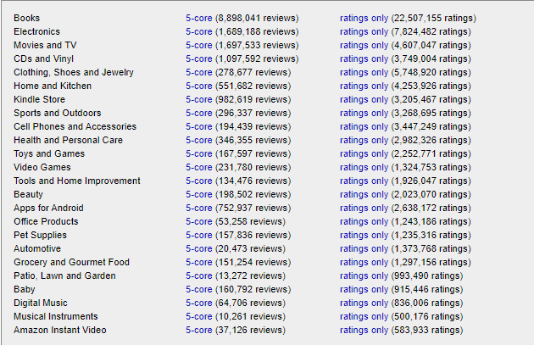
Problem
This project will help us to identify product category that is correct for investing from the amazon giant datasets as below.
http://jmcauley.ucsd.edu/data/amazon/
Key Points:
Which product category has a larger market size
Which product category is likely to be purchased heavily
Which product category is likely to make the customers happy after the purchase

Slide 4
Solution
Use Amazon S3 to store the Amazon review data
1
Create Hive Tables for the defined schema.
2
Use SparkR to do exploratory data analysis.
3
Predict the best product category
4

Slide 5
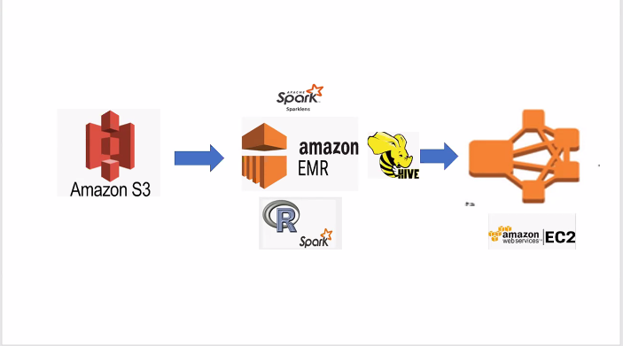
Architecture

Slide 6
Technologies
Amazon S3
Amazon Simple Storage Service (Amazon S3) is an object storage service that offers industry-leading scalability.
We can use it to store and protect any amount of data.
Amazon EMR
Industry-leading cloud big data platform for processing vast amounts of data.
use open-source tools such as Apache Spark, Apache Hive, Apache HBase,
Amazon EC2
Amazon Elastic Compute Cloud provides secure, resizable compute capacity in the cloud.
Apache Hive
Hive compiler generates map-reduce jobs for most queries.
These jobs are then submitted to the Map-Reduce cluster.
Apache Spark
Apache Spark is a unified analytics engine for large-scale data processing
It provides high-level APIs in Java, Scala, Python and R, and an optimized engine that supports general execution graphs.
It also supports a rich set of higher-level tools including Spark SQL for SQL and structured data processing,
R
R is a powerful data-analysis package with many standard and cutting-edge statistical functions.

Slide 7
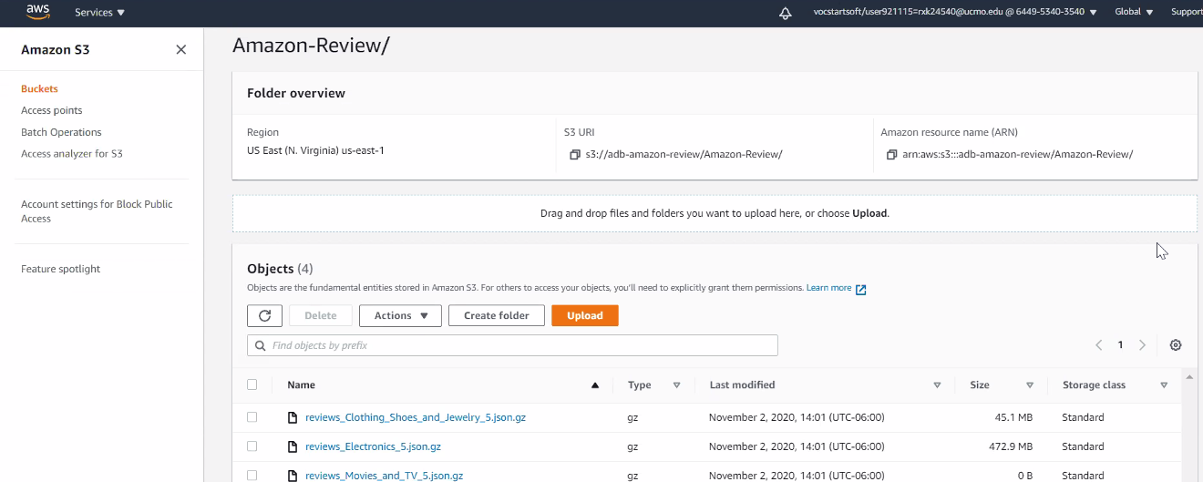
Simple Storage Solution(S3)

Slide 8
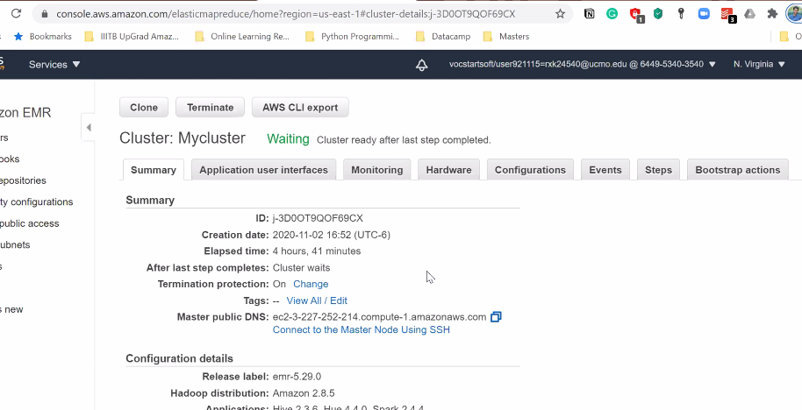
Amazon EMR

Slide 9
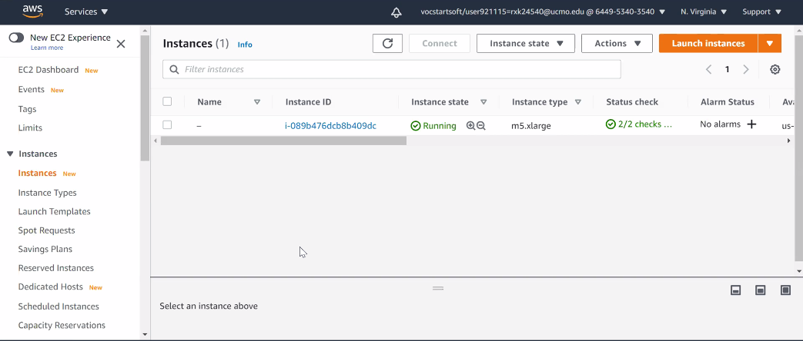
Amazon EC2

Slide 10
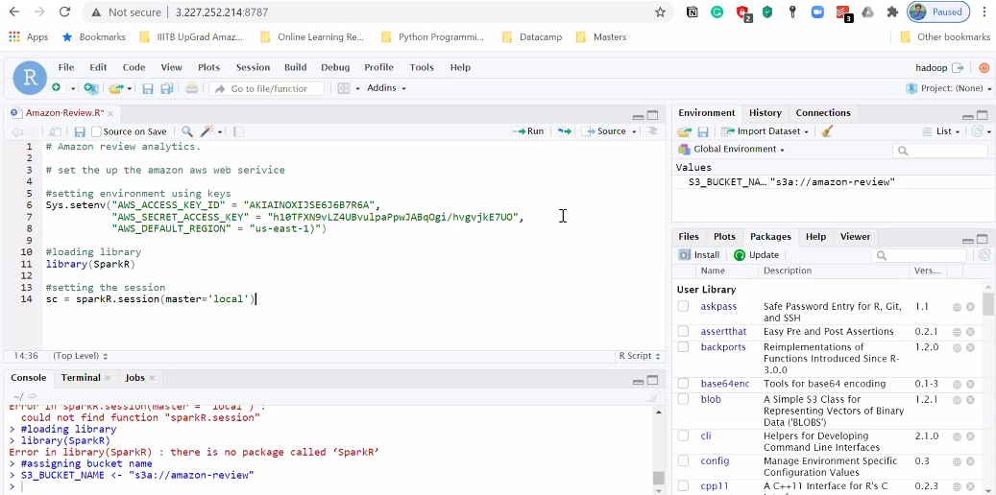
SparkR

Slide 11
References
Amazon Data: http://jmcauley.ucsd.edu/data/amazon/
Database System Concepts (7th ed.), Silberschatz, Korth, and Sudarshan, McGraw-Hill 2011.
Book: Learning Spark - Damji, Jules S ; Wenig, Brooke ; Das, Tathagata ; Lee, Denny 2020
PySpark:https://www.datacamp.com/community/tutorials/apache-spark-tutorial-machine-learning
Book: Hadoop: The Definitive Guide-Storage and Analysis at Internet Scale - White, Tom 2015

Slide 12

Thank You!!

