Slide 1

Schengen state visa stats 2018
SRN Name
PES2201800371 Charan raj
PES2201800570 M Rajesh
PES2201800378 Tejas v
November 22, 2019
1

Slide 2

Schengen state visa stats 2018
Description:
Data set contains a complete set of visa statistics for all states fully applying the Schengen acquis and their consulates in third Countries.
Number of columns=19
Number of rows=1900
Out of 19 columns 3 are categorical data and remaining 16 are numeric columns.
November 22, 2019
2

Slide 3
Data Cleaning
1. All NAN’S are for numeric columns is replaced with mean of column
If there is relation between columns then replace NAN’s with the relation
For example:
In visa stats ‘visas not issued’ column depends on column ‘visas applied’ and The column ‘visas issued’.
Visas not issued=visas applied-visas issued.
All NAN’S of categorical columns are replaced with its previous row values
If a column contains NAN’S more 90% we can drop the column that contains
NAN’S more than 90%.
November 22, 2019
3

Slide 4
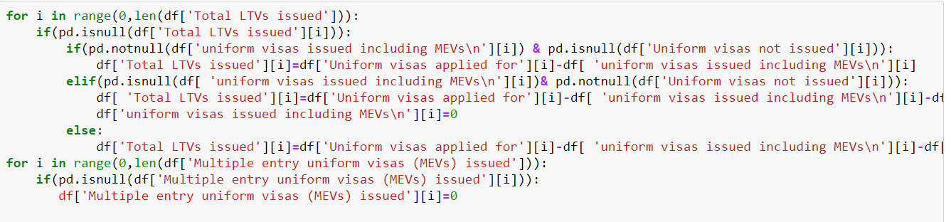
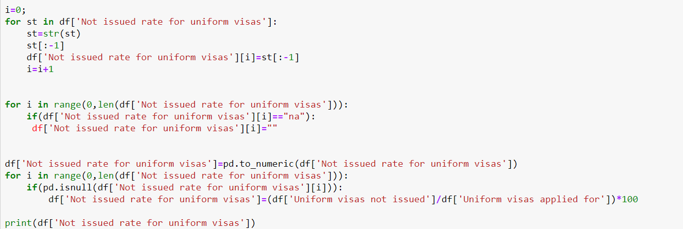

Slide 5
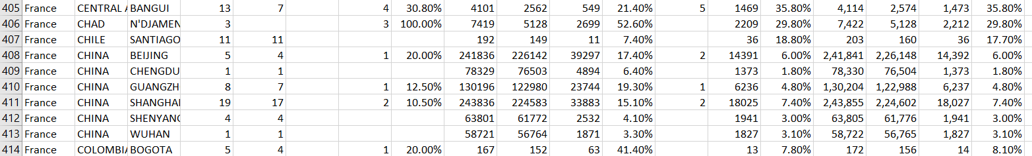
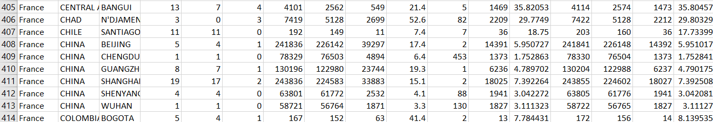
Data Cleaning
Before data cleaning
After data cleaning
November 22, 2019
5

Slide 6
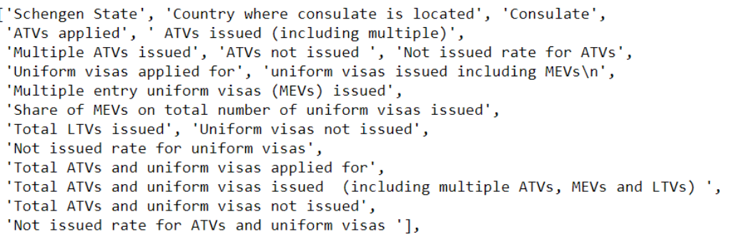
Data cleansing columns: 1)Total LTVs issued 2)Multiple entry uniform visas issued 3)Uniform visas not issued

Slide 7
Normalization and standardization
Importance
Normalization helps to reduce data redundancy and complexity of data
In machine learning Normalization makes training less sensitive to scale of features
The use of a normalization method will improve analysis from multiple models
Normalization of data will make sure that data doesn’t vary more
A variable is said to be normally distributed or have a normal distribution if its distribution has the shape of a normal curve — a special bell-shaped curve. …
The graph of a normal distribution is called the normal curve, which has all of the following properties: 1. The mean, median, and mode are equal
Impacts on Dataset
Visualization of data would be difficult without normalization of data
Normalization changes the values of numeric columns in the dataset to a common scale without distorting differences In the ranges of values
November 22, 2019
7

Slide 8
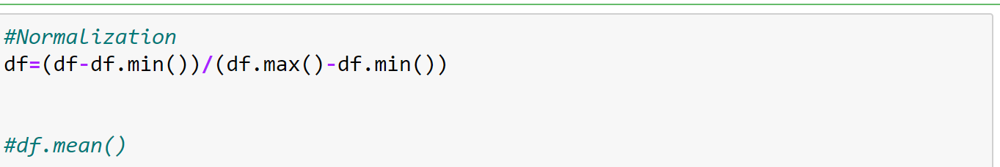
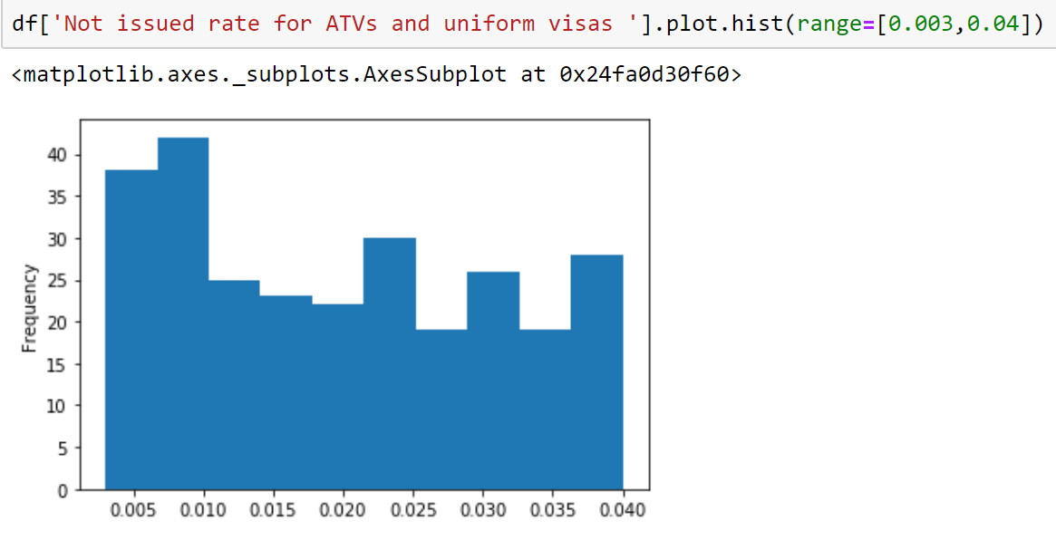
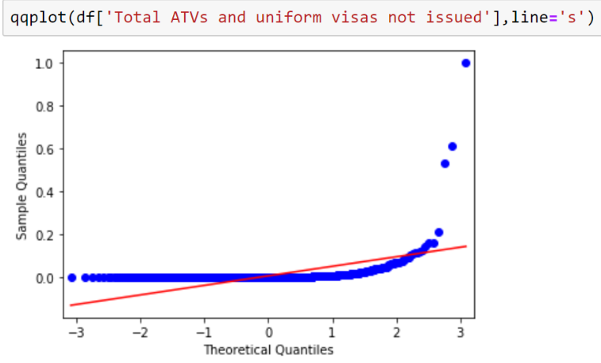
November 22, 2019
8

Slide 9
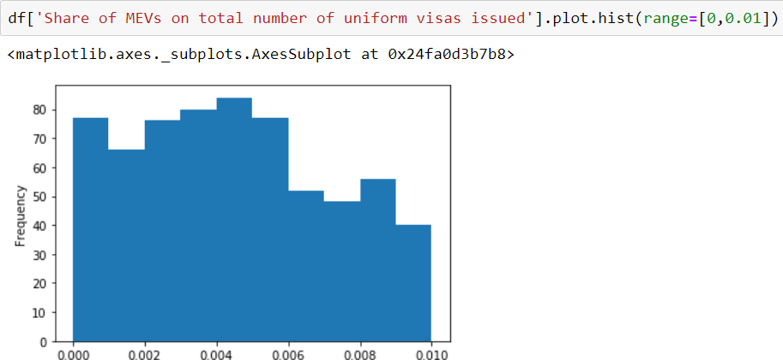
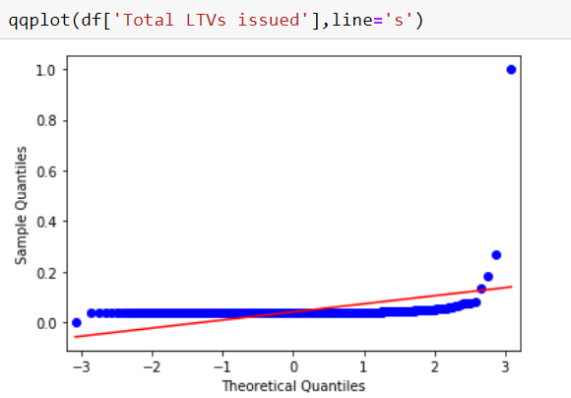

Standardization:
November 22, 2019
9

Slide 10
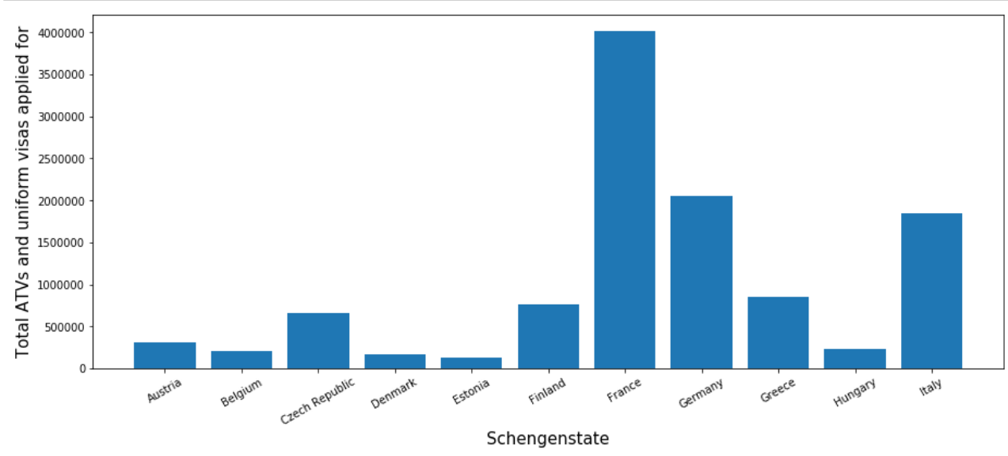
Visualization
A bar graph which shows visas applied to different Schengen countries
The above graph gives the information on visas applied to different Schengen countries.

Slide 11
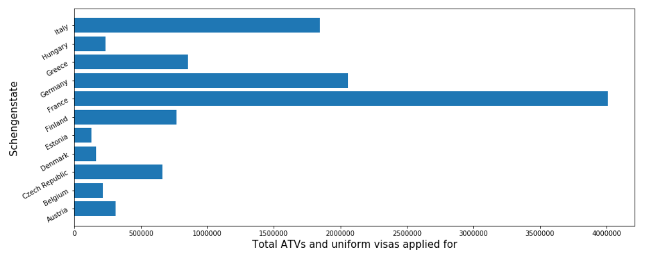
Same as before graph but it is horizontal bar graph

Slide 12
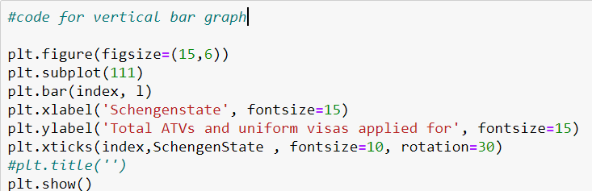
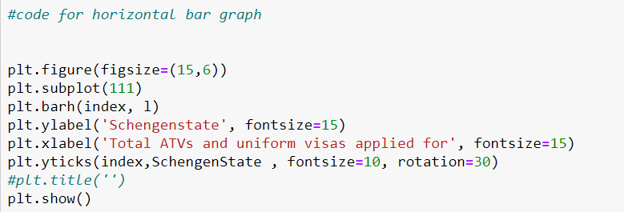

Slide 13
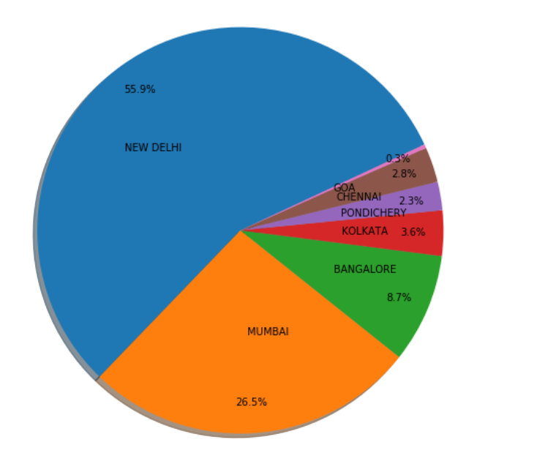
The above graph shows the visas applied from different consulate’s of india to all Schengen states. The above graph tells us that most of the visas applicants are from New Delhi and then Mumbai.

Slide 14
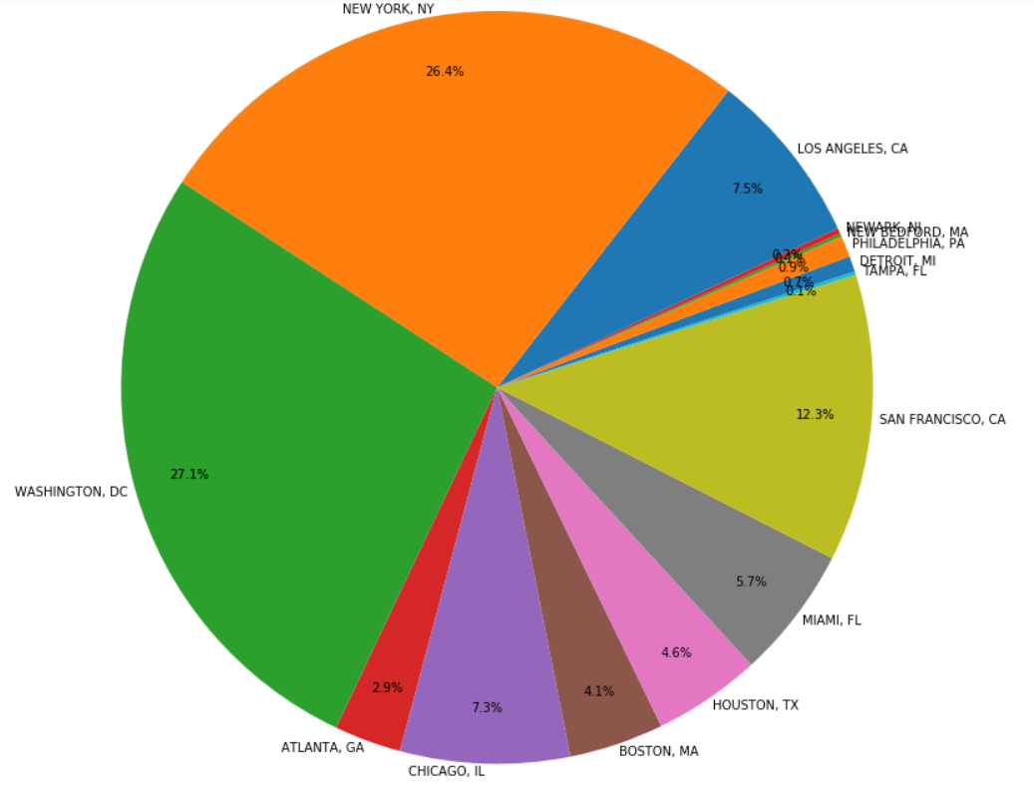
Same as before graph but for the graph is for United states.

Slide 15
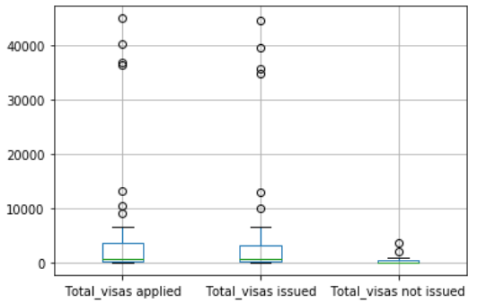
Above graph gives information about visas applied, visas issued and visas not issued.
From the above box plot we can find many outliers In visas applied and visas issued.
From above data we can conclude visas applied and issued doesn’t lie in particular range.

Slide 16
Hypothesis Testing
we will be proving that issue rate of visa doesn’t depend on consulate applied from.
Hypothesis test will help us to prove.
Hypothesis test:
Hypothesis testing is a statistical procedure that uses sample data to determine, whether a statement about the value of a population parameter should or should not be rejected.

Slide 17
In the hypothesis testing a sample data is taken .Here data of USA country is used as sample data in hypothesis test
Procedure:
Visa issued rate is calculated for every consulate in USA
Here Sample is divided into two parts .The First part is consulate’s with high applications and second part is list of consulates with less visa’s applications

Slide 18
The following are the all consulates in USA .
'LOS ANGELES, CA', 'NEW YORK, NY', 'WASHINGTON, DC','CHICAGO, IL', 'BOSTON, MA', 'HOUSTON, TX','SAN FRANCISCO, CA’, 'NEWARK, NJ', 'PHILADELPHIA, PA','TAMPA, FL', 'MIAMI, FL’, 'ATLANTA, GA', 'DETROIT, MI', 'NEW BEDFORD, MA’
The above list of consulates are divided into two lists one list with the consulates with more Visa’s application’s and the another is list of consulates with less number of applications.
Then issued rate is calculated for each consulate.
Hypothesis Testing:
H0:Both the lists are identical are dependent
H1:Both the lists are not identical and independent
We can use TWO sampled T-test.
Two sampled T-test :-The Independent Samples t Test or 2-sample t-test compares the means of two independent groups in order to determine whether there is statistical evidence that the associated population means are significantly different.

Slide 19
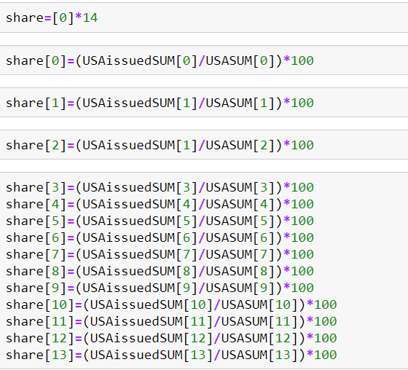

Slide 20
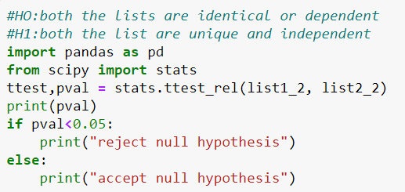
The above code snippet shows us that list1_2 and list2_2 are identical. Which means that visa issue rate doesn’t depend on consulate applied from. Here list1_2 is visa issued rate of list1 and list2 visa issued rate of list2.

Slide 21
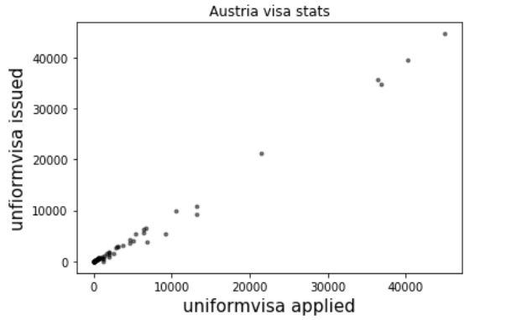
Correlation
The above scatter plot is uniform visas applied vs uniform visas issued for Austria country. It shows linear relationship between them which means that almost all visas which are applied are issued
The value correlation coefficient is 0.9897 which depicts us that uniform visas applied is strongly related to uniform visas issued.

Slide 22
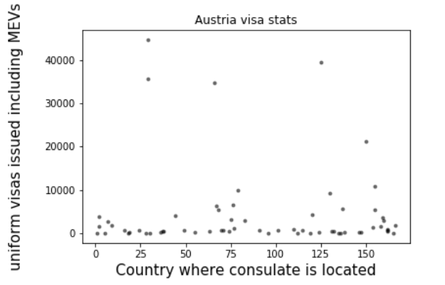
For the above graph the correlation coefficient is 0.001 approximately 0 which shows us that visas issued doesn’t depend on the consulate applied from.

Slide 23

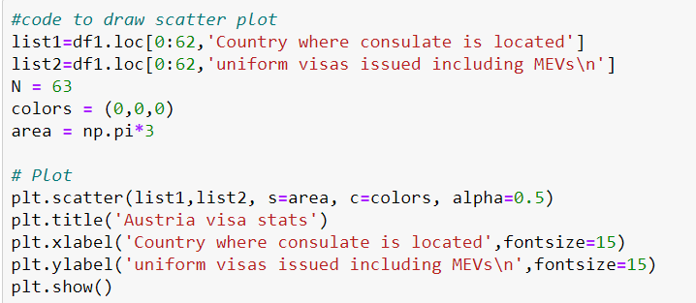

Slide 24
Thank you

