Slide 1
Lending Club Case Study
Identifying Risky Loan Applicants to Reduce Credit Losses

Slide 2
Problem Statement
The company is the largest online loan marketplace, facilitating personal loans, business loans, and financing of medical procedures. The aim is to identify risky loan applicants to reduce credit loss by understanding the driving factors behind loan default. Specifically, we aim to identify variables that are strong indicators of default, focusing on customers labeled as 'charged-off'.

Slide 3
Analysis Approach
Load and Prepare Data
Visualize Key Distributions
Bivariate Analysis
Correlation Analysis
Identify Key Variables Affecting Loan Default
Summarize Insights and Recommendations

Slide 4
Data Preparation
Loaded the dataset and dropped columns with a high percentage of missing values.
Filled missing values in 'annual_inc' with the mean of the column.
Converted 'term' to integer and 'int_rate' to float.
Removed outliers in 'annual_inc' and 'loan_amnt' using the IQR method.

Slide 5
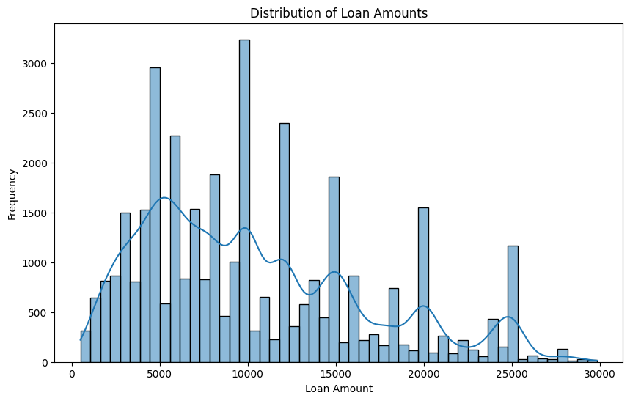
Distribution of Loan Amounts

Slide 6
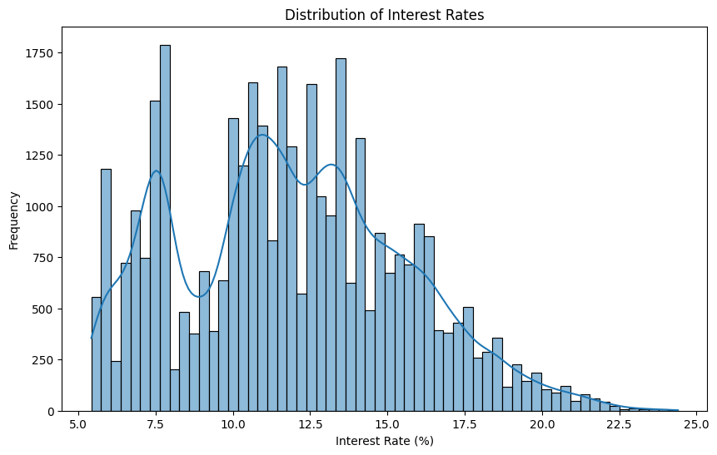
Distribution of Interest Rates

Slide 7
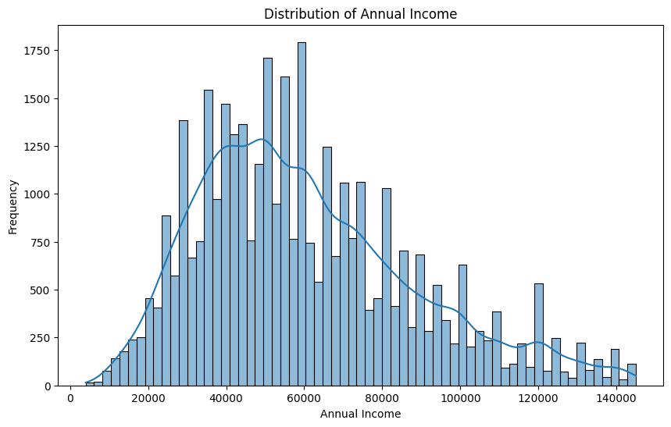
Distribution of Annual Income

Slide 8
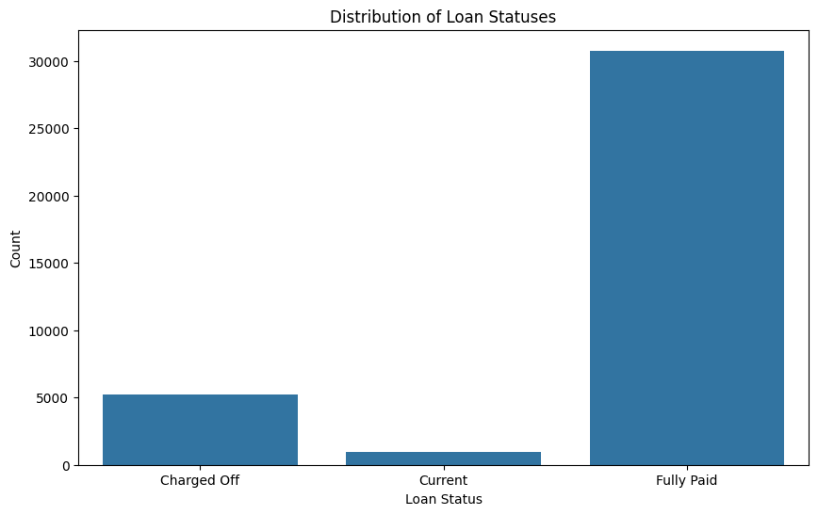
Distribution of Loan Statuses

Slide 9
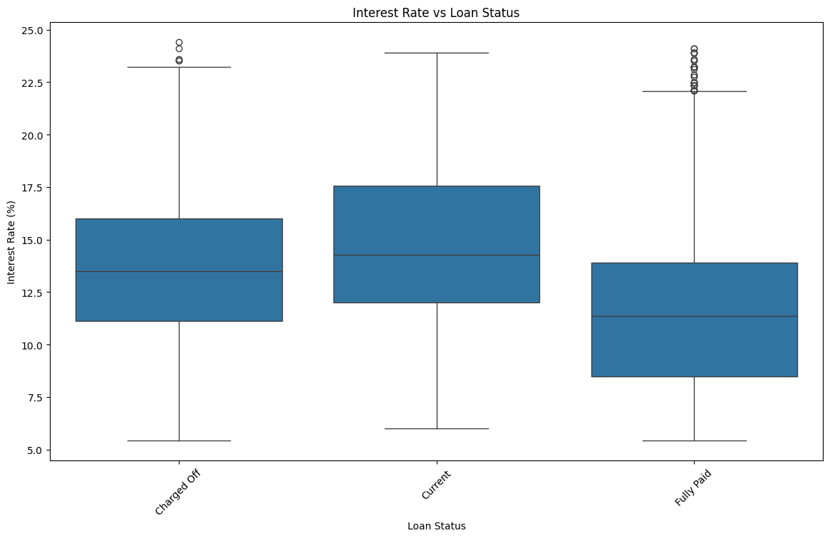
Loan Amount vs Loan Status

Slide 10
Interest Rate vs Loan Status

Slide 11
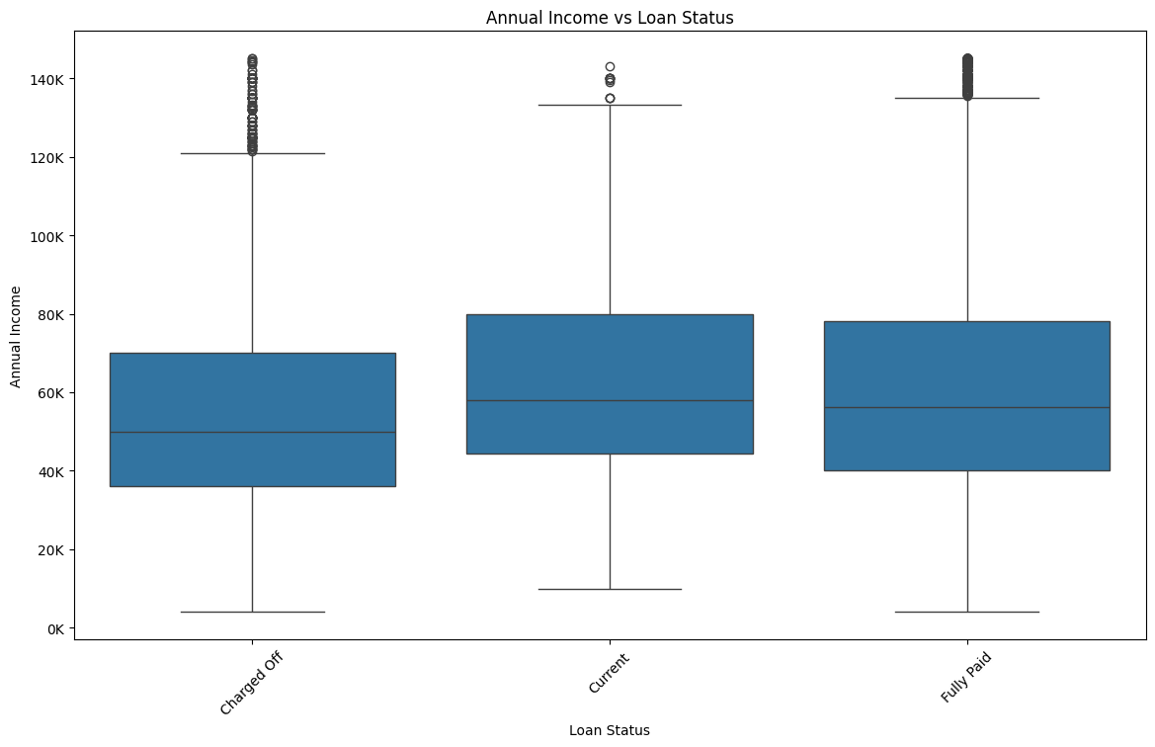
Annual Income vs Loan Status

Slide 12
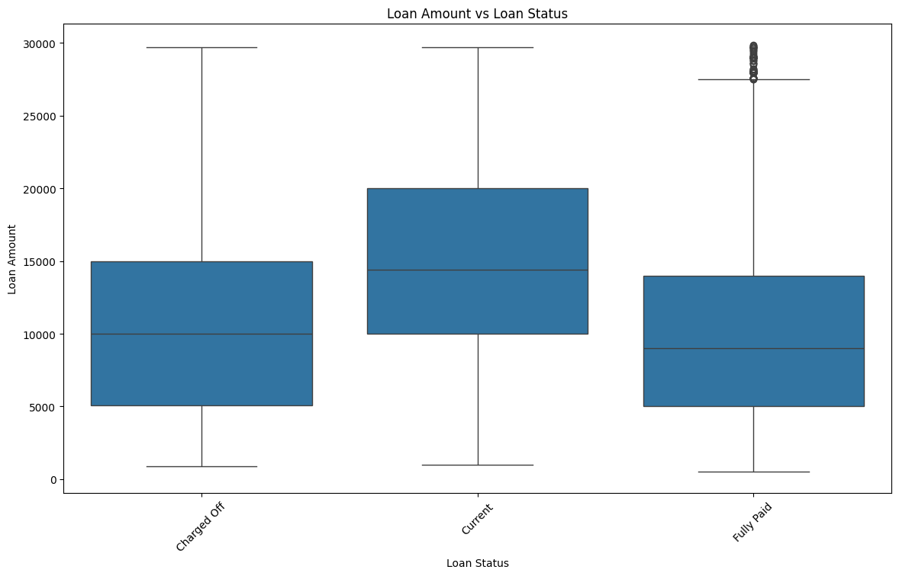
Debt-to-Income Ratio vs Loan Status

Slide 13
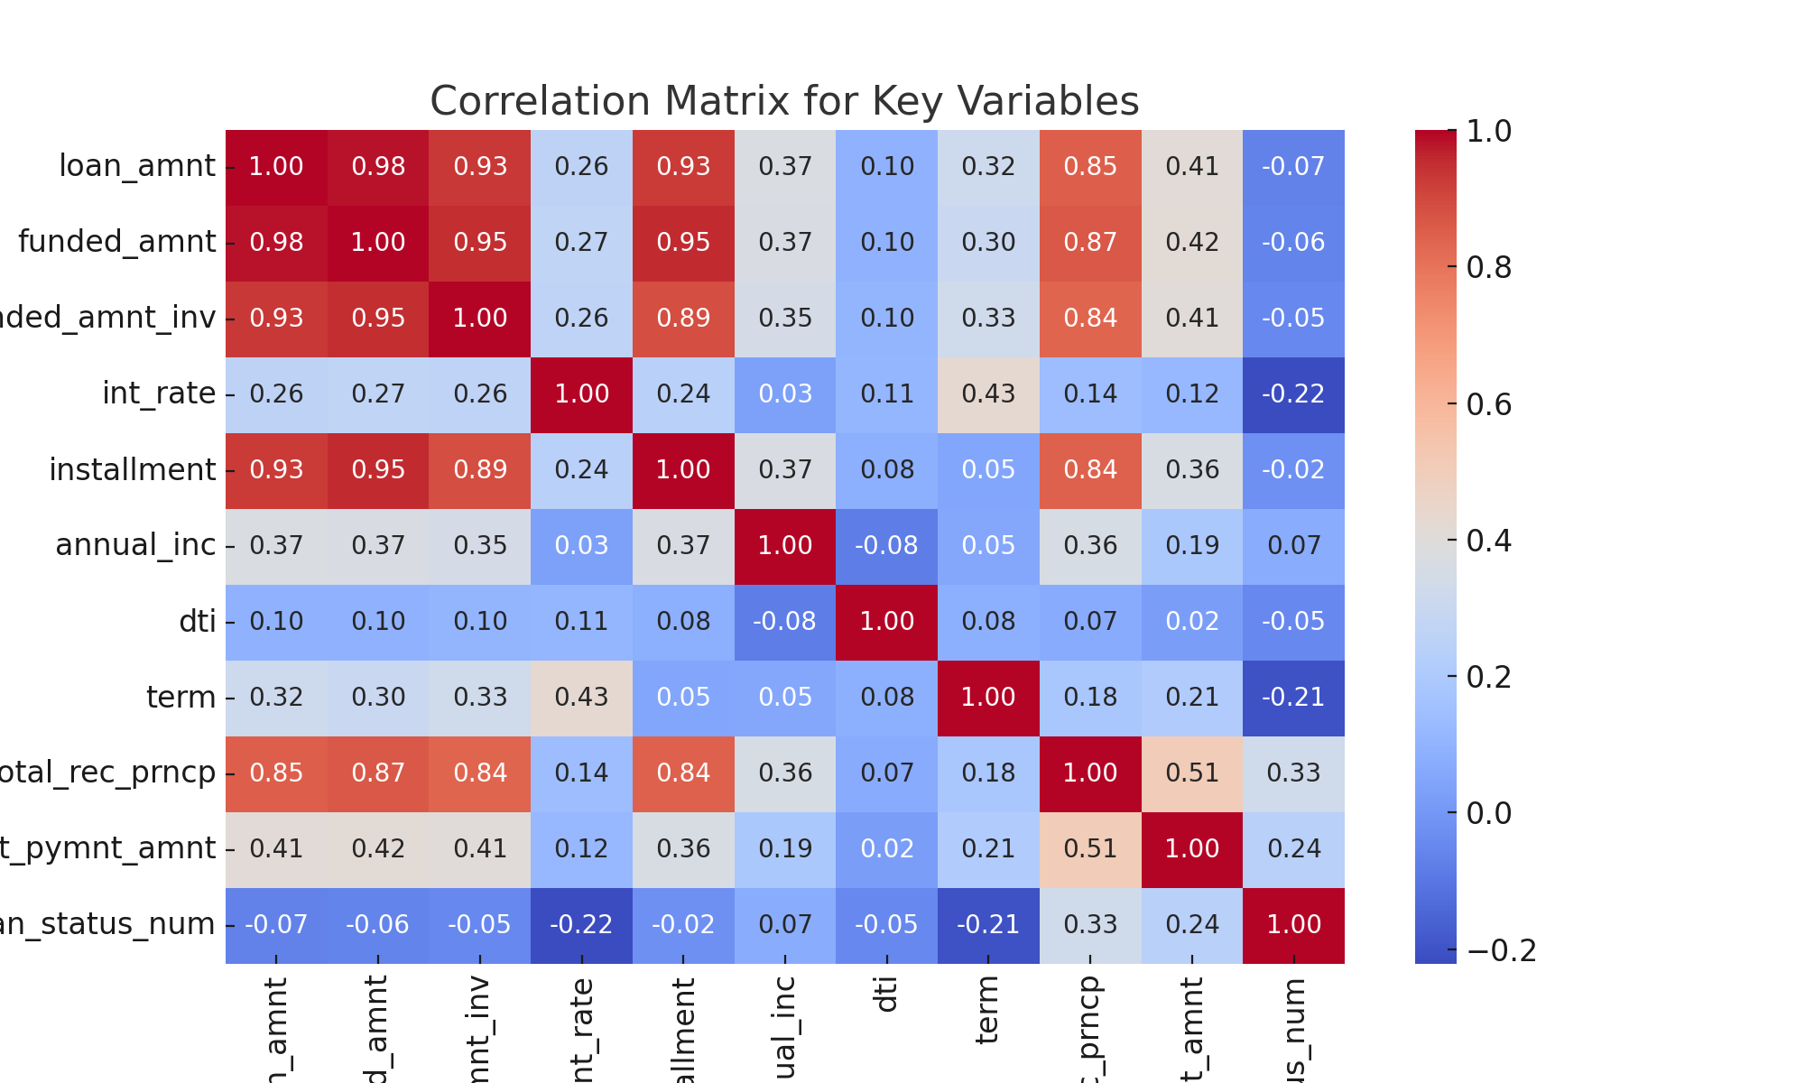
Correlation Matrix for Key Variables

Slide 14
Key Insights
Higher interest rates are associated with higher default rates.
Larger loan amounts are positively correlated with defaults.
Lower annual incomes are associated with higher default rates.
Higher debt-to-income ratios are associated with greater risk of default.
Total received principal and last payment amount are positively correlated with loan status, suggesting lower risk of default.

Slide 15
Recommendations
Focus on applicants with lower interest rates to reduce the risk of default.
Consider setting limits on loan amounts based on the applicant's financial stability.
Prioritize applicants with higher annual incomes to minimize default risk.
Pay attention to the debt-to-income ratio when evaluating loan applications.
Utilize machine learning models for better prediction of loan defaults.

