Slide 1
Analog To Digital Conversion
Lecture-11
Chapter 04

Slide 2
Topics to be discussed
PCM
Delta Modulation
Transmission Modes

Slide 3
ANALOG-TO-DIGITAL CONVERSION
We have seen in Chapter 3 that a digital signal is superior to an analog signal. The tendency today is to change an analog signal to digital data. In this section we discus two techniques, pulse code modulation and delta modulation.

Slide 4
Pulse Code Modulation:
The most common technique to change an analog signal to digital data (digitization) is called pulse code modulation (PCM).
A PCM encoder has three processes, and they are:
1. The analog signal is sampled. (Sampling)
2. The sampled signal is quantized. (Quantizing)
3. The quantized values are encoded as streams of bits. (Encoding)
Figure 4.21 shows the three processes

Slide 5
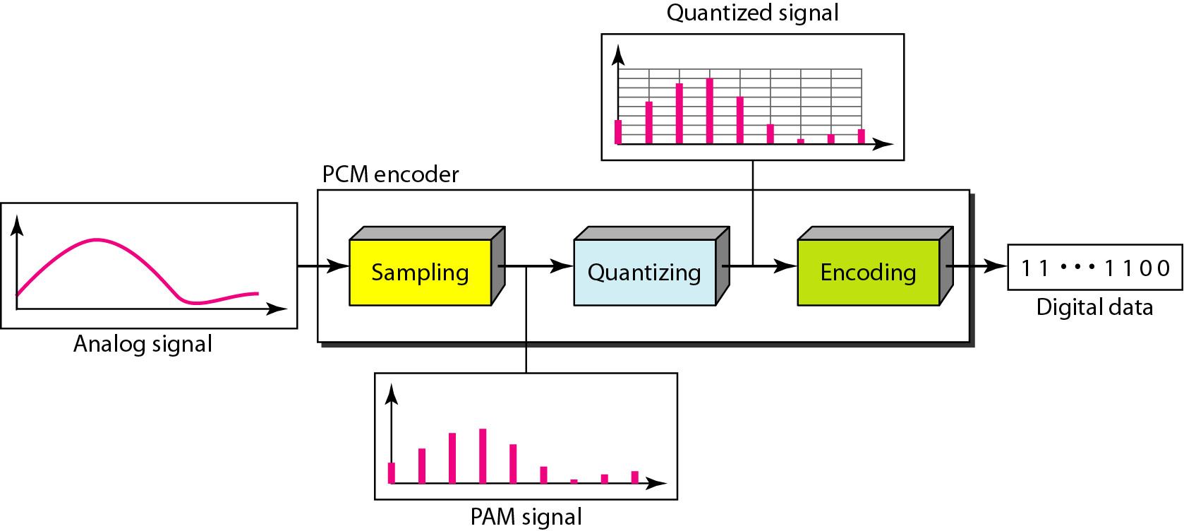
Figure 4.21 Components of PCM encoder

Slide 6
1. Sampling
The first step in PCM is sampling. The analog signal is sampled every Ts second, where Ts is the sample interval or period.
The inverse of the sampling interval is called the sampling rate or sampling frequency and denoted by fs, where fs = 1/Ts.
There are three sampling methods:
Ideal: In ideal sampling, pulses from the analog signal are sampled. This is an ideal sampling method and cannot be easily implemented.
Natural: In natural sampling, a high-speed switch is turned on for only the small period of time when the sampling occurs. The result is a sequence of samples that retains the shape of the analog signal.
Flat-top: The most common sampling method, called sample and hold, however, creates flat-top samples by using a circuit.
The sampling process is sometimes referred to as pulse amplitude modulation (PAM).
We need to remember, however, that the result is still an analog signal with nonintegral values.

Slide 7
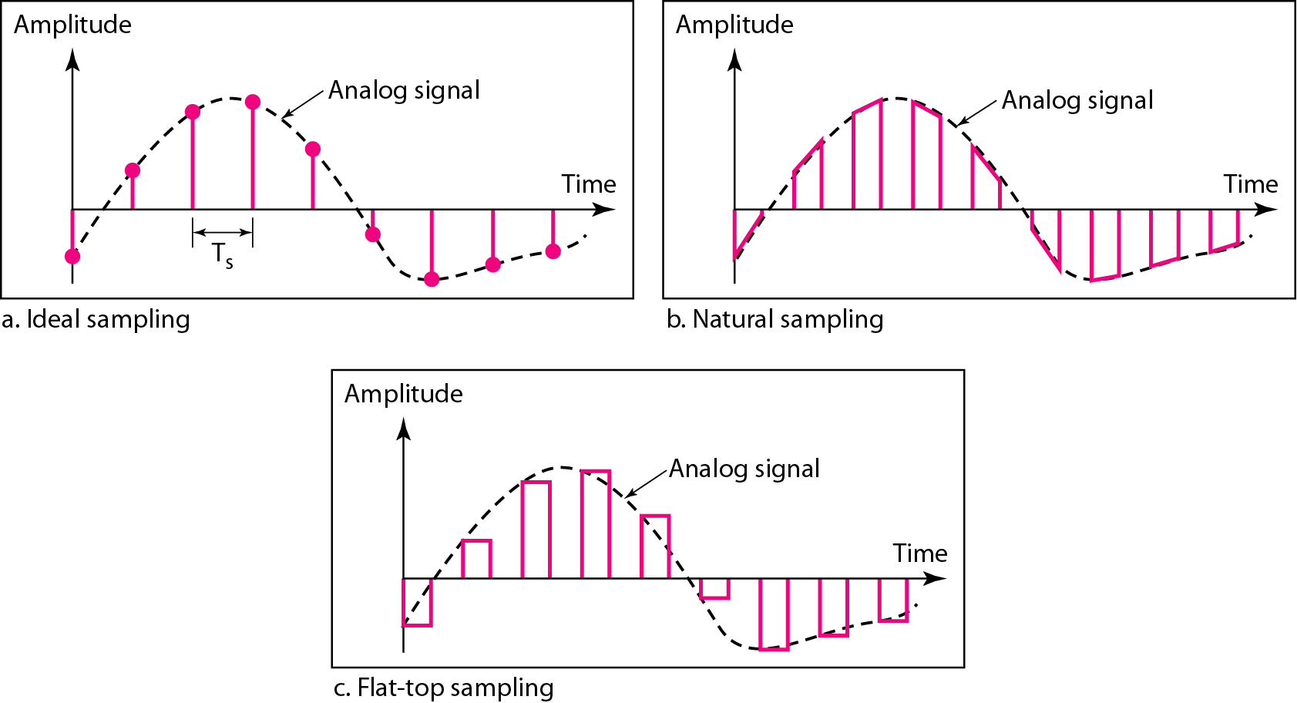
Figure 4.22 Three different sampling methods for PCM

Slide 8

Note
According to the Nyquist theorem, the sampling rate must be
at least 2 times the highest frequency contained in the signal.

Slide 9
Example 4.6
For an intuitive example of the Nyquist theorem, let us sample a simple sine wave at three sampling rates: f_{s} = 4f (2 times the Nyquist rate), f_{s} = 2f (Nyquist rate), and f_{s} = f (one-half the Nyquist rate). Figure 4.24 shows the sampling and the subsequent recovery of the signal.
It can be seen that sampling at the Nyquist rate can create a good approximation of the original sine wave (part a). Oversampling in part b can also create the same approximation, but it is redundant and unnecessary. Sampling below the Nyquist rate (part c) does not produce a signal that looks like the original sine wave.

Slide 10
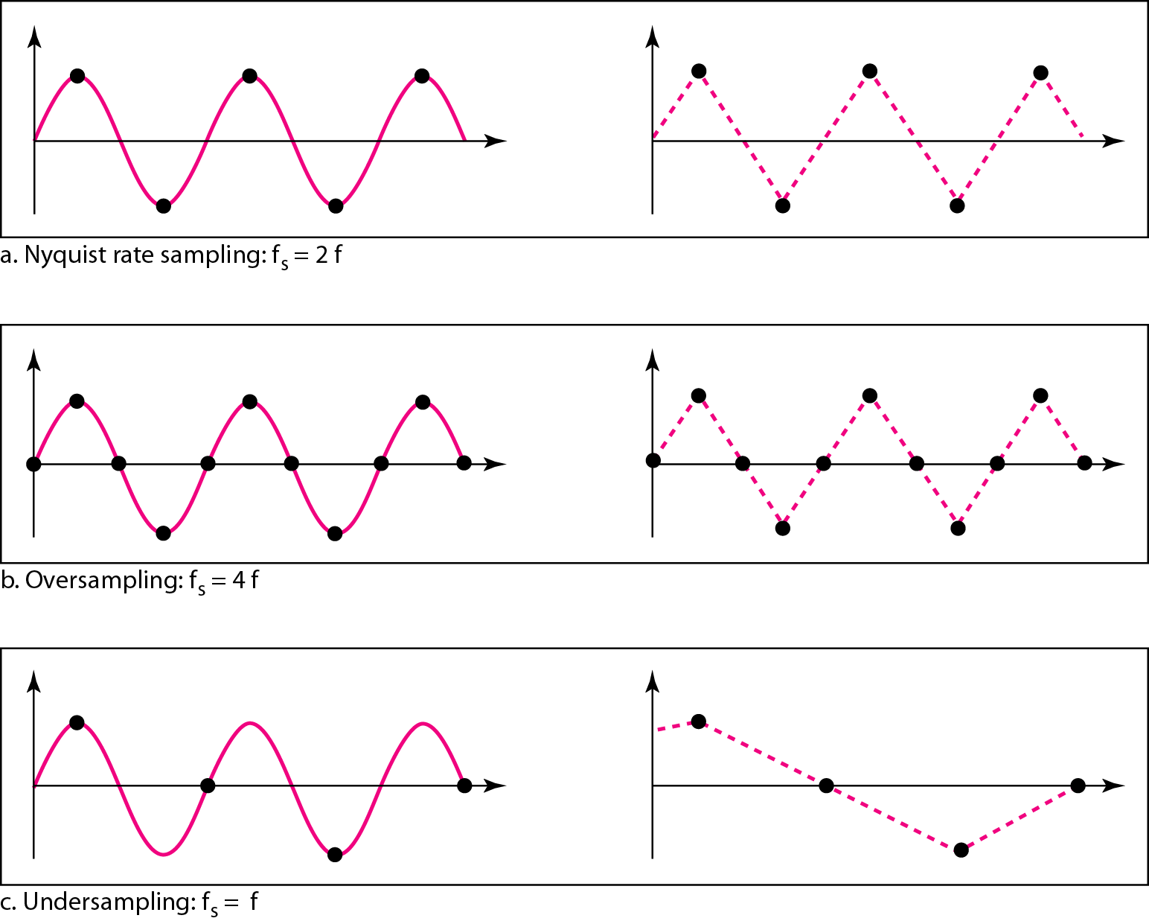
Figure 4.24 Recovery of a sampled sine wave for different sampling rates

Slide 11
Example 4.7
Consider the revolution of a hand of a clock. The second hand of a clock has a period of 60 s.
According to the Nyquist theorem, we need to sample the hand every 30 s (T_{s} = T or f_{s} = 2f ).
In part a of Figure 4.25, the sample points, in order, are 12, 6, 12, 6, 12, and 6. The receiver of the samples cannot tell if the clock is moving forward or backward.
In part b, we sample at double the Nyquist rate (every 15 s). The sample points are 12, 3, 6, 9, and 12. The clock is moving forward.
In part c, we sample below the Nyquist rate (T_{s} = T or f_{s} = f ). The sample points are 12, 9, 6, 3, and 12. Although the clock is moving forward, the receiver thinks that the clock is moving backward.

Slide 12
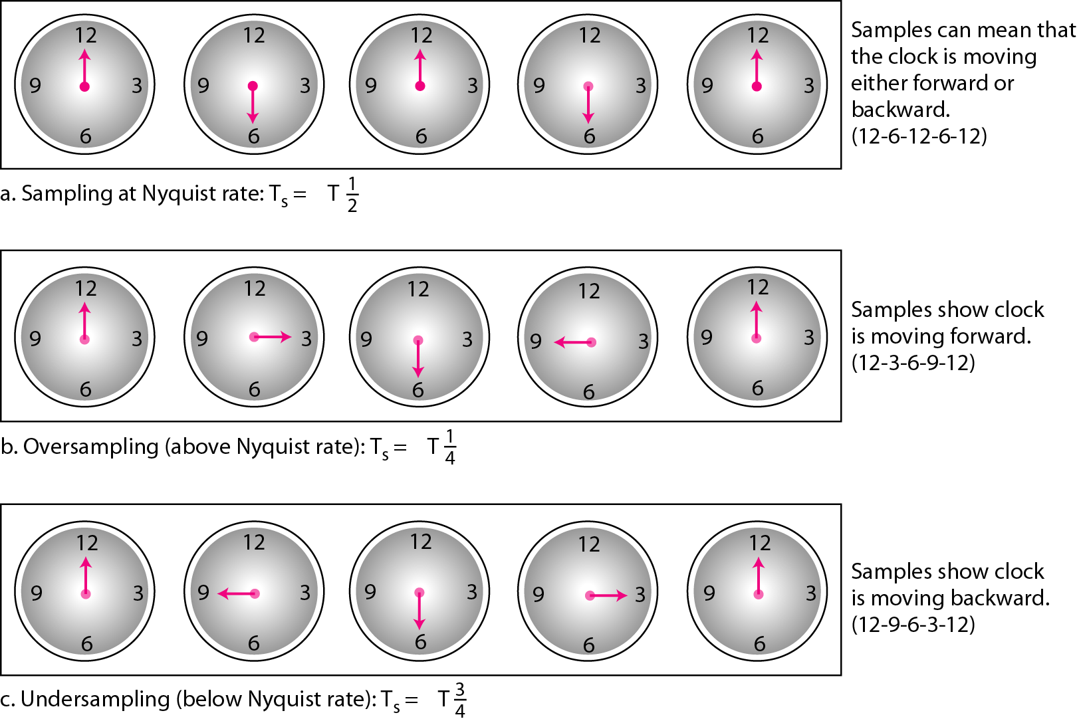
Figure 4.25 Sampling of a clock with only one hand

Slide 13
Example 4.8
An example related to Example 4.7 is the seemingly backward rotation of the wheels of a forward-moving car in a movie. This can be explained by under-sampling. A movie is filmed at 24 frames per second. If a wheel is rotating more than 12 times per second, the under-sampling creates the impression of a backward rotation.

Slide 14
Example 4.9
Telephone companies digitize voice by assuming a maximum frequency of 4000 Hz. The sampling rate therefore is 8000 samples per second.

Slide 15
Example 4.10
A complex low-pass signal has a bandwidth of 200 kHz. What is the minimum sampling rate for this signal?
Solution
The bandwidth of a low-pass signal is between 0 and f, where f is the maximum frequency in the signal.
Therefore, we can sample this signal at 2 times the highest frequency (200 kHz).
The sampling rate is therefore 400,000 samples per second.

Slide 16
Example 4.11
A complex bandpass signal has a bandwidth of 200 kHz. What is the minimum sampling rate for this signal?
Solution:
We cannot find the minimum sampling rate in this case because we do not know where the bandwidth starts or ends. We do not know the maximum frequency in the signal.

Slide 17

2. Quantization
The result of sampling is a series of pulses with amplitude values between the maximum and minimum amplitudes of the signal.
The set of amplitudes can be infinite with nonintegral values between the two limits. These values cannot be used in the encoding process.
The following are the steps in quantization:
1. We assume that the original analog signal has instantaneous amplitudes between V_{min} and V_{max}.
2. We divide the range into L zones, each of height Δ (delta).
3. We assign quantized values of 0 to L − 1 to the midpoint of each zone.
4. We approximate the value of the sample amplitude to the quantized values.
For example: If we have a sampled signal and the sample amplitudes are between −20 and +20 V. And we decide to have eight levels (L = 8). This means that Δ = (+20V − − 20 V)/8= 5 V

Slide 18
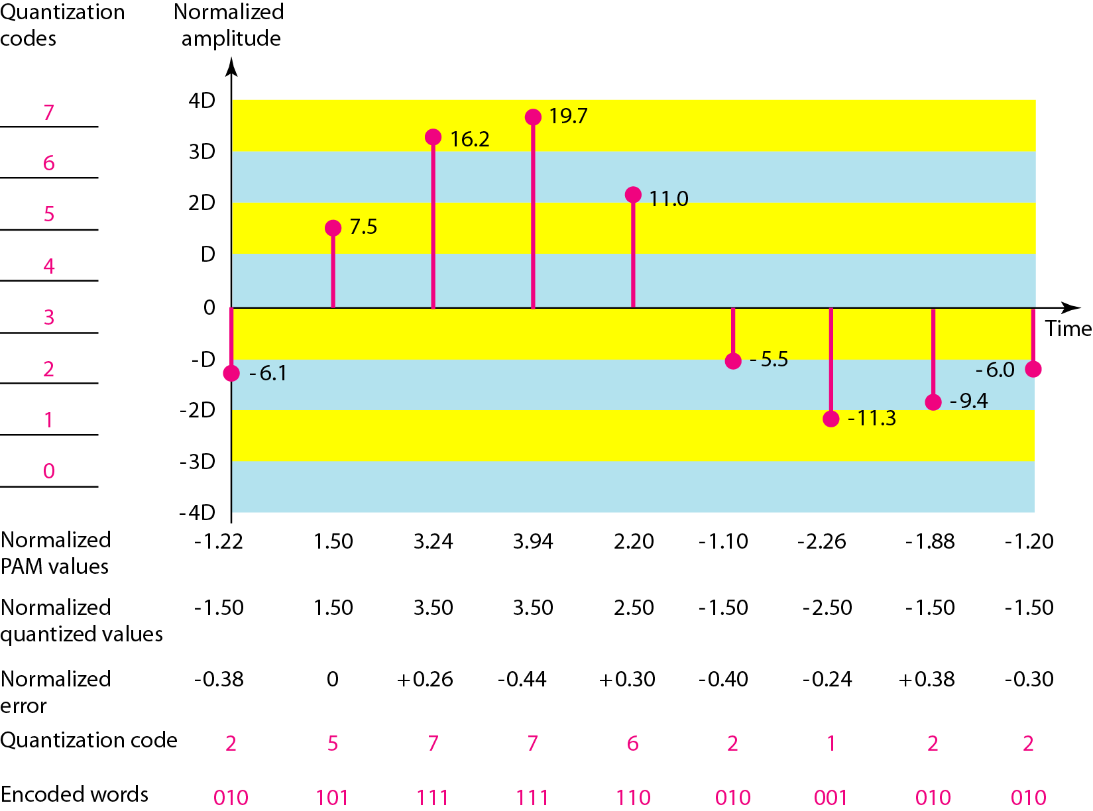
Figure 4.26 Quantization and encoding of a sampled signal

Slide 19
We have shown only nine samples using ideal sampling (for simplicity).
The value at the top of each sample in the graph shows the actual amplitude.
In the chart, the first row is the normalized value for each sample (actual amplitude/Δ).
The quantization process selects the quantization value from the middle of each zone.
This means that the normalized quantized values (second row) are different from the normalized amplitudes.
The difference is called the normalized error (third row).
The fourth row is the quantization code for each sample based on the quantization levels at the left of the graph.
The encoded words (fifth row) are the final products of the conversion.

Slide 20
Quantization Levels(L):
The choice of the number of levels, depends on the range of the amplitudes of the analog signal and how accurately we need to recover the signal.
If the amplitude of a signal fluctuates between two values only, we need only two levels.
In audio digitizing, L is normally chosen to be 256; in video it is normally thousands.
Choosing lower values of L increases the quantization error if there is a lot of fluctuation in the signal.

Slide 21
Quantization Error:
Quantization is an approximation process where the input values to the quantizer are the real values but the output values are the approximated values.
The output values are chosen to be the middle value in the zone. If the input value is also at the middle of the zone, there is no quantization error; otherwise, there is an error.
In the previous example, the normalized amplitude of the third sample is 3.24, but the normalized quantized value is 3.50. This means that there is an error of +0.26.
The value of the error for any sample is less than Δ/2. In other words, we have −Δ/2 ≤ error ≤ Δ/2.
The quantization error changes the signal-to-noise ratio of the signal, which in turn reduces the upper limit capacity according to Shannon.
The contribution of the quantization error to the SNR_{dB} of the signal depends on the number of quantization levels L, or the bits per sample n_{b}, as shown in the following formula:
SNR_{dB} = 6.02n_{b} + 1.76 dB

Slide 22
Example 4.12
What is the SNRdB in the example of Figure 4.26?
Solution
We can use the formula to find the quantization. We have eight levels and 3 bits per sample, so
SNRdB = 6.02(3) + 1.76 = 19.82 dB
“Increasing the number of levels increases the SNR”

Slide 23
Example 4.13
A telephone subscriber line must have an SNRdB above 40. What is the minimum number of bits per sample?
Solution
We can calculate the number of bits as:
Telephone companies usually assign 7 or 8 bits per sample.

Slide 24
3. Encoding
The last step in PCM is encoding. After each sample is quantized and the number of
bits per sample is decided, each sample can be changed to an n_{b}-bit code word. In Figure 4.26 the encoded words are shown in the last row.
A quantization code of 2 is encoded as 010; 5 is encoded as 101; and so on.
Note that the number of bits for each sample is determined from the number of quantization levels.
If the number of quantization levels is L, the number of bits is nb = log2 L. In our example L is 8 and n_{b} is therefore 3.
The bit rate can be found from the formula:

Slide 25
Example 4.14
We want to digitize the human voice. What is the bit rate, assuming 8 bits per sample?
Solution
The human voice normally contains frequencies from 0 to 4000 Hz. So the sampling rate and bit rate are calculated as follows:

Slide 26
Decoding
The decoder first uses circuitry to convert the code words into a pulse that holds the amplitude until the next pulse.
After the staircase signal is completed, it is passed through a low-pass filter to smooth the staircase signal into an analog signal.
The filter has the same cutoff frequency as the original signal at the sender. If the signal has been sampled at (or greater than) the Nyquist sampling rate and if there are enough quantization levels, the original signal will be recreated.
Note that the maximum and minimum values of the original signal can be achieved by using amplification. Figure 4.27 shows the simplified process.

Slide 27
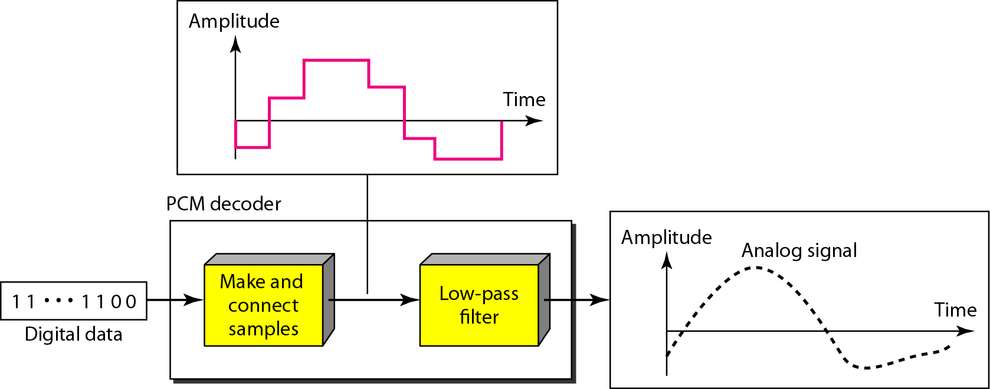
Figure 4.27 Components of a PCM decoder

Slide 28

PCM Bandwidth
Suppose we are given the bandwidth of a low-pass analog signal.
If we then digitize the signal, what is the new minimum bandwidth of the channel that can pass this digitized signal?
We have said that the minimum bandwidth of a line-encoded signal is
B_{min} = c × N × (1/r).
We substitute the value of N in this formula:
When 1/r = 1 (for a NRZ or bipolar signal) and c = (1/2) (the average situation), the
minimum bandwidth is
This means the minimum bandwidth of the digital signal is n_{b} times greater than the
bandwidth of the analog signal. This is the price we pay for digitization.

Slide 29
Example 4.15
We have a low-pass analog signal of 4 kHz. If we send the analog signal, we need a channel with a minimum bandwidth of 4 kHz. If we digitize the signal and send 8 bits per sample, we need a channel with a minimum bandwidth of 8 × 4 kHz = 32 kHz.

Slide 30
Delta Modulation
Delta modulation is the simplest modulation.
PCM finds the value of the signal amplitude for each sample but Delta Modulation finds the change from the previous sample.
Figure 4.28 shows the process.
There are no code words used in DM.
The bits are sent one after another.

Slide 31
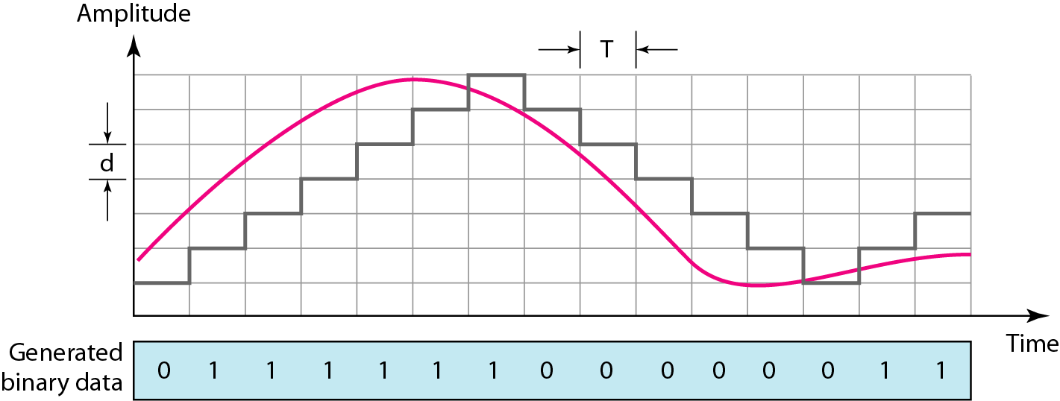
Figure 4.28 The process of delta modulation

Slide 32
Modulator
The modulator is used at the sender site to create a stream of bits from an analog signal.
The process records the small positive or negative changes, called delta δ.
If the delta is positive, the process records a 1; if it is negative, the process records a 0. However, the process needs a base against which the analog signal is compared.
The modulator builds a second signal that resembles a staircase.
Finding the change is then reduced to comparing the input signal with the gradually made staircase signal.
The modulator, at each sampling interval, compares the value of the analog signal with the last value of the staircase signal.
If the amplitude of the analog signal is larger, the next bit in the digital data is 1; otherwise, it is 0.
The output of the comparator, however, also makes the staircase itself. If the next bit is 1, the staircase maker moves the last point of the staircase signal δ up; if the next bit is 0, it moves it δ down.
We need a delay unit to hold the staircase function for a period between two comparisons.

Slide 33
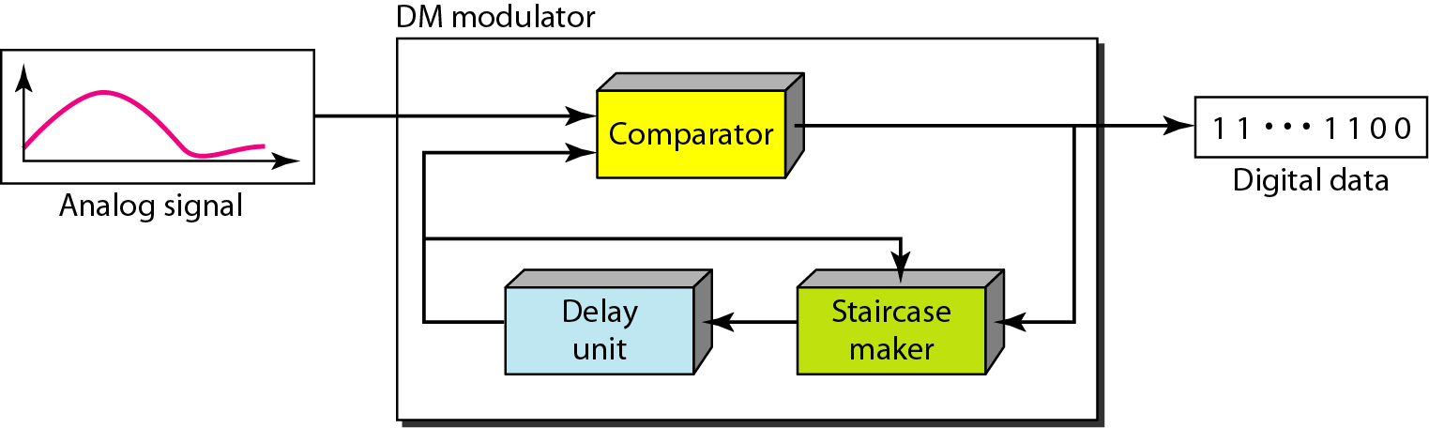
Figure 4.29 Delta modulation components

Slide 34
Demodulator
The demodulator takes the digital data and, using the staircase maker and the delay unit, creates the analog signal.
The created analog signal, however, needs to pass through a low-pass filter for smoothing.
Figure 4.30 shows the schematic diagram.

Slide 35
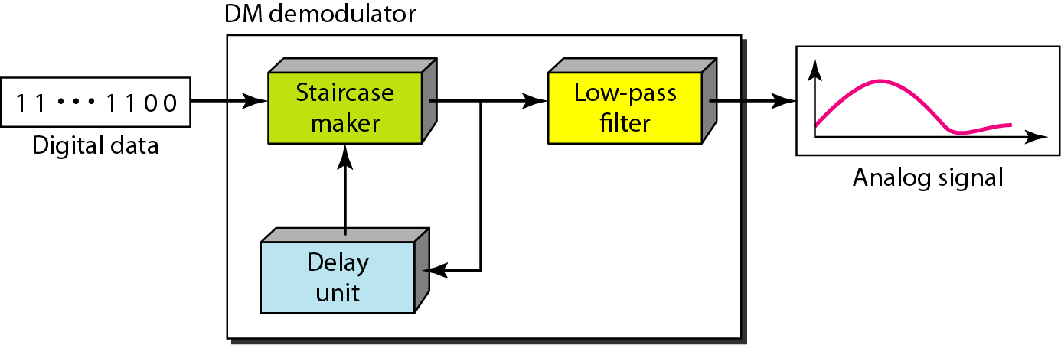
Figure 4.30 Delta demodulation components

Slide 36
TRANSMISSION MODES
The transmission of binary data across a link can be accomplished in either parallel or serial mode.
In parallel mode, multiple bits are sent with each clock tick.
In serial mode, 1 bit is sent with each clock tick. While there is only one way to send parallel data, there are three subclasses of serial transmission: asynchronous, synchronous, and isochronous.

Slide 37
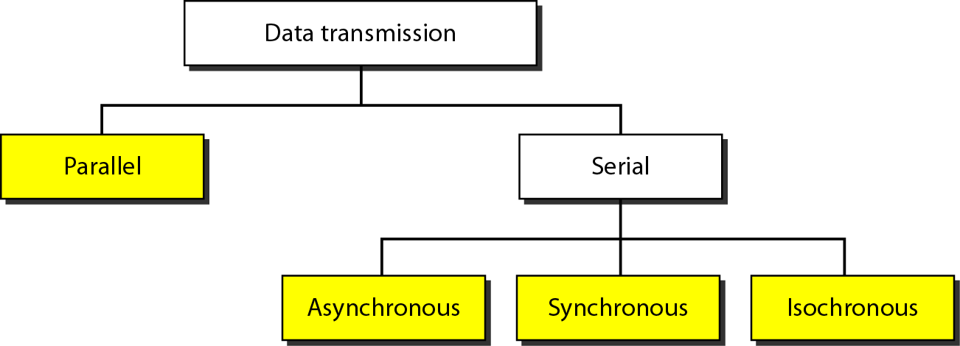
Figure 4.31 Data transmission and modes

Slide 38
Parallel Transmission
In this technique bits are organized into groups of n bits each, and sent as group instead of one bit at a time.
The mechanism for parallel transmission is a conceptually simple one: Use n wires to send n bits at one time.
That way each bit has its own wire, and all n bits of one group can be transmitted with each clock tick from one device to another.
Figure 4.32 shows how parallel transmission works for n = 8. Typically, the eight wires are bundled in a cable with a connector at each end.
Advantage of parallel transmission is speed. All else being equal, parallel transmission can increase the transfer speed by a factor of n over serial transmission.
Disadvantage: cost. Parallel transmission requires n communication lines (wires in the example) just to transmit the data stream. Because this is expensive, parallel transmission is usually limited to short distances.

Slide 39
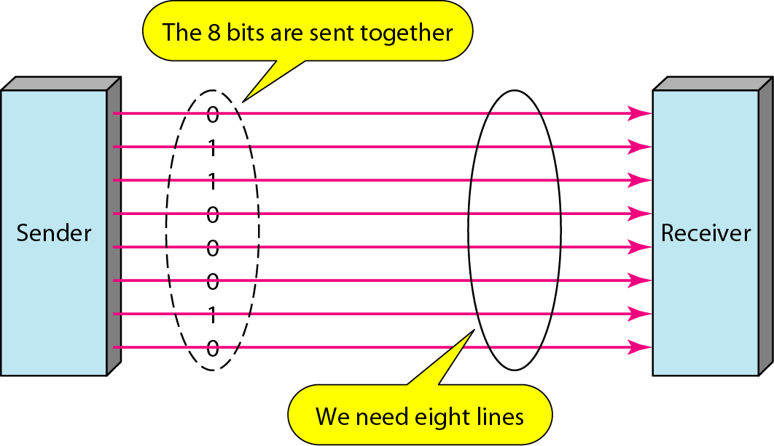
Figure 4.32 Parallel transmission

Slide 40
Serial Transmission
In serial transmission one bit follows another, so we need only one communication channel rather than n to transmit data between two communicating devices (see Figure 4.33).
The advantage of serial over parallel transmission is that with only one communication channel, serial transmission reduces the cost of transmission over parallel by roughly a factor of n.
Since communication within devices is parallel, conversion devices are required at the interface between the sender and the line (parallel-to-serial) and between the line and the receiver (serial-to-parallel).
Serial transmission occurs in one of three ways: asynchronous, synchronous, and isochronous.

Slide 41
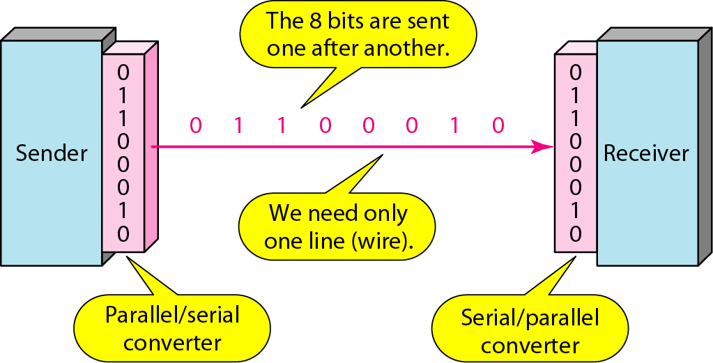
Figure 4.33 Serial transmission

Slide 42
Asynchronous transmission
It is so named because the timing of a signal is unimportant i.e. the sender & receiver need not to be synchronized always.
To alert the receiver to the arrival of a new group, therefore, an extra bit is added to the beginning of each byte. This bit, usually a 0, is called the start bit.
To let the receiver know that the byte is finished, 1 or more additional bits are appended to the end of the byte.
These bits, usually 1s, are called stop bits.
By this method, each byte is increased in size to at least 10 bits, of which 8 bits is information and 2 bits or more are signals to the receiver.
This mechanism is called asynchronous because, at the byte level, the sender and receiver do not have to be synchronized.
But within each byte, the receiver must still be synchronized with the incoming bit stream.
That is, some synchronization is required, but only for the duration of a single byte.
Advantages: it is cheap and effective, that make it an attractive choice for situations such as low-speed communication.
Example: the connection of a keyboard to a computer is a natural application for asynchronous transmission.

Slide 43
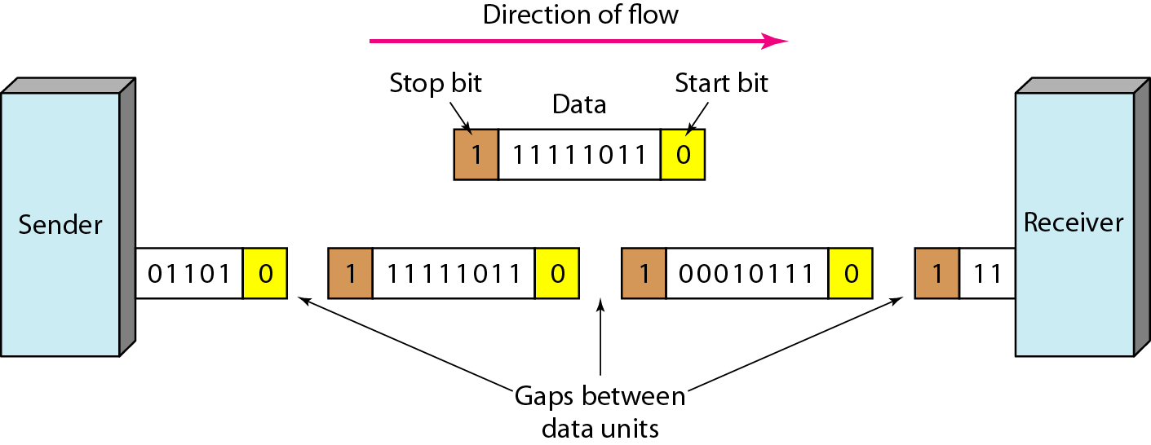
Figure 4.34 Asynchronous transmission

Slide 44
Synchronous Transmission
In synchronous transmission, the bit stream is combined into longer “frames,” which may contain multiple bytes.
Each byte, however, is introduced onto the transmission link without a gap between it and the next one.
It is left to the receiver to separate the bit stream into bytes for decoding purposes.
In other words, data are transmitted as an unbroken string of 1s and 0s, and the receiver separates that string into the bytes, or characters, it needs to reconstruct the information.
If the sender wishes to send data in separate bursts, the gaps between bursts must be filled with a special sequence of 0s and 1s that means idle. The receiver counts the bits as they arrive and groups them in 8-bit units.
The advantage of synchronous transmission is speed. With no extra bits or gaps to introduce at the sending end and remove at the receiving end, and, by extension, with fewer bits to move across the link, synchronous transmission is faster than asynchronous transmission.
It is more useful for high-speed applications such as the transmission of data from one computer to another.
Although there is no gap between characters in synchronous serial transmission, there may be uneven gaps between frames.

Slide 45
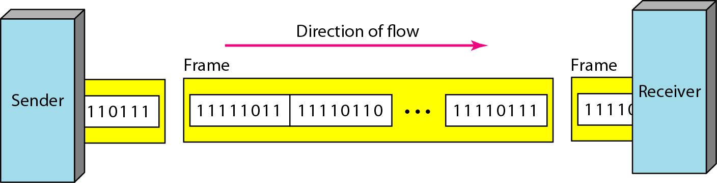
Figure 4.35 Synchronous transmission

Slide 46
Note
In synchronous transmission, we send bits one after another without start or stop bits or gaps. It is the responsibility of the receiver to group the bits.

Slide 47
Isochronous
In real-time audio and video, in which uneven delays between frames are not acceptable, synchronous transmission fails.
For example, TV images are broadcast at the rate of 30 images per second; they must be viewed at the same rate. If each image is sent by using one or more frames, there should be no delays between frames.
For this type of application, synchronization between characters is not enough; the entire stream of bits must be synchronized.
The isochronous transmission guarantees that the data arrive at a fixed rate.

Slide 48
What have we completed?
Thank You
PCM
Delta Modulation
Transmission Modes

