Slide 1
Error Detection and Correction
Lecture-15-17
Chapter 10

Slide 2
Topics to be discussed
Error Detection Vs Error Correction
Block Codes
Hamming Distance
Hamming Code
Linear Block Codes
Cyclic Redundancy Check
Polynomials
Checksum

Slide 3
Errors
Single-bit error: only 1 bit in the data unit has changed.
Burst error :2 or more bits in the data unit have changed.

Slide 4
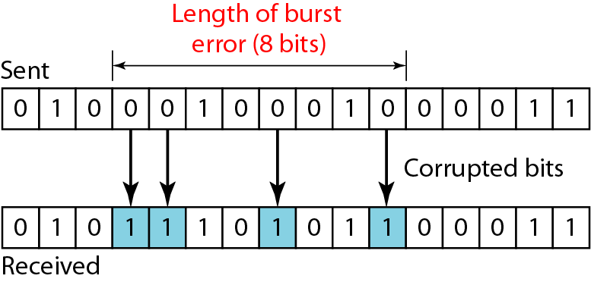
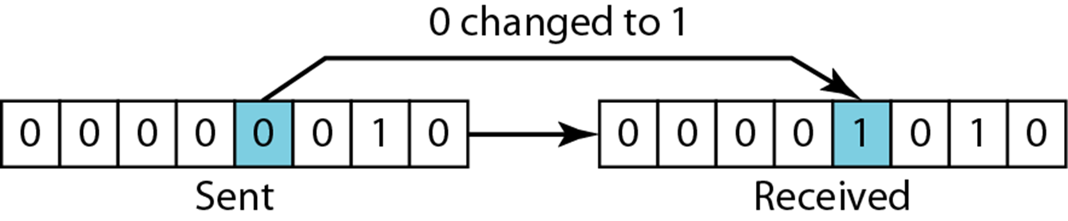
Single-bit error
Burst error of length 8

Slide 5
Detection versus Correction
In error detection, we are only looking to see if any error has occurred.
In error correction, we need to know the exact number of bits that are corrupted and, more importantly, their location in the message.

Slide 6
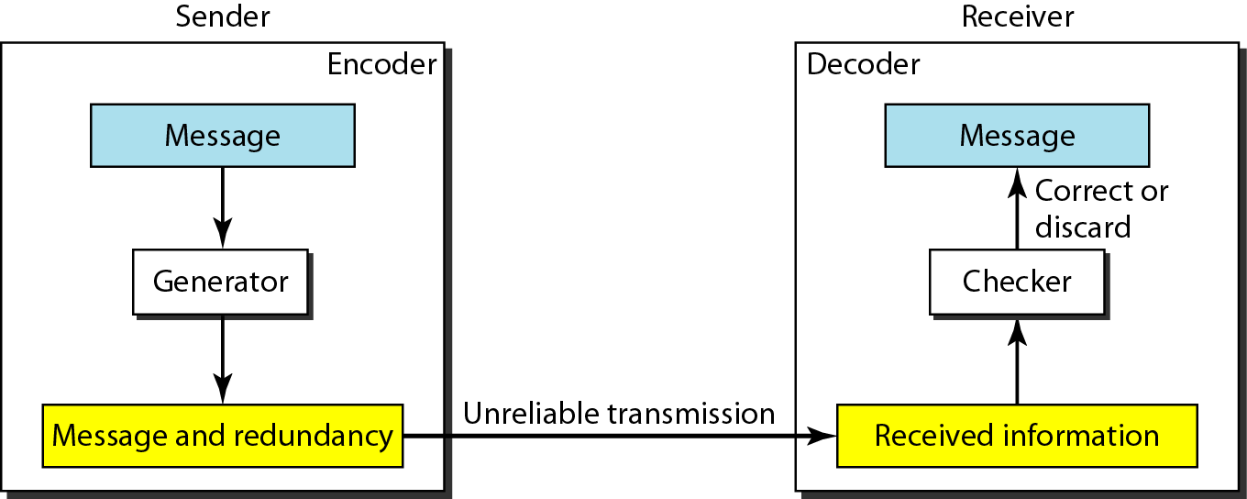
Figure 10.3 The structure of encoder and decoder

Slide 7
Codding scheme
Block Codding
Convolution Codding

Slide 8
BLOCK CODING
In block coding, we divide our message into blocks, each of k bits, called data words. We add r redundant bits to each block to make the length n = k + r. The resulting n-bit blocks are called code words.

Slide 9
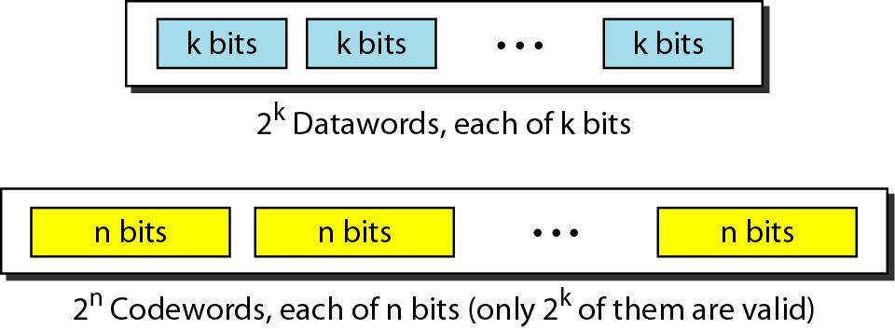
Figure 10.5 Datawords and codewords in block coding

Slide 10
Example 10.1
The 4B/5B block coding discussed in Chapter 4 is a good example of this type of coding. In this coding scheme, k = 4 and n = 5. As we saw, we have 2^{k} = 16 datawords and 2^{n} = 32 codewords. We saw that 16 out of 32 codewords are used for message transfer and the rest are either used for other purposes or unused.

Slide 11
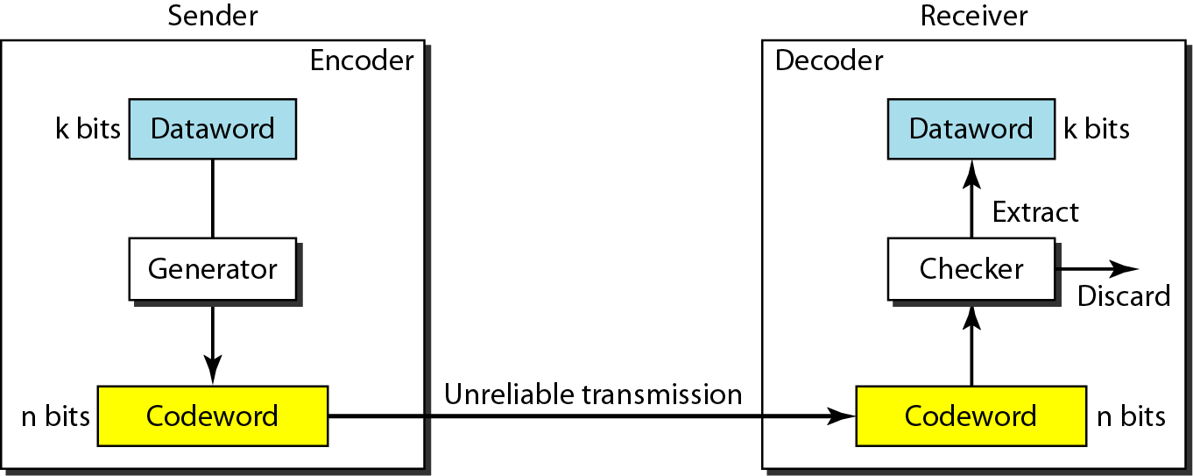
Figure 10.6 Process of error detection in block coding

Slide 12
Example 10.2
Let us assume that k = 2 and n = 3. Table 10.1 shows the list of datawords and codewords. Later, we will see how to derive a codeword from a dataword.
Assume the sender encodes the dataword 01 as 011 and
sends it to the receiver. Consider the following cases:
1. The receiver receives 011. It is a valid codeword. The receiver extracts the dataword 01 from it.

Slide 13
Example 10.2 (continued)
2. The codeword is corrupted during transmission, and 111 is received. This is not a valid codeword and is discarded.
3. The codeword is corrupted during transmission, and 000 is received. This is a valid codeword. The receiver incorrectly extracts the dataword 00. Two corrupted bits have made the error undetectable.

Slide 14
Table 10.1 A code for error detection (Example 10.2)

Slide 15
Note
An error-detecting code can detect only the types of errors for which it is designed; other types of errors may remain undetected.

Slide 16
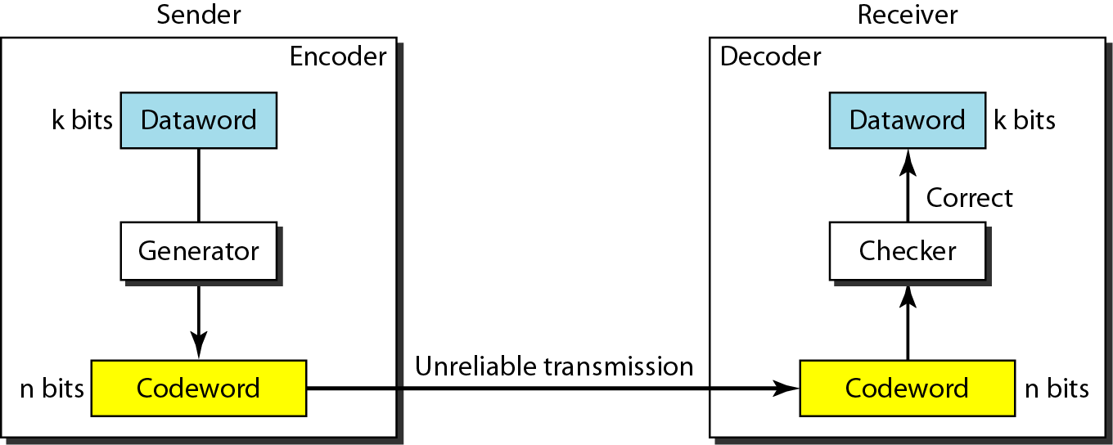
Figure 10.7 Structure of encoder and decoder in error correction

Slide 17
Example 10.3
Let us add more redundant bits to Example 10.2 to see if the receiver can correct an error without knowing what was actually sent.
We add 3 redundant bits to the 2-bit dataword to make 5-bit codewords.
Table 10.2 shows the datawords and codewords.
Assume the dataword is 01.
The sender creates the codeword 01011.
The codeword is corrupted during transmission, and 01001 is received.
First, the receiver finds that the received codeword is not in the table.
This means an error has occurred. The receiver, assuming that there is only 1 bit corrupted, uses the following strategy to guess the correct dataword.

Slide 18
Example 10.3 (continued)
1. Comparing the received codeword with the first codeword in the table (01001 versus 00000), the receiver decides that the first codeword is not the one that was sent because there are two different bits.
2. By the same reasoning, the original codeword cannot be the third or fourth one in the table.
3. The original codeword must be the second one in the table because this is the only one that differs from the received codeword by 1 bit. The receiver replaces 01001 with 01011 and consults the table to find the dataword 01.

Slide 19
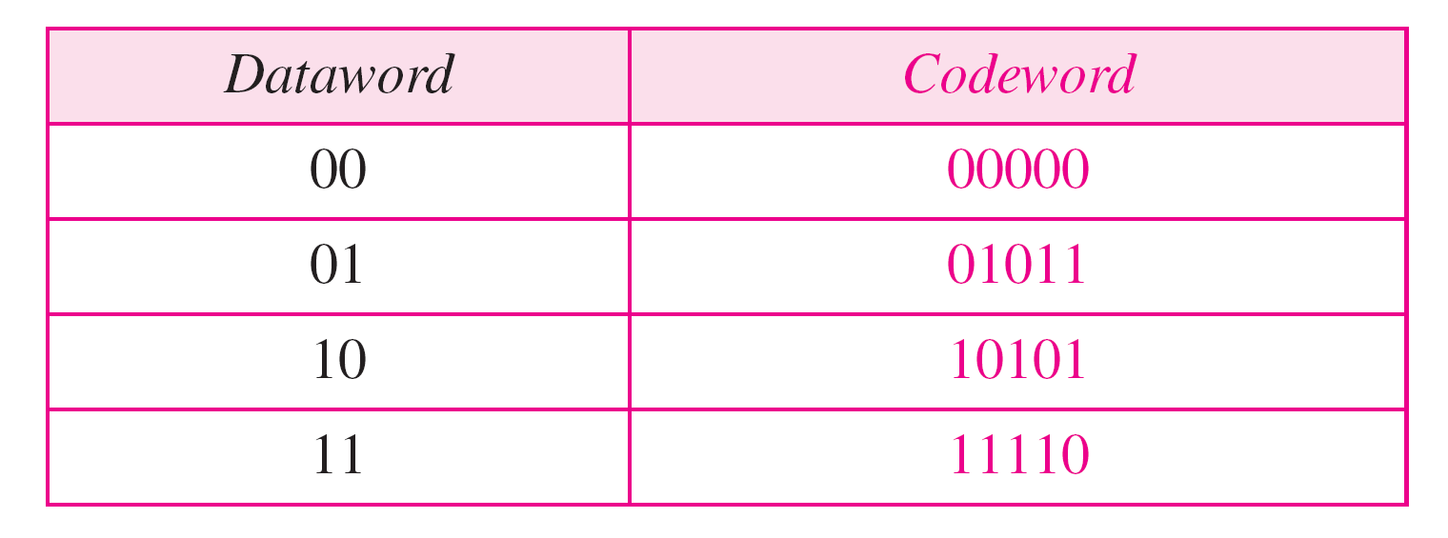
Table 10.2 A code for error correction (Example 10.3)

Slide 20

Note
The Hamming distance between two words is the number of differences between corresponding bits.

Slide 21
Example 10.4
Let us find the Hamming distance between two pairs of words.
1. The Hamming distance d(000, 011) is 2 because
2. The Hamming distance d(10101, 11110) is 3 because

Slide 22
Note
The minimum Hamming distance is the smallest Hamming distance between all possible pairs in a set of words.

Slide 23
Example 10.5
Find the minimum Hamming distance of the coding scheme in Table 10.1.
Solution
We first find all Hamming distances.
The d_{min} in this case is 2.

Slide 24
Example 10.6
Find the minimum Hamming distance of the coding scheme in Table 10.2.
Solution
We first find all the Hamming distances.
The d_{min} in this case is 3.

Slide 25
Note
To guarantee the detection of up to s errors in all cases, the minimum Hamming distance in a block code must be d_{min} = s + 1.

Slide 26
Example 10.7
The minimum Hamming distance for our first code scheme (Table 10.1) is 2.
This code guarantees detection of only a single error.
For example, if the third codeword (101) is sent and one error occurs, the received codeword does not match any valid codeword.
If two errors occur, however, the received codeword may match a valid codeword and the errors are not detected.

Slide 27
Example 10.8
Our second block code scheme (Table 10.2) has d_{min} = 3.
This code can detect up to two errors.
Again, we see that when any of the valid codewords is sent, two errors create a codeword which is not in the table of valid codewords. The receiver cannot be fooled.
However, some combinations of three errors change a valid codeword to another valid codeword.
The receiver accepts the received codeword and the errors are undetected.

Slide 28
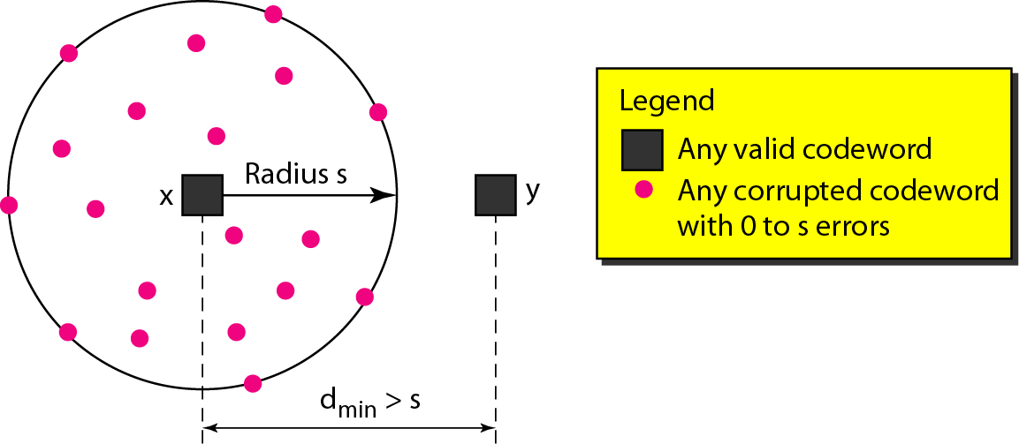
Figure 10.8 Geometric concept for finding d_{min} in error detection

Slide 29
Example 10.9
A code scheme has a Hamming distance d_{min} = 4. What is the error detection and correction capability of this scheme?
Solution
This code guarantees the detection of up to three errors (s = 3), but it can correct up to one error. In other words, if this code is used for error correction, part of its capability is wasted. Error correction codes need to have an odd minimum distance (3, 5, 7, . . . ).

Slide 30
LINEAR BLOCK CODES
Almost all block codes used today belong to a subset called linear block codes.
A linear block code is a code in which the exclusive OR (addition modulo-2) of two valid codewords creates another valid codeword.

Slide 31
Note
In a linear block code, the exclusive OR (XOR) of any two valid codewords creates another valid codeword.

Slide 32
Example 10.10
Let us see if the two codes we defined in Table 10.1 and Table 10.2 belong to the class of linear block codes.
The scheme in Table 10.1 is a linear block code because the result of XORing any codeword with any other codeword is a valid codeword. For example, the XORing of the second and third codewords creates the fourth one.
The scheme in Table 10.2 is also a linear block code. We can create all four codewords by XORing two other codewords.

Slide 33
Minimum Distance for Linear Block Codes
The minimum Hamming distance is the number of 1s in the nonzero valid codeword with the smallest number of 1s.

Slide 34
Example 10.11
In our first code (Table 10.1), the numbers of 1s in the nonzero codewords are 2, 2, and 2. So the minimum Hamming distance is d_{min} = 2.
In our second code (Table 10.2), the numbers of 1s in the nonzero codewords are 3, 3, and 4. So in this code we have d_{min} = 3.

Slide 35
Note
A simple parity-check code is a single-bit error-detecting code in which n = k + 1 with d_{min} = 2.
Where k is the length of dataword and n is the length of codeword.

Slide 36
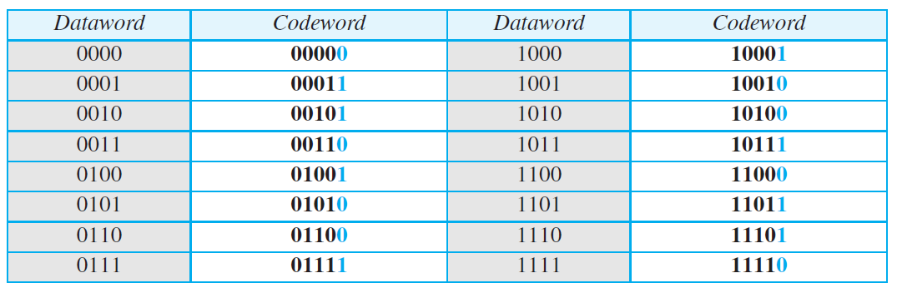
Table 10.3 Simple parity-check code C(5, 4)

Slide 37
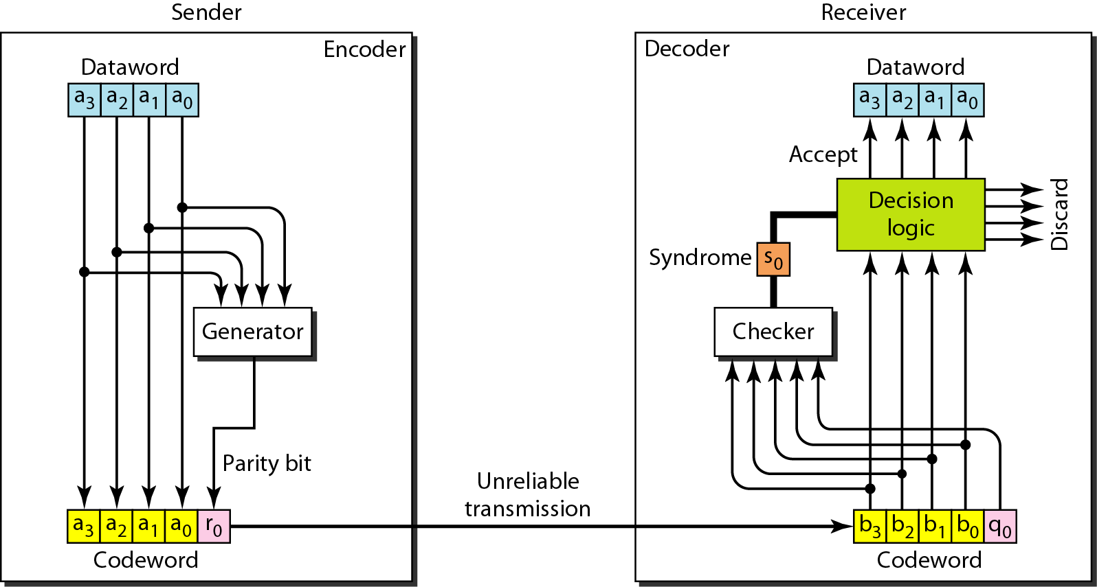
Figure 10.10 Encoder and decoder for simple parity-check code

Slide 38

The Process of encoding
The encoder uses a generator that takes a copy of a 4-bit dataword (a0, a1, a2, and a3) and generates a parity bit r0.
The dataword bits and the parity bit create the 5-bit codeword.
The parity bit that is added makes the number of 1s in the codeword even.
This is normally done by adding the 4 bits of the dataword (modulo-2); the result is the parity bit.
If the number of 1s is even, the result is 0; if the number of 1s is odd, the result is 1.

Slide 39

The Process of decoding
The receiver receives a 5-bit word. The checker at the receiver does the same thing as the generator in the sender with one exception: The addition is done over all 5 bits.
The result, which is called the syndrome, is just 1 bit.
The syndrome is 0 when the number of 1s in the received codeword is even; otherwise, it is 1.
The syndrome is passed to the decision logic analyzer.
If the syndrome is 0, there is no detectable error in the received codeword; the data portion of the received codeword is accepted as the dataword; if the syndrome is 1, the data portion of the received codeword is discarded.
The dataword is not created.

Slide 40
Example 10.12
Let us look at some transmission scenarios. Assume the sender sends the dataword 1011. The codeword created from this dataword is 10111, which is sent to the receiver. We examine five cases:
No error occurs; the received codeword is 10111. The syndrome is 0. The dataword 1011 is created.
One single-bit error changes a₁ . The received codeword is 10011. The syndrome is 1. No dataword is created.
One single-bit error changes r₀ . The received codeword is 10110. The syndrome is 1. No dataword is created.

Slide 41
Example 10.12 (continued)
An error changes r₀ and a second error changes a₃ .The received codeword is 00110. The syndrome is 0. The dataword 0011 is created at the receiver. Note that here the dataword is wrongly created due to the syndrome value.
Three bits—a₃, a₂, and a₁—are changed by errors. The received codeword is 01011. The syndrome is 1. The dataword is not created. This shows that the simple parity check, guaranteed to detect one single error, can also find any odd number of errors.

Slide 42
Note
A simple parity-check code can detect an odd number of errors.

Slide 43
Note
All Hamming codes discussed in this book have d_{min} = 3.
The relationship between m and n in these codes is n = 2m − 1.

Slide 44
2D- Parity check:
In this method, the dataword is organized in a table (rows and columns).
In Figure 10.11, the data to be sent, five 7-bit bytes, are put in separate rows.
For each row and each column, 1 parity-check bit is calculated.
The whole table is then sent to the receiver, which finds the syndrome for each row and each column.
As Figure 10.11 shows, the two-dimensional parity check can detect up to three errors that occur anywhere in the table (arrows point to the locations of the created nonzero syndromes).
However, errors affecting 4 bits may not be detected.

Slide 45
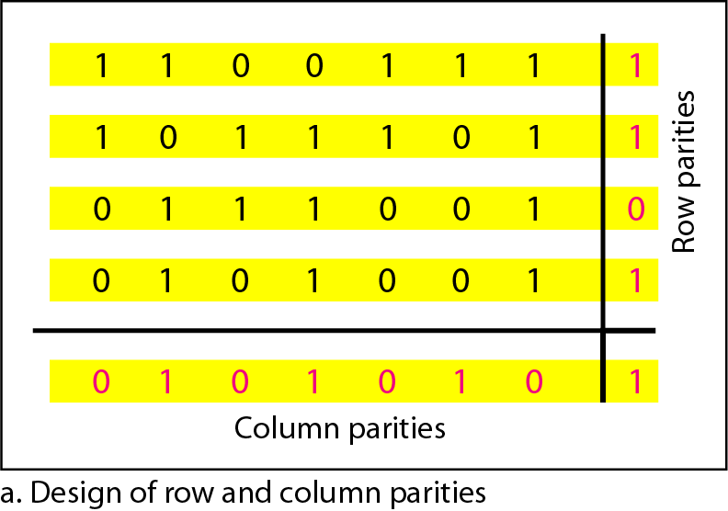
Figure 10.11 Two-dimensional parity-check code

Slide 46
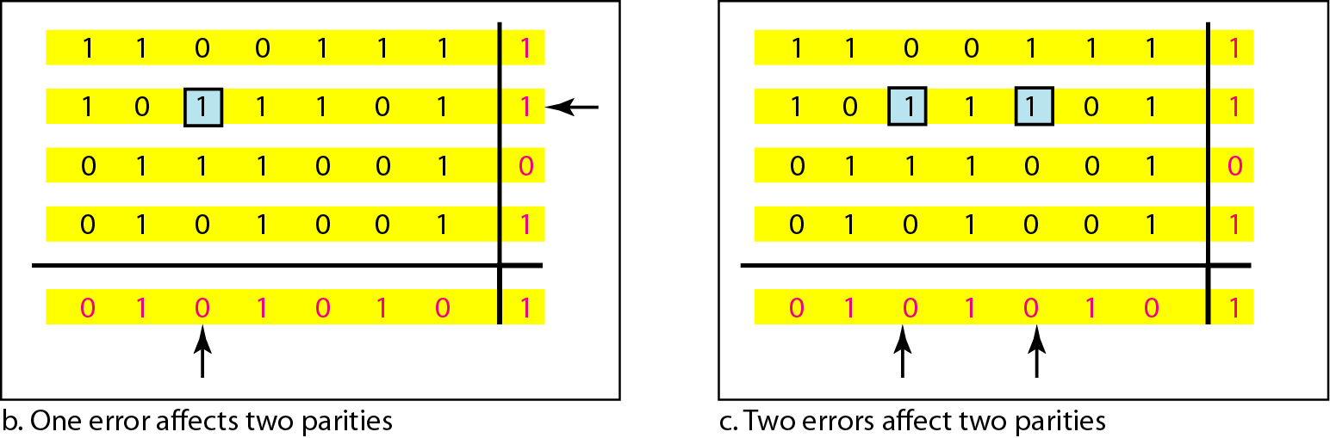
Figure 10.11 Two-dimensional parity-check code

Slide 47
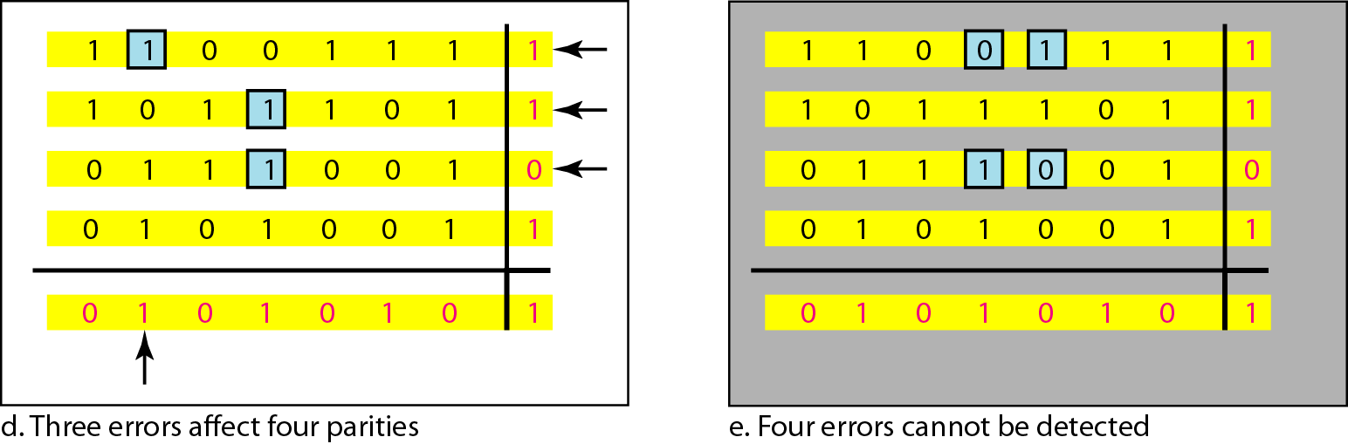
Figure 10.11 Two-dimensional parity-check code

Slide 48
Hamming Codes:
These codes were originally designed with d_{min} = 3, which means that they can detect up to two errors or correct one single error.
Although there are some Hamming codes that can correct more than one error, our discussion focuses on the single-bit error-correcting code.
First let us find the relationship between n and k in a Hamming code.
We need to choose an integer m >= 3. The values of n and k are then calculated from m as n = 2^{m} – 1 and k =n - m.
The number of check bits r =m.
For example, if m =3, then n=7 and k =4. This is a Hamming code C(7, 4) with d_{min} =3. Table 10.4 shows the datawords and codewords for this code.

Slide 49






$$r_{0}=a_{2}+a_{1}+a_{0}$$
$$r_{1}=a_{3}+a_{2}+a_{1}$$
$$r_{2}=a_{1}+a_{0}+a_{3}$$
$$S_{0}=b_{2}+b_{1}+b_{0}+q0$$
$$S_{1}=b_{3}+b_{2}+b_{1}+q1$$
$$S_{2}=b_{1}+b_{0}+b_{3}+q2$$

Slide 50
Table 10.4 Hamming code C(7, 4)

Slide 51
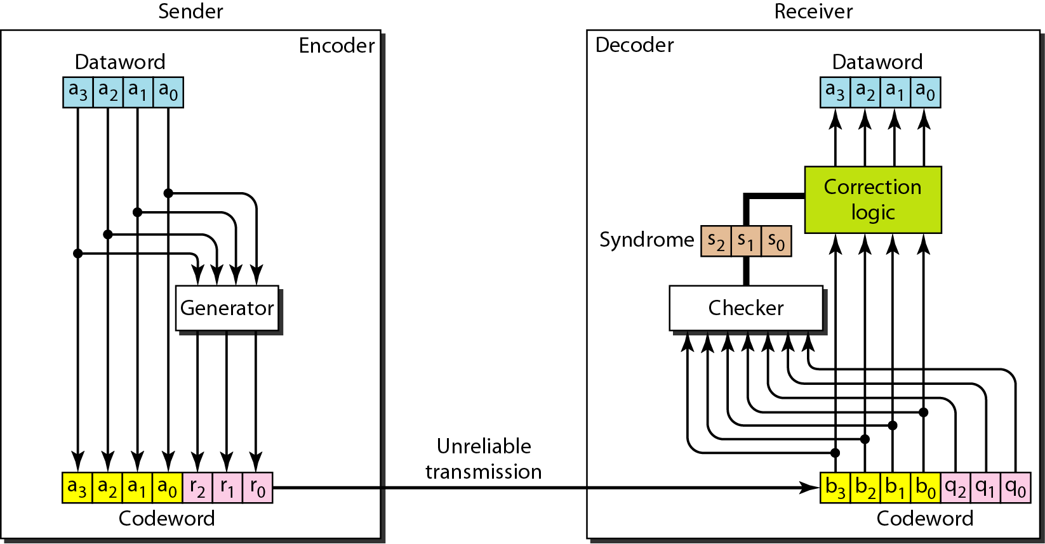
Figure 10.12 The structure of the encoder and decoder for a Hamming code

Slide 52
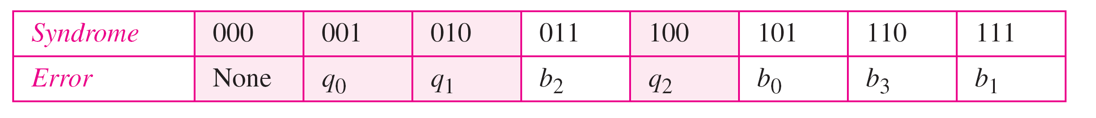
Table 10.5 Logical decision made by the correction logic analyzer

Slide 53
Example 10.13
Let us trace the path of three datawords from the sender to the destination:
The dataword 0100 becomes the codeword 0100011. The codeword 0100011 is received. The syndrome is 000, the final dataword is 0100.
The dataword 0111 becomes the codeword 0111001. The codeword 0011001 is received The syndrome is 011. After flipping b₂ (changing the 1 to 0), the final dataword is 0111.
The dataword 1101 becomes the codeword 1101000. The codeword 0001000 is received (two errors).The syndrome is 101. After flipping b₀, we get 0000, the wrong dataword. This shows that our code cannot correct two errors.

Slide 54
Example 10.14
We need a dataword of at least 7 bits. Calculate values of k and n that satisfy this requirement.
Solution
We need to make k = n − m greater than or equal to 7, or 2^{m} − 1 − m ≥ 7.
1. If we set m = 3, the result is n = 2³ − 1 and k = 7 − 3, or 4, which is not acceptable.
2. If we set m = 4, then n = 2⁴ − 1 = 15 and k = 15 − 4 = 11, which satisfies the condition. So the code is
C(15, 11)

Slide 55
Burst Error Detection using Hamming Code:
A Hamming code can only correct a single error or detect a double error.
However, there is a way to make it detect a burst error, as shown in Figure 10.13.
The key is to split a burst error between several codewords, one error for each codeword.
In data communications, we normally send a packet or a frame of data. To make the Hamming code respond to a burst error of size N, we need to make N codewords out of our frame.
Then, instead of sending one codeword at a time, we arrange the codewords in a table and send the bits in the table a column at a time.
In Figure 10.13, the bits are sent column by column (from the left). In each column, the bits are sent from the bottom to the top.
In this way, a frame is made out of the four codewords and sent to the receiver. Figure 10.13 shows

Slide 56
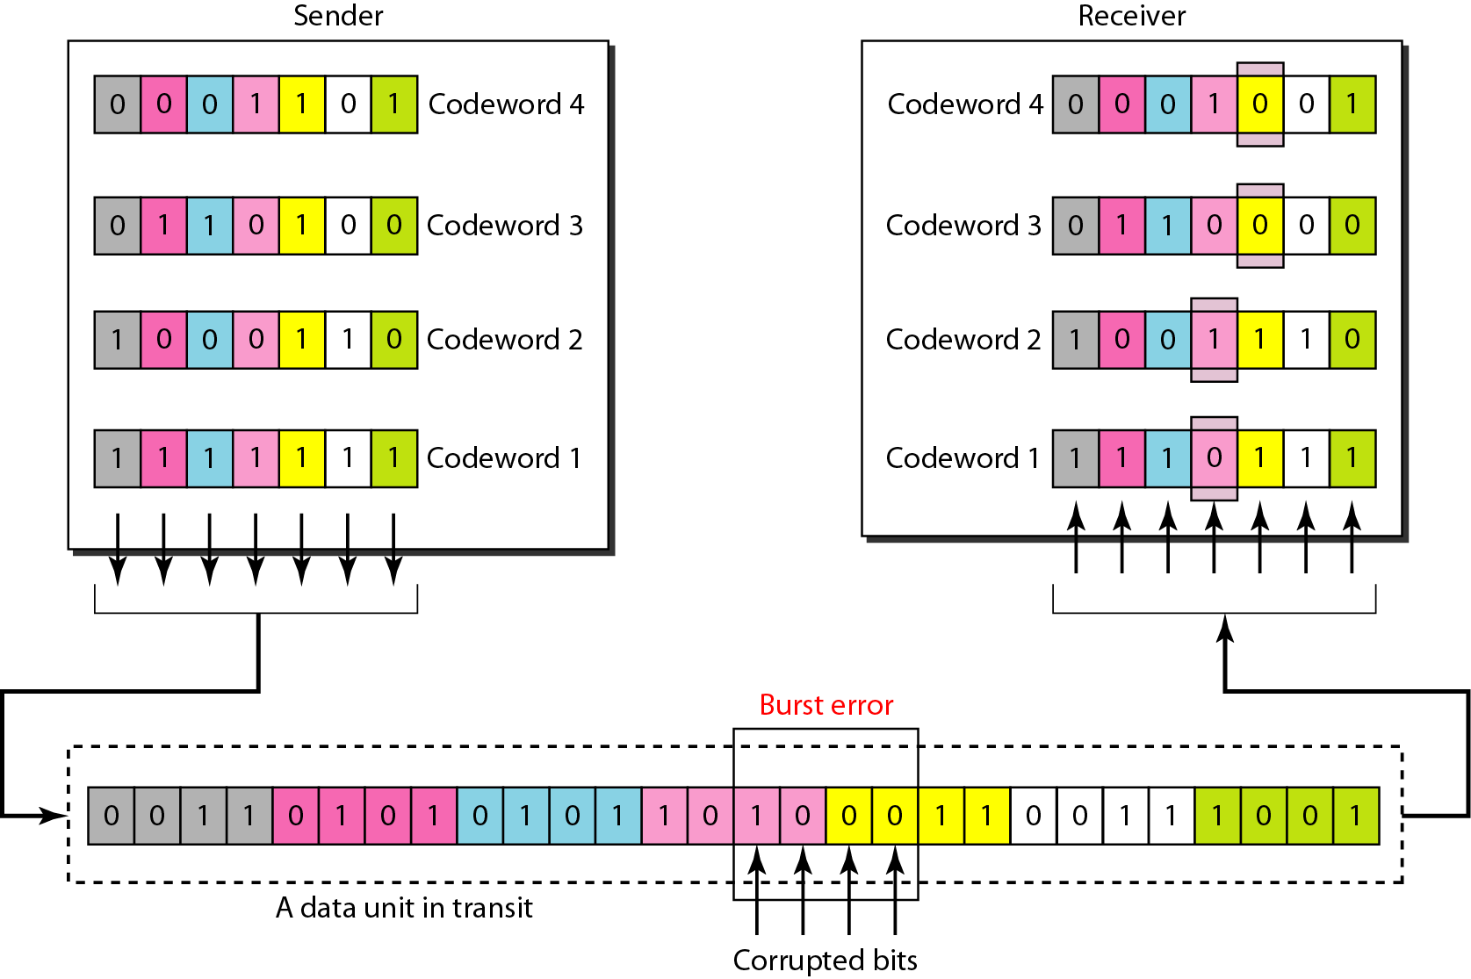
Figure 10.13 Burst error correction using Hamming code

Slide 57
CYCLIC CODES
Cyclic codes are special linear block codes with one extra property. In a cyclic code, if a codeword is cyclically shifted (rotated), the result is another codeword.
For example,
if 1011000 is a codeword and we cyclically left-shift, then 0110001 is also a codeword.
There are many cyclic codes but we are going to discuss a specific one i.e. Cyclic Redundancy Check (CRC). which is used in networks such as LANs and WANs.

Slide 58
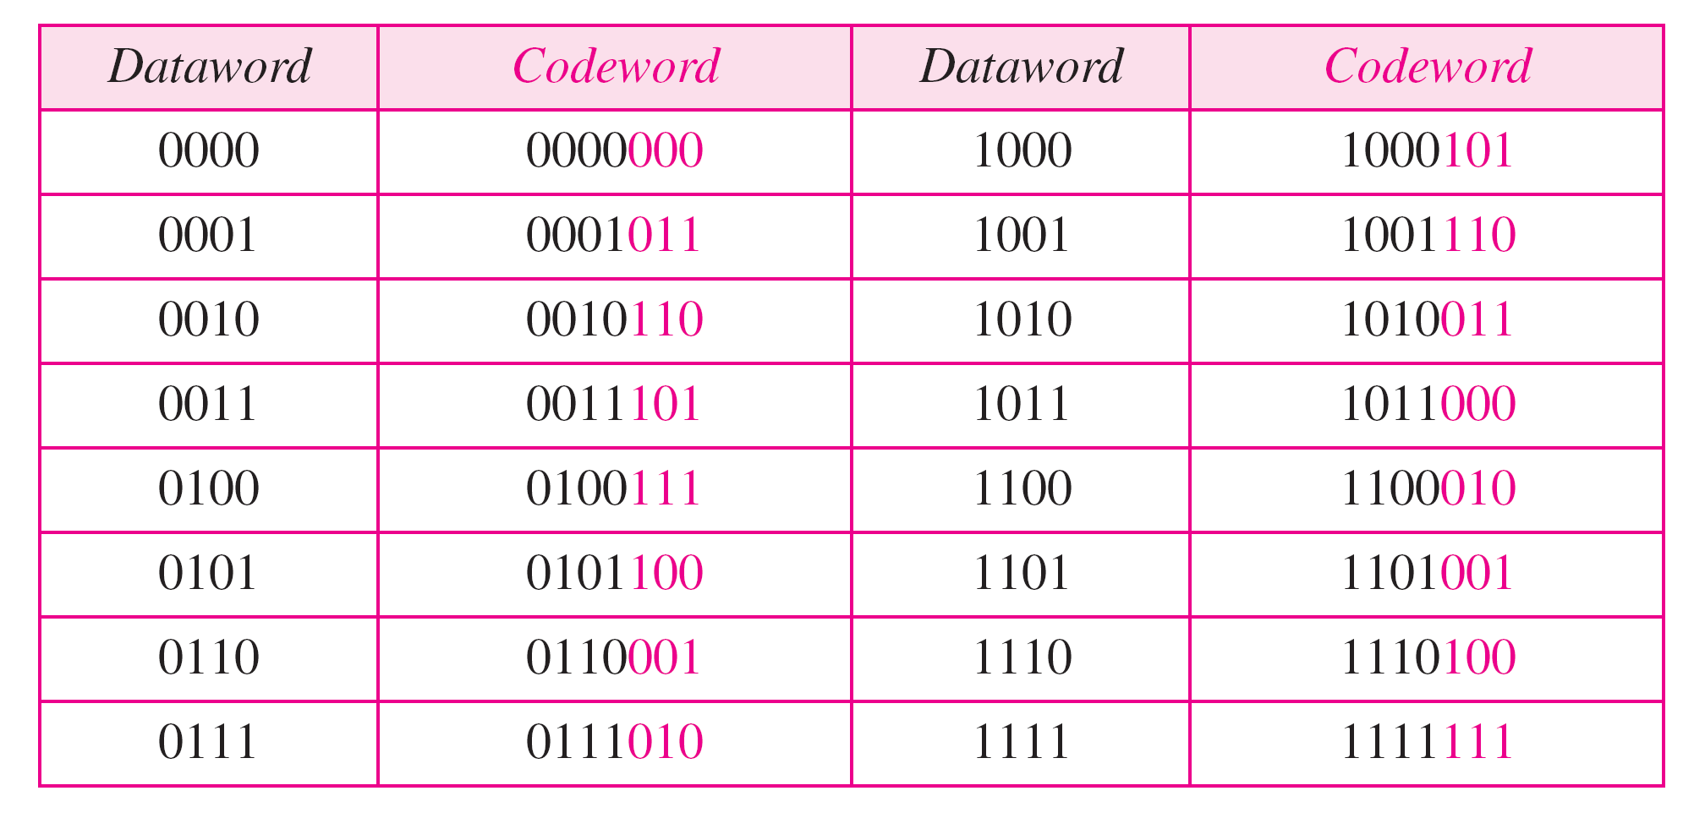
Table 10.6 A CRC code with C(7, 4)

Slide 59
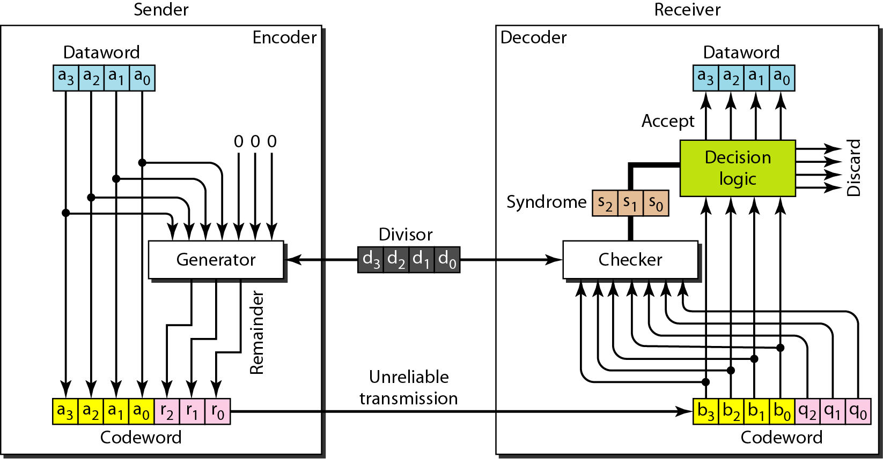
Figure 10.14 CRC encoder and decoder

Slide 60
Encoder
In the encoder, the dataword has k bits (4 here); the codeword has n bits (7 here).
The size of the dataword is augmented by adding n − k (3 here) 0s to the right-hand side of the word. The n-bit result is fed into the generator.
The generator uses a divisor of size n − k + 1 (4 here), predefined and agreed upon.
The generator divides the augmented dataword by the divisor (modulo-2 division).
The quotient of the division is discarded; the remainder (r₂r₁r0) is appended to the dataword to create the codeword.
The encoder takes a dataword and augments it with n − k number of 0s. It then divides the augmented dataword by the divisor, as shown in Figure 10.15.

Slide 61
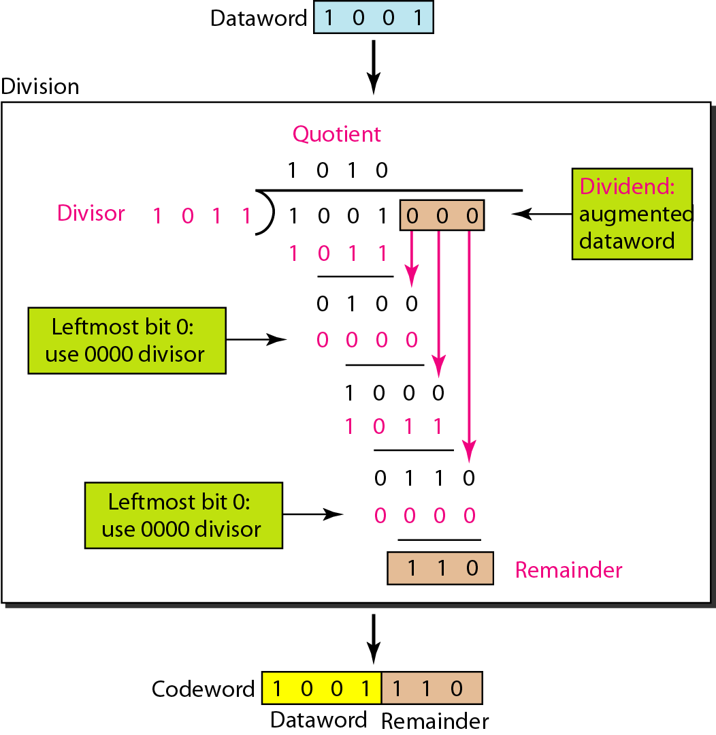
Figure 10.15 Division in CRC encoder

Slide 62
Decoder
A copy of all n bits is fed to the checker, which is a replica of the generator.
The remainder produced by the checker is a syndrome of n − k (3 here) bits, which is fed to the decision logic analyzer.
The analyzer has a simple function. If the syndrome bits are all 0s, the 4 leftmost bits of the codeword are accepted as the dataword (interpreted as no error); otherwise, the 4 bits are discarded (error).
The decoder does the same division process as the encoder. The remainder of the division is the syndrome. If the syndrome is all 0s, there is no error with a high probability; the dataword is separated from the received codeword and accepted. Otherwise, everything is discarded.
Figure 10.16 shows two cases: The left-hand figure shows the value of the syndrome when no error has occurred; the syndrome is 000.
The right-hand part of the figure shows the case in which there is a single error. The syndrome is not all 0s (it is 011).

Slide 63
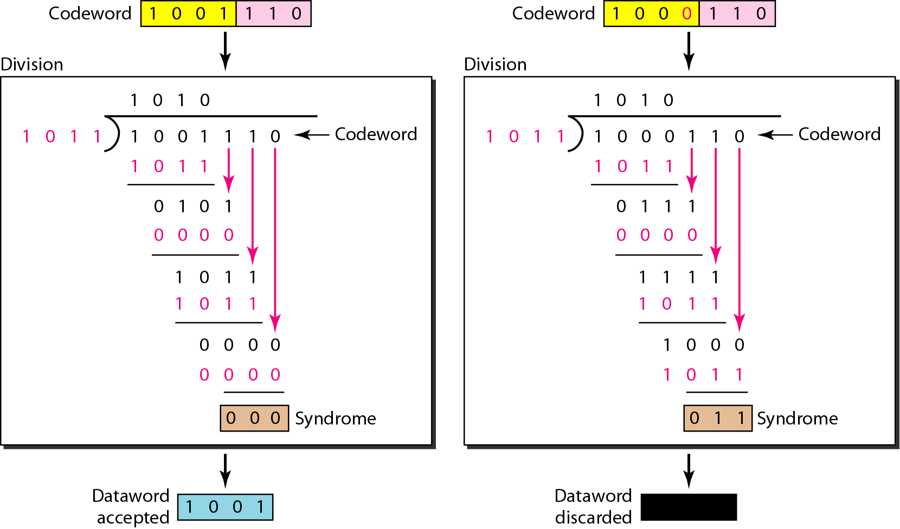
Figure 10.16 Division in the CRC decoder for two cases

Slide 64
Polynomials

Slide 65
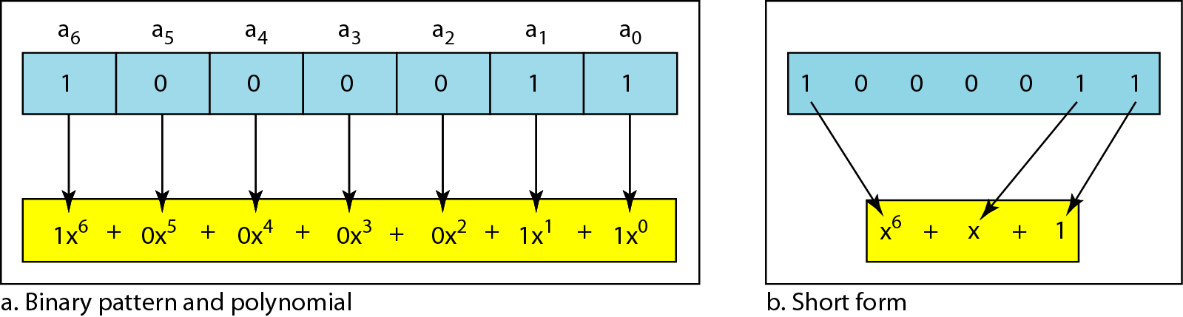
A pattern of 0s and 1s can be represented as a polynomial with coefficients of 0 and 1. The power of each term shows the position of the bit; the coefficient shows the value of the bit.
Figure 10.21 A polynomial to represent a binary word

Slide 66
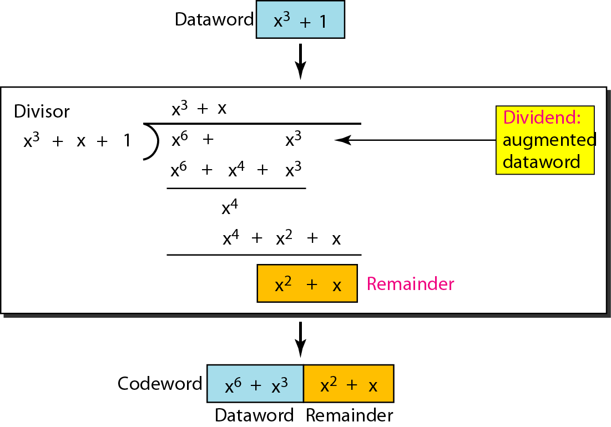
Figure 10.22 CRC division using polynomials

Slide 67
Note
The divisor in a cyclic code is normally called the generator polynomial
or simply the generator.

Slide 68
Dataword: d(x) Codeword: c(x) Generator: g(x) Syndrome: s(x) Error: e(x)
Note
In a cyclic code,
If s(x) ≠ 0, one or more bits is corrupted.
If s(x) = 0, either
a. No bit is corrupted. or
b. Some bits are corrupted, but the decoder failed to detect them.

Slide 69

The received codeword is the sum of the sent codeword and the error.
Received codeword = c(x) + e(x)
The receiver divides the received codeword by g(x) to get the syndrome. We can write this as:
The first term at the right-hand side of the equality has a remainder of zero .
So the syndrome is actually the remainder of the second term on the right-hand side.
If this term does not have a remainder (syndrome = 0), either e(x) is 0 or e(x) is divisible by g(x).
We do not have to worry about the first case (there is no error); the second case is very important. Those errors that are divisible by g(x) are not caught.

Slide 70
Note
In a cyclic code, those e(x) errors that are divisible by g(x) are not caught.

Slide 71
Single-Bit Error
What should the structure of g(x) be to guarantee the detection of a single-bit error?
A single-bit error is e(x) = x^{i}, where i is the position of the bit. If a single-bit error is caught, then x^{i} is not divisible by g(x). (Note that when we say not divisible, we mean that there is a remainder.)
If g(x) has at least two terms (which is normally the case) and the coefficient of x⁰ is not zero (the rightmost bit is 1), then e(x) cannot be divided by g(x).
Note
If the generator has more than one term and the coefficient of x⁰ is 1, all single errors can be caught.

Slide 72
Example 10.15
Which of the following g(x) values guarantees that a single-bit error is caught? For each case, what is the error that cannot be caught?
a. x + 1 b. x³ c. 1
a. No x^{i} can be divisible by x + 1. In other words, xi/(x + 1) always has a remainder. So the syndrome is nonzero. Any single-bit error can be caught.
b. If i is equal to or greater than 3, x^{i} is divisible by g(x). The remainder of x^{i}/x³ is zero, and the receiver is fooled into believing that there is no error, although there might be one. Note that in this case, the corrupted bit must be in position 4 or above. All single-bit errors in positions 1 to 3 are caught.
c. All values of i make x^{i} divisible by g(x). No single-bit error can be caught. In addition, this g(x) is useless because it means the codeword is just the dataword augmented with n − k zeros.

Slide 73
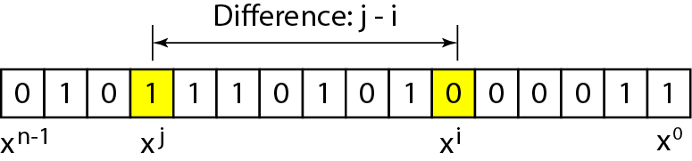
Figure 10.23 Representation of two isolated single-bit errors using polynomials

Slide 74
Note
If a generator cannot divide x^{t} + 1 (t between 0 and n – 1),
then all isolated double errors can be detected.

Slide 75
Example 10.16
Find the status of the following generators related to two isolated, single-bit errors.
a. x + 1 b. x⁴ + 1 c. x⁷ + x⁶ + 1 d. x¹⁵ + x¹⁴ + 1
Solution
a. This is a very poor choice for a generator. Any two errors next to each other cannot be detected.
b. This generator cannot detect two errors that are four positions apart.
c. This is a good choice for this purpose.
d. This polynomial cannot divide x^{t} + 1 if t is less than 32,768. A codeword with two isolated errors up to 32,768 bits apart can be detected by this generator.

Slide 76
Odd Numbers of Errors:
A generator with a factor of x + 1 can catch all odd numbers of errors.
This means that we need to make x + 1 a factor of any generator.
Note that we are not saying that the generator itself should be x + 1; we are saying that it should have a factor of x + 1.
If it is only x + 1, it cannot catch the two adjacent isolated errors.
For example, x⁴ + x² + x + 1 can catch all odd-numbered errors since it can be written as a product of the two polynomials x + 1 and x³ + x² + 1.

Slide 77
Note
A generator that contains a factor of x + 1 can detect all odd-numbered errors.

Slide 78
Note
❏ All burst errors with L ≤ r will be detected.
❏ All burst errors with L = r + 1 will be detected with probability 1 – (1/2)^{r–1}.
❏ All burst errors with L > r + 1 will be detected with probability 1 – (1/2)^{r}.

Slide 79
Example 10.17
Find the suitability of the following generators in relation to burst errors of different lengths.
a. x⁶ + 1 b. x¹⁸ + x⁷ + x + 1 c. x³² + x²³ + x⁷ + 1
Solution
a. This generator can detect all burst errors with a length less than or equal to 6 bits; 3 out of 100 burst errors with length 7 will slip by; 16 out of 1000 burst errors of length 8 or more will slip by.

Slide 80
Example 10.17 (continued)
b. This generator can detect all burst errors with a length less than or equal to 18 bits; 8 out of 1 million burst errors with length 19 will slip by; 4 out of 1 million burst errors of length 20 or more will slip by.
c. This generator can detect all burst errors with a length less than or equal to 32 bits; 5 out of 10 billion burst errors with length 33 will slip by; 3 out of 10 billion burst errors of length 34 or more will slip by.

Slide 81
Note
A good polynomial generator needs to have the following characteristics:
1. It should have at least two terms.
2. The coefficient of the term x⁰ should be 1.
3. It should not divide x^{t} + 1, for t between 2 and n −1.
4. It should have the factor x + 1.

Slide 82
Table 10.7 Standard polynomials

Slide 83
Advantages of Cyclic Codes
Cyclic codes have a very good performance in detecting single-bit errors, double errors, an odd number of errors, and burst errors.
They can easily be implemented in hardware and software.
They are especially fast when implemented in hardware.

Slide 84
Checksum

Slide 85
CHECKSUM
Checksum is an error-detecting technique that can be applied to a message of any length.
The checksum is mostly used at the network and transport layer rather than the data-link layer.
At the source, the message is first divided into m-bit units.
The generator then creates an extra m-bit unit called the checksum, which is sent with the message.
At the destination, the checker creates a new checksum from the combination of the message and sent checksum.
If the new checksum is all 0s, the message is accepted; otherwise,
the message is discarded (Figure 10.23).

Slide 86
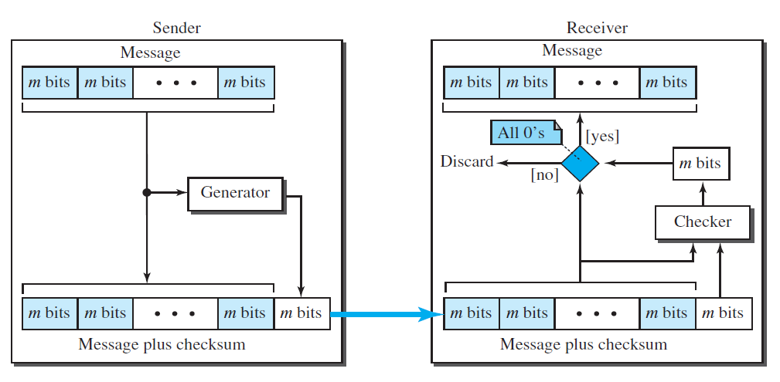
Figure 10.23 Check sum process

Slide 87
Example 10.18
Suppose our data is a list of five 4-bit numbers that we want to send to a destination.
In addition to sending these numbers, we send the sum of the numbers. For example, if the set of numbers is (7, 11, 12, 0, 6), we send (7, 11, 12, 0, 6, 36), where 36 is the sum of the original numbers.
The receiver adds the five numbers and compares the result with the sum.
If the two are the same, the receiver assumes no error, accepts the five numbers, and discards the sum. Otherwise, there is an error somewhere and the data are not accepted.

Slide 88
One’s Complement Addition
The previous example has one major drawback.
Each number can be written as a 4-bit word (each is less than 15) except for the sum. One solution is to use one’s complement arithmetic.
In this arithmetic, we can represent unsigned numbers between 0 and 2^{m} −1 using only m bits.
If the number has more than m bits, the extra leftmost bits need to be added to the m rightmost bits (wrapping).
In the previous example, the decimal number 36 in binary is (100100)2. To change it to a 4-bit number we add the extra leftmost bit to the right four bits as shown below.
Instead of sending 36 as the sum, we can send 6 as the sum (7, 11, 12, 0, 6, 6).
The receiver can add the first five numbers in one’s complement arithmetic. If the result is 6, the numbers are accepted; otherwise, they are rejected.

Slide 89
Checksum
We can make the job of the receiver easier if we send the complement of the sum, the checksum.
In one’s complement arithmetic, the complement of a number is found by completing all bits (changing all 1s to 0s and all 0s to 1s).
This is the same as subtracting the number from 2^{m} − 1. In one’s complement arithmetic, we have two 0s: one positive and one negative, which are complements of each other.
The positive zero has all m bits set to 0; the negative zero has all bits set to 1 (it is 2^{m} − 1).
If we add a number with its complement, we get a negative zero (a number with all bits set to 1).
When the receiver adds all five numbers (including the checksum), it gets a negative zero. The receiver can complement the result again to get a positive zero.

Slide 90
Example 10.19
We can make the job of the receiver easier if we send the negative (complement) of the sum, called the checksum.
In this case, we send (7, 11, 12, 0, 6, −36).
The receiver can add all the numbers received (including the checksum).
If the result is 0, it assumes no error; otherwise, there is an error.

Slide 91
Example 10.20
How can we represent the number 21 in one’s complement arithmetic using only four bits?
Solution
The number 21 in binary is 10101 (it needs five bits). We can wrap the leftmost bit and add it to the four rightmost bits. We have (0101 + 1) = 0110 or 6.

Slide 92
Example 10.21
How can we represent the number −6 in one’s complement arithmetic using only four bits?
Solution
In one’s complement arithmetic, the negative or complement of a number is found by inverting all bits.
Positive 6 is 0110; negative 6 is 1001.
If we consider only unsigned numbers, this is 9. In other words, the complement of 6 is 9.
Another way to find the complement of a number in one’s complement arithmetic is to subtract the number from 2^{n} − 1 (16 − 1=15 in this case).

Slide 93
Example 10.22
Let us redo Exercise 10.19 using one’s complement arithmetic. Figure 10.24 shows the process at the sender and at the receiver.
The sender initializes the checksum to 0 and adds all data items and the checksum (the checksum is considered as one data item and is shown in color).
The result is 36. However, 36 cannot be expressed in 4 bits.
The extra two bits are wrapped and added with the sum to create the wrapped sum value 6.
In the figure, we have shown the details in binary.
The sum is then complemented, resulting in the checksum value 9 (15 − 6 = 9).
The sender now sends six data items to the receiver including the checksum 9.

Slide 94
Example 10.22 (continued)
The receiver follows the same procedure as the sender.
It adds all data items (including the checksum); the result is 45.
The sum is wrapped and becomes 15.
The wrapped sum is complemented and becomes 0.
Since the value of the checksum is 0, this means that the data is not corrupted.
The receiver drops the checksum and keeps the other data items.
If the checksum is not zero, the entire packet is dropped.

Slide 95
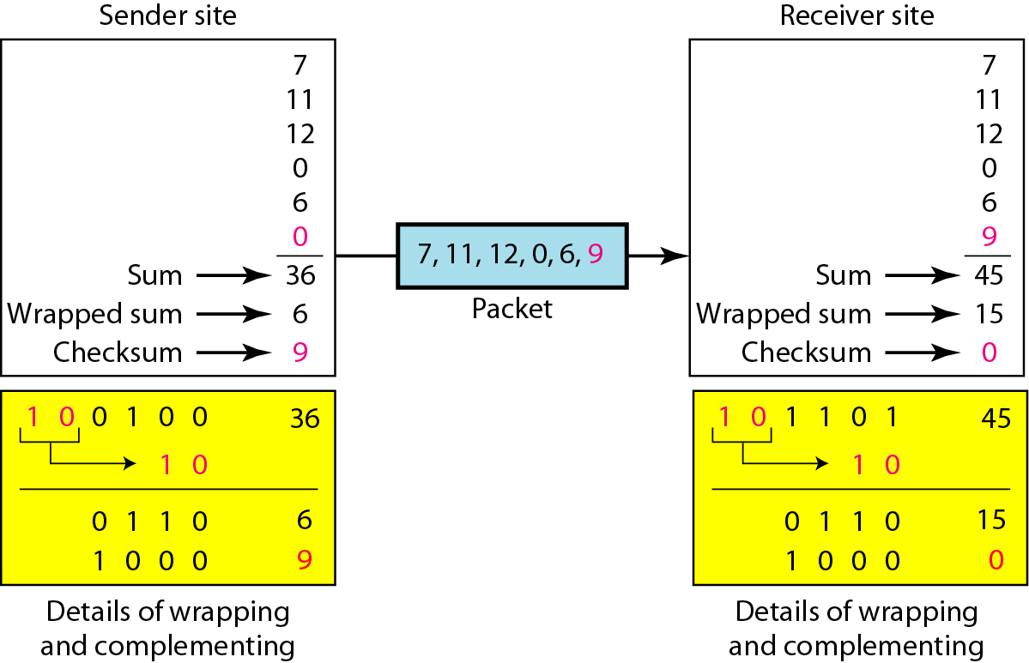
Figure 10.24 Example 10.22
1
1
1
0

Slide 96
Note
Sender site: (Internet Checksum)
1. The message is divided into 16-bit words.
2. The value of the checksum word is set to 0.
3. All words including the checksum are added using one’s complement addition.
4. The sum is complemented and becomes the checksum.
5. The checksum is sent with the data.

Slide 97
Note
Receiver site: (Internet Checksum)
1. The message (including checksum) is divided into 16-bit words.
2. All words are added using one’s complement addition.
3. The sum is complemented and becomes the new checksum.
4. If the value of checksum is 0, the message is accepted; otherwise, it is rejected.

Slide 98
Example 10.23
Let us calculate the checksum for a text of 8 characters (“Forouzan”). The text needs to be divided into 2-byte (16-bit) words.
We use ASCII (see Appendix A) to change each byte to a 2-digit hexadecimal number.
For example, F is represented as 0x46 and o is represented as 0x6F.
Figure 10.25 shows how the checksum is calculated at the sender and receiver sites.
In part a of the figure, the value of partial sum for the first column is 0x36.
We keep the rightmost digit (6) and insert the leftmost digit (3) as the carry in the second column.
The process is repeated for each column.
Note that if there is any corruption, the checksum recalculated by the receiver is not all 0s. We leave this an exercise.

Slide 99
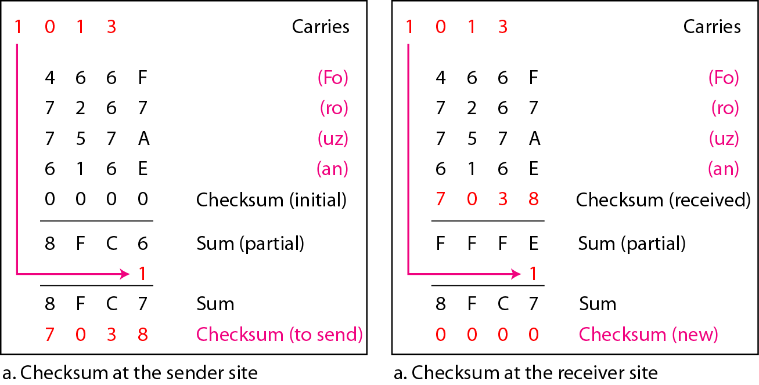
Figure 10.25 Example 10.23

Slide 100
What have we completed?
Thank You
Error Detection Vs Error Correction
Block Codes
Hamming Distance
Hamming Code
Linear Block Codes
Cyclic Redundancy Check
Polynomials
Checksum

