Slide 1
Switching
Lecture-18-19
Chapter 08

Slide 2
Topics to be discussed
Taxonomy of switched network
Circuit switched network
Datagram Network
Virtual circuit Network

Slide 3
Switched network
A switched network consists of a series of interlinked nodes, called switches.
Switches are devices capable of creating temporary connections between two or more devices linked to the switch.
In a switched network, some of these nodes are connected to the end systems (computers or telephones, for example).
Others are used only for routing. Figure 8.1 shows a switched network.
The end systems (communicating devices) are labeled A, B, C, D, and so on, and the switches are labeled I, II, III, IV, and V. Each switch is connected to multiple links.

Slide 4
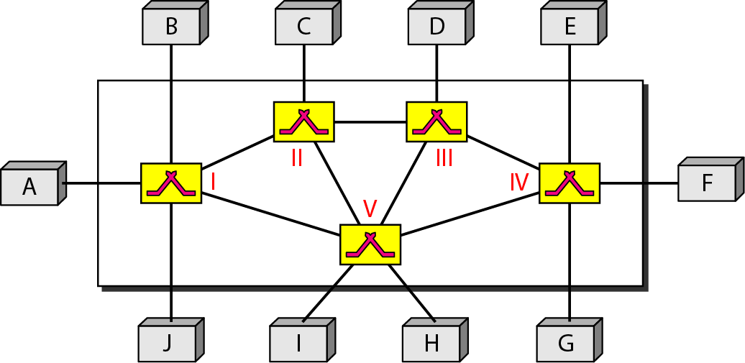
Figure 8.1 Switched network

Slide 5
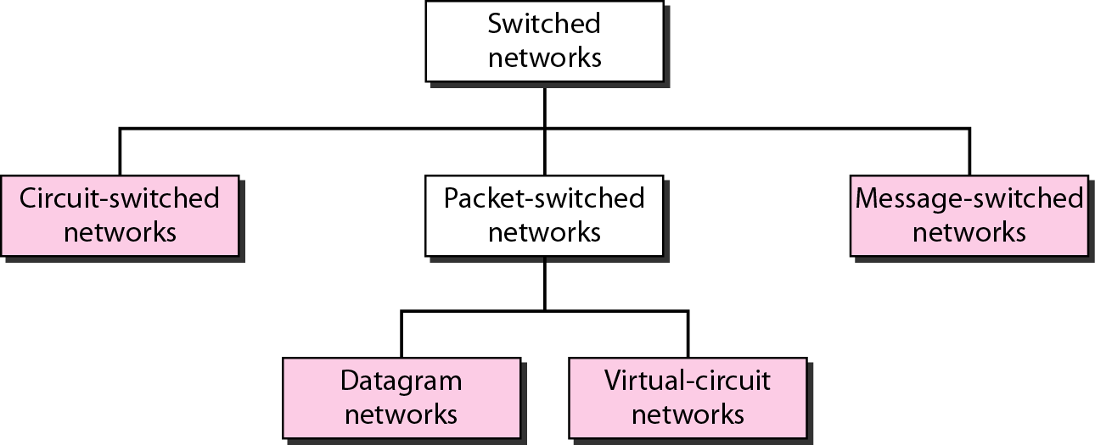
Figure 8.2 Taxonomy of switched networks
The Circuit switching & Packet switching are commonly used today.
The message switching has been phased out in general communications but still has networking applications.
Packet switching can further be divided into two subcategories—virtual circuit approach and datagram approach—as shown in Figure.

Slide 6
Form of switching and TCP/IP Layers
Switching at Physical Layer:
At the physical layer, we can have only circuit switching.
The switches at the physical layer allow signals to travel in one path or another.
Switching at Data-Link Layer:
At the data-link layer, we can have packet switching.
However, the term packet in this case means frames or cells.
Packet switching at the data-link layer is normally done using a virtual-circuit approach.
Switching at Network Layer:
At the network layer, we can have packet switching.
In this case, either a virtual-circuit approach or a datagram approach can be used.
Currently the Internet uses a datagram approach, but the tendency is to move to a virtual-circuit approach.
Switching at Application Layer:
At the application layer, we can have only message switching.
The communication at the application layer occurs by exchanging messages.
Conceptually, we can say that communication using e-mail is a kind of message-switched communication, but we do not see any network that actually can be called a message-switched network.

Slide 7
CIRCUIT-SWITCHED NETWORKS
A circuit-switched network consists of a set of switches connected by physical links.
A connection between two stations is a dedicated path made of one or more links.
However, each connection uses only one dedicated channel on each link.
Each link is normally divided into n channels by using FDM or TDM.

Slide 8
Note
A circuit-switched network is made of a set of switches connected by physical links, in which each link is divided into n channels.

Slide 9
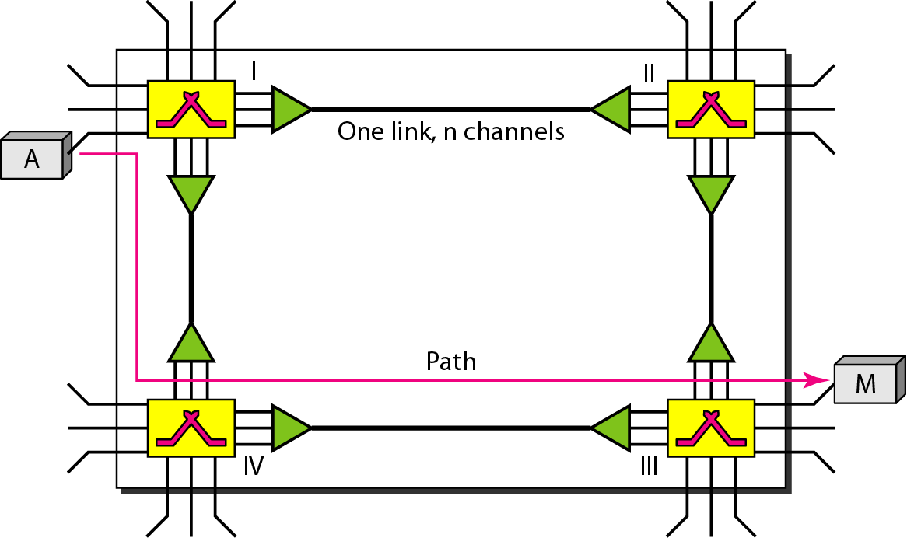
Figure 8.3 A trivial circuit-switched network

Slide 10
Note
In circuit switching, the resources need to be reserved during the setup phase; the resources remain dedicated for the entire duration of data transfer until the teardown phase.

Slide 11
Example 8.1
As a trivial example, let us use a circuit-switched network to connect eight telephones in a small area. Communication is through 4-kHz voice channels.
We assume that each link uses FDM to connect a maximum of two voice channels.
The bandwidth of each link is then 8 kHz.
Figure 8.4 shows the situation. Telephone 1 is connected to telephone 7; 2 to 5; 3 to 8; and 4 to 6.
Of course the situation may change when new connections are made.
The switch controls the connections.

Slide 12
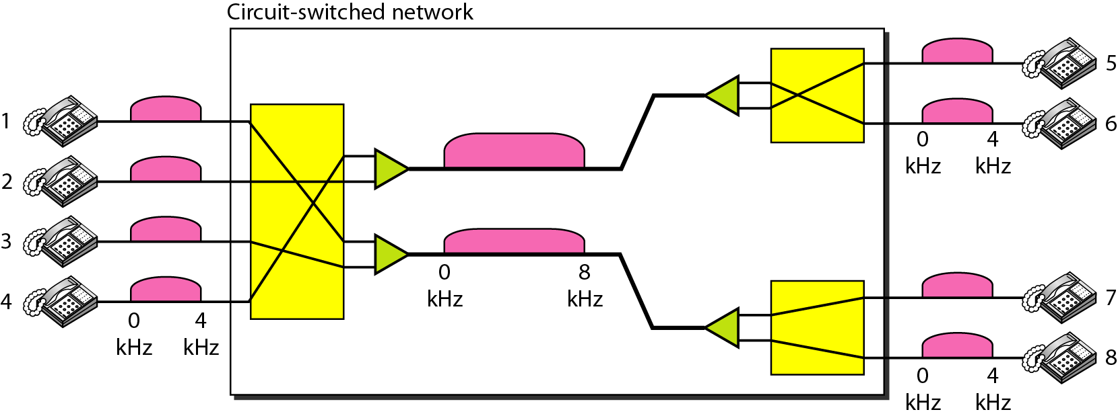
Figure 8.4 Circuit-switched network used in Example 8.1

Slide 13
Example 8.2
As another example, consider a circuit-switched network that connects computers in two remote offices of a private company.
The offices are connected using a T-1 line leased from a communication service provider.
There are two 4 × 8 (4 inputs and 8 outputs) switches in this network.
For each switch, four output ports are folded into the input ports to allow communication between computers in the same office.
Four other output ports allow communication between the two offices. Figure 8.5 shows the situation.

Slide 14
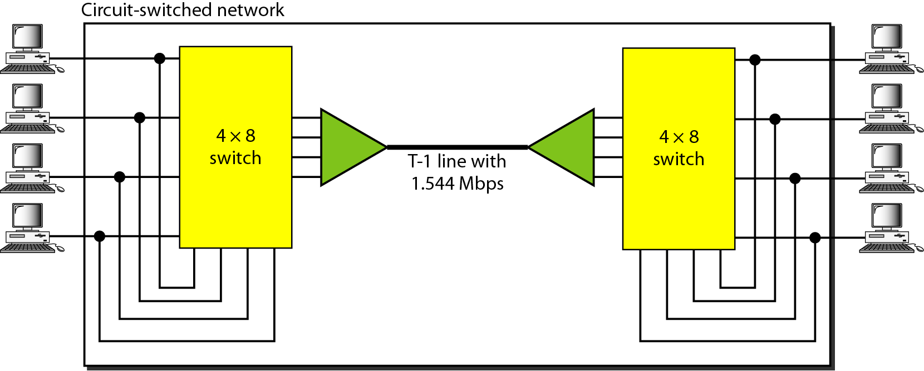
Figure 8.5 Circuit-switched network used in Example 8.2

Slide 15
Three Phases of Circuit Switching
1. Setup Phase
Before the two parties (or multiple parties in a conference call) can communicate, a dedicated circuit (combination of channels in links) needs to be established.
The end systems are normally connected through dedicated lines to the switches, so connection setup means creating dedicated channels between the switches.
For example, in Figure 8.3, when system A needs to connect to system M, it sends a setup request that includes the address of system M, to switch I.
Switch I finds a channel between itself and switch IV that can be dedicated for this purpose.
Switch I then sends the request to switch IV, which finds a dedicated channel between itself and switch III.
Switch III informs system M of system A’s intention at this time.
To establish a connection, an acknowledgment from system M needs to be sent in the opposite direction to system A.
Only after system A receives this acknowledgment, the connection is established.
Note that end-to-end addressing is required for creating a connection between the two end systems.

Slide 16
2. Data-Transfer Phase
After the establishment of the dedicated circuit (channels), the two parties can transfer data.
3. Teardown Phase
When one of the parties needs to disconnect, a signal is sent to each switch to release the resources.

Slide 17
Delay in circuit Switching
Although a circuit-switched network normally has low efficiency, the delay in this type of network is minimal. During data transfer the data are not delayed at each switch; the resources are allocated for the duration of the connection.
The total delay is due to the time needed to create the connection, transfer data, and disconnect the circuit.
The delay caused by the setup is the sum of four parts: the propagation time of the source computer request (slope of the first green box), the request signal transfer time (height of the first gray box), the propagation time of the acknowledgment from the destination computer (slope of the second green box), and the signal transfer time of the acknowledgment (height of the second green box).
The delay due to data transfer is the sum of two parts: the propagation time (slope of the colored box) and data transfer time (height of the colored box), which can be very long.
The third box shows the time needed to tear down the circuit. We have shown the case in which the receiver requests disconnection, which creates the maximum delay.

Slide 18
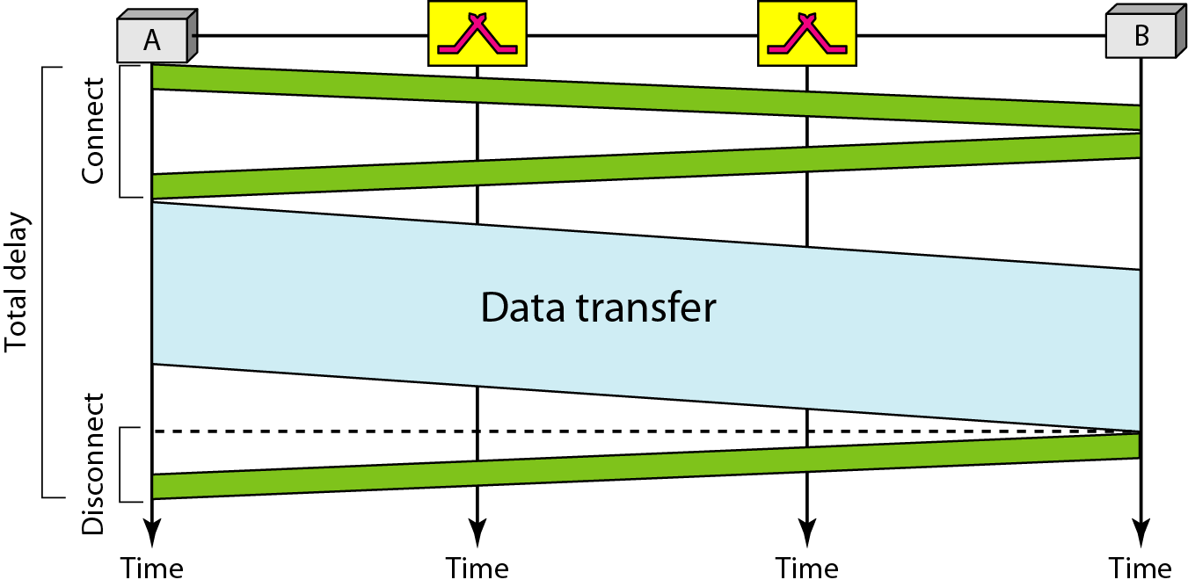
Figure 8.6 Delay in a circuit-switched network

Slide 19

Note
Switching at the physical layer in the traditional telephone network uses
the circuit-switching approach.

Slide 20
Note
In a packet-switched network, there is no resource reservation;
resources are allocated on demand.

Slide 21
DATAGRAM NETWORKS
In data communications, we need to send messages from one end system to another.
If the message is going to pass through a packet-switched network, it needs to be divided into packets of fixed or variable size.
The size of the packet is determined by the network and the governing protocol.

Slide 22
In a datagram network, each packet (also known as datagram) is treated independently of all others.
Datagram switching is normally done at the network layer. Figure 8.7 shows how the datagram approach is used to deliver four packets from station A to station X.
The switches in a datagram network are traditionally referred to as routers.
That is why we use a different symbol for the switches in the figure. In this example, all four packets (or datagrams) belong to the same message, but may travel different paths to reach their destination.
This is so because the links may be involved in carrying packets from other sources and do not have the necessary bandwidth available to carry all the packets from A to X.
This approach can cause the datagrams of a transmission to arrive at their destination out of order with different delays between the packets. Packets may also be lost or dropped because of a lack of resources. In most protocols, it is the responsibility of an upper-layer protocol to reorder the datagrams or ask for lost datagrams before passing them on to the application.
The datagram networks are sometimes referred to as connectionless networks. The term connectionless here means that the switch (packet switch) does not keep information about the connection state.
There are no setup or teardown phases. Each packet is treated the same by a switch regardless of its source or destination.

Slide 23
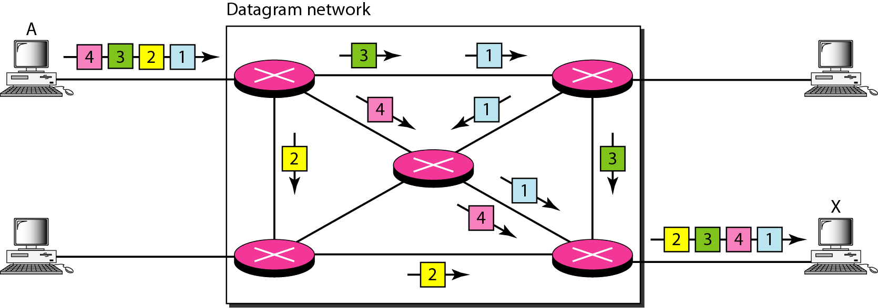
Figure 8.7 A datagram network with four switches (routers)

Slide 24
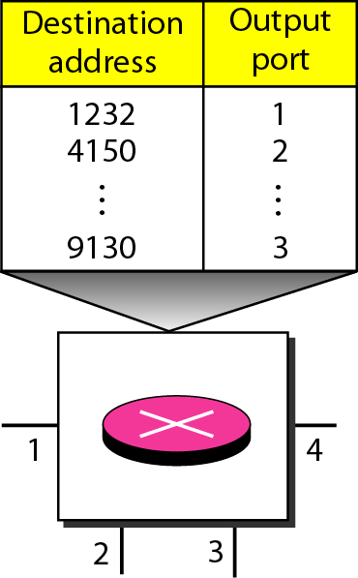
Figure 8.8 Routing table in a datagram network
Routing Table
If there are no setup or teardown phases, how are the packets routed to their destinations in a datagram network?
In this type of network, each switch (or packet switch) has a routing table which is based on the destination address.
The routing tables are dynamic and are updated periodically.
The destination addresses and the corresponding forwarding output ports are recorded in the tables.
This is different from the table of a circuits-witched network (discussed later) in which each entry is created when the setup phase is completed and deleted when the teardown phase is over.
Figure 8.8 shows the routing table for a switch.

Slide 25
Note
A switch in a datagram network uses a routing table that is based on the destination address.

Slide 26
Note
The destination address in the header of a packet in a datagram network
remains the same during the entire journey of the packet.

Slide 27

Efficiency
The efficiency of a datagram network is better than that of a circuit-switched network; resources are allocated only when there are packets to be transferred.
If a source sends a packet and there is a delay of a few minutes before another packet can be sent, the resources can be reallocated during these minutes for other packets from other sources.
Delay
There may be greater delay in a datagram network than in a virtual-circuit network.
Although there are no setup and teardown phases, each packet may experience a wait at a switch before it is forwarded.
In addition, since not all packets in a message necessarily travel through the same switches, the delay is not uniform for the packets of a message.
Figure 8.9 gives an example of delay in a datagram network for one packet.
The packet travels through two switches. There are three transmission times (3T), three propagation delays (slopes 3τ of the lines), and two waiting times (w1 + w2). We ignore the processing time in each switch.
The total delay is:

Slide 28
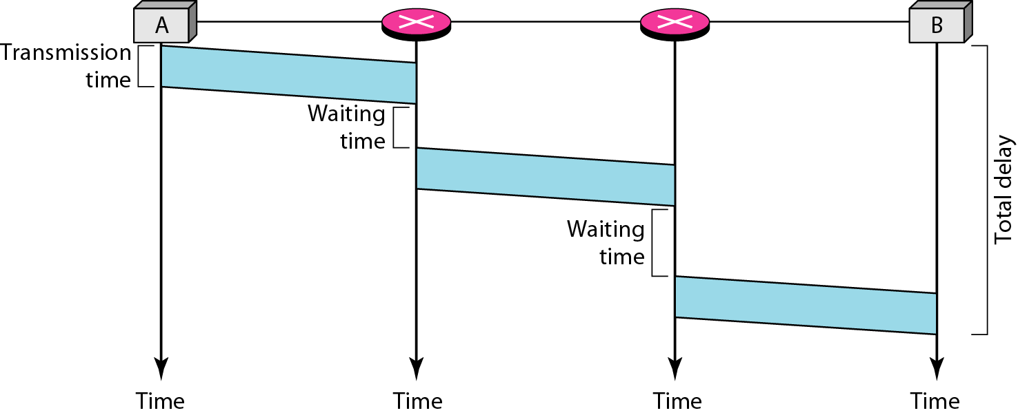
Figure 8.9 Delay in a datagram network

Slide 29
Note
Switching in the Internet is done by using the datagram approach to packet switching at the network layer.

Slide 30
VIRTUAL-CIRCUIT NETWORKS
A virtual-circuit network is a cross between a circuit-switched network and a datagram network.
It has some characteristics of both.

Slide 31
Characteristics of virtual-circuit network
As in a circuit-switched network, there are setup and teardown phases in addition to the data transfer phase.
Resources can be allocated during the setup phase, as in a circuit-switched network, or on demand, as in a datagram network.
As in a datagram network, data are packetized and each packet carries an address in the header. However, the address in the header has local jurisdiction (it defines what the next switch should be and the channel on which the packet is being carried), not end-to-end jurisdiction.
As in a circuit-switched network, all packets follow the same path established during the connection.
A virtual-circuit network is normally implemented in the data-link layer, while a circuit-switched network is implemented in the physical layer and a datagram network in the network layer. But this may change in the future.

Slide 32
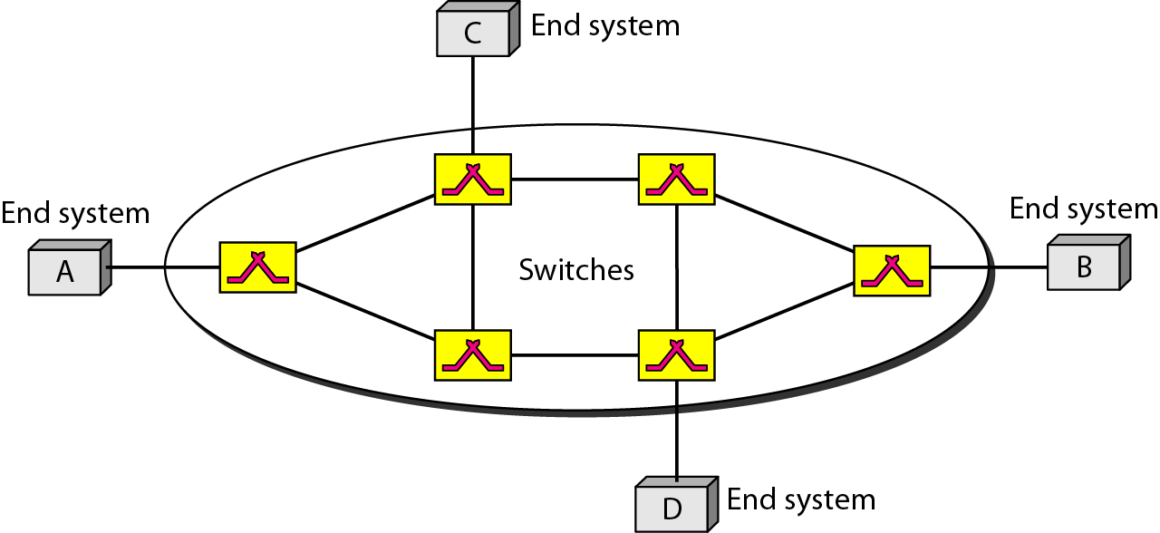
Figure 8.10 Virtual-circuit network

Slide 33
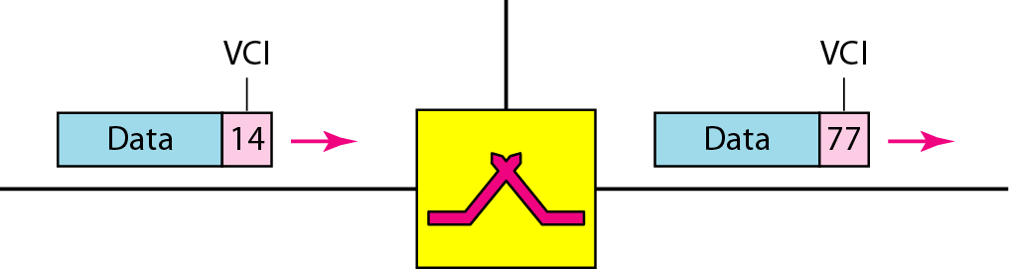
Figure 8.11 Virtual-circuit identifier
Virtual-Circuit Identifier
The identifier that is actually used for data transfer is called the virtual-circuit identifier (VCI) or the label.
A VCI, unlike a global address, is a small number that has only switch scope; it is used by a frame between two switches.
When a frame arrives at a switch, it has a VCI; when it leaves, it has a different VCI.
Figure 8.11 shows how the VCI in a data frame changes from one switch to another.
Note that a VCI does not need to be a large number since each switch can use its own unique set of VCIs.

Slide 34
1. Data-Transfer Phase
To transfer a frame from a source to its destination, all switches need to have a table entry for this virtual circuit. The table, in its simplest form, has four columns.
This means that the switch holds four pieces of information for each virtual circuit that is already set up.
For the moment we assume that each switch has a table with entries for all active virtual circuits. Figure 8.12 shows a frame arriving at port 1 with a VCI of 14.
When the frame arrives, the switch looks in its table to find port 1 and a VCI of 14.
When it is found, the switch knows to change the VCI to 22 and send out the frame from port 3. Figure 8.13 shows how a frame from source A reaches destination B and how its VCI changes during the trip.
Each switch changes the VCI and routes the frame.
The data-transfer phase is active until the source sends all its frames to the destination.
The procedure at the switch is the same for each frame of a message.
The process creates a virtual circuit, not a real circuit, between the source and destination.

Slide 35
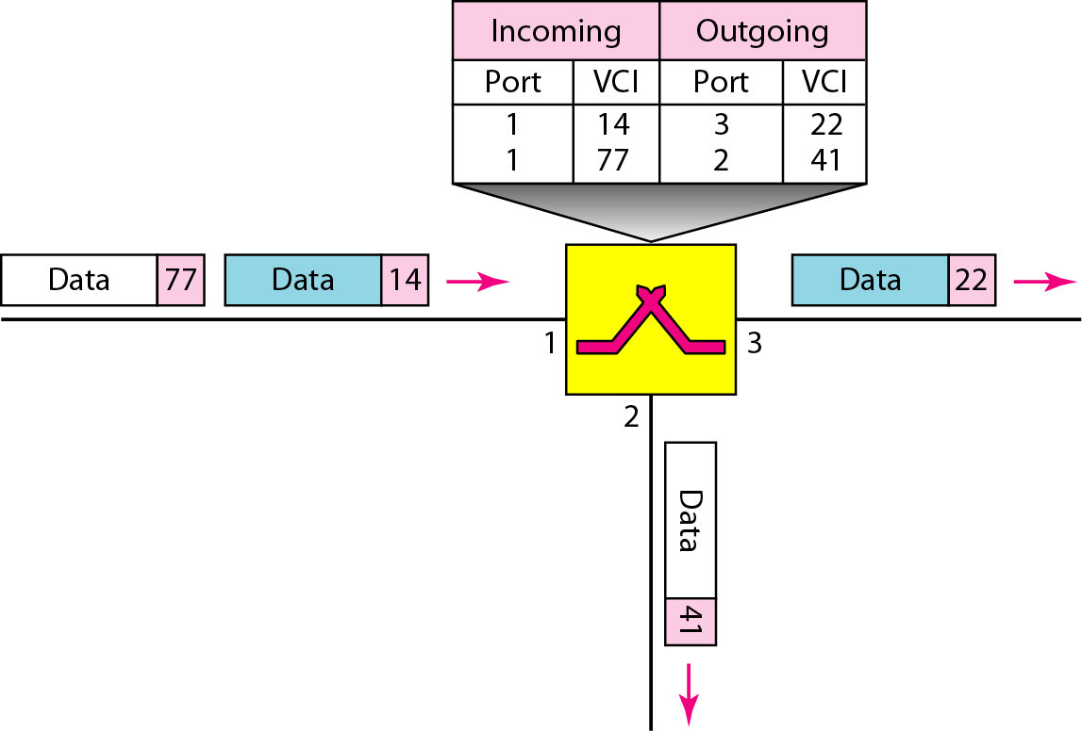
Figure 8.12 Switch and tables in a virtual-circuit network

Slide 36
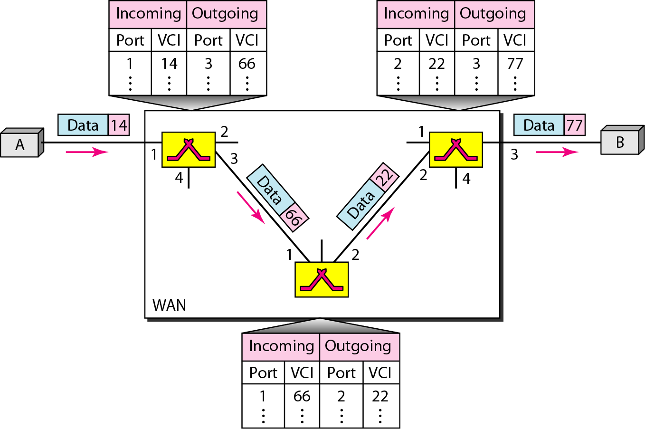
Figure 8.13 Source-to-destination data transfer in a virtual-circuit network

Slide 37
2. Setup Phase
It consists of two steps: (a)setup request and (b) acknowledgment.
(a) Setup Request
A setup request frame is sent from the source to the destination. Figure 8.14 shows the process.
Source A sends a setup frame to switch 1.
Switch 1 receives the setup request frame. It knows that a frame going from A to B goes out through port 3. The switch, in the setup phase, acts as a packet switch; it has a routing table which is different from the switching table. For the moment, assume that it knows the output port. The switch creates an entry in its table for this virtual circuit, but it is only able to fill three of the four columns. The switch assigns the incoming port (1) and chooses an available incoming VCI (14) and the outgoing port (3). It does not yet know the outgoing VCI, which will be found during the acknowledgment step. The switch then forwards the frame through port 3 to switch 2.
Switch 2 receives the setup request frame. The same events happen here as at switch 1; three columns of the table are completed: in this case, incoming port (1),incoming VCI (66), and outgoing port (2).
Switch 3 receives the setup request frame. Again, three columns are completed: incoming port (2), incoming VCI (22), and outgoing port (3).
Destination B receives the setup frame, and if it is ready to receive frames from A, it assigns a VCI to the incoming frames that come from A, in this case 77. This VCI lets the destination know that the frames come from A, and not other sources.

Slide 38
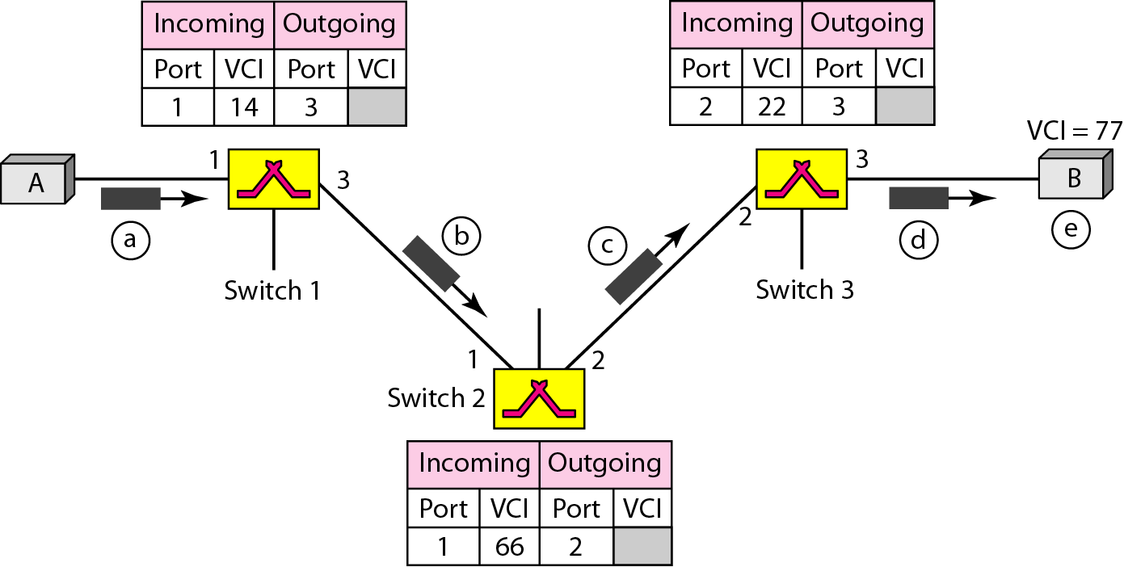
Figure 8.14 Setup request in a virtual-circuit network

Slide 39
(b)Acknowledgment
A special frame, called the acknowledgment frame, completes the entries in the switching tables. Figure 8.15 shows the process.
The destination sends an acknowledgment to switch 3. The acknowledgment carries the global source and destination addresses so the switch knows which entry in the table is to be completed. The frame also carries VCI 77, chosen by the destination as the incoming VCI for frames from A. Switch 3 uses this VCI to complete the outgoing VCI column for this entry. Note that 77 is the incoming VCI for destination B, but the outgoing VCI for switch 3.
Switch 3 sends an acknowledgment to switch 2 that contains its incoming VCI in the table, chosen in the previous step. Switch 2 uses this as the outgoing VCI in the table.
Switch 2 sends an acknowledgment to switch 1 that contains its incoming VCI in the table, chosen in the previous step. Switch 1 uses this as the outgoing VCI in the table.
Finally switch 1 sends an acknowledgment to source A that contains its incoming VCI in the table, chosen in the previous step.
The source uses this as the outgoing VCI for the data frames to be sent to destination B.

Slide 40
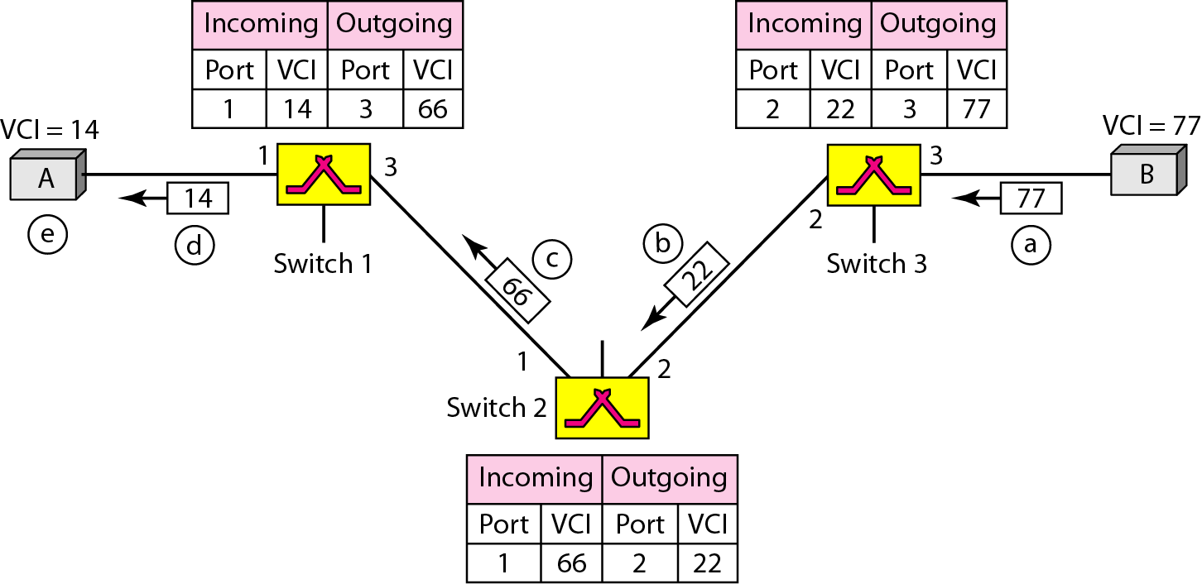
Figure 8.15 Setup acknowledgment in a virtual-circuit network

Slide 41
3. Teardown Phase
In this phase, source A, after sending all frames to B, sends a special frame called a teardown request.
Destination B responds with a teardown confirmation frame. All switches delete the corresponding entry from their tables.

Slide 42
Note
In virtual-circuit switching, all packets belonging to the same source and destination travel the same path;
but the packets may arrive at the destination with different delays if resource allocation is on demand.

Slide 43
Delay in Virtual-Circuit Networks
In a virtual-circuit network, there is a one-time delay for setup and a one-time delay for teardown.
If resources are allocated during the setup phase, there is no wait time for individual packets. Figure 8.16 shows the delay for a packet traveling through two switches in a virtual-circuit network.
The packet is traveling through two switches (routers).
There are three transmission times (3T ), three propagation times (3τ), data transfer depicted by the sloping lines, a setup delay (which includes transmission and propagation in two directions), and a teardown delay (which includes transmission and propagation in one direction).
We ignore the processing time in each switch. The total delay time is
=

Slide 44
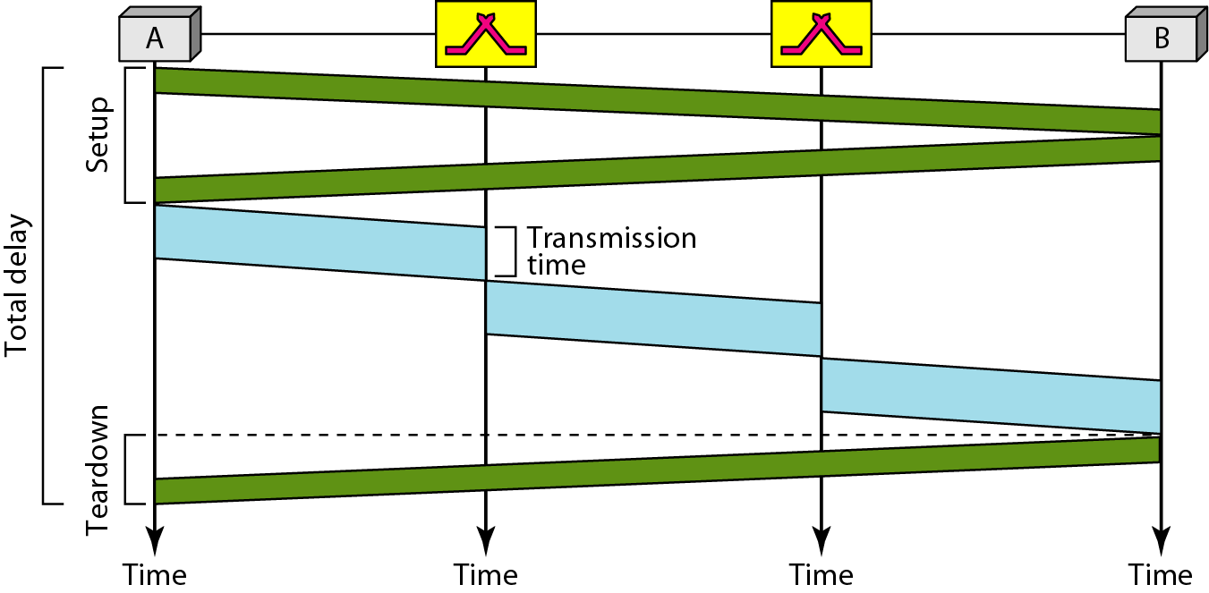
Figure 8.16 Delay in a virtual-circuit network

Slide 45
Note
Switching at the data link layer in a switched WAN is normally
implemented by using virtual-circuit techniques.

Slide 46
What have we completed?
Thank You
Taxonomy of switched network
Circuit switched network
Datagram Network
Virtual circuit Network

