Slide 1
Introduction
(Overview of Data Communication Networks, Protocols and Standards)
By dr. R. K. Ojha
Lecture-01
Chapter 01

Slide 2

Topics to be discussed
Data Communication & it’s components
Factors affecting Data Communication
Types of data flow
Types of connections
Network topologies
The internet
Protocols
Standard Organizations

Slide 3
DATA COMMUNICATIONS
The term telecommunication means communication at a distance. The word data refers to information presented in whatever form is agreed upon by the parties creating and using the data. Data communications are the exchange of data between two devices via some form of transmission medium such as a wire cable.

Slide 4
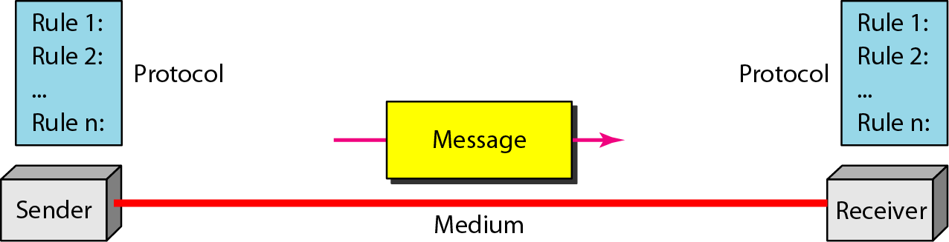
Five components of data communication

Slide 5
Factors affecting the data communication
Delivery. The system must deliver data to the correct destination. Data must be received by the intended device or user and only by that device or user.
Accuracy. The system must deliver the data accurately. Data that have been altered in transmission and left uncorrected are unusable.
Timeliness. The system must deliver data in a timely manner. Data delivered late are Useless. In the case of video and audio, timely delivery means delivering data as they are produced, in the same order that they are produced, and without signifi­cant delay. This kind of delivery is called real-time transmission.
Jitter. Jitter refers to the variation in the packet arrival time. It is the uneven delay in the delivery of audio or video packets. For example, let us assume that video packets are sent every 3D ms. If some of the packets arrive with 3D-ms delay and others with 4D-ms delay, an uneven quality in the video is the result.

Slide 6
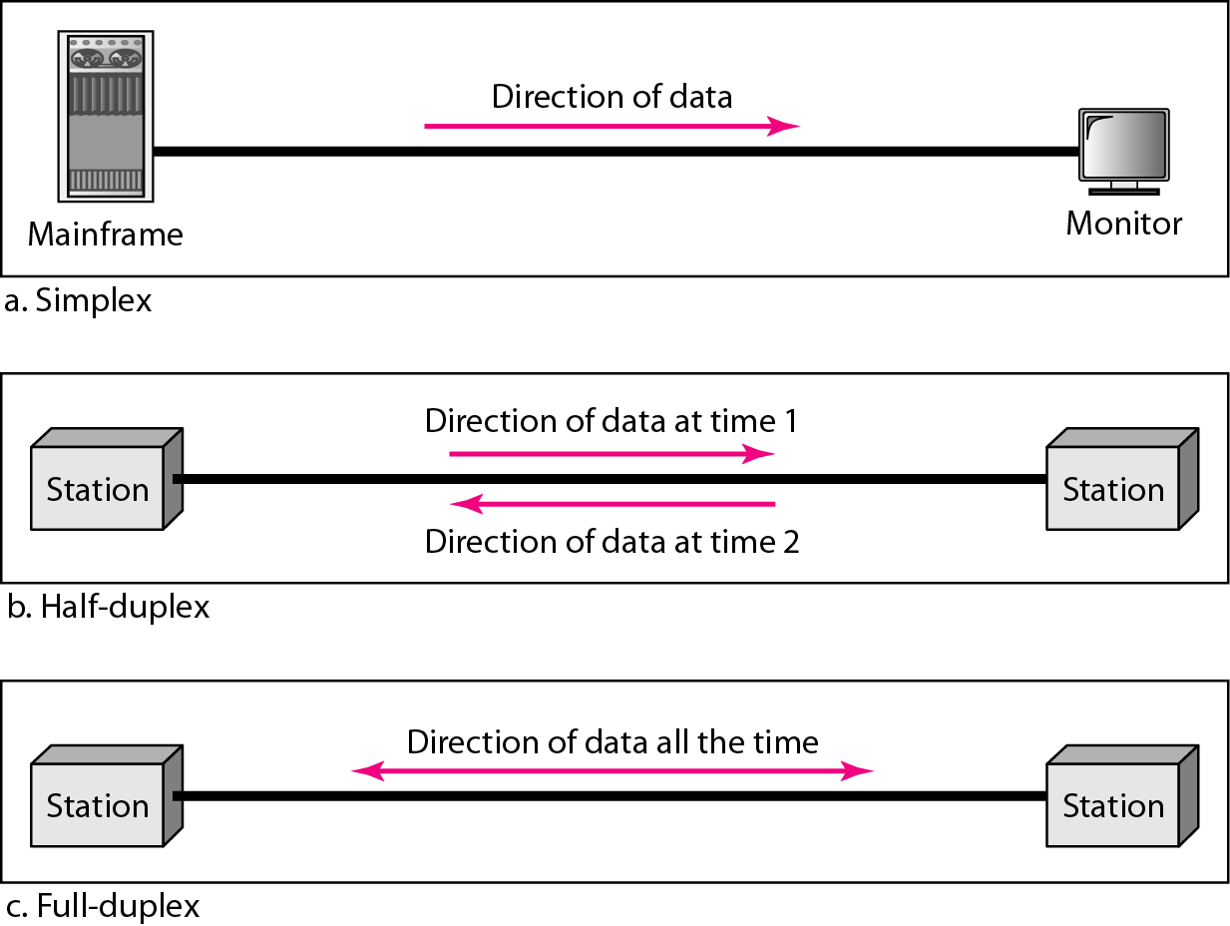
Data flow (simplex, half-duplex, and full-duplex)

Slide 7
NETWORKS
A network is a set of devices (often referred to as nodes) connected by communication links. A node can be a computer, printer, or any other device capable of sending and/or receiving data generated by other nodes on the network.

Slide 8
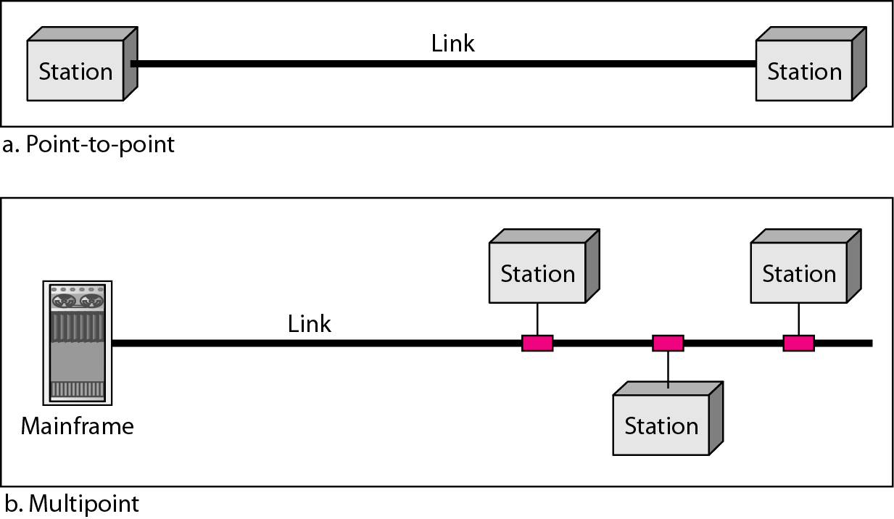
Types of connections: point-to-point and multipoint

Slide 9
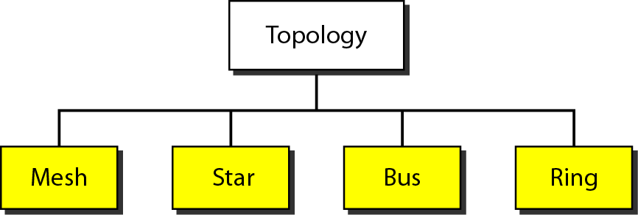
Network topologies

Slide 10
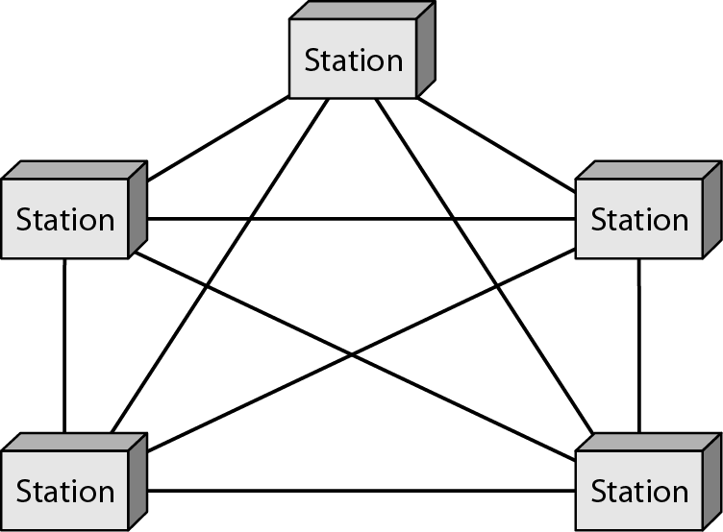
A fully connected mesh topology (five devices)

Slide 11
Advantages:
Dedicated link: The dedicated links guarantees that each connection can carry its own data load, so links not to be shared by multiple devices.
Robustness: If one link becomes unusable, it does not incapacitate the entire system.
Privacy or security: When every message travels along a dedicated line, only the intended recipient sees it.
Easy fault identification: The point-to-point links make fault identification and fault isolation easy.
Disadvantages:
Every device must be connected to every other device, installation and reconnection are difficult.
The sheer bulk of the wiring can be greater than the available space (in walls, ceilings, or floors) can accommodate.
The hardware required to connect each link (I/O ports and cable) can be prohibitively expensive.
Application: The connection of telephone regional offices in which each regional office needs to be connected to every other regional office.

Slide 12
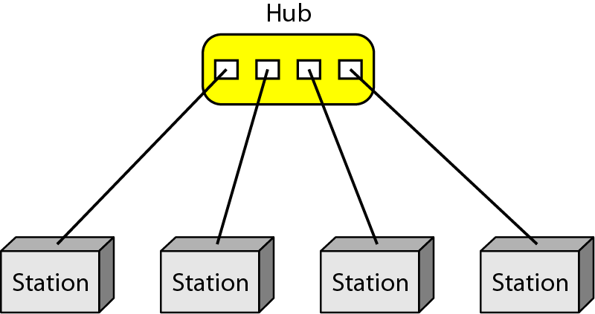
A star topology connecting four stations

Slide 13
Advantages:
It is less expensive than a mesh topology. Each device needs only one link and one I/O port to connect. it to any number of others.
Easy to install and reconfigure. Far less cabling needs to be housed.
Robustness: If one link fails, only that link is affected. All other links remain active.
Easy fault identification and fault isolation: As long as the hub is working, it can be used to monitor link problems and bypass defective links.
Disadvantages:
Dependency of the whole topology on one single point, the hub. If the hub goes down, the whole system is dead.
Although a star requires far less cable than a mesh, often more cabling is required in a star than in some other topologies (such as ring or bus).
Application:
The star topology is used in local-area networks (LANs), and High-speed LANs often use a star topology with a central hub.

Slide 14
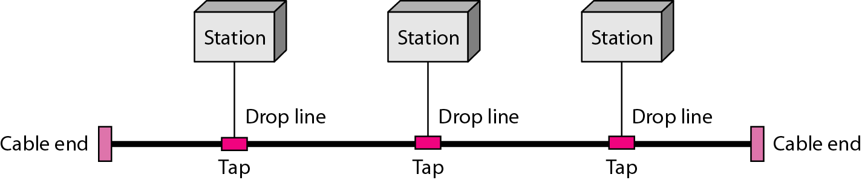
A bus topology connecting three stations

Slide 15
Advantages:
Ease of installation. Backbone cable can be laid along the most efficient path, then connected to the nodes by drop lines of various lengths.
Less cabling than mesh or star topologies. Only the backbone cable stretches through the entire facility. Each drop line has to reach only as far as the nearest point on the backbone.
Disadvantages:
Difficult reconnection and fault isolation. It is difficult to add new devices. Adding new devices may require modification or replacement of the backbone.
A fault or break in the bus cable stops all transmission, even between devices on the same side of the problem.
Application:
Ethernet LANs can use a bus topology

Slide 16
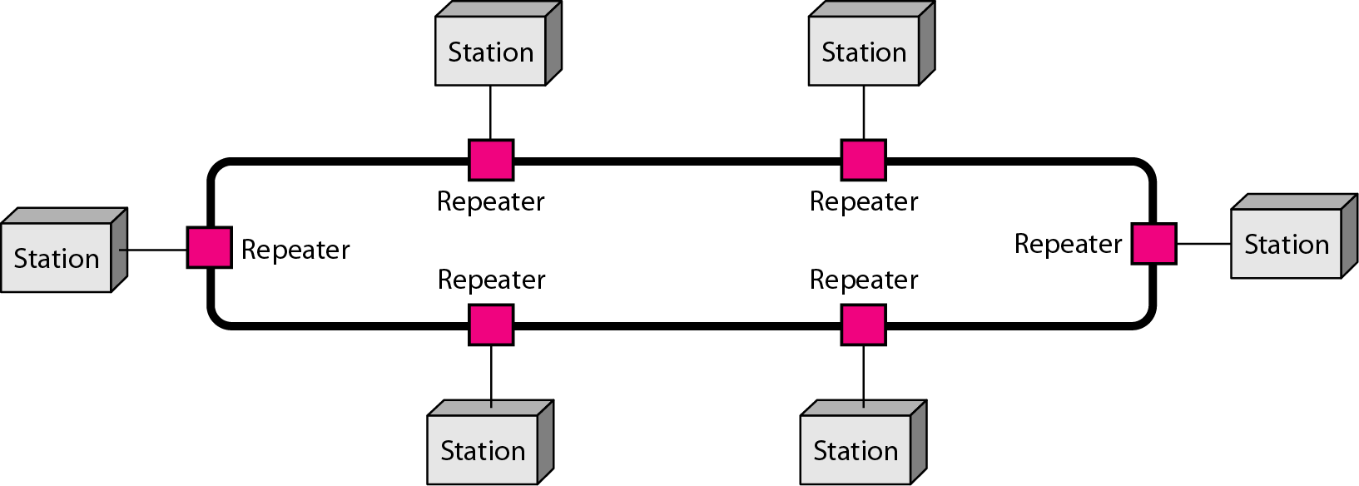
A ring topology connecting six stations

Slide 17
Advantages:
Relatively easy to install and reconfigure.
Easy to add or delete a device requires changing only two connections.
Fault isolation is simple, If one device does not receive a signal within a specified period, it can issue an alarm. The alarm alerts the network operator to the problem and its location.
Disadvantages:
Unidirectional traffic can be a disadvantage.
In a simple ring, a break in the ring (such as a disabled station) can disable the entire network.
Applications:
Ring topology was prevalent when IBM introduced its local-area network Token
Ring. Today, the need for higher-speed LANs has made this topology less popular.

Slide 18
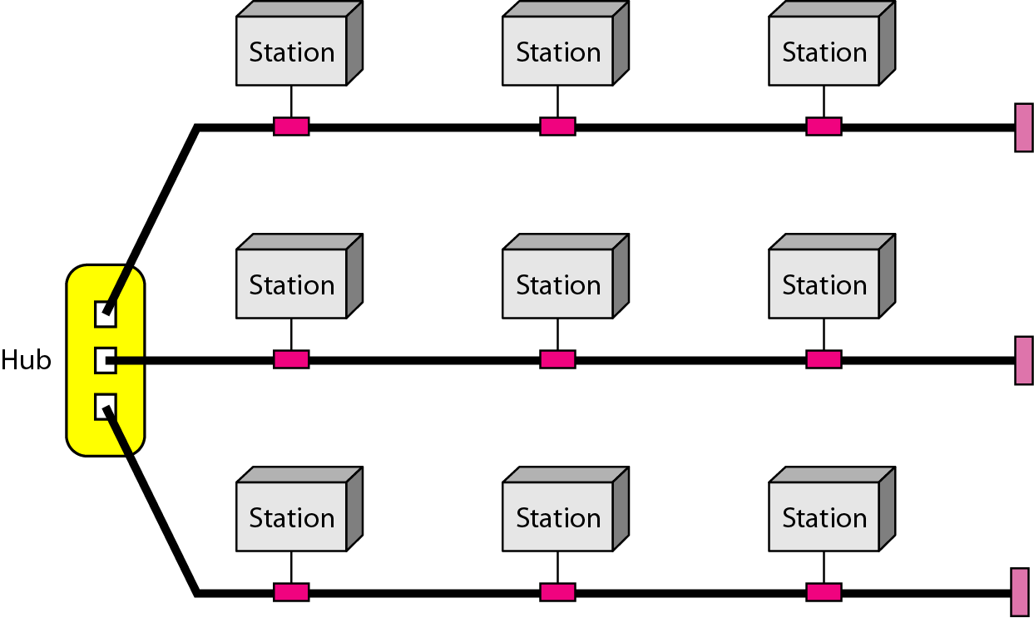
A hybrid topology: a star backbone with three bus networks

Slide 19
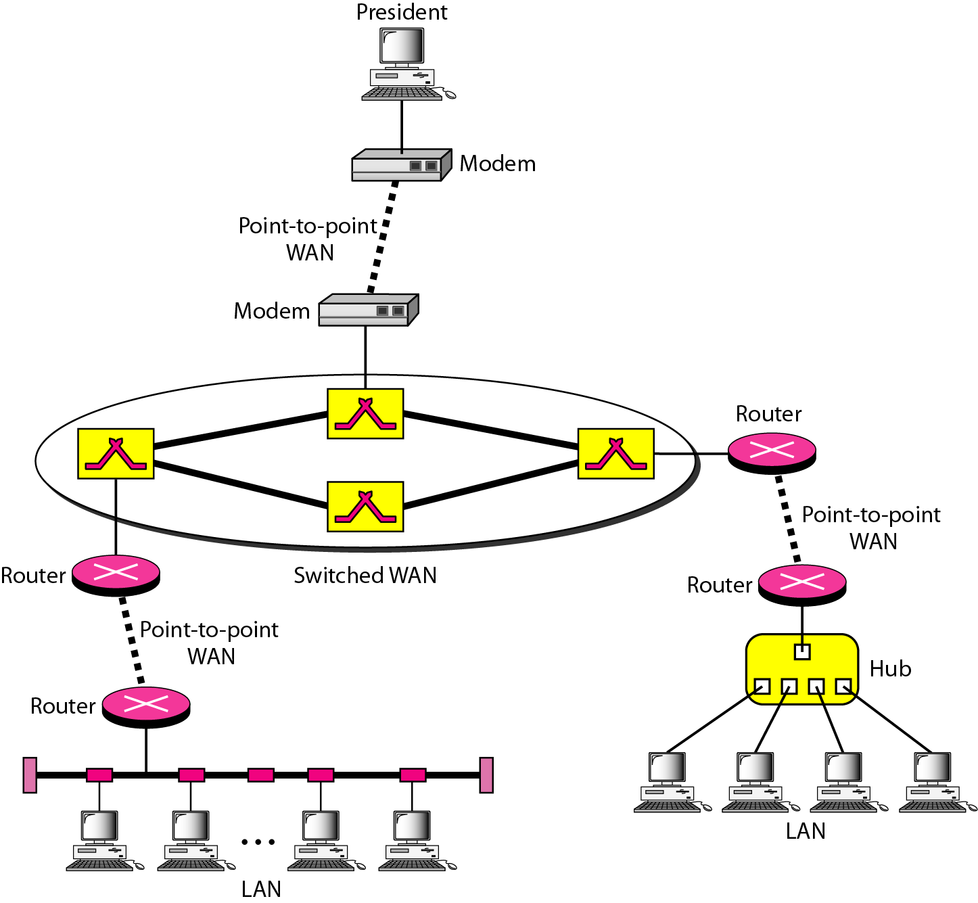
A heterogeneous network made of four WANs and two LANs

Slide 20
THE INTERNET
The Internet has revolutionized many aspects of our daily lives. It has affected the way we do business as well as the way we spend our leisure time. The Internet is a communication system that has brought a wealth of information to our fingertips and organized it for our use.

Slide 21
ARPANET (1969)
The Advanced Research Projects Agency (ARPA) in the Department of Defense (DoD) was interested in finding a way to connect computers so that the researchers they funded could share their findings, thereby reducing costs and eliminating duplication of effort.
Only four nodes, at the University of California at Los Angeles (UCLA), the University of California at Santa Barbara (UCSB), Stanford Research Institute (SRI), and the University of Utah, were connected via the interface message processor (IMP) to form a network. Software called the Network Control Protocol (NCP) provided communication between the hosts.
Vint Cerf and Bob Kahn, both of whom were part of the core ARPANET group, collaborated on what they called the Internetting Project. Cerf and Kahn's landmark 1973 paper outlined the Transmission Control Protocol (TCP) and included concepts such as encapsulation, the datagram, and the functions of a gateway for point-to-point delivery.

Slide 22
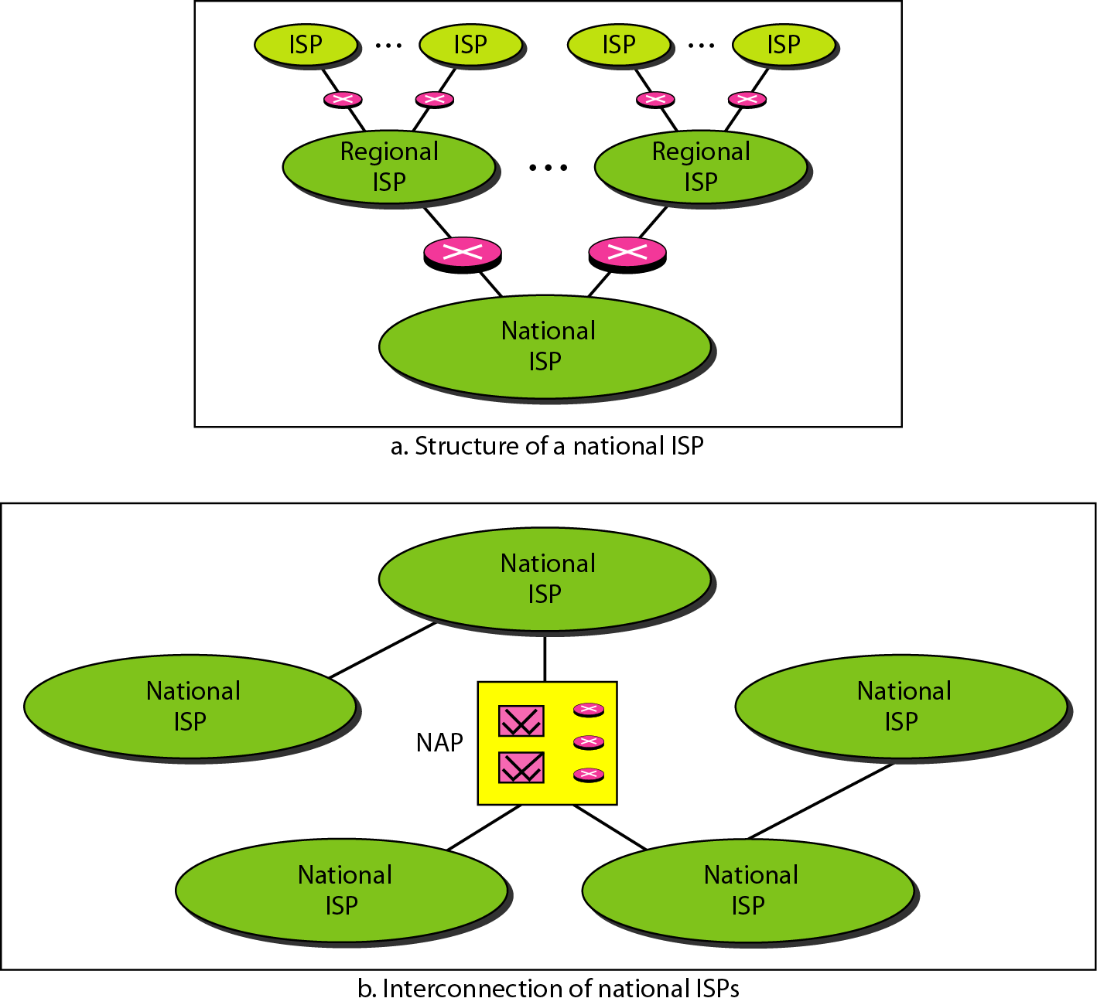
Hierarchical organization of the Internet

Slide 23
PROTOCOL
A protocol is a set of rules that govern data communications. A protocol defines what is communicated, how it is communicated, and when it is communicated. The key elements of a protocol are syntax, semantics, and timing.
Syntax: refers to the structure or format of the data, meaning the order in which they are presented. For example, a simple protocol might expect the first 8 bits of data to be the address of the sender, the second 8 bits to be the address of the receiver, and the rest of the stream to be the message itself.
Semantics: refers to the meaning of each section of bits. How is a particular pattern to be interpreted, and what action is to be taken based on that interpretation? For example, does an address identify the route to be taken or the final destination of the message?
Timing: refers to two characteristics: when data should be sent and how fast they can be sent. For example, if a sender produces data at 100 Mbps but the receiver can process data at only 1 Mbps, the transmission will overload the receiver and some data will be lost.

Slide 24
STANDARD ORGANIZATIONS
International Organization for Standardization (ISO).
International Telecommunication Union-Telecommunication Standards Sector (ITU-T).
American National Standards Institute (ANSI).
Institute of Electrical and Electronics Engineers (IEEE).
Electronic Industries Association (EIA).

Slide 25
What have we completed?
Thank You
Data Communication & it’s components
Factors affecting Data Communication
Types of data flow
Types of connections
Network topologies
The internet
Protocols
Standard Organizations

