Slide 1
Digital to Analog conversion
Lecture-20-21
Chapter 05

Slide 2
Topics to be discussed
Digital to Analog Conversion
Amplitude Shift Keying (ASK)
Frequency Shift Keying (FSK)
Phase Shift Keying (PSK)

Slide 3
Digital-to-analog conversion is the process of changing one of the characteristics of an analog signal based on the information in digital data.
Figure 5.1 shows the relationship between the digital information, the digital-to-analog modulating process, and the resultant analog signal.
A sine wave is defined by three characteristics: amplitude, frequency, and phase. When we vary any one of these characteristics, we create a different version of that wave.
Any of the three characteristics can be altered in this way, giving us at least three mechanisms for modulating digital data into an analog signal: amplitude shift keying (ASK), frequency shift keying (FSK), and phase shift keying (PSK).
In addition, there is a fourth (and better) mechanism that combines changing both the amplitude and phase, called quadrature amplitude modulation (QAM). QAM is the most efficient of these options and is the mechanism commonly used today (see Figure 5.2).

Slide 4
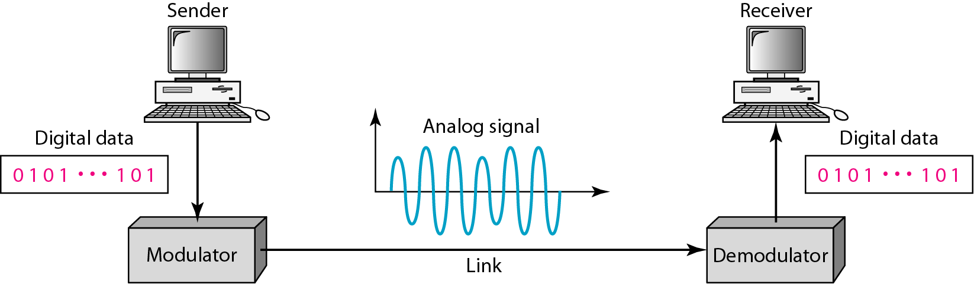
Figure 5.1 Digital-to-analog conversion
The sending device produces a high-frequency signal that acts as a base for the information signal. This base signal is called the carrier signal or carrier frequency.
The receiving device is tuned to the frequency of the carrier signal that it expects from the sender.
Digital information then changes the carrier signal by modifying one or more of its characteristics (amplitude, frequency, or phase). This kind of modification is called modulation (shift keying).

Slide 5
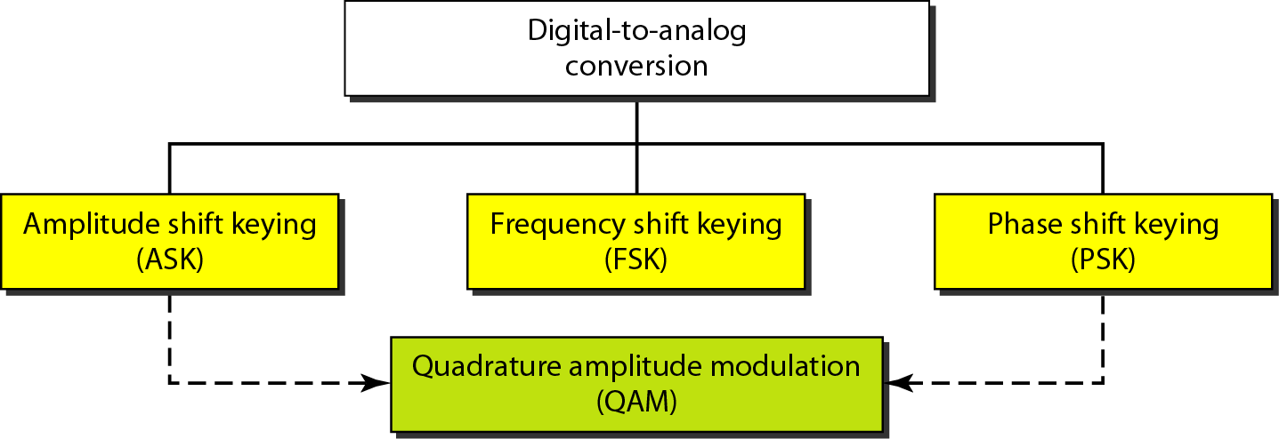
Figure 5.2 Types of digital-to-analog conversion

Slide 6

Note
Bit rate is the number of bits per second. Baud rate is the number of signal elements per second.
In the analog transmission of digital data, the baud rate is less than or equal to the bit rate.

Slide 7

Data Rate Versus Signal Rate
We can define the data rate (bit rate) and the signal rate (baud rate) as we did for digital transmission. The relationship between them is:
where N is the data rate (bps) and r is the number of data elements carried in one signal element.
The value of r in analog transmission is r = log2 L, where L is the number of different signal elements.

Slide 8
Example 5.1
An analog signal carries 4 bits per signal element. If 1000 signal elements are sent per second, find the bit rate.
Solution
In this case, r = 4, S = 1000, and N is unknown. We can find the value of N from

Slide 9
Example 5.2
An analog signal has a bit rate of 8000 bps and a baud rate of 1000 baud. How many data elements are carried by each signal element? How many signal elements do we need?
Solution
In this example, S = 1000, N = 8000, and r and L are unknown. We find first the value of r and then the value of L.

Slide 10
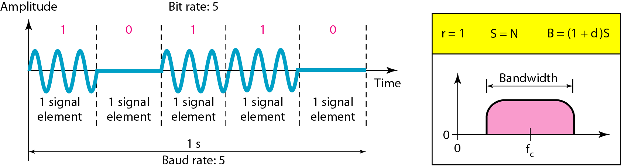
Figure 5.3 Binary amplitude shift keying
Although we can have several levels (kinds) of signal elements, each with a different amplitude, ASK is normally implemented using only two levels. This is referred to as binary amplitude shift keying or on-off keying (OOK). The peak amplitude of one signal level is 0; the other is the same as the amplitude of the carrier frequency. As we expect, the bandwidth is proportional to the signal rate (baud rate). However the value of d, depends on the modulation and filtering process. The value of d is between 0 and 1.
This means that the bandwidth can be expressed as shown, where S is the signal rate and the B is the bandwidth.

Slide 11
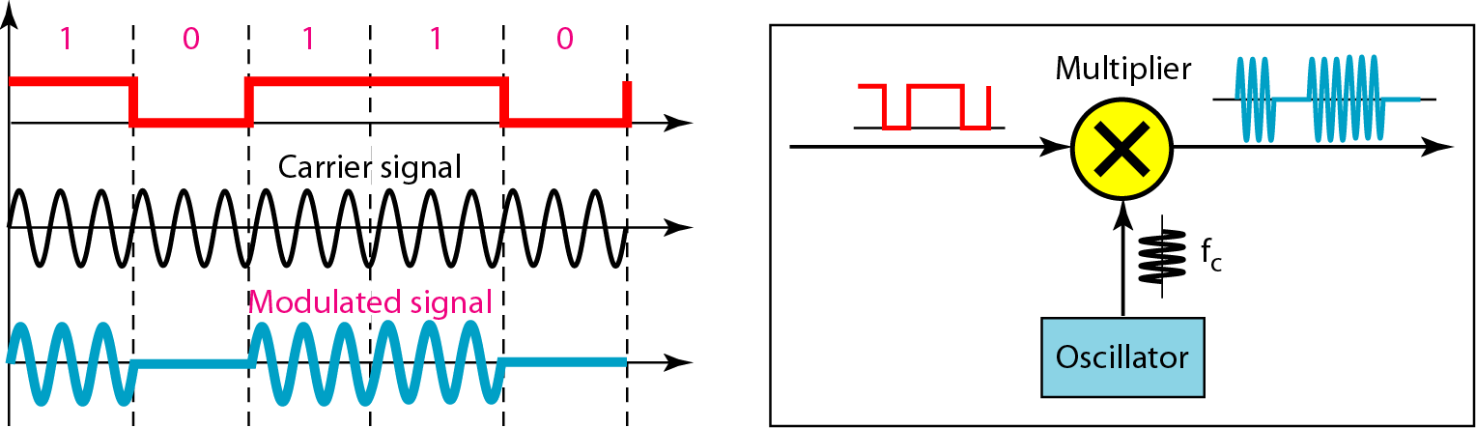
Figure 5.4 Implementation of binary ASK
If digital data are presented as a unipolar NRZ (see Chapter 4) digital signal with a high voltage of 1 V and a low voltage of 0 V, the implementation can achieved by multiplying the NRZ digital signal by the carrier signal coming from an oscillator.
When the amplitude of the NRZ signal is 1, the amplitude of the carrier frequency is held; when the amplitude of the NRZ signal is 0, the amplitude of the carrier frequency is zero.

Slide 12
Example 5.3
We have an available bandwidth of 100 kHz which spans from 200 to 300 kHz. What are the carrier frequency and the bit rate if we modulated our data by using ASK with d = 1?
Solution
The middle of the bandwidth is located at 250 kHz. This means that our carrier frequency can be at f_{c} = 250 kHz. We can use the formula for bandwidth to find the bit rate (with d = 1 and r = 1).

Slide 13
Example 5.4
In data communications, we normally use full-duplex links with communication in both directions.
We need to divide the bandwidth into two with two carrier frequencies, as shown in Figure 5.5.
The figure shows the positions of two carrier frequencies and the bandwidths.
The available bandwidth for each direction is now 50 kHz, which leaves us with a data rate of 25 kbps in each direction.

Slide 14
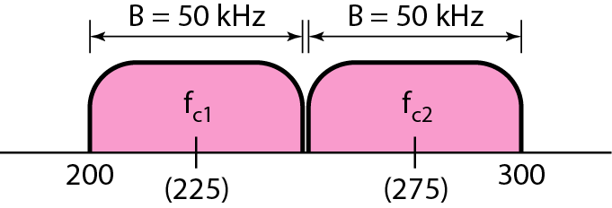
Figure 5.5 Bandwidth of full-duplex ASK used in Example 5.4

Slide 15
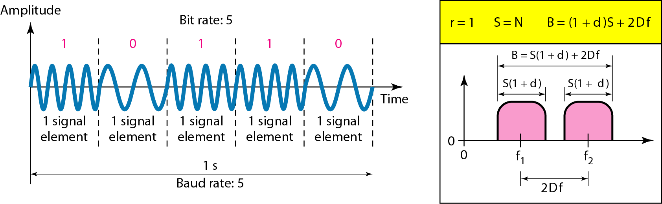
Figure 5.6 Binary frequency shift keying
Binary FSK (or BFSK) uses two carrier frequencies. In Figure 5.6, we have selected two carrier frequencies, f1 and f2. We use the first carrier if the data element is 0; we use the second if the data element is 1. However, note that this is an unrealistic example used only for demonstration purposes. Normally the carrier frequencies are very high, and the difference between them is very small. As Figure 5.6 shows, the middle of one bandwidth is f1 and the middle of the other is f2. Both f1 and f2 are Δf apart from the midpoint between the two bands. The difference between the two frequencies is 2Δf.

Slide 16
Bandwidth for BFSK
Figure 5.6 also shows the bandwidth of FSK. Again the carrier signals are only simple sine waves, but the modulation creates a non-periodic composite signal with continuous frequencies. We can think of FSK as two ASK signals, each with its own carrier frequency ( f1 or f2).
If the difference between the two frequencies is 2Δf, then the required bandwidth is:
What should be the minimum value of 2Δf ? In Figure 5.6, we have chosen a value greater than (1 + d )S. It can be shown that the minimum value should be at least S for the proper operation of modulation and demodulation.
f

Slide 17
Example 5.5
We have an available bandwidth of 100 kHz which spans from 200 to 300 kHz. What should be the carrier frequency and the bit rate if we modulated our data by using FSK with d = 1?
Solution
This problem is similar to Example 5.3, but we are modulating by using FSK. The midpoint of the band is at 250 kHz. We choose 2Δf to be 50 kHz; this means

Slide 18
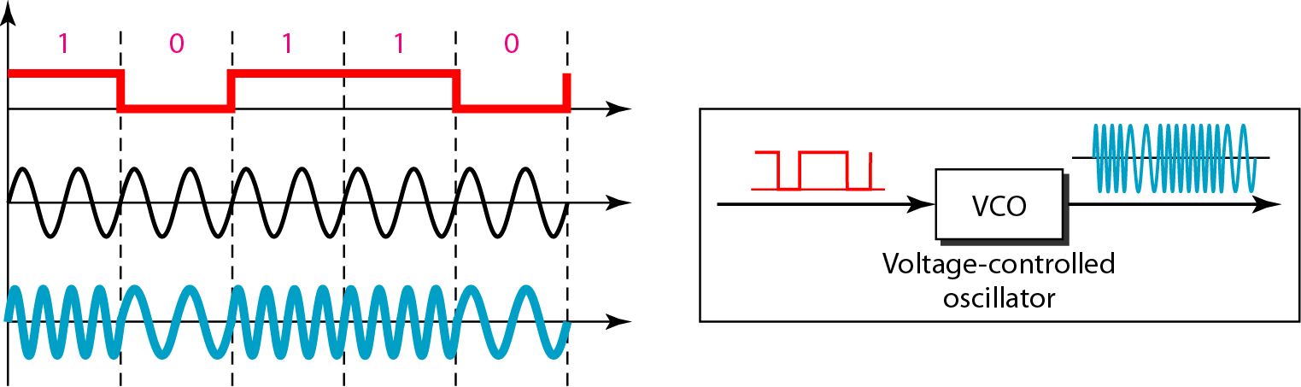
Figure 5.7 Bandwidth of MFSK used in Example 5.6

Slide 19
Multilevel FSK
Multilevel modulation (MFSK) is not uncommon with the FSK method. We can use more than two frequencies.
For example, we can use four different frequencies f1, f2, f3, and f4 to send 2 bits at a time.
To send 3 bits at a time, we can use eight frequencies.
However, we need to remember that the frequencies need to be 2Δf apart.
For the proper operation of the modulator and demodulator, it can be shown that the minimum value of 2Δf needs to be S. We can show that the bandwidth is

Slide 20
Example 5.6
We need to send data 3 bits at a time at a bit rate of 3 Mbps. The carrier frequency is 10 MHz. Calculate the number of levels (different frequencies), the baud rate, and the bandwidth.
Solution
We can have L = 2³ = 8. The baud rate is S = 3 MHz/3 = 1000 Mbaud. This means that the carrier frequencies must be 1 MHz apart (2Δf = 1 MHz). The bandwidth is B = 8 × 1000 = 8000. Figure 5.8 shows the allocation of frequencies and bandwidth.

Slide 21
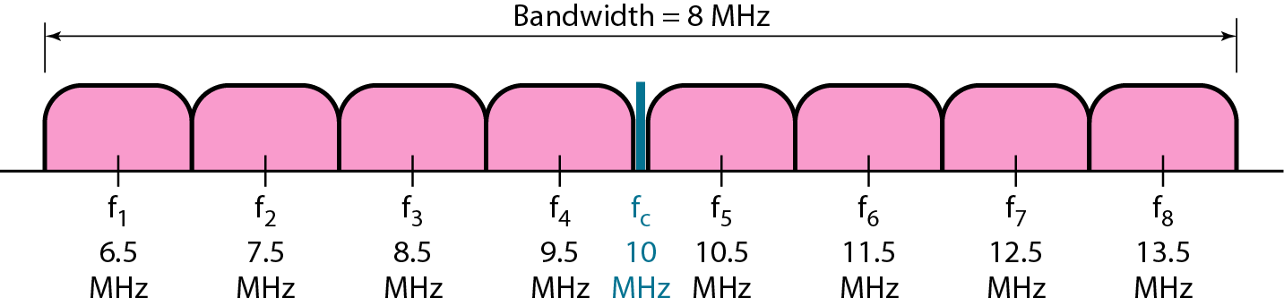
Figure 5.8 Bandwidth of MFSK used in Example 5.6

Slide 22
Phase Shift Keying
In phase shift keying, the phase of the carrier is varied to represent two or more different
signal elements. Both peak amplitude and frequency remain constant as the phase changes. Today, PSK is more common than ASK or FSK.
Binary PSK (BPSK)
The simplest PSK is binary PSK, in which we have only two signal elements, one with a phase of 0°, and the other with a phase of 180°. Figure 5.9 gives a conceptual view of PSK.
Binary PSK is as simple as binary ASK with one big advantage—it is less susceptible to noise.
In ASK, the criterion for bit detection is the amplitude of the signal; in PSK, it is the phase.
Noise can change the amplitude easier than it can change the phase. In other words, PSK is less susceptible to noise than ASK.
PSK is superior to FSK because we do not need two carrier signals.
However, PSK needs more sophisticated hardware to be able to distinguish between phases.
The bandwidth is the same as that for binary ASK, but less than that for BFSK. No bandwidth is wasted for separating two carrier signals.

Slide 23
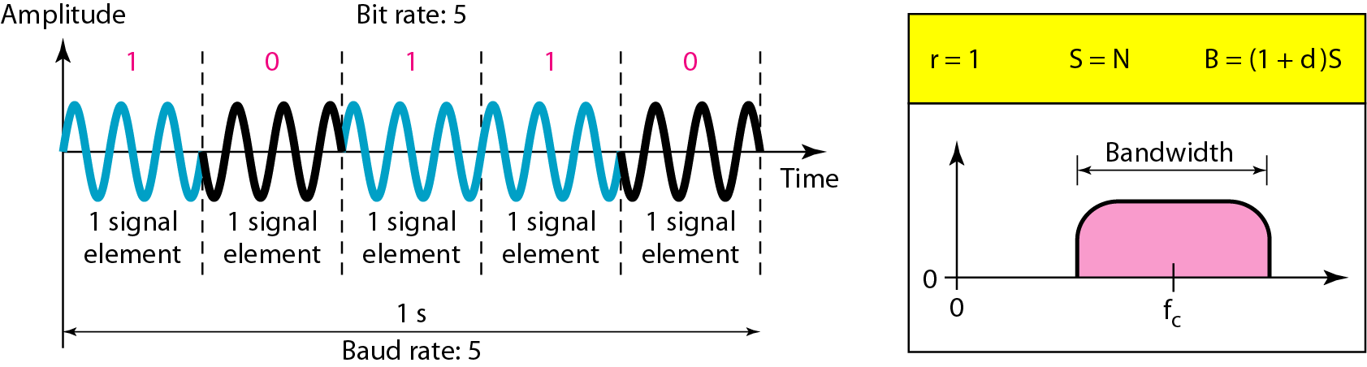
Figure 5.9 Binary phase shift keying

Slide 24
Implementation of BPSK
The implementation of BPSK is as simple as that for ASK.
The reason is that the signal element with phase 180° can be seen as the complement of the signal element with phase 0°.
This gives us a clue on how to implement BPSK.
We use the same idea we used for ASK but with a polar NRZ signal instead of a unipolar NRZ signal, as shown in Figure 5.10.
The polar NRZ signal is multiplied by the carrier frequency; the 1 bit (positive voltage) is represented by a phase starting at 0°; the 0 bit (negative voltage) is represented by a phase starting at 180°.

Slide 25
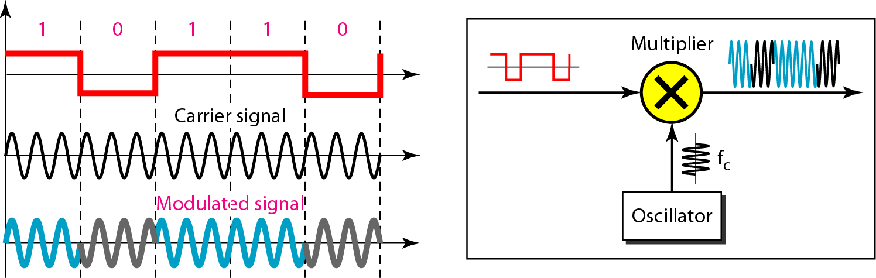
Figure 5.10 Implementation of BASK

Slide 26
Quadrature PSK (QPSK)
The simplicity of BPSK enticed designers to use 2 bits at a time in each signal element, thereby decreasing the baud rate and eventually the required bandwidth.
The scheme is called quadrature PSK or QPSK because it uses two separate BPSK modulations; one is in-phase, the other quadrature (out-of-phase).
The incoming bits are first passed through a serial-to-parallel conversion that sends one bit to one modulator and the next bit to the other modulator.
If the duration of each bit in the incoming signal is T, the duration of each bit sent to the corresponding BPSK signal is 2T.
This means that the bit to each BPSK signal has one-half the frequency of the original signal. Figure 5.11 shows the idea.
The two composite signals created by each multiplier are sine waves with the same
frequency, but different phases. When they are added, the result is another sine wave, with one of four possible phases: 45°, −45°, 135°, and −135°.
There are four kinds of signal elements in the output signal (L = 4), so we can send 2 bits per signal element (r = 2).

Slide 27
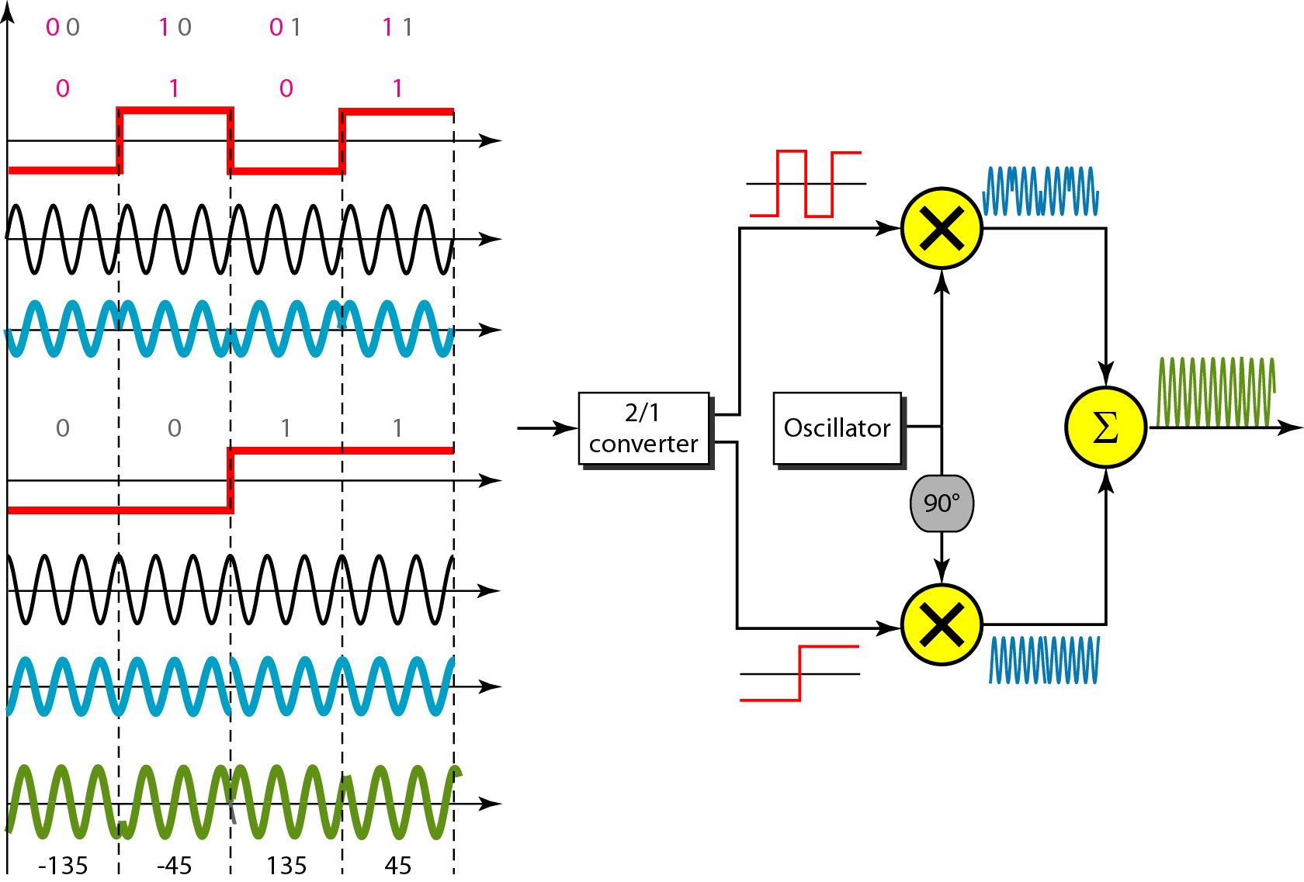
Figure 5.11 QPSK and its implementation

Slide 28
Example 5.7
Find the bandwidth for a signal transmitting at 12 Mbps for QPSK. The value of d = 0.
Solution
For QPSK, 2 bits is carried by one signal element. This means that r = 2. So the signal rate (baud rate) is S = N × (1/r) = 6 Mbaud. With a value of d = 0, we have B = S = 6 MHz.

Slide 29
What have we completed?
Thank You
Digital to Analog Conversion
Amplitude Shift Keying (ASK)
Frequency Shift Keying (FSK)
Phase Shift Keying (PSK)

