Slide 1
Media Access Control
By dr. R. K. Ojha
Lecture-25-27
( Chapter 12 )

Slide 2
Topics to be discussed
ALOHA
Carrier Sense Multiple Access
Carrier Sense Multiple Access with Collision Detection
Carrier Sense Multiple Access with Collision Avoidance
Frequency-Division Multiple Access (FDMA)
Time-Division Multiple Access (TDMA)
Code-Division Multiple Access (CDMA)

Slide 3
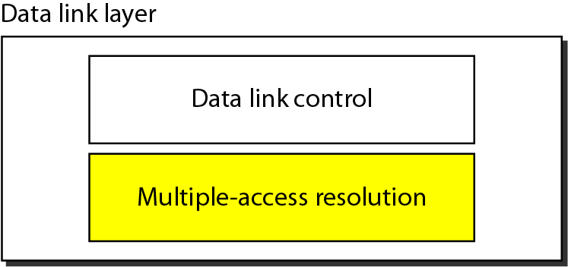
Figure 12.1 Data link layer divided into two functionality-oriented sublayers

Slide 4
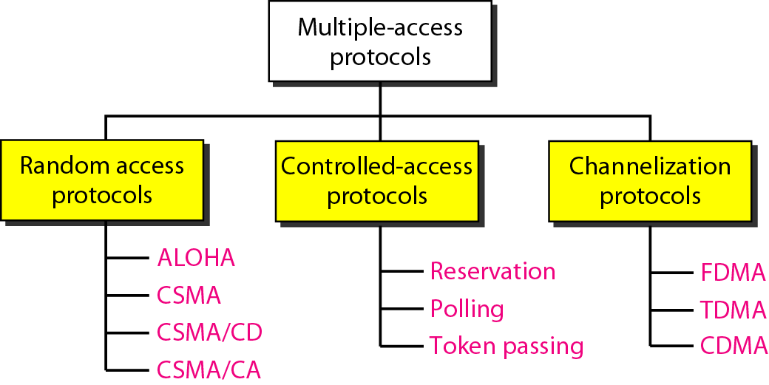
Figure 12.2 Taxonomy of multiple-access protocols discussed in this chapter
❑ When can the station access the medium?
❑ What can the station do if the medium is busy?
❑ How can the station determine the success or failure of the transmission?
❑ What can the station do if there is an access conflict?

Slide 5
RANDOM ACCESS
In random access or contention methods, no station is superior to another station and none is assigned the control over another.
No station permits, or does not permit, another station to send.
At each instance, a station that has data to send uses a procedure defined by the protocol to make a decision on whether or not to send.

Slide 6
ALOHA
It is the earliest random access method, was developed at the University of Hawaii in early 1970.
It was designed for a radio (wireless) LAN, but it can be used on any shared medium.
This is a simple but elegant protocol.
The idea is that each station sends a frame whenever it has a frame to send .
However, since there is only one channel to share, there is the possibility of collision between frames from different stations.

Slide 7
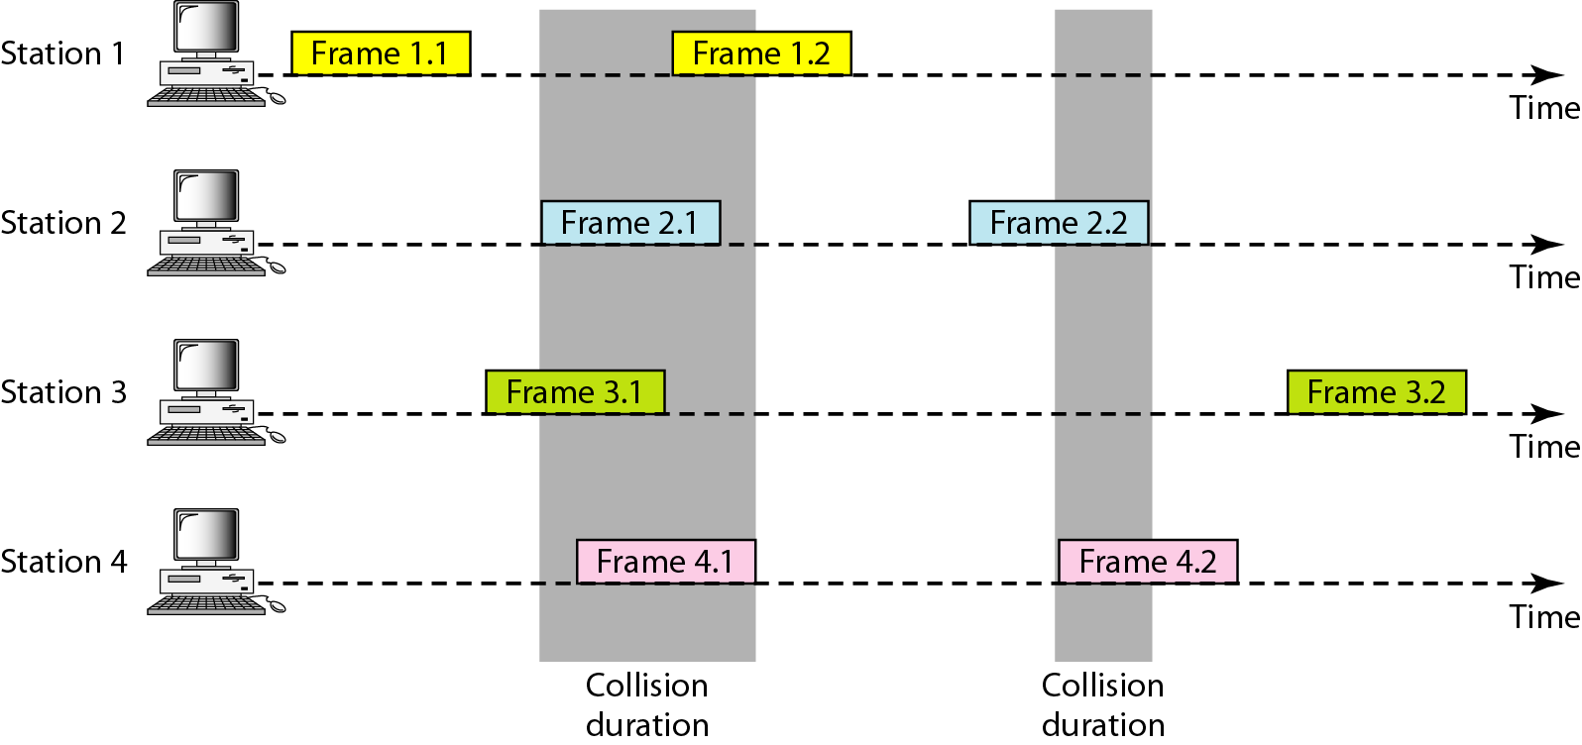
Figure 12.3 Frames in a pure ALOHA network

Slide 8
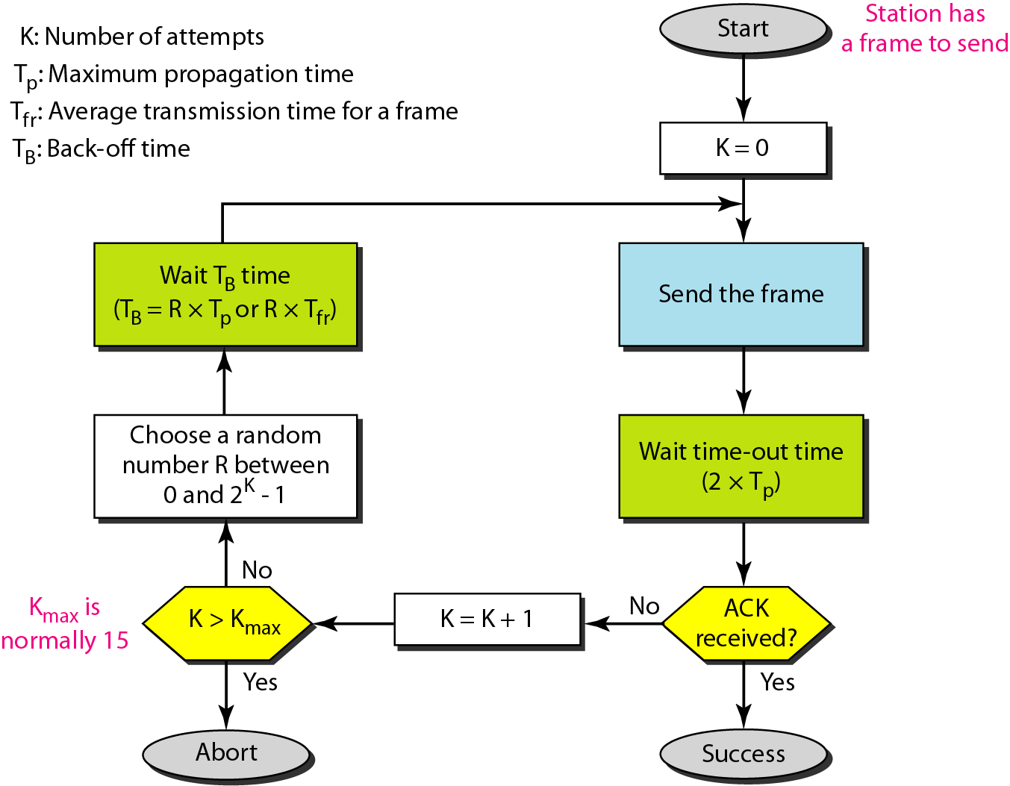
Figure 12.4 Procedure for pure ALOHA protocol

Slide 9

Example 12.1
The stations on a wireless ALOHA network are a maximum of 600 km apart. If we assume that signals propagate at 3 × 10⁸ m/s, we find
Tp = (600 × 10⁵ ) / (3 × 10⁸ ) = 2 ms.
Now we can find the value of T_{B} for different values of K .
a. For K = 1, the range is {0, 1}. The station needs to| generate a random number with a value of 0 or 1. This means that T_{B} is either 0 ms (0 × 2) or 2 ms (1 × 2), based on the outcome of the random variable.

Slide 10
Example 12.1 (continued)
b. For K = 2, the range is {0, 1, 2, 3}. This means that T_{B} can be 0, 2, 4, or 6 ms, based on the outcome of the random variable.
c. For K = 3, the range is {0, 1, 2, 3, 4, 5, 6, 7}. This means that T_{B} can be 0, 2, 4, . . . , 14 ms, based on the outcome of the random variable.
d. We need to mention that if K > 10, it is normally set to 10.

Slide 11
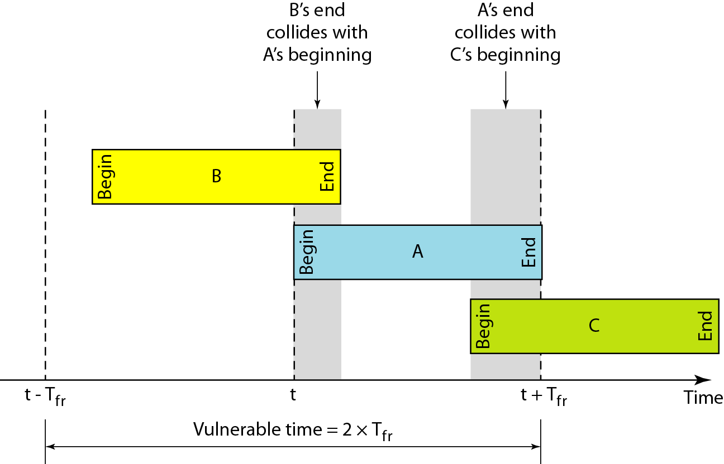
Figure 12.5 Vulnerable time for pure ALOHA protocol

Slide 12
Example 12.2
A pure ALOHA network transmits 200-bit frames on a shared channel of 200 kbps. What is the requirement to make this frame collision-free?
Solution
Average frame transmission time T_{fr} is 200 bits/200 kbps or 1 ms.
The vulnerable time is 2 × 1 ms = 2 ms.
This means no station should send later than 1 ms before this station starts transmission and no station should start sending during the one 1-ms period that this station is sending.

Slide 13

Note
The throughput for pure ALOHA is S = G × e ^{−2G} .
The maximum throughput
S_{max} = 0.184 when G= (1/2).

Slide 14
Example 12.3
A pure ALOHA network transmits 200-bit frames on a shared channel of 200 kbps. What is the throughput if the system (all stations together) produces
a. 1000 frames per second b. 500 frames per second
c. 250 frames per second.
Solution
The frame transmission time is 200/200 kbps or 1 ms.
a. If the system creates 1000 frames per second, this is 1 frame per millisecond. The load is 1. In this case S = G× e^{−2 G} or S = 0.135 (13.5 percent). This means that the throughput is 1000 × 0.135 = 135 frames. Only 135 frames out of 1000 will probably survive.

Slide 15
Example 12.3 (continued)
b. If the system creates 500 frames per second, this is (1/2) frame per millisecond. The load is (1/2). In this case S = G × e ^{−2G} or S = 0.184 (18.4 percent). This means that the throughput is 500 × 0.184 = 92 and that only 92 frames out of 500 will probably survive. Note that this is the maximum throughput case, percentagewise.
c. If the system creates 250 frames per second, this is (1/4) frame per millisecond. The load is (1/4). In this case S = G × e −^{2G} or S = 0.152 (15.2 percent). This means that the throughput is 250 × 0.152 = 38. Only 38 frames out of 250 will probably survive.

Slide 16
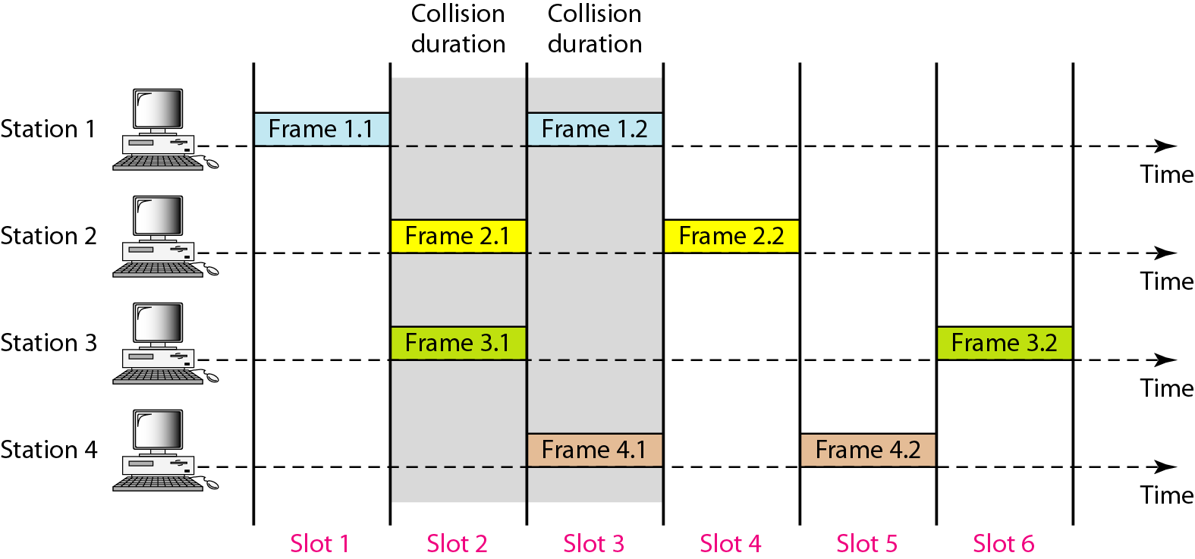
Figure 12.6 Frames in a slotted ALOHA network

Slide 17
Note
The throughput for slotted ALOHA is S = G × e^{−G} .
The maximum throughput S_{max} = 0.368 when G = 1.

Slide 18
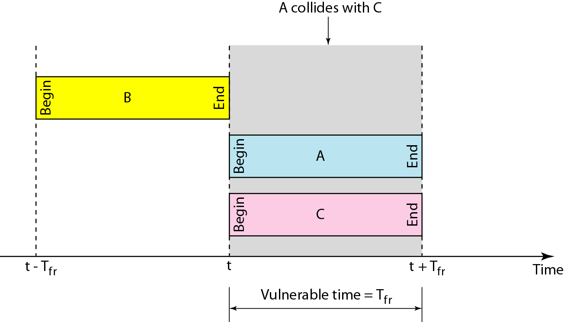
Figure 12.7 Vulnerable time for slotted ALOHA protocol

Slide 19
Example 12.4
A slotted ALOHA network transmits 200-bit frames on a shared channel of 200 kbps. What is the throughput if the system (all stations together) produces
a. 1000 frames per second b. 500 frames per second
c. 250 frames per second.
Solution
The frame transmission time is 200/200 kbps or 1 ms.
a. If the system creates 1000 frames per second, this is 1 frame per millisecond. The load is 1. In this case S = G× e^{−G} or S = 0.368 (36.8 percent). This means that the throughput is 1000 × 0.0368 = 368 frames. Only 386 frames out of 1000 will probably survive.

Slide 20
Example 12.4 (continued)
b. If the system creates 500 frames per second, this is (1/2) frame per millisecond. The load is (1/2). In this case S = G × e^{−G} or S = 0.303 (30.3 percent). This means that the throughput is 500 × 0.0303 = 151. Only 151 frames out of 500 will probably survive.
c. If the system creates 250 frames per second, this is (1/4) frame per millisecond. The load is (1/4). In this case S = G × e ^{−G} or S = 0.195 (19.5 percent). This means that the throughput is 250 × 0.195 = 49. Only 49 frames out of 250 will probably survive.

Slide 21
CSMA
Carrier sense multiple access (CSMA) requires that each station first listen to the medium (or check the state of the medium) before sending.
In other words, CSMA is based on the principle “sense before transmit” or “listen before talk.”
CSMA can reduce the possibility of collision, but it cannot eliminate it.
The possibility of collision still exists because of propagation delay; when a station sends a frame, it still takes time (although very short) for the first bit to reach every station and for every station to sense it.

Slide 22
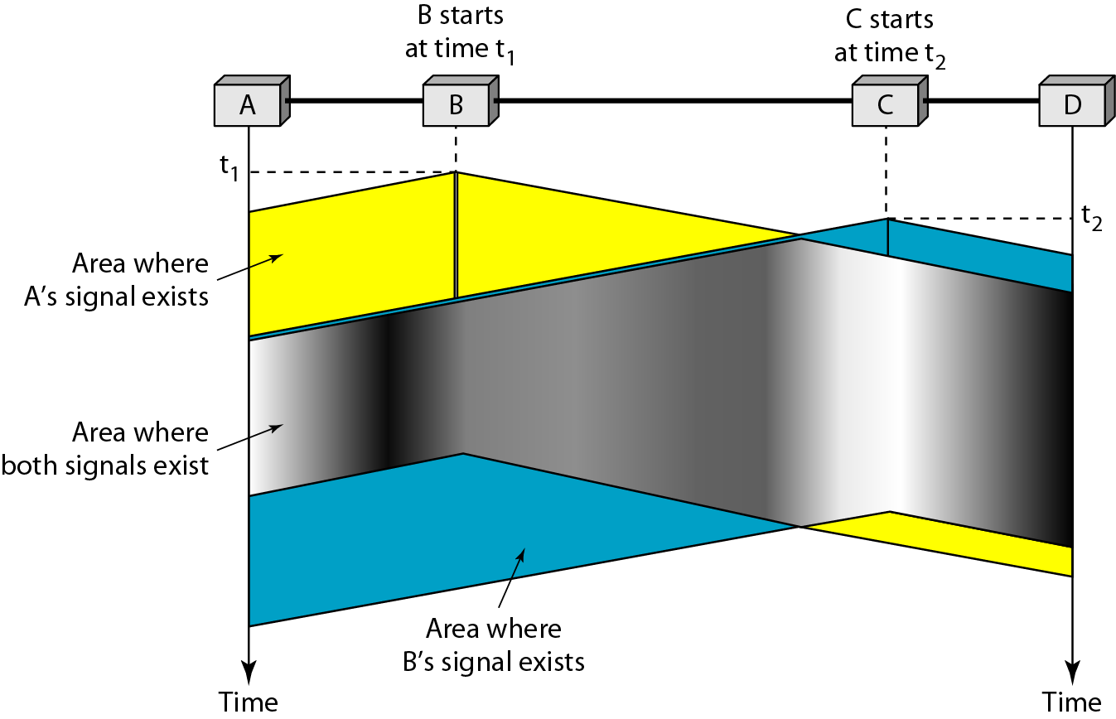
Figure 12.7 Space/time model of the collision in CSMA

Slide 23
Vulnerable time for CSMA
The vulnerable time for CSMA is the propagation time Tp.
This is the time needed for a signal to propagate from one end of the medium to the other.
When a station sends a frame and any other station tries to send a frame during this time, a collision will result.
But if the first bit of the frame reaches the end of the medium, every station will already have heard the bit and will refrain from sending. Figure 12.9 shows the worst case.
The leftmost station, A, sends a frame at time t1, which reaches the rightmost station, D, at time t1 + Tp.
The gray area shows the vulnerable area in time and space.

Slide 24
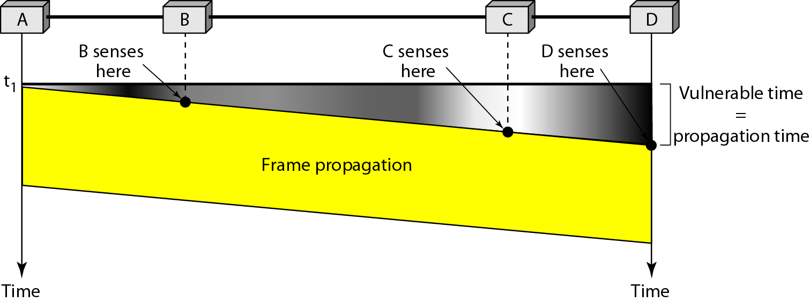
Figure 12.8 Vulnerable time in CSMA

Slide 25
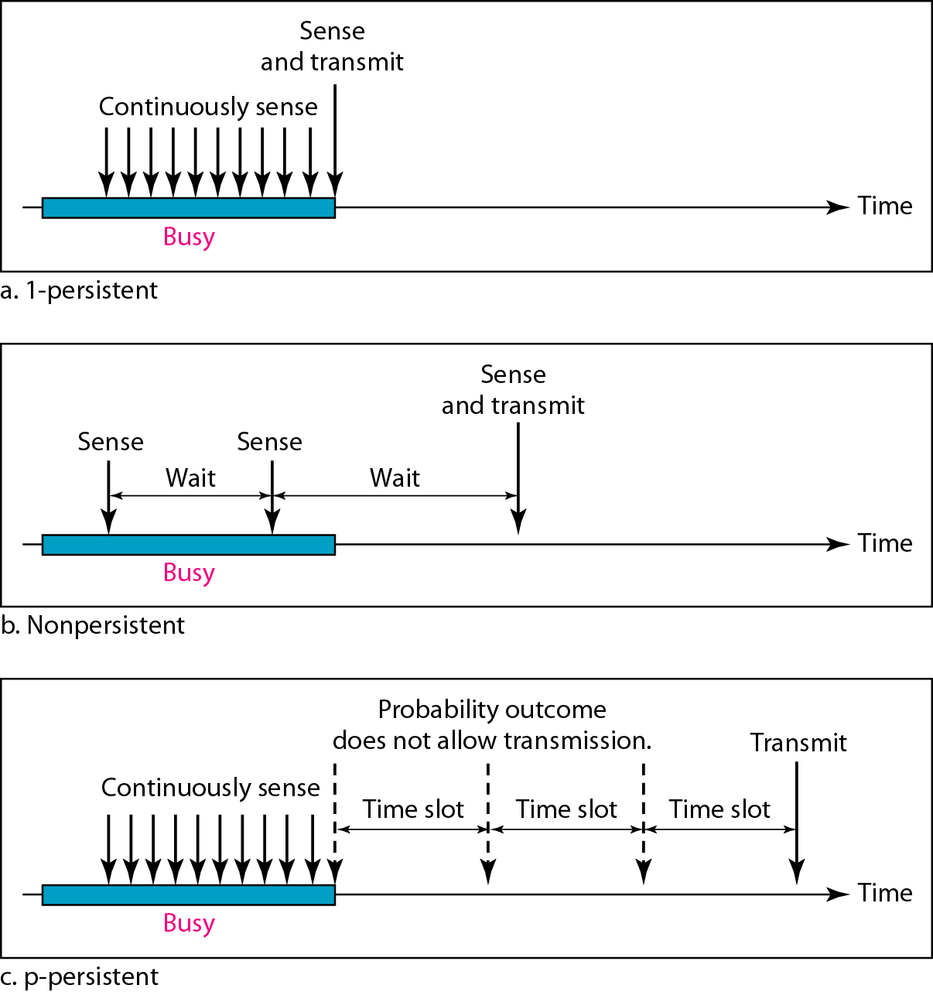
Figure 12.10 Behavior of three persistence methods
Persistence Methods
What should a station do if the channel is busy?
What should a station do if the channel is idle?

Slide 26
1-Persistent
In this method, after the station finds the line idle, it sends its frame immediately (with probability 1). This method has the highest chance of collision because two or more stations may find the line idle and send their frames immediately.
Nonpersistent
In the nonpersistent method, a station that has a frame to send senses the line. If the line is idle, it sends immediately. If the line is not idle, it waits a random amount of time and then senses the line again. The nonpersistent approach reduces the chance of collision because it is unlikely that two or more stations will wait the same amount of time and retry to send simultaneously. However, this method reduces the efficiency of the network because the medium remains idle when there may be stations with frames to send.
p-Persistent
The p-persistent method is used if the channel has time slots with a slot duration equal to or greater than the maximum propagation time. The p-persistent approach combines the advantages of the other two strategies. It reduces the chance of collision and improves efficiency. In this method, after the station finds the line idle it follows these steps:
With probability p, the station sends its frame.
With probability q = 1 − p, the station waits for the beginning of the next time slot and checks the line again.
a. If the line is idle, it goes to step 1.
b. If the line is busy, it acts as though a collision has occurred and uses the backoff procedure.

Slide 27
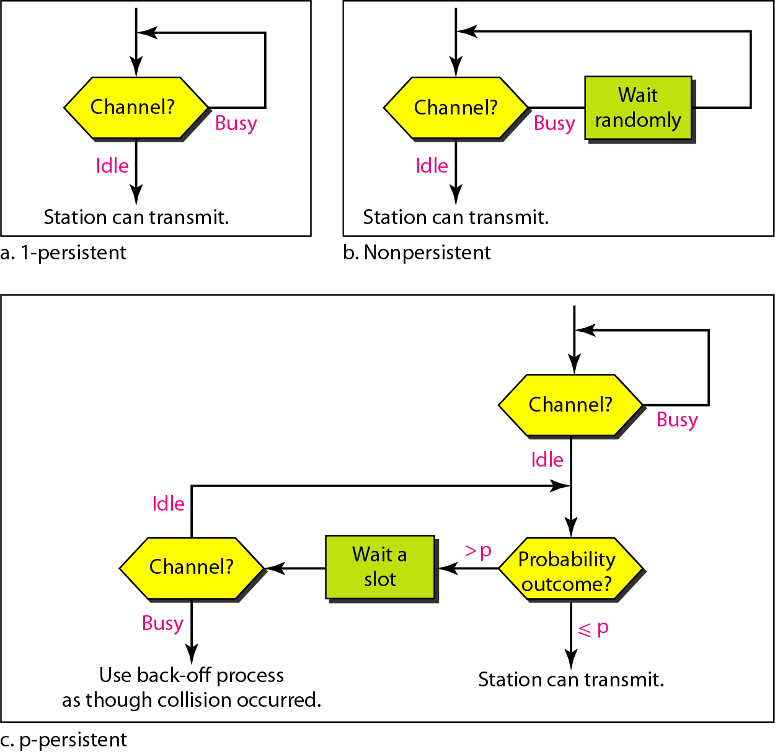
Figure 12.11 Flow diagram for three persistence methods

Slide 28
CSMA/CD
Carrier sense multiple access with collision detection (CSMA/CD) augments the algorithm to handle the collision.
In this method, a station monitors the medium after it sends a frame to see if the transmission was successful.
If so, the station is finished. If, however, there is a collision, the frame is sent again.
To better understand CSMA/CD, let us look at the first bits transmitted by the two stations involved in the collision.
Although each station continues to send bits in the frame until it detects the collision, we show what happens as the first bits collide.
In Figure 12.12, stations A and C are involved in the collision.

Slide 29
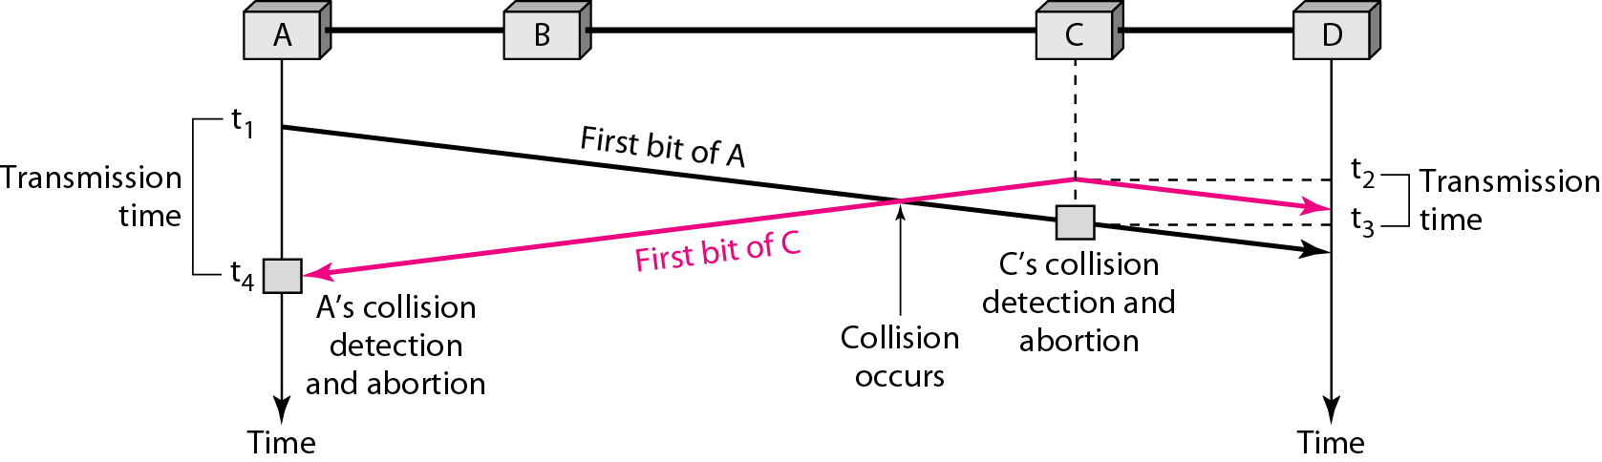
Figure 12.12 Collision of the first bit in CSMA/CD

Slide 30
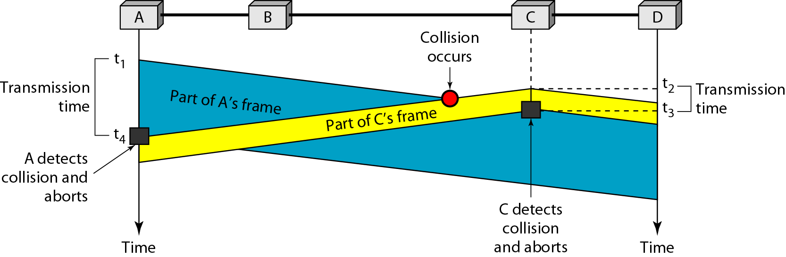
Figure 12.13 Collision and abortion in CSMA/CD

Slide 31
Example 12.5
A network using CSMA/CD has a bandwidth of 10 Mbps. If the maximum propagation time (including the delays in the devices and ignoring the time needed to send a jamming signal, as we see later) is 25.6 μs, what is the minimum size of the frame?
Solution
The frame transmission time is T_{fr} = 2 × T_{p} = 51.2 μs. This means, in the worst case, a station needs to transmit for a period of 51.2 μs to detect the collision. The minimum size of the frame is 10 Mbps × 51.2 μs = 512 bits or 64 bytes. This is actually the minimum size of the frame for Standard Ethernet.

Slide 32
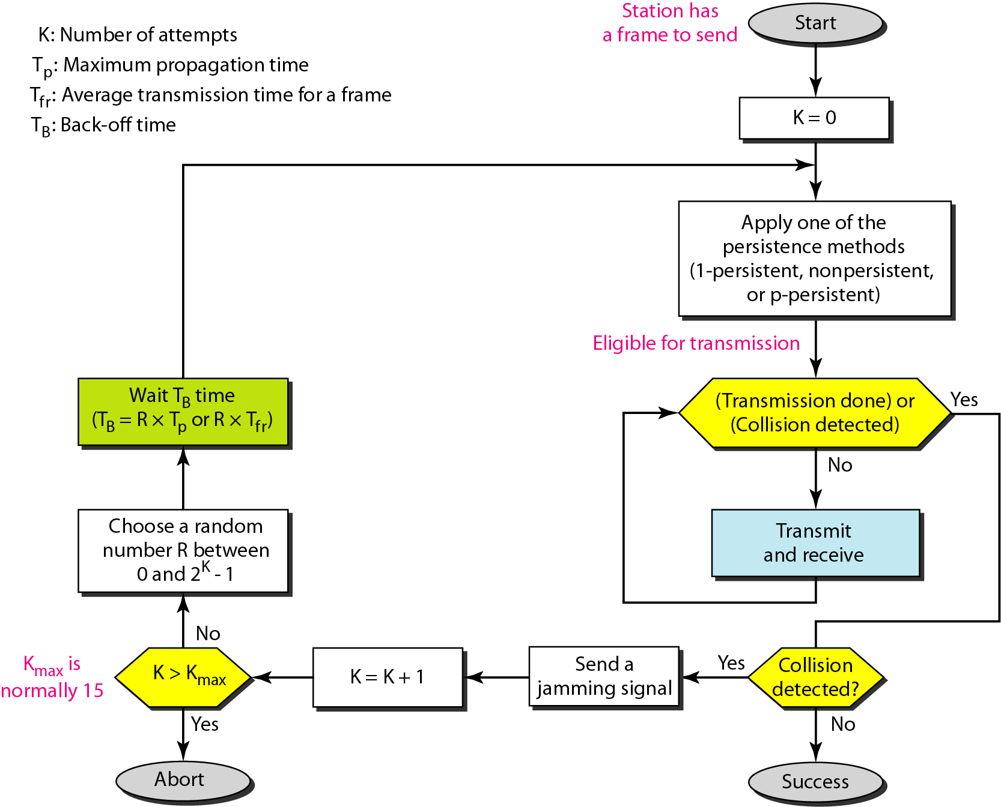
Figure 12.14 Flow diagram for the CSMA/CD

Slide 33
Difference between ALOHA & CSMA/CD
The first difference is the addition of the persistence process. We need to sense the channel before we start sending the frame by using one of the persistence processes we discussed previously (nonpersistent, 1-persistent, or p-persistent).
The second difference is the frame transmission. In ALOHA, we first transmit the entire frame and then wait for an acknowledgment. In CSMA/CD, transmission and collision detection are continuous processes.
The third difference is the sending of a short jamming signal to make sure that all other stations become aware of the collision.

Slide 34
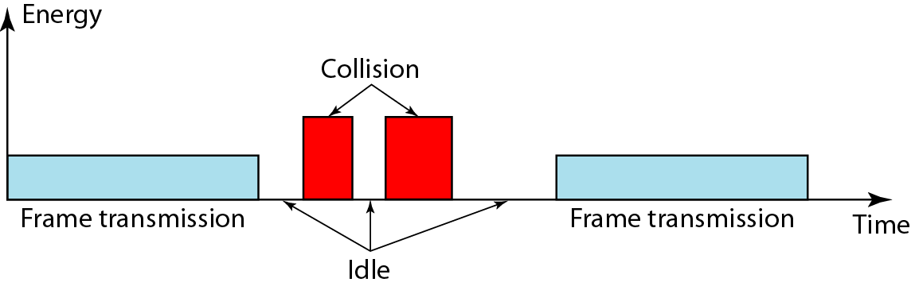
Figure 12.15 Energy level during transmission, idleness, or collision
Energy Level
We can say that the level of energy in a channel can have three values: zero, normal, and abnormal.
At the zero level, the channel is idle.
At the normal level, a station has successfully captured the channel and is sending its frame.
At the abnormal level, there is a collision and the level of the energy is twice the normal level.

Slide 35
CSMA/CA
Carrier sense multiple access with collision avoidance (CSMA/CA) was invented for wireless networks. Collisions are avoided through the use of CSMA/CA’s three strategies: the interframe space, the contention window, and acknowledgments, as shown in Figure 12.15.
Interframe Space (IFS)
First, collisions are avoided by deferring transmission even if the channel is found idle.
When an idle channel is found, the station does not send immediately. It waits for a period of time called the interframe space or IFS.
Even though the channel may appear idle when it is sensed, a distant station may have already started transmitting. The distant station’s signal has not yet reached this station.
The IFS time allows the front of the transmitted signal by the distant station to reach this station.
After waiting an IFS time, if the channel is still idle, the station can send, but it still needs to wait a time equal to the contention window (described next).
The IFS variable can also be used to prioritize stations or frame types. For example, a station that is assigned a shorter IFS has a higher priority.

Slide 36
Contention Window
The contention window is an amount of time divided into slots.
A station that is ready to send chooses a random number of slots as its wait time. The number of slots in the window changes according to the binary exponential backoff strategy.
This means that it is set to one slot the first time and then doubles each time the station cannot detect an idle channel after the IFS time.
This is very similar to the p-persistent method except that a random outcome defines the number of slots taken by the waiting station.
One interesting point about the contention window is that the station needs to sense the channel after each time slot. However, if the station finds the channel busy, it does not restart the process; it just stops the timer and restarts it when the channel is sensed as idle.
This gives priority to the station with the longest waiting time. See Figure 12.16.

Slide 37
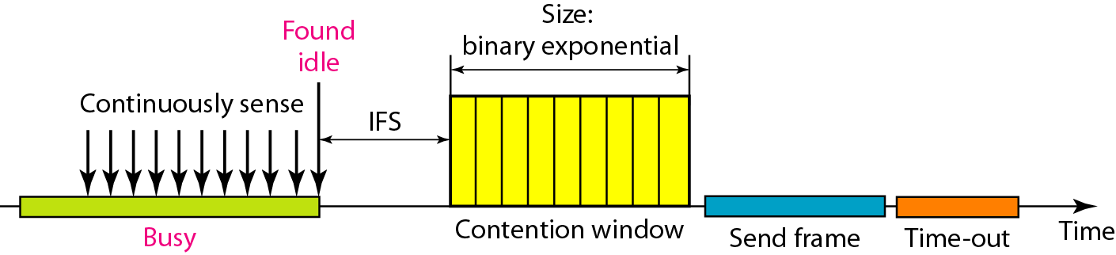
Figure 12.16 Timing in CSMA/CA

Slide 38
Frame Exchange Time Line
Figure 12.17 shows the exchange of data and control frames in time.
1. Before sending a frame, the source station senses the medium by checking the energy level at the carrier frequency.
a. The channel uses a persistence strategy with backoff until the channel is idle.
b. After the station is found to be idle, the station waits for a period of time called the DCF interframe space (DIFS); then the station sends a control frame called the request to send (RTS).
2. After receiving the RTS and waiting a period of time called the short interframe space (SIFS), the destination station sends a control frame, called the clear to send (CTS), to the source station. This control frame indicates that the destination station is ready to receive data.
3. The source station sends data after waiting an amount of time equal to SIFS.
4. The destination station, after waiting an amount of time equal to SIFS, sends an acknowledgment to show that the frame has been received. Acknowledgment is needed in this protocol because the station does not have any means to check for the successful arrival of its data at the destination. On the other hand, the lack of collision in CSMA/CD is a kind of indication to the source that data have arrived.

Slide 39
Network Allocation Vector
How do other stations defer sending their data if one station acquires access? In other words, how is the collision avoidance aspect of this protocol accomplished? The key is a feature called NAV.
When a station sends an RTS frame, it includes the duration of time that it needs to occupy the channel.
The stations that are affected by this transmission create a timer called a network allocation vector (NAV) that shows how much time must pass before these stations are allowed to check the channel for idleness.
Each time a station accesses the system and sends an RTS frame, other stations start their NAV.
In other words, each station, before sensing the physical medium to see if it is idle, first checks its NAV to see if it has expired. Figure 12.17 shows the idea of NAV.

Slide 40
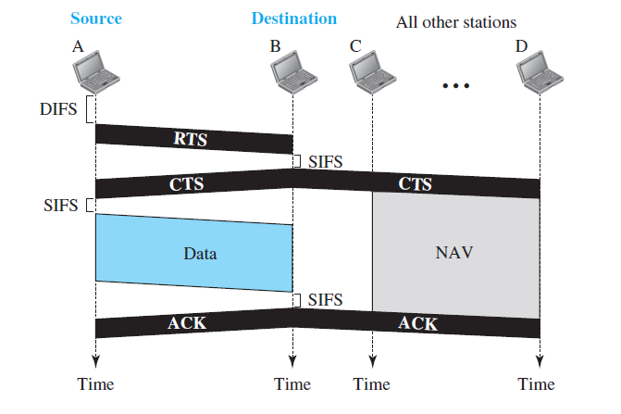
Figure 12.17 Frame Exchange in CSMA/CA

Slide 41
Note
In CSMA/CA, the IFS can also be used to define the priority of a station or a frame.

Slide 42
Note
In CSMA/CA, if the station finds the channel busy, it does not restart the timer of the contention window;
it stops the timer and restarts it when the channel becomes idle.

Slide 43
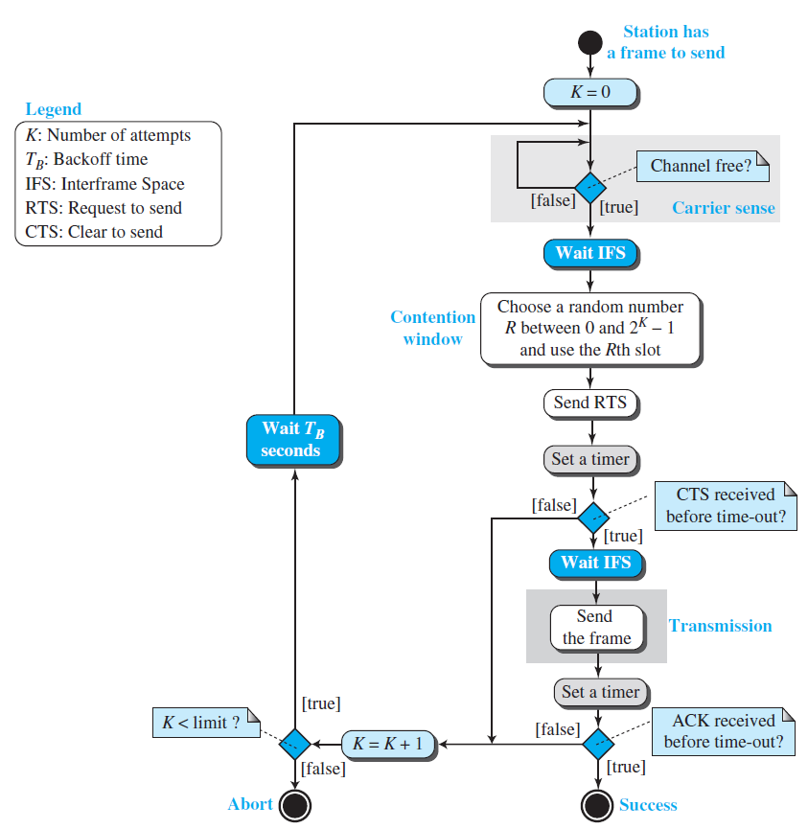
Figure 12.17 Flow diagram for CSMA/CA

Slide 44
CONTROLLED ACCESS
In controlled access, the stations consult one another to find which station has the right to send. A station cannot send unless it has been authorized by other stations. We discuss three popular controlled-access methods.
Reservation
Polling
Token Passing

Slide 45
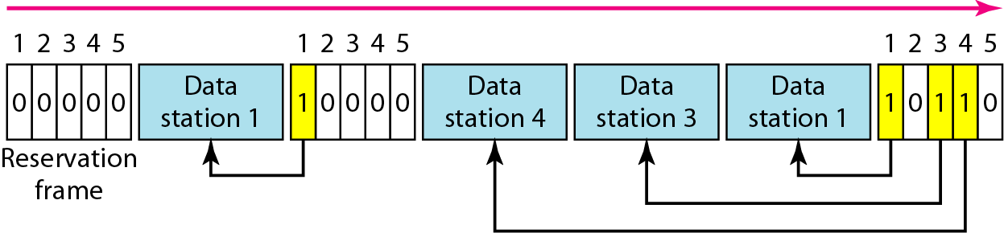
Figure 12.18 Reservation access method

Slide 46
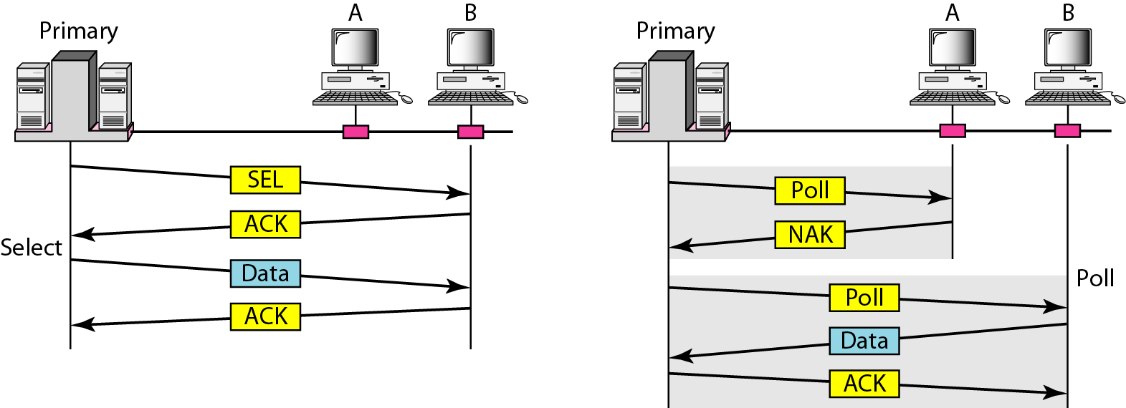
Figure 12.19 Select and poll functions in polling access method

Slide 47
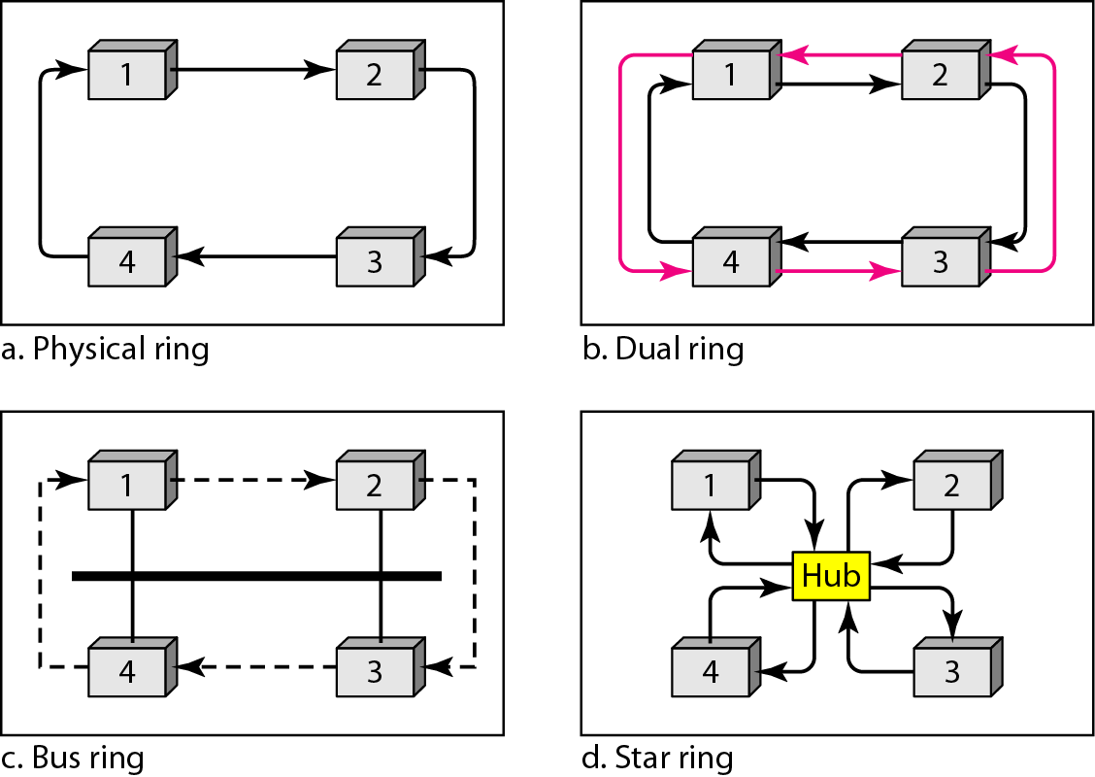
Figure 12.20 Logical ring and physical topology in token-passing access method

Slide 48
CHANNELIZATION
Channelization is a multiple-access method in which the available bandwidth of a link is shared in time, frequency, or through code, between different stations. In this section, we discuss three channelization protocols.

Slide 49
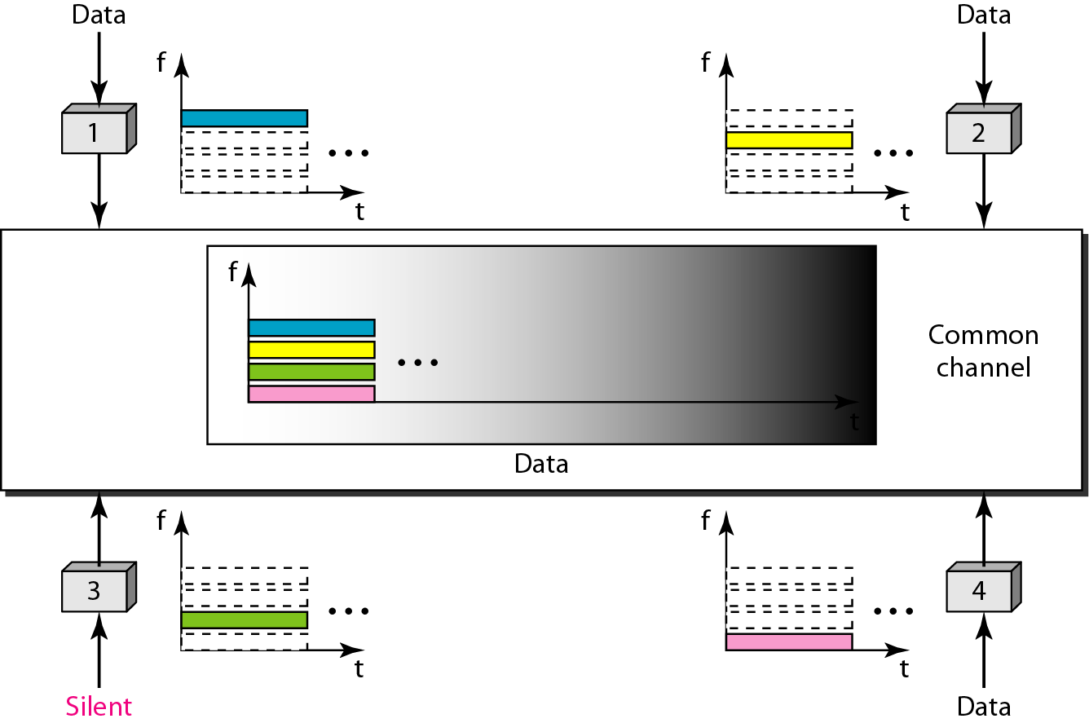
Figure 12.21 Frequency-division multiple access (FDMA)

Slide 50
Note
In FDMA, the available bandwidth of the common channel is divided into bands that are separated by guard bands.

Slide 51
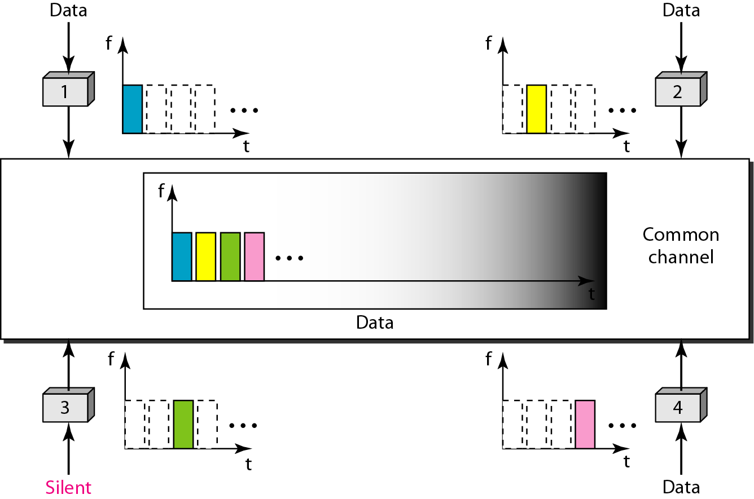
Figure 12.22 Time-division multiple access (TDMA)

Slide 52
Note
In TDMA, the bandwidth is just one channel that is timeshared between different stations.

Slide 53
Note
In CDMA, one channel carries all transmissions simultaneously.

Slide 54
Basic idea behind CDMA
Let us assume we have four stations, 1, 2, 3, and 4, connected to the same channel. The data from station 1 are d1, from station 2 are d2, and so on. The code assigned to the first station is c1, to the second is c2, and so on. We assume that the assigned codes have two properties.
1. If we multiply each code by another, we get 0.
2. If we multiply each code by itself, we get 4 (the number of stations).
With these two properties in mind, let us see how the above four stations can send data using the same common channel, as shown in Figure 12.23.
Station 1 multiplies (a special kind of multiplication, as we will see) its data by its code to get d1 ⋅ c1, station 2 multiplies its data by its code to get d2 ⋅ c2, and so on.
The data that go on the channel are the sum of all these terms, as shown in the box.
Any station that wants to receive data from one of the other three multiplies the data on the channel by the code of the sender.
For example, suppose stations 1 and 2 are talking to each other. Station 2 wants to hear what station 1 is saying. It multiplies the data on the channel by c1, the code of station 1. Because (c1 ⋅ c1) is 4, but (c2 ⋅ c1), (c3 ⋅ c1), and (c4 ⋅ c1) are all 0s, station 2 divides the result by 4 to get the data from station 1.

Slide 55
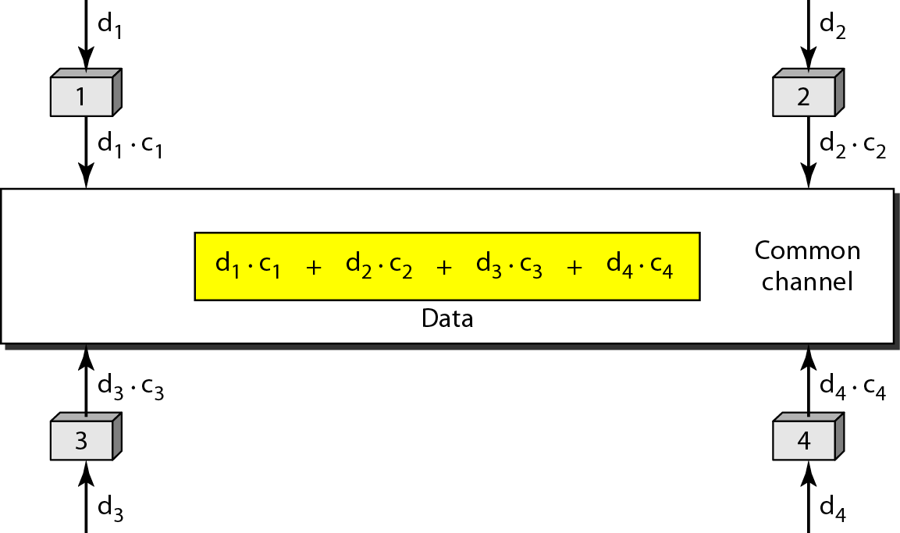
Figure 12.23 Simple idea of communication with code
data = (d1 ⋅ c1 + d2 ⋅ c2 + d3 ⋅ c3 + d4 ⋅ c4) ⋅ c1
= d1 ⋅ c1 ⋅ c1 + d2 ⋅ c2 ⋅ c1 + d3 ⋅ c3 ⋅ c1 + d4 ⋅ c4 ⋅ c1 = 4 × d1

Slide 56
Figure 12.24 Chip sequences
Each station is assigned a code, which is a sequence of numbers called chips, as shown in Figure 12.24. The codes are for the previous example.

Slide 57
Properties of orthogonal sequences
They are called orthogonal sequences and have the following properties:
1. Each sequence is made of N elements, where N is the number of stations.
2. If we multiply a sequence by a number, every element in the sequence is multiplied by that element. This is called multiplication of a sequence by a scalar.
For example, 2 • [+1 +1 −1 −1] = [+2 +2 −2 −2]
3. If we multiply two equal sequences, element by element, and add the results, we get N, where N is the number of elements in each sequence. This is called the inner product of two equal sequences. For example, [+1 +1 −1 −1] • [+1 +1 −1 −1] = 1 + 1 + 1 + 1 = 4
4. If we multiply two different sequences, element by element, and add the results, we get 0. This is called the inner product of two different sequences. For example, Figure 12.23 Simple idea of communication with code [+1 +1 −1 −1] • [+1 +1 +1 +1] = 1 + 1 − 1 − 1 = 0
5. Adding two sequences means adding the corresponding elements. The result is another sequence. For example, [+1 +1 −1 −1] + [+1 +1 +1 +1] = [+2 +2 0 0]

Slide 58
Figure 12.25 Data representation in CDMA
Data Representation:
We follow these rules for encoding:
If a station needs to send a 0 bit, it encodes it as −1; if it needs to send a 1 bit, it encodes it as +1. When a station is idle, it sends no signal, which is interpreted as a 0.

Slide 59
Encoding and Decoding
As a simple example, we show how four stations share the link during a 1-bit interval.
The procedure can easily be repeated for additional intervals. We assume that stations 1 and 2 are sending a 0 bit and channel 4 is sending a 1 bit. Station 3 is silent.
The data at the sender site are translated to −1, −1, 0, and +1. Each station multiplies the corresponding number by its chip (its orthogonal sequence), which is unique for each station.
The result is a new sequence which is sent to the channel. For simplicity, we assume that all stations send the resulting sequences at the same time.
The sequence on the channel is the sum of all four sequences as defined before. Figure 12.26 shows the situation.
Now imagine that station 3, which we said is silent, is listening to station 2. Station 3 multiplies the total data on the channel by the code for station 2, which is [+1 −1 +1 −1], to get:
[−1 −1 −3 +1] • [+1 −1 +1 −1] = −4/4 = −1 → bit 1

Slide 60
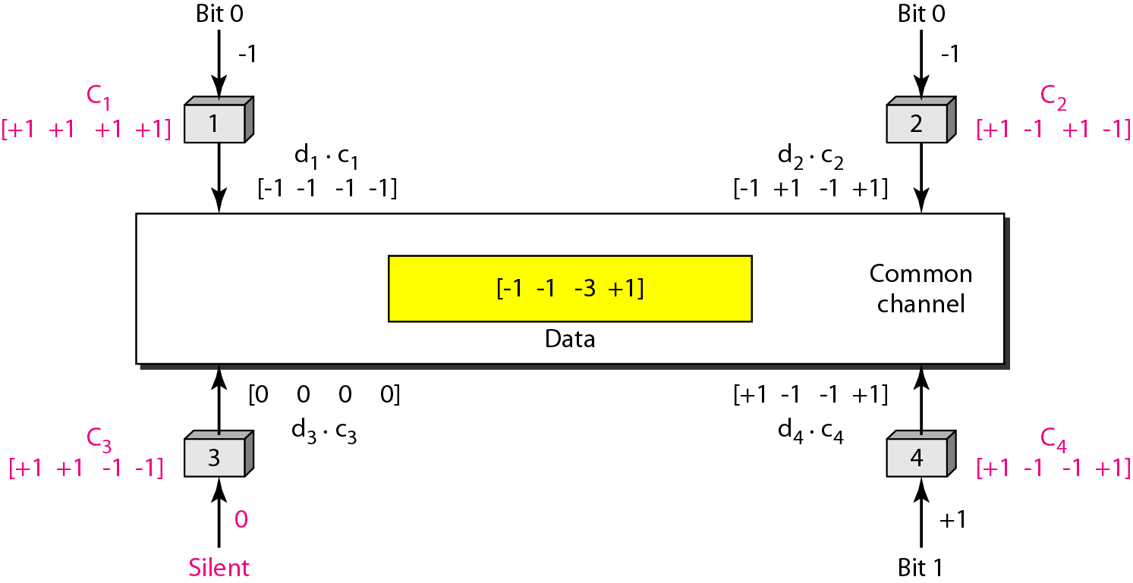
Figure 12.26 Sharing channel in CDMA

Slide 61
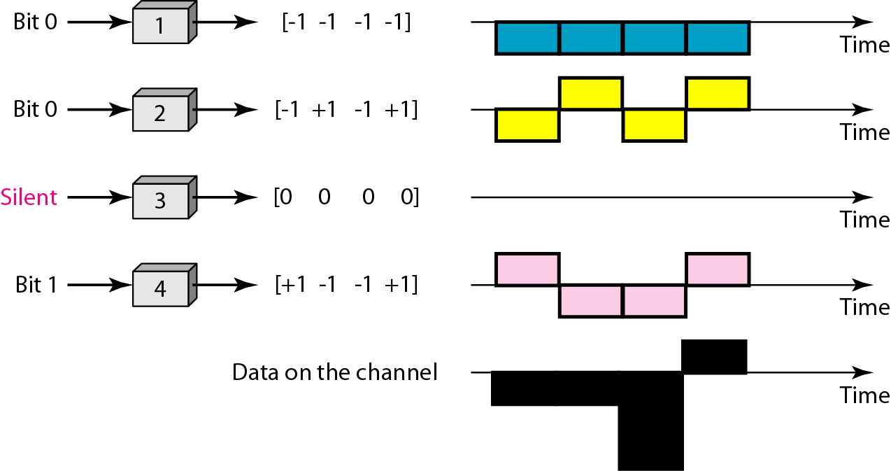
Figure 12.27 Digital signal created by four stations in CDMA

Slide 62
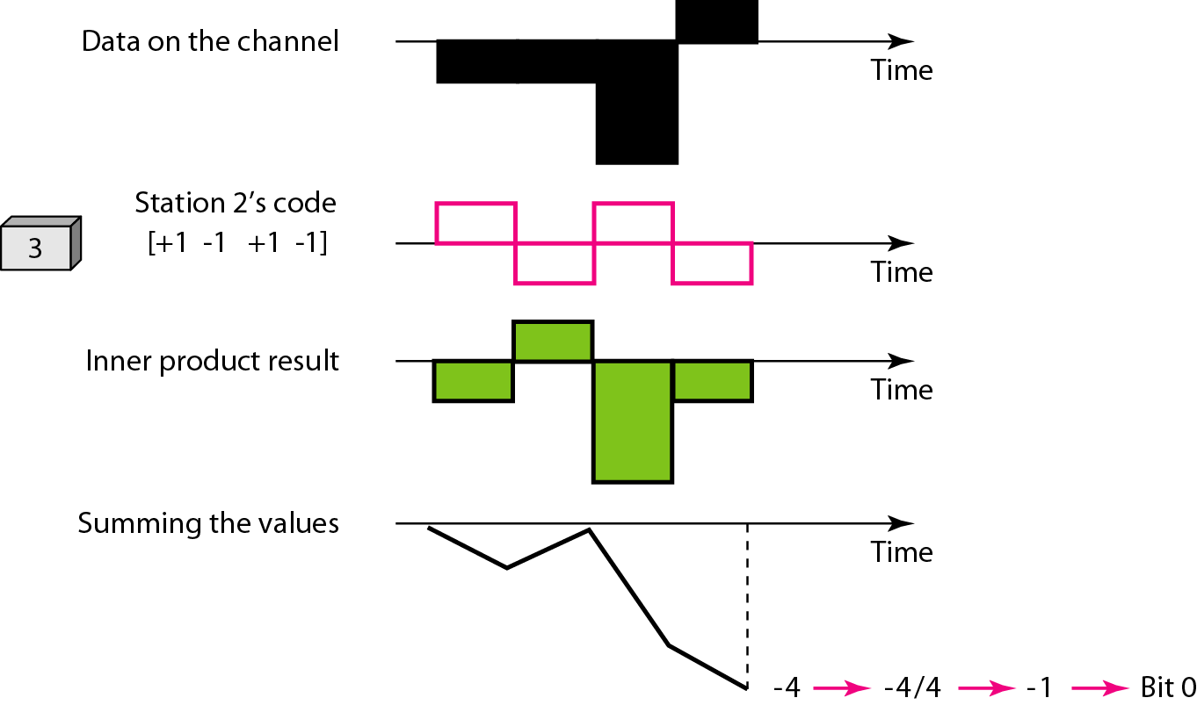
Figure 12.28 Decoding of the composite signal for one in CDMA

Slide 63
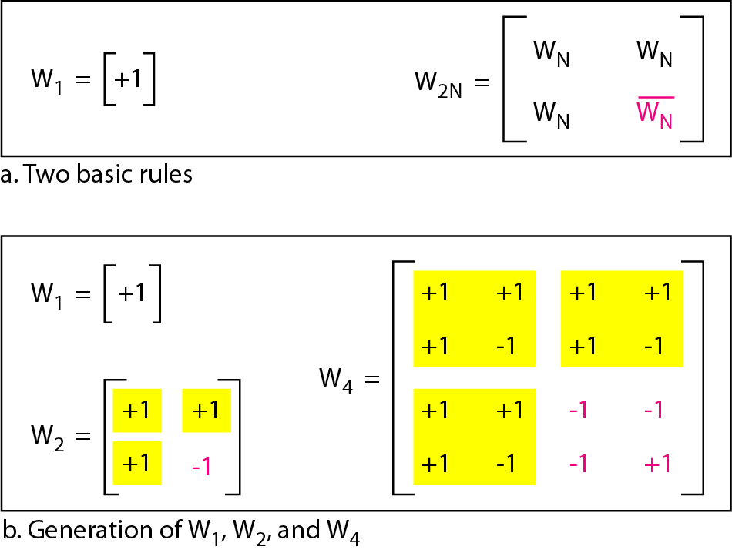
Figure 12.29 General rule and examples of creating Walsh tables

Slide 64
Note
The number of sequences in a Walsh table needs to be N = 2^{m}.

Slide 65
Example 12.6
Find the chips for a network with
a. Two stations b. Four stations
Solution
We can use the rows of W2 and W4 in Figure 12.29:
a. For a two-station network, we have [+1 +1] and [+1 −1].
b. For a four-station network we have [+1 +1 +1 +1], [+1 −1 +1 −1], [+1 +1 −1 −1], and [+1 −1 −1 +1].

Slide 66
Example 12.7
What is the number of sequences if we have 90 stations in our network?
Solution
The number of sequences needs to be 2^{m}.
We need to choose m = 7 and N = 2⁷ or 128.
We can then use 90 of the sequences as the chips.

Slide 67
Example 12.8
Prove that a receiving station can get the data sent by a specific sender if it multiplies the entire data on the channel by the sender’s chip code and then divides it by the number of stations.
Solution
Let us prove this for the first station, using our previous four-station example.
We can say that the data on the channel D = (d1 ⋅ c1 + d2 ⋅ c2 + d3 ⋅ c3 + d4 ⋅ c4). The receiver which wants to get the data sent by station 1 multiplies these data by c1.

Slide 68
Example 12.8 (continued)
When we divide the result by N, we get d1 .

Slide 69
What have we completed?
Thank You
ALOHA
Carrier Sense Multiple Access
Carrier Sense Multiple Access with Collision Detection
Carrier Sense Multiple Access with Collision Avoidance
Frequency-Division Multiple Access (FDMA)
Time-Division Multiple Access (TDMA)
Code-Division Multiple Access (CDMA)

