Slide 1
OSI Reference model
By dr. R. K. Ojha
Lecture-02
Chapter 02

Slide 2
Topics to be discussed
Layered Tasks
The OSI model
Layers of the OSI model
Summery of the layers

Slide 3

LAYERED TASKS
We use the concept of layers in our daily life.
As an example, let us consider two friends who communicate through postal mail.
The process of sending a letter to a friend would be complex if there were no services available from the post office.

Slide 4
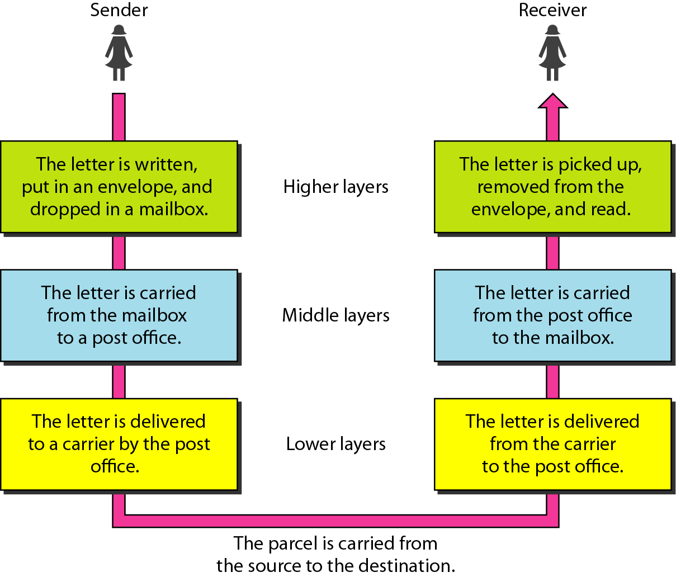
Tasks involved in sending a letter

Slide 5

THE OSI MODEL
Established in 1947, the International Standards Organization (ISO) is a multinational body dedicated to worldwide agreement on international standards. An ISO standard that covers all aspects of network communications is the Open Systems Interconnection (OSI) model. It was first introduced in the late 1970s.
Let’s understand through an animation
https://www.youtube.com/watch?v=Q3WpcO6vtQ8

Slide 6
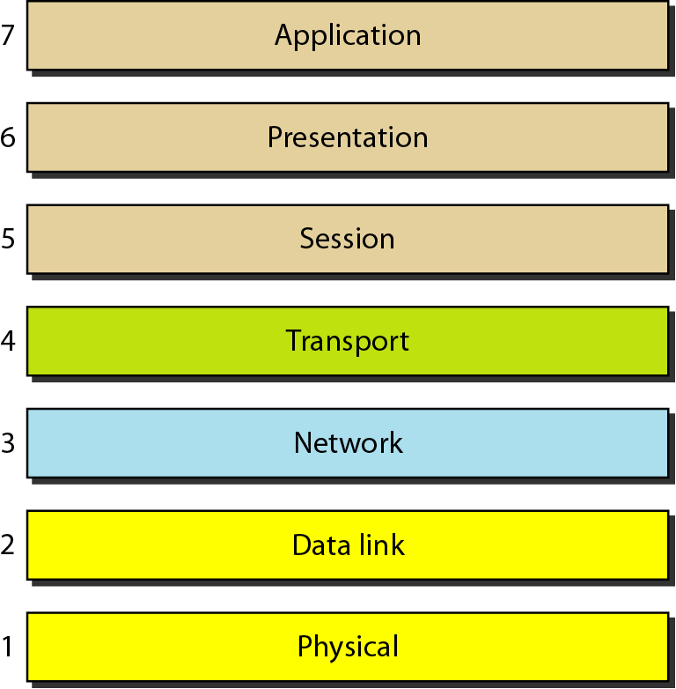
Seven layers of the OSI model

Slide 7
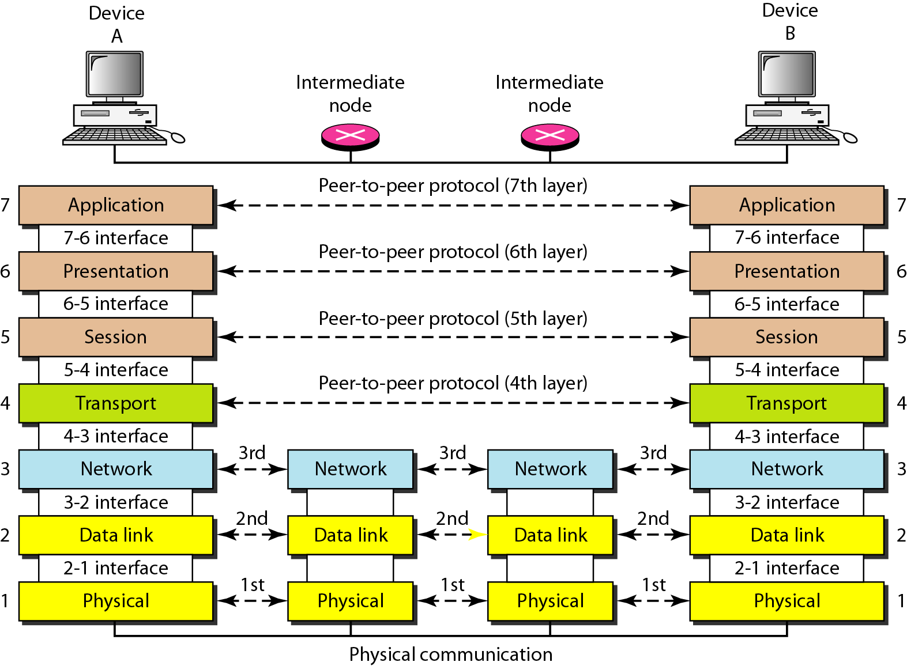
The interaction between layers in the OSI model

Slide 8
The first 3 layers i.e. physical, data link, and network are the network support layers; they deal with the physical aspects of moving data from one device to another (such as electrical specifications, physical connections, physical addressing, and transport timing and reliability).
Layers 5, 6, and 7 i.e. session, presentation, and application can be thought of as the user support layers; they allow interoperability among unrelated software systems. Layer 4, the transport layer, links the two subgroups and ensures that what the lower layers have transmitted is in a form that the upper layers can use.
The upper OSI layers are almost always implemented in software; lower layers are a combination of hardware and software, except for the physical layer, which is mostly hardware.

Slide 9
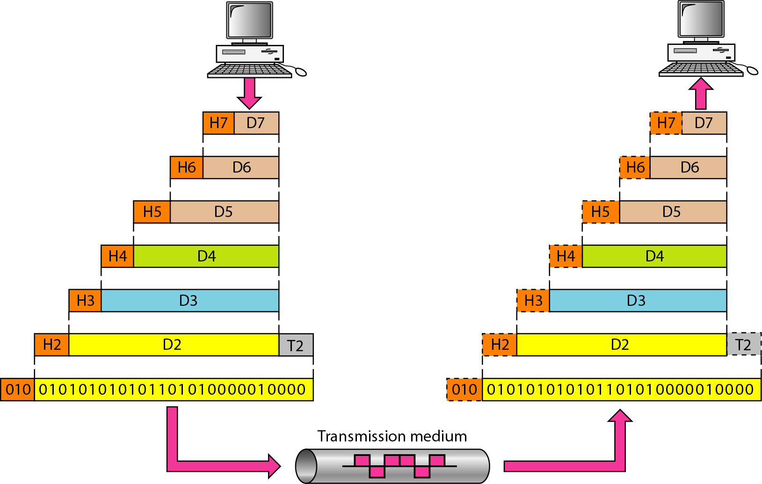
An exchange using the OSI model

Slide 10
The communication process starts at layer 7 (the application layer), then moves from layer to layer in descending, sequential order. At each layer, a header, or possibly a trailer, can be added to the data unit.
Commonly, the trailer is added only at layer 2. When the formatted data unit passes through the physical layer (layer 1), it is changed into an electromagnetic signal and transported along a physical link.
As each block of data reaches the next higher layer, the headers and trailers attached to it at the corresponding sending layer are removed, and actions appropriate to that layer are taken.
level N - 1 is not aware of which part of the encapsulated packet is data and which part is the header or trailer. For level N - 1, the whole packet coming from level N is treated as one integral unit.

Slide 11
LAYERS IN THE OSI MODEL

Slide 12
Physical Layer
Data Link Layer
Network Layer
Transport Layer
Session Layer
Presentation Layer
Application Layer
7
6
5
4
3
2
1

Slide 13
Physical layer: functionalities
Physical characteristics of interfaces and medium: The physical layer defines the characteristics of the interface between the devices and the transmission medium.
Representation of bits: The physical layer defines the type of encoding (how 0s and 1s are changed to signals).
Data rate: The transmission rate i.e. the number of bits sent each second (i.e. the duration of a bit/ is how long it lasts)is also defined by the physical layer.
Synchronization of bits: The sender and receiver not only must use the same bit rate but also must be synchronized at the bit level. In other words, the sender and the receiver clocks must be synchronized.

Slide 14
Physical layer: functionalities . . .
Line configuration: The physical layer is concerned with the connection of devices to the media (i.e. point-to-point / multi-point).
Physical topology: The physical topology defines how devices are connected to make a network.
Transmission mode: The physical layer also defines the direction of transmission between two devices: simplex, half-duplex, or full-duplex.

Slide 15
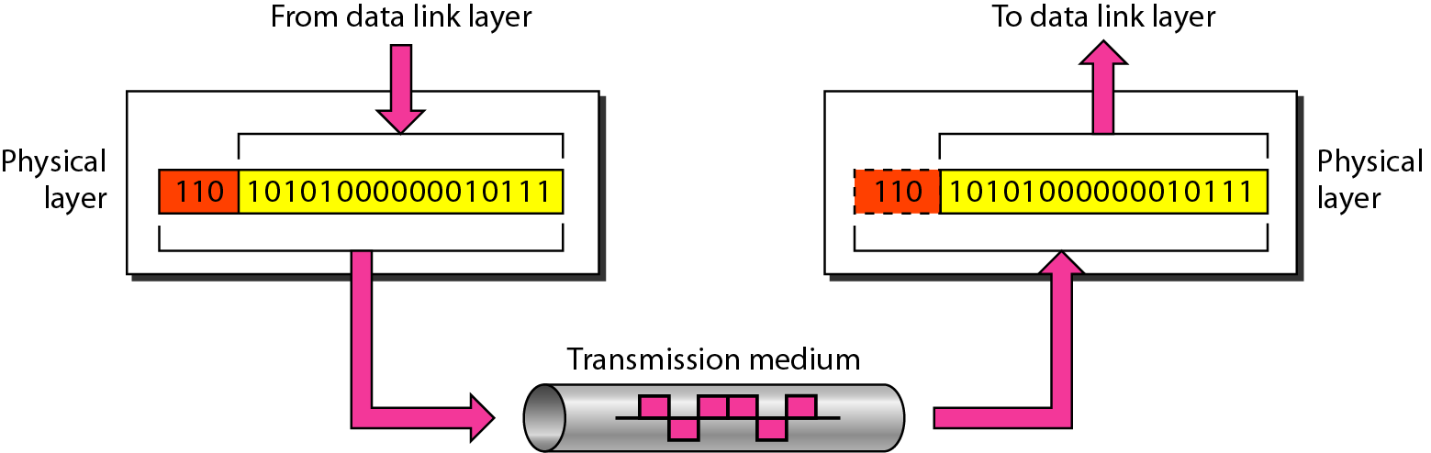
Physical layer

Slide 16
Physical Layer
Data Link Layer
Network Layer
Transport Layer
Session Layer
Presentation Layer
Application Layer
7
6
5
4
3
2
1

Slide 17
Datalink layer: functionalities
Framing: The data link layer divides the stream of bits received from the network layer into frames.
Physical addressing: The data link layer adds a header to the frame to define the sender and/or receiver of the frame.
Flow control: If the rate at which the data are absorbed by the receiver is less than the rate at which data are produced in the sender, the data link layer imposes a flow control mechanism to avoid overwhelming the receiver.
Error control: The data link layer adds reliability to the physical layer by adding mechanisms to detect and retransmit damaged or lost frames. It also uses a mechanism to recognize duplicate frames. Error control is normally achieved through a trailer added to the end of the frame.
Access control: When two or more devices are connected to the same link, data link layer protocols are necessary to determine which device has control over the link at any given time.

Slide 18
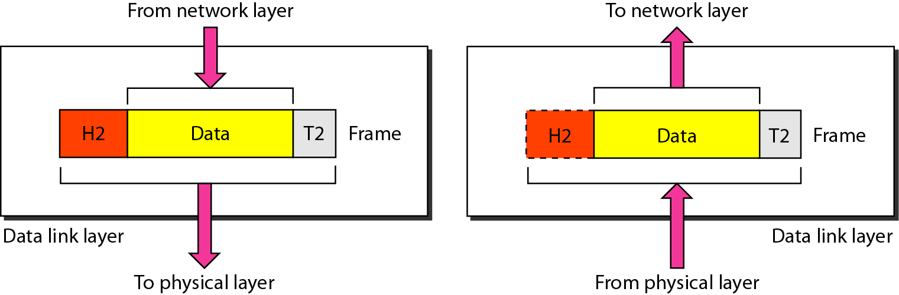
Data link layer

Slide 19
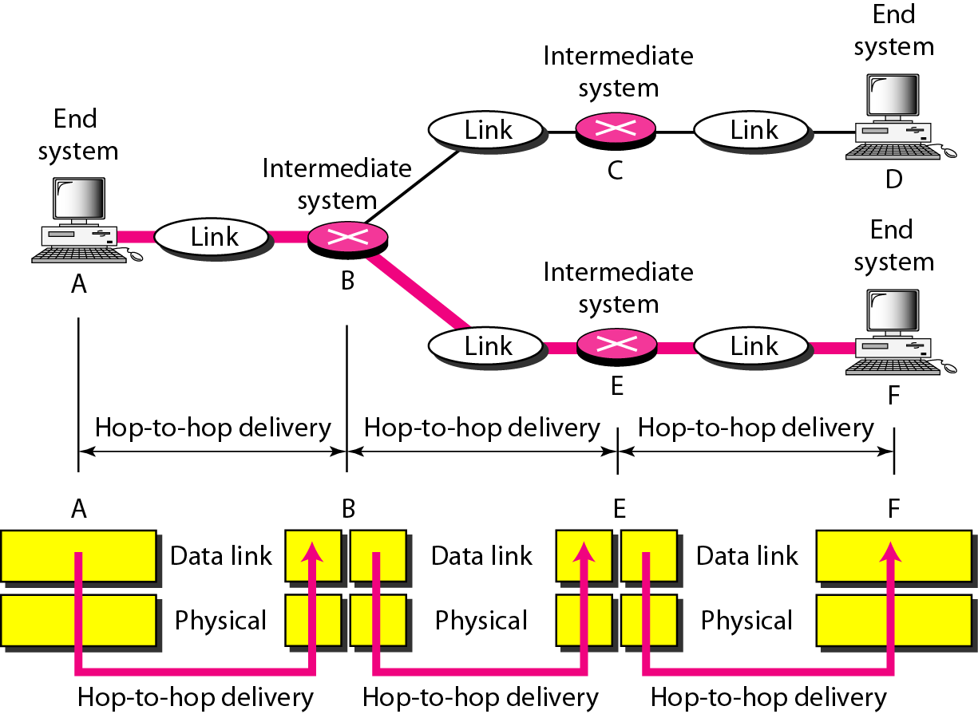
Hop-to-hop delivery

Slide 20
Physical Layer
Data Link Layer
Network Layer
Transport Layer
Session Layer
Presentation Layer
Application Layer
7
6
5
4
3
2
1

Slide 21
Network layer: functionalities
The network layer is responsible for the source-to-destination delivery of a packet, possibly across multiple networks (links).
If two systems are connected to the same link, there is usually no need for a network layer.
Logical addressing: The network layer adds a header to the packet coming from the upper layer that, among other things, includes the logical addresses of the sender and receiver.
Routing: Provides routing mechanism through routers & switches.

Slide 22
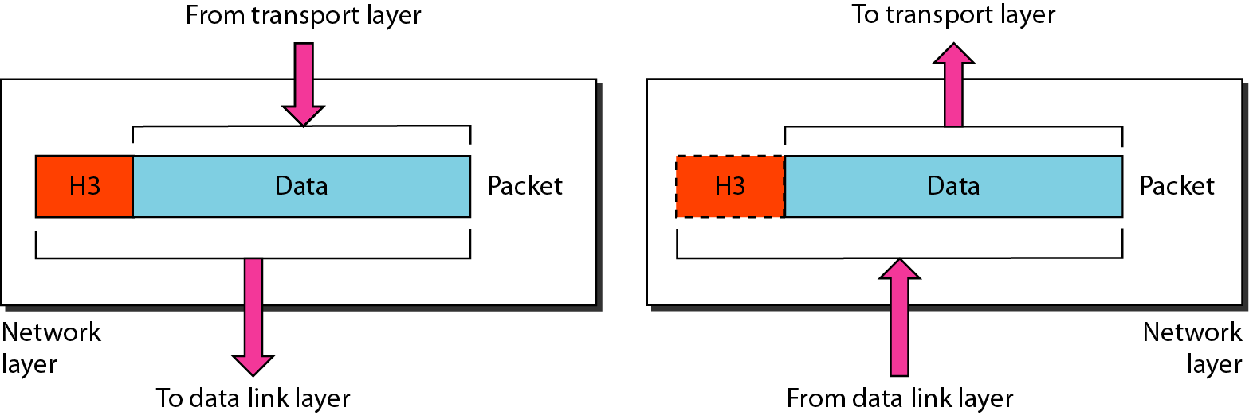
Network layer

Slide 23
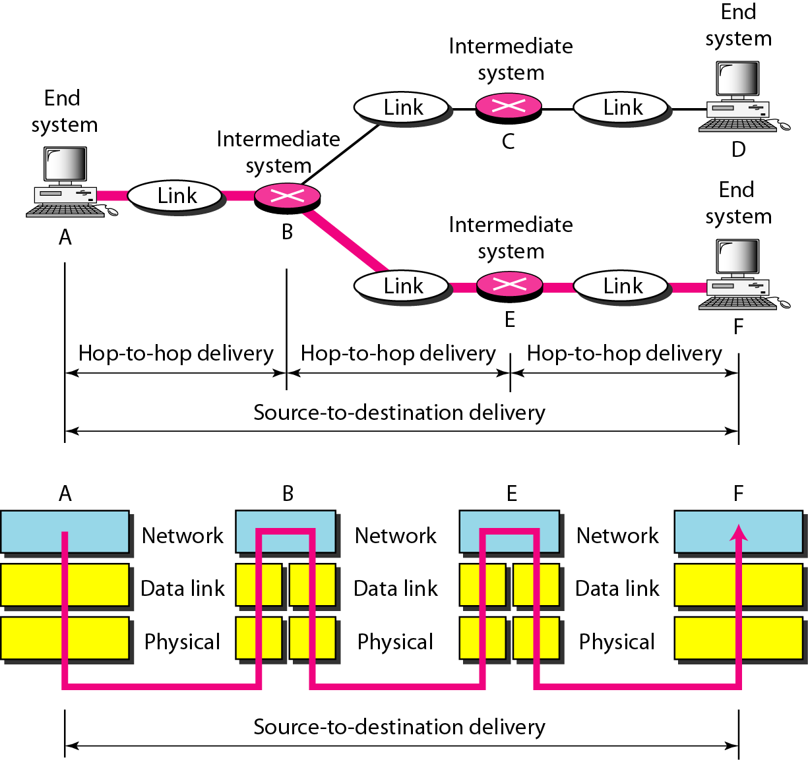
Source-to-destination delivery

Slide 24
Physical Layer
Data Link Layer
Network Layer
Transport Layer
Session Layer
Presentation Layer
Application Layer
7
6
5
4
3
2
1

Slide 25
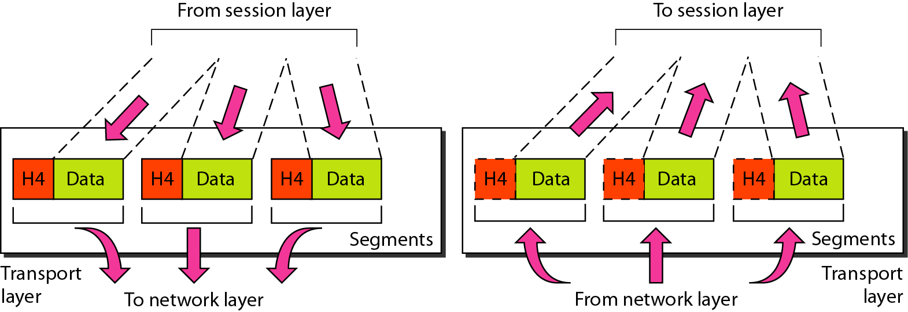
Transport layer

Slide 26
Transport layer: functionalities
Service-point addressing: The transport layer header includes a type of address called a service-point address (or port address). The transport layer gets the entire message to the correct process on that computer.
Segmentation and reassembly: A message is divided into transmittable segments and each segment has a sequence number. These numbers helps to reassemble the message correctly upon arriving at the destination and to identify and replace packets that were lost in transmission.
Connection control: The transport layer can be either connectionless or connection oriented.
Flow control: Like the data link layer, the transport layer is responsible for flow control. However, flow control at this layer is performed end to end rather than across a single link.
Error control: Like the data link layer, the transport layer is responsible for error control. However, error control at this layer is performed process-to process rather than across a single link.

Slide 27
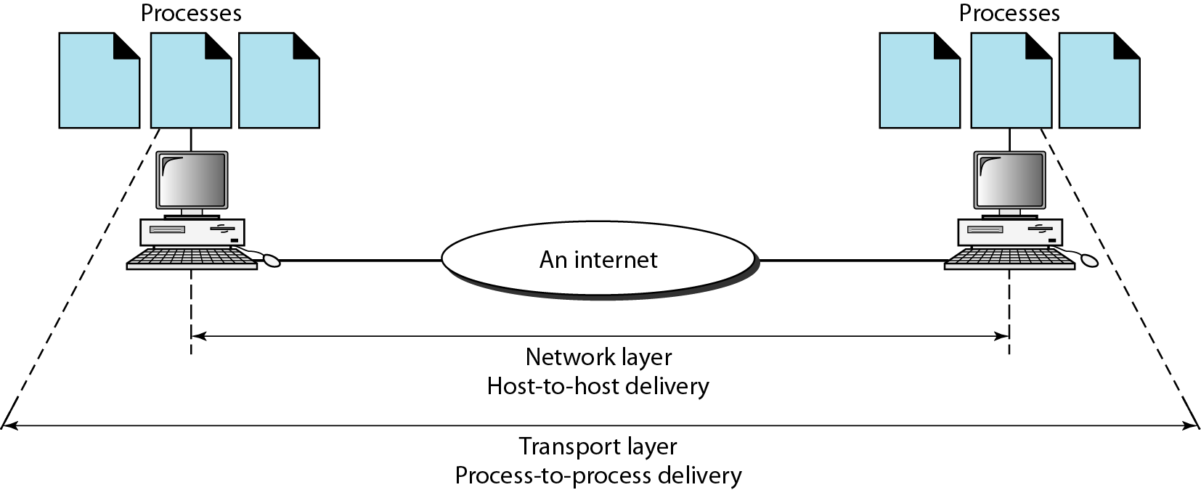
Reliable process-to-process delivery of a message

Slide 28
7
Physical Layer
Data Link Layer
Network Layer
Transport Layer
Session Layer
Presentation Layer
Application Layer
6
5
4
3
2
1

Slide 29
Session Layer: functionalities
Dialog control: The session layer allows two systems to enter into a dialog and allows the communication between two processes to take place in either halfduplex (one way at a time) or full-duplex (two ways at a time) mode.
Synchronization: The session layer allows a process to add checkpoints, or synchronization points, to a stream of data.

Slide 30
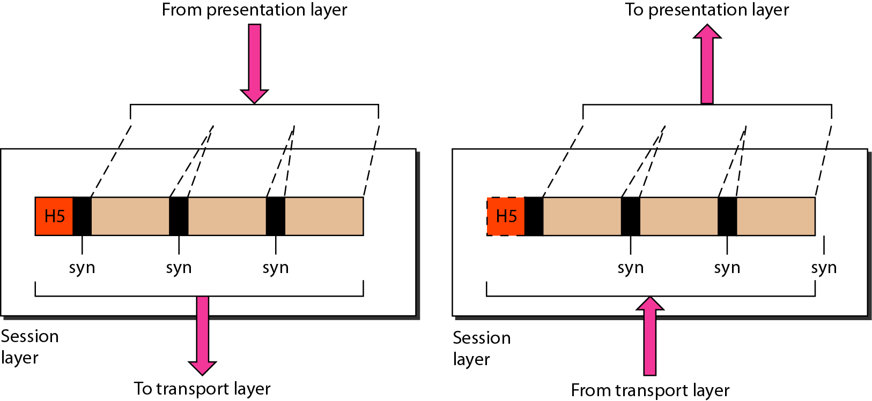
Session layer

Slide 31
7
Physical Layer
Data Link Layer
Network Layer
Transport Layer
Session Layer
Presentation Layer
Application Layer
6
5
4
3
2
1

Slide 32
Presentation Layer : functionalities
Translation: The presentation layer at the sender changes the information from its sender-dependent format into a common format. The presentation layer at the receiving machine changes the common format into its receiver-dependent format.
Encryption: The sender transforms the original information to another form and sends the resulting message out over the network. Decryption reverses the original process to transform the message back to its original form.
Compression: Data compression reduces the number of bits contained in the information which becomes particularly important in the transmission of multimedia such as text, audio, and video.

Slide 33
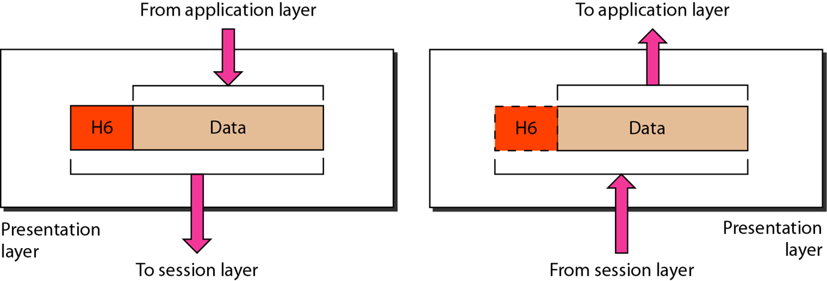
Presentation Layer

Slide 34
7
Physical Layer
Data Link Layer
Network Layer
Transport Layer
Session Layer
Presentation Layer
Application Layer
6
5
4
3
2
1

Slide 35
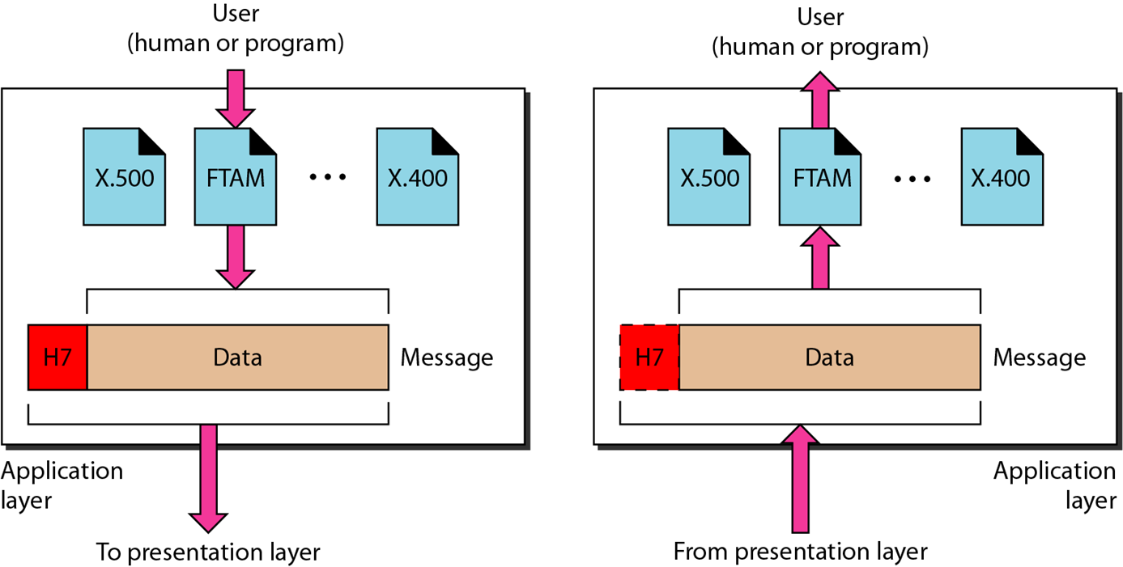
Application layer
Notes:
The application layer enables the user, whether human or software, to access the network.
It provides user interfaces and support for services such as electronic mail, remote file access and transfer, shared database management, and other types of distributed information services.
Of the many application services available, the figure shows only three: XAOO (message-handling services), X.500 (directory services), and file transfer, access, and management (FTAM).
The user in this example employs XAOO to send an e-mail message.

Slide 36
Application layer: functionalities
Network virtual terminal: A network virtual terminal is a software version of a physical terminal, and it allows a user to log on to a remote host.
File transfer, access, and management: This application allows a user to access files in a remote host (to make changes or read data), to retrieve files from a remote computer for use in the local computer, and to manage or control files in a remote computer locally.
Mail services: This application provides the basis for e-mail forwarding and storage.
Directory services: This application provides distributed database sources and access for global information about various objects and services.

Slide 37
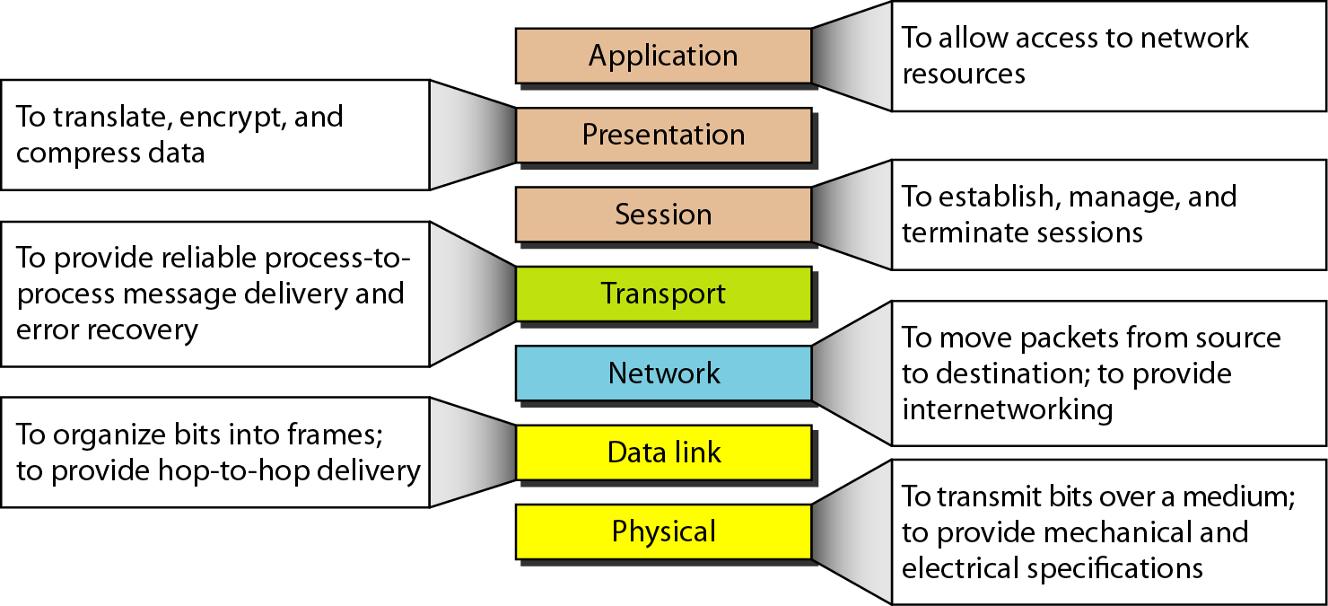
Summary of layers
Let’s conclude with an animation:
https://www.youtube.com/watch?v=-6Uoku-M6oY

Slide 38
What have we completed?
Thank You
Layered Tasks
The OSI model
Layers of the OSI model
Summery of the layers

