Slide 1
Network Layer:
Protocols (IPv4 & IPv6)
By dr. R. K. Ojha
Lecture-30-31
( Chapter 20 )

Slide 2
Topics to be discussed
Need for Network Layer
Internet as a Datagram Network
Internet as a Connectionless Network
IPv4 Datagram
IPv4 Fragmentation
IPv4 Checksum
IPV6 Advantages
IPV6 Packet Format
IPV6 Extension Headers
Transition from IPV4 to IPV6

Slide 3
INTERNETWORKING
In this section, we discuss internetworking, connecting networks together to make an internetwork or an internet.
Topics discussed in this section:
Need for Network Layer Internet as a Datagram Network Internet as a Connectionless Network

Slide 4
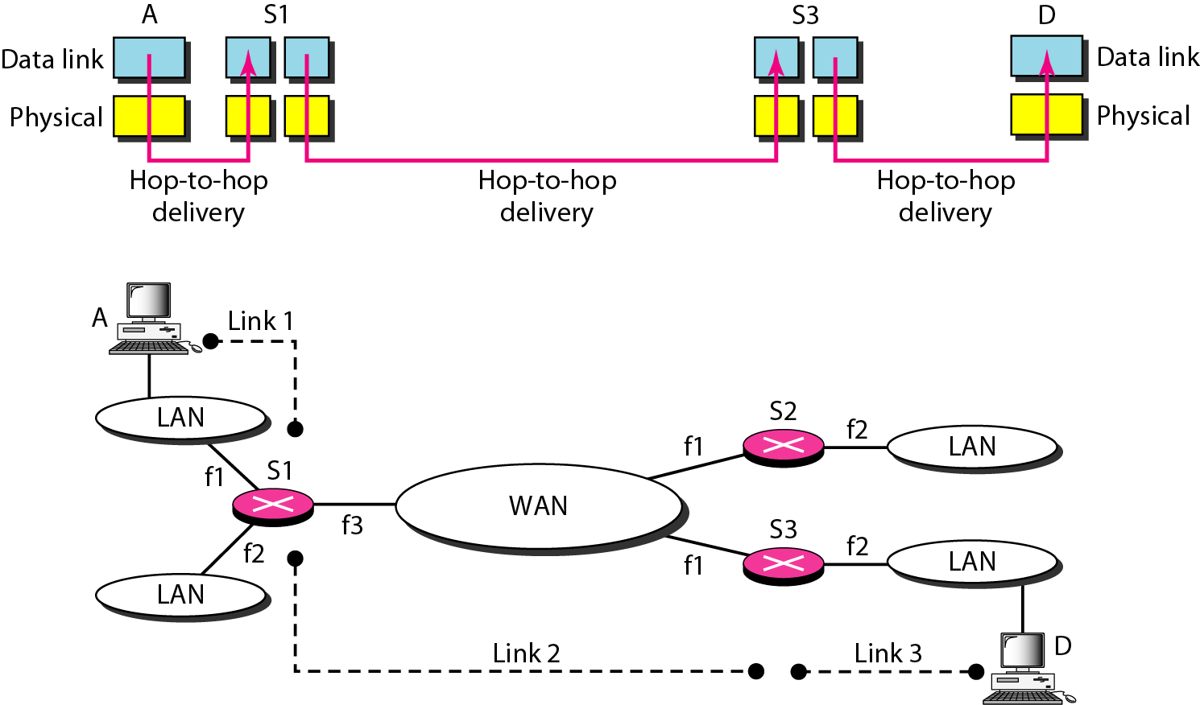
Figure 20.1 Links between two hosts

Slide 5
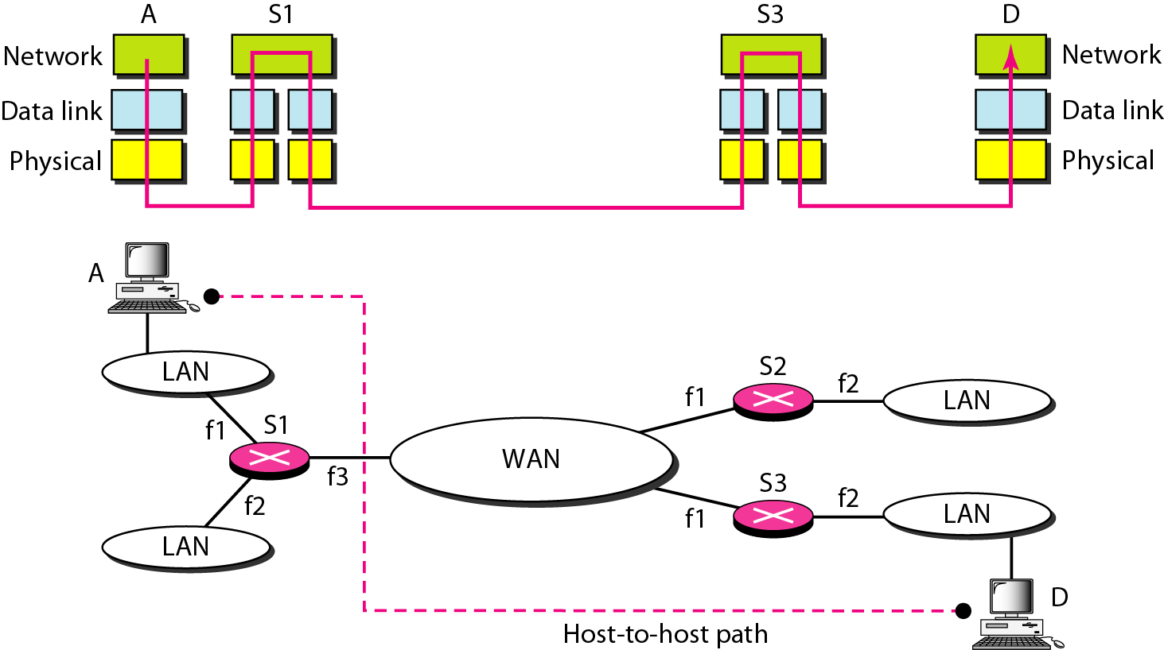
Figure 20.2 Network layer in an internetwork

Slide 6
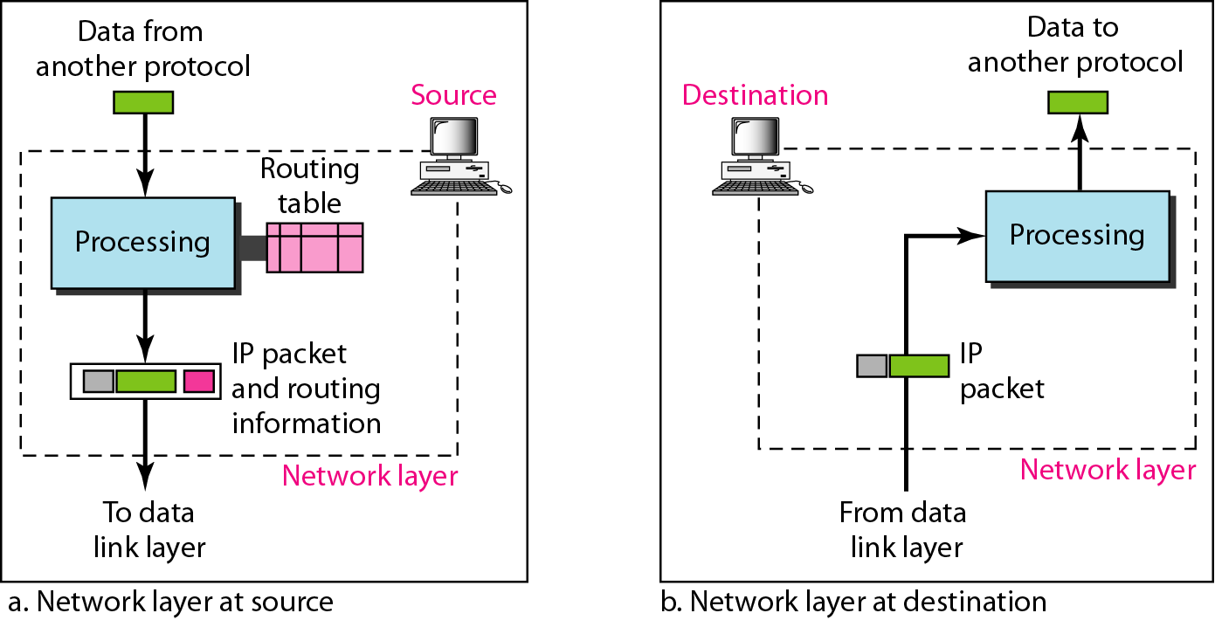
Figure 20.3 Network layer at the source, router, and destination

Slide 7
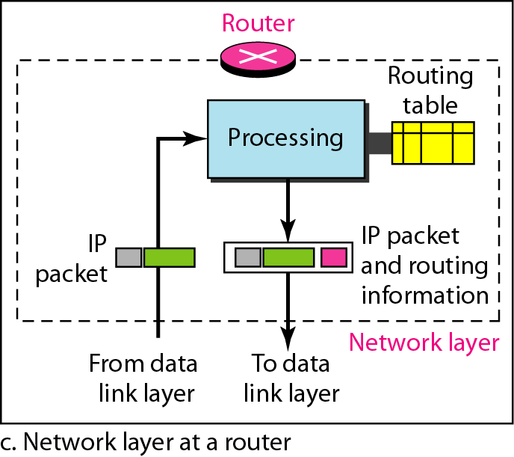
Figure 20.3 Network layer at the source, router, and destination (continued)

Slide 8

Note
Switching at the network layer in the Internet uses the datagram approach to packet switching.

Slide 9
Note
Communication at the network layer in the Internet is connectionless.

Slide 10
IPv4
The Internet Protocol version 4 (IPv4) is the delivery mechanism used by the TCP/IP protocols.
Topics discussed in this section:
Datagram Fragmentation Checksum
Options

Slide 11
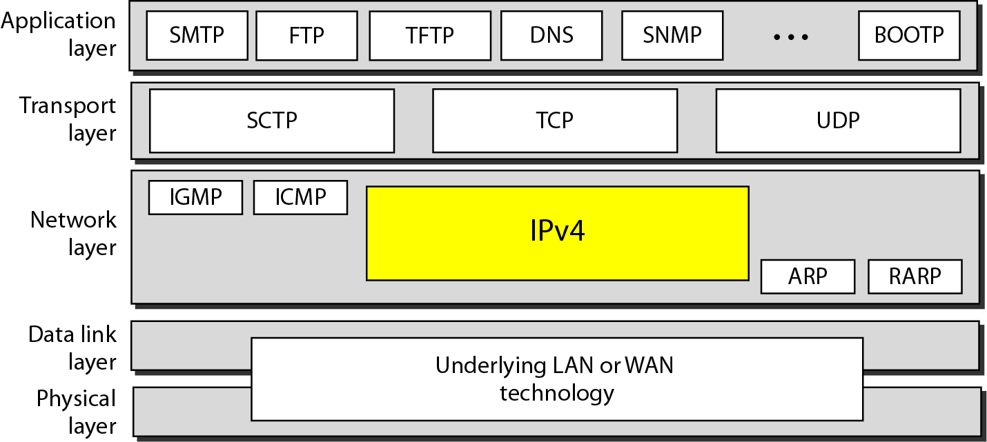
Figure 20.4 Position of IPv4 in TCP/IP protocol suite

Slide 12
The main protocol, Internet Protocol version 4 (IPv4), is responsible for packetizing, forwarding, and delivery of a packet at the network layer.
The Internet Control Message Protocol version 4 (ICMPv4) helps IPv4 to handle some errors that may occur in the network-layer delivery.
The Internet Group Management Protocol (IGMP) is used to help IPv4 in multicasting.
The Address Resolution Protocol (ARP) is used to glue the network and data-link layers in mapping network-layer addresses to link-layer addresses.
IPv4 is an unreliable datagram protocol—a best-effort delivery service. The term best-effort means that IPv4 packets can be corrupted, be lost, arrive out of order, or be delayed, and may create congestion for the network.
If reliability is important, IPv4 must be paired with a reliable transport-layer protocol such as TCP.

Slide 13
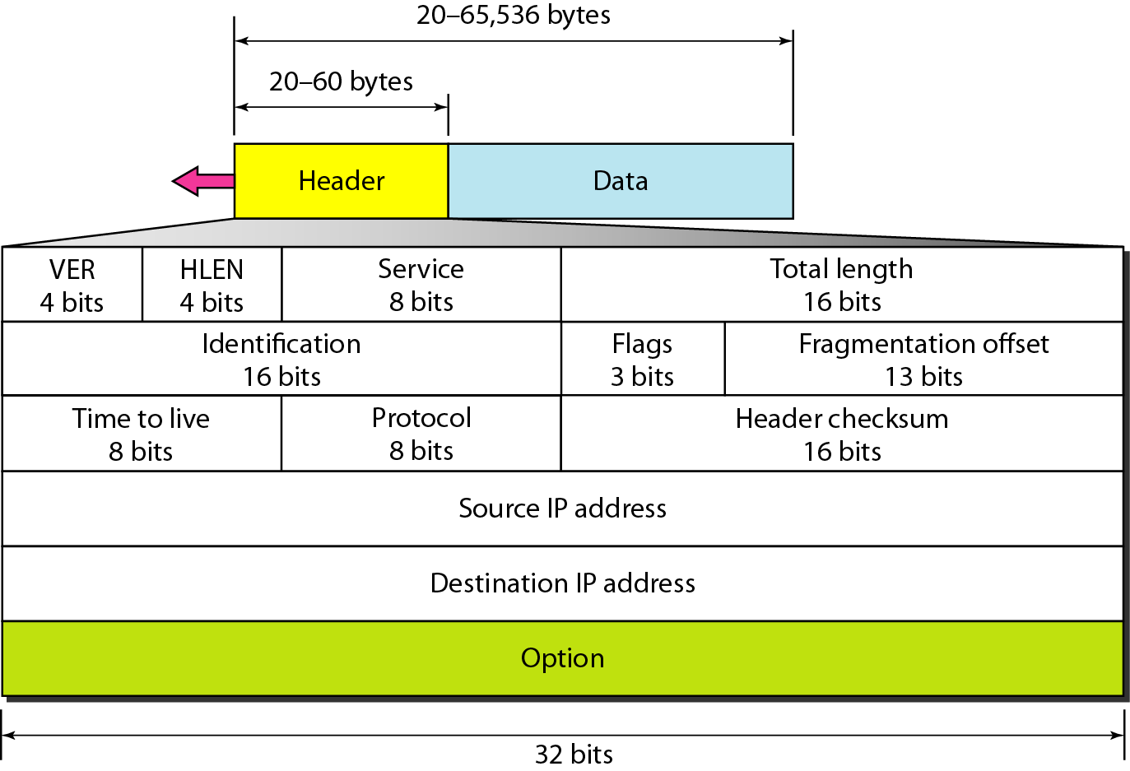
Figure 20.5 IPv4 datagram format

Slide 14
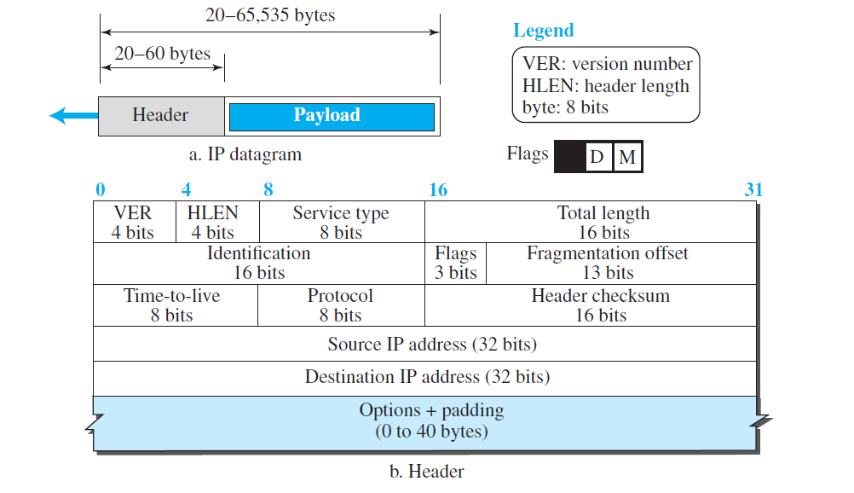

Slide 15
Brief description of each field
Version Number. The 4-bit version number (VER) field defines the version of the IPv4 protocol, which, obviously, has the value of 4.
Header Length. The 4-bit header length (HLEN) field defines the total length of the datagram header in 4-byte words. The IPv4 datagram has a variable-length header. When a device receives a datagram, it needs to know when the header stops and the data, which is encapsulated in the packet, starts. However, to make the value of the header length (number of bytes) fit in a 4-bit header length, the total length of the header is calculated as 4-byte words. The total length is divided by 4 and the value is inserted in the field. The receiver needs to multiply the value of this field by 4 to find the total length.
Service Type. In the original design of the IP header, this field was referred to as type of service (TOS), which defined how the datagram should be handled. In the late 1990s, IETF redefined the field to provide differentiated services (DiffServ). The use of 4-byte words for the length header is also logical because the IP header always needs to be aligned in 4-byte boundaries.

Slide 16
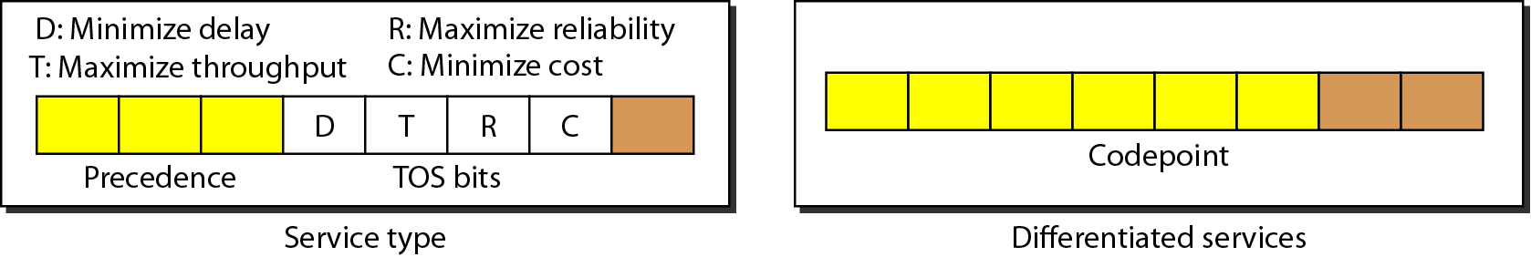
Figure 20.6 Service type or differentiated services

Slide 17
Total Length. This 16-bit field defines the total length (header plus data) of the IP datagram in bytes. A 16-bit number can define a total length of up to 65,535 (when all bits are 1s). However, the size of the datagram is normally much less than this. This field helps the receiving device to know when the packet has completely arrived. To find the length of the data coming from the upper layer, subtract the header length from the total length. The header length can be found by multiplying the value in the HLEN field by 4. Length of data = total length − (HLEN) × 4
Identification, Flags, and Fragmentation Offset. These three fields are related to the fragmentation of the IP datagram when the size of the datagram is larger than the underlying network can carry. We discuss the contents and importance of these fields when we talk about fragmentation in the next section.
Time-to-live. The time-to-live (TTL) field is used to control the maximum number of hops (routers) visited by the datagram. When a source host sends the datagram, it stores a number in this field. This value is approximately two times the maximum number of routers between any two hosts. Each router that processes the datagram decrements this number by one. If this value, after being decremented, is zero, the router discards the datagram.

Slide 18
Protocol. The Internet authority has given any protocol that uses the service of IP a unique 8-bit number which is inserted in the protocol field. When the payload is encapsulated in a datagram at the source IP, the corresponding protocol number is inserted in this field; when the datagram arrives at the destination, the value of this field helps to define to which protocol the payload should be delivered.
Header checksum. Errors in the IP header can be a disaster. For example, if the destination IP address is corrupted, the packet can be delivered to the wrong host. If the protocol field is corrupted, the payload may be delivered to the wrong protocol. If the fields related to the fragmentation are corrupted, the datagram cannot be reassembled correctly at the destination, and so on. For these reasons, IP adds a header checksum field to check the header, but not the payload. We need to remember that, since the value of some fields, such as TTL, which are related to fragmentation and options, may change from router to router, the checksum needs to be recalculated at each router.

Slide 19
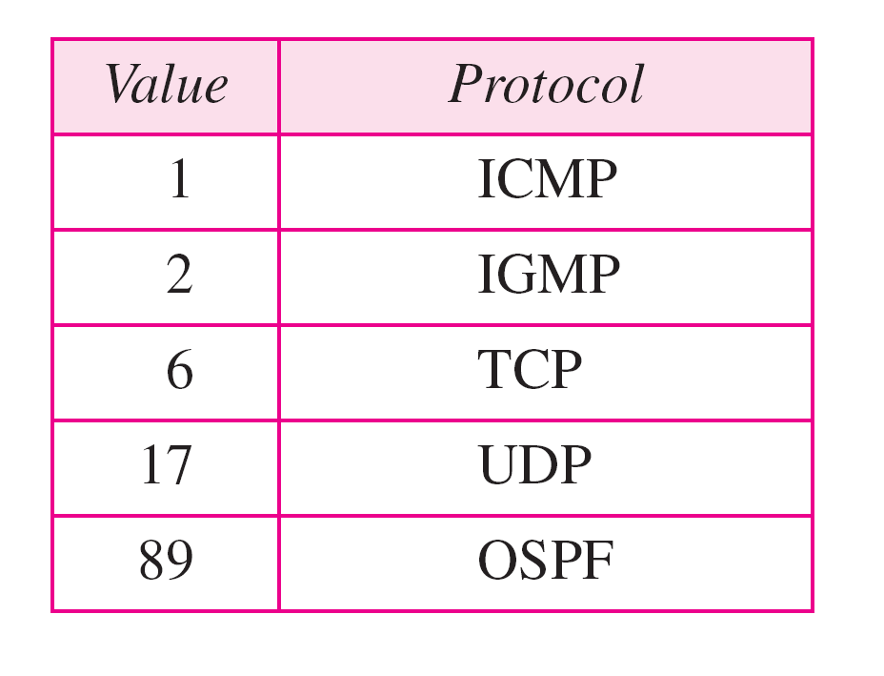
Table 20.4 Protocol values

Slide 20
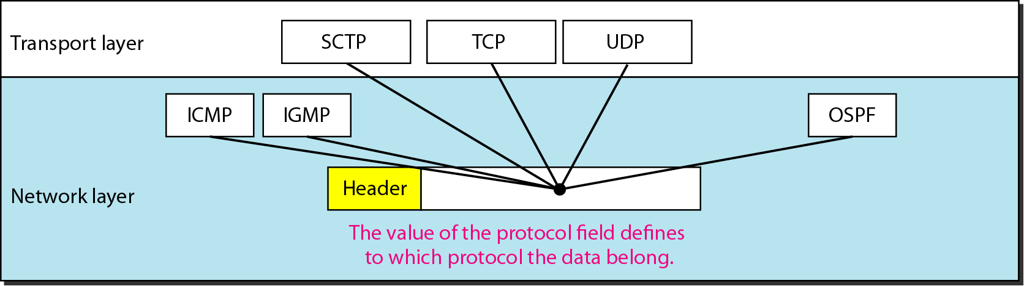
Figure 20.8 Protocol field and encapsulated data

Slide 21
Source and Destination Addresses. These 32-bit source and destination address fields define the IP address of the source and destination respectively. The source host should know its IP address. The destination IP address is either known by the protocol that uses the service of IP or is provided by the DNS as described in Chapter 26. Note that the value of these fields must remain unchanged during the time the IP datagram travels from the source host to the destination host.
Options. A datagram header can have up to 40 bytes of options. Options can be used for network testing and debugging. Although options are not a required part of the IP header, option processing is required of the IP software. This means that all implementations must be able to handle options if they are present in the header. The existence of options in a header creates some burden on the datagram handling; some options can be changed by routers, which forces each router to recalculate the header checksum.
Payload. Payload, or data, is the main reason for creating a datagram. Payload is the packet coming from other protocols that use the service of IP. Comparing a datagram to a postal package, payload is the content of the package; the header is only the information written on the package.

Slide 22
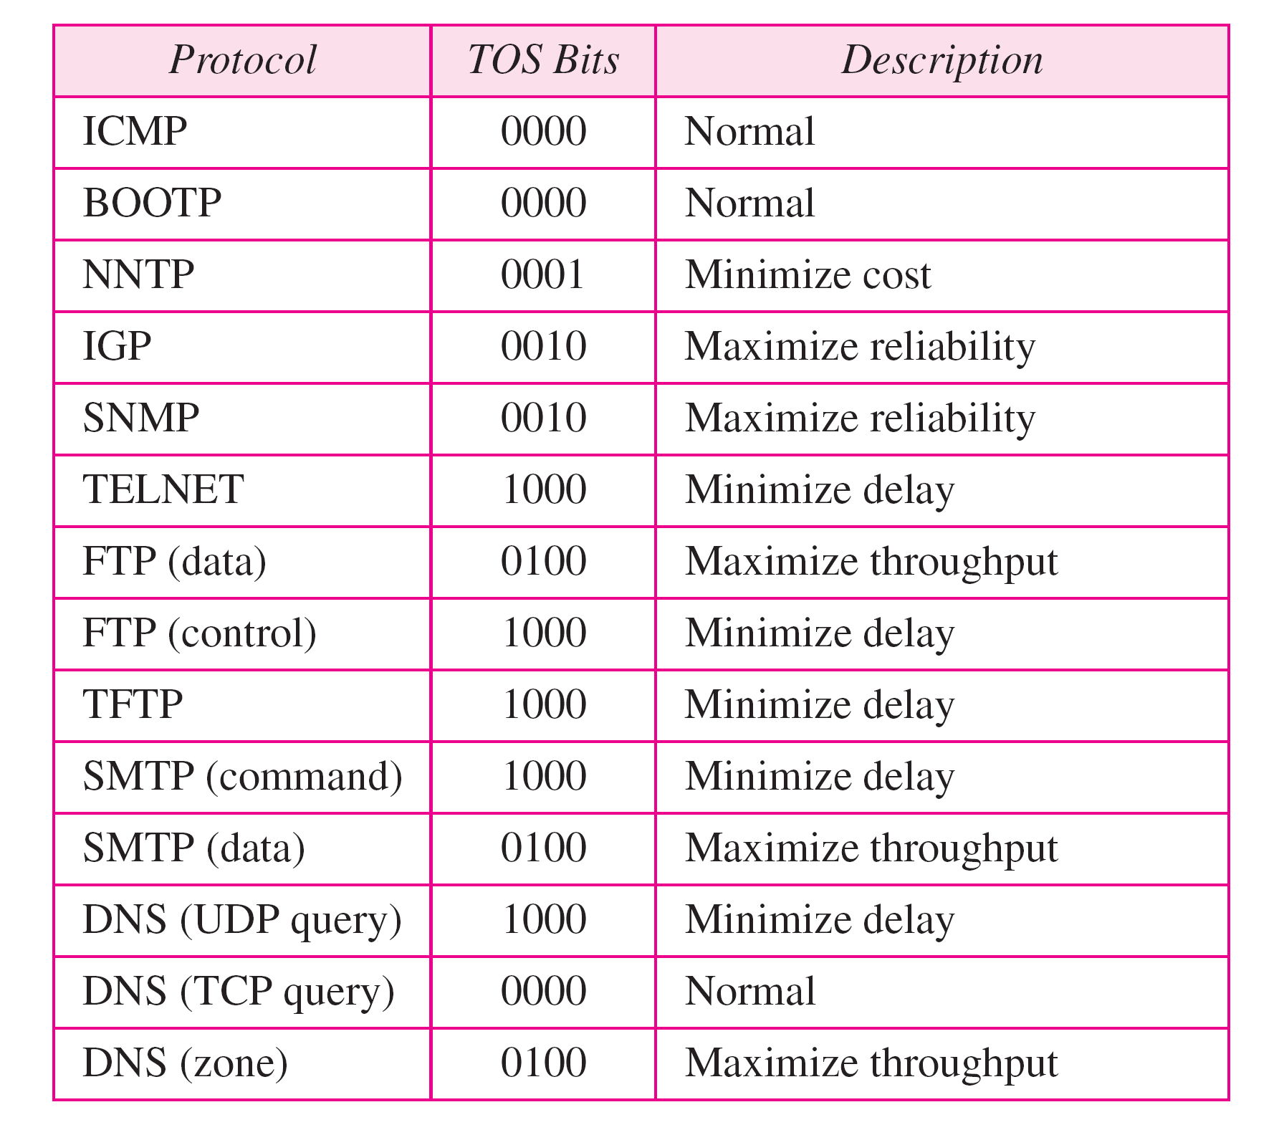
Table 20.2 Default types of service

Slide 23
Table 20.3 Values for codepoints

Slide 24
Note
The total length field defines the total length of the datagram including the header.

Slide 25
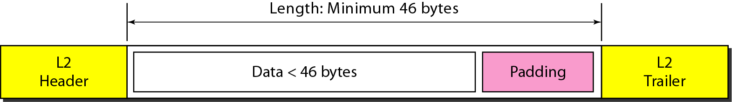
Figure 20.7 Encapsulation of a small datagram in an Ethernet frame

Slide 26
Example 20.1
An IPv4 packet has arrived with the first 8 bits as shown:
01000010
The receiver discards the packet. Why?
Solution
There is an error in this packet.
The 4 leftmost bits (0100) show the version, which is correct. The next 4 bits (0010) show an invalid header length (2 × 4 = 8). The minimum number of bytes in the header must be 20. The packet has been corrupted in transmission.

Slide 27
Example 20.2
In an IPv4 packet, the value of HLEN is 1000 in binary. How many bytes of options are being carried by this packet?
Solution
The HLEN value is 8, which means the total number of bytes in the header is 8 × 4, or 32 bytes.
The first 20 bytes are the base header, the next 12 bytes are the options.

Slide 28
Example 20.3
In an IPv4 packet, the value of HLEN is 5, and the value of the total length field is 0x0028. How many bytes of data are being carried by this packet?
Solution
The HLEN value is 5, which means the total number of bytes in the header is 5 × 4, or 20 bytes (no options).
The total length is 40 bytes, which means the packet is carrying 20 bytes of data (40 − 20).

Slide 29
Example 20.4
An IPv4 packet has arrived with the first few hexadecimal digits as shown.
0x45000028000100000102 . . .
How many hops can this packet travel before being dropped? The data belong to what upper-layer protocol?
Solution
To find the time-to-live field, we skip 8 bytes.
The time-to-live field is the ninth byte, which is 01. This means the packet can travel only one hop.
The protocol field is the next byte (02), which means that the upper-layer protocol is IGMP.

Slide 30
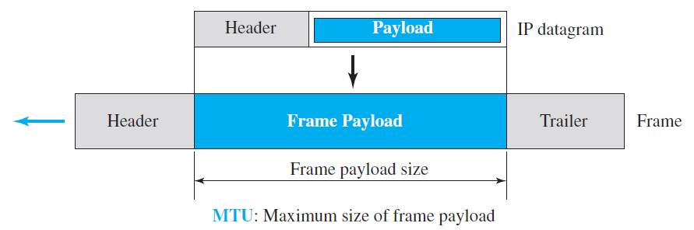
Maximum transfer unit (MTU)
Each link-layer protocol has its own frame format i.e. when a datagram is encapsulated in a frame, the total size of the datagram must be less than this maximum size, which is defined by the restrictions imposed by the hardware and software used in the network

Slide 31
Each link-layer protocol has its own frame format i.e. when a datagram is encapsulated in a frame, the total size of the datagram must be less than this maximum size, which is defined by the restrictions imposed by the hardware and software used in the network.
The value of the MTU differs from one physical network protocol to another. For example, the value for a LAN is normally 1500 bytes, but for a WAN it can be larger or smaller.
In order to make the IP protocol independent of the physical network, the designers decided to make the maximum length of the IP datagram equal to 65,535 bytes.
Fragmentation: For physical networks, the datagram has to be divided to make it possible for it to pass through the networks and it is called fragmentation.
When a datagram is fragmented, each fragment has its own header with most of the fields repeated, but some have been changed.
A fragmented datagram may itself be fragmented if it encounters a network with an even smaller MTU.
A datagram can be fragmented by the source host or any router in the path. The reassembly of the datagram, however, is done only by the destination host, because each fragment becomes an independent datagram.

Slide 32
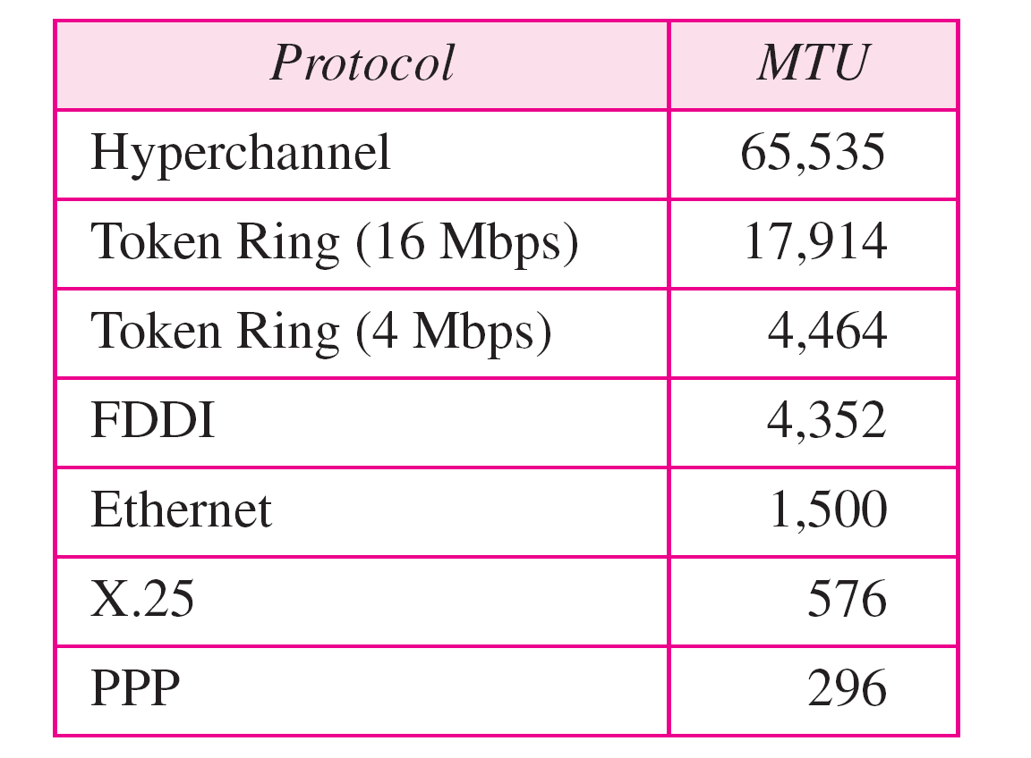
Table 20.5 MTUs for some networks

Slide 33
Fields Related to Fragmentation
The identification field (16-bit): It identifies a datagram originating from the source host. The combination of the identification and source IP address must uniquely define a datagram as it leaves the source host. To guarantee uniqueness, the IP protocol uses a counter to label the datagrams. The counter is initialized to a positive number. When the IP protocol sends a datagram, it copies the current value of the counter to the identification field and increments the counter by one. As long as the counter is kept in the main memory, uniqueness is guaranteed. When a datagram is fragmented, the value in the identification field is copied into all fragments.
The flags field (3-bit): The leftmost bit is reserved (not used). The second bit (D bit) is called the do not fragment bit. If its value is 1, the machine must not fragment the datagram. If it cannot pass the datagram through any available physical network, it discards the datagram and sends an ICMP error message to the source host (discussed later). If its value is 0, the datagram can be fragmented if necessary. The third bit (M bit) is called the more fragment bit. If its value is 1, it means the datagram is not the last fragment; there are more fragments after this one. If its value is 0, it means this is the last or only fragment.

Slide 34
The fragmentation offset (13-bit): This field shows the relative position of the fragment with respect to the whole datagram. It is the offset of the data in the original datagram measured in units of 8 bytes. Figure 20.11 shows a datagram with a data size of 4000 bytes fragmented into three fragments. The bytes in the original datagram are numbered 0 to 3999. The first fragment carries bytes 0 to 1399. The offset for this datagram is 0/8 = 0. The second fragment carries bytes 1400 to 2799; the offset value for this fragment is 1400/8 = 175. Finally, the third fragment carries bytes 2800 to 3999. The offset value for this fragment is 2800/8 = 350.

Slide 35
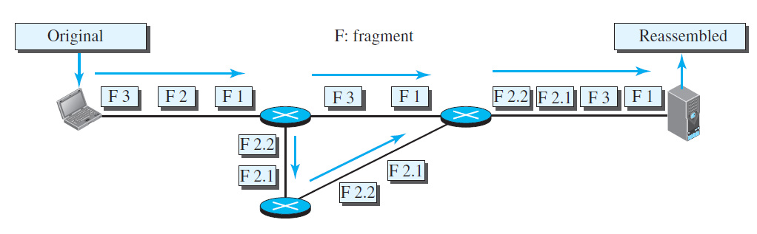
Figure 20.10 Fragmentation from source to destination

Slide 36
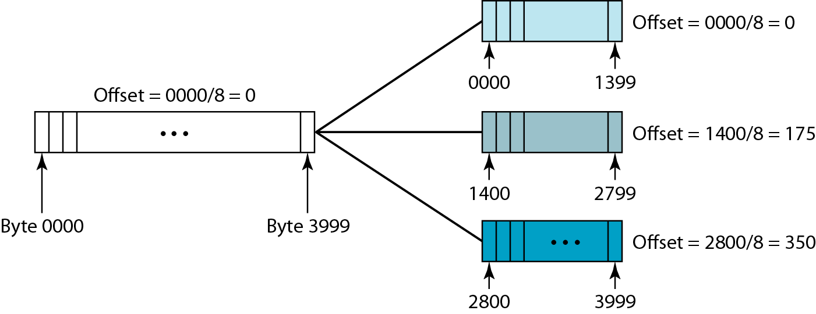
Figure 20.11 Fragmentation example

Slide 37
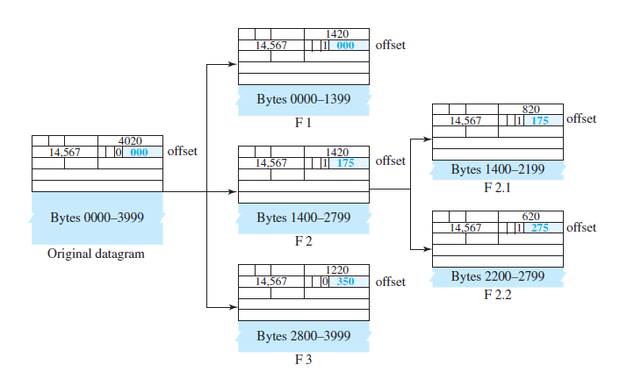
Figure 20.12 Detailed fragmentation example

Slide 38
Strategy of the receiver to collect and arrange the fragments:
The first fragment has an offset field value of zero.
Divide the length of the first fragment by 8. The second fragment has an offset value equal to that result.
Divide the total length of the first and second fragment by 8. The third fragment has an offset value equal to that result.
Continue the process. The last fragment has its M bit set to 0.
Continue the process. The last fragment has a more bit value of 0.

Slide 39
Example 20.5
A packet has arrived with an M bit value of 0. Is this the first fragment, the last fragment, or a middle fragment? Do we know if the packet was fragmented?
Solution
If the M bit is 0, it means that there are no more fragments; the fragment is the last one.
However, we cannot say if the original packet was fragmented or not. A non-fragmented packet is considered the last fragment.

Slide 40
Example 20.6
A packet has arrived with an M bit value of 1. Is this the first fragment, the last fragment, or a middle fragment? Do we know if the packet was fragmented?
Solution
If the M bit is 1, it means that there is at least one more fragment.
This fragment can be the first one or a middle one, but not the last one.
We don’t know if it is the first one or a middle one; we need more information (the value of the fragmentation offset).

Slide 41
Example 20.7
A packet has arrived with an M bit value of 1 and a fragmentation offset value of 0. Is this the first fragment, the last fragment, or a middle fragment?
Solution
Because the M bit is 1, it is either the first fragment or a middle one.
Because the offset value is 0, it is the first fragment.

Slide 42
Example 20.8
A packet has arrived in which the offset value is 100. What is the number of the first byte? Do we know the number of the last byte?
Solution
To find the number of the first byte, we multiply the offset value by 8.
This means that the first byte number is 800.
We cannot determine the number of the last byte unless we know the length.

Slide 43
Example 20.9
A packet has arrived in which the offset value is 100, the value of HLEN is 5, and the value of the total length field is 100. What are the numbers of the first byte and the last byte?
Solution
The first byte number is 100 × 8 = 800.
The total length is 100 bytes, and the header length is 20 bytes (5 × 4), which means that there are 80 bytes in this datagram.
If the first byte number is 800, the last byte number must be 879.

Slide 44
Example 20.10
Figure 20.13 shows an example of a checksum calculation for an IPv4 header without options. The header is divided into 16-bit sections. All the sections are added and the sum is complemented. The result is inserted in the checksum field.

Slide 45
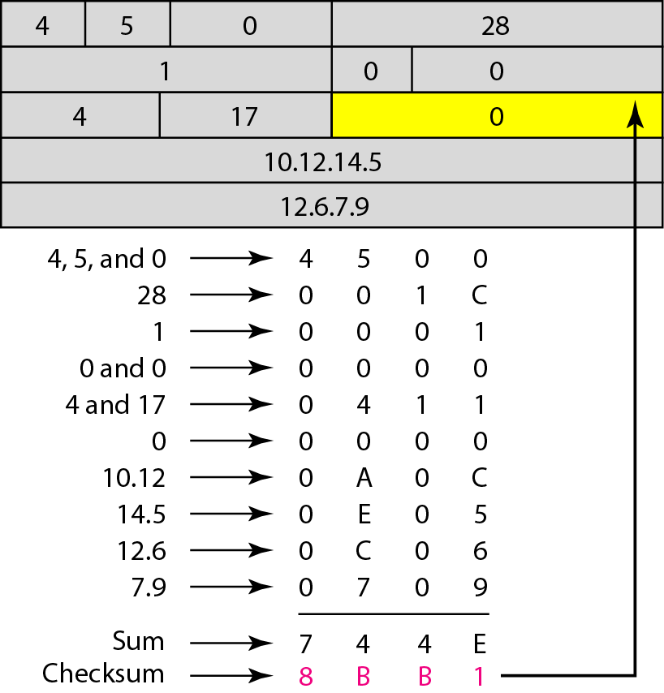
Figure 20.13 Example of checksum calculation in IPv4

Slide 46
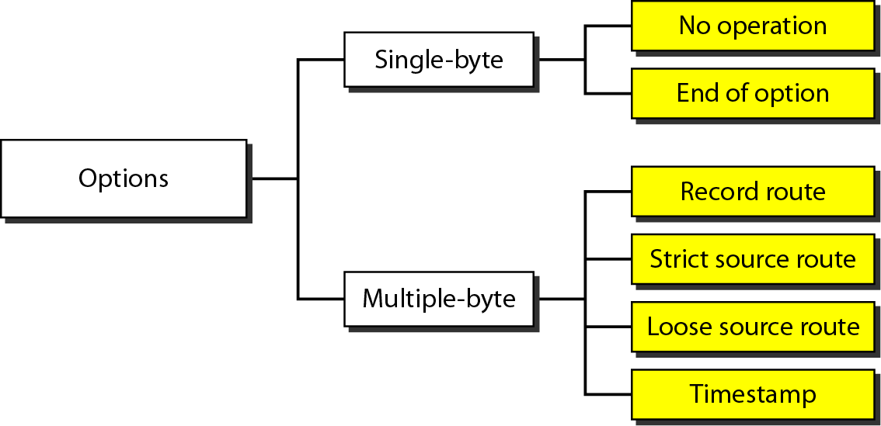
Figure 20.14 Taxonomy of options in IPv4

Slide 47
Pv6
The network layer protocol in the TCP/IP protocol suite is currently IPv4. Although IPv4 is well designed, data communication has evolved since the inception of IPv4 in the 1970s. IPv4 has some deficiencies that make it unsuitable for the fast-growing Internet.
Topics discussed in this section:
Advantages Packet Format Extension Headers

Slide 48
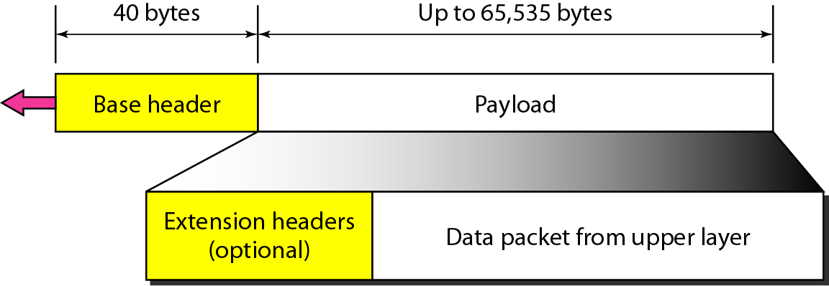
Figure 20.15 IPv6 datagram header and payload

Slide 49
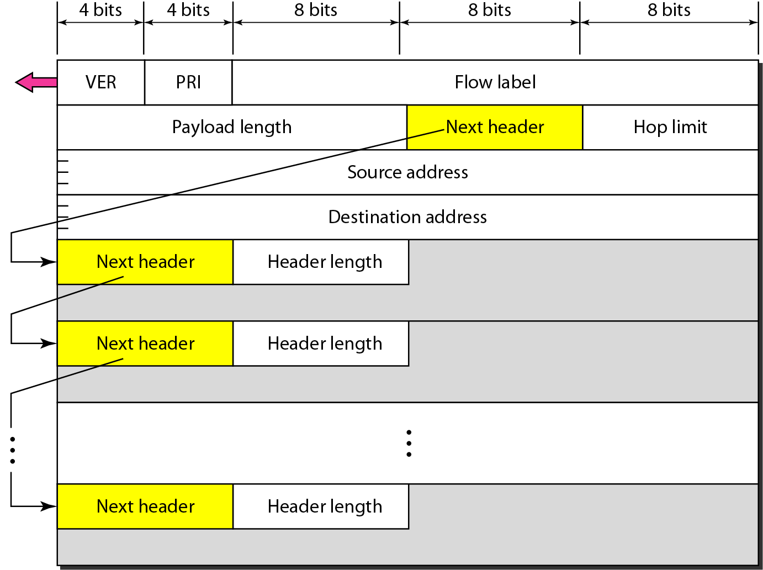
Figure 20.16 Format of an IPv6 datagram

Slide 50
Table 20.6 Next header codes for IPv6

Slide 51
Table 20.7 Priorities for congestion-controlled traffic

Slide 52
Table 20.8 Priorities for noncongestion-controlled traffic

Slide 53
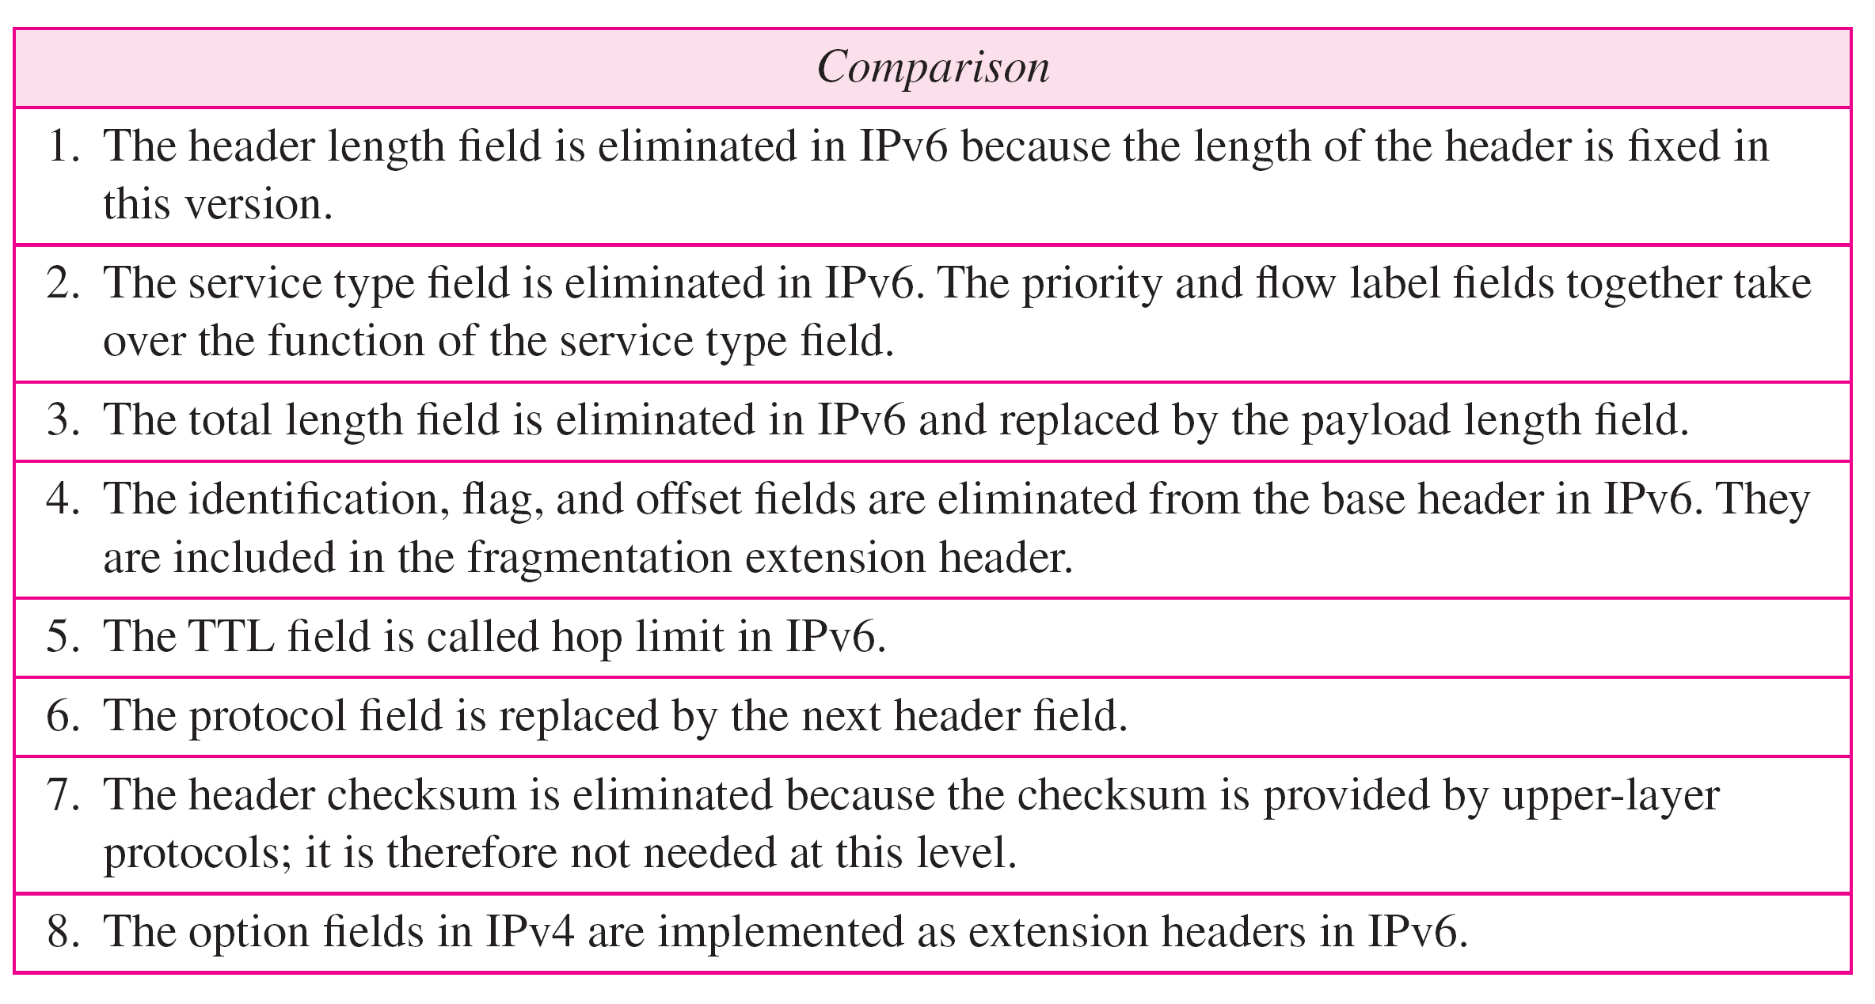
Table 20.9 Comparison between IPv4 and IPv6 packet headers

Slide 54
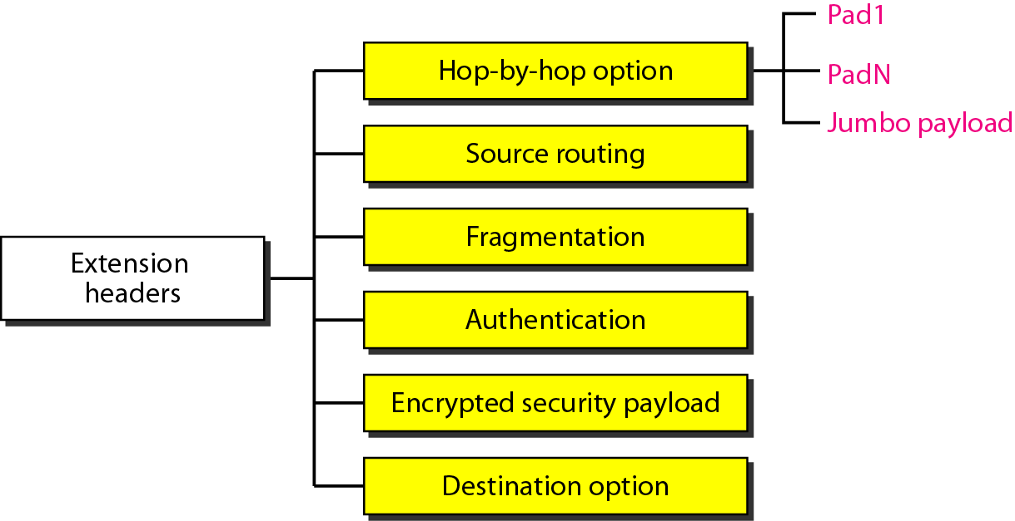
Figure 20.17 Extension header types

Slide 55
Table 20.10 Comparison between IPv4 options and IPv6 extension headers

Slide 56
TRANSITION FROM IPv4 TO IPv6
Because of the huge number of systems on the Internet, the transition from IPv4 to IPv6 cannot happen suddenly. It takes a considerable amount of time before every system in the Internet can move from IPv4 to IPv6. The transition must be smooth to prevent any problems between IPv4 and IPv6 systems.
Topics discussed in this section:
Dual Stack Tunneling Header Translation

Slide 57
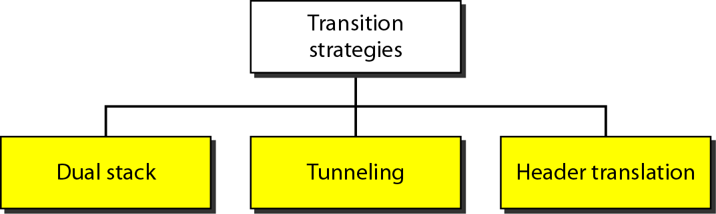
Figure 20.18 Three transition strategies

Slide 58
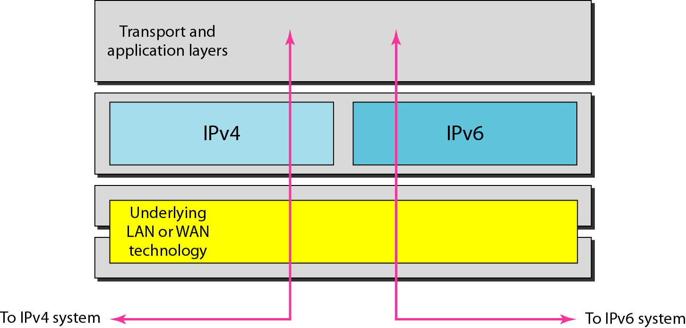
Figure 20.19 Dual stack

Slide 59
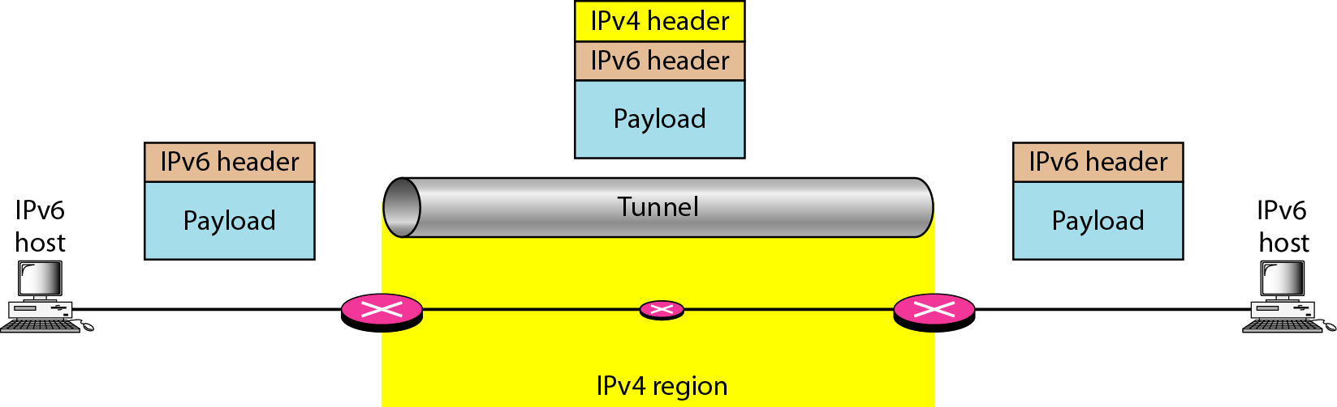
Figure 20.20 Tunneling strategy

Slide 60
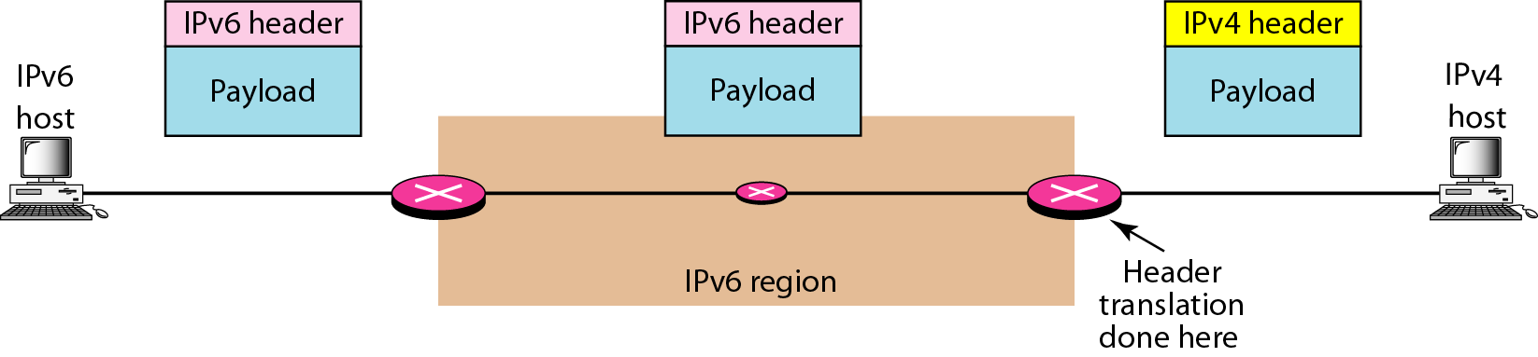
Figure 20.21 Header translation strategy

Slide 61
Table 20.11 Header translation

Slide 62
What have we completed?
Thank You
Need for Network Layer
Internet as a Datagram Network
Internet as a Connectionless Network
IPv4 Datagram
IPv4 Fragmentation
IPv4 Checksum
IPV6 Advantages
IPV6 Packet Format
IPV6 Extension Headers
Transition from IPV4 to IPV6

